Slide 1
Using Visual Studio 2010: Part 1
Dr. Yihsiang Liow
08/22/12
Visual Studio 2010 : Part 1 (Dr Liow)

Slide 2
Objectives
Installation advice
Start Microsoft Visual Studio 2010
Create project
Add C++ file
Compile and run a program
Disable MS Language Extensions
Miscellaneous
08/22/12
Visual Studio 2010 : Part 1 (Dr Liow)

Slide 3
“I can’t install Microsoft Studio 2010”
If the software CD is corrupted, ask the instructor for another set.
If you were getting the software from dreamspark, read the tutorial again and make sure you to follow properly.
Make sure you update your Windows.
Seek help with other CS people.
08/22/12
Visual Studio 2010 : Part 1 (Dr Liow)

Slide 4
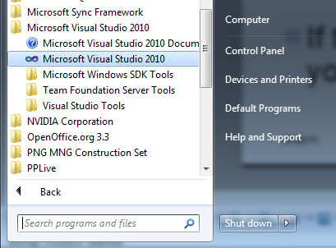
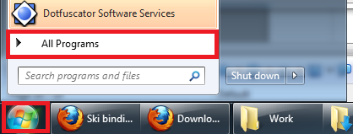
Start Studio 2010
Fire up Visual Studio 2010:
You should get the following screen …
08/22/12
Visual Studio 2010 : Part 1 (Dr Liow)

Slide 5
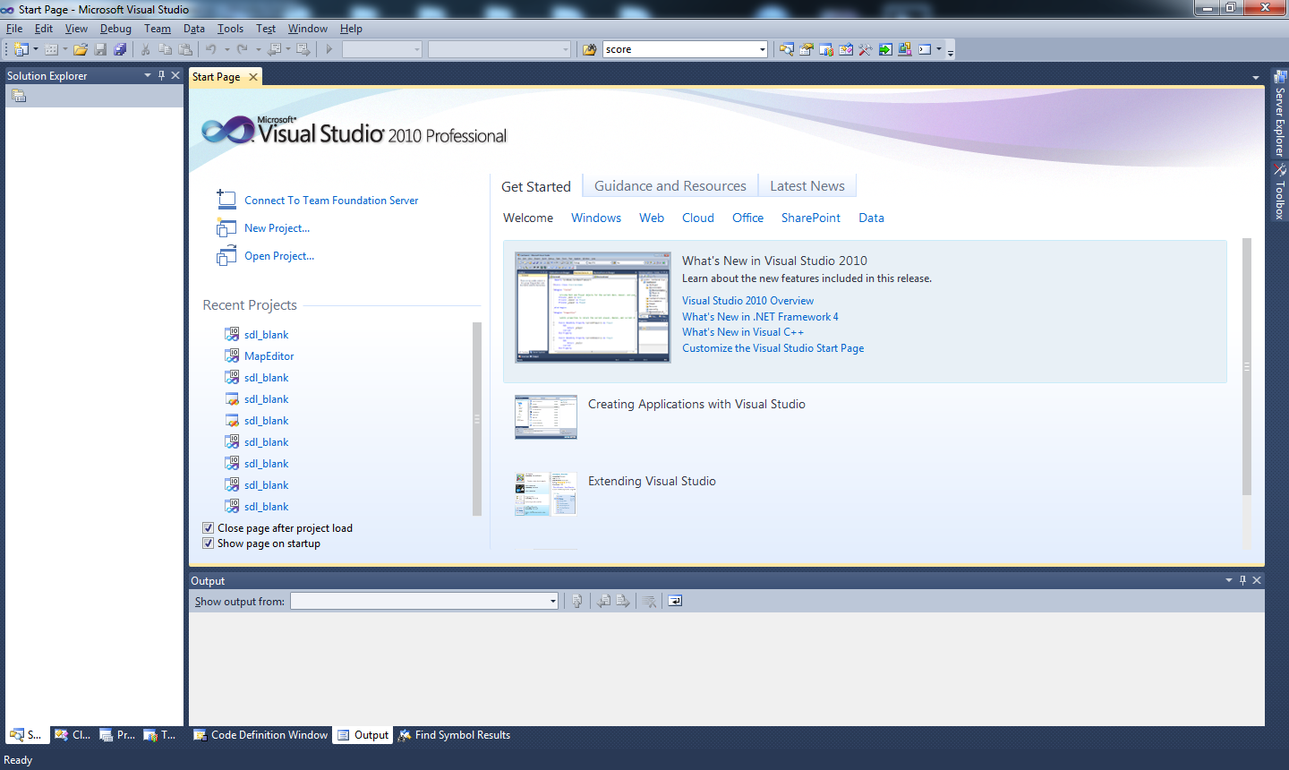
Start Studio 2010
08/22/12
Visual Studio 2010 : Part 1 (Dr Liow)

Slide 6
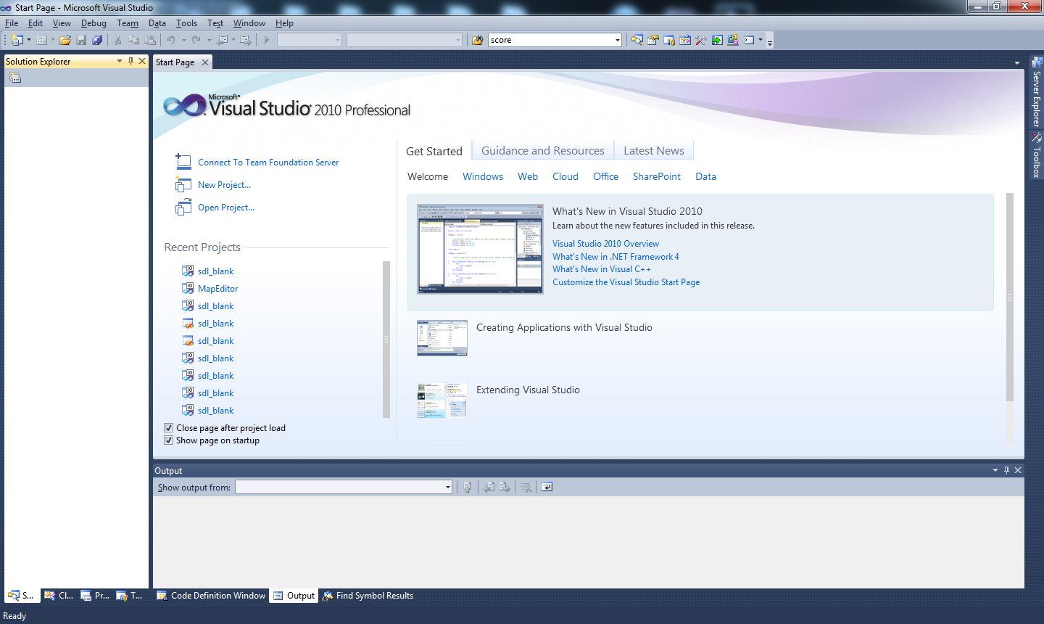
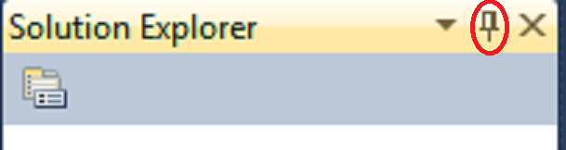
Auto-Hide Windows
Unpin to allow
auto-hide
08/22/12
Visual Studio 2010 : Part 1 (Dr Liow)

Slide 7
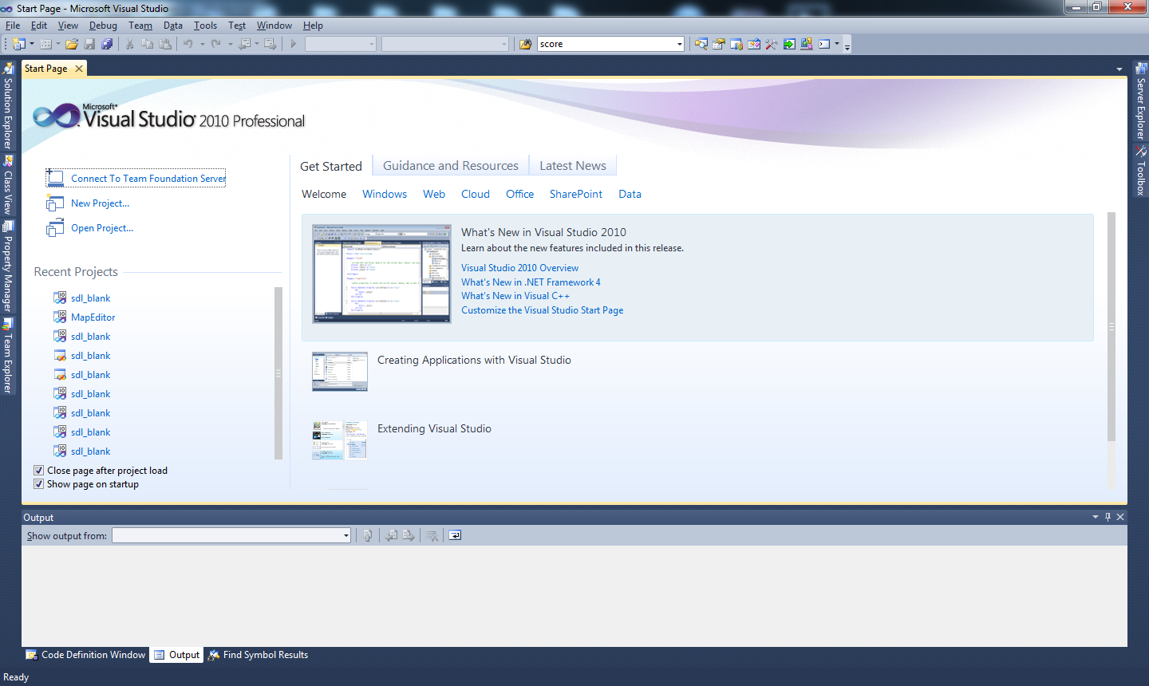
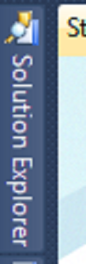
Auto-Hide Windows
The Solution Explorer window hides to the side
To open the Solution Explorer window put your mouse cursor next to it and it open again.
08/22/12
Visual Studio 2010 : Part 1 (Dr Liow)

Slide 8
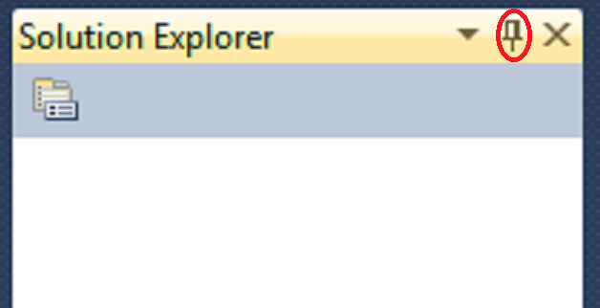
Auto-Hide Windows
Why auto-hide? You need to unclutter your workspace to write programs.
If you want the Solution Explorer to stay open at all time, pin it
08/22/12
Visual Studio 2010 : Part 1 (Dr Liow)

Slide 9
Creating New Project
To write a program in Studio 2010, you need to
  create a project
  put your program (C++ source file) to the project.
Each program requires a new project.
Let’s begin …
08/22/12
Visual Studio 2010 : Part 1 (Dr Liow)

Slide 10
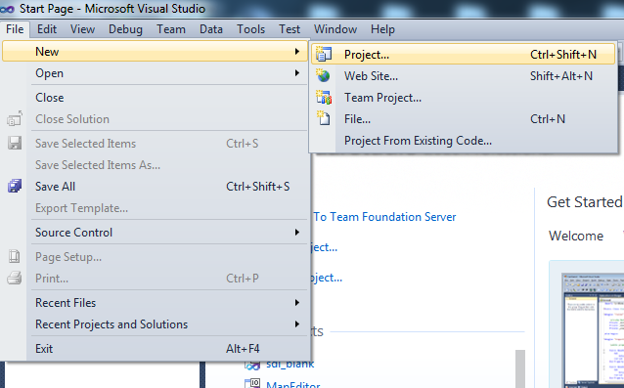
Creating New Project
1. Pull down File
3. Click on Project
2. Click on New
08/22/12
Visual Studio 2010 : Part 1 (Dr Liow)

Slide 11
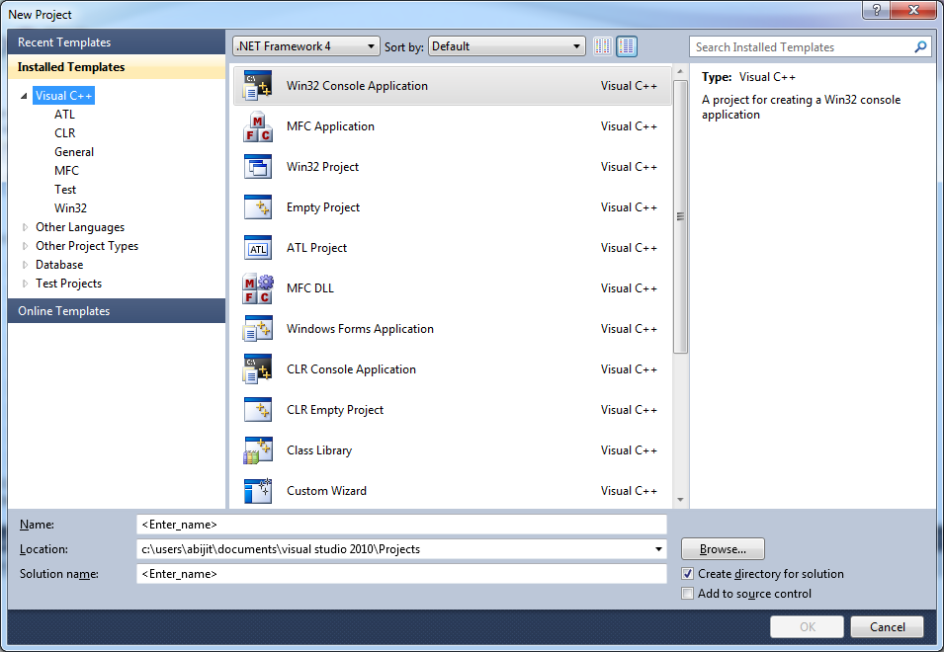
Creating New Project
You should see this:
08/22/12
Visual Studio 2010 : Part 1 (Dr Liow)

Slide 12
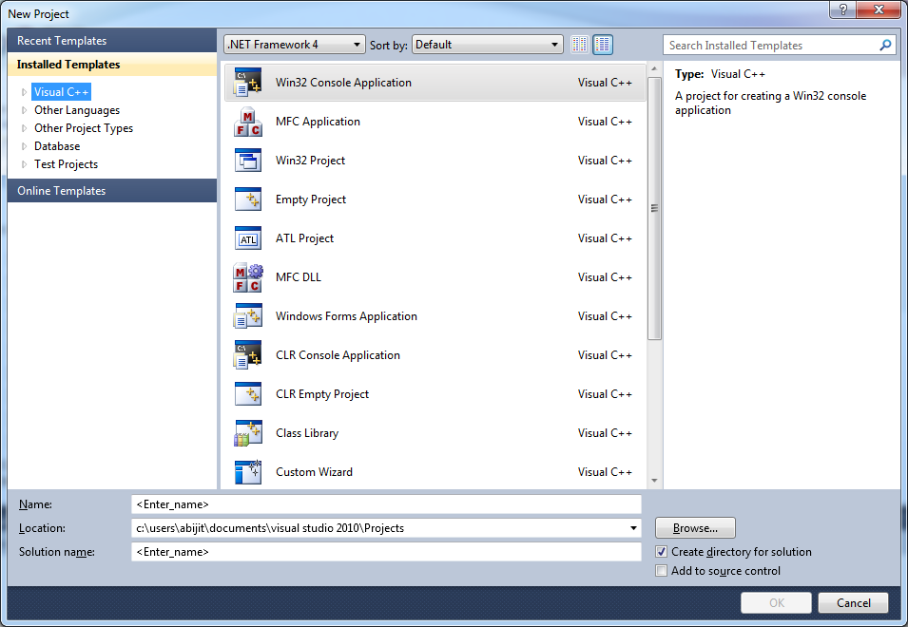
Creating New Project
Click on Visual C++
08/22/12
Visual Studio 2010 : Part 1 (Dr Liow)

Slide 13
Creating New Project
Select Win32
Console Project
08/22/12
Visual Studio 2010 : Part 1 (Dr Liow)

Slide 14
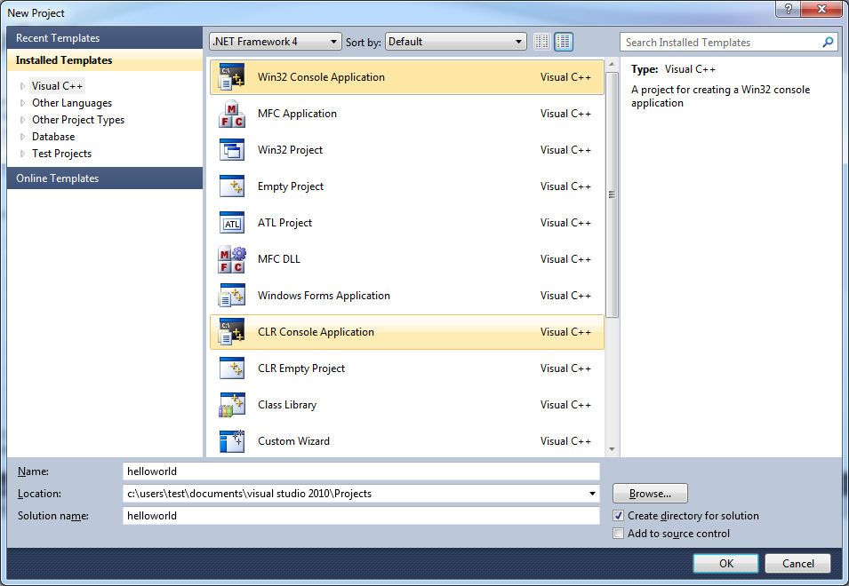
Creating New Project
Enter a name for your project.
For this tutorial, I’ll use helloworld.
2. Click Browse
to enter location
of project
08/22/12
Visual Studio 2010 : Part 1 (Dr Liow)

Slide 15
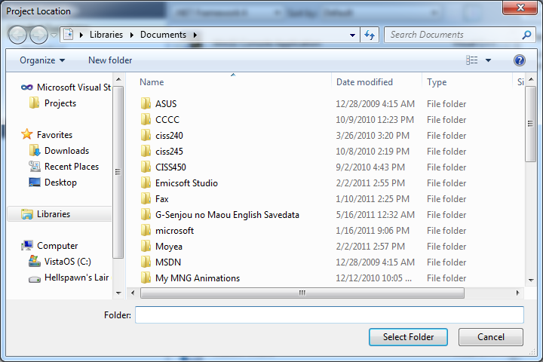
Creating New Project
You should see this:
08/22/12
Visual Studio 2010 : Part 1 (Dr Liow)

Slide 16
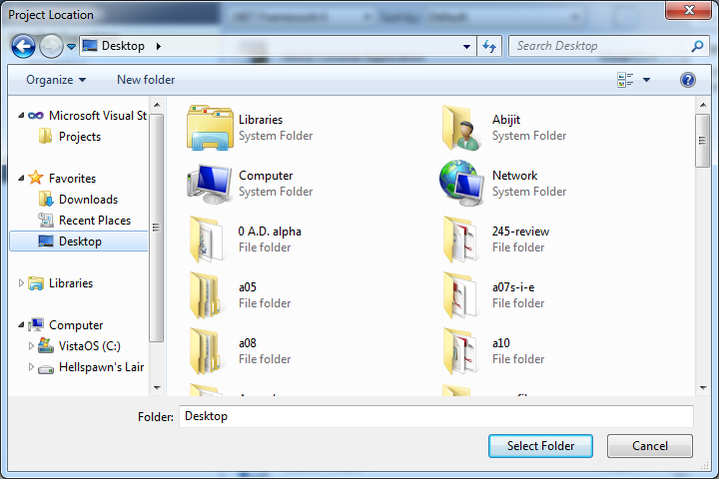
Creating New Project
1. Click Desktop for
project location.
(You can choose
another location if
you like).
2. Click Select
08/22/12
Visual Studio 2010 : Part 1 (Dr Liow)

Slide 17
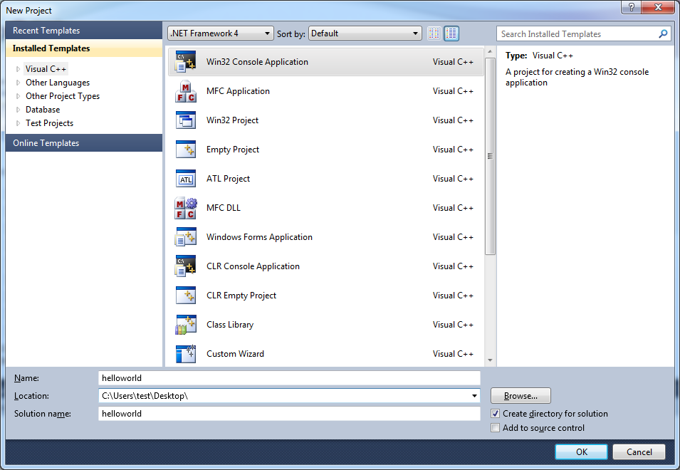
Creating New Project
Note that the location of
project is now on desktop
Click OK
08/22/12
Visual Studio 2010 : Part 1 (Dr Liow)

Slide 18
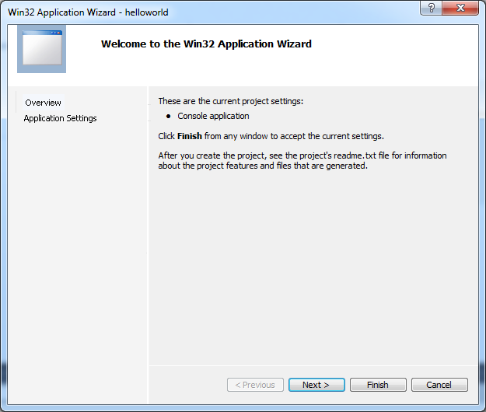
Creating New Project
Click Application Settings
08/22/12
Visual Studio 2010 : Part 1 (Dr Liow)

Slide 19
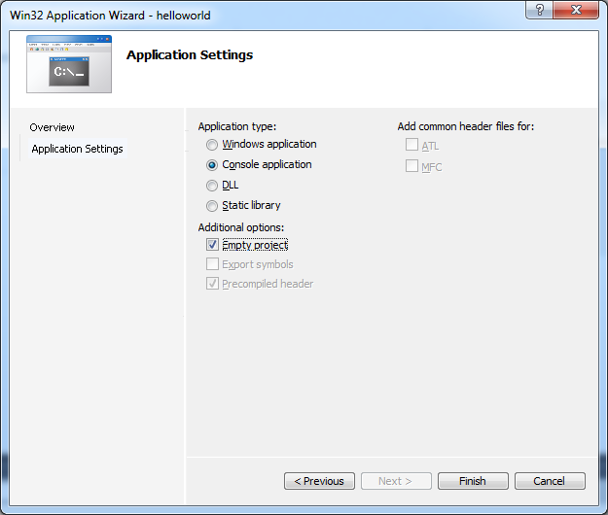
Creating New Project
1. Check Empty project
2. Click Finish
08/22/12
Visual Studio 2010 : Part 1 (Dr Liow)

Slide 20

Creating New Project
Go to your Desktop and verify that there is a folder on your Desktop:
The program you write will be in this folder.
08/22/12
Visual Studio 2010 : Part 1 (Dr Liow)

Slide 21
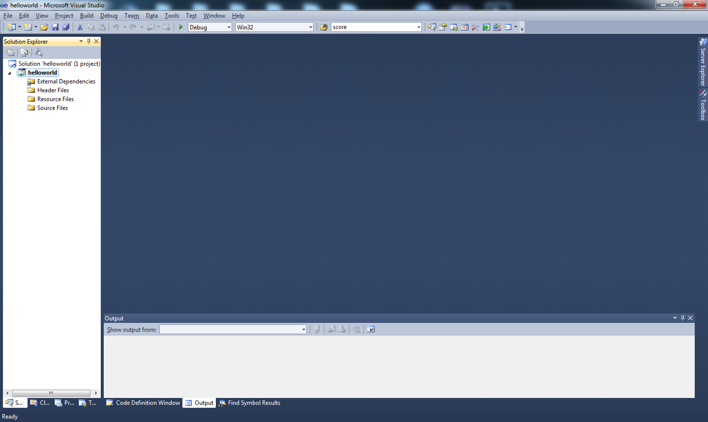
Creating New Project
08/22/12
Visual Studio 2010 : Part 1 (Dr Liow)

Slide 22
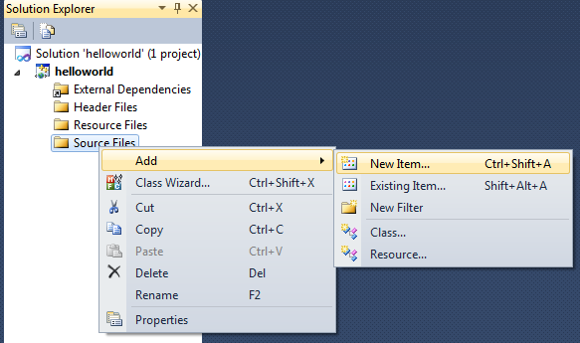
Add C++ Source File to Project
1. Right-click Source Files
2. Click on Add
3. Click on New Item
08/22/12
Visual Studio 2010 : Part 1 (Dr Liow)

Slide 23
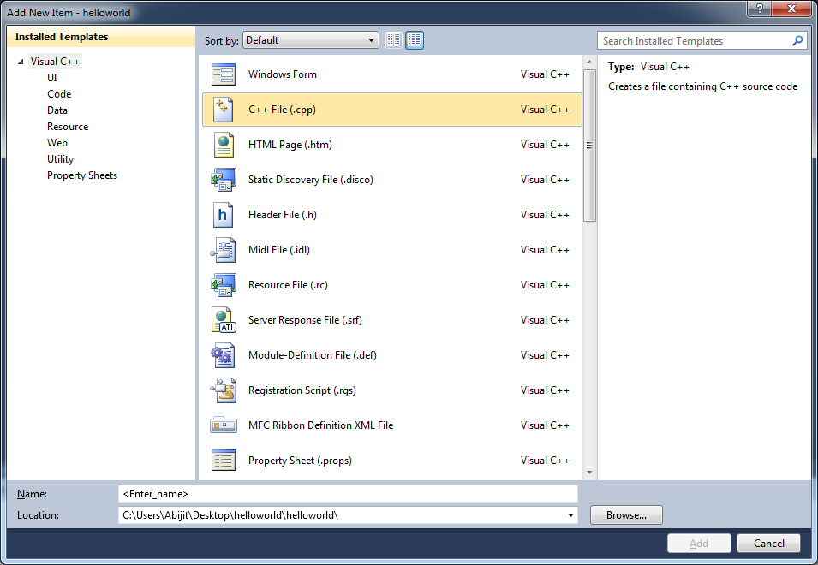
Add C++ Source File to Project
You should see this:
08/22/12
Visual Studio 2010 : Part 1 (Dr Liow)

Slide 24
Add C++ Source File to Project
Click on Visual C++
08/22/12
Visual Studio 2010 : Part 1 (Dr Liow)

Slide 25
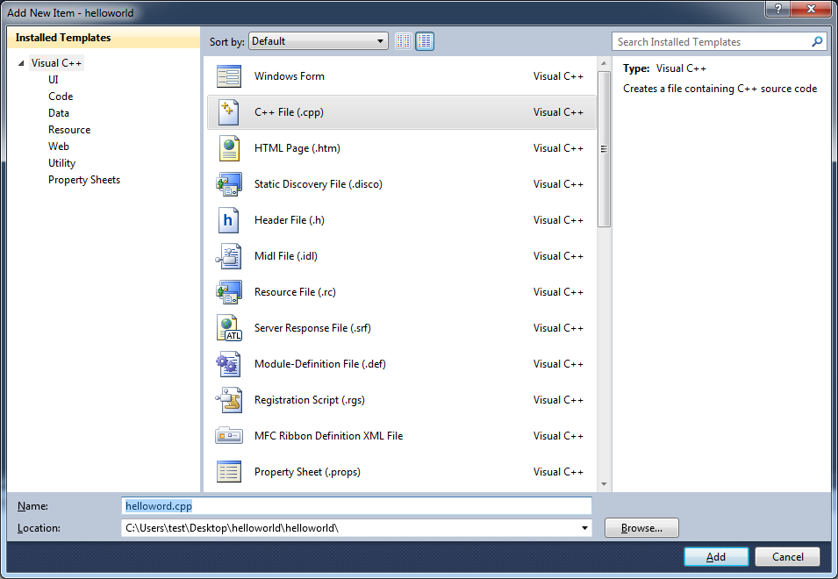
Add C++ Source File to Project
1. Select C++ File (.cpp)
2. Enter a name for your C++ file.
IT MUST END WITH .cpp!!!
3. Click on Add
08/22/12
Visual Studio 2010 : Part 1 (Dr Liow)

Slide 26
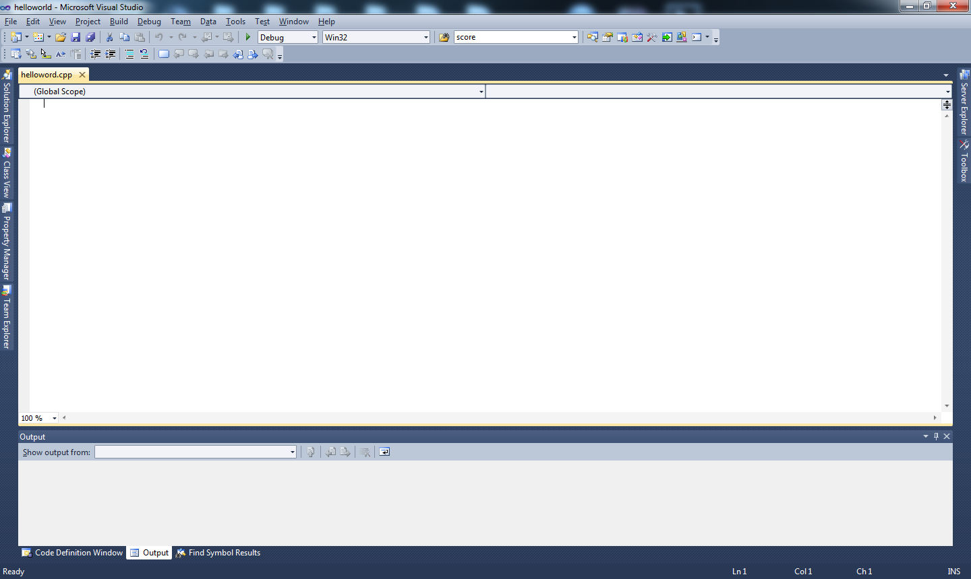
Add C++ Source File to Project
You’ve just created a blank
program (source) file called
helloworld.cpp.
This is where you enter
the program.
08/22/12
Visual Studio 2010 : Part 1 (Dr Liow)

Slide 27
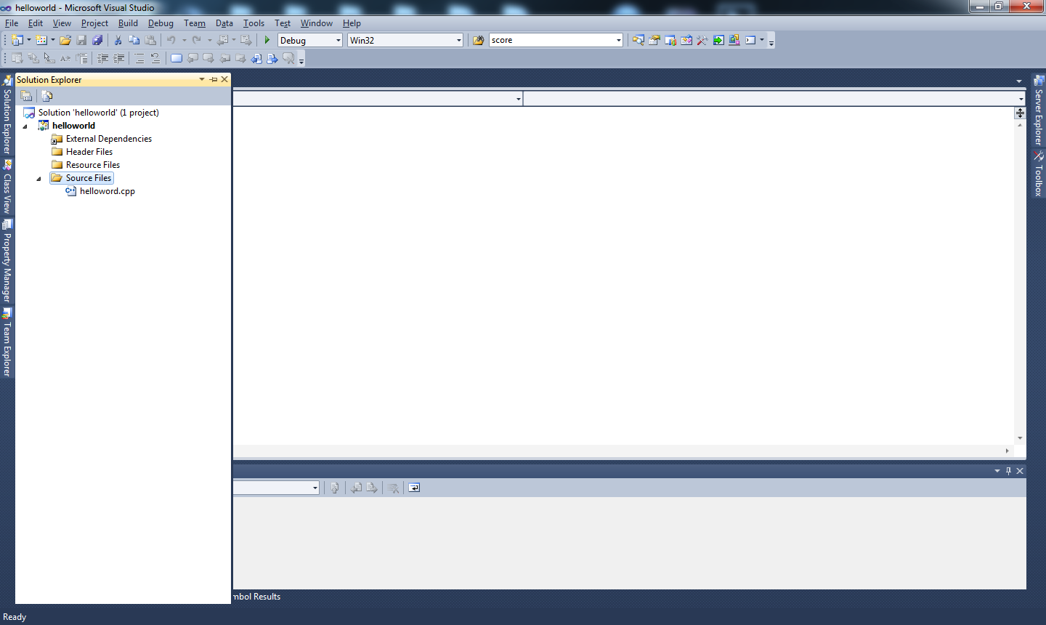
Add C++ Source File to Project
Before entering your program,
open the Solution Explorer and
you will see that “helloworld.cpp”
is now in “Source Files”.
08/22/12
Visual Studio 2010 : Part 1 (Dr Liow)

Slide 28
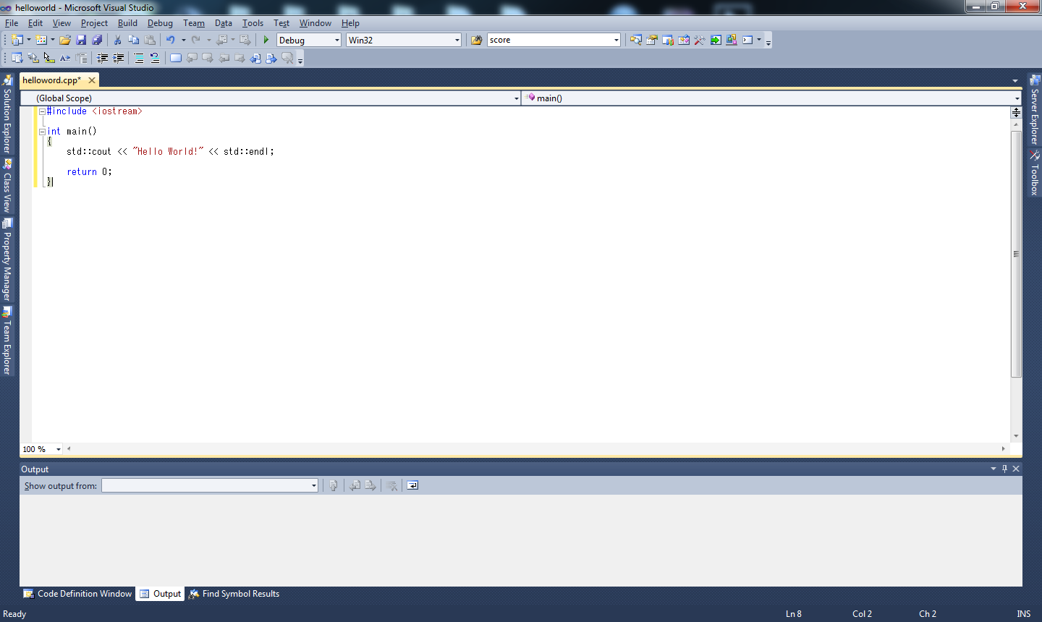
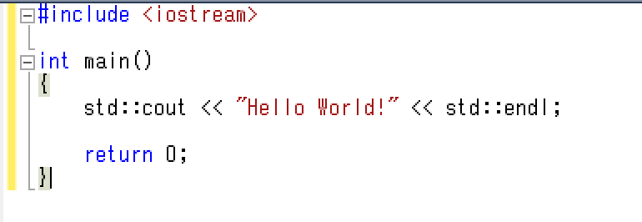
Entering Program
Type in the following program
08/22/12
Visual Studio 2010 : Part 1 (Dr Liow)

Slide 29
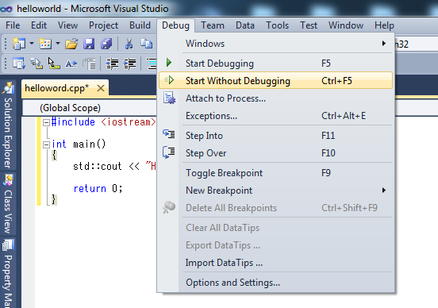
Compiling and Running the Program
1. Debug
2. Start Without Debugging
… or do Ctrl-F5
Learn to use Ctrl-F5! Don’t let the mouse slow you down!
08/22/12
Visual Studio 2010 : Part 1 (Dr Liow)

Slide 30
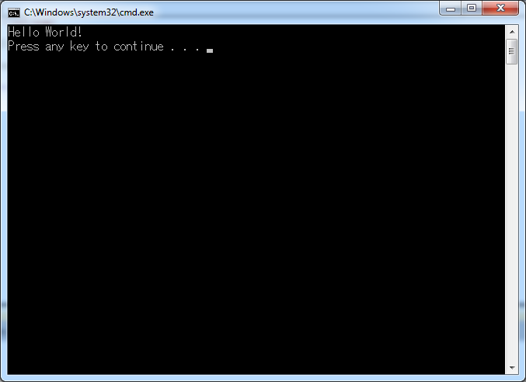
Compiling and Running the Program
You should see this console window:
Close the console window
to end your program.
Congratulations!
08/22/12
Visual Studio 2010 : Part 1 (Dr Liow)

Slide 31
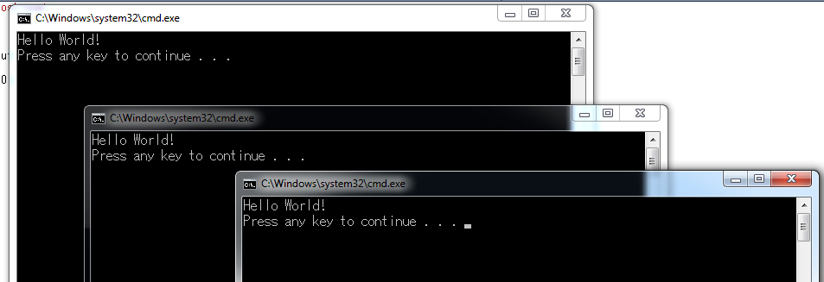
WARNING to the Trigger Happy
When you have too many console windows you might run into an error. SO … close useless console windows!!!
08/22/12
Visual Studio 2010 : Part 1 (Dr Liow)

Slide 32
“Press any key to continue”
Extra line printed: Press any key to continue.
When you press any key, the window closes.
Listen very carefully: The two effects
  Printing “Press any key to continue” to the console window
  Waiting for keypress to close the console window
are commands added by Studio 2010.
08/22/12
Visual Studio 2010 : Part 1 (Dr Liow)

Slide 33
“Press any key to continue”
Without these extra commands, the program would print Hello, World!, the program ends, and the console window closes.
Studio 2010 gives you an opportunity to see the output.
But remember: These two things were not due to your program.
08/22/12
Visual Studio 2010 : Part 1 (Dr Liow)

Slide 34
Project Name and cpp Name
Project name can be different from cpp source file name
08/22/12
Visual Studio 2010 : Part 1 (Dr Liow)

Slide 35
Debugging
Debugging = getting rid of “bugs” (i.e. errors) in your program
Studio 2010 can help you find some errors in your program
08/22/12
Visual Studio 2010 : Part 1 (Dr Liow)

Slide 36
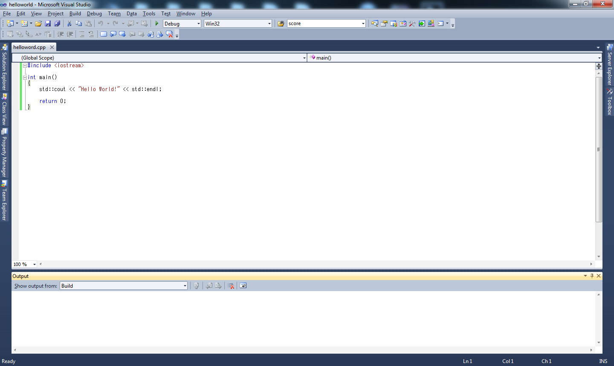
Debugging
Output window.
You may unpin it.
08/22/12
Visual Studio 2010 : Part 1 (Dr Liow)

Slide 37
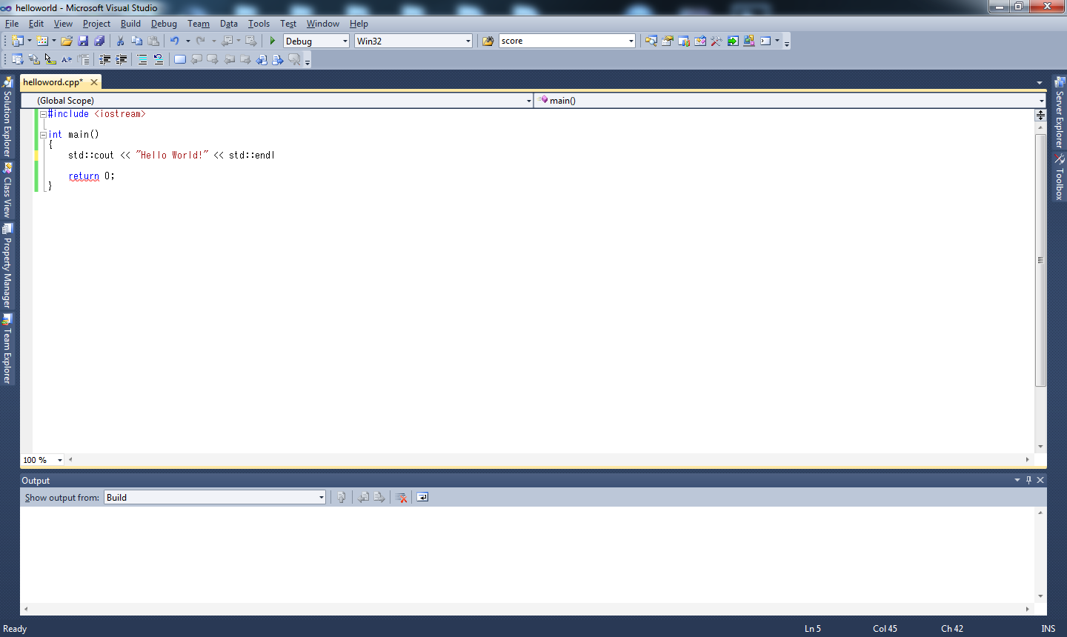
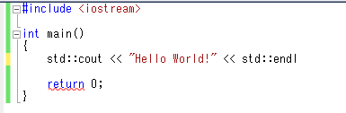
Debugging
Make the following changes to your
program: remove the first semicolon ;
Build the solution again.
08/22/12
Visual Studio 2010 : Part 1 (Dr Liow)

Slide 38
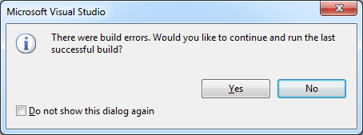
Debugging
08/22/12
Visual Studio 2010 : Part 1 (Dr Liow)

Slide 39
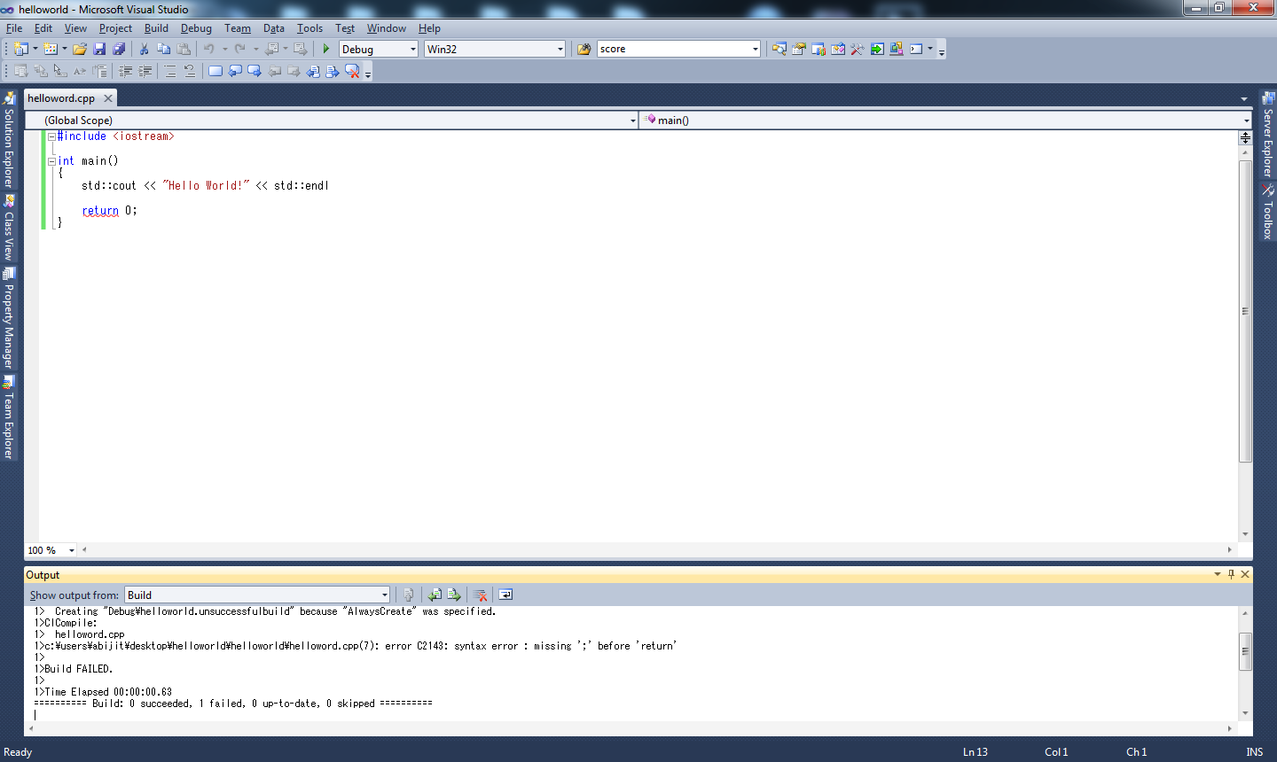
Debugging
error C2143: syntax error : missing ';' before 'return'
08/22/12
Visual Studio 2010 : Part 1 (Dr Liow)

Slide 40
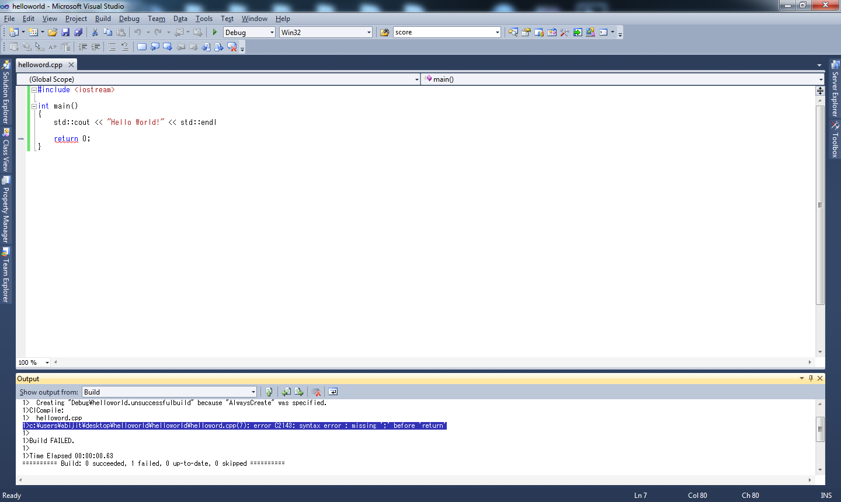
Debugging
2. … the cursor jumps
to approximately the
place where the error
occurred. Correct the
error and rebuild the
solution.
1. Double-click on error
and …
08/22/12
Visual Studio 2010 : Part 1 (Dr Liow)

Slide 41
Debugging
The error message is sometimes helpful in finding the error.
The error pointer points to (only) roughly the place when the error occurs. You usually have to analyze the code before the pointer.
08/22/12
Visual Studio 2010 : Part 1 (Dr Liow)

Slide 42
Disable Language Extensions
The next step is very important!
You must modify your project property so that Studio 2010 works “correctly”
Open your project’s property. You can do this in two ways; see next slide. (The second method on the right is recommended.)
08/22/12
Visual Studio 2010 : Part 1 (Dr Liow)

Slide 43
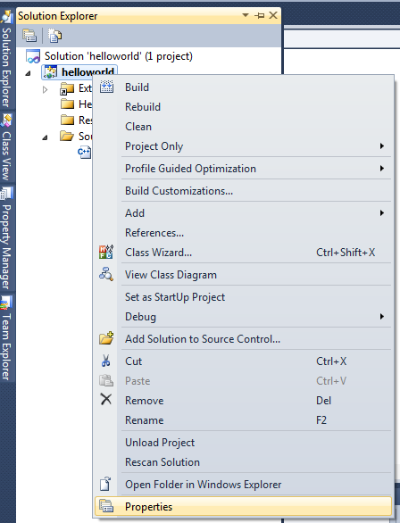
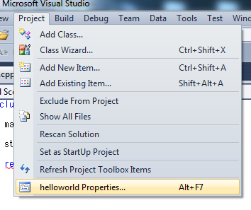
Disable Language Extensions
Open
Solutions
Explorer
1. Project
2. Right-click
on your project
2. Click on project’s properties
3. Click on
Properties
NOTE: If you use the first method, make
sure on the Solution Explorer, any part
of the helloworld project has been selected.
08/22/12
Visual Studio 2010 : Part 1 (Dr Liow)

Slide 44
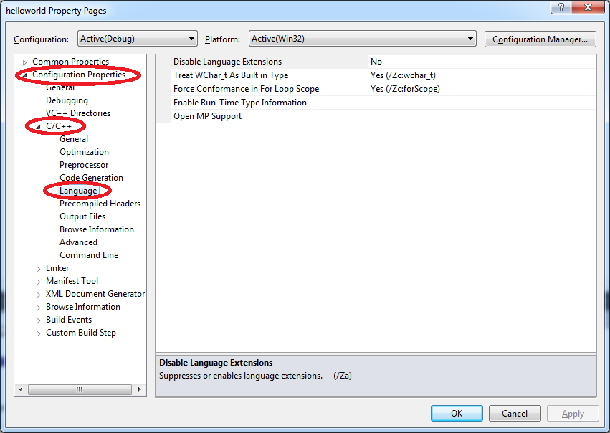
Disable Language Extensions
Open Configuration Properties, then C/C++, and then Language
08/22/12
Visual Studio 2010 : Part 1 (Dr Liow)

Slide 45
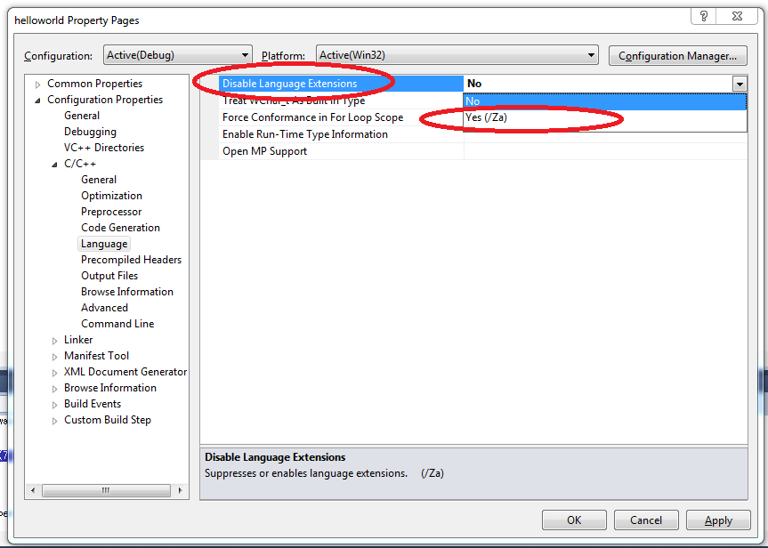
Disable Language Extensions
1. Click on Disable Language Extensions
2. Select Yes (/Za) for
Disable Language Extensions
3. Click OK
08/22/12
Visual Studio 2010 : Part 1 (Dr Liow)

Slide 46
Disable Language Extensions
This step (disabling language extensions) should be done after adding a cpp file.
08/22/12
Visual Studio 2010 : Part 1 (Dr Liow)
Notes:
“For the next class you will be given one minute to rebuild the hello world program, run it, and show me the console window and with ‘disable language extensions’.”

Slide 47
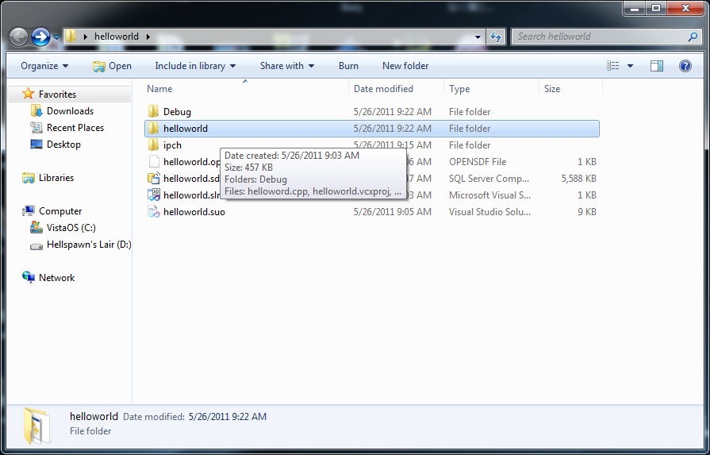
“Where’s my cpp file???”
1. Double-click on the folder on your Desktop (if you choose Desktop as the location).
This is the solution folder.
2. Double-click on the folder on helloworld. This is the project folder.
08/22/12
Visual Studio 2010 : Part 1 (Dr Liow)

Slide 48
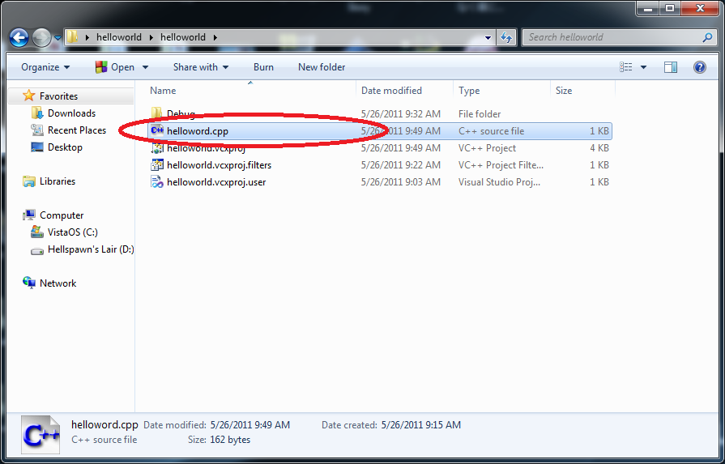
“Where’s my cpp file???”
08/22/12
Visual Studio 2010 : Part 1 (Dr Liow)

Slide 49
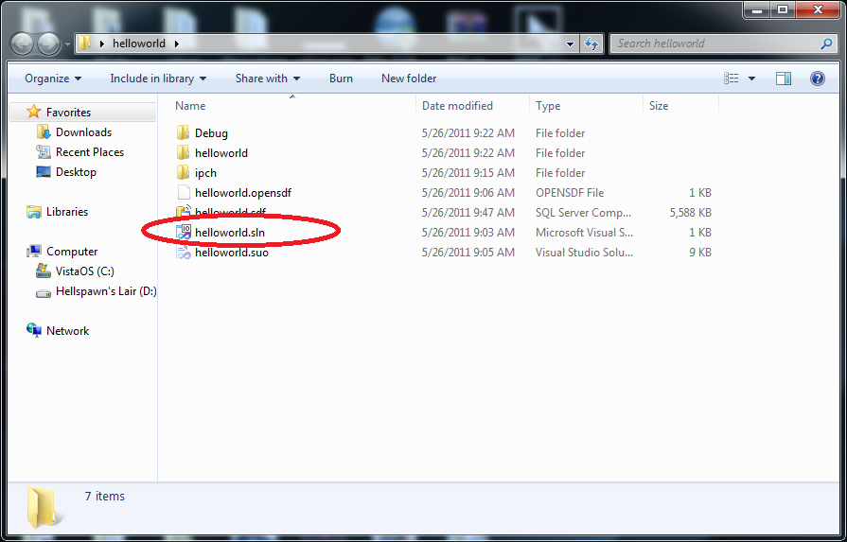
“What about opening an old project?”
If you know the location of your project:
1. Double-click on the solution folder
2. Double-click on the solution icon
08/22/12
Visual Studio 2010 : Part 1 (Dr Liow)

Slide 50
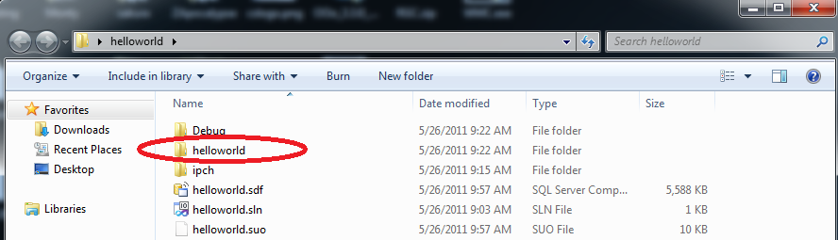
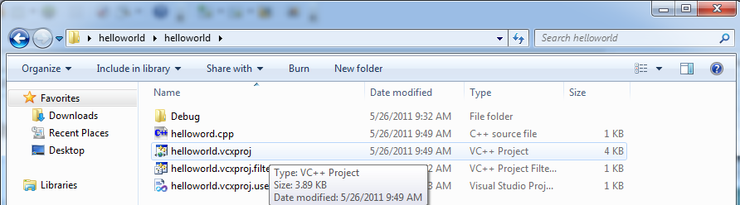
“What about opening an old project?”
… or … you can go one step deeper:
1. Double-click on the helloworld folder
2. Double-click on the helloworld project
08/22/12
Visual Studio 2010 : Part 1 (Dr Liow)

Slide 51
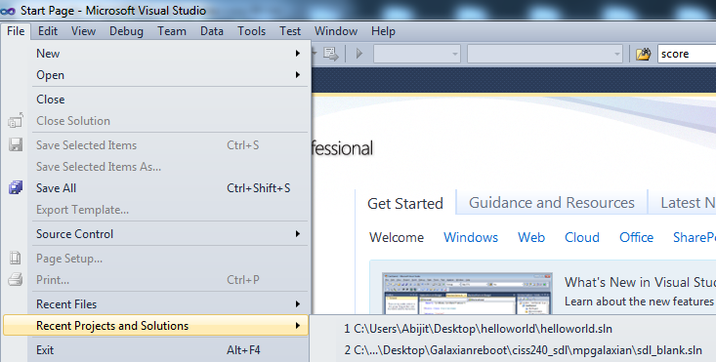
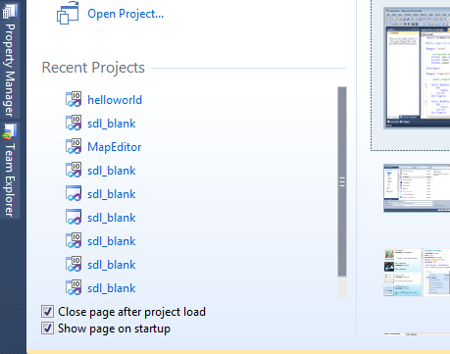
“What about opening an old project?”
If you do not know the location:
You can also get them when you pull down the File menu
When you open Studio 2010, it will show you recently opened projects
08/22/12
Visual Studio 2010 : Part 1 (Dr Liow)

Slide 52
“What about opening an old project?”
We’ve created a “solution” which contains a “project” which contains the cpp file.
It’s possible to have a solution containing multiple projects where each project contains a cpp file meant for a single program.
We’ll stick to one solution, one project, one cpp file for each program – this is less confusing for beginners.
08/22/12
Visual Studio 2010 : Part 1 (Dr Liow)

Slide 53
“What about opening an old project?”
Last resort: Search your machine’s hard drive for the solution folder if you remember the name.
08/22/12
Visual Studio 2010 : Part 1 (Dr Liow)

Slide 54
“I’m out of space!”
Most of the files in your solution folder are created when you do Ctrl-F5 and so can be deleted if you don’t have enough space.
The easiest way to remove these files is to do “Clean Solution” …
08/22/12
Visual Studio 2010 : Part 1 (Dr Liow)

Slide 55
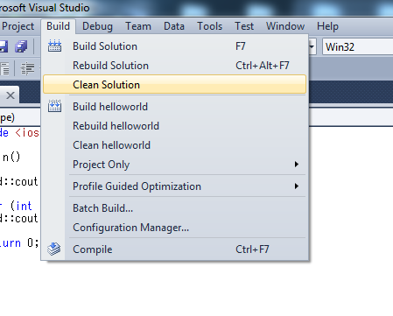
“I’m out of space!”
1. Pull down Build
2. Click on Clean Solution
08/22/12
Visual Studio 2010 : Part 1 (Dr Liow)

Slide 56
“How do I copy my work to my stick?”
Do “Clean Solution”
Copy the solution folder you’ve created
to your (USB) storage
To resume work on another machine: Copy the solution folder from your (USB) storage to the machine and work from there
08/22/12
Visual Studio 2010 : Part 1 (Dr Liow)

Slide 57
“How do I copy my work to my stick?”
Note: USB drives are slow. Use it only for backup.
08/22/12
Visual Studio 2010 : Part 1 (Dr Liow)

Slide 58
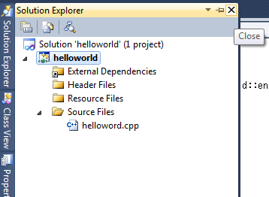
“Where did Solutions Explorer go?”
There are two ways to open the Solution Explorer …
Oh no!!! I closed the Solution Explorer …
08/22/12
Visual Studio 2010 : Part 1 (Dr Liow)

Slide 59
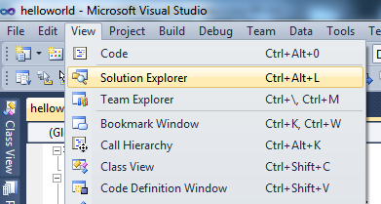

“Where did Solutions Explorer go?”
You can find most of the windows this way
1. View
Click on this icon near the top of Studio 2010
2. Click on Solution Explorer
08/22/12
Visual Studio 2010 : Part 1 (Dr Liow)

Slide 60
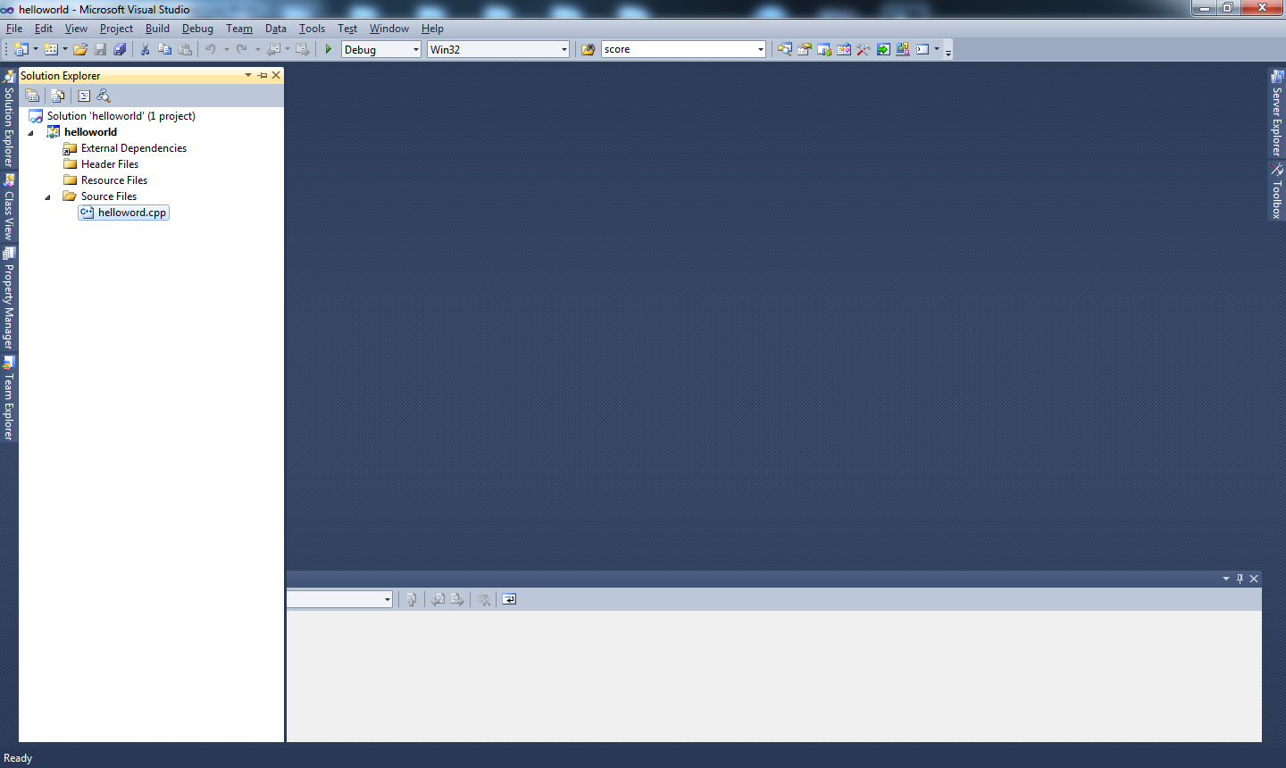
“Oops, I closed my source file!!!”
Yikes!!! Where’s the cpp file???
Open the Solution Explorer and double-click on your file
08/22/12
Visual Studio 2010 : Part 1 (Dr Liow)

Slide 61
“Ctrl-F5 doesn’t do anything!” or “It runs the same after I changed the cpp file!”
Do NOT double-click on a C++ file in your Windows environment – you should double-click on the solution icon.
If in doubt, close MS Studio 2010, and then double-click on the solution icon for the right program.
08/22/12
Visual Studio 2010 : Part 1 (Dr Liow)

Slide 62
“Ctrl-F5 doesn’t do anything!” or “It runs the same after I changed the cpp file!”
The point: In order to build the executable, MS Studio 2010 needs more than just the cpp file. The information needed is associated with the solution (or project), not the cpp file.
08/22/12
Visual Studio 2010 : Part 1 (Dr Liow)

Slide 63
“Can I use another C++ compiler?”
Yes … as long as you’re writing standard C/C++ code.
All work will be checked against the following two compilers:
  g++
  MS Studio 2010
08/22/12
Visual Studio 2010 : Part 1 (Dr Liow)

Slide 64
Proficiency with Editor
Knowing how to use a modern-day editor today is like knowing how to use a pen in 1900 – you’d better be proficient with it
Learn to use hotkeys (shortcuts)
Most hotkeys in MS Studio 2010 are the same for MS Word, Powerpoint, etc.
Force yourself to use them
08/22/12
Visual Studio 2010 : Part 1 (Dr Liow)

Slide 65
Proficiency with Editor
Short list of common hotkeys:
  Copy Ctrl-c
  Paste Ctrl-v
  Cut Ctrl-x
  Undo Ctrl-z
  Alt-Tab Switch between windows
  Etc. (google for more)
For building and running your program:
  Ctrl-F5
08/22/12
Visual Studio 2010 : Part 1 (Dr Liow)

