Slide 1
Using Visual Studio 2022: Part 1
Dr. Yihsiang Liow
1/11/22
Visual Studio 2022 : Part 1 (Dr Liow)

Slide 2
Objectives
Installation
Start Microsoft Visual Studio 2022
Create project
Add C++ file
Compile and run a program
Disable MS Language Extensions
Miscellaneous
1/11/22
Visual Studio 2022 : Part 1 (Dr Liow)

Slide 3
Installation
Go to https://www.visualstudio.com/downloads/ and select the Community Edition.
You will be asked to select the “payloads” or “workloads” -- choose “Desktop Development with C++” (you can choose others if you like, but for CISS240, Desktop Dev with C++ is enough.)
01/11/22
Visual Studio 2022 : Part 1 (Dr Liow)

Slide 4
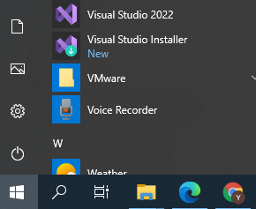
Start Studio 2022
Fire up Visual Studio 2022:
You should get the following screen …
01/11/22
Visual Studio 2022 : Part 1 (Dr Liow)

Slide 5
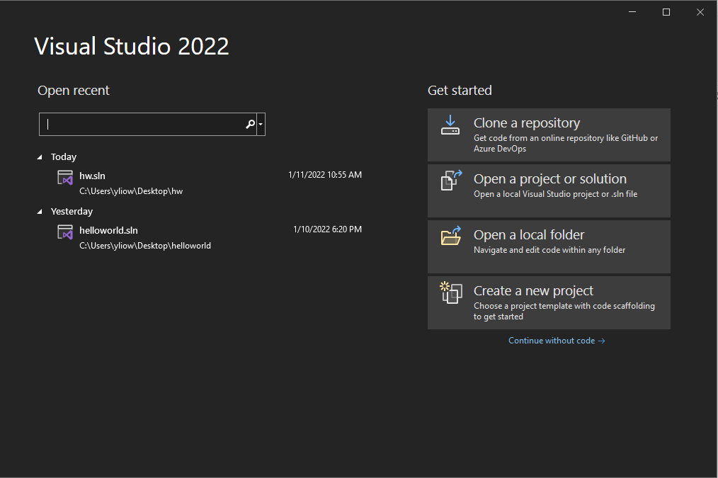
Start Studio 2022
01/11/22
Visual Studio 2022 : Part 1 (Dr Liow)

Slide 6

Start Studio 2022
Click on this:
01/11/22
Visual Studio 2022 : Part 1 (Dr Liow)

Slide 7
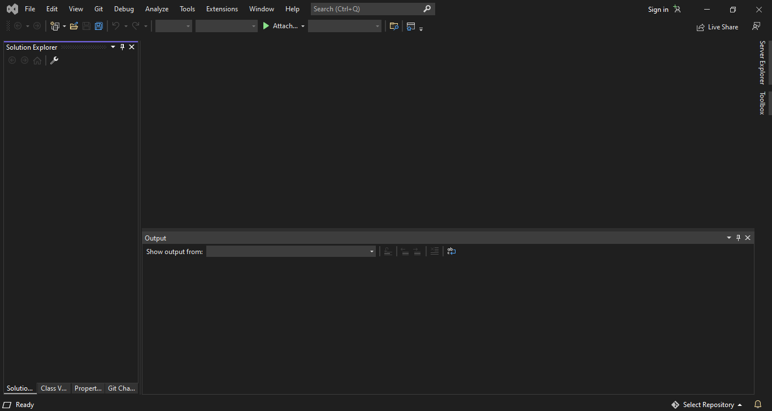
Start Studio 2022
You get this:
1/11/22
Visual Studio 2022 : Part 1 (Dr Liow)

Slide 8
Creating New Project
To write a program in Studio 2022, you need to
    create a project
    put your program (C++ source file) to the project.
Each program requires a new project.
Let’s begin …
1/11/22
Visual Studio 2022 : Part 1 (Dr Liow)

Slide 9
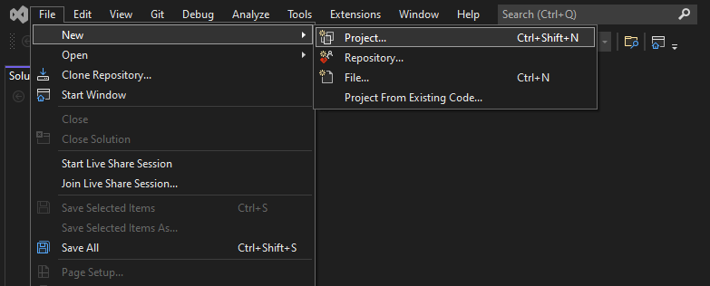
Creating New Project
1. Pull down File
2. Click on New
3. Click on Project
1/11/22
Visual Studio 2022 : Part 1 (Dr Liow)

Slide 10
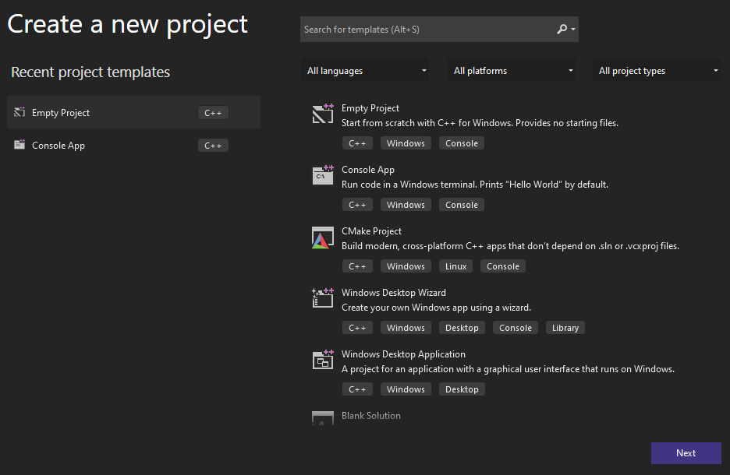
Creating New Project
You should see this:
If you installed multiple languages instead of just C++, then you will also need to select C++, etc.
1/11/22
Visual Studio 2022 : Part 1 (Dr Liow)

Slide 11

Creating New Project
Click on Empty Project
1/11/22
Visual Studio 2022 : Part 1 (Dr Liow)

Slide 12
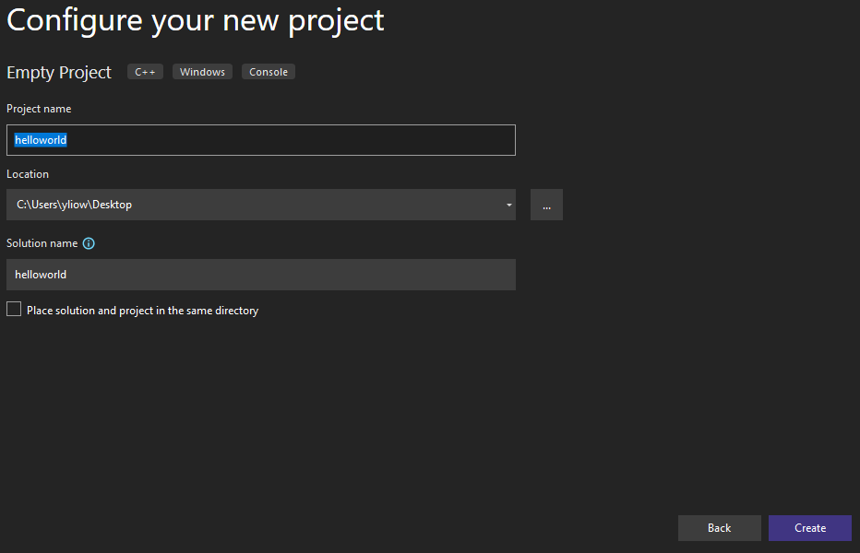
Creating New Project
Enter a name for your project.
For this tutorial, I’ll use helloworld.
Fill in the following
2. Click browse
to enter location
of project. I’ll choose
My Desktop.
3. Click on Create
1/11/22
Visual Studio 2022 : Part 1 (Dr Liow)

Slide 13

Creating New Project
Go to your Desktop and verify that there is a folder on your Desktop:
The program you write will be in this folder.
1/11/22
Visual Studio 2022 : Part 1 (Dr Liow)

Slide 14
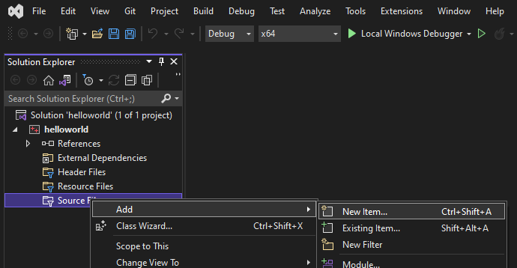
Creating New Project
1. Right-click Source Files
2. Click on Add
3. Click on New Item
1/11/22
Visual Studio 2022 : Part 1 (Dr Liow)

Slide 15
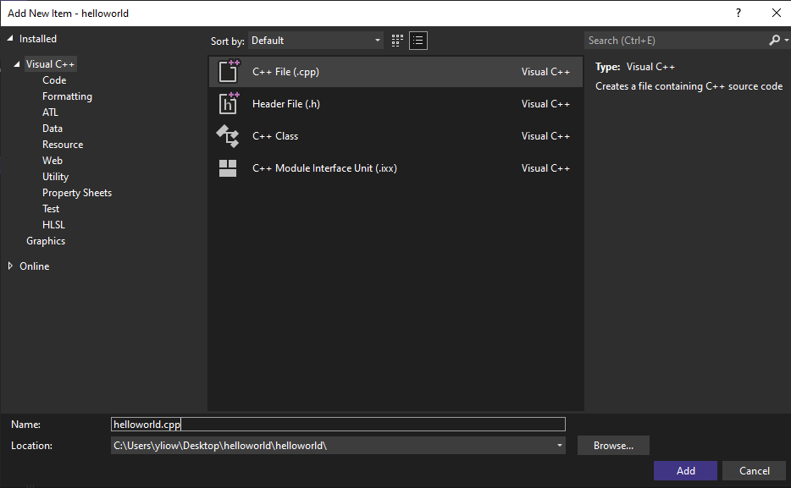
Add C++ Source File to Project
You should see this:
1. Select C++ File (.cpp)
3. Click on Add
2. Enter a name for your C++ file. IT MUST END WITH .cpp!!! I’ll use helloworld.cpp
1/11/22
Visual Studio 2022 : Part 1 (Dr Liow)

Slide 16
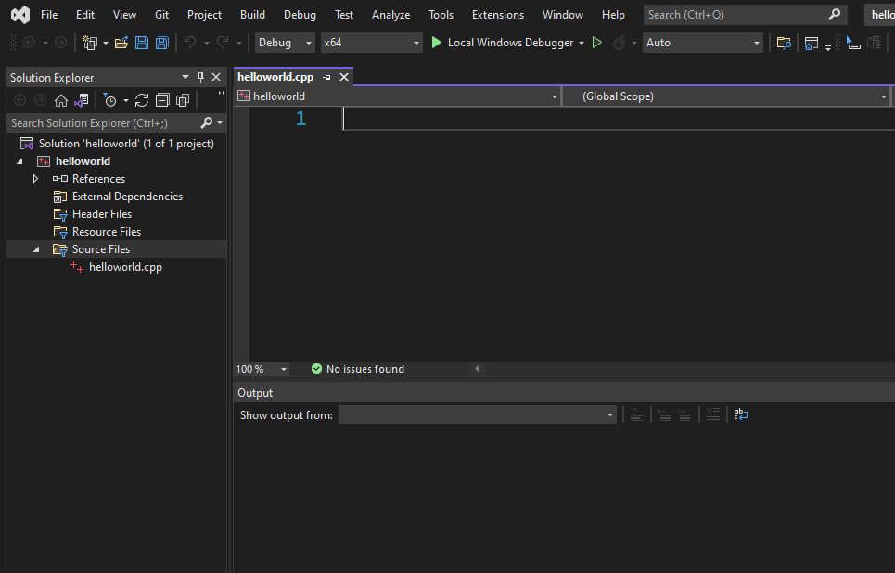
Add C++ Source File to Project
You’ve just created a blank
program (source) file called
helloworld.cpp.
This is where you enter
the program.
1/11/22
Visual Studio 2022 : Part 1 (Dr Liow)

Slide 17
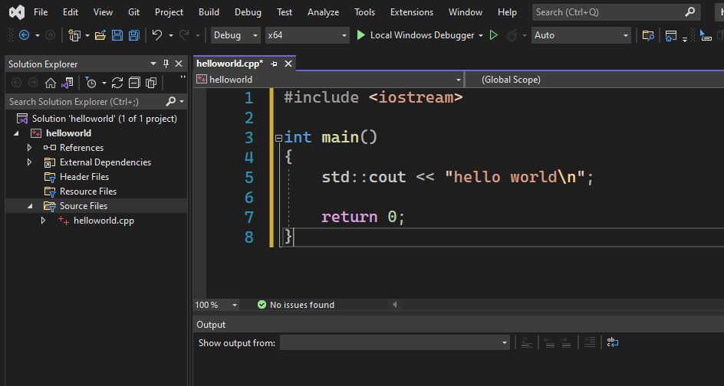
Entering Program
Type in the following program
1/11/22
Visual Studio 2022 : Part 1 (Dr Liow)

Slide 18
Compiling and Running the Program
Now do Ctrl-F5 to compile and run your program
1/11/22
Visual Studio 2022 : Part 1 (Dr Liow)

Slide 19
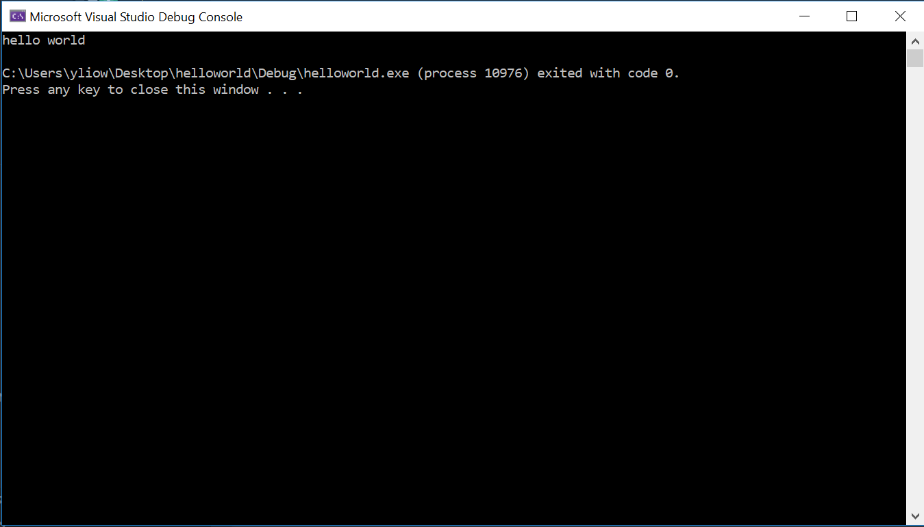
Compiling and Running the Program
You should see this console window:
Close the console window
to end your program.
Or just press any key to close it.
Congratulations!
1/11/22
Visual Studio 2022 : Part 1 (Dr Liow)

Slide 20
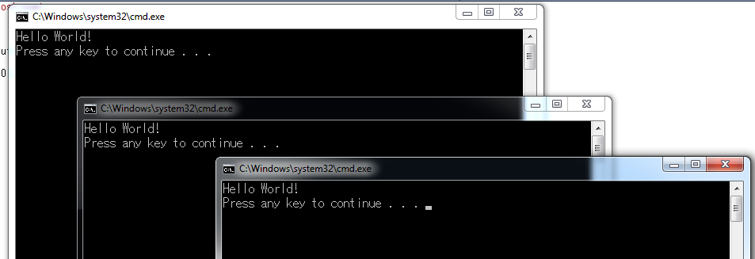
WARNING to the Trigger Happy
When you have too many console windows you might run into an error. SO … close useless console windows!!!
1/11/22
Visual Studio 2022 : Part 1 (Dr Liow)

Slide 21
“Press any key to continue”
Extra line printed: Press any key to continue.
When you press any key, the window closes.
Listen very carefully: The two effects
    Printing “Press any key to continue” to the console window
    Waiting for keypress to close the console window are commands added by Visual Studio 2022.
1/11/22
Visual Studio 2022 : Part 1 (Dr Liow)

Slide 22
“Press any key to continue”
Without these extra commands, the program would print hello world, the program ends, and the console window closes.
Visual Studio 2022 gives you an opportunity to see the output.
But remember: These two things were not due to your program.
1/11/22
Visual Studio 2022 : Part 1 (Dr Liow)

Slide 23
Project Name and cpp Name
Project name can be different from cpp source file name
1/11/22
Visual Studio 2022 : Part 1 (Dr Liow)

Slide 24
Debugging
Debugging = getting rid of “bugs” (i.e. errors) in your program
Visual Studio 2022 can help you find some errors in your program
1/11/22
Visual Studio 2022 : Part 1 (Dr Liow)

Slide 25
Debugging
Output window.
You may minimize it
1/11/22
Visual Studio 2022 : Part 1 (Dr Liow)

Slide 26
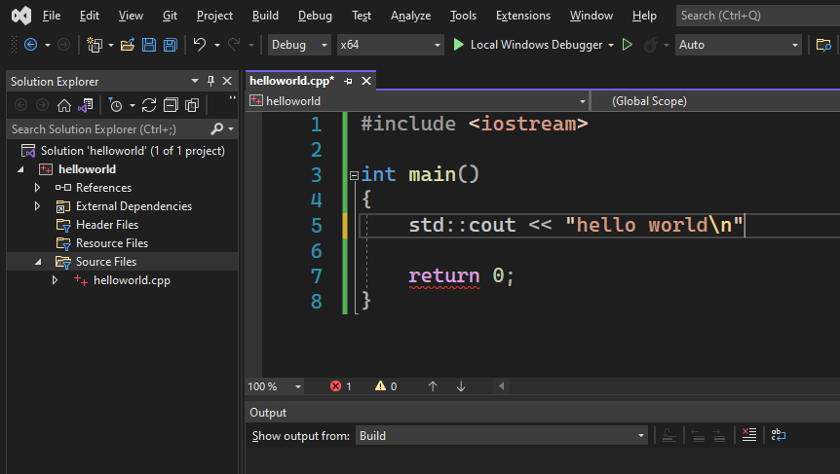
Debugging
Make the following changes to your
program: remove the first semicolon ;
Ctrl-F5 again
1/11/22
Visual Studio 2022 : Part 1 (Dr Liow)

Slide 27
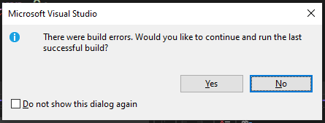
Debugging
1/11/22
Visual Studio 2022 : Part 1 (Dr Liow)

Slide 28
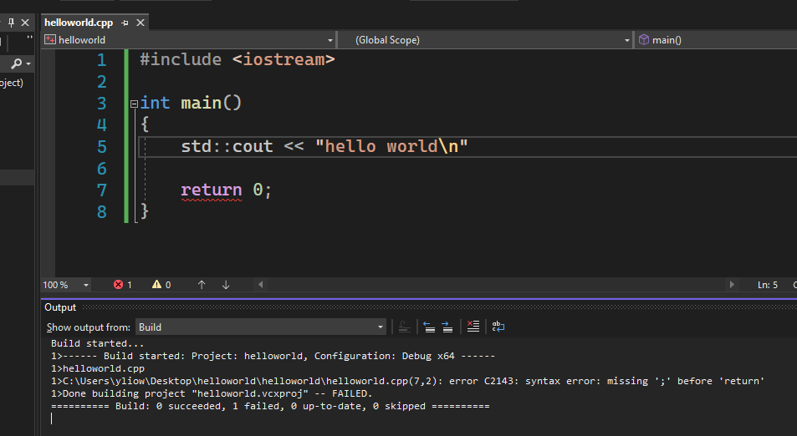
Debugging
error C2143: syntax error : missing ';' before 'return'
1/11/22
Visual Studio 2022 : Part 1 (Dr Liow)

Slide 29
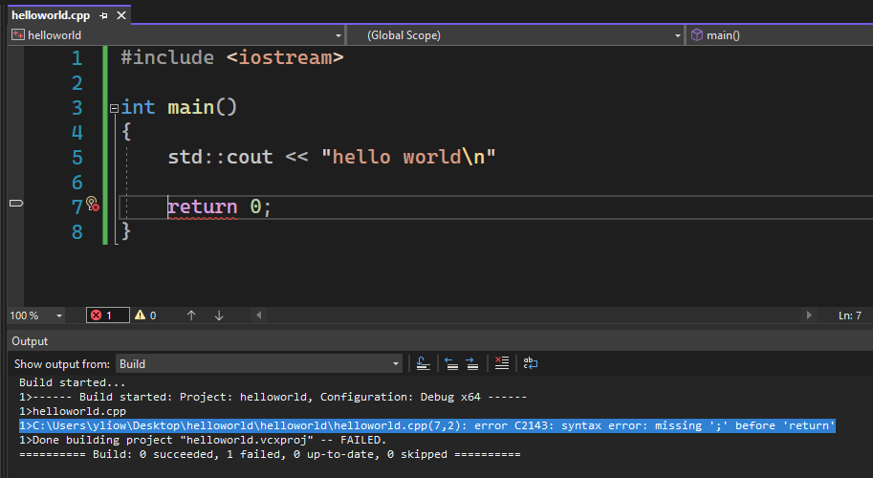
Debugging
2. … the cursor jumps
to approximately the
place where the error
occurred. Correct the
error and rebuild the
solution.
1. Double-click on error
and …
1/11/22
Visual Studio 2022 : Part 1 (Dr Liow)

Slide 30
Debugging
The error message is sometimes helpful in finding the error.
The error pointer points to (only) roughly the place when the error occurs. You usually have to analyze the code before the pointer.
If you have multiple errors, always fix the first error before fixing the second.
1/11/22
Visual Studio 2022 : Part 1 (Dr Liow)

Slide 31
Disable Language Extensions
The next step is very important!
You must modify your project property so that Visual Studio 2019 works “correctly”
Open your project’s property. You can do this in two ways; see next slide. (The second method on the right is recommended.)
1/11/22
Visual Studio 2022 : Part 1 (Dr Liow)

Slide 32
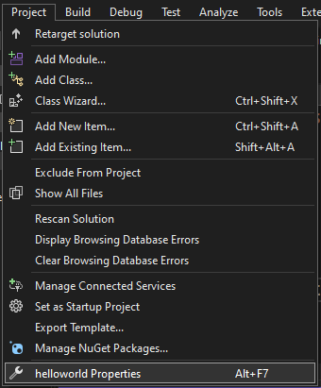
Disable Language Extensions
1. Project
2. Click on project’s properties
1/11/22
Visual Studio 2022 : Part 1 (Dr Liow)

Slide 33
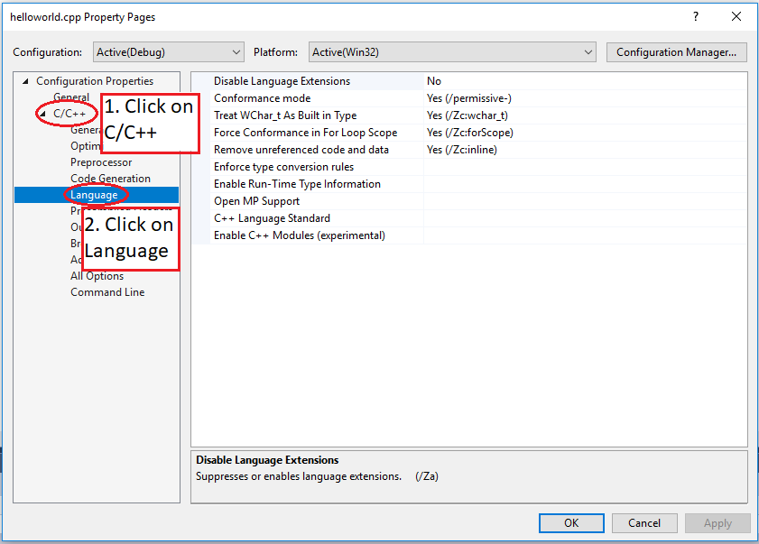
Disable Language Extensions
1/11/22
Visual Studio 2022 : Part 1 (Dr Liow)

Slide 34
Disable Language Extensions
1/11/22
Visual Studio 2022 : Part 1 (Dr Liow)

Slide 35
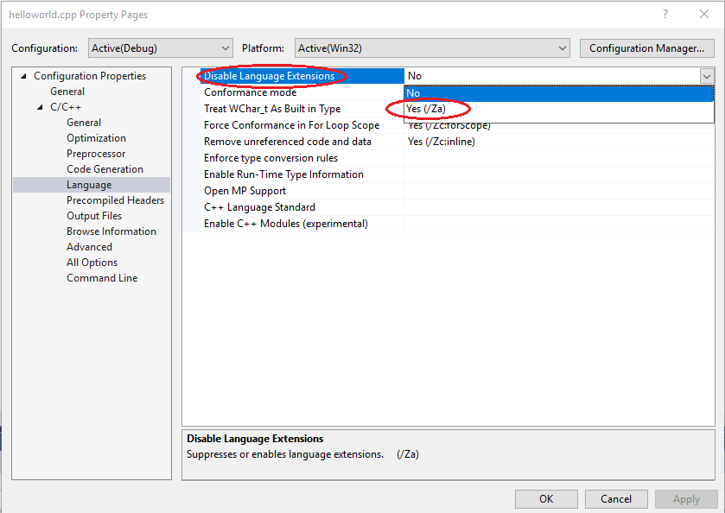
Disable Language Extensions
1. Click on Disable Language Extensions
2. Select Yes (/Za) for
Disable Language Extensions
3. Click OK
1/11/22
Visual Studio 2022 : Part 1 (Dr Liow)

Slide 36
Disable Language Extensions
This step (disabling language extensions) should be done after adding a cpp file.
1/11/22
Visual Studio 2022 : Part 1 (Dr Liow)
Notes:
“For the next class you will be given one minute to rebuild the hello world program, run it, and show me the console window and with ‘disable language extensions’.”

Slide 37
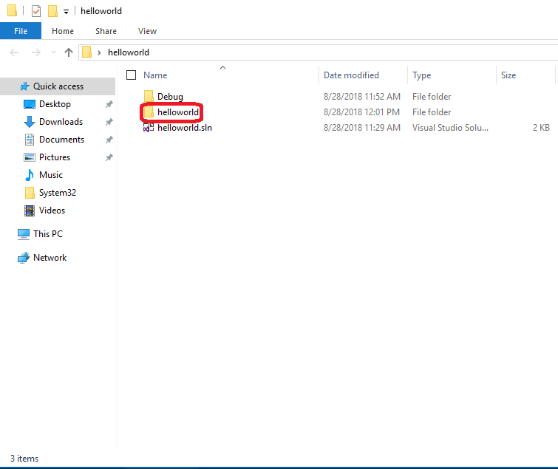

“Where’s my cpp file???”
1. Double-click on the folder on your Desktop (if you choose Desktop as the location).
This is the solution folder.
2. Double-click on the folder on helloworld. This is the project folder.
1/11/22
Visual Studio 2022 : Part 1 (Dr Liow)

Slide 38
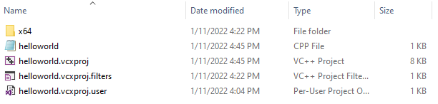
“Where’s my cpp file???”
1/11/22
Visual Studio 2022 : Part 1 (Dr Liow)

Slide 39
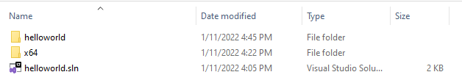
“What about opening an old project?”
If you know the location of your project:
1. Double-click on the solution folder
2. Double-click on the solution icon
1/11/22
Visual Studio 2022 : Part 1 (Dr Liow)

Slide 40
“What about opening an old project?”
If you do not know the location: When you start MSVS you can select recent solutions.
But the best is to be organized and put all your projects for a class in a folder.
1/11/22
Visual Studio 2022 : Part 1 (Dr Liow)

Slide 41
“What about opening an old project?”
We’ve created a “solution” which contains a “project” which contains the cpp file.
It’s possible to have a solution containing multiple projects where each project contains a cpp file meant for a single program.
We’ll stick to one solution, one project, one cpp file for each program – this is less confusing for beginners.
1/11/22
Visual Studio 2022 : Part 1 (Dr Liow)

Slide 42
“What about opening an old project?”
Last resort: Search your machine’s hard drive for the solution folder if you remember the name.
1/11/22
Visual Studio 2022 : Part 1 (Dr Liow)

Slide 43
“I’m out of space!”
Most of the files in your solution folder are created when you do Ctrl-F5 and so can be deleted if you don’t have enough space.
The easiest way to remove these files is to do “Clean Solution” …
1/11/22
Visual Studio 2022 : Part 1 (Dr Liow)

Slide 44
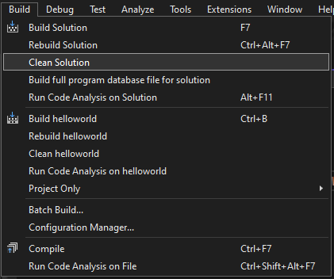
“I’m out of space!”
1. Pull down Build
2. Click on Clean Solution
1/11/22
Visual Studio 2022 : Part 1 (Dr Liow)

Slide 45
“How do I copy my work to my stick?”
Do “Clean Solution”
Copy the solution folder you’ve created
to your USB storage, external HD, etc.
To resume work on another machine: Copy the solution folder from your storage to the machine and work from there
1/11/22
Visual Studio 2022 : Part 1 (Dr Liow)

Slide 46
“How do I copy my work to my stick?”
Note: USB drives are slow. Use it only for backup.
I strongly suggest you get a Western Digital external HD for backup.
1/11/22
Visual Studio 2022 : Part 1 (Dr Liow)

Slide 47
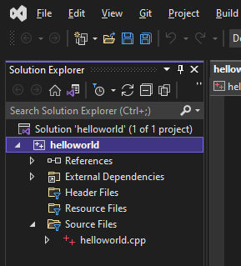
“Where did Solutions Explorer go?”
Oh no!!! I closed the Solution Explorer …
1/11/22
Visual Studio 2022 : Part 1 (Dr Liow)

Slide 48
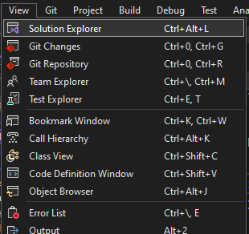
“Where did Solutions Explorer go?”
1. View
2. Click on Solution Explorer
You can find most of the windows this way
1/11/22
Visual Studio 2022 : Part 1 (Dr Liow)

Slide 49
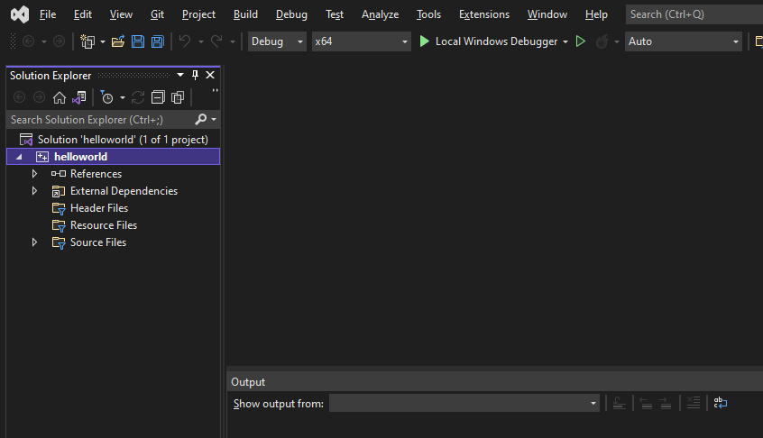
“Oops, I closed my source file!!!”
Yikes!!! Where’s the cpp file???
Open the Solution Explorer and double-click on your file
1/11/22
Visual Studio 2022: Part 1 (Dr Liow)

Slide 50
“Ctrl-F5 doesn’t do anything!” or “It runs the same after I changed the cpp file!”
Do NOT double-click on a C++ file in your Windows environment – you should double-click on the solution icon.
If in doubt, close Visual Studio 2022, and then double-click on the solution icon for the right program.
1/11/22
Visual Studio 2022 : Part 1 (Dr Liow)

Slide 51
“Ctrl-F5 doesn’t do anything!” or “It runs the same after I changed the cpp file!”
The point: In order to build the executable, Visual Studio 2022 needs more than just the cpp file. The information needed is associated with the solution (or project), not the cpp file.
1/11/22
Visual Studio 2022 : Part 1 (Dr Liow)

Slide 52
“Can I use another C++ compiler?”
Yes … as long as you’re writing standard C/C++ code.
All work will be checked against the following two compilers:
    g++
    Visual Studio 2022
1/11/22
Visual Studio 2022 : Part 1 (Dr Liow)

Slide 53
Proficiency with Editor
Knowing how to use a modern-day editor today is like knowing how to use a pen in 1900 – you’d better be proficient with it
Learn to use hotkeys (shortcuts)
Most hotkeys in Visual Studio 2022 are the same for MS Word, Powerpoint, etc.
Force yourself to use them
1/11/22
Visual Studio 2022 : Part 1 (Dr Liow)

Slide 54
Proficiency with Editor
Short list of common hotkeys:
    Copy Ctrl-c
    Paste Ctrl-v
    Cut Ctrl-x
    Undo Ctrl-z
    Alt-Tab Switch between windows
    Etc. (google for more)
For building and running your program:
    Ctrl-F5
1/11/22
Visual Studio 2022 : Part 1 (Dr Liow)

