Slide 1

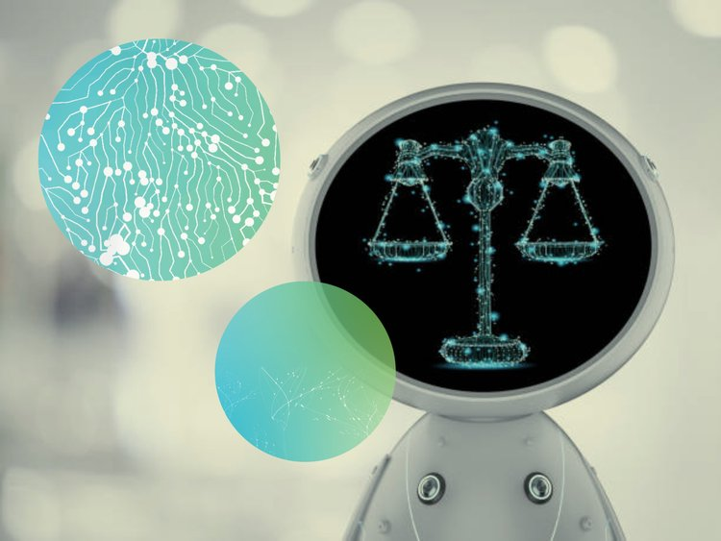


On Moral AIs
Yuxin Liu
Society for Philosophy and Technology
23rd Biennial Conference
Panel: Mobilising Technomoral Knowledge
June 9, 2023
Tokyo, Japan

Slide 2
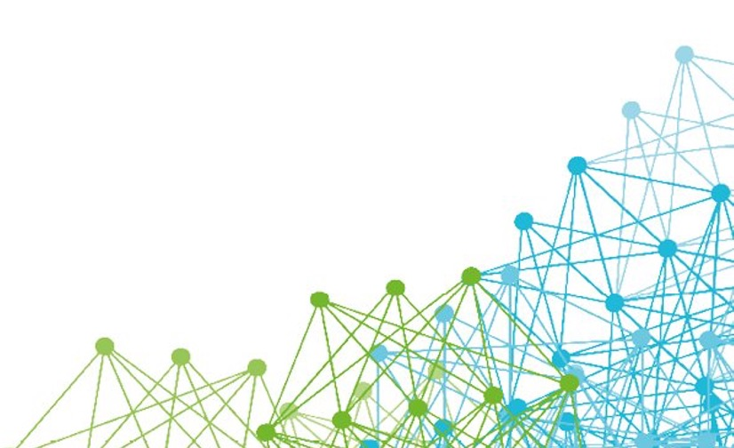
Moral AIs
Artificial morality, moral AIs, moral machines, artificial moral agents, artificial moral advisors, etc.
Mainly concerned with implicit/explicit ethical agents (Moor, 2006)
One major motivation in machine ethics
AIs are superior moral reasoners over humans
Part I: Introduction – Moral AI & IOT

Slide 3
Today’s talk
Moral AI as ideal observer for the purpose of helping people achieve moral enhancement?
I. Moral AI & the Ideal Observer Theory
II. Moral AI as ideal observer?
III. Responding to moral AI
Part I: Introduction – Moral AI & IOT

Slide 4
Ideal observer theory (IOT)
Firth (1952)
Omniscient: possessing factual knowledge of all non-morally relevant information involved in the procedure of deciding the rightness/wrongness of a particular act
Omnipercipient: capable of simultaneously imagining or visualising all alternatives and consequences of any given act
Disinterested: completely impartial about reacting (dis)favourably to any person/thing
Dispassionate: incapable of any emotional experience at all
Consistent: having exactly similar ethically significant reactions to any given act
Normal: in other aspects as a human being
Part I: Introduction – Moral AI & IOT

Slide 5
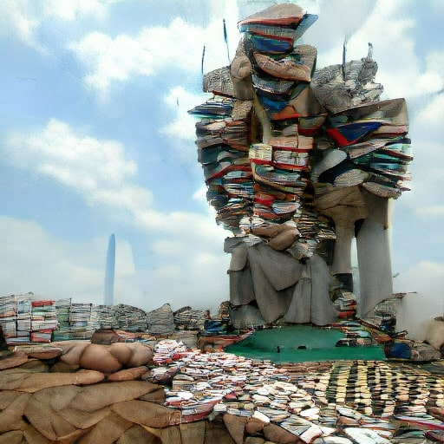

Omniscience & omnipercipience
IOT is unattainable
Humans are epistemically bounded
IOT’s circular reasoning
The view from nowhere (Gebru, 2020)
The bootstrapping problem (Vallor, 2016)
Human moral fallacies
↓↑
Need for moral machines
Part II: Moral AIs as Ideal Observer?

Slide 6
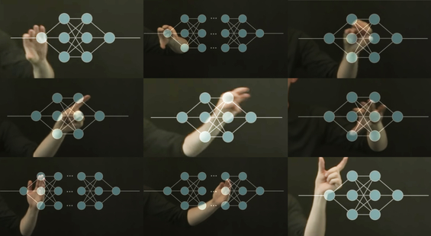
Consistency
Consistency reframed as (dis)similar features
Two actions, however similar they are, are dissimilar in at least one aspect (Harrison, 1956)
Part II: Moral AIs as Ideal Observer?

Slide 7
Dispassion
Dispassionate machines ≠ superior reasoners
Bootstrapping again – bias/ prejudice seeping through machines
Creates/manifests a hierarchy of values – blanket rejection of intuitions
Part II: Moral AIs as Ideal Observer?

Slide 8
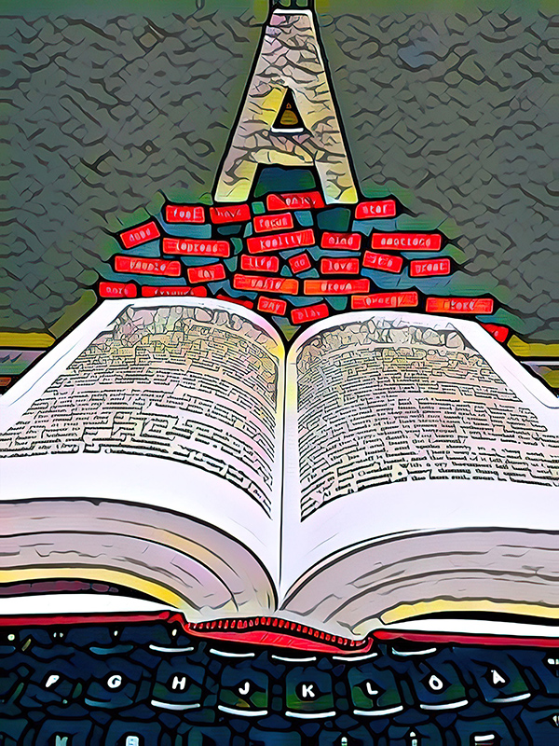
Impartiality
Inherent political properties of moral AIs as a product of intentional human creation (Winner, 1980)
Political by explicit/implicit design
Deliberately/inevitable benefit some and disadvantage others
Political by necessity
Technosolutionist nature of moral machine projects
Part II: Moral AIs as Ideal Observer?

Slide 9

Responding to moral AIs
Passive acceptance
Genuine moral enhancement?
Risks of moral deskilling from outsourcing
The only option?
Part III: Responding to Moral AIs

Slide 10
Responding to moral AIs
Passive acceptance is not the only option – inescapability and irreducibility of human decisions
Sartre’s advice-seeking soldier
Prescriptive nature of AI moral advisors
Diminishing benefits of moral AIs
Possibility of moral degradation from motivated reasoning
Part III: Responding to Moral AIs

Slide 11
Necessity for technomoral wisdom
Moral AI as an ideal observer?
Bootstrapping problem
Misconception of appropriate decision making
Political properties of moral AIs
Moral AI to help humans achieve moral enhancement?
Inescapability and irreducibility of human moral decisions
Summary

Slide 12



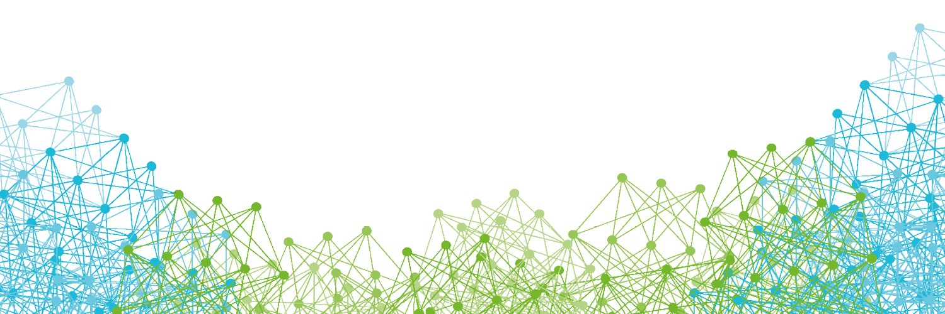

Thank you
technomoralfutures.uk
yliu3310@ed.ac.uk
@_yuxinl_

