Slide 1
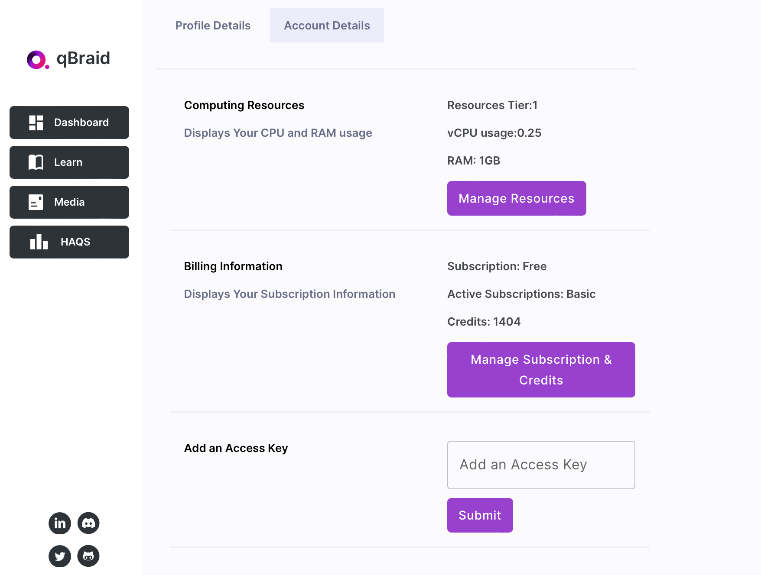
Create an account with your aggies.ncat.edu mail
Check you email from qBraid “welcome to qBraid”
Type your access key.

Slide 2
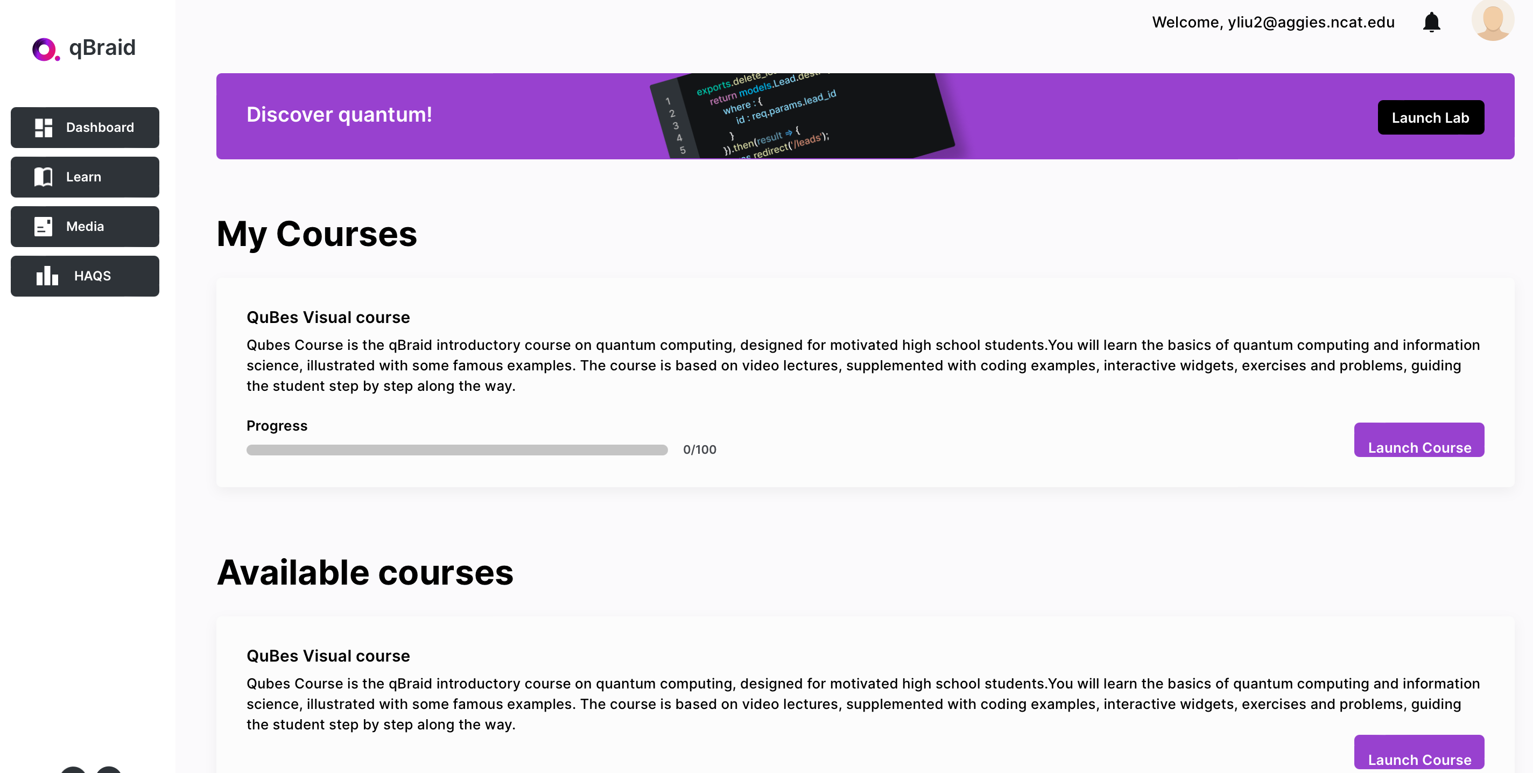
Launch course
Green Ready (connect with the kernel)

Slide 3
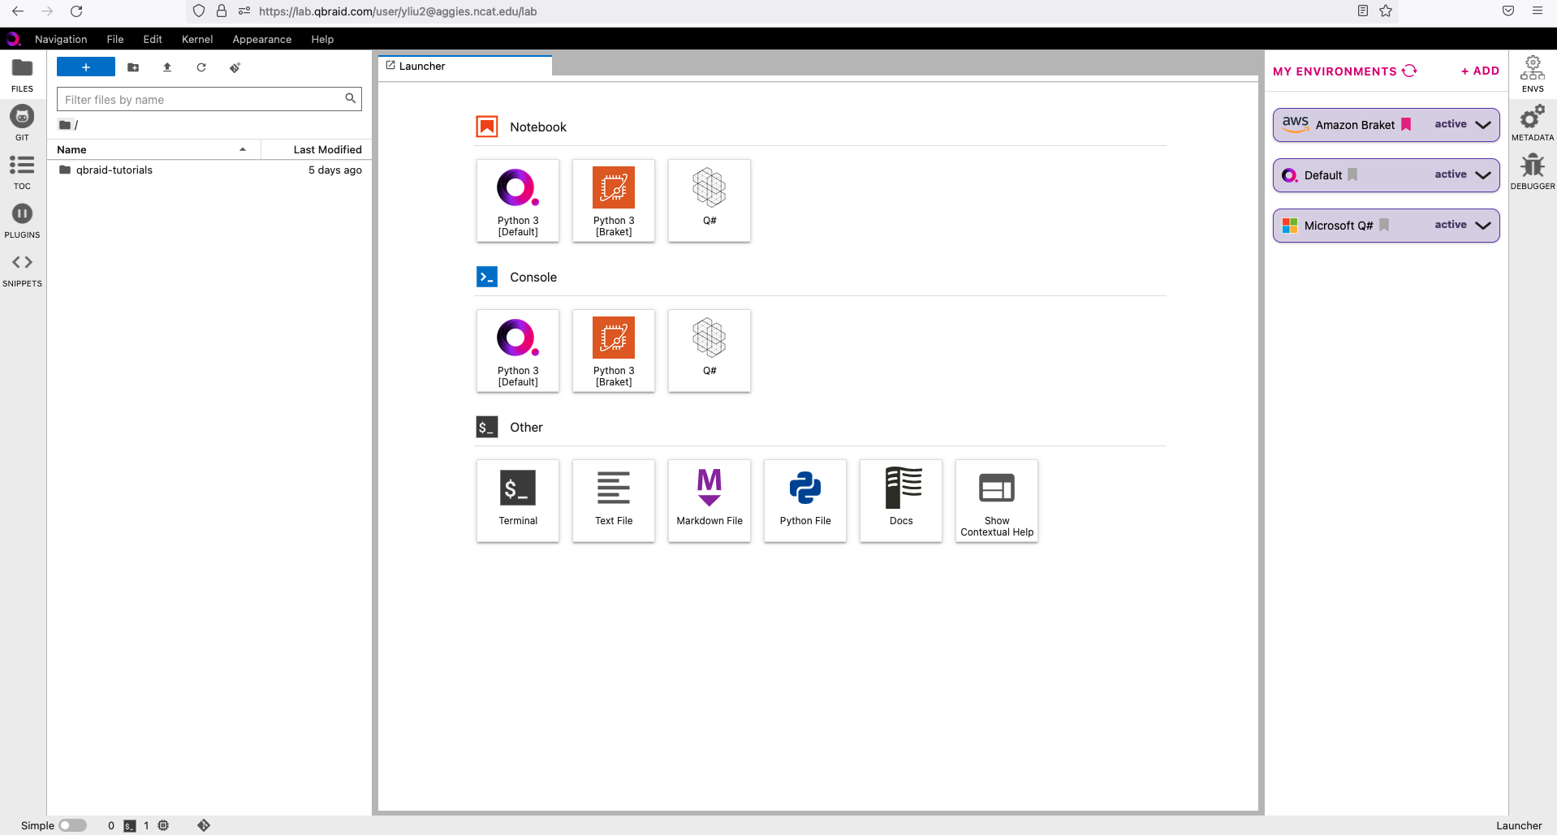
Launch Lab
Jupyter Notebook: a web-based interactive computing platform

Slide 4
Click ENVS
Click Add
Find Amazon Braket and install it.

Slide 5
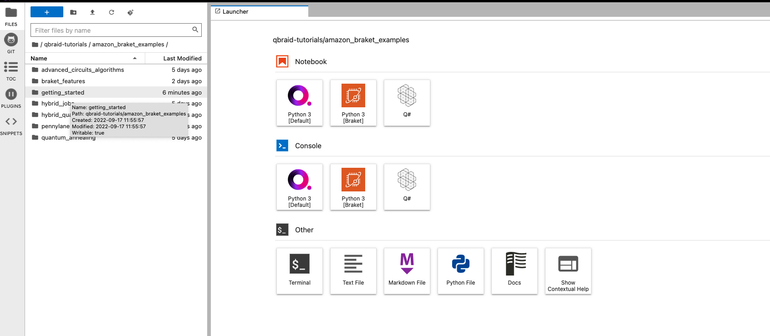

Slide 6
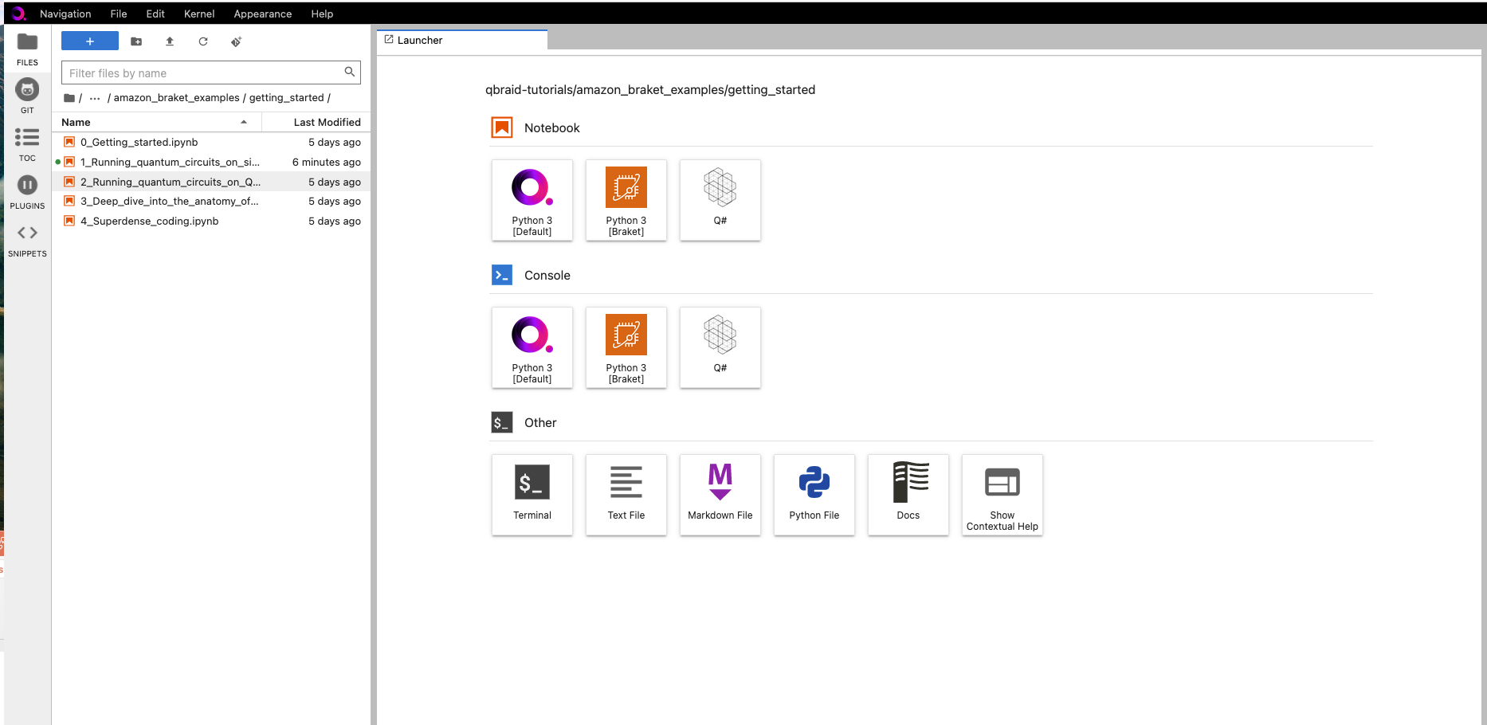

Slide 7
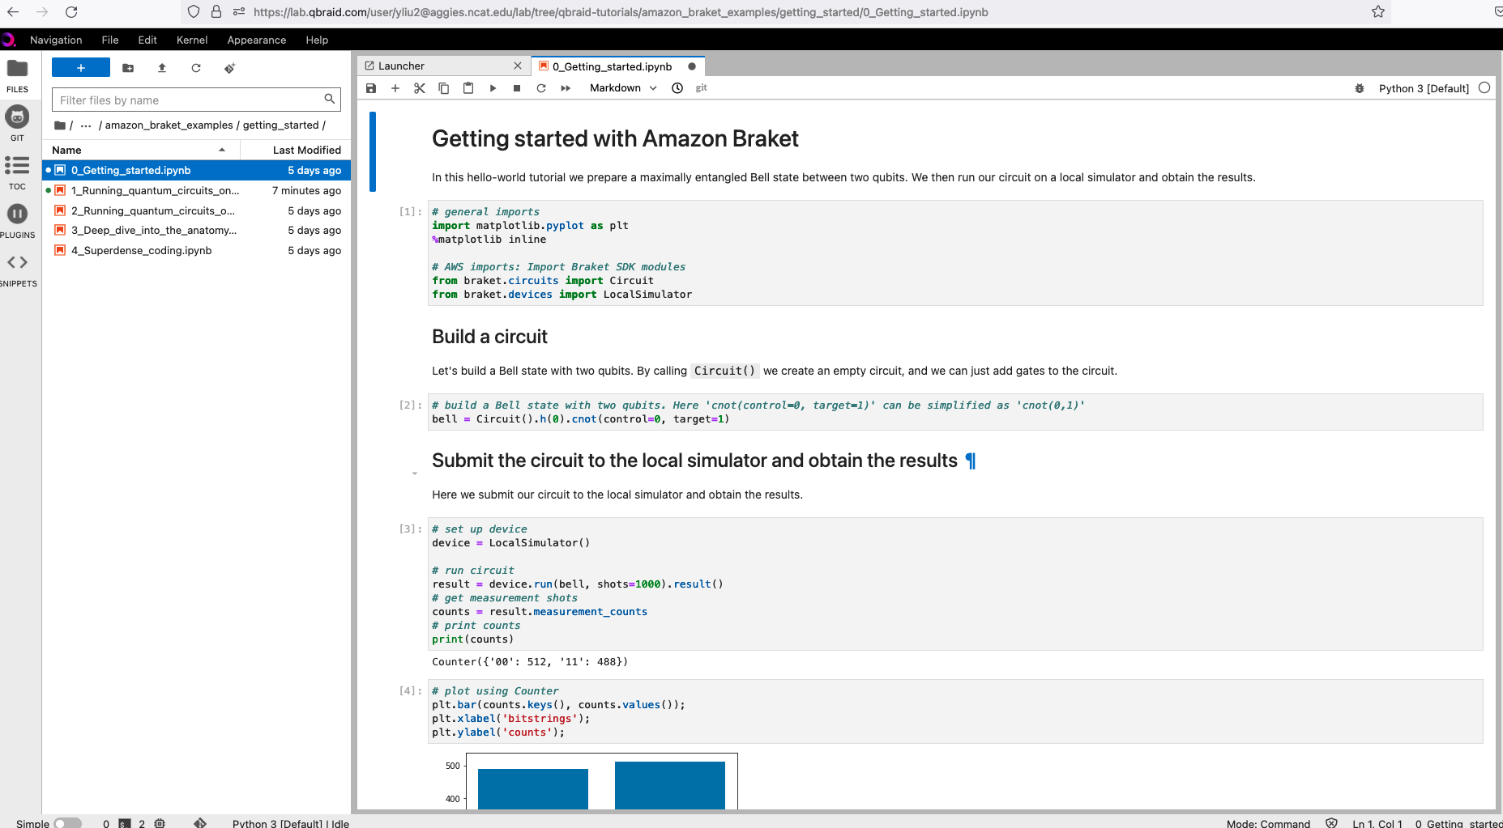

Slide 8
ENVS find aws and active the Amazon Braket

Slide 9
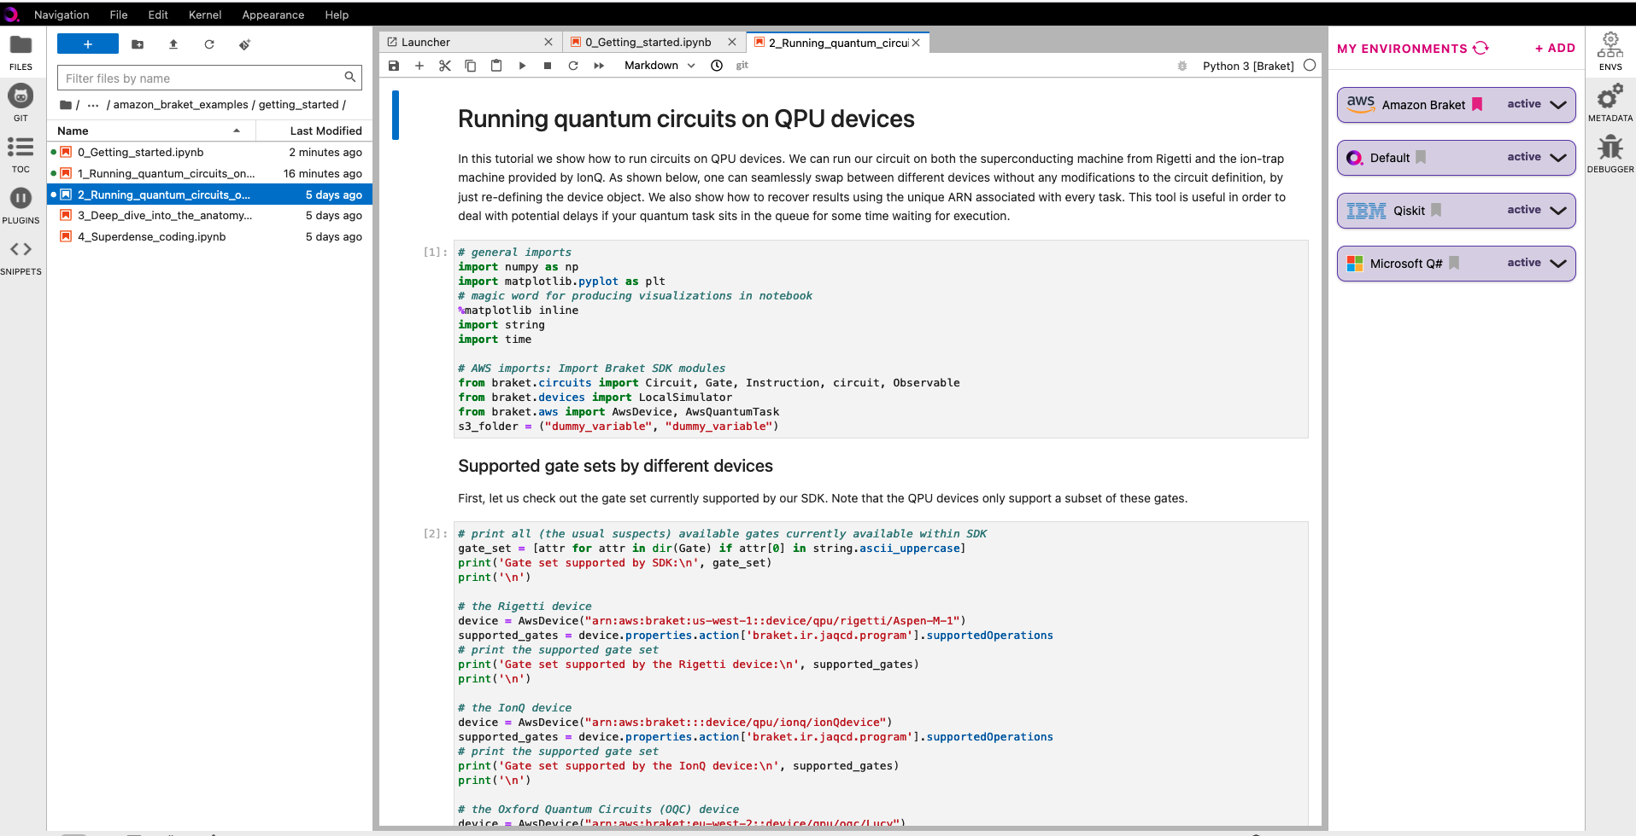
Real quantum computing server

Slide 10
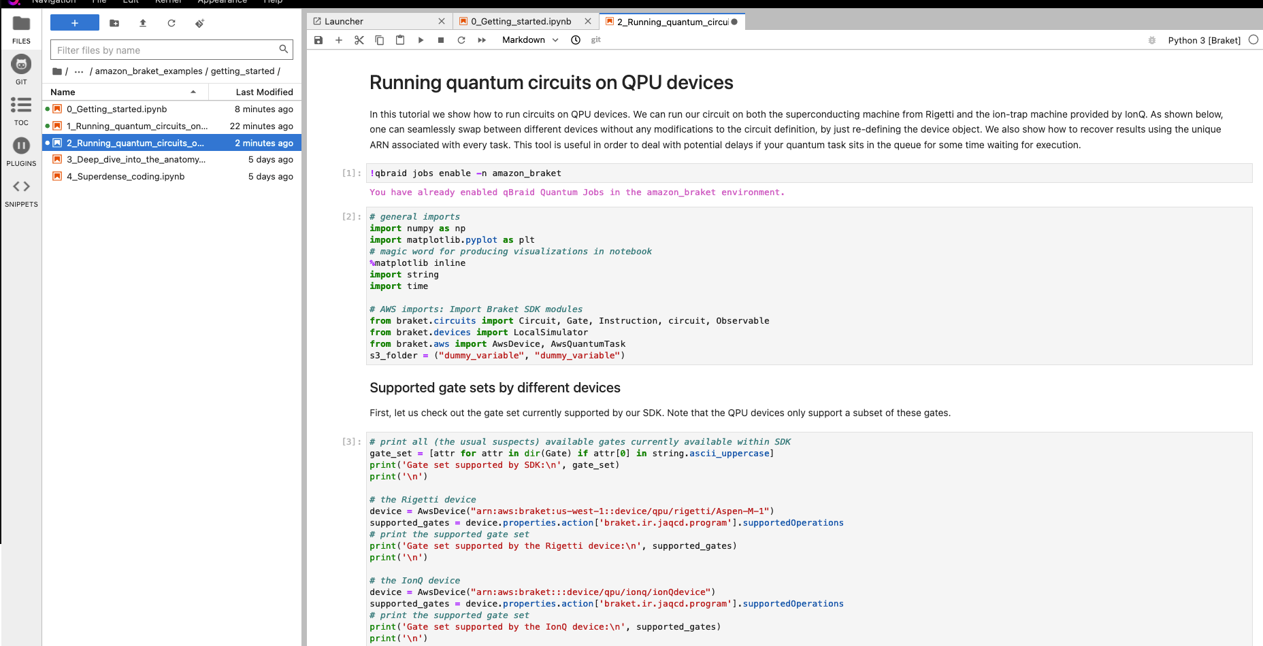

Slide 11
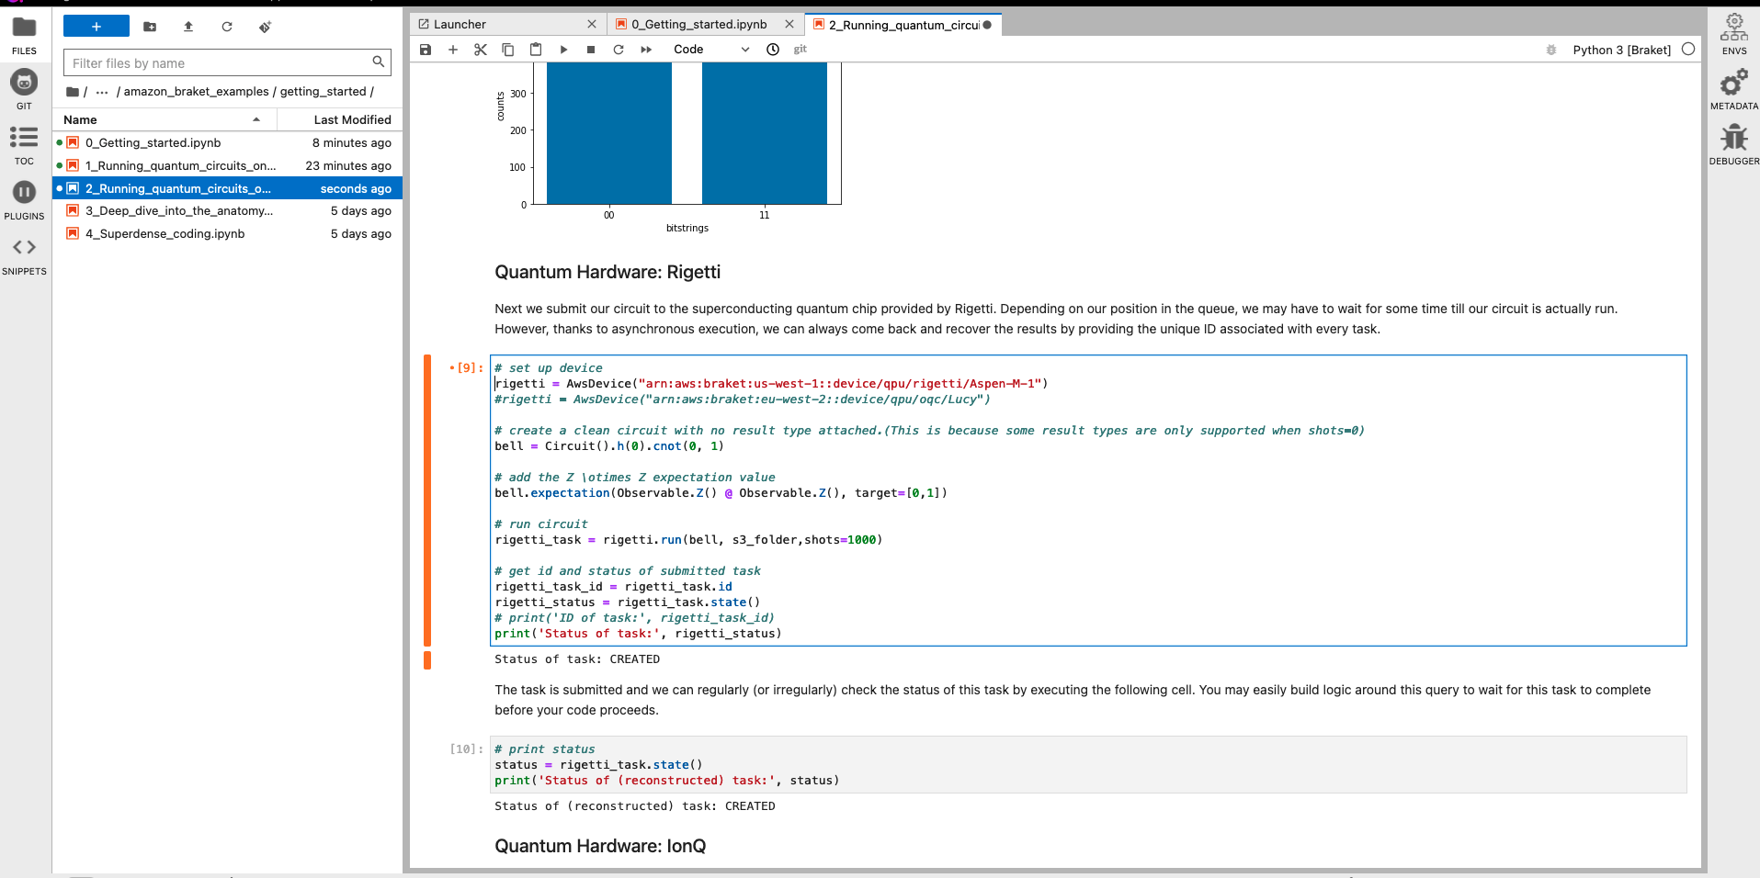

Slide 12
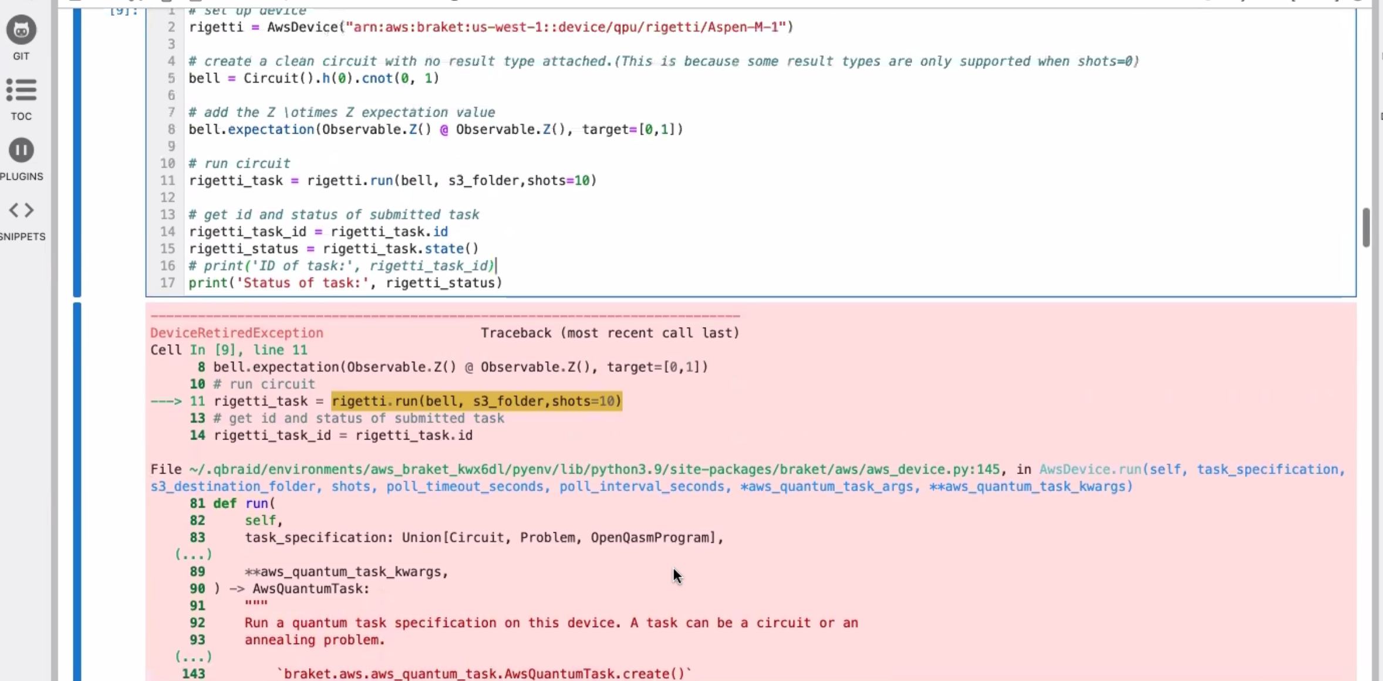

Slide 13
