Slide 1
Quantum Natural Language Processing
Yang Liu
Ph.D. Candidate of Computer Science
Human-Centered AI (HCAI) Lab
Quantum Computing Research Center <QC|RC>
Advisor: Dr. Mohd Anwar
Professor of Computer Science
Director, Quantum Computing Research Center
Director, Human-Centered AI (HCAI) Lab
Director, Center for Advanced Studies in Identity Sciences

Slide 2
Quantum Natural Language Processing
QNLP
QNLP is a very young area of research, aimed at the design and implementation of NLP models that exploit certain quantum phenomena such as superposition, entanglement, and interference to perform language-related tasks on quantum hardware.
lambeq, an open-source, modular, extensible high-level Python library, which provides the necessary tools for implementing a pipeline for experimental QNLP.

Slide 3
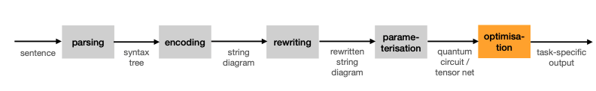
Pipeline
In lambeq, the conversion of a sentence into a quantum circuit goes through the steps shown in Fig.1.
Figure 1: Pipeline implemented by lambeq.

Slide 4
qnlp-tutorial Drawing cooking recipes
https://discopy.readthedocs.io/en/main/notebooks/qnlp-tutorial.html

Slide 5
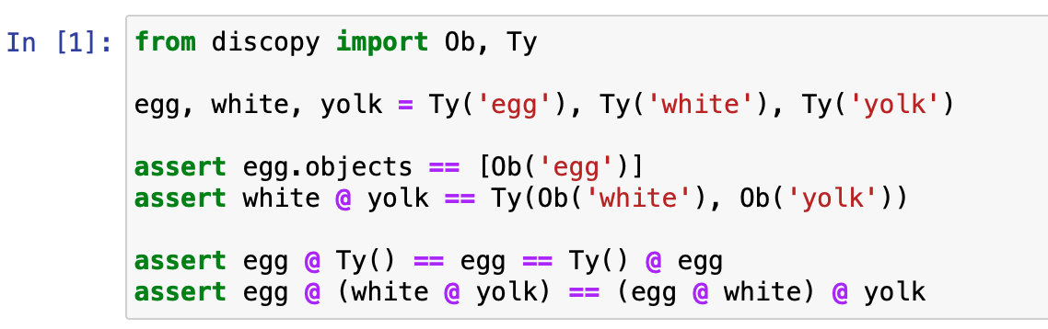
Drawing cooking recipes
qnlp-tutorial
An Ob (object) can be thought of as a basic ingredient in a recipe, it is defined only by its name, e.g., 'egg', 'sentence', 'qubit', etc.
A Ty (type) is simply a sequence of objects, i.e., a bunch of ingredients side by side, e.g., Ty('egg', 'qubit') represents an egg next to a qubit.
Types form a monoid with @ (tensor) as product and Ty() (the empty type) as unit.
Notes:
Commutative property

Slide 6
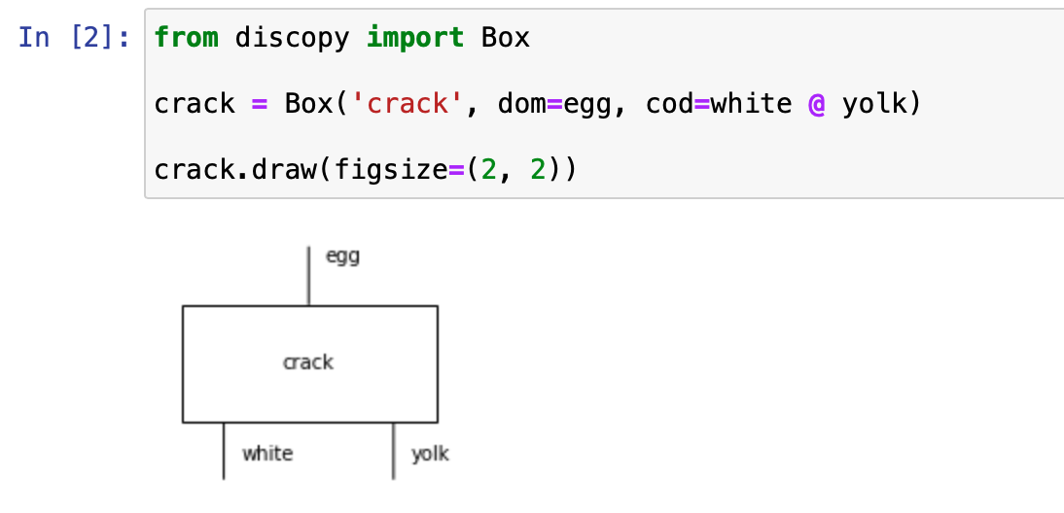
Drawing cooking recipes
qnlp-tutorial
Draw a Box with some types as dom (domain) and cod (codomain) which represent the inputs and outputs of a process.
Notes:
Once we have defined some types, we can draw ….

Slide 7
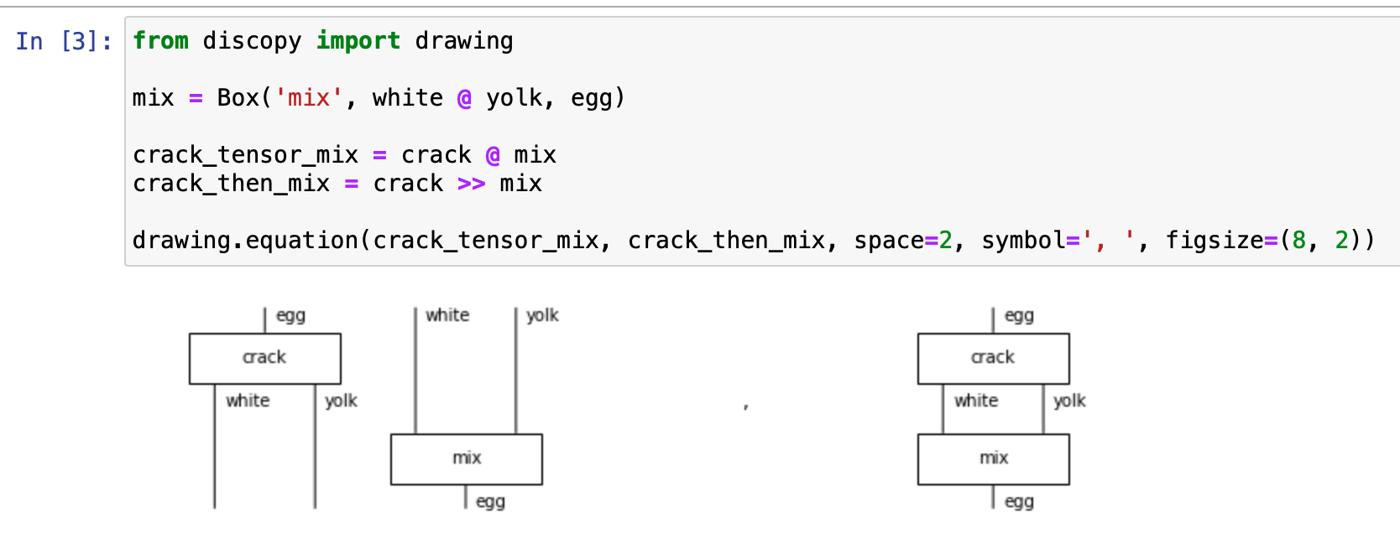
Drawing cooking recipes
qnlp-tutorial
We can put boxes side by side with @ (tensor) and compose them in sequence with >> (then).

Slide 8
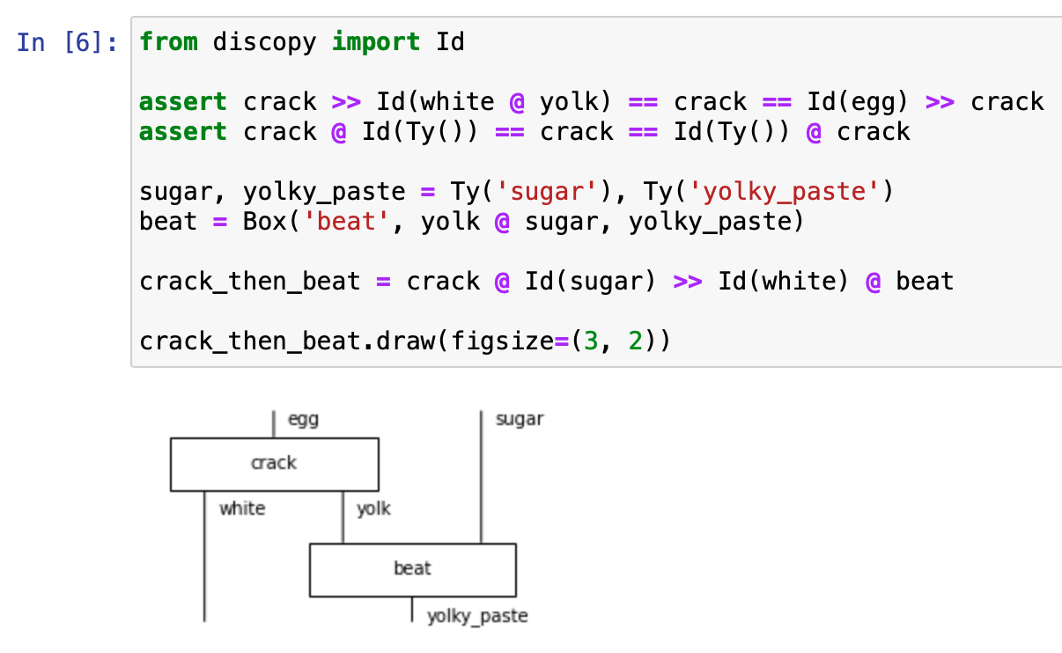
Drawing cooking recipes
qnlp-tutorial
We can draw the Id (identity) for a type, i.e., just some parallel wires. Composing with an identity does nothing. Tensoring with Id(Ty()) (the empty diagram) does nothing either. Using the monoidal identity Id() as a starting point.
Notes:
Using the monoidal identity Id() as a starting point

Slide 9
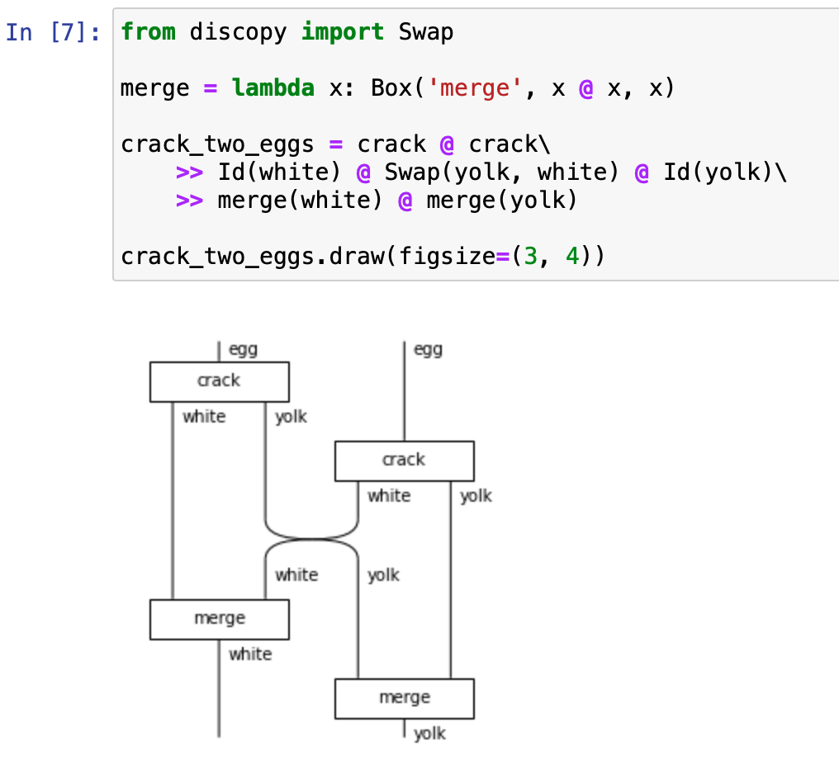
Drawing cooking recipes
qnlp-tutorial
We can change the order of ingredients using special boxes called Swap.

Slide 10
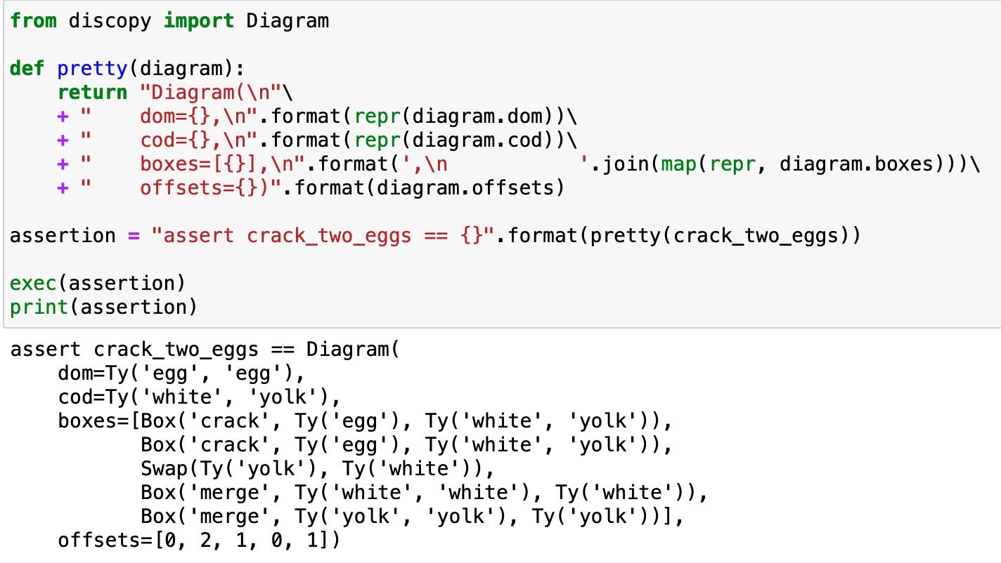
Diagram: Anything we can draw using boxes, tensor, composition and identities.
A diagram is uniquely defined by a domain, a codomain, a list of boxes and a list of offsets.
The offset of a box encodes its 𝑥-coordinate as the number of wires passing to its left, its 𝑦-coordinate is given by its index in the list.

Slide 11
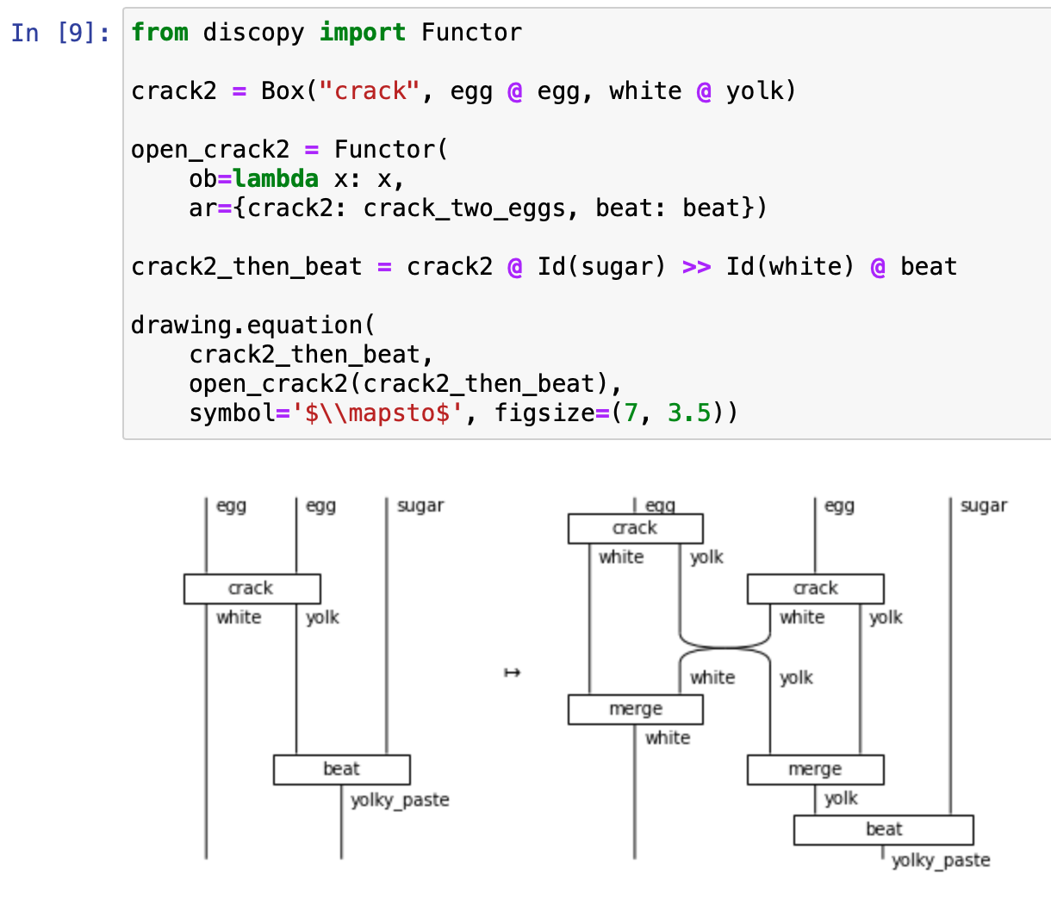
Diagram is the core data structure of DisCoPy, Functor is its main algorithm. It is initialized by two mappings:
ob maps objects (i.e. types of length 1) to types,
ar maps boxes to diagrams.

Slide 12
Tensors as boxes
Dim (dimension) is a subclass of Ty where the objects are integers greater than 1, with multiplication as tensor and the unit dimension Dim(1).
Tensor is a subclass of Box defined by a pair of dimensions dom, cod and an array with shape dom @ cod.

Slide 13
Drawing quantum circuits

Slide 14
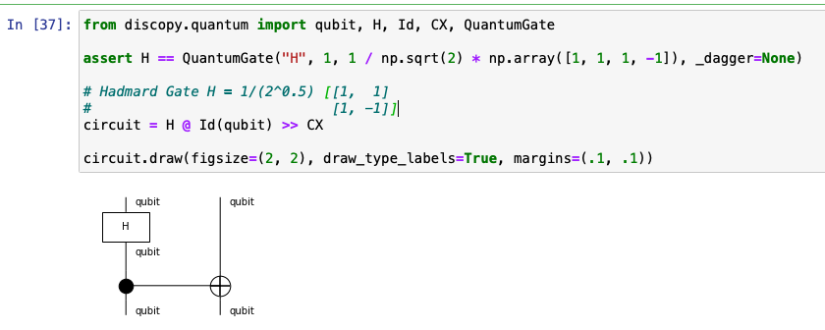
A (pure) quantum Circuit is simply a recipe with qubits as ingredients and QuantumGate boxes as cooking steps. A quantum gate is defined by a number of qubits and a unitary matrix.
Notes:
H gate allows us to move away from the poles of the Bloch sphere and create a superposition of |0⟩ and |1⟩

Slide 15
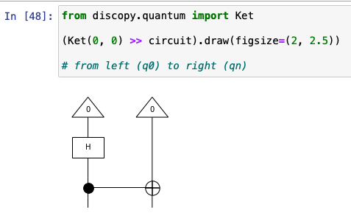
To simulate the quantum state that the circuit produces, we need to pre-compose it with a Ket

Slide 16
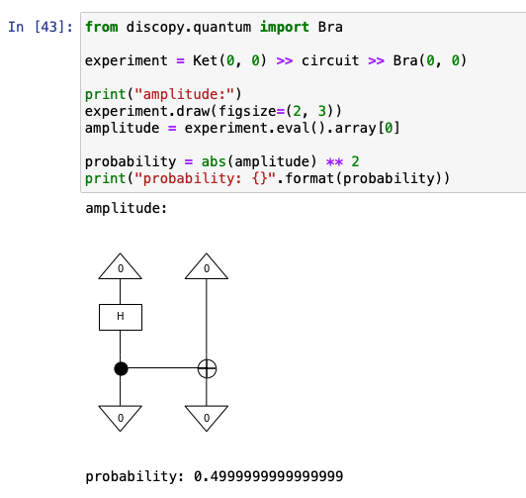
To compute the probability of a particular measurement result, we need to post-compose our circuit with a Bra, the dagger of Ket, then apply the Born rule.
Notes:
conjugate transpose of a tensor using [::-1] (dagger).
<x| is a row vector -> (Bra)
|x> is a column vector -> (Ket)
Born rule: a key postulate of quantum mechanics which gives the probability that a measurement of a quantum system will yield a given result.

Slide 17
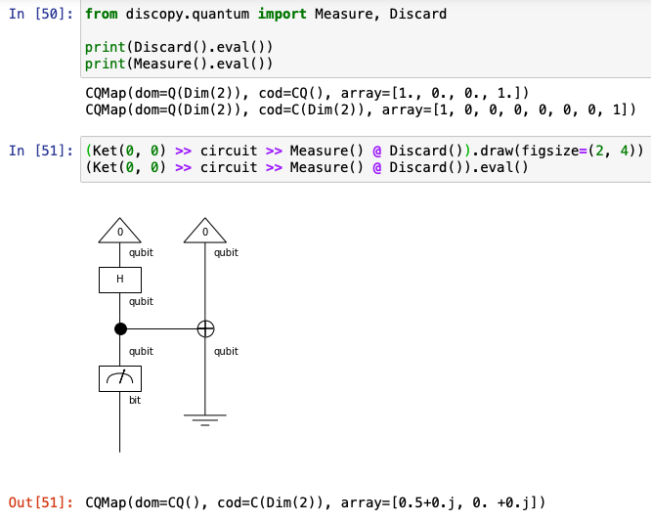
The Measure box has dom=qubit and cod=bit. Another example of a mixed box is Discard which computes a partial trace over a qubit. Mixed circuits cannot be evaluated as a unitary matrix anymore. Instead, whenever the circuit is mixed, circuit.eval() outputs a CQMap: a numpy.ndarray with axes for the classical and quantum dimensions of the circuit.

Slide 18
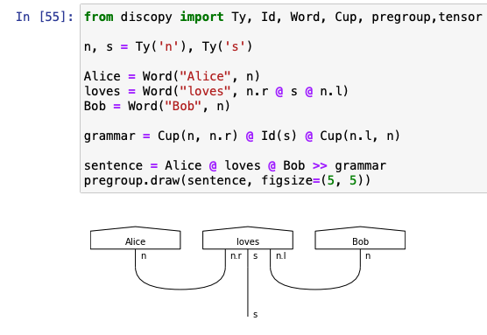
Drawing grammatical structure
The basic ingredients are grammatical types: n for noun, s for sentence, etc.
Each ingredient has left and right adjoints n.l and n.r which represent a missing noun on the right and left respectively.
For example, the type for intransitive verbs n.r @ s reads “take a noun on your left and give a sentence”.

Slide 19
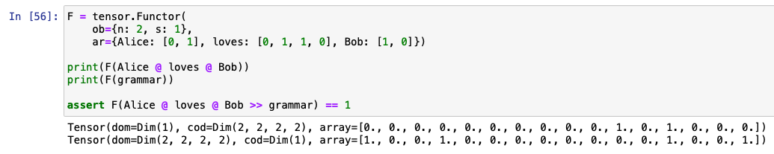
we map n to 2, i.e. we encode a noun as a 2d vector,
we map s to 1, i.e. we encode a sentence as a scalar,
we map Alice and Bob to [0, 1] and [1, 0], i.e. we encode them as the basis vectors,
we map loves to the matrix [[0, 1], [1, 0]], i.e. Alice loves Bob and Bob loves Alice.
Notes:
Alice and Bob are different: we defined their meaning to be orthogonal.

Slide 20
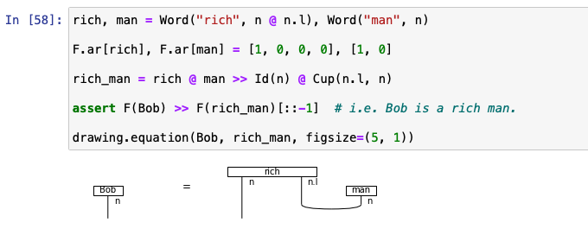
we map man to [1, 0], i.e. Bob is the only man in our model,
we map the adjective rich of type n @ n.l to the projector [[1, 0], [0, 0]], i.e. only Bob is rich.
Notes:
Alice and Bob are different: we defined their meaning to be orthogonal.

Slide 21
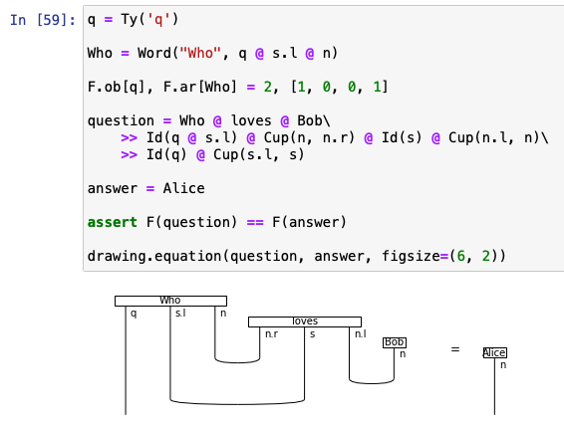
If we draw the diagram of a Who? question, the inner product with a noun phrase measures how well it answers the question.

Slide 22
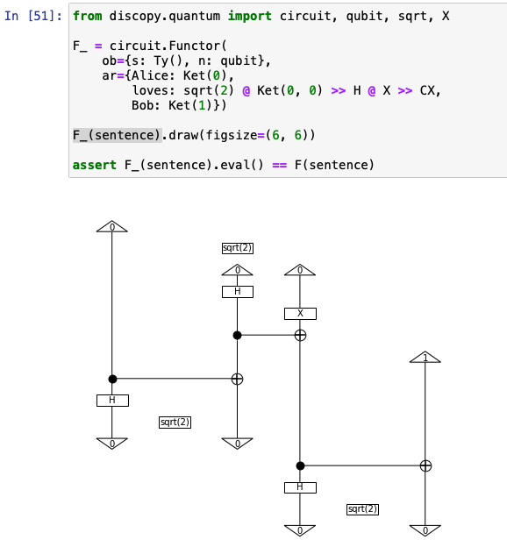
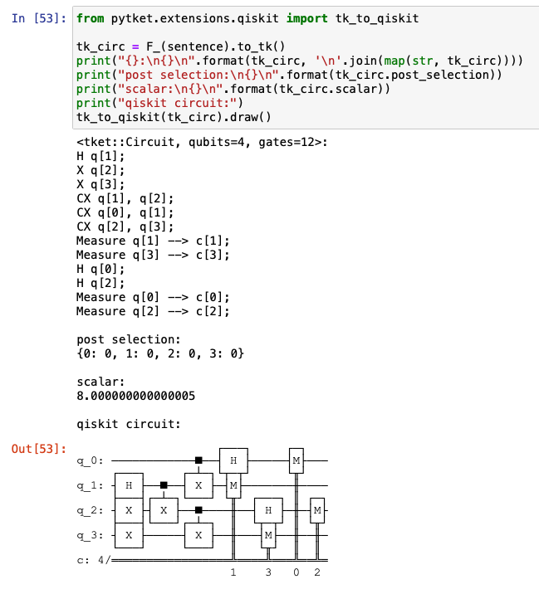
Putting it all together
Notes:
Entanglement of Loves
Alice Loves Bob & Bob loves Alice

Slide 23
This ansatz always returns a tensor with real-valued entries, since the ansatz is constructed using only the CNOT and Y rotation gates, which both implement real-valued unitarizes.
Now, a single-qubit 𝑅𝑌 rotation confined the qubit state remains real. That is, it is restricted to the 𝑥𝑧-plane.
Furthermore, if we use CNOT as our entangling gate operation, then it has a real representation. Thus if we restrict our single-qubit operations to leave each qubit state in the real subspace then the state as a whole will be in real. This is why, people consider the 𝑅𝑌 ansatzes.

