Slide 1
Linux UIO Driver for AXI DMA
Yu-Tang Liu
Advisor: Chen-Mou Cheng, Ph.D.
Notes:
0:30

Slide 2
Outline
Introduction
Linux on FPGA
UIO Driver
Custom IP and DMA
Linux UIO Driver for AXI DMA
Experimental Results
Conclusion
Notes:
Motivation, Strategy, Preliminaries
Scheduler
Comparison, Simulation
Processor, System
Contribution, Future
2:00

Slide 3
Outline
Introduction
Linux on FPGA
UIO Driver
Custom IP and DMA
Linux UIO Driver for AXI DMA
Experimental Results
Conclusion
Notes:
Motivation, Strategy, Preliminaries
Scheduler
Comparison, Simulation
Processor, System
Contribution, Future
2:00

Slide 4
We want to develop software to control our custom IP with UIO driver in Linux on FPGA.

Slide 5
We want to develop software to control our custom IP with UIO driver in Linux on FPGA.

Slide 6
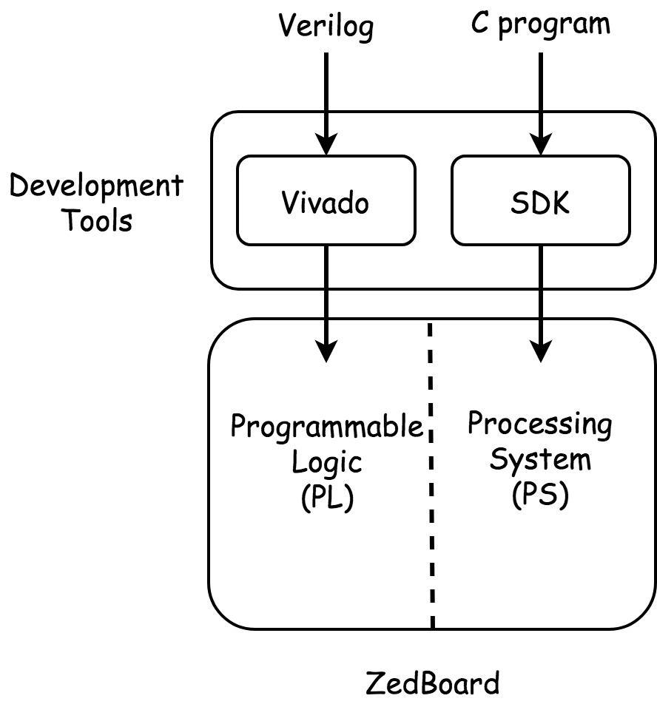
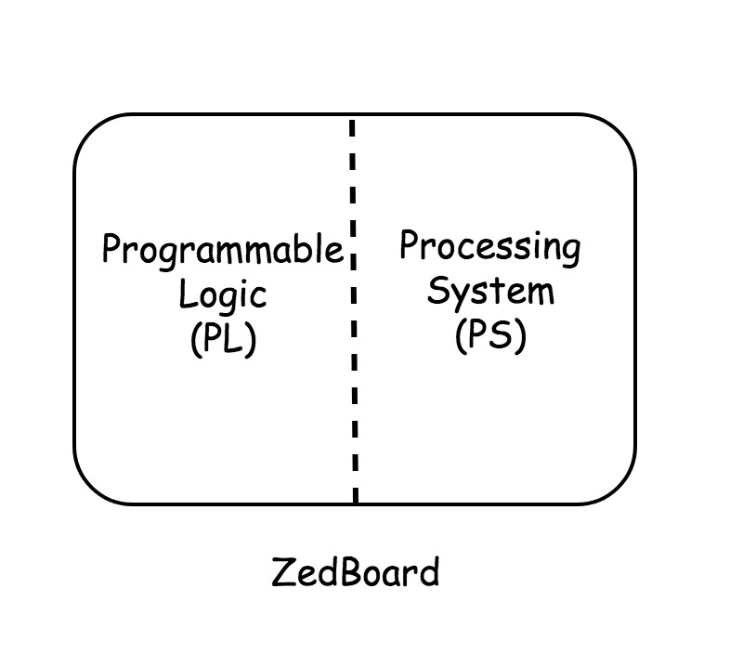
FPGA Board(ZedBoard)
Two parts on FPGA Board
Programmable Logic (PL)
Processing System (PS)
Development Tools
Vivado
SDK
Notes:
Prime: Intuitive, CPUs
Binary: Abstract, ASICs
571: Less Works, Military Observe Topics
5:00

Slide 7
SDK
Advantage
Full Suite of Libraries and Device Driver
Disadvantages
Full Suite of Libraries and Device Driver
Run Program
=> Linux on FPGA
Notes:
Upgrade Protocols
EC Group
ECDLP
7:00

Slide 8
Outline
Introduction
Linux on FPGA
UIO Driver
Custom IP and DMA
Linux UIO Driver for AXI DMA
Experimental Results
Conclusion
Notes:
Motivation, Strategy, Preliminaries
Scheduler
Comparison, Simulation
Processor, System
Contribution, Future
2:00

Slide 9
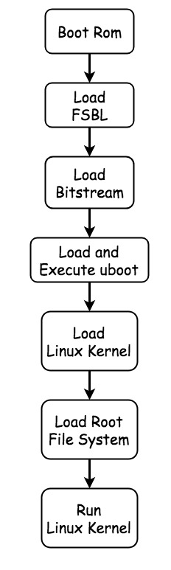
Linux on FPGA
Required Files
FSBL
Bitstream
U-boot
Linux Kernel
Root File System
[13] Y. K. Lee and I. Verbauwhede. A compact architecture for montgomery elliptic curve scalar multiplication processor. In International Workshop on Information Security Applications, pages 115–127. Springer, 2007.
[18] J. López and R. Dahab. Fast multiplication on elliptic curves over gf (2 m) without precomputation. In International Workshop on Cryptographic Hardware and Embedded Systems, pages 316–327. Springer, 1999.
Notes:
Omit Y
Steps: 11, 11
Registers: 7, 6
Out-of-Place
10:00

Slide 10
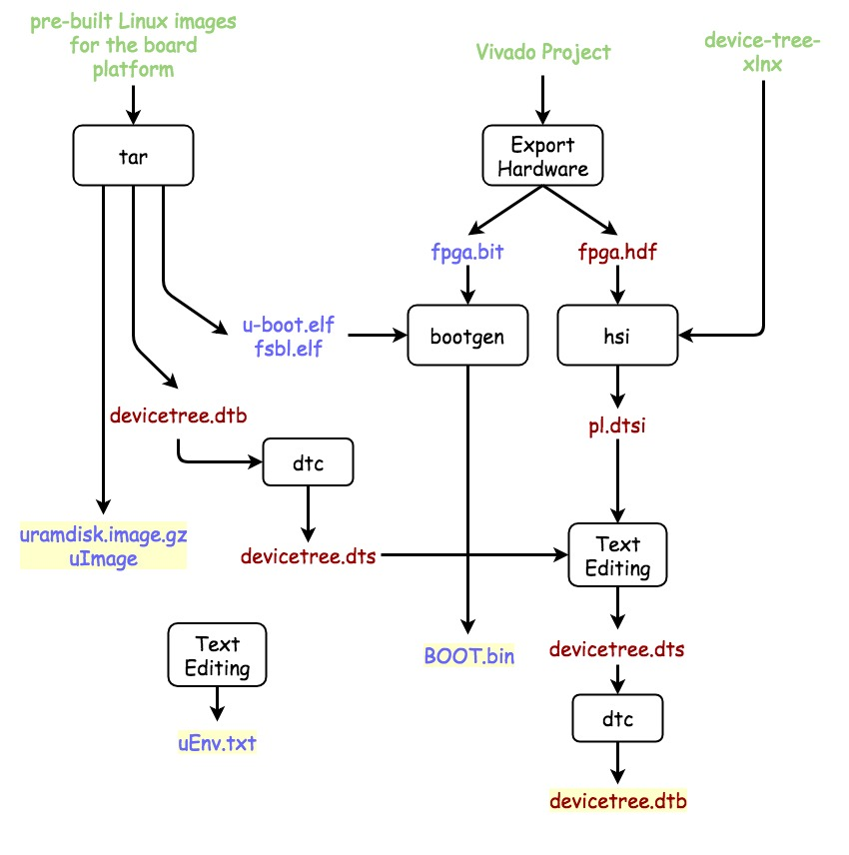
Example
Boot Linux by SD Card
Two partition
1st Partition Files
BOOT.bin
FSBL + bitstream + u-boot
uEnv.txt
uImage
uramdisk.image.gz
devicetree.dtb
Notes:
Omit Y
Steps: 11, 11
Registers: 7, 6
Out-of-Place
10:00

Slide 11
Device Tree
Non Coverable Device
Old Linux
Hard Coded
New Linux
Device Tree
[13] Y. K. Lee and I. Verbauwhede. A compact architecture for montgomery elliptic curve scalar multiplication processor. In International Workshop on Information Security Applications, pages 115–127. Springer, 2007.
[18] J. López and R. Dahab. Fast multiplication on elliptic curves over gf (2 m) without precomputation. In International Workshop on Cryptographic Hardware and Embedded Systems, pages 316–327. Springer, 1999.
Notes:
Omit Y
Steps: 11, 11
Registers: 7, 6
Out-of-Place
10:00

Slide 12
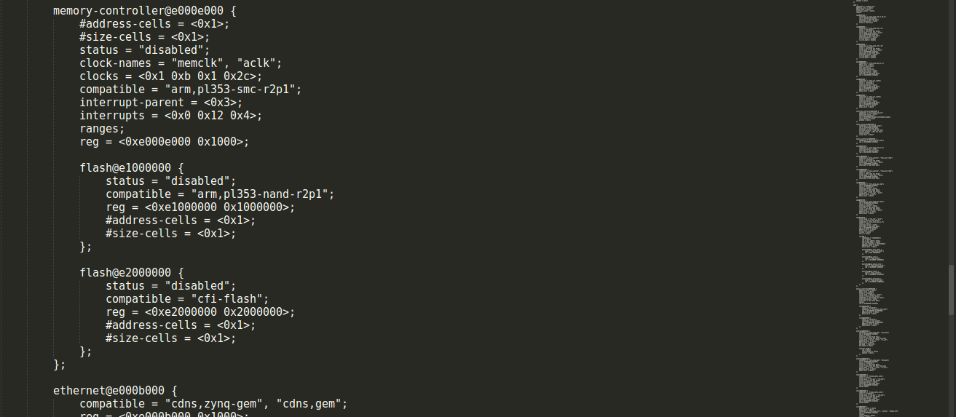

Slide 13
Outline
Introduction
Linux on FPGA
UIO Driver
Custom IP and DMA
Linux UIO Driver for AXI DMA
Experimental Results
Conclusion
Notes:
Motivation, Strategy, Preliminaries
Scheduler
Comparison, Simulation
Processor, System
Contribution, Future
2:00

Slide 14
UIO Driver[]
Suitable
The device has memory that can mapped and can be controlled by writing to this memory.
The device usually generates interrupt.
The device does not fit into one of the standard kernel subsystems.
About UIO
Main part of driver is developed in userspace.
Driver won’t crash the kernel.
Update driver don’t need recompile kernel.
[5] The Userspace I/O HOWTO URL https://www.kernel.org/doc/html/v4.12/driver-api/uio-howto.html .
[7] R. Govindarajan, H. Yang, J. N. Amaral, C. Zhang, and G. R. Gao. Minimum register instruction sequencing to reduce register spills in out-of-order issue superscalar architectures. IEEE Transactions on Computers, 52(1):4–20, 2003.
Notes:
ECC Small Instances
500 Variables, 8000 Equations
13:00

Slide 15
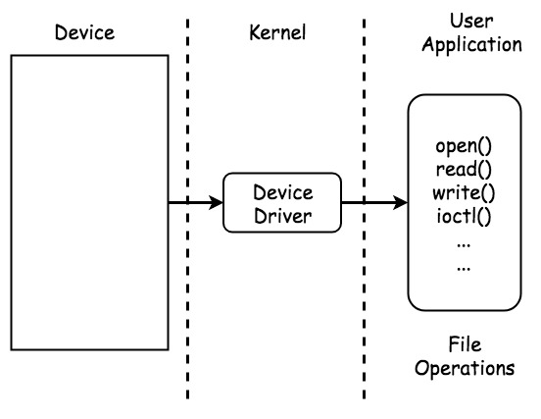
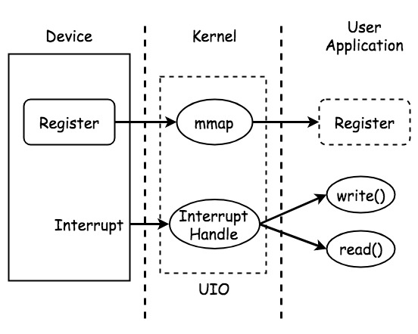
Kernel Device Driver UIO Driver
Notes:
ECC Small Instances
500 Variables, 8000 Equations
13:00

Slide 16
Outline
Introduction
Linux on FPGA
UIO Driver
Custom IP and DMA
Linux UIO Driver for AXI DMA
Experimental Results
Conclusion
Notes:
Motivation, Strategy, Preliminaries
Scheduler
Comparison, Simulation
Processor, System
Contribution, Future
2:00

Slide 17
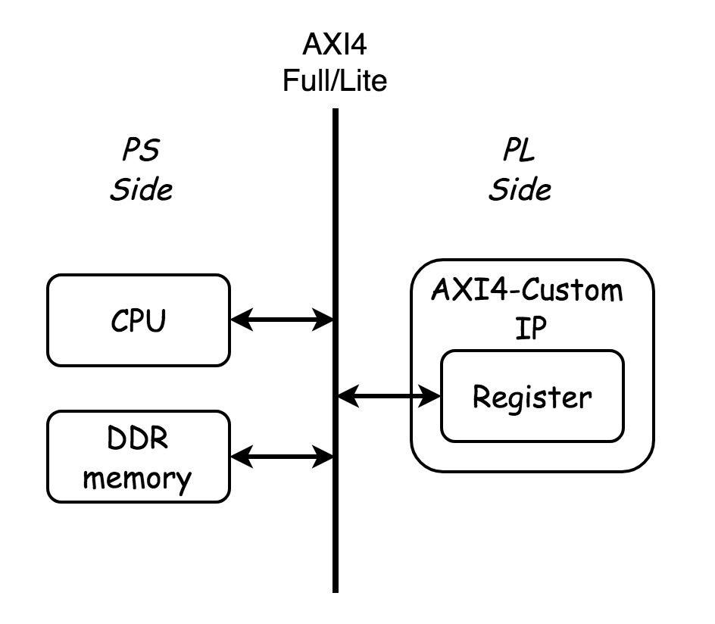

Custom IP
Register Types
Full
Lite
Stream
AXI4 Bus Interface
AXI4
AXI4-Lite
AXI4-Stream
->
UIO Driver
->
->
[5] The Userspace I/O HOWTO URL https://www.kernel.org/doc/html/v4.12/driver-api/uio-howto.html .
[7] R. Govindarajan, H. Yang, J. N. Amaral, C. Zhang, and G. R. Gao. Minimum register instruction sequencing to reduce register spills in out-of-order issue superscalar architectures. IEEE Transactions on Computers, 52(1):4–20, 2003.
Notes:
ECC Small Instances
500 Variables, 8000 Equations
13:00

Slide 18
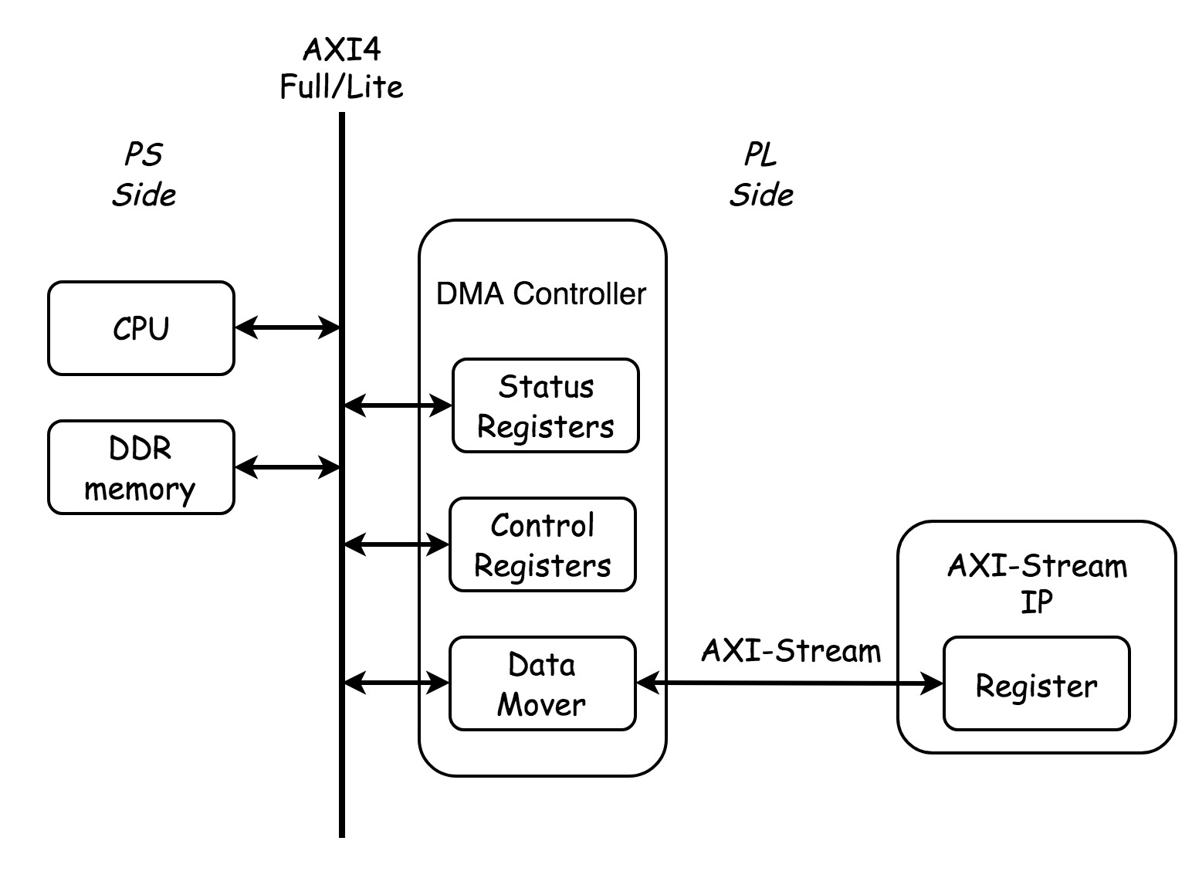
Custom Stream IP
[5] The Userspace I/O HOWTO URL https://www.kernel.org/doc/html/v4.12/driver-api/uio-howto.html .
[7] R. Govindarajan, H. Yang, J. N. Amaral, C. Zhang, and G. R. Gao. Minimum register instruction sequencing to reduce register spills in out-of-order issue superscalar architectures. IEEE Transactions on Computers, 52(1):4–20, 2003.
Notes:
ECC Small Instances
500 Variables, 8000 Equations
13:00

Slide 19
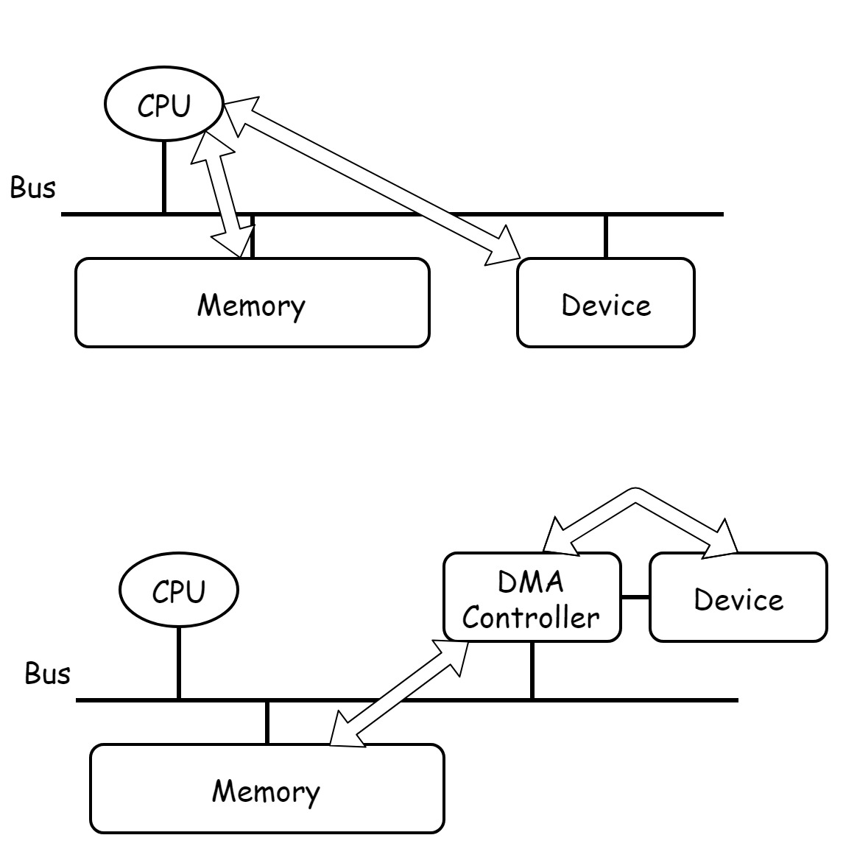
DMA
Direct Memory Access
Moving data without CPU
DMA Controller
Usage
Data Address(Physical)
Data Length
Destination Address(Physical)
[5] The Userspace I/O HOWTO URL https://www.kernel.org/doc/html/v4.12/driver-api/uio-howto.html .
Notes:
ECC Small Instances
500 Variables, 8000 Equations
13:00

Slide 20
Outline
Introduction
Linux on FPGA
UIO Driver
Custom IP and DMA
Linux UIO Driver for AXI DMA
Experimental Results
Conclusion
Notes:
Motivation, Strategy, Preliminaries
Scheduler
Comparison, Simulation
Processor, System
Contribution, Future
2:00

Slide 21
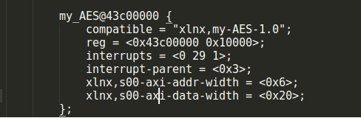
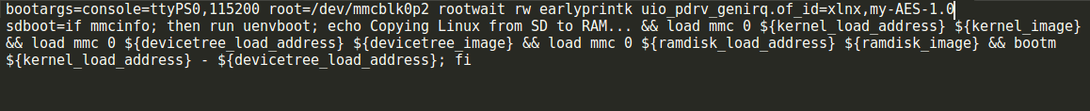
Linux UIO Driver for AXI4/Lite Custom IP
EX:OpenCore-tinyAES
Devicetree node
compatible
reg
Interrupts
uEnv.txt
[5] The Userspace I/O HOWTO URL https://www.kernel.org/doc/html/v4.12/driver-api/uio-howto.html .
[7] R. Govindarajan, H. Yang, J. N. Amaral, C. Zhang, and G. R. Gao. Minimum register instruction sequencing to reduce register spills in out-of-order issue superscalar architectures. IEEE Transactions on Computers, 52(1):4–20, 2003.
Notes:
ECC Small Instances
500 Variables, 8000 Equations
13:00

Slide 22
Linux UIO Driver for AXI4/Lite Custom IP
UIO Node
UIO Memory Address
[5] The Userspace I/O HOWTO URL https://www.kernel.org/doc/html/v4.12/driver-api/uio-howto.html .
[7] R. Govindarajan, H. Yang, J. N. Amaral, C. Zhang, and G. R. Gao. Minimum register instruction sequencing to reduce register spills in out-of-order issue superscalar architectures. IEEE Transactions on Computers, 52(1):4–20, 2003.
Notes:
ECC Small Instances
500 Variables, 8000 Equations
13:00

Slide 23
Linux UIO Driver for AXI4/Lite Custom IP
Code
[5] The Userspace I/O HOWTO URL https://www.kernel.org/doc/html/v4.12/driver-api/uio-howto.html .
[7] R. Govindarajan, H. Yang, J. N. Amaral, C. Zhang, and G. R. Gao. Minimum register instruction sequencing to reduce register spills in out-of-order issue superscalar architectures. IEEE Transactions on Computers, 52(1):4–20, 2003.
Notes:
ECC Small Instances
500 Variables, 8000 Equations
13:00

Slide 24
Linux UIO Driver for AXI4/Lite Custom IP
Result
[5] The Userspace I/O HOWTO URL https://www.kernel.org/doc/html/v4.12/driver-api/uio-howto.html .
[7] R. Govindarajan, H. Yang, J. N. Amaral, C. Zhang, and G. R. Gao. Minimum register instruction sequencing to reduce register spills in out-of-order issue superscalar architectures. IEEE Transactions on Computers, 52(1):4–20, 2003.
Notes:
ECC Small Instances
500 Variables, 8000 Equations
13:00

Slide 25
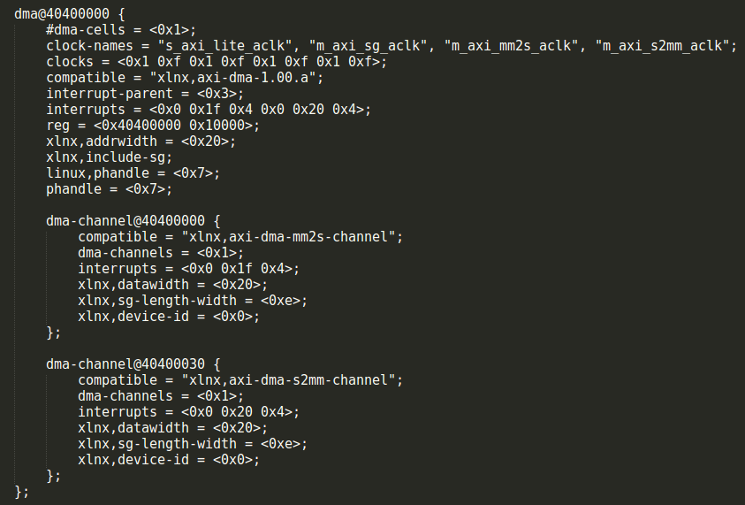
Observation
Device Node
Program
User-space without Root
UIO Usage
open() , mmap()
Value Assignment
[5] The Userspace I/O HOWTO URL https://www.kernel.org/doc/html/v4.12/driver-api/uio-howto.html .
[7] R. Govindarajan, H. Yang, J. N. Amaral, C. Zhang, and G. R. Gao. Minimum register instruction sequencing to reduce register spills in out-of-order issue superscalar architectures. IEEE Transactions on Computers, 52(1):4–20, 2003.
Notes:
ECC Small Instances
500 Variables, 8000 Equations
13:00

Slide 26
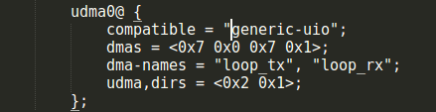
Linux UIO Driver for AXI DMA
Device Node
Virtual Device Node
No Memory Address, Length
No interrupt
DMA Informations
[5] The Userspace I/O HOWTO URL https://www.kernel.org/doc/html/v4.12/driver-api/uio-howto.html .
[7] R. Govindarajan, H. Yang, J. N. Amaral, C. Zhang, and G. R. Gao. Minimum register instruction sequencing to reduce register spills in out-of-order issue superscalar architectures. IEEE Transactions on Computers, 52(1):4–20, 2003.
Notes:
ECC Small Instances
500 Variables, 8000 Equations
13:00

Slide 27
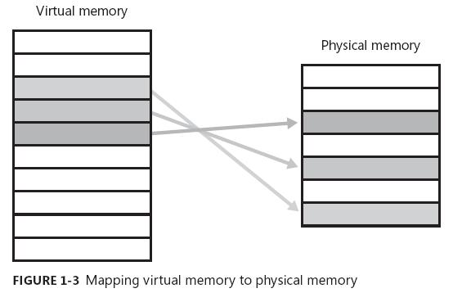

Linux UIO Driver for AXI DMA
Program
User-space without Root
Control the DMA Controller directly
Virtual Memory
UIO Usage
How to send transaction?
[5] The Userspace I/O HOWTO URL https://www.kernel.org/doc/html/v4.12/driver-api/uio-howto.html .
[7] R. Govindarajan, H. Yang, J. N. Amaral, C. Zhang, and G. R. Gao. Minimum register instruction sequencing to reduce register spills in out-of-order issue superscalar architectures. IEEE Transactions on Computers, 52(1):4–20, 2003.
Notes:
ECC Small Instances
500 Variables, 8000 Equations
13:00

Slide 28
Linux UIO Driver for AXI DMA
AXI DMA
S2MM-Channel
Steam To Memory Map
MM2S-Channel
Memory Map To Steam
[5] The Userspace I/O HOWTO URL https://www.kernel.org/doc/html/v4.12/driver-api/uio-howto.html .
[7] R. Govindarajan, H. Yang, J. N. Amaral, C. Zhang, and G. R. Gao. Minimum register instruction sequencing to reduce register spills in out-of-order issue superscalar architectures. IEEE Transactions on Computers, 52(1):4–20, 2003.
Notes:
ECC Small Instances
500 Variables, 8000 Equations
13:00

Slide 29
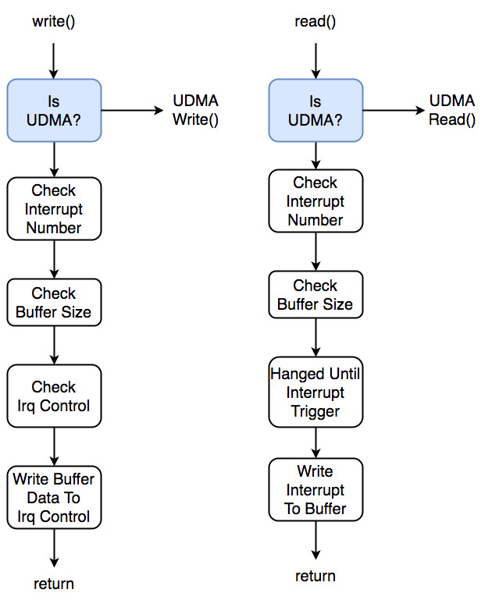
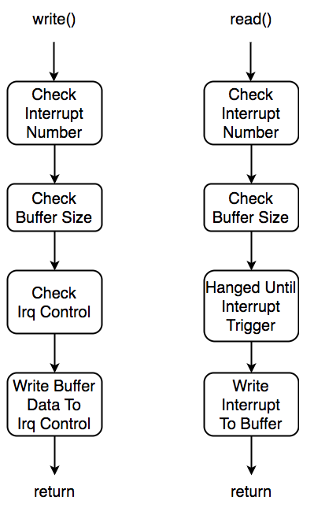
Linux UIO Driver for AXI DMA
File Operation
Only open(), mmap()
UIO read(),write()
Interrupt control
Function parameters
uio_read(filep, buf, count, ppos)
uio_write(filep, buf, count, ppos)

Slide 30
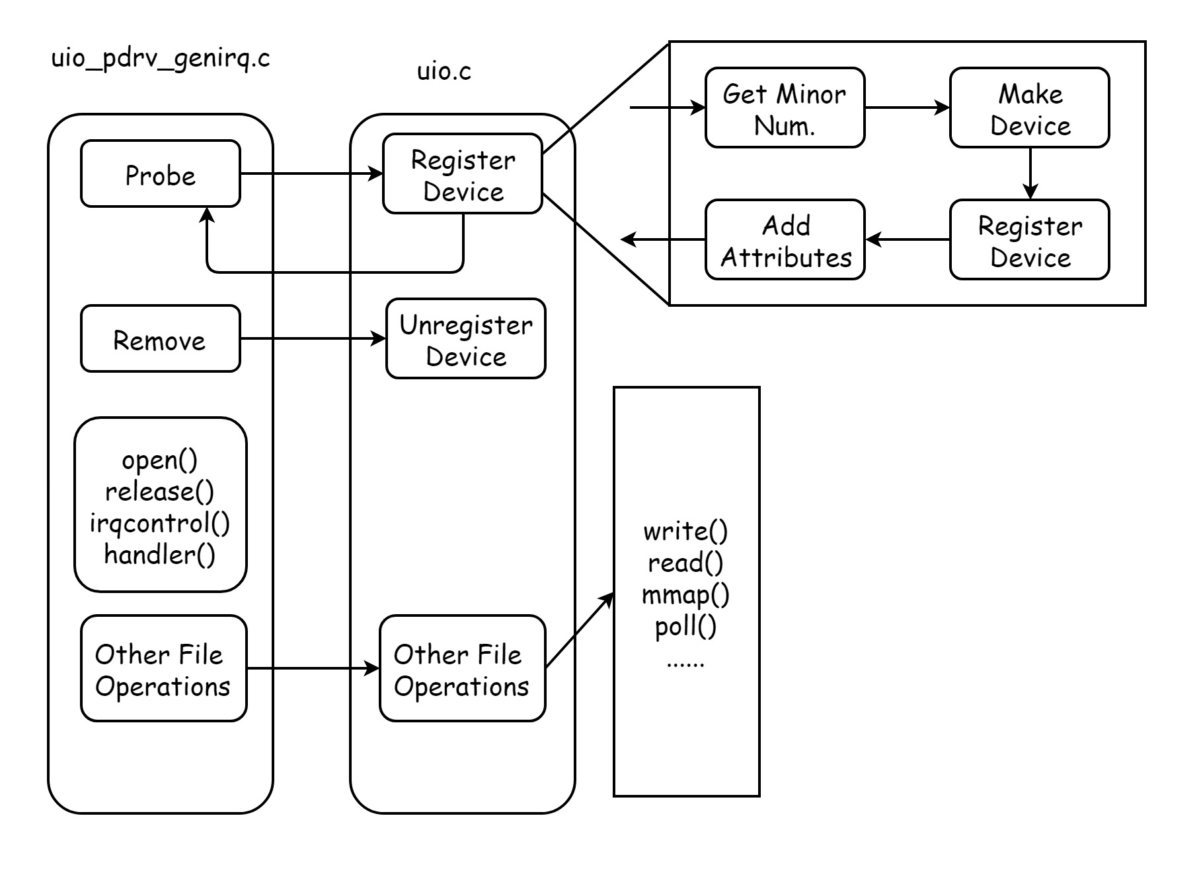
UIO
Notes:
ECC Small Instances
500 Variables, 8000 Equations
13:00

Slide 31
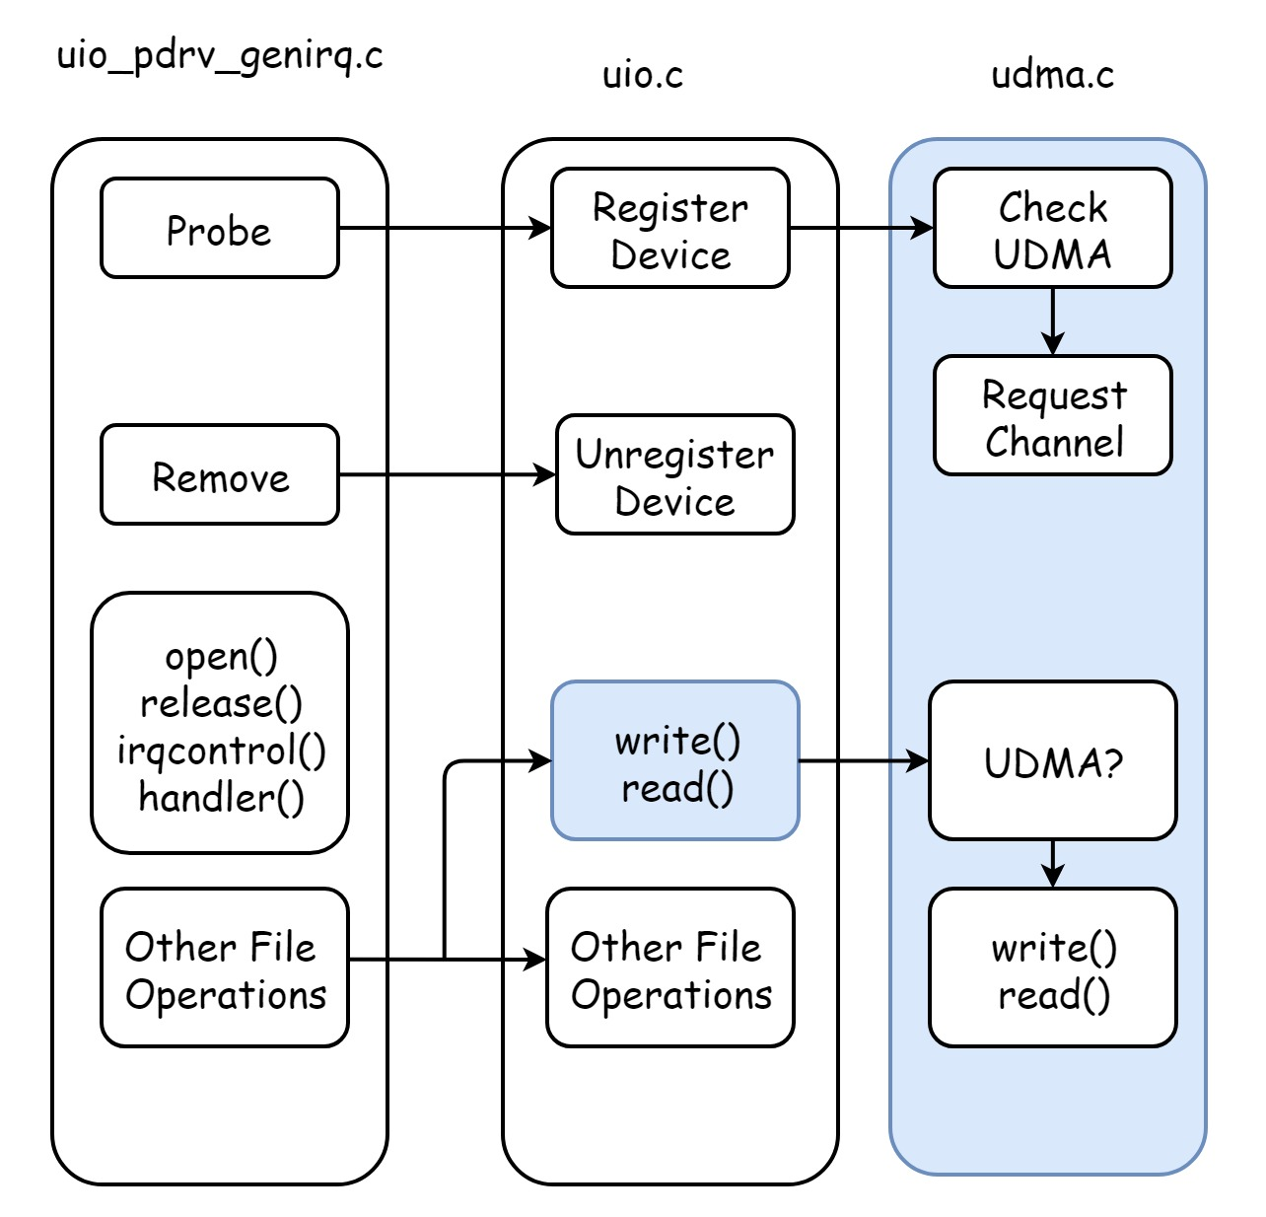
UDMA
Notes:
ECC Small Instances
500 Variables, 8000 Equations
13:00

Slide 32
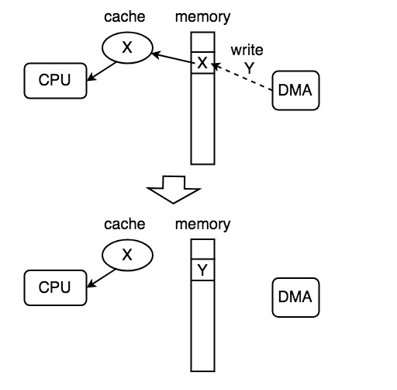
Linux UIO Driver for AXI DMA
DMA Issues
Continuous Memory
CMA
Scatter-Gather
Scatterlist
Cache Coherency

Slide 33
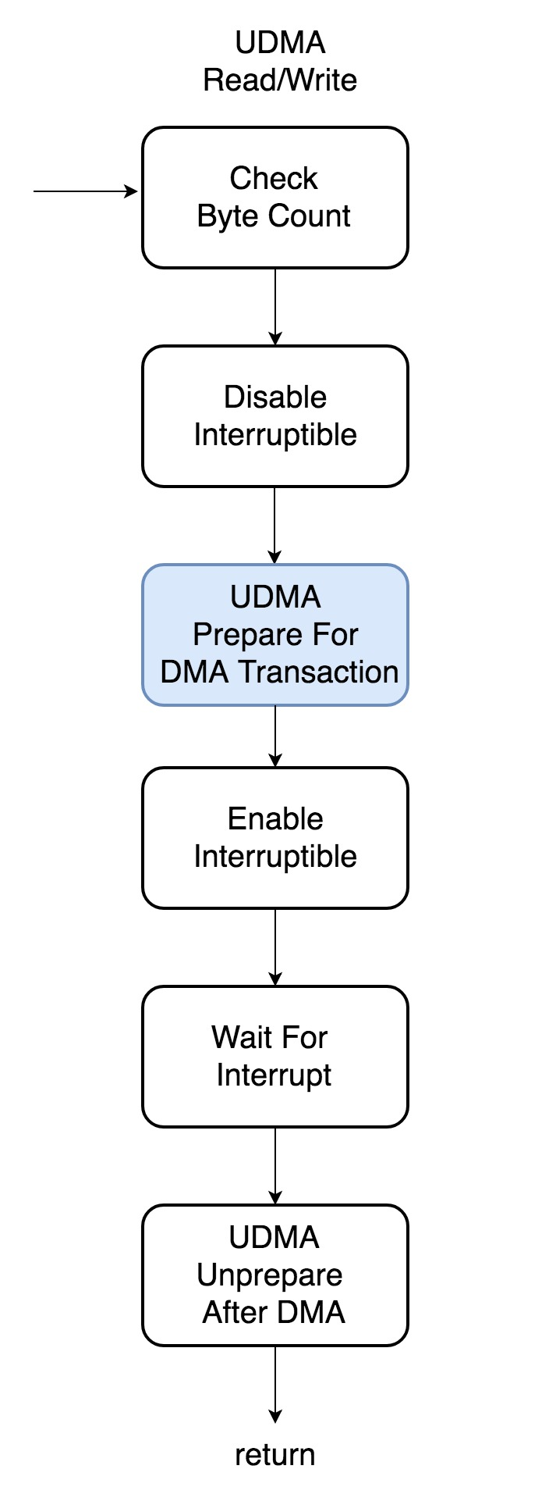
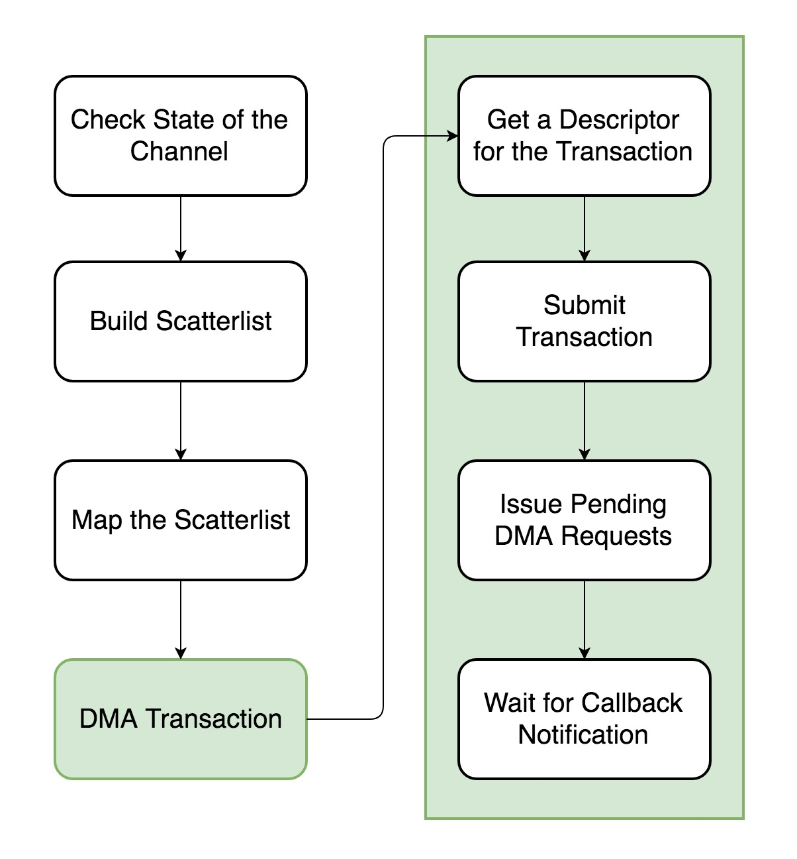
UDMA
Notes:
ECC Small Instances
500 Variables, 8000 Equations
13:00

Slide 34
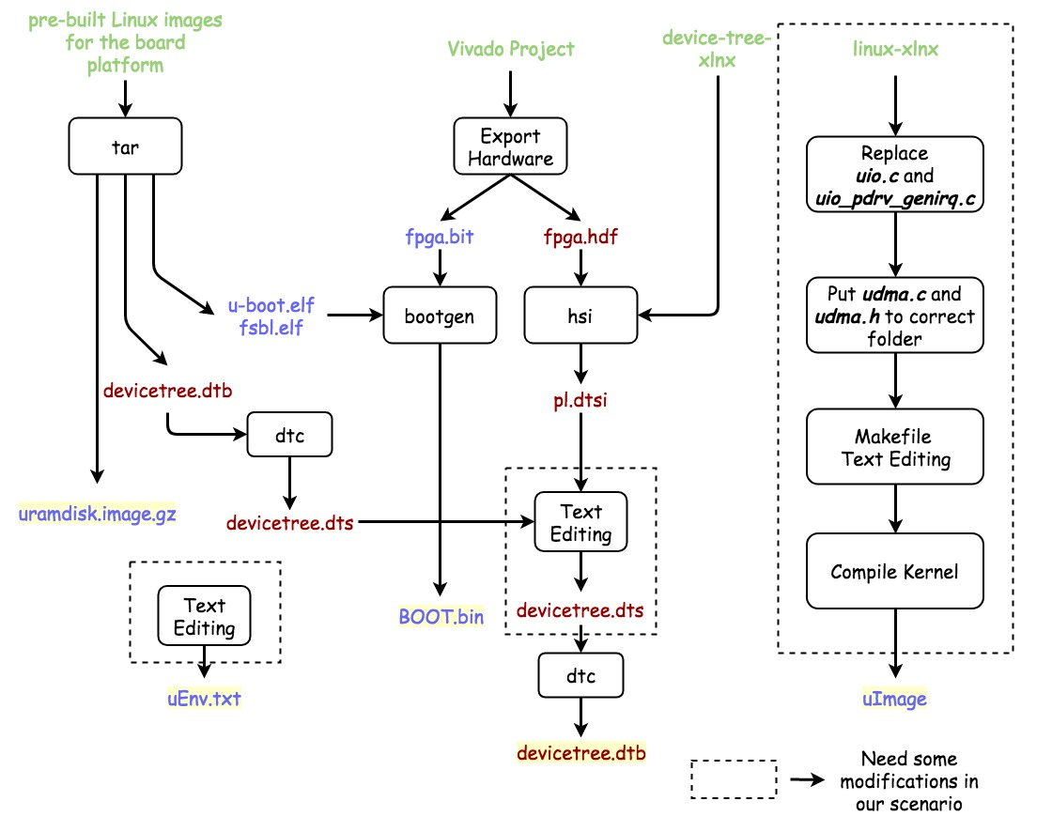
Notes:
Heuristic: Lazy, Short-Sighted
16:00

Slide 35
Linux UIO Driver for AXI DMA
EX:OpenCore-tinyAES with DMA
Devicetree node
uEnv.txt
[5] The Userspace I/O HOWTO URL https://www.kernel.org/doc/html/v4.12/driver-api/uio-howto.html .
[7] R. Govindarajan, H. Yang, J. N. Amaral, C. Zhang, and G. R. Gao. Minimum register instruction sequencing to reduce register spills in out-of-order issue superscalar architectures. IEEE Transactions on Computers, 52(1):4–20, 2003.
Notes:
ECC Small Instances
500 Variables, 8000 Equations
13:00

Slide 36
Linux UIO Driver for AXI4/Lite Custom IP
UIO Node
UIO Memory Address
[5] The Userspace I/O HOWTO URL https://www.kernel.org/doc/html/v4.12/driver-api/uio-howto.html .
[7] R. Govindarajan, H. Yang, J. N. Amaral, C. Zhang, and G. R. Gao. Minimum register instruction sequencing to reduce register spills in out-of-order issue superscalar architectures. IEEE Transactions on Computers, 52(1):4–20, 2003.
Notes:
ECC Small Instances
500 Variables, 8000 Equations
13:00

Slide 37
Linux UIO Driver for AXI4/Lite Custom IP
Code
[5] The Userspace I/O HOWTO URL https://www.kernel.org/doc/html/v4.12/driver-api/uio-howto.html .
[7] R. Govindarajan, H. Yang, J. N. Amaral, C. Zhang, and G. R. Gao. Minimum register instruction sequencing to reduce register spills in out-of-order issue superscalar architectures. IEEE Transactions on Computers, 52(1):4–20, 2003.
Notes:
ECC Small Instances
500 Variables, 8000 Equations
13:00

Slide 38
Linux UIO Driver for AXI4/Lite Custom IP
Result
[5] The Userspace I/O HOWTO URL https://www.kernel.org/doc/html/v4.12/driver-api/uio-howto.html .
[7] R. Govindarajan, H. Yang, J. N. Amaral, C. Zhang, and G. R. Gao. Minimum register instruction sequencing to reduce register spills in out-of-order issue superscalar architectures. IEEE Transactions on Computers, 52(1):4–20, 2003.
Notes:
ECC Small Instances
500 Variables, 8000 Equations
13:00

Slide 39
Outline
Introduction
Linux on FPGA
UIO Driver
Custom IP and DMA
Linux UIO Driver for AXI DMA
Experimental Results
Conclusion
Notes:
Motivation, Strategy, Preliminaries
Scheduler
Comparison, Simulation
Processor, System
Contribution, Future
2:00

Slide 40
Experimental Results
Other DMA Kernel Drivers
xilinx_axidma[] ->CMA
ezdma[] -> Scatter-Gather
[5] xilinx_axidma driver URL https://github.com/bperez77/xilinx_axidma.
[7] ezdma driver URL https://github.com/jeremytrimble/ezdma
Notes:
ECC Small Instances
500 Variables, 8000 Equations
13:00

Slide 41
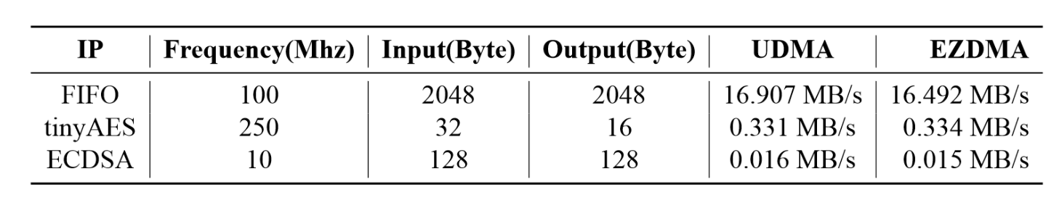
Experimental Results
Test IP
AXI-Stream FIFO
OpenCore tinyAES with DMA
ECDSA(curve secp256k1)
Notes:
ECC Small Instances
500 Variables, 8000 Equations
13:00

Slide 42
Outline
Introduction
Linux on FPGA
UIO Driver
Custom IP and DMA
Linux UIO Driver for AXI DMA
Experimental Results
Conclusion
Notes:
Motivation, Strategy, Preliminaries
Scheduler
Comparison, Simulation
Processor, System
Contribution, Future
2:00

Slide 43
Conclusion
Practical
Easy and Intuitive
No bad throughput
Our Contributions
Little modification to UIO driver to adapt AXI DMA
Provide an analysis on different styles of multipliers
Design a compact architecture for our ECC Processor
Future Works
Squares / DPAs / Formula Database
Notes:
Temporary Records
45:00

Slide 44
Thanks for your listening!
Yu-Tang Liu
Advisor: Chen-Mou Cheng, Ph.D.

