Slide 1
Linux UIO Driver for AXI DMA
Yu-Tang Liu
Advisor: Chen-Mou Cheng, Ph.D.
Notes:
0:30

Slide 2
Outline
Introduction
Preliminaries
Linux UIO Driver for AXI DMA
Experimental Results
Conclusion
Notes:
Introduction
Background Technology
Mainwork
Test Result
Conclusion
2:00

Slide 3
Outline
Introduction
Preliminaries
Linux UIO Driver for AXI DMA
Experimental Results
Conclusion
Notes:
Motivation, Strategy, Preliminaries
Scheduler
Comparison, Simulation
Processor, System
Contribution, Future
2:00

Slide 4
We want to develop software to control our custom IP with UIO driver in Linux on FPGA.

Slide 5
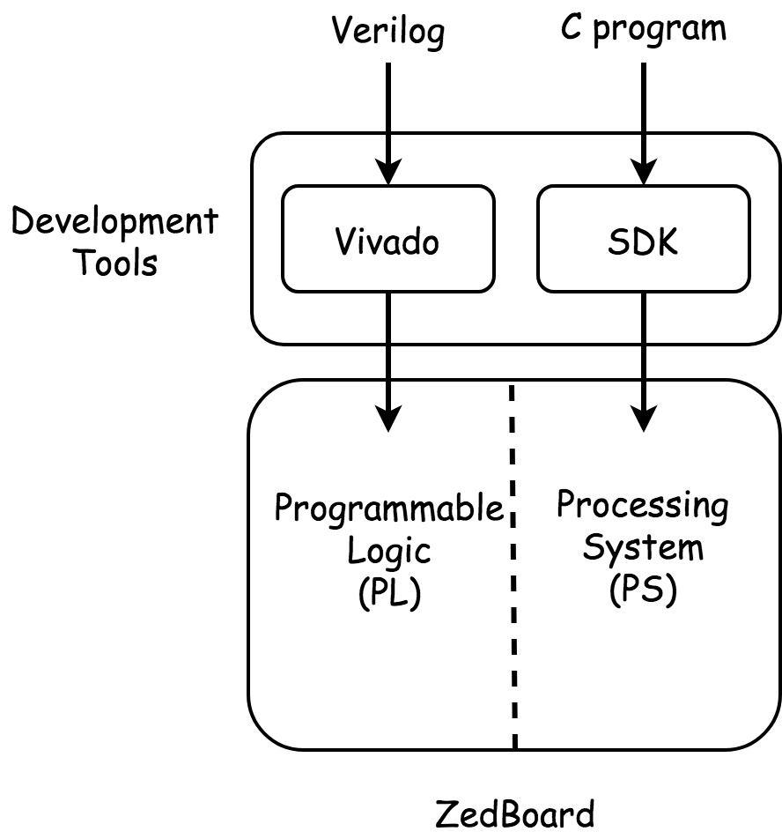
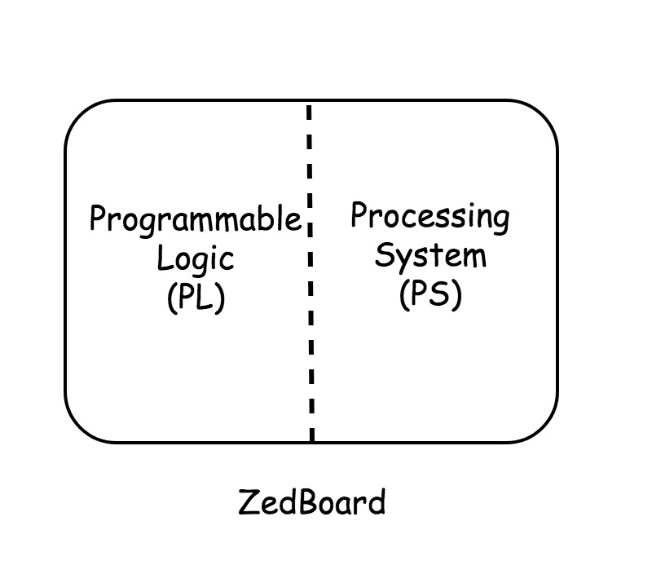
FPGA Board(ZedBoard)
Two parts on FPGA Board
Programmable Logic (PL)
Processing System (PS)
Development Tools
Vivado
SDK
Notes:
講解FPGA有兩個part
PL跟PS端
PL端用VIVADO開發 PS端用SDK開發
5:00

Slide 6
SDK
Advantage
Full Suite of Libraries and Device Driver.
Disadvantages
Libraries are different from Linux Kernel Libraries.
Run Program.
=> Linux on FPGA
Notes:
SDK的好處 在於它提供了很完整的LIB跟DRIVER 讓我們去控制在FPGA端設計出來的硬體
缺點在於 這些LIB跟我們所熟悉的LIB不太一樣 而且在RUN prog的時候很容易出問題
把軟體開發的環境拉回到linux 會是一個不錯的方法
7:00

Slide 7
We want to develop software to control our custom IP with UIO driver in Linux on FPGA.
Notes:
回到動機 講解UIO driver custom ip的問題

Slide 8
We want to develop software to control our custom IP with UIO driver in Linux on FPGA.
Notes:
我們提出了一個方法 來解決這個問題

Slide 9
Outline
Introduction
Preliminaries
Linux UIO Driver for AXI DMA
Experimental Results
Conclusion
Notes:
Motivation, Strategy, Preliminaries
Scheduler
Comparison, Simulation
Processor, System
Contribution, Future
2:00

Slide 10
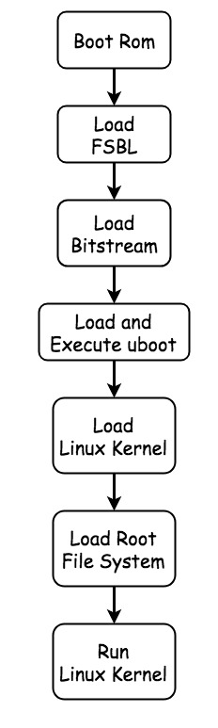
Linux on FPGA
Required Files
FSBL
Bitstream
U-boot
Linux Kernel
Root File System
Device Tree
Notes:
FSBL負責把bit 燒進FPGA
並把SSBL load進來 這裡我們用uboot當作SSBL
uboot是我們在嵌入式系統常常用到的bootloader 用來load linux kernel
10:00

Slide 11
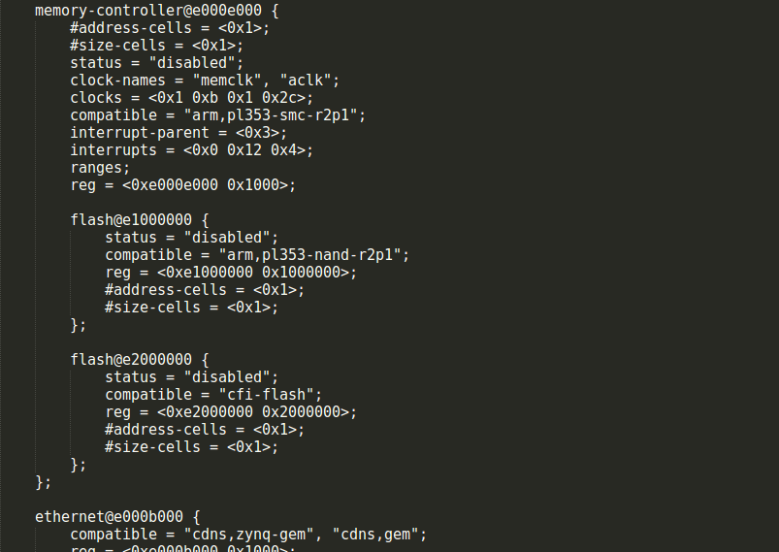
Device Tree
Non Coverable Device
Old Linux
Hard Coded
New Linux
Device Tree
FPGA
devicetree.dts (default) + devicetree.dtsi (PL design)
Notes:
Devietree機制
在FPGA板子中 可以理解為dt.dts + dt.dtsi 其中dtsi的部分為PL端設計所多出來的硬體

Slide 12
UIO Driver[1]
Suitable
The device has memory that can be mapped and can be controlled by writing to this memory.
The device usually generates interrupt.
The device does not fit into one of the standard kernel subsystems.
About UIO
Main part of driver is developed in userspace.
Driver won’t crash the kernel.
Update driver don’t need recompile kernel.
[1] The Userspace I/O HOWTO URL https://www.kernel.org/doc/html/v4.12/driver-api/uio-howto.html .
Notes:
UIO driver
適用於那些裝置 以及特色
13:00

Slide 13
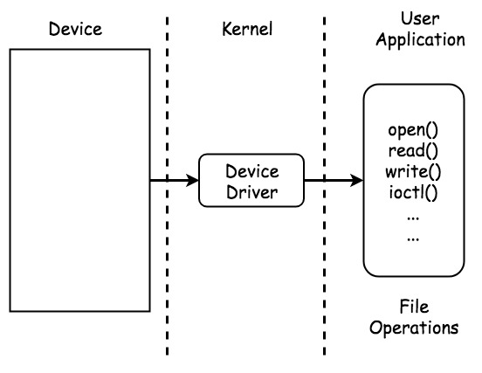
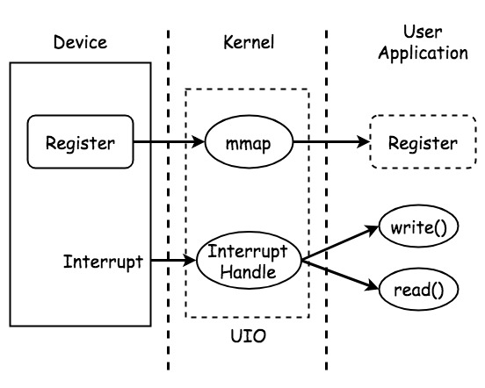
Kernel Device Driver UIO Driver
Notes:
Kernel device driver vs uio driver
13:00

Slide 14
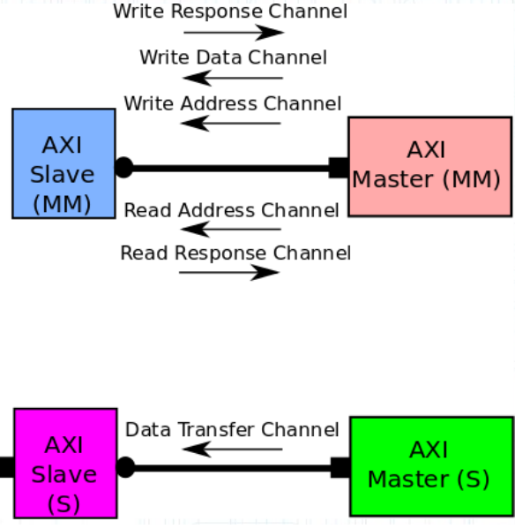

Custom IP
Register Types
Full
Lite
Stream
AXI4 Bus Interface[2]
AXI4
AXI4-Lite
AXI4-Stream
->
UIO Driver
->
->
[3]
[2] AXI Referenct Guide URL https://www.xilinx.com/support/documentation/ip_documentation/ug761_axi_reference_guide.pdf .
[3] AXI Protocol URL http://www.googoolia.com/wp/wp-content/uploads/2014/04/axi_stream.pdf
Notes:
Regitster types in Vivado design
Three types vs three protocol
13:00

Slide 15
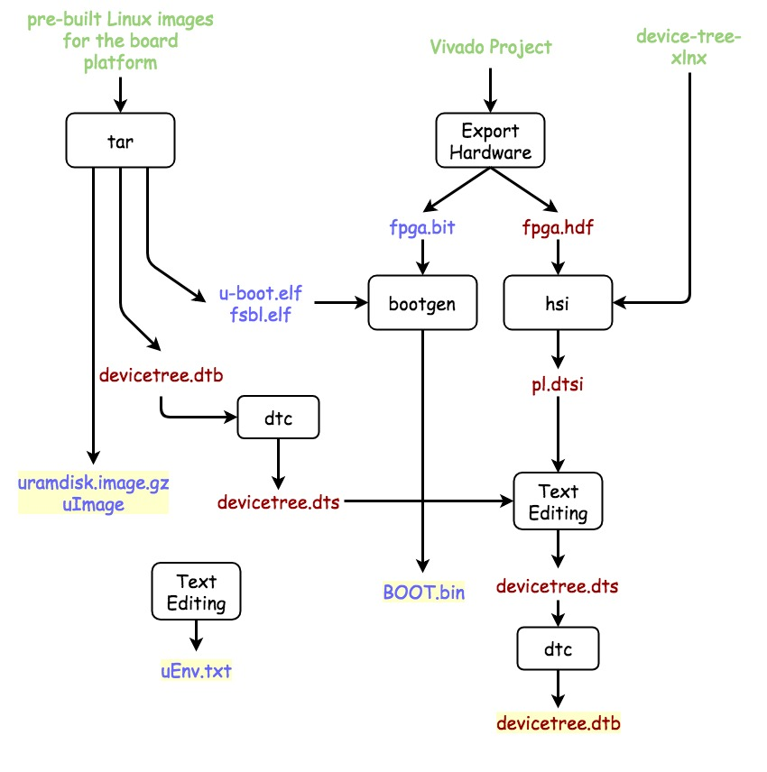
Example[4]
Boot Linux by SD Card
1st partition: boot files
2nd partition: file system
1st Partition Files
BOOT.bin
FSBL + bitstream + u-boot
uEnv.txt
uImage
uramdisk.image.gz
devicetree.dtb
[4] zedboard-hwswcodesign-example URL https://github.com/concise/zedboard-hwswcodesign-example .
Notes:
Simple example: uio driver for axi/lite custom ip
10:00

Slide 16
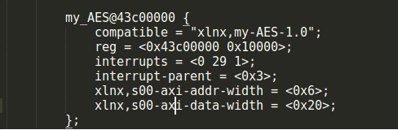
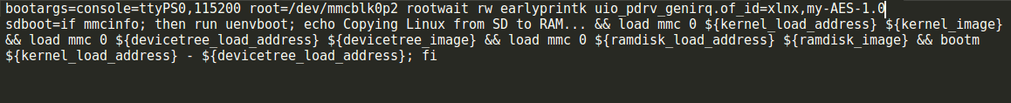
Linux UIO Driver for Full/Lite Custom IP
EX:OpenCores-tinyAES[5]
Devicetree node
compatible
reg
Interrupts
uEnv.txt
[5] OpenCores tinyAES URL https://opencores.org/project/tiny_aes .
Notes:
Opencore tinyaes 128 12reg 8+4
Device node of custom ip
Compatible = of_id
13:00

Slide 17
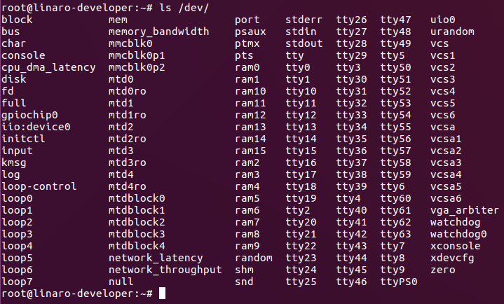
Linux UIO Driver for Full/Lite Custom IP
UIO Node
Notes:
Uio node under /dev/
13:00

Slide 18
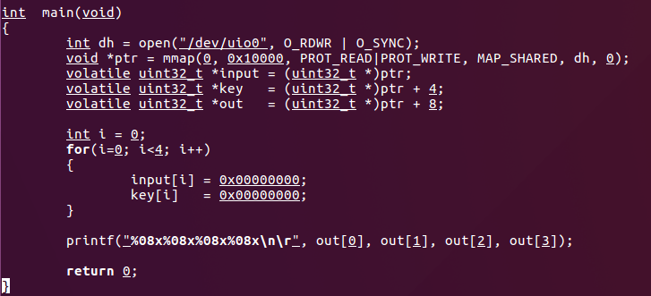
Linux UIO Driver for Full/Lite Custom IP
Code
Notes:
Example c code of using UIO driver
13:00

Slide 19
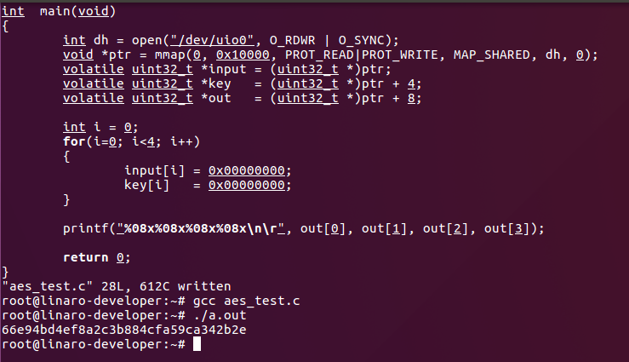
Linux UIO Driver for Full/Lite Custom IP
Result
Notes:
Testing result
13:00

Slide 20
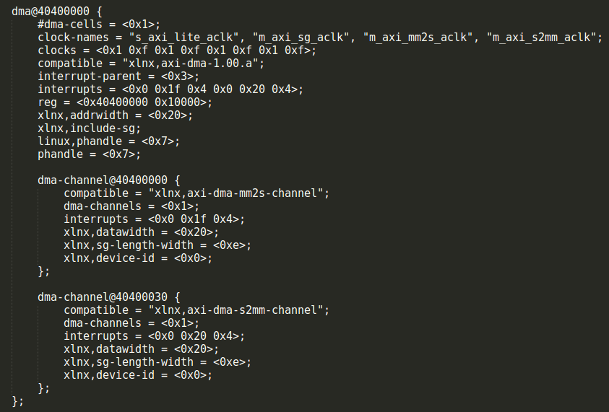
Observation
Device Node
DMA Controller node
No custom IP node.
Notes:
Device node of axi stream ip
13:00

Slide 21
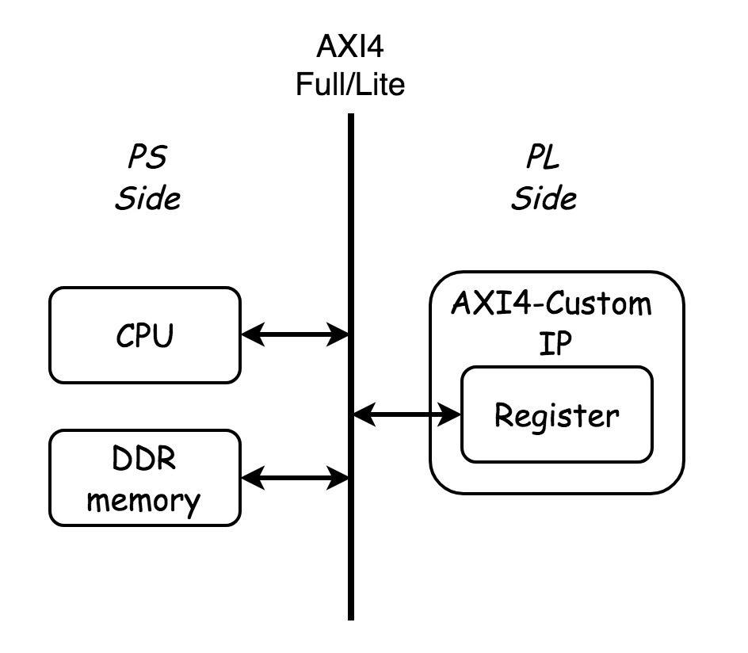
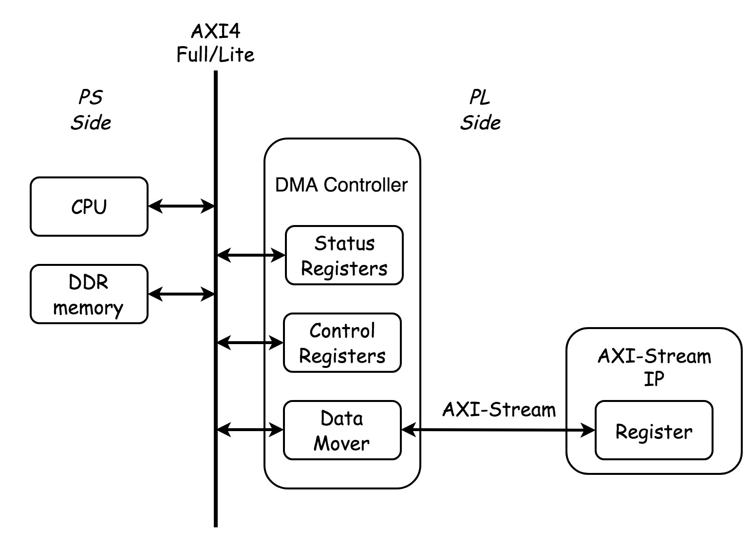
Full/Lite Custom IP v.s Stream Custom IP
Notes:
ECC Small Instances
500 Variables, 8000 Equations
13:00

Slide 22
Outline
Introduction
Preliminaries
Linux UIO Driver for AXI DMA
Experimental Results
Conclusion
Notes:
Motivation, Strategy, Preliminaries
Scheduler
Comparison, Simulation
Processor, System
Contribution, Future
2:00

Slide 23
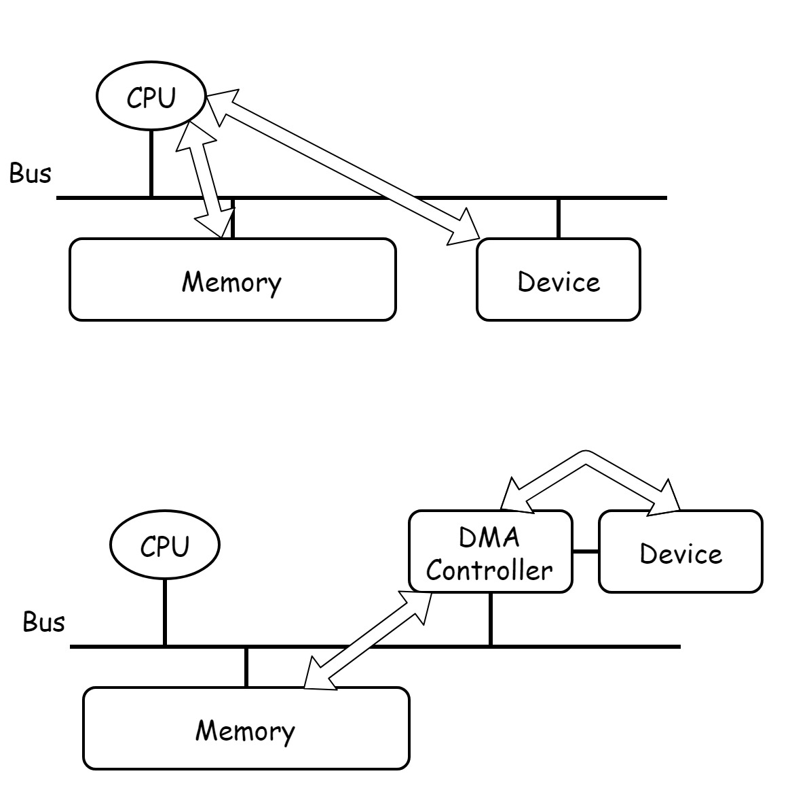
DMA
Direct Memory Access
Moving data without CPU.
DMA Controller
Usage
Data Address(Physical)
Data Length
Destination Address(Physical)
Notes:
ECC Small Instances
500 Variables, 8000 Equations
13:00

Slide 24
DMA Engine
Linux Kernel API[6]
Request Slave Channel.
Set Channel Parameter.
Get a descriptor for transaction.
Submit the transaction.
Issue pending requests and wait for callback notification.
[6] DMA Engine API Guide URL https://www.kernel.org/doc/html/v4.16/driver-api/dmaengine/client.html .
Notes:
ECC Small Instances
500 Variables, 8000 Equations
13:00

Slide 25

AXI DMA[7]
Two Unidirectional Channels
S2MM-Channel
Stream To Memory Map
MM2S-Channel
Memory Map To Stream
Data Address
Data Length
Destination Address
[7] AXI DMA URL https://www.xilinx.com/support/documentation/ip_documentation/axi_dma/v7_1/pg021_axi_dma.pdf .
Notes:
AXI DMA = DMA Contoller
13:00

Slide 26
Problem
Device Node
Only DMA Controller Node.
No UIO device node.
Program(User-space without Root)
How to send DMA transaction?
Notes:
Need device node to bind with driver
How to send transaction?
13:00

Slide 27
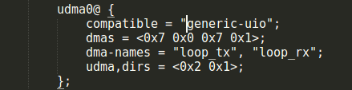
Linux UIO Driver for AXI DMA
Device Node
Virtual device node.
No register address, length.
No interrupts.
DMA information.
Notes:
ECC Small Instances
500 Variables, 8000 Equations
13:00

Slide 28
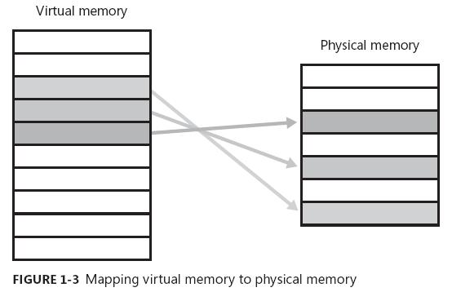
Linux UIO Driver for AXI DMA
Program
User-space without Root
Control the DMA Controller directly.
Virtual Memory
DMA Usage
CMA
Scatter-Gather
Scatterlist[8]
[8] Scatterlist Chaining URL https://lwn.net/Articles/234617/ .
Notes:
ECC Small Instances
500 Variables, 8000 Equations
13:00

Slide 29
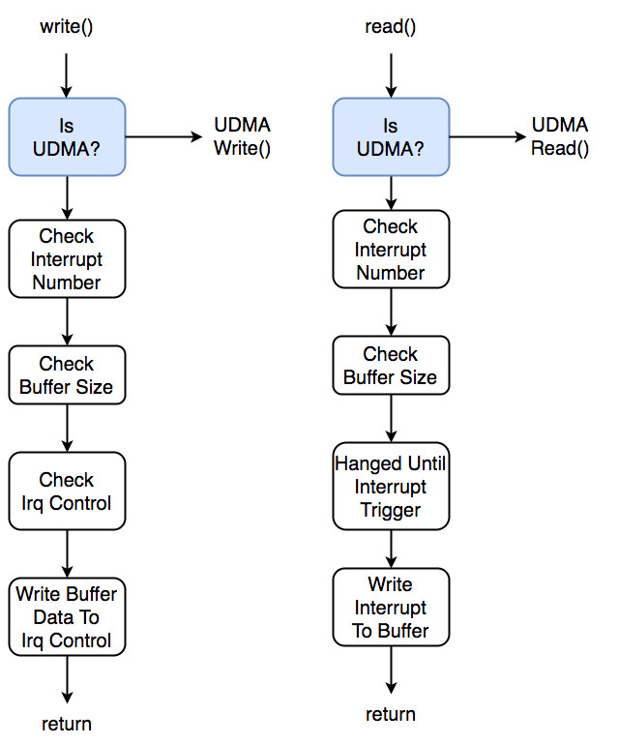
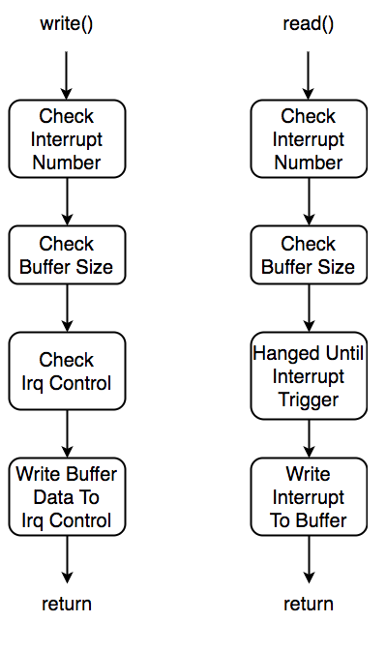
Linux UIO Driver for AXI DMA
File Operation
UIO read(),write()
Interrupt Control
Function Parameters
read(filep, buf, count)
write(filep, buf, count)

Slide 30
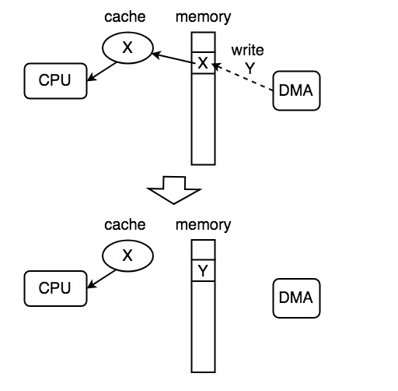
Linux UIO Driver for AXI DMA
DMA Issues
Cache Coherency
Cache Invalid
Cache Flush

Slide 31
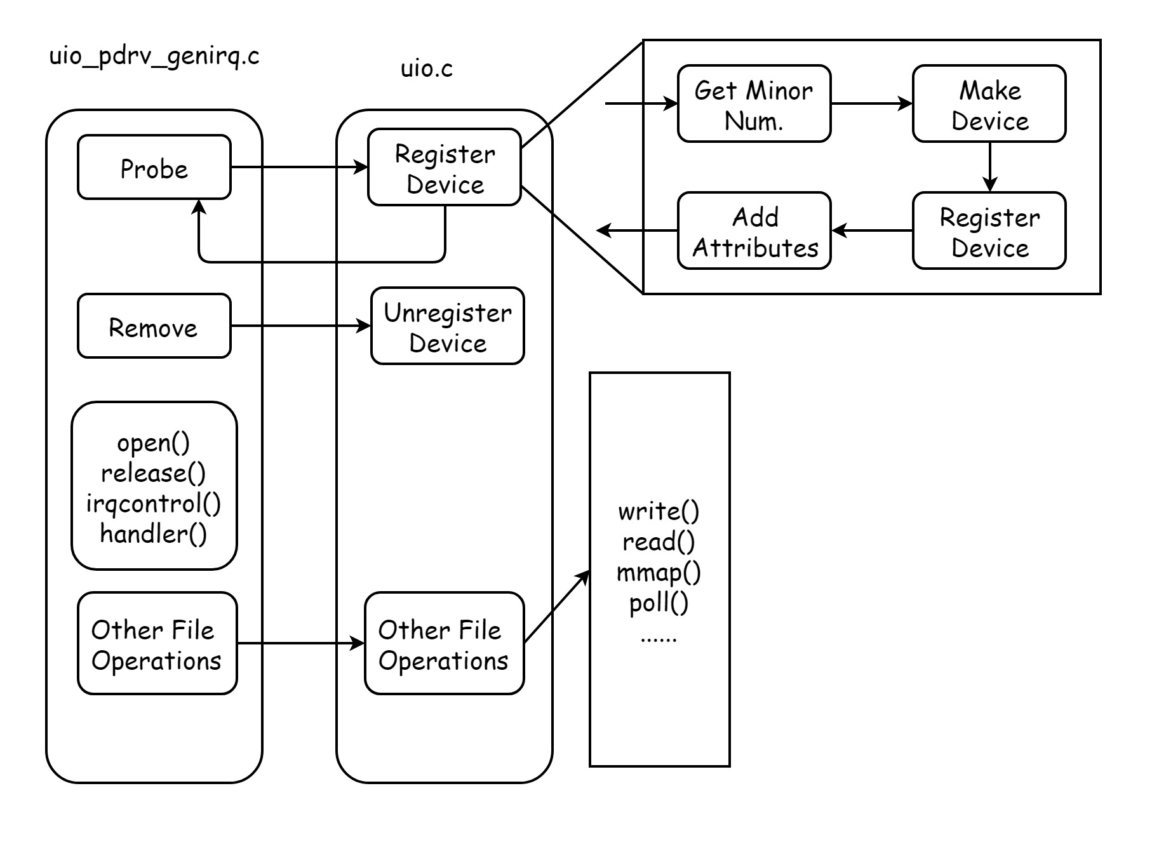
UIO
Notes:
ECC Small Instances
500 Variables, 8000 Equations
13:00

Slide 32
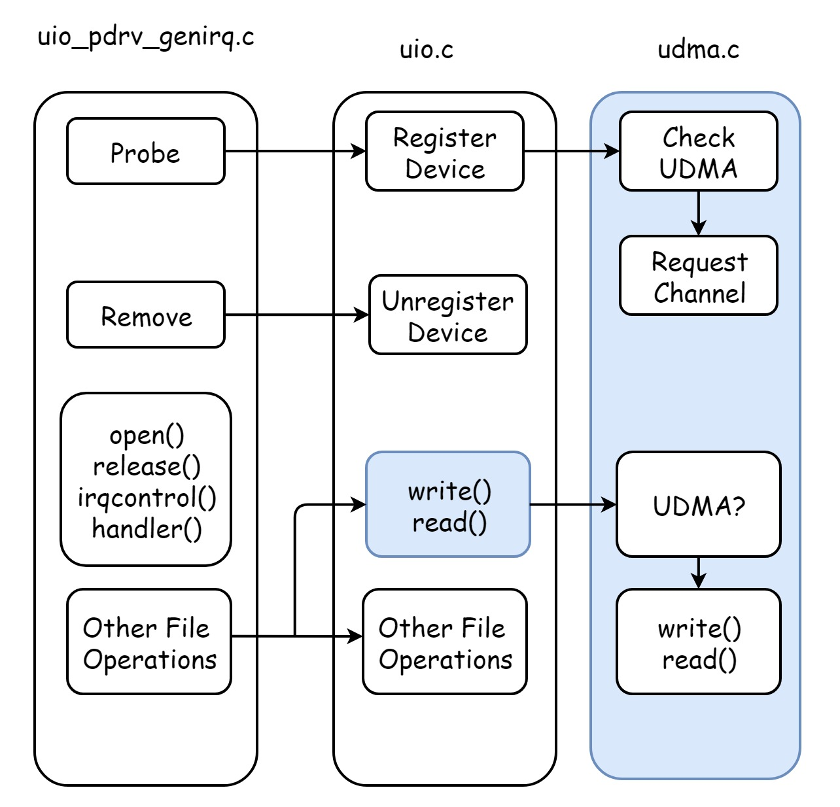
UDMA
Notes:
ECC Small Instances
500 Variables, 8000 Equations
13:00

Slide 33
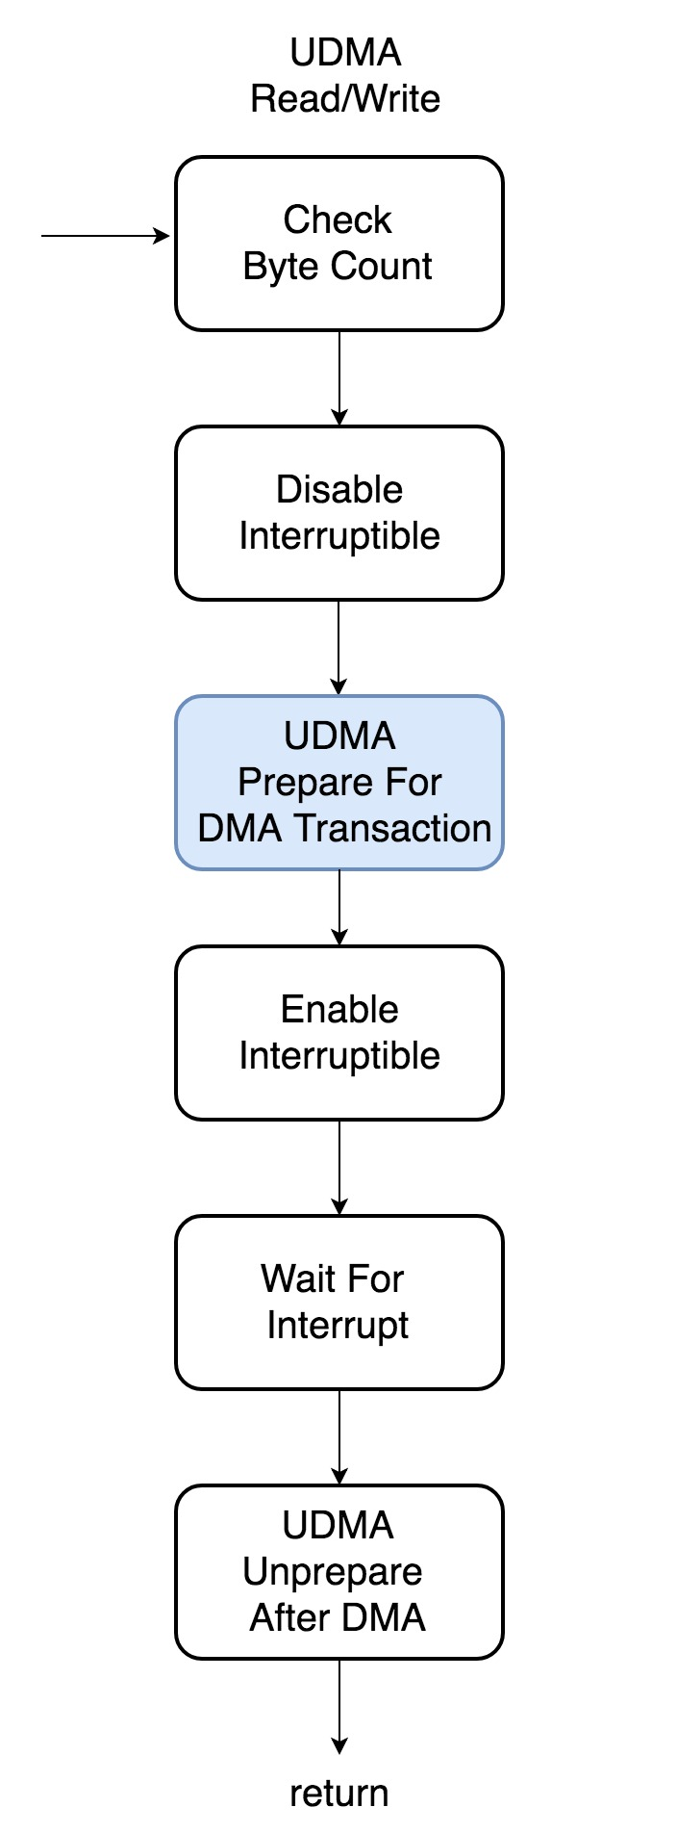
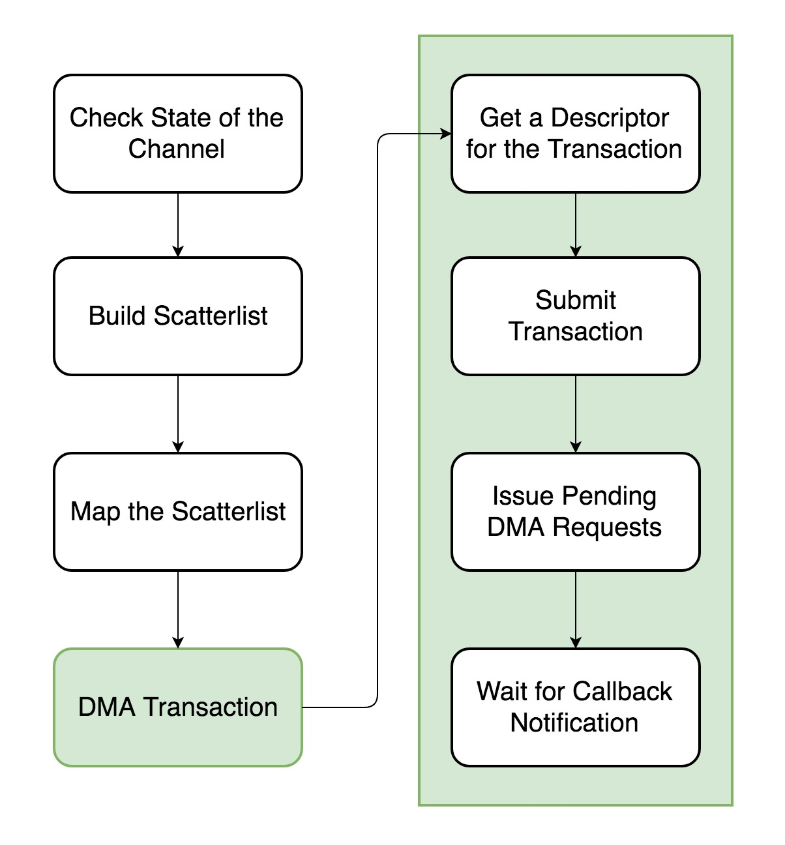
UDMA
Notes:
ECC Small Instances
500 Variables, 8000 Equations
13:00

Slide 34
Outline
Introduction
Preliminaries
Linux UIO Driver for AXI DMA
Experimental Results
Conclusion
Notes:
Motivation, Strategy, Preliminaries
Scheduler
Comparison, Simulation
Processor, System
Contribution, Future
2:00

Slide 35
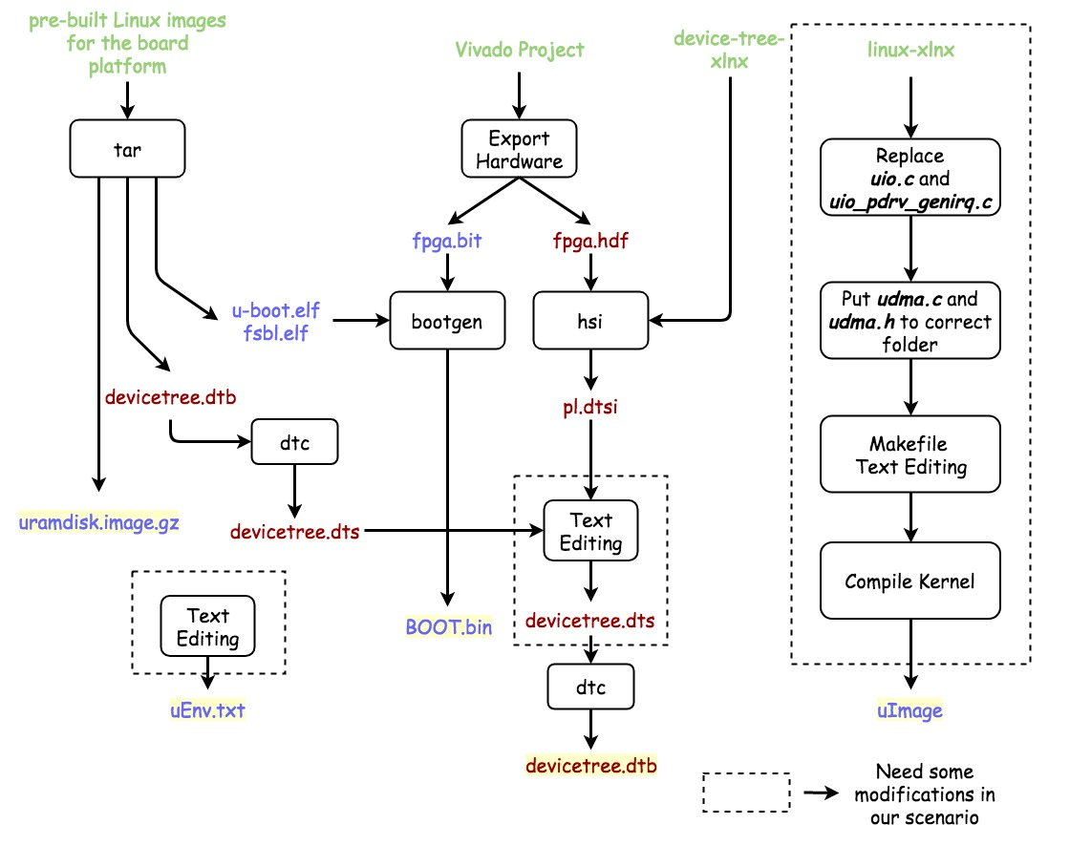
Notes:
Boot files after modification
16:00

Slide 36
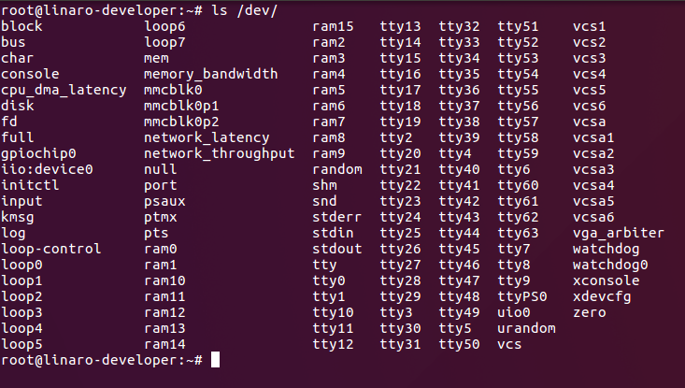
Linux UIO Driver for AXI DMA
EX:OpenCores-tinyAES with DMA
UIO Node
Notes:
Same example
13:00

Slide 37
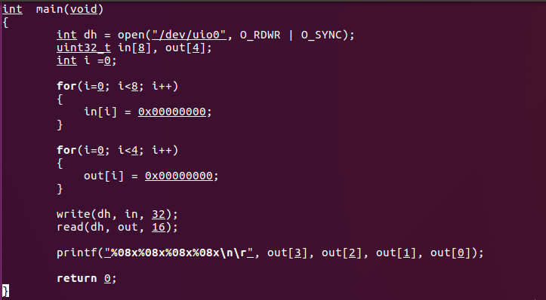
Linux UIO Driver for AXI DMA
Code
Notes:
Usage of our driver
13:00

Slide 38
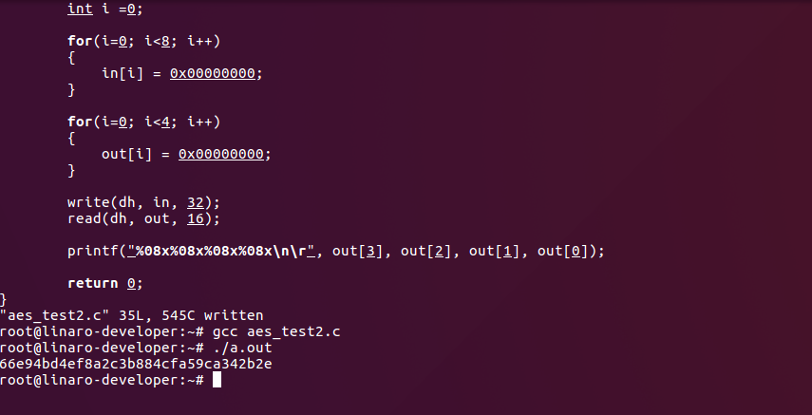
Linux UIO Driver for AXI DMA
Result
Notes:
ECC Small Instances
500 Variables, 8000 Equations
13:00

Slide 39
Experimental Results
Other DMA Kernel Drivers
xilinx_axidma[9] ->CMA
ezdma[10] -> Scatter-Gather
[9] xilinx_axidma driver URL https://github.com/bperez77/xilinx_axidma.
[10] ezdma driver URL https://github.com/jeremytrimble/ezdma
Notes:
No other uio modification
Compare with kernel driver
13:00

Slide 40
Experimental Results
Experiment Environment
Platform : ZedBoard
Linux Kernel : 4.9.9
Vivado & SDK Version : 2016.04
Booting Linux from SD card
Notes:
Test environment
13:00

Slide 41
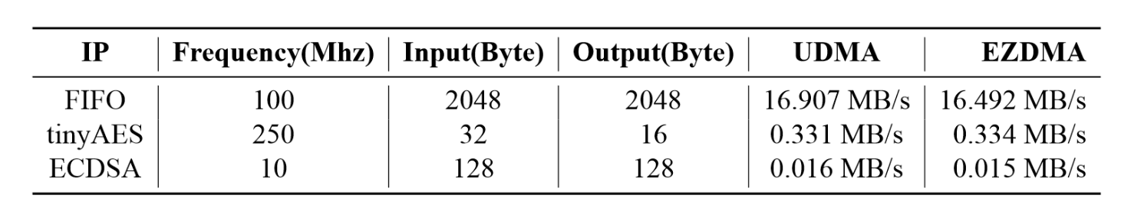
Experimental Results
Test IP
AXI-Stream FIFO
OpenCores tinyAES with DMA
ECDSA(curve secp256k1)
Notes:
AXI-stream fifo
Opencore …
Ecdsa curve secp 256k1
Average 1000000 times
13:00

Slide 42
Outline
Introduction
Preliminaries
Linux UIO Driver for AXI DMA
Experimental Results
Conclusion
Notes:
Motivation, Strategy, Preliminaries
Scheduler
Comparison, Simulation
Processor, System
Contribution, Future
2:00

Slide 43

Conclusion
Our Contributions
Modify UIO driver slightly to adapt AXI DMA.
Design an easy and intuitive way to control AXI4-Stream IP.
Not bad throughput.
Future Works
VDMA, CDMA / Faster / Merge into Linux kernel.
Notes:
Temporary Records
45:00

Slide 44
Thanks for your listening!
Yu-Tang Liu
Advisor: Chen-Mou Cheng, Ph.D.

