Slide 1
Linux UIO Driver for AXI DMA
Yu-Tang Liu
Advisor: Chen-Mou Cheng, Ph.D.
Notes:
0:30

Slide 2
Outline
Introduction
Linux on FPGA
UIO Driver
Custom IP and DMA
Linux UIO Driver for AXI DMA
Experimental Results
Conclusion
Notes:
Motivation, Strategy, Preliminaries
Scheduler
Comparison, Simulation
Processor, System
Contribution, Future
2:00

Slide 3
Outline
Introduction
Linux on FPGA
UIO Driver
Custom IP and DMA
Linux UIO Driver for AXI DMA
Experimental Results
Conclusion
Notes:
Motivation, Strategy, Preliminaries
Scheduler
Comparison, Simulation
Processor, System
Contribution, Future
2:00

Slide 4
We want to develop software to control our custom IP with UIO driver in Linux on FPGA.

Slide 5
We want to develop software to control our custom IP with UIO driver in Linux on FPGA.

Slide 6
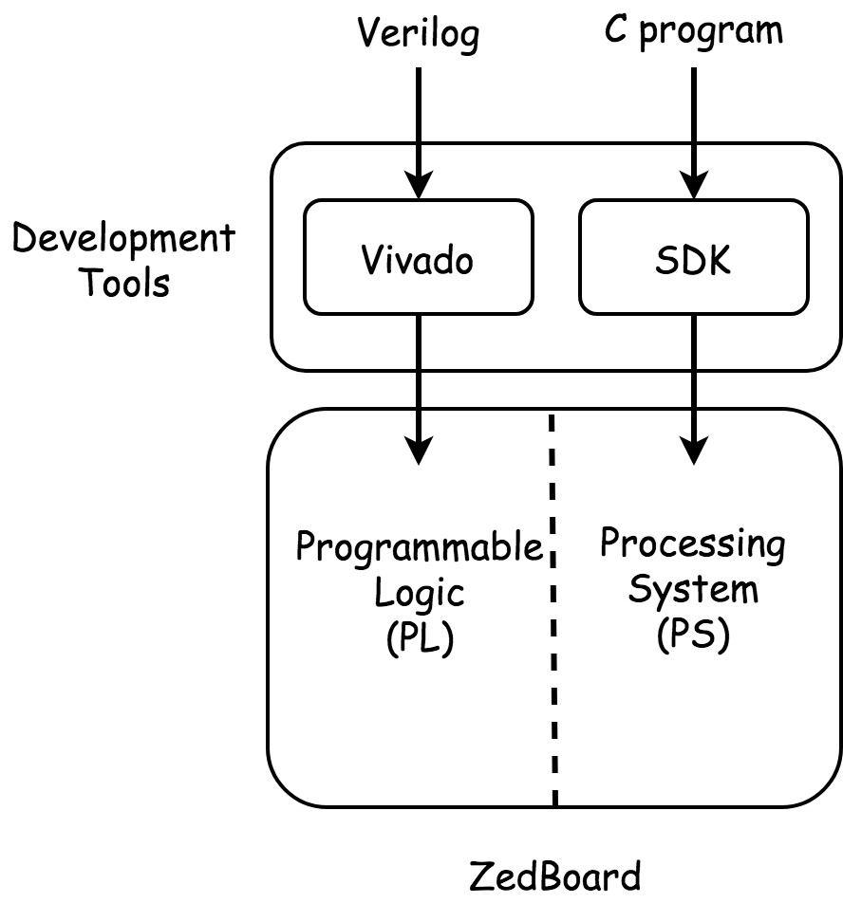
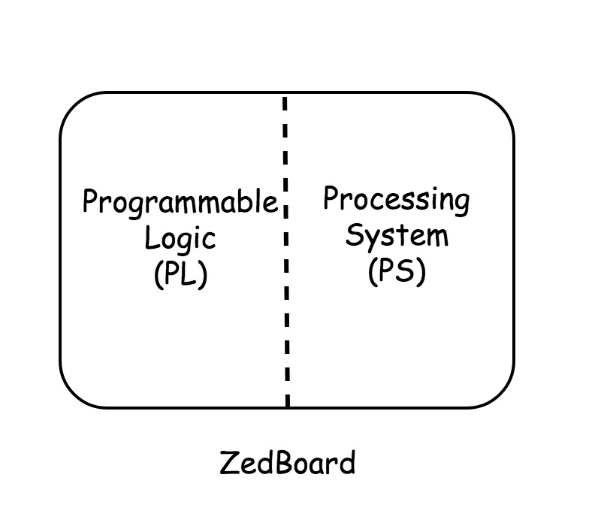
FPGA Board(ZedBoard)
Two parts on FPGA Board
Programmable Logic (PL)
Processing System (PS)
Development Tools
Vivado
SDK
Notes:
Prime: Intuitive, CPUs
Binary: Abstract, ASICs
571: Less Works, Military Observe Topics
5:00

Slide 7
SDK
Advantage
Full Suite of Libraries and Device Driver
Disadvantages
Full Suite of Libraries and Device Driver
Run Program
=> Linux on FPGA
Notes:
Upgrade Protocols
EC Group
ECDLP
7:00

Slide 8
Outline
Introduction
Linux on FPGA
UIO Driver
Custom IP and DMA
Linux UIO Driver for AXI DMA
Experimental Results
Conclusion
Notes:
Motivation, Strategy, Preliminaries
Scheduler
Comparison, Simulation
Processor, System
Contribution, Future
2:00

Slide 9
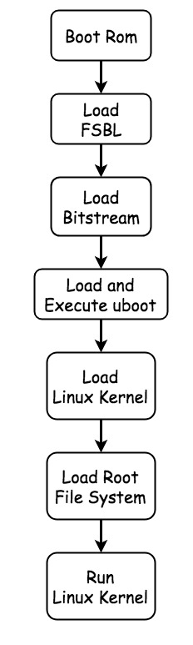
Linux on FPGA
Required Files
FSBL
Bitstream
U-boot
Linux Kernel
Root File System
[13] Y. K. Lee and I. Verbauwhede. A compact architecture for montgomery elliptic curve scalar multiplication processor. In International Workshop on Information Security Applications, pages 115–127. Springer, 2007.
[18] J. López and R. Dahab. Fast multiplication on elliptic curves over gf (2 m) without precomputation. In International Workshop on Cryptographic Hardware and Embedded Systems, pages 316–327. Springer, 1999.
Notes:
Omit Y
Steps: 11, 11
Registers: 7, 6
Out-of-Place
10:00

Slide 10
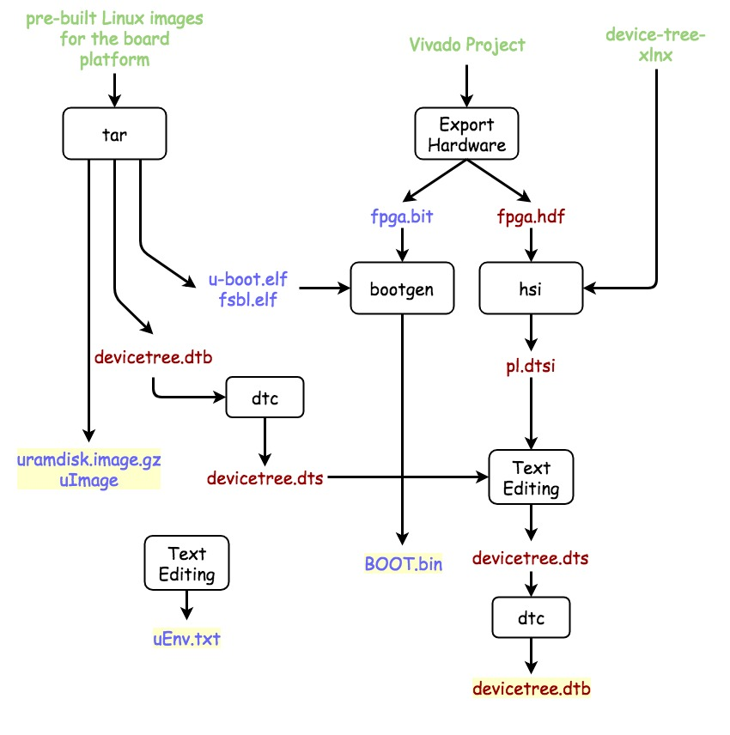
Example
Boot Linux by SD Card
Two partition
1st Partition Files
BOOT.bin
FSBL + bitstream + u-boot
uImage
uramdisk.image.gz
devicetree.dtb
Notes:
Omit Y
Steps: 11, 11
Registers: 7, 6
Out-of-Place
10:00

Slide 11
Device Tree
Non Coverable Device
Old Linux
Hard Coded
New Linux
Device Tree
[13] Y. K. Lee and I. Verbauwhede. A compact architecture for montgomery elliptic curve scalar multiplication processor. In International Workshop on Information Security Applications, pages 115–127. Springer, 2007.
[18] J. López and R. Dahab. Fast multiplication on elliptic curves over gf (2 m) without precomputation. In International Workshop on Cryptographic Hardware and Embedded Systems, pages 316–327. Springer, 1999.
Notes:
Omit Y
Steps: 11, 11
Registers: 7, 6
Out-of-Place
10:00

Slide 12
Outline
Introduction
Linux on FPGA
UIO Driver
Custom IP and DMA
Linux UIO Driver for AXI DMA
Experimental Results
Conclusion
Notes:
Motivation, Strategy, Preliminaries
Scheduler
Comparison, Simulation
Processor, System
Contribution, Future
2:00

Slide 13
UIO Driver[]
Suitable
The device has memory that can mapped and can be controlled by writing to this memory.
The device usually generates interrupt.
The device does not fit into one of the standard kernel subsystems.
About UIO
Main part of driver is developed in userspace.
Driver won’t crash the kernel.
Update driver don’t need recompile kernel.
[5] The Userspace I/O HOWTO URL https://www.kernel.org/doc/html/v4.12/driver-api/uio-howto.html .
[7] R. Govindarajan, H. Yang, J. N. Amaral, C. Zhang, and G. R. Gao. Minimum register instruction sequencing to reduce register spills in out-of-order issue superscalar architectures. IEEE Transactions on Computers, 52(1):4–20, 2003.
Notes:
ECC Small Instances
500 Variables, 8000 Equations
13:00

Slide 14
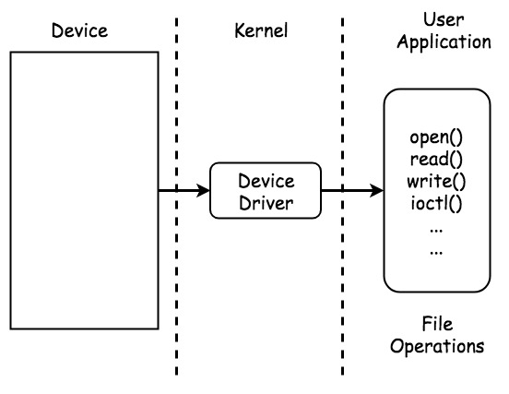
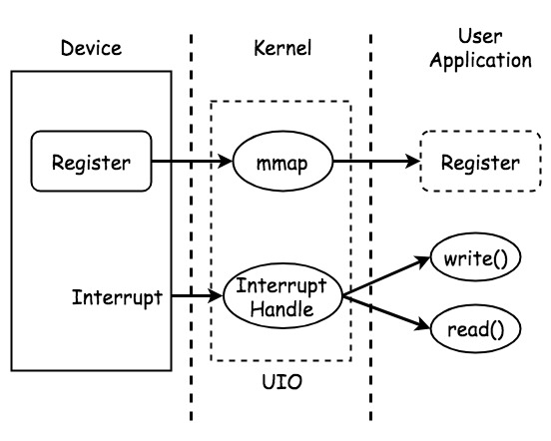
Kernel Device Driver UIO Driver
Notes:
ECC Small Instances
500 Variables, 8000 Equations
13:00

Slide 15
Outline
Introduction
Linux on FPGA
UIO Driver
Custom IP and DMA
Linux UIO Driver for AXI DMA
Experimental Results
Conclusion
Notes:
Motivation, Strategy, Preliminaries
Scheduler
Comparison, Simulation
Processor, System
Contribution, Future
2:00

Slide 16
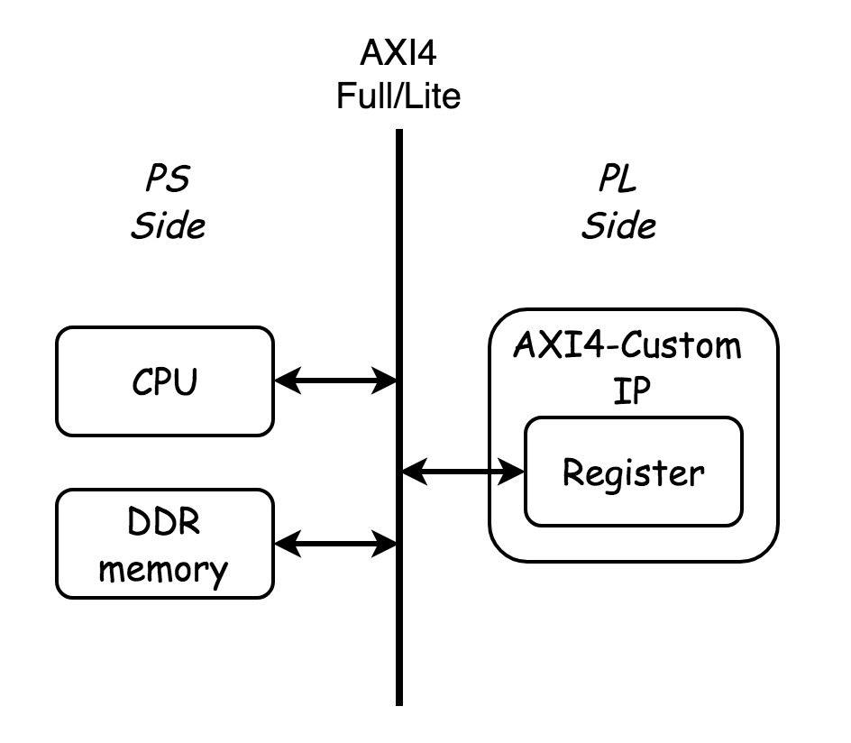
Custom IP
Register Types
Full
Lite
Stream
AXI4 Bus Interface
AXI4
AXI4-Lite
AXI4-Stream
->
UIO Driver
->
[5] The Userspace I/O HOWTO URL https://www.kernel.org/doc/html/v4.12/driver-api/uio-howto.html .
[7] R. Govindarajan, H. Yang, J. N. Amaral, C. Zhang, and G. R. Gao. Minimum register instruction sequencing to reduce register spills in out-of-order issue superscalar architectures. IEEE Transactions on Computers, 52(1):4–20, 2003.
Notes:
ECC Small Instances
500 Variables, 8000 Equations
13:00

Slide 17
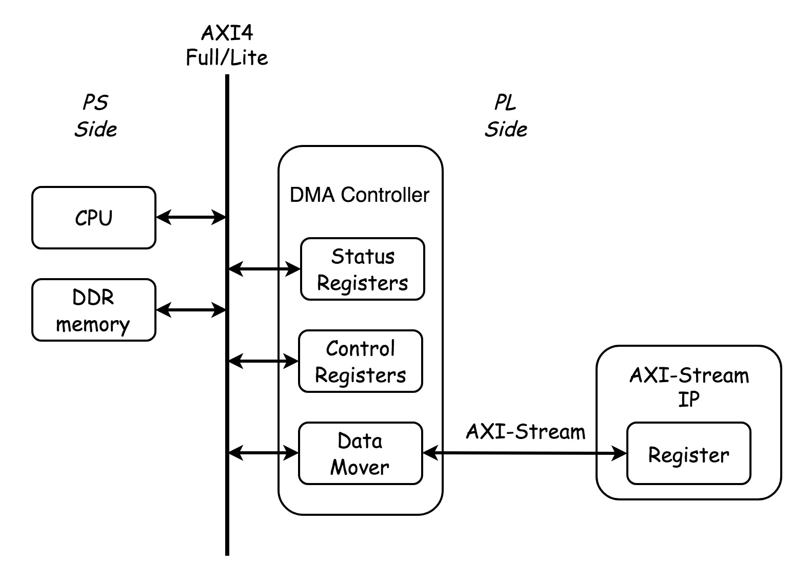
Custom Stream IP
[5] The Userspace I/O HOWTO URL https://www.kernel.org/doc/html/v4.12/driver-api/uio-howto.html .
[7] R. Govindarajan, H. Yang, J. N. Amaral, C. Zhang, and G. R. Gao. Minimum register instruction sequencing to reduce register spills in out-of-order issue superscalar architectures. IEEE Transactions on Computers, 52(1):4–20, 2003.
Notes:
ECC Small Instances
500 Variables, 8000 Equations
13:00

Slide 18
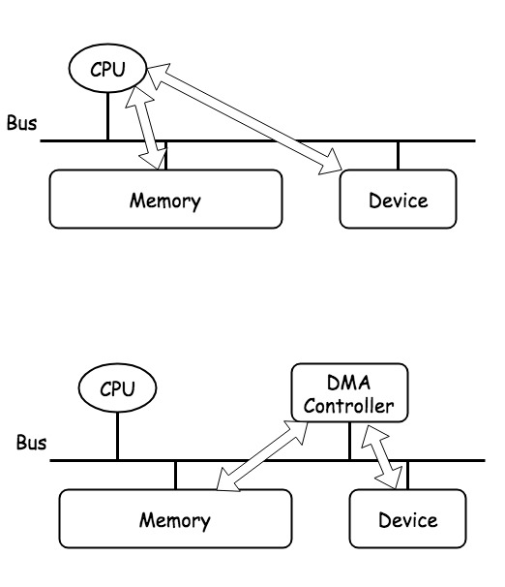
DMA
Direct Memory Access
Moving data without CPU
DMA Controller
Usage
Data Address
Data Length
Destination Address
[5] The Userspace I/O HOWTO URL https://www.kernel.org/doc/html/v4.12/driver-api/uio-howto.html .
[7] R. Govindarajan, H. Yang, J. N. Amaral, C. Zhang, and G. R. Gao. Minimum register instruction sequencing to reduce register spills in out-of-order issue superscalar architectures. IEEE Transactions on Computers, 52(1):4–20, 2003.
Notes:
ECC Small Instances
500 Variables, 8000 Equations
13:00

Slide 19
Outline
Introduction
Linux on FPGA
UIO Driver
Custom IP and DMA
Linux UIO Driver for AXI DMA
Experimental Results
Conclusion
Notes:
Motivation, Strategy, Preliminaries
Scheduler
Comparison, Simulation
Processor, System
Contribution, Future
2:00

Slide 20
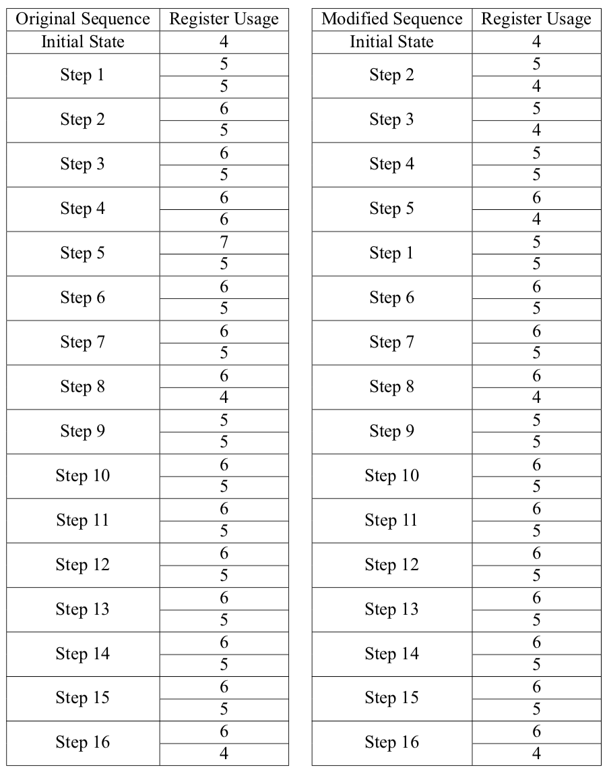
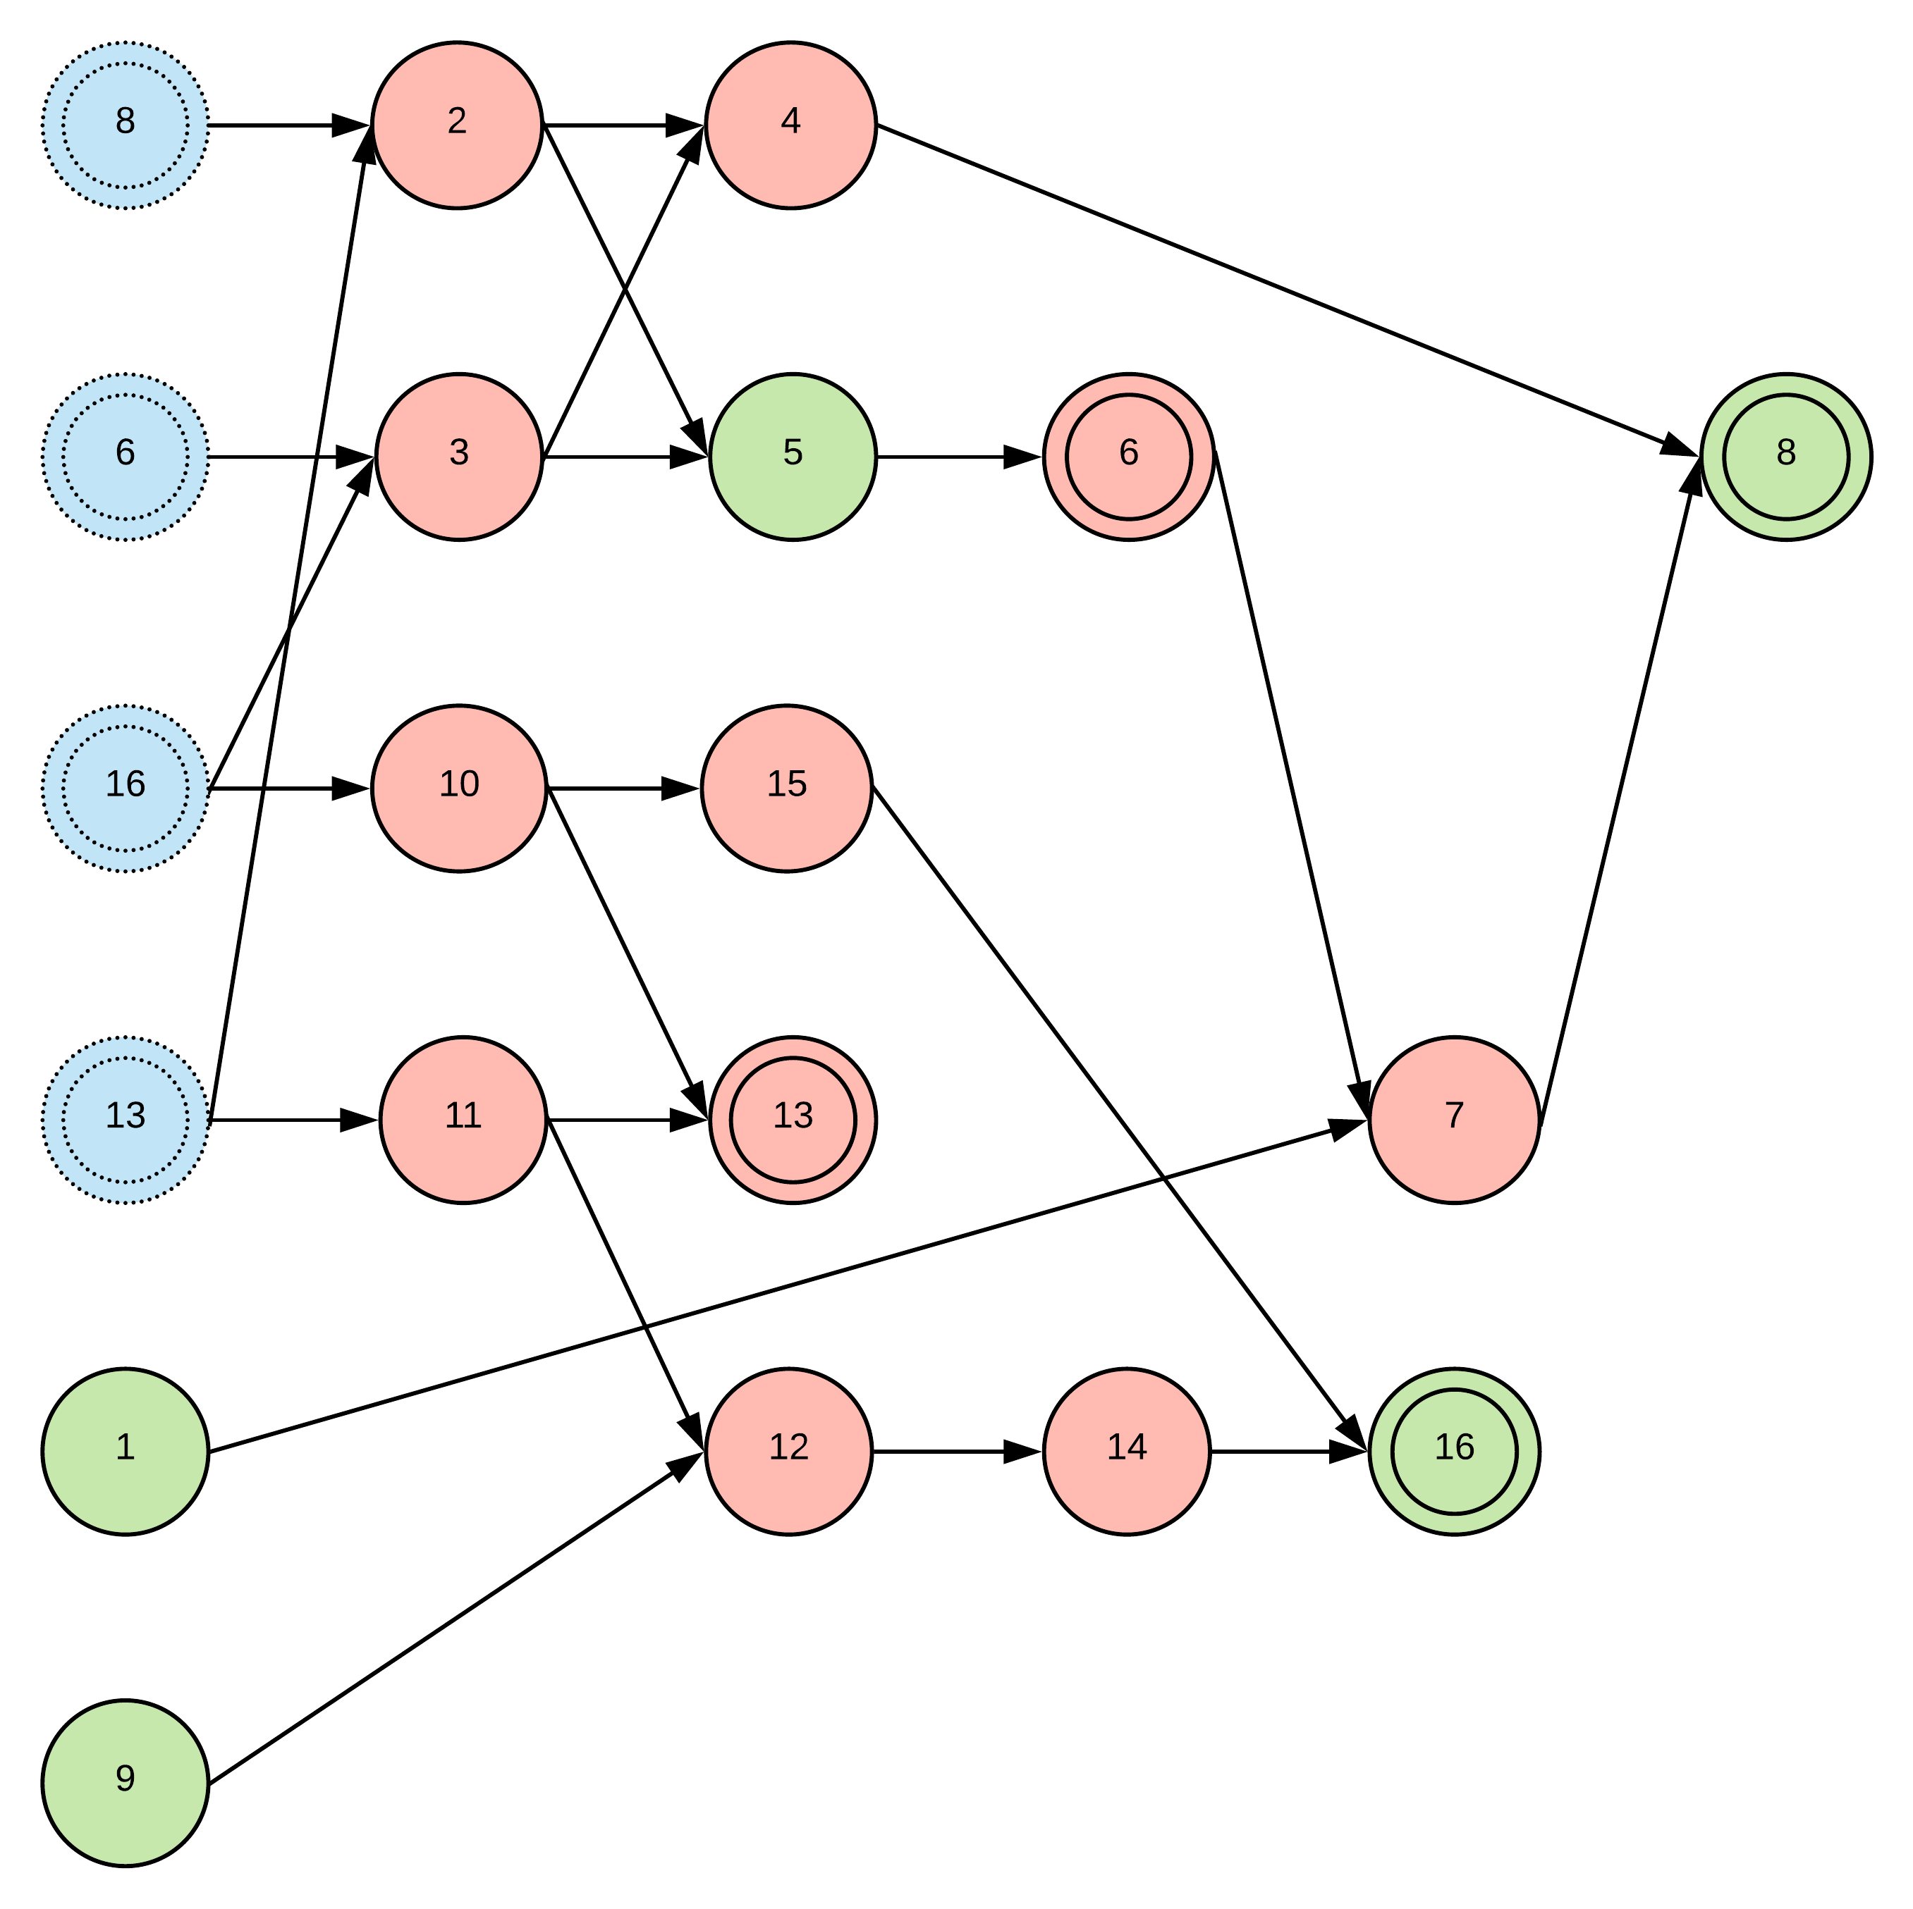
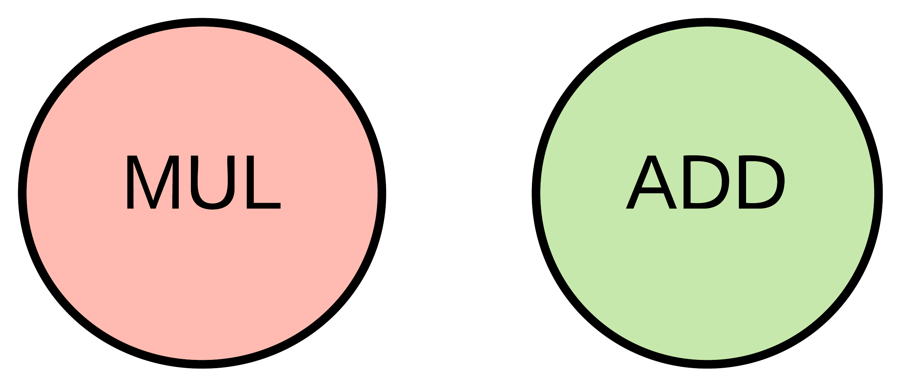
Notes:
Heuristic: Lazy, Short-Sighted
16:00

Slide 21
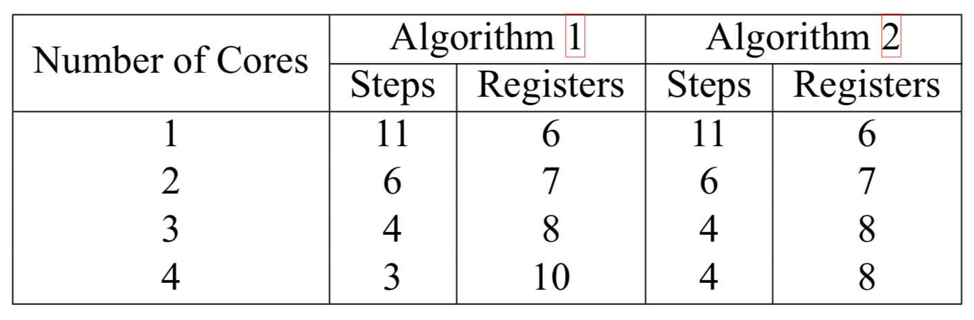
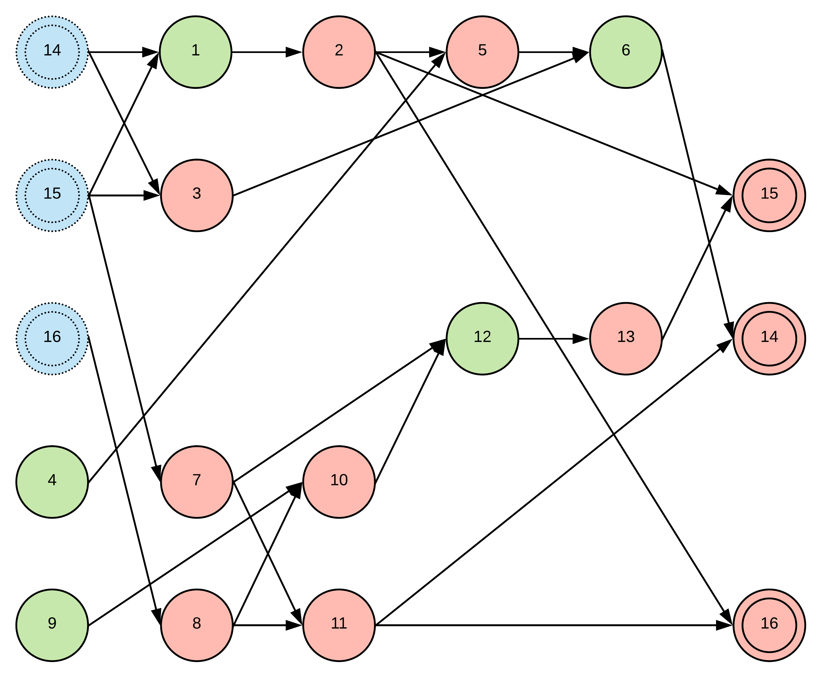
Considering Multi-Core Issues
Notes:
Lee's: Optimal Already
17:30

Slide 22
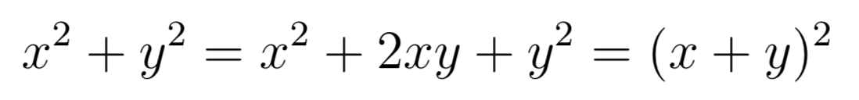
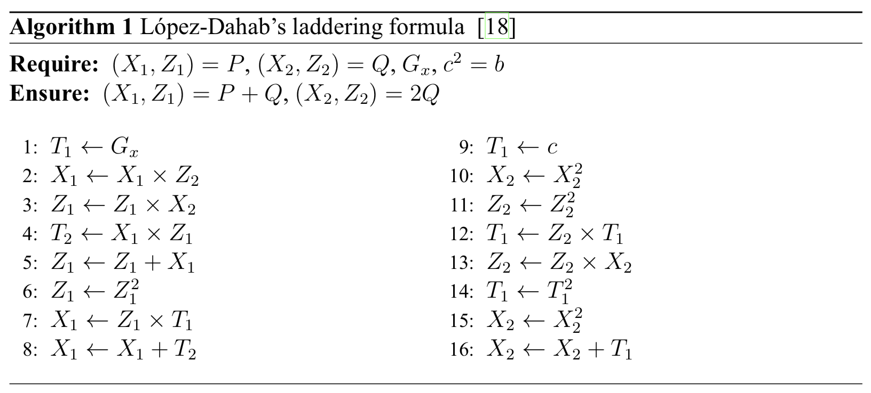
Optimal Parallelization
Least Steps and Least Registers
Notes:
19:00

Slide 23
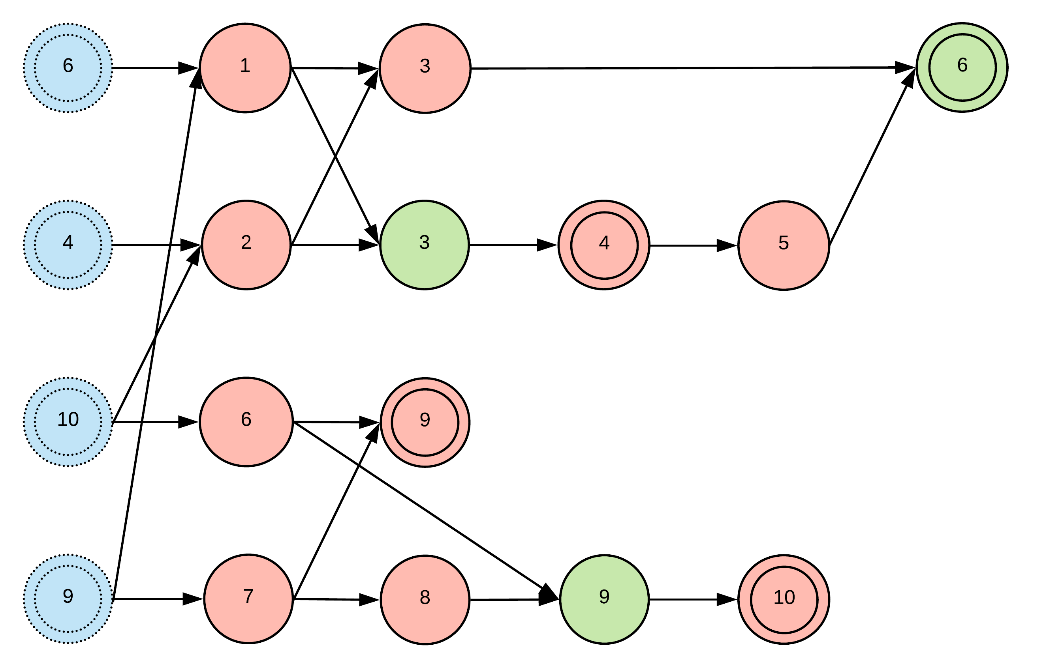
Our Optimal Formulas
Reduce 1 Multiplication
In-Place
1 / 2 / 3 / 4 Cores
Notes:
Multiplications with Addition
Multiplications with Constants
20:00

Slide 24
Outline
Introduction
Parallelization of Laddering Formulas
Multiplier over Binary Fields
Architecture and Experimental Results
Conclusion

Slide 25
Method to Analyze
Multiplier Styles
Shift-and-Add (SAA)
Hybrid-KOA (HKOA)
Overlap-Free HKOA (OF-HKOA)
Simulation Rules
Gate / FF / Critical Path / Total Cycles
Area-Time Product (ATP)
Notes:
21:30

Slide 26
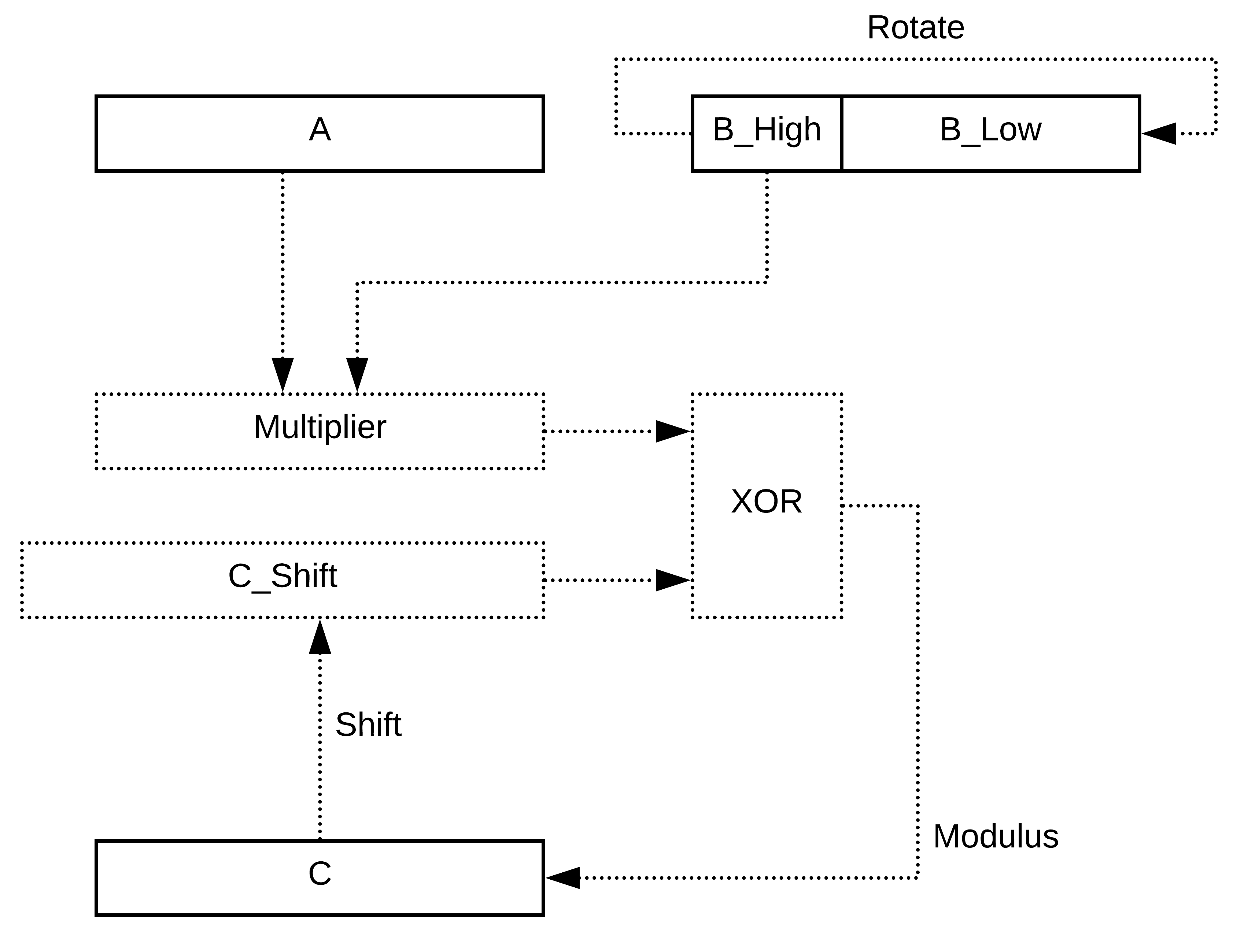
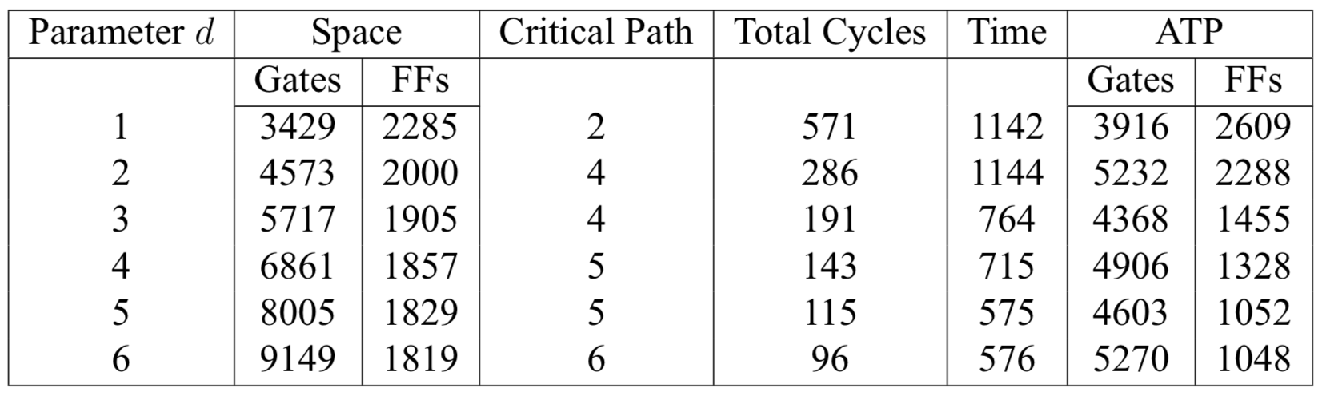
Shift-and-Add (SAA)
Notes:
23:00

Slide 27
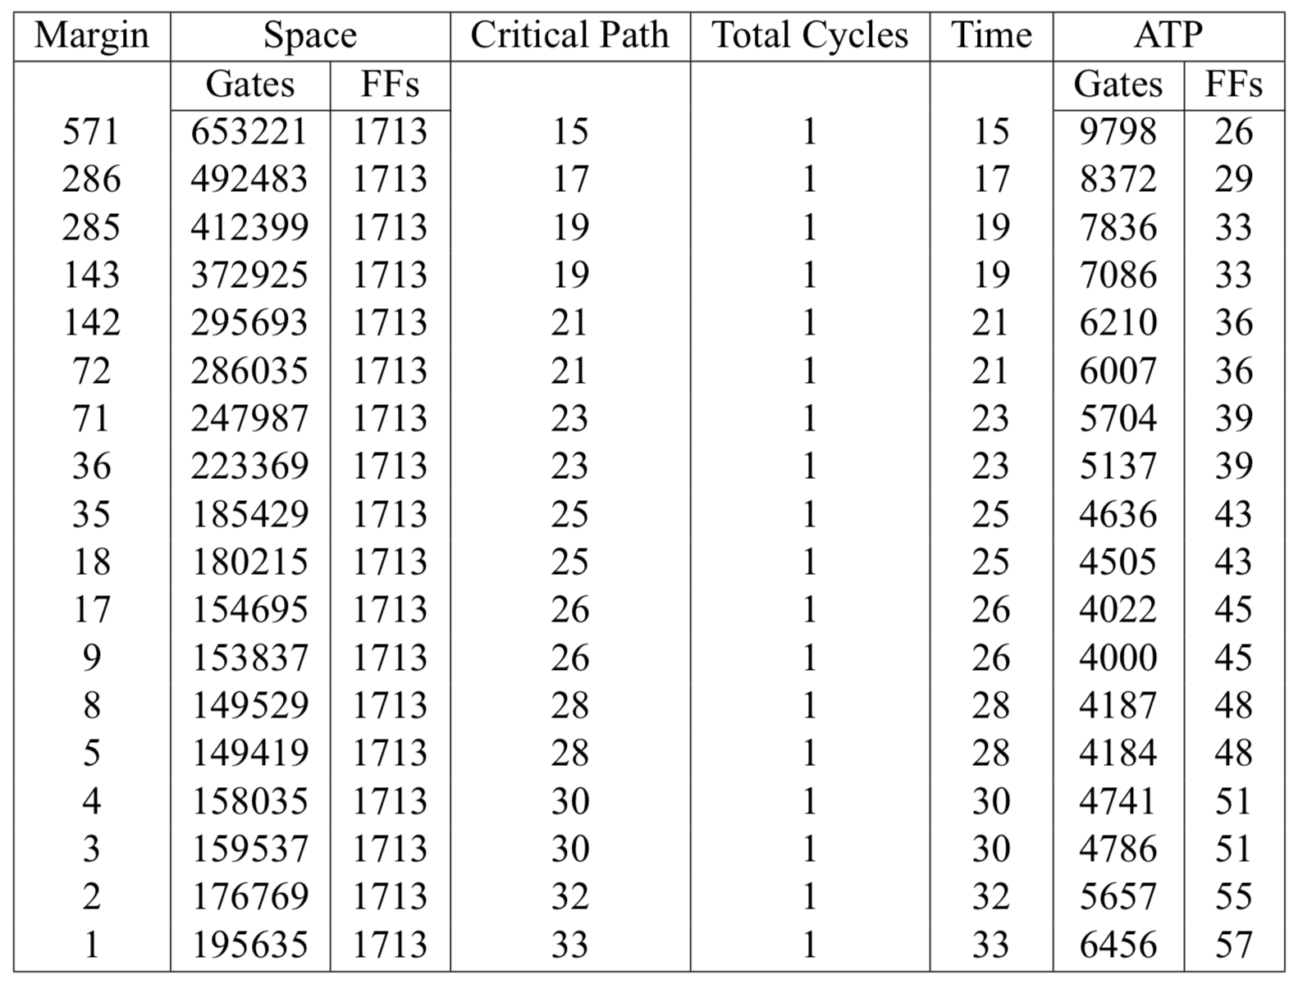
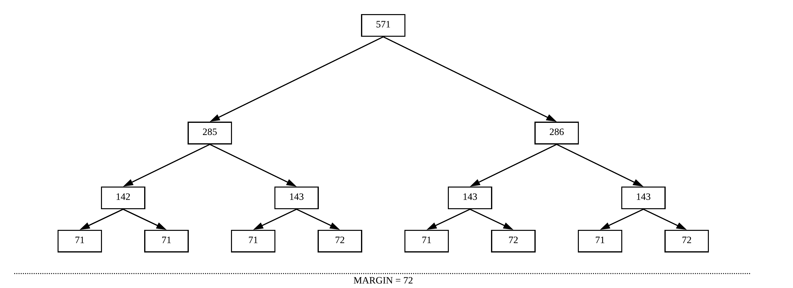
Hybrid-KOA (HKOA)
Notes:
24:30

Slide 28
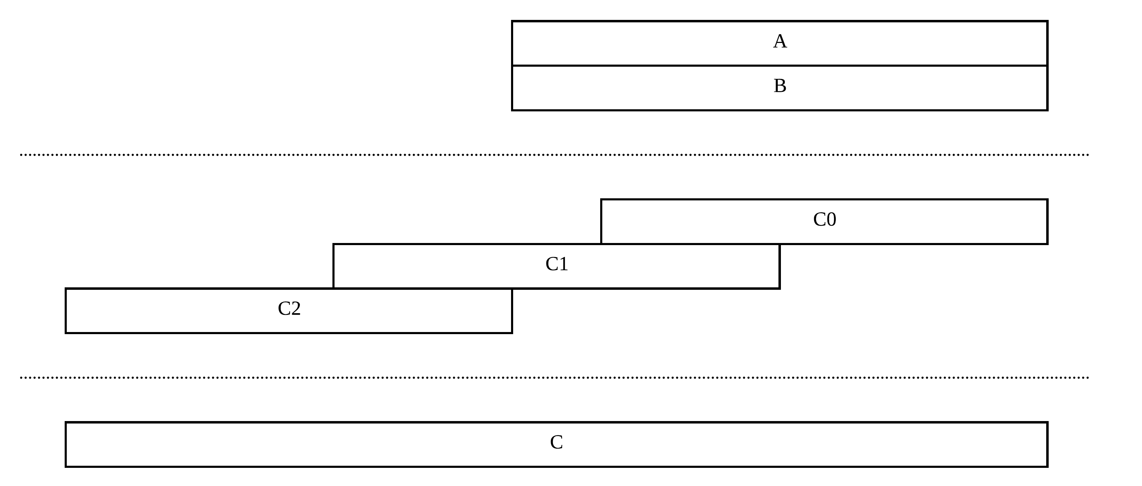
Overlap-Free HKOA (OF-HKOA)
Notes:
26:00

Slide 29


Critical Path Simulator
Define XOR and AND functions
Perform the corresponding Boolean operations
Calculate the corresponding Dijkstra’s steps
Update the global counters
Notes:
Longest Path Problem
28:30

Slide 30
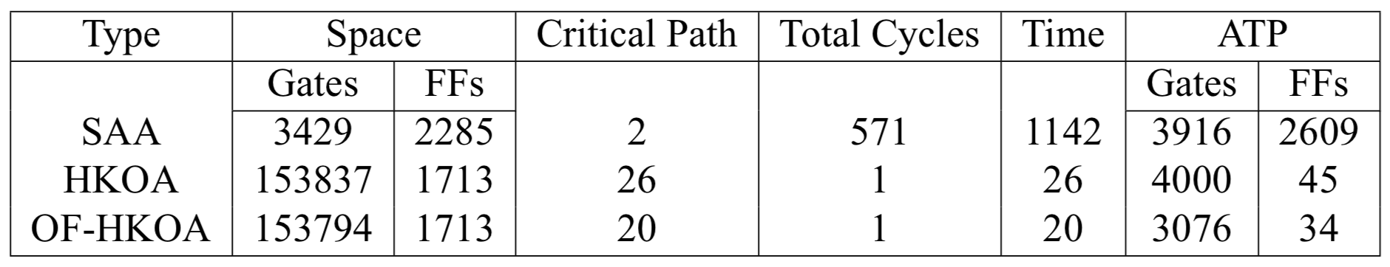
Comparisons among Different Multipliers
Notes:
Theoretical
30:00

Slide 31
Outline
Introduction
Parallelization of Laddering Formulas
Multiplier over Binary Fields
Architecture and Experimental Results
Conclusion

Slide 32
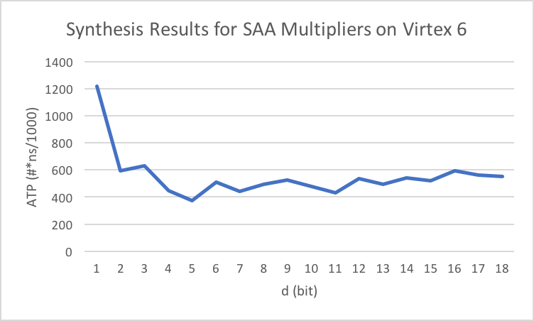
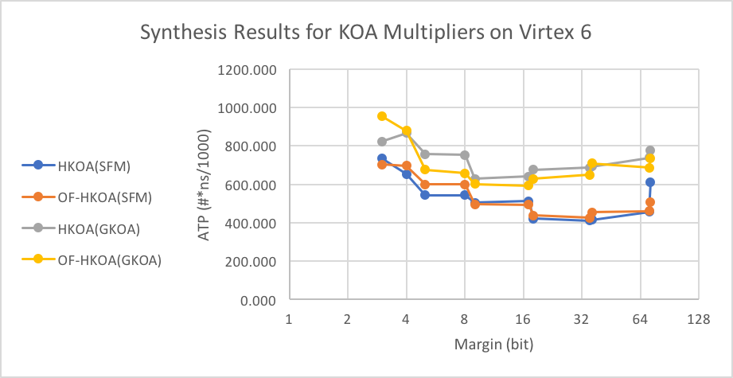
Synthesis Results for Multipliers
Notes:
Experimental
Best Equipment
32:30

Slide 33
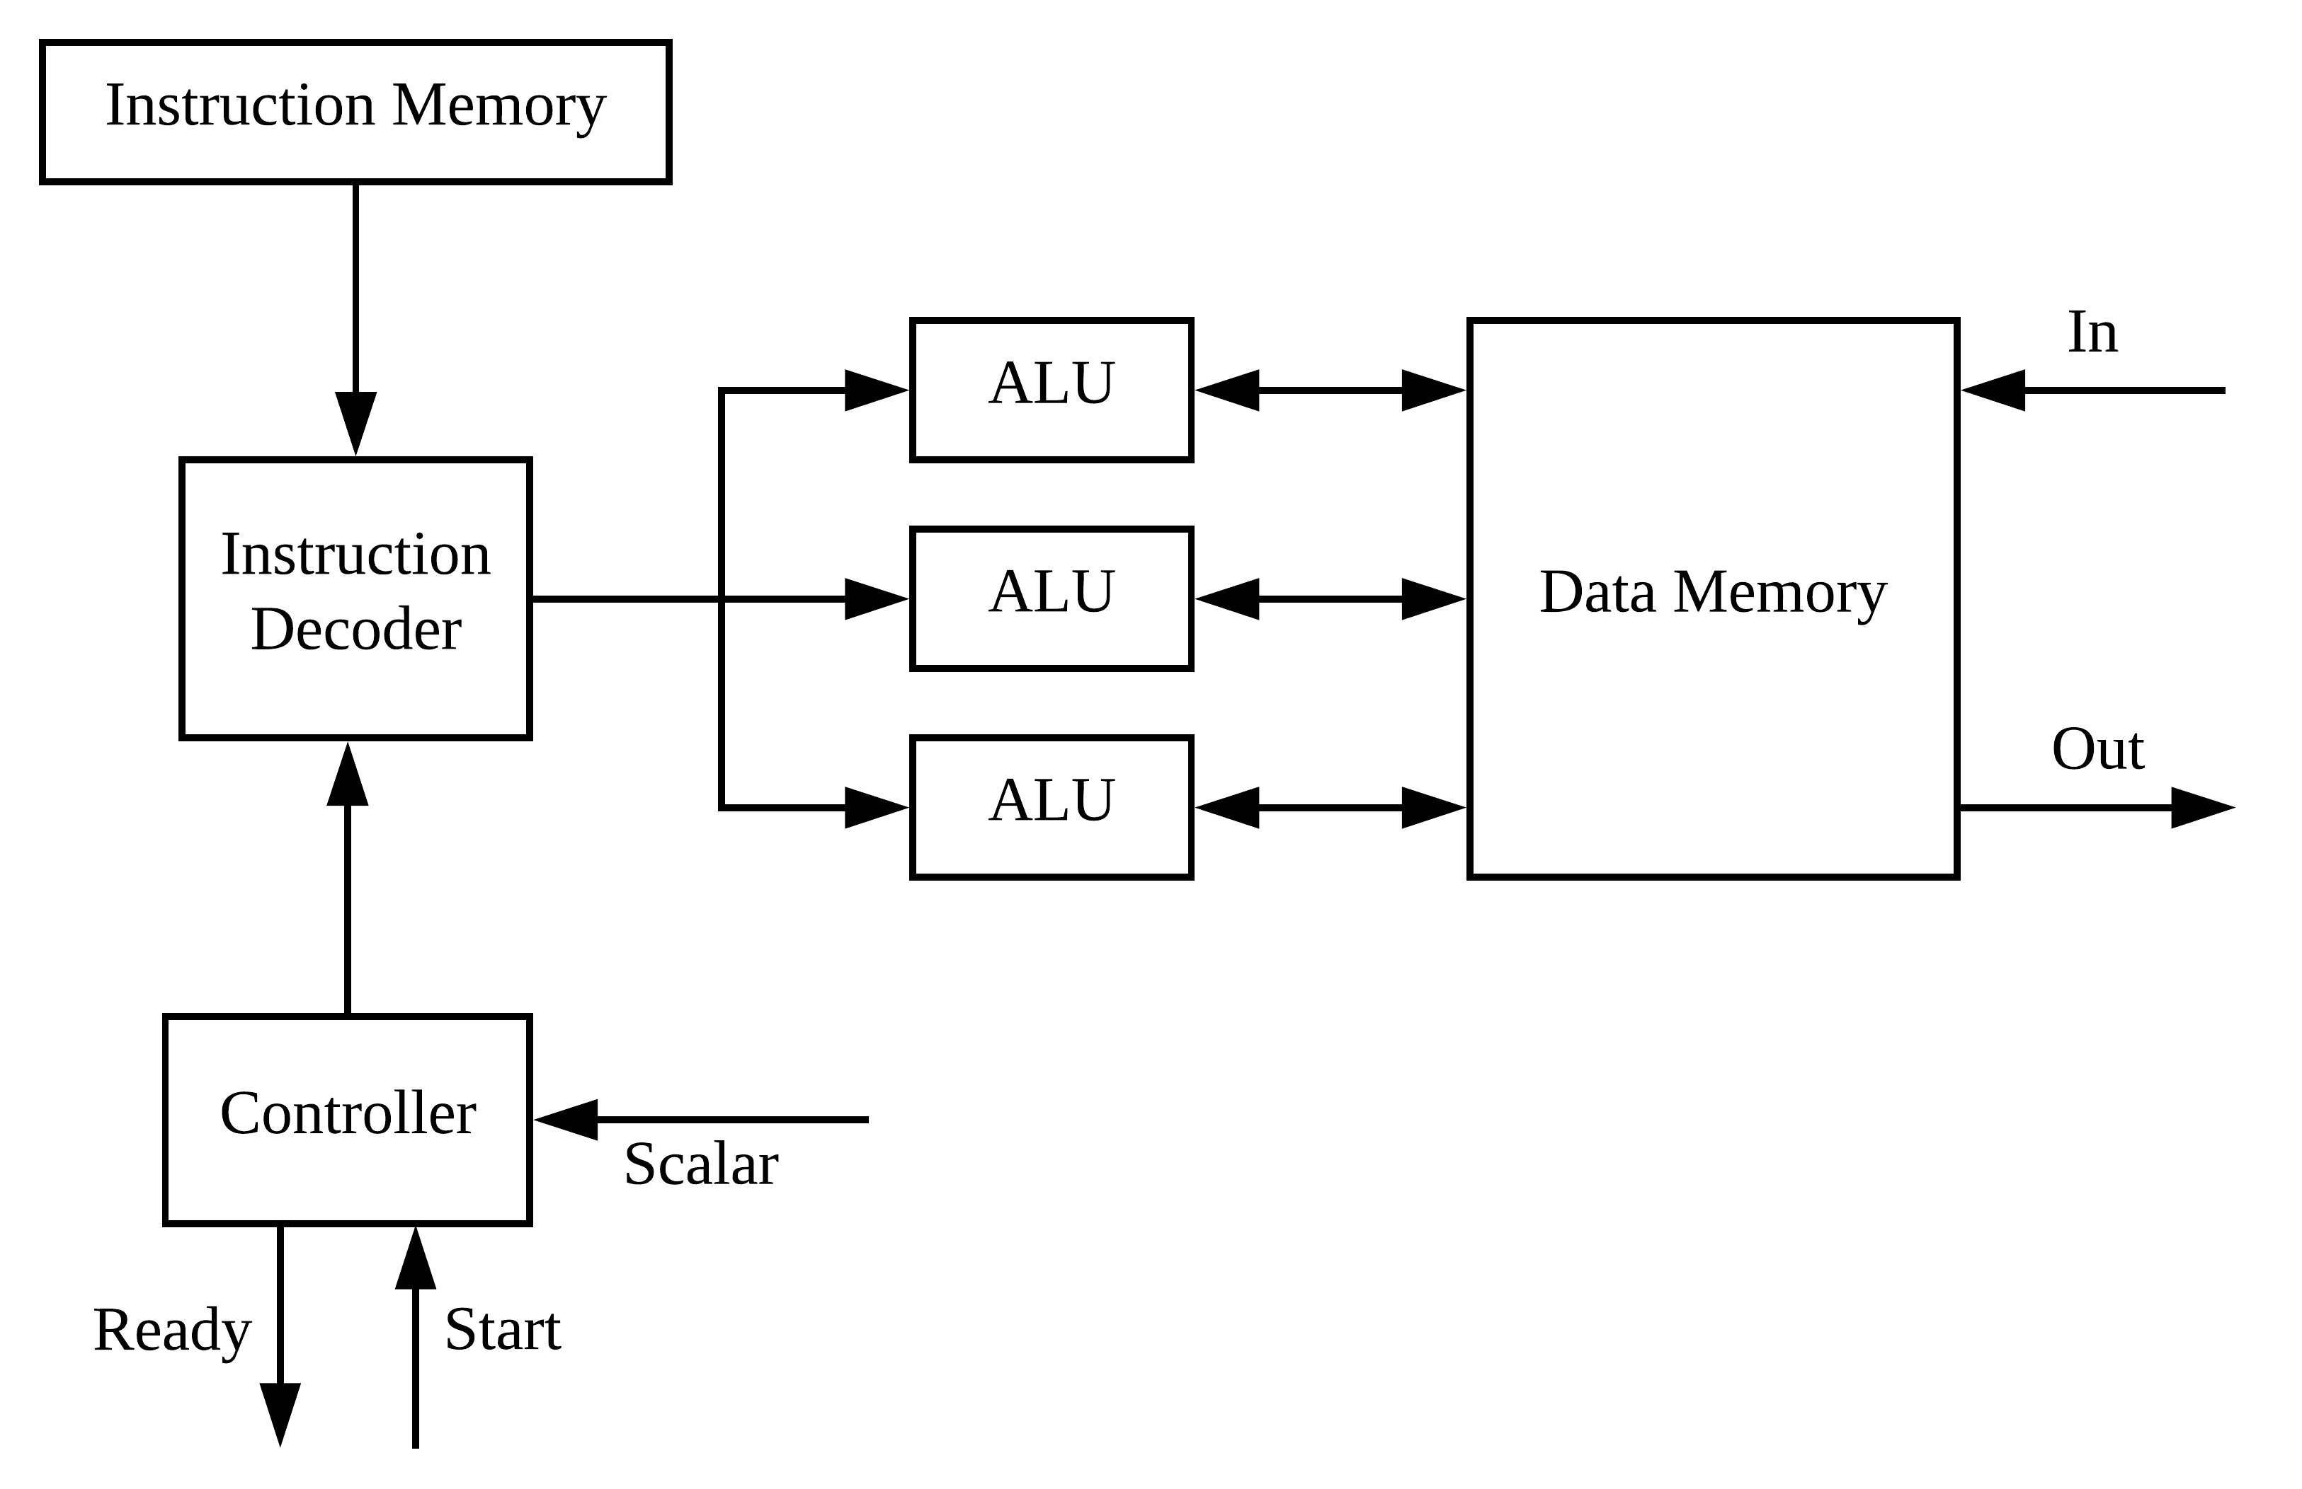
Processor Architecture
Notes:
34:30

Slide 34
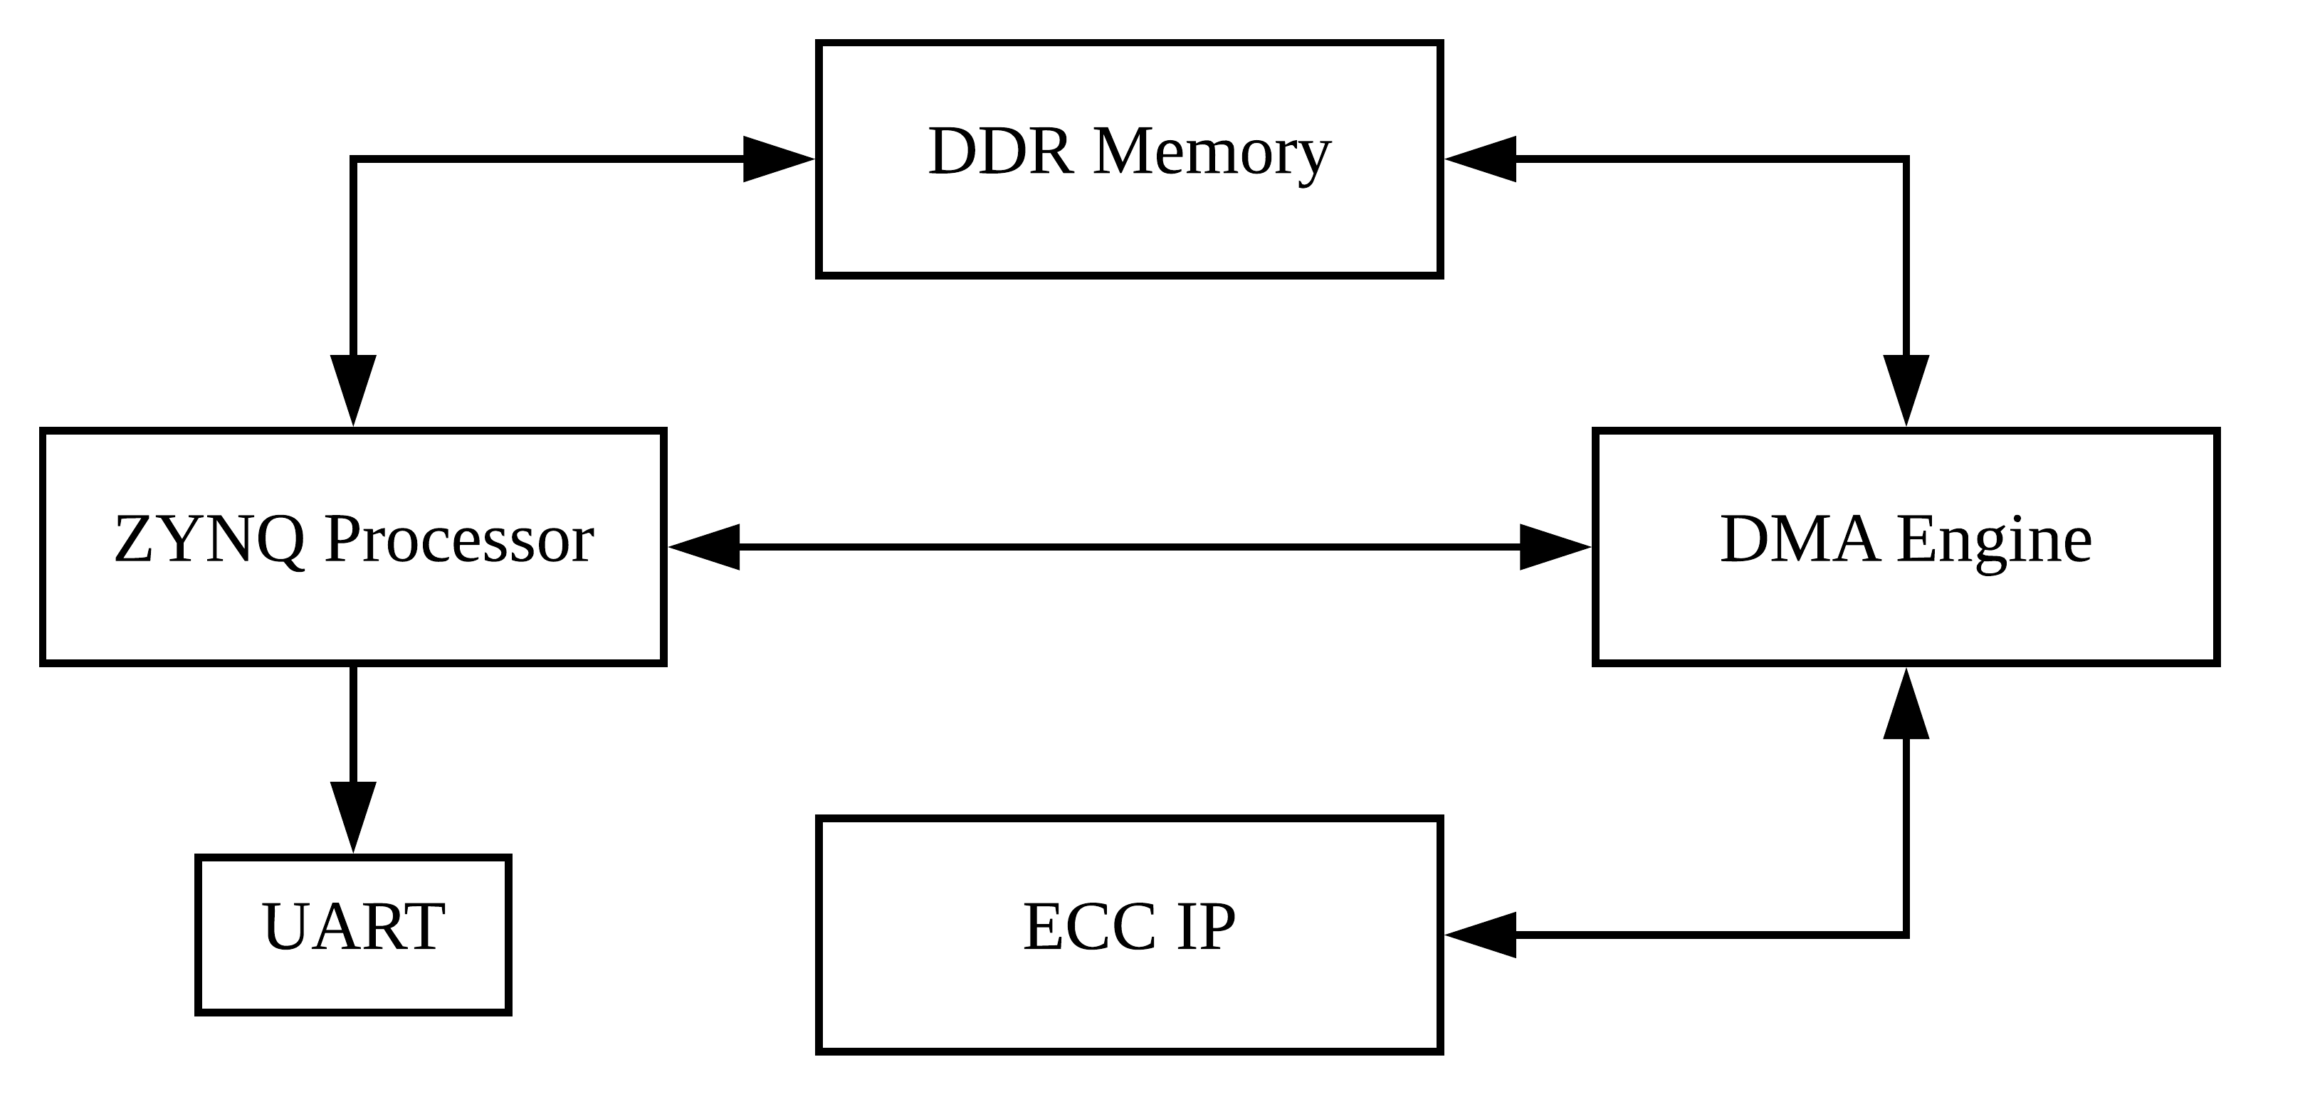
System Architecture
Notes:
Zynq UltraScale+
36:30

Slide 35
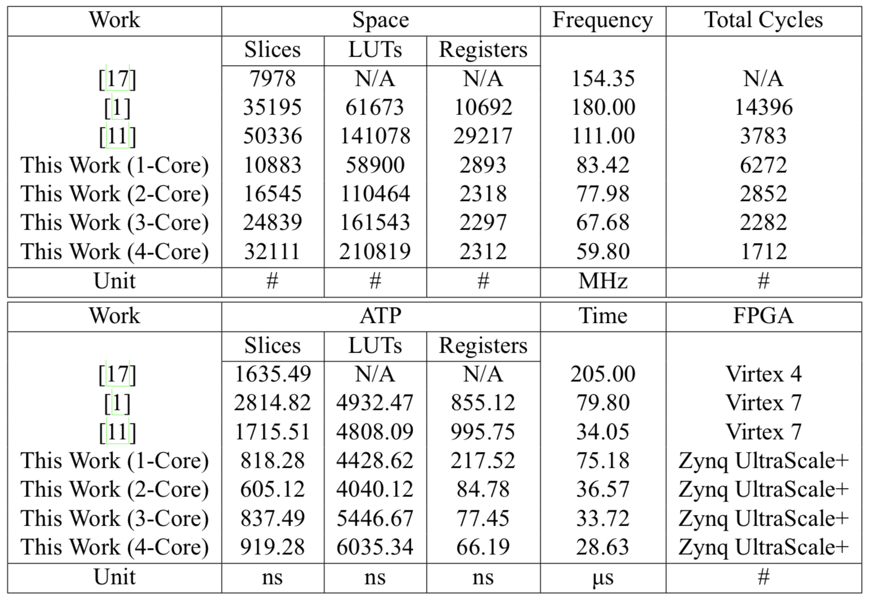
Implementation Results
[1] M. Benaissa et al. Throughput/area-efficient ecc processor using montgomery point multiplication on fpga. IEEE Transactions on Circuits and Systems II: Express Briefs, 62(11):1078–1082, 2015.
[11] Z. U. Khan and M. Benaissa. High-speed and low-latency ecc processor implementation over gf (2 m) on fpga. IEEE Transactions on Very Large Scale Integration (VLSI) Systems, 25(1):165–176, 2017.
[17] K. C. Loi, S. An, and S.-B. Ko. Fpga implementation of low latency scalable elliptic curve cryptosystem processor in gf (2 m). In Circuits and Systems (ISCAS), 2014 IEEE International Symposium on, pages 822–825. IEEE, 2014.
Notes:
40:00

Slide 36
Outline
Introduction
Parallelization of Laddering Formulas
Multiplier over Binary Fields
Architecture and Experimental Results
Conclusion

Slide 37
Conclusion
Feasible for Commercial Use
Most Efficient (2-Core)
Fastest (4-Core)
Our Contributions
Introduce a method to search for optimal laddering formulas
Provide an analysis on different styles of multipliers
Design a compact architecture for our ECC Processor
Future Works
Squares / DPAs / Formula Database
Notes:
Temporary Records
45:00

Slide 38
Thanks for your listening!
Yuan-Che Hsu
Advisor: Chen-Mou Cheng, Ph.D.

