Slide 1
A Multi-Core ECC Processor over Binary Fields
Yuan-Che Hsu
Advisor: Chen-Mou Cheng, Ph.D.
Notes:
0:30

Slide 2
Outline
Introduction
Parallelization of Laddering Formulas
Multiplier over Binary Fields
Architecture and Experimental Results
Conclusion
Notes:
Motivation, Strategy, Preliminaries
Scheduler
Comparison, Simulation
Processor, System
Contribution, Future
2:00

Slide 3
Outline
Introduction
Parallelization of Laddering Formulas
Multiplier over Binary Fields
Architecture and Experimental Results
Conclusion

Slide 4
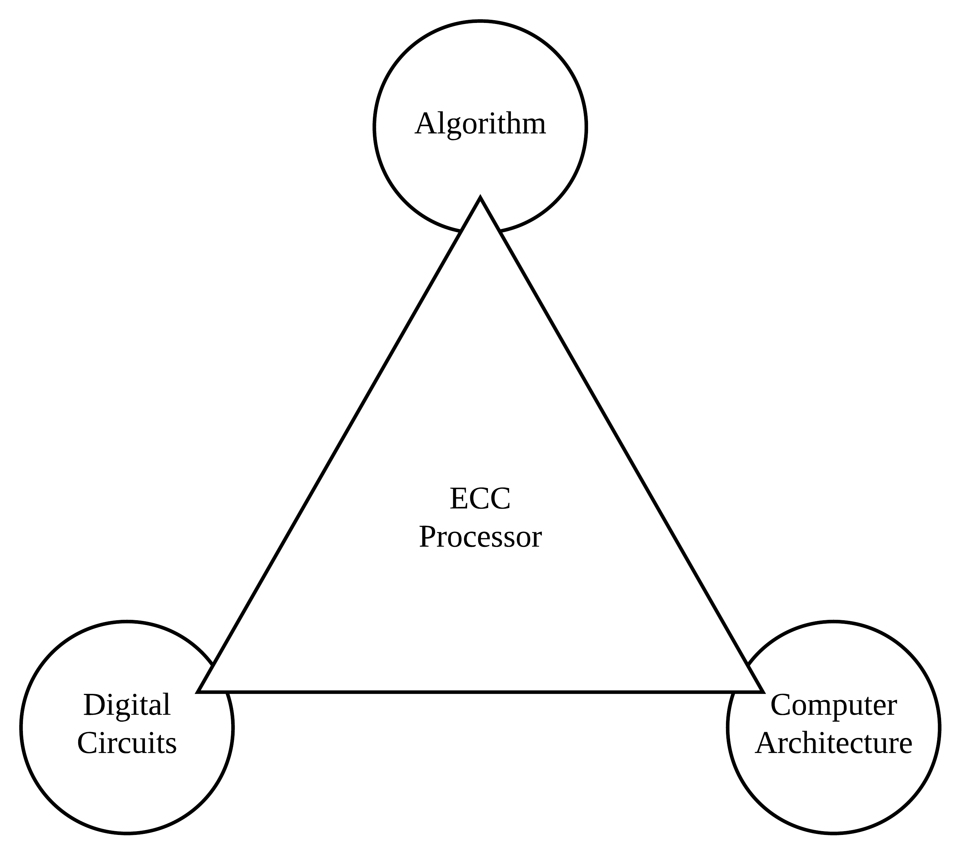
Motivation and Strategy
NIST ECC Standards
Prime / Binary Fields
5 Security Levels
Our Goals
Binary Fields
Degree 571
Multi-Core
Notes:
Prime: Intuitive, CPUs
Binary: Abstract, ASICs
571: Less Works, Military Observe Topics
5:00

Slide 5
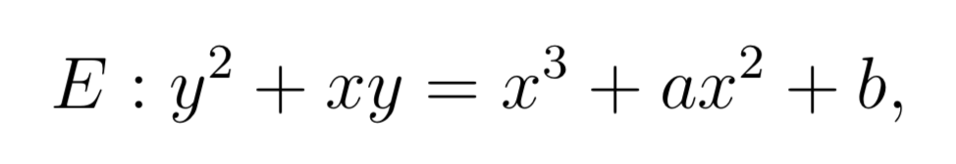
Elliptic Curve Cryptography (ECC)
Building Block of PKC
ECDH / ECDSA
Scalar Multiplication (ECSM)
[d]P
Time-Consuming
Key-Dependent
Notes:
Upgrade Protocols
EC Group
ECDLP
7:00

Slide 6
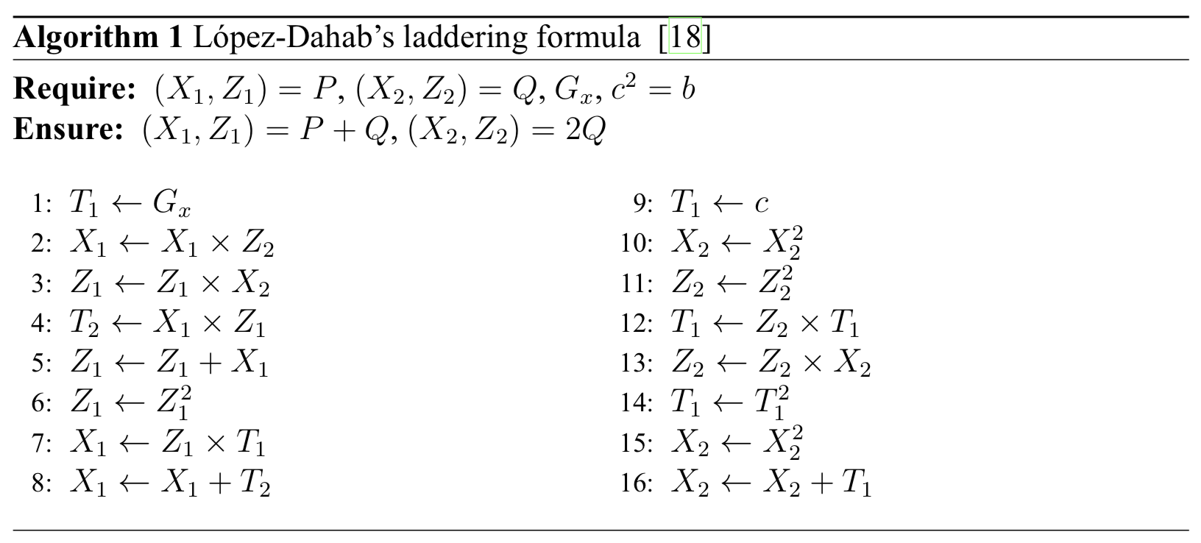
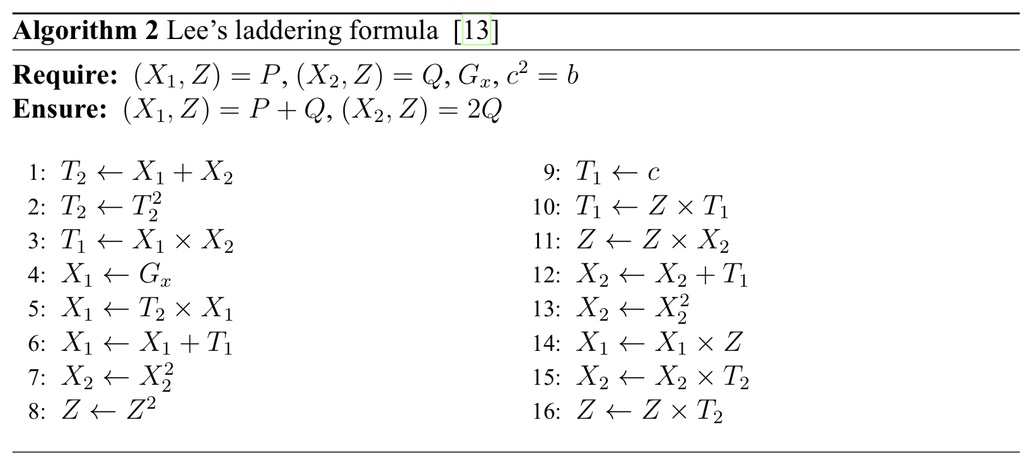
Laddering Formulas
Montgomery Powering Ladder
SPA / DFA Resistance
Projective Coordinates
Common-Z
Formula Evaluation
Steps
Registers
[13] Y. K. Lee and I. Verbauwhede. A compact architecture for montgomery elliptic curve scalar multiplication processor. In International Workshop on Information Security Applications, pages 115–127. Springer, 2007.
[18] J. López and R. Dahab. Fast multiplication on elliptic curves over gf (2 m) without precomputation. In International Workshop on Cryptographic Hardware and Embedded Systems, pages 316–327. Springer, 1999.
Notes:
Omit Y
Steps: 11, 11
Registers: 7, 6
Out-of-Place
10:00

Slide 7
Outline
Introduction
Parallelization of Laddering Formulas
Multiplier over Binary Fields
Architecture and Experimental Results
Conclusion

Slide 8
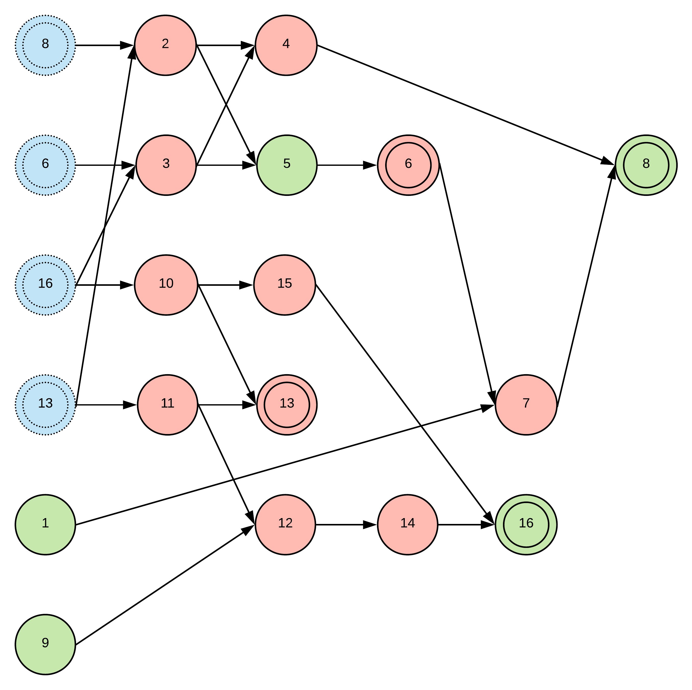
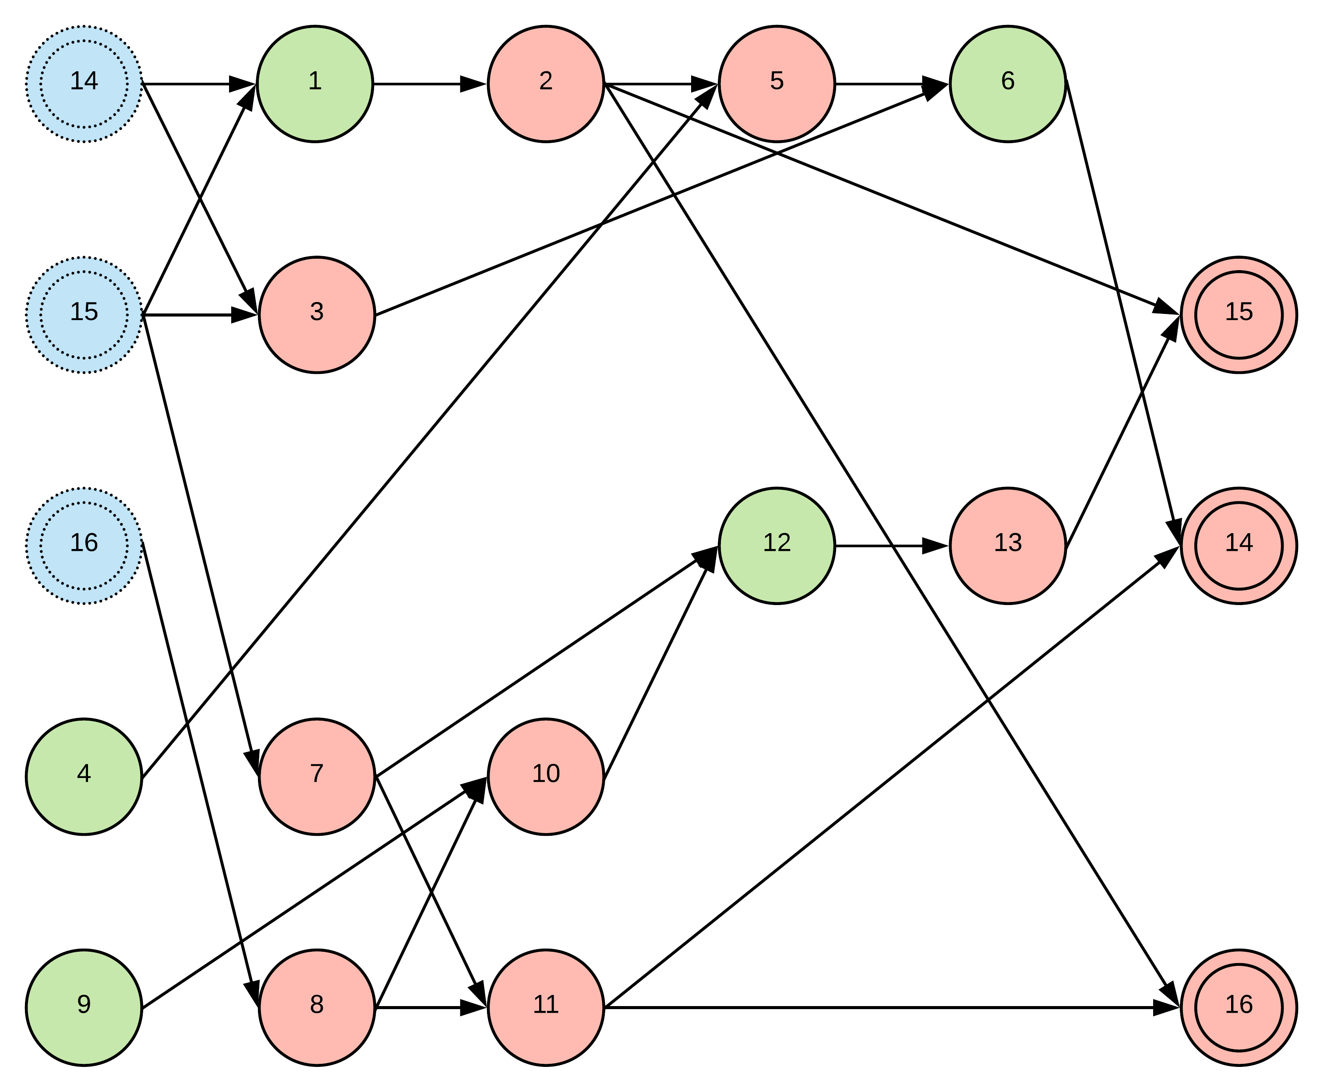
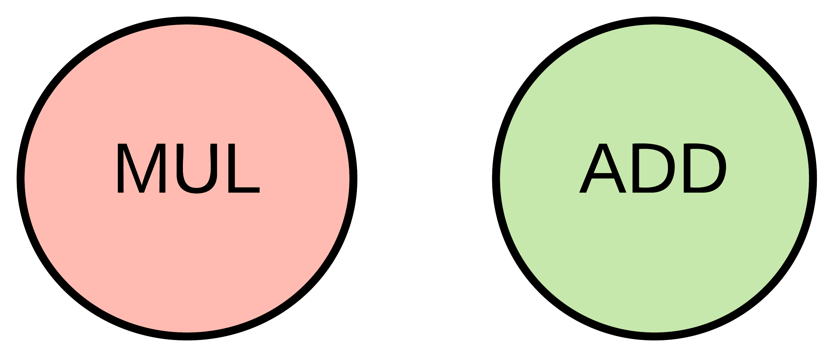
Observation on Previous Formulas
Notes:
Visualization
Transformation
Small Experiment
11:30

Slide 9
Register Allocation
Finding Optimal Solution
Linear Time for Trees
Exponential Time for DAGs
Heuristic / Exact Solver [7]
Our Experiments
Formulate to ILP and apply Cbc [5]
Build a specialized scheduler
[5] J. Forrest. Cbc (coin-or branch and cut) open-source mixed integer programming solver, 2012. URL https://projects. coin-or. org/Cbc.
[7] R. Govindarajan, H. Yang, J. N. Amaral, C. Zhang, and G. R. Gao. Minimum register instruction sequencing to reduce register spills in out-of-order issue superscalar architectures. IEEE Transactions on Computers, 52(1):4–20, 2003.
Notes:
ECC Small Instances
500 Variables, 8000 Equations
13:00

Slide 10
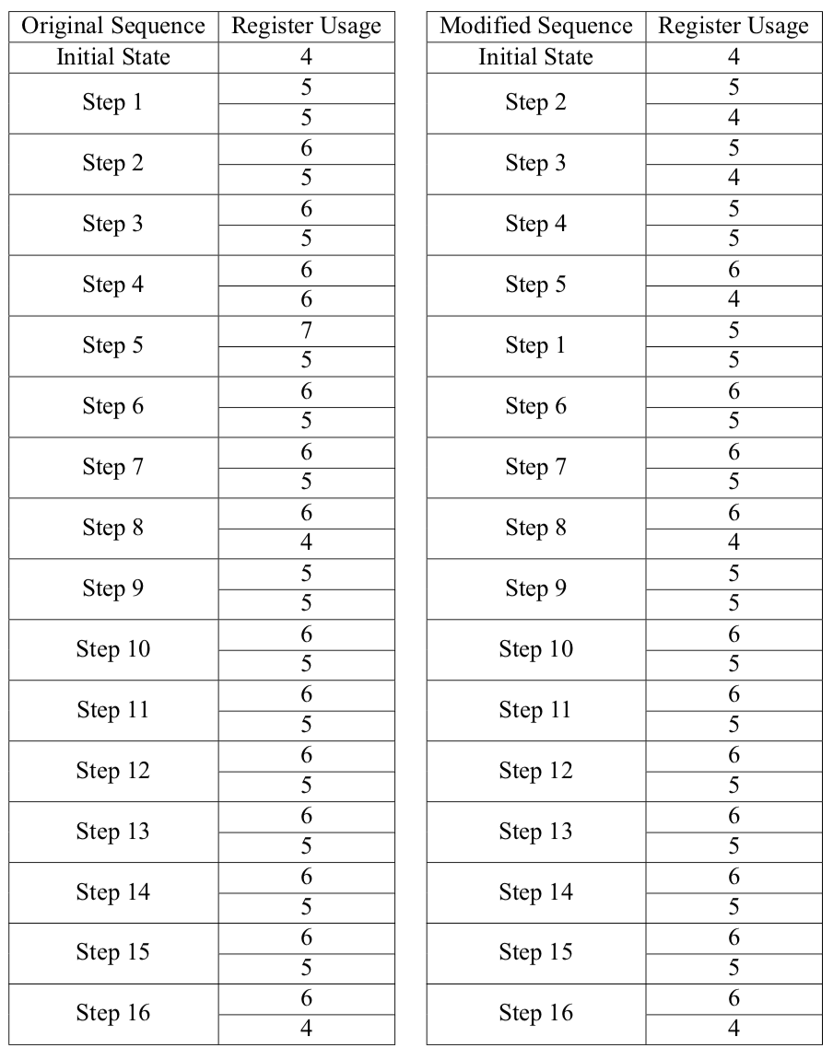
Register Usage
Notes:
Heuristic: Lazy, Short-Sighted
16:00

Slide 11
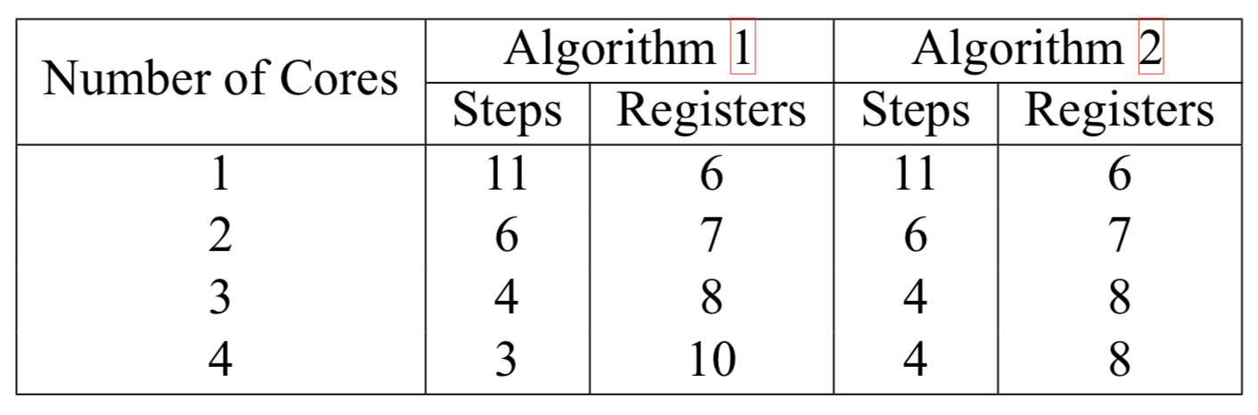
Considering Multi-Core Issues
Notes:
Lee's: Optimal Already
17:30

Slide 12
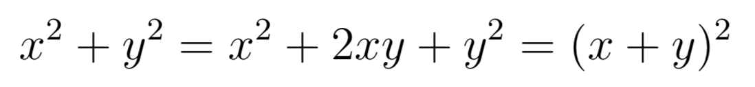
Optimal Parallelization
Least Steps and Least Registers
Notes:
19:00

Slide 13
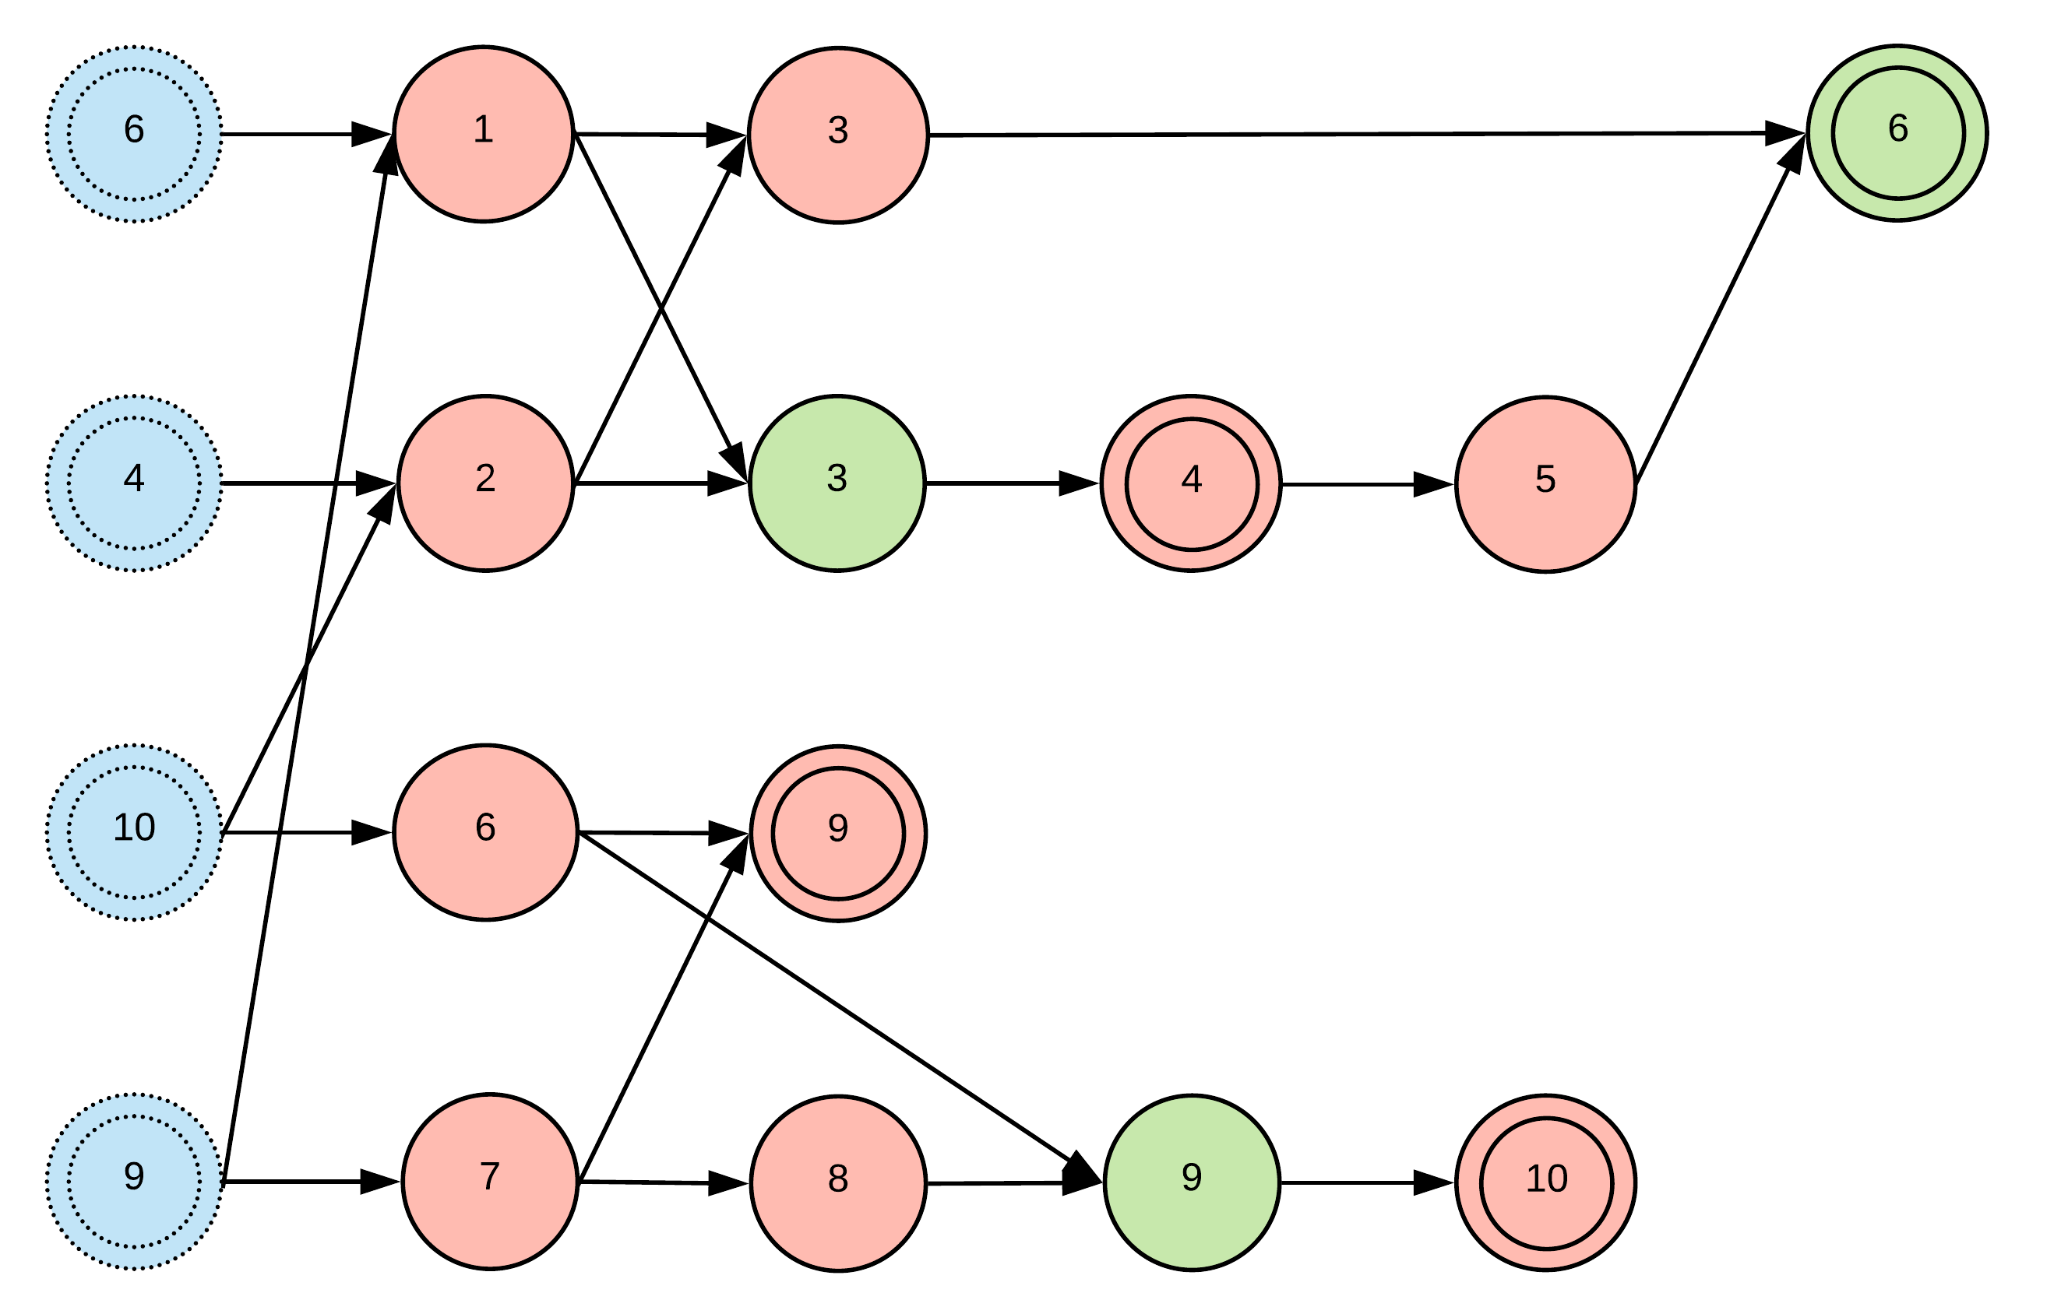
Our Optimal Formulas
Reduce 1 Multiplication
In-Place
1 / 2 / 3 / 4 Cores
Notes:
Multiplications with Addition
Multiplications with Constants
20:00

Slide 14
Outline
Introduction
Parallelization of Laddering Formulas
Multiplier over Binary Fields
Architecture and Experimental Results
Conclusion

Slide 15
Method to Analyze
Multiplier Styles
Shift-and-Add (SAA)
Hybrid-KOA (HKOA)
Overlap-Free HKOA (OF-HKOA)
Simulation Rules
Gate / FF / Critical Path / Total Cycles
Area-Time Product (ATP)
Notes:
21:30

Slide 16
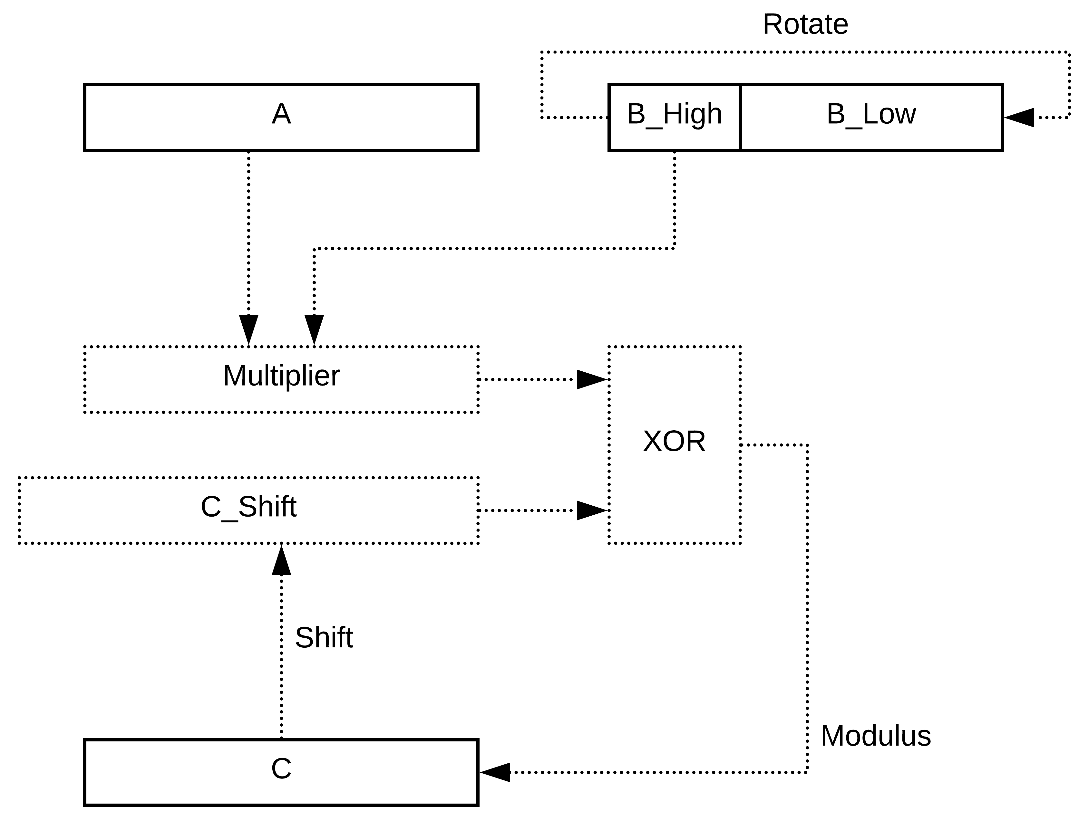
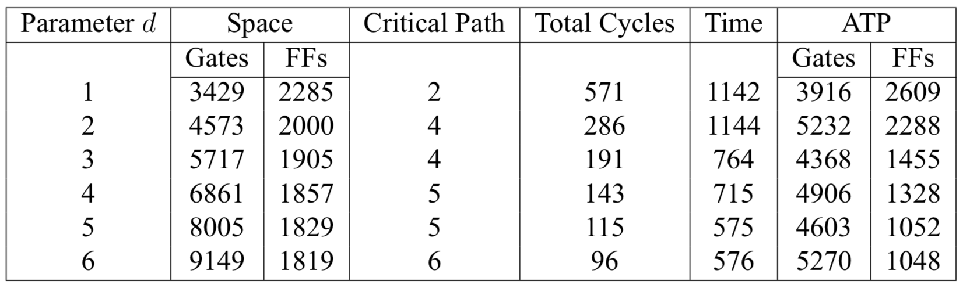
Shift-and-Add (SAA)
Notes:
23:00

Slide 17
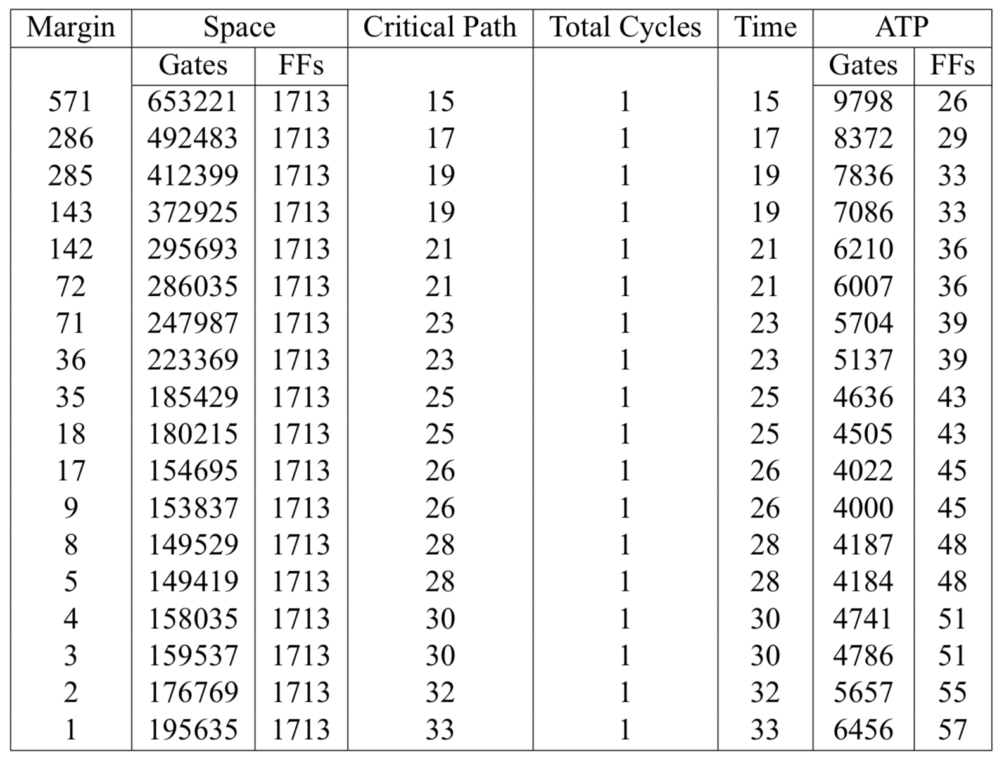
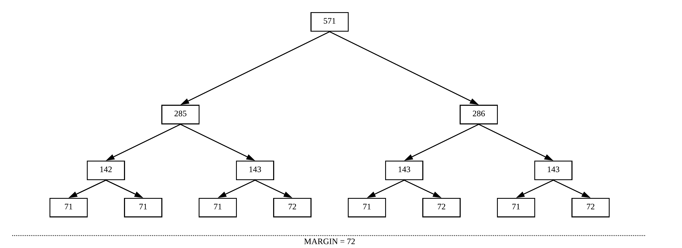
Hybrid-KOA (HKOA)
Notes:
24:30

Slide 18
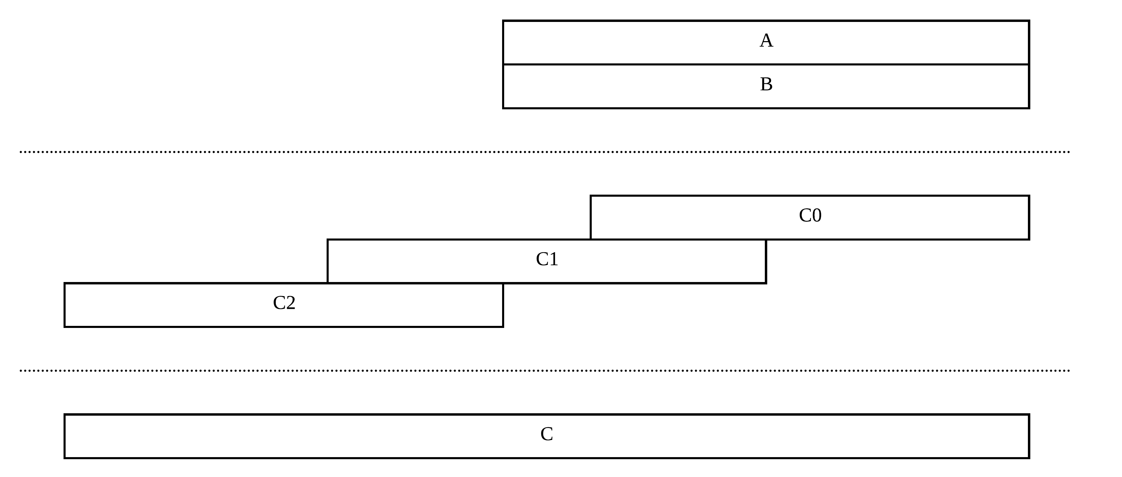
Overlap-Free HKOA (OF-HKOA)
Notes:
26:00

Slide 19


Critical Path Simulator
Define XOR and AND functions
Perform the corresponding Boolean operations
Calculate the corresponding Dijkstra’s steps
Update the global counters
Notes:
Longest Path Problem
28:30

Slide 20
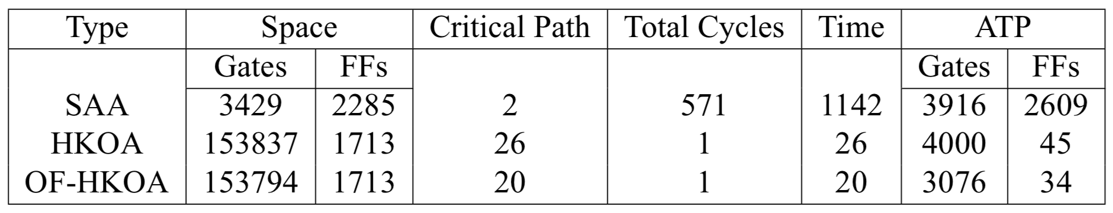
Comparisons among Different Multipliers
Notes:
Theoretical
30:00

Slide 21
Outline
Introduction
Parallelization of Laddering Formulas
Multiplier over Binary Fields
Architecture and Experimental Results
Conclusion

Slide 22
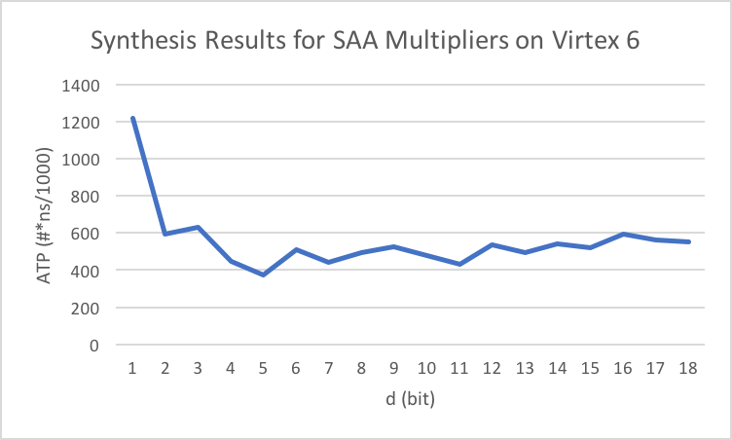
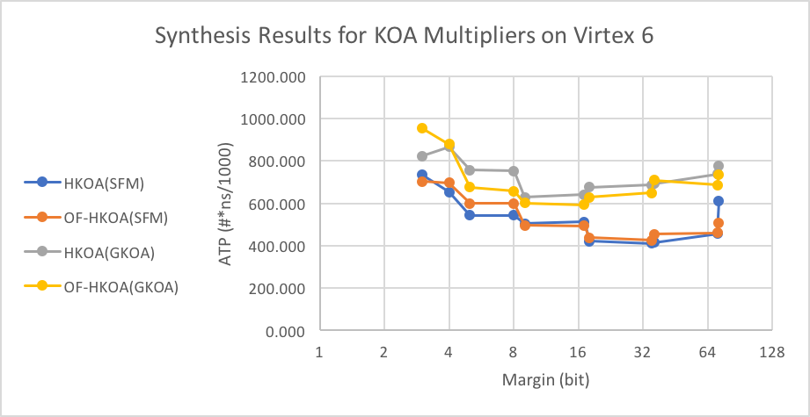
Synthesis Results for Multipliers
Notes:
Experimental
Best Equipment
32:30

Slide 23
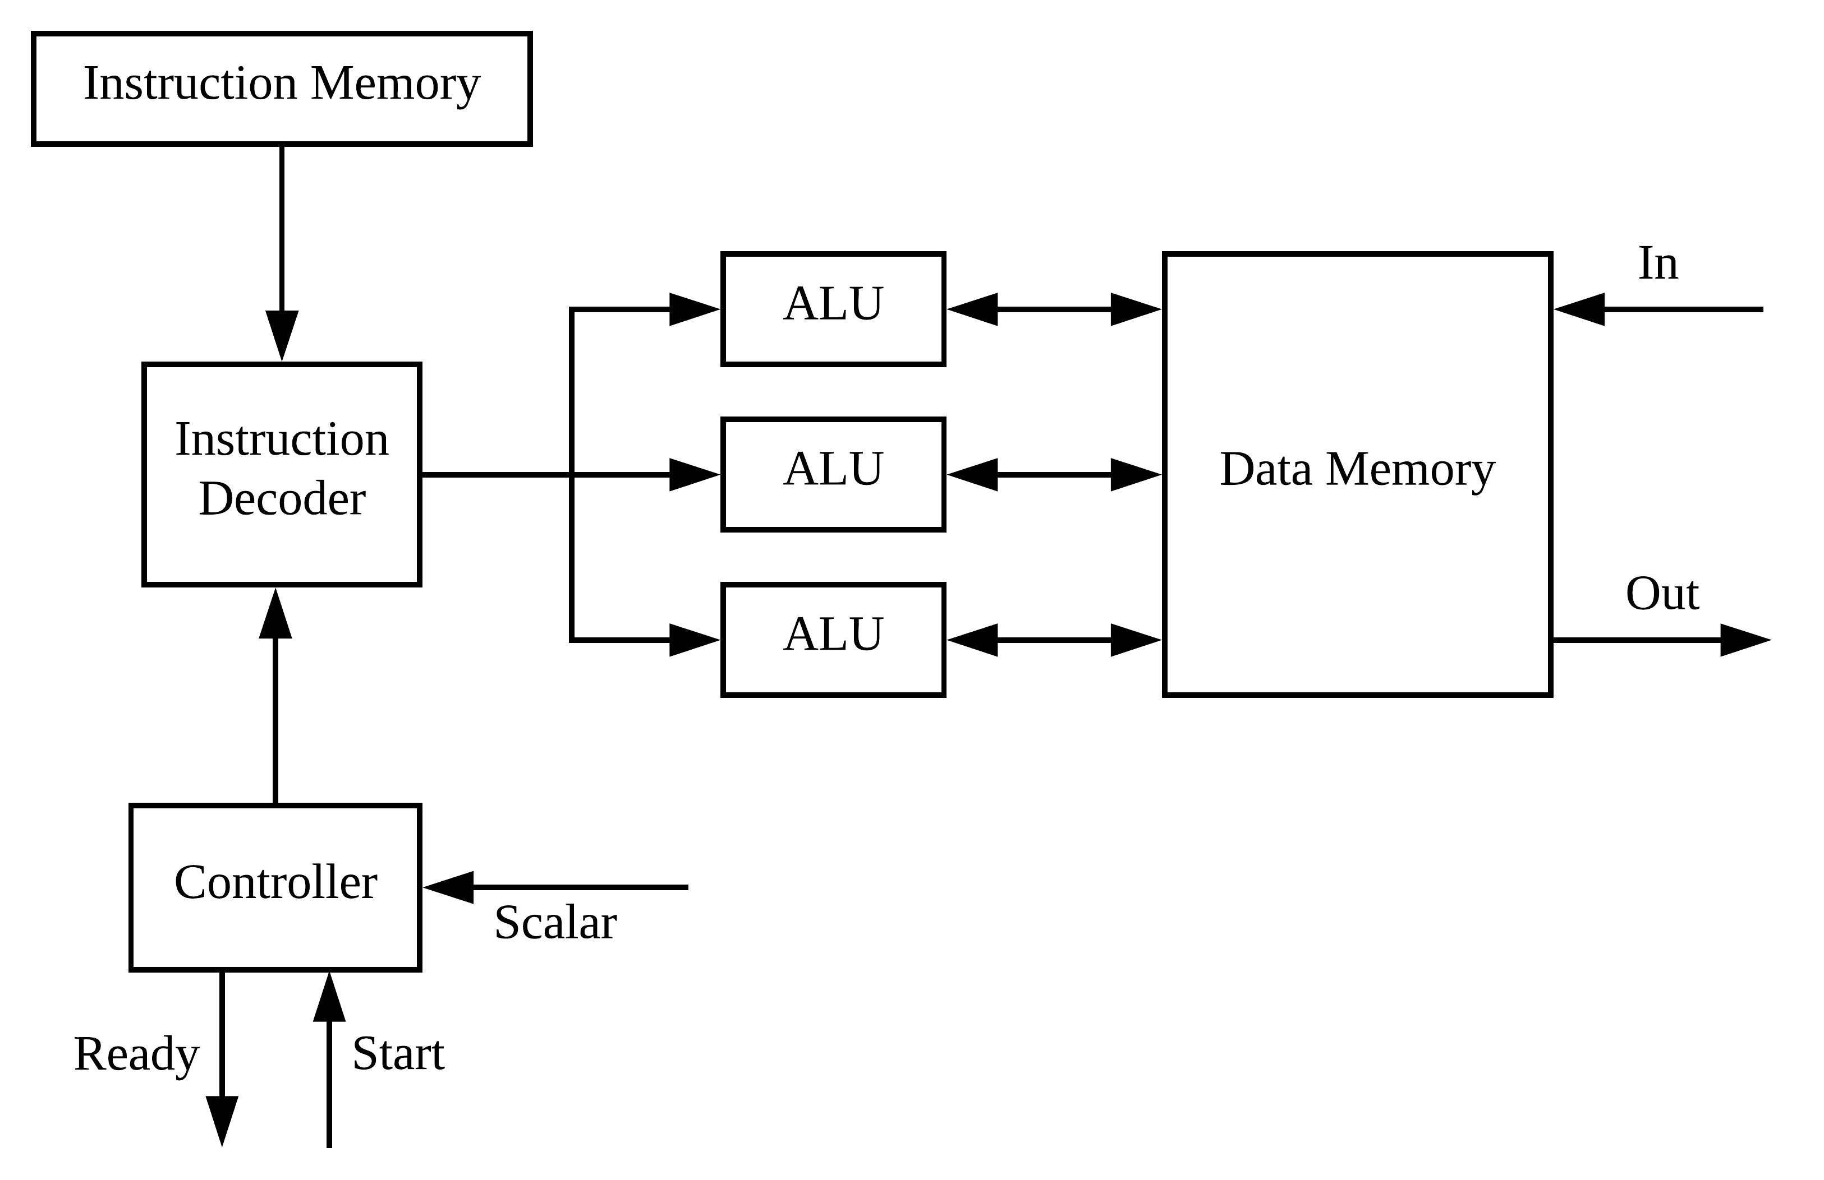
Processor Architecture
Notes:
34:30

Slide 24
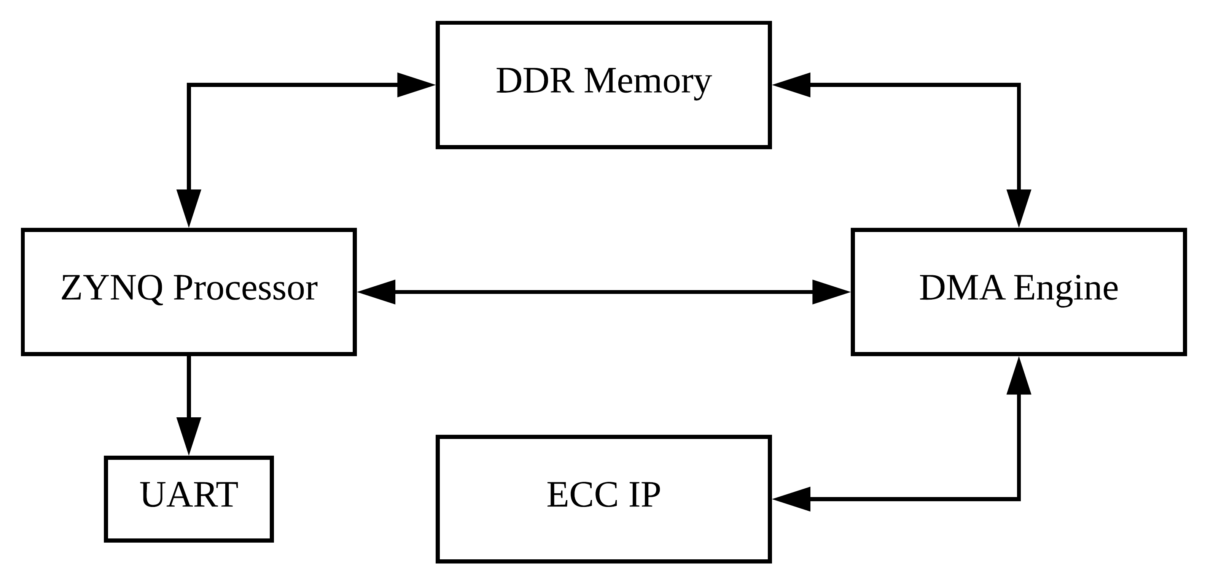
System Architecture
Notes:
Zynq UltraScale+
36:30

Slide 25
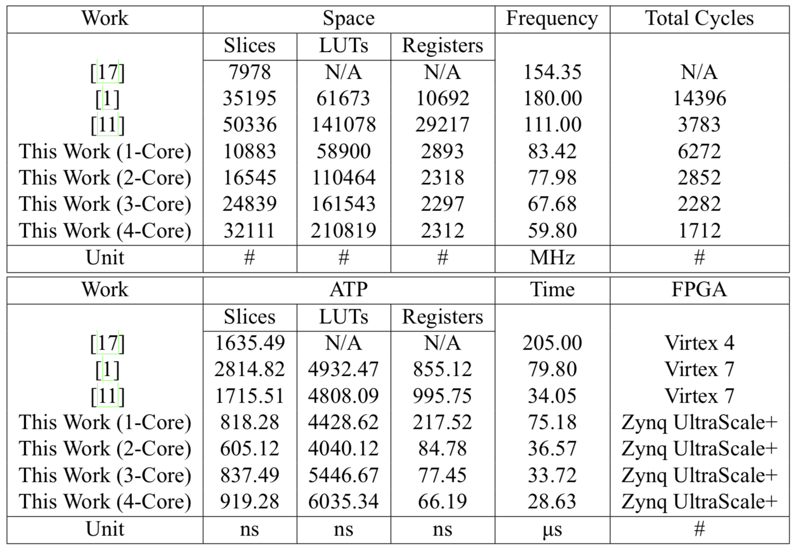
Implementation Results
[1] M. Benaissa et al. Throughput/area-efficient ecc processor using montgomery point multiplication on fpga. IEEE Transactions on Circuits and Systems II: Express Briefs, 62(11):1078–1082, 2015.
[11] Z. U. Khan and M. Benaissa. High-speed and low-latency ecc processor implementation over gf (2 m) on fpga. IEEE Transactions on Very Large Scale Integration (VLSI) Systems, 25(1):165–176, 2017.
[17] K. C. Loi, S. An, and S.-B. Ko. Fpga implementation of low latency scalable elliptic curve cryptosystem processor in gf (2 m). In Circuits and Systems (ISCAS), 2014 IEEE International Symposium on, pages 822–825. IEEE, 2014.
Notes:
40:00

Slide 26
Outline
Introduction
Parallelization of Laddering Formulas
Multiplier over Binary Fields
Architecture and Experimental Results
Conclusion

Slide 27
Conclusion
Feasible for Commercial Use
Most Efficient (2-Core)
Fastest (4-Core)
Our Contributions
Introduce a method to search for optimal laddering formulas
Provide an analysis on different styles of multipliers
Design a compact architecture for our ECC Processor
Future Works
Squares / DPAs / Formula Database
Notes:
Temporary Records
45:00

Slide 28
Thanks for your listening!
Yuan-Che Hsu
Advisor: Chen-Mou Cheng, Ph.D.

