Slide 1









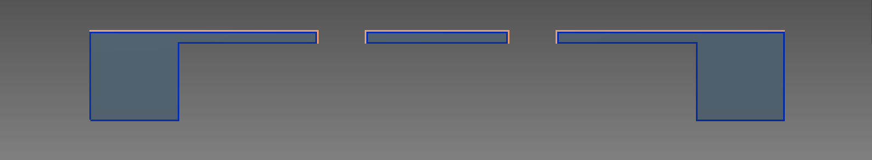




Amateur MEMS: Toward a low-budget microfabrication process
Process Overview
Our Contributions
Step 1: Wafer clean
Step 10: Lithography for through-wafer etch
Step 2: Contact lithography for dicing trench mask
Step 11: HCl etch top hardmask
Step 3: Evaporate ~1000nm Cr for backside hardmask
Step 12: KOH through-wafer etch
Step 4: Lift off backside hardmask
Step 13: Strip hardmask in HCl, grow thermal oxide
Step 5: Evaporate ~1000nm Cr for front hardmask
Step 14: Deposit and pattern metal 1
Step 6: KOH etch trenches ~100 μm
Acknowledgements
Step 7: Lithography for wafer thinning
Step 8: HCl etch bottom hardmask
Step 9: KOH etch for wafer thinning and die separation

