Slide 1



Fend for Yourself! Backdoor Purification in Federated Graph Learning with an Evolving Knowledge Anchor
Chengcheng Zhu¹, Yunlong Mao¹, Jiale Zhang², Bosen Rao², and Sheng Zhong¹
——1 Nanjing University
——2 Yangzhou University
The 35th USENIX Security Symposium
Notes:
Today, I will present our work, "Fend for Yourself! Backdoor Purification in Federated Graph Learning with an Evolving Knowledge Anchor."
In this work, we propose GBHINDER, a trusted-server-free defense framework that enables benign clients to defend themselves against backdoor attacks in federated graph learning.

Slide 2
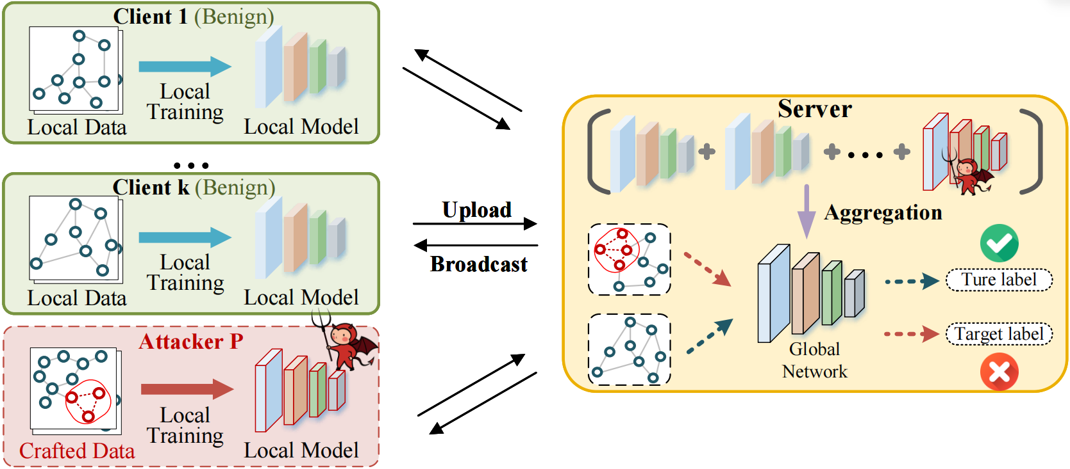

Backdoor Threats in Federated Graph Learning
General FL Methods：The complex topological structures and inherent non-independent and identically distributed characteristics of graph data cause gradients of benign clients to be naturally diverse.
Outlier
Detection
Notes:
Federated Graph Learning enables multiple organizations to collaboratively train graph neural networks while keeping their private graph data locally.
However, the distributed nature of FedGL introduces new security risks, especially backdoor attacks.
In a backdoor attack, malicious clients inject hidden behaviors into the global model.
The model behaves normally on clean inputs, but misclassifies inputs containing specific triggers.
Existing defenses mainly follow two directions.
The first direction directly adapts general federated learning defenses, such as FoolsGold, FLAME, and RLR.
However, graph data introduces unique challenges.
Due to flexible graph topology and inherent non-IID distributions, benign clients naturally produce diverse updates.
Therefore, these methods struggle to distinguish malicious deviations from benign heterogeneity.

Slide 3
Backdoor Threats in Federated Graph Learning
FedGL-specific Defense： GNNCert [CCS'24] sacrifices global context and reduces accuracy; FedTGE [ICLR'25] mainly focuses on node-level features and can be unstable on graph-level tasks.
Notes:
The second direction designs defenses specifically for FedGL.
However, GNNCert sacrifices global graph context and may reduce accuracy, while FedTGE mainly focuses on node-level features and can be unstable for graph-level tasks.

Slide 4

A Common Bottleneck: Trusted Server Dependency
Existing FedGL defenses remain fundamentally anchored to server-side orchestration.
Can we design a defense mechanism that does not depend on a trusted server?
Notes:
Despite their different designs, these defenses share a common limitation:
They rely on a trusted server to inspect updates or perform robust aggregation.
However, this creates a fundamental conflict with privacy-preserving technologies such as differential privacy and secure multi-party computation, where the server should not access individual client updates.
Therefore, we ask:
Can benign clients defend themselves without trusting the server?

Slide 5



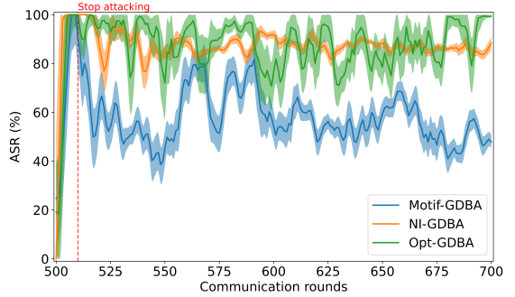
A Paradigm Shift: Fend for Yourself
Server-Side Defense
Client-Side Defense
Challenge 1
Backdoor Invisibility. Backdoors are trigger-free on clean local data. Standard Cross-Entropy loss generates no gradient signal to penalize malicious neurons.
Benign local training can be viewed as backdoor erasure.
Challenge 2
Local Data Insufficiency. Local datasets are too small and heavily biased (non-llD) to overwrite deep-seated, complex trojans.
Notes:
A natural solution is to let each benign client perform local fine-tuning using its clean data.
Intuitively, clean training should gradually overwrite malicious behaviors.
However, our analysis shows that this simple approach is insufficient due to two challenges.
First, backdoor invisibility.
Since triggers do not appear in clean local data, the standard cross-entropy loss provides no gradient signal to suppress malicious neurons.
Second, local data insufficiency.
Each client only observes a small and biased view of the global distribution, making it difficult to overwrite deeply embedded trojans.

Slide 6
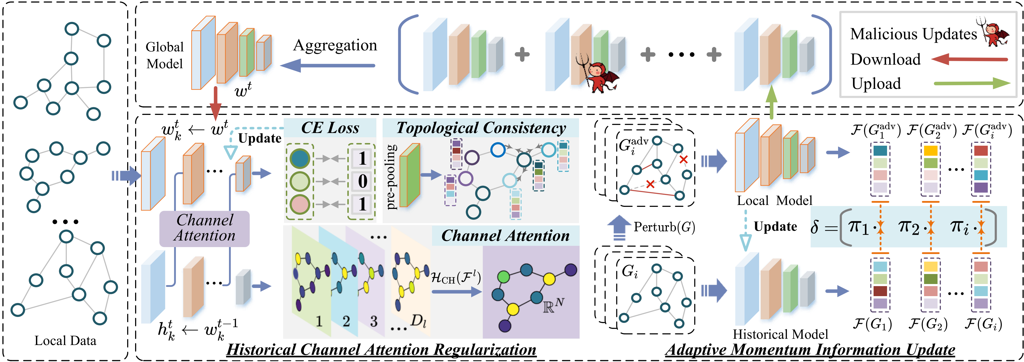
GBHINDER: Client-side Backdoor Purification
A trusted-server-free backdoor defense framework in FedGL
Historical Channel Attention Regularization: use the historical model as a trusted anchor and constrains suspicious representations in the current global model.
Adaptive Momentum Information Update: enable the historical anchor to evolve over time by selectively incorporating robust global knowledge.
Framework of GBHINDER
Notes:
Based on these observations, we propose GBHINDER.
The key idea is to use each client's historical knowledge as a trusted anchor.
GBHINDER creates a self-defense cycle:
the historical model purifies the downloaded global model, and the purified model is then used to update the historical knowledge.
It contains two components:
Historical Channel Attention Regularization and Adaptive Momentum Information Update.

Slide 7

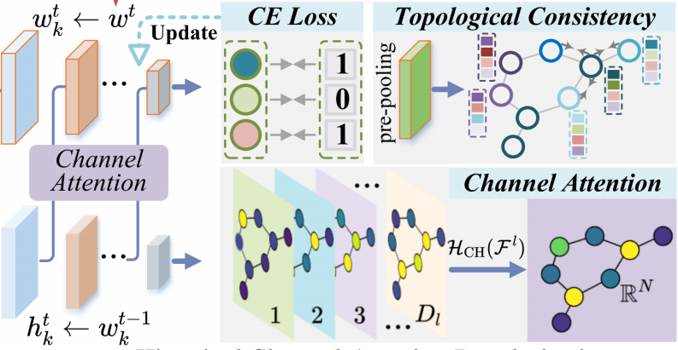


Historical Channel Attention Regularization
Maintain beneficial knowledge
Maintain topological consistency
Disrupting the Amplification Chain
Exposing the Malicious Signature
Use historical local model as a trusted anchor to constrain malicious representations in the global model.
Notes:
The first component is Historical Channel Attention Regularization.
Direct feature matching is insufficient because backdoor models can produce similar representations on clean samples.
Instead, we analyze channel-wise activation patterns, where malicious neurons often leave specific signatures.
By aligning shallow representations from the historical model with deeper representations of the current model, we disrupt the amplification process of backdoor features in GNNs.

Slide 8


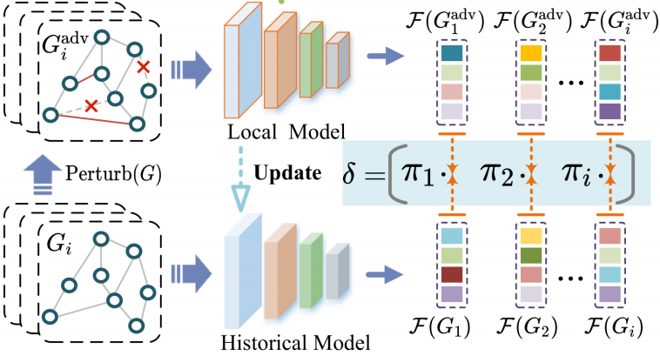

Adaptive Momentum Information Update
Create an adversarial view
Calculate the stability score.
Safely Absorbing Global Knowledge
Notes:
The second component is Adaptive Momentum Information Update.
A static historical model may become outdated under non-IID federated learning.
Therefore, we dynamically update the historical anchor.
We evaluate the stability of the current model under graph perturbations and adaptively balance historical knowledge preservation and global knowledge integration.

Slide 9

Performance of GBHINDER
Dataset
Attack Baselines
NCI1 (4,110 Graphs, 2 classes)
PROTEINS (1,113 Graphs, 2 classes)
DD (1,178 Graphs, 2 classes)
AIDS (2,000 Graphs, 2 classes)
Rand-GDBA
Motif-GDBA
Opt-GDBA (CCS’24)
NI-GDBA (WWW’25)
Defense Baselines
Evaluation Metrics
FoolsGold (RAID’22)
FLAME (Usenix Security’22)
RLR (AAAI’21)
GNNCert (CCS’24)
FedTGE (ICLR’25)
Model Accuracy (ACC)
Attack Success Rate (ASR)
Notes:
We extensively evaluate GBHINDER on four benchmark graph datasets, including NCI1, PROTEINS, DD, and AIDS.
We compare with five state-of-the-art defenses and four representative backdoor attacks.
The main metrics are clean accuracy and attack success rate.

Slide 10
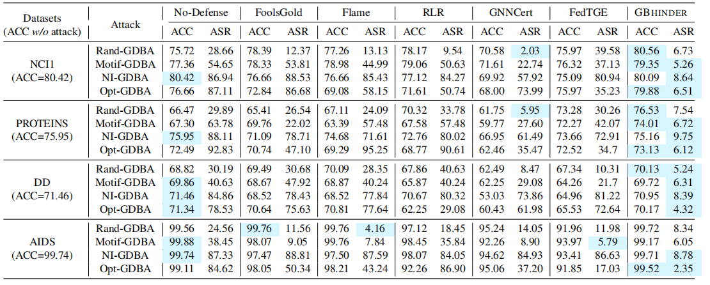
Performance of GBHINDER
Main Comparison Results
Performance comparison between GBHINDER and SOTA defense methods.
Across different datasets and attacks, GBHINDER consistently reduces attack success rates below 10%.
Notes:
The results demonstrate that GBHINDER significantly outperforms existing defenses.
Across different datasets and attacks, GBHINDER consistently reduces attack success rates below 10% while maintaining high main-task accuracy.
For example, against the strong NI-GDBA attack on NCI1, GBHINDER reduces ASR from 86.94% to only 8.64%.

Slide 11
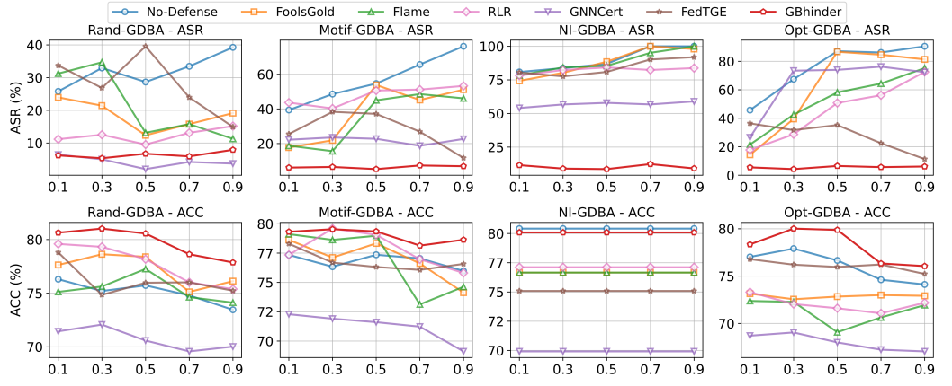
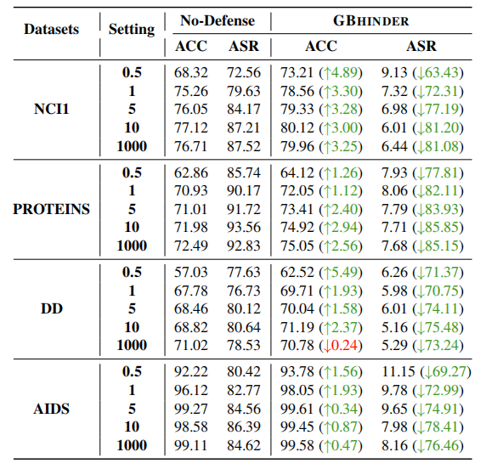
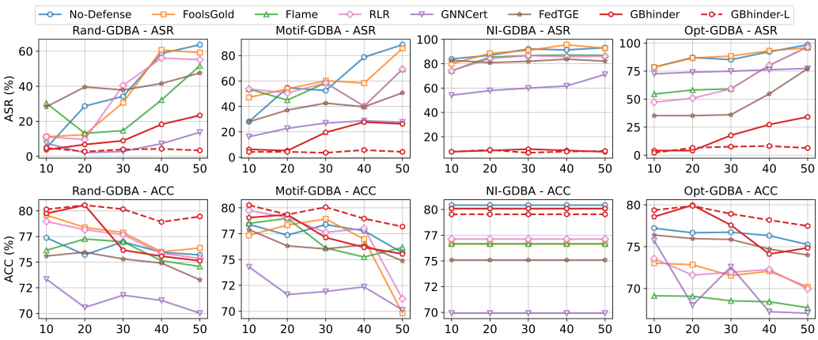
Performance of GBHINDER
Robust to Different Attack and FL Settings
Performance under different poisoning ratios.
Impact of non-IID data distributions.
Performance under a varying ratio of malicious clients.
Notes:
We further evaluate GBHINDER under different attack settings, federated configurations, and non-IID scenarios.
The results show that GBHINDER remains robust under different malicious ratios, poisoning ratios, and graph distributions.

Slide 12
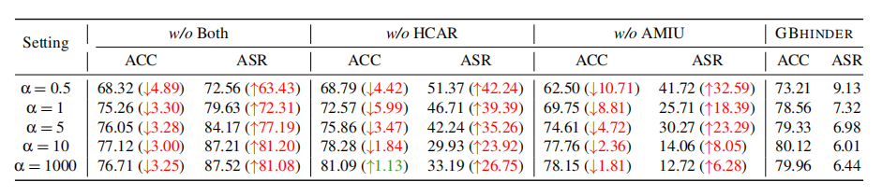
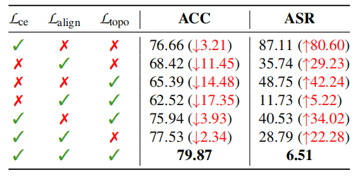
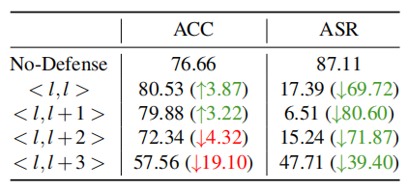
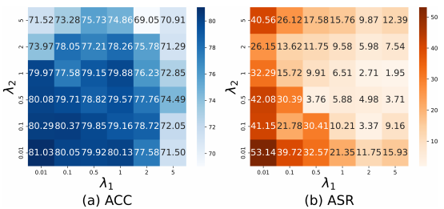
Performance of GBHINDER
Parameter Sensitivity and Ablation
Different components
Different loss terms.
Layer alignment strategies
Balance of λ1 and λ2.
Notes:
Ablation studies also confirm that both proposed components are important for achieving effective purification and stable collaboration.

Slide 13
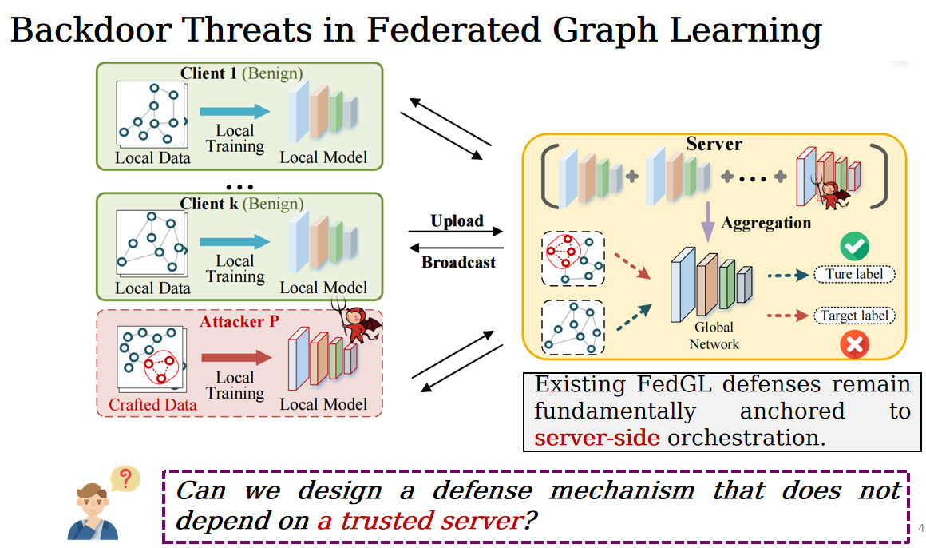
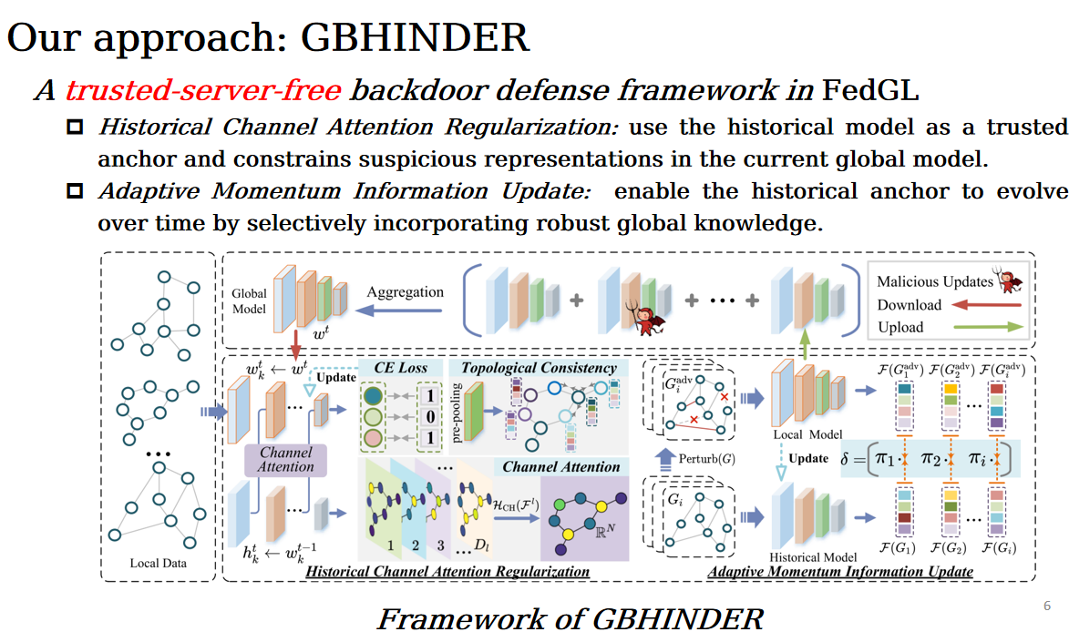
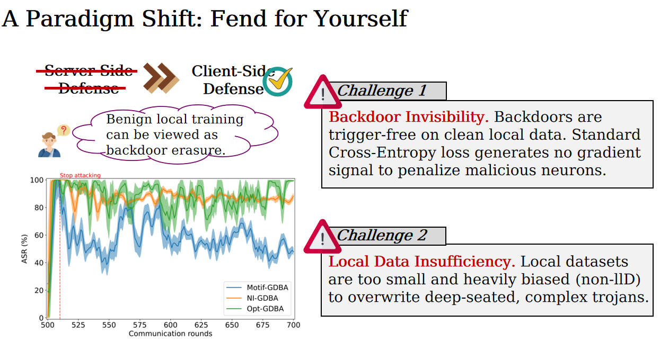
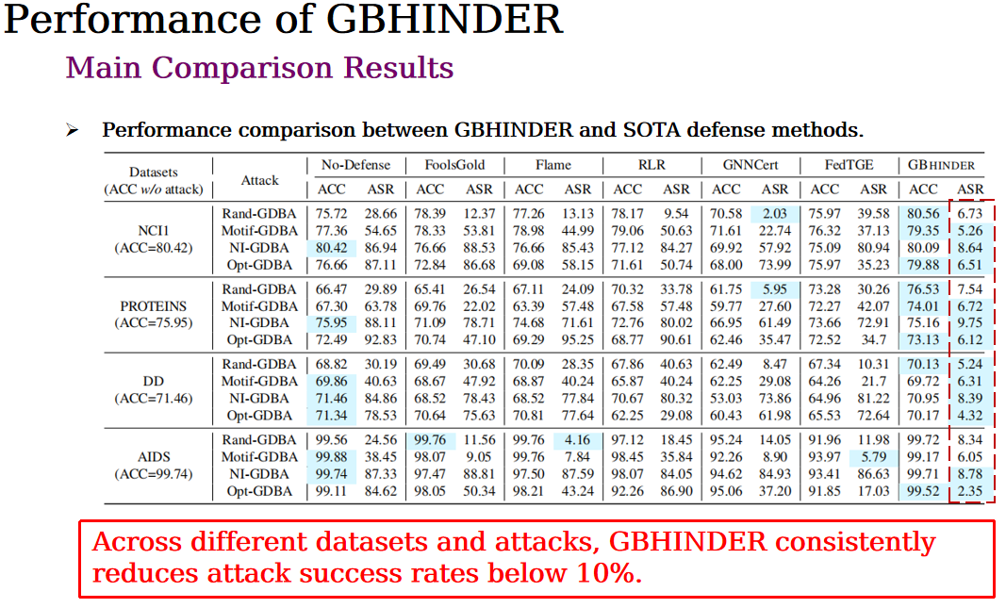
Conclusion
Notes:
In summary, we introduce GBHINDER, a new client-centric defense paradigm for federated graph learning.
Instead of relying on a trusted server, GBHINDER enables benign clients to defend themselves using evolving historical knowledge.
Extensive experiments demonstrate strong protection against backdoor attacks while preserving model utility.
Thank you for your attention.

Slide 14



The 35th USENIX Security Symposium
Thanks for listening!
chengchengzhu@smail.nju.edu.cn
https://zenodo.org/records/18402758

