Slide 1
COVERT
Privacy-Preserving Covariant Obfuscation for VLMaaS
via Exact Reparameterization and Tailored Tuning
Wenqiang Ruan*, Zirui Huang*, Yu Lin, Qizhi Zhang, Yunlong Mao, Quanwei Cai, Jue Hong, Sheng Zhong, Ye Wu
ByteDance · State Key Laboratory of Novel Software Technology, Nanjing University
ECCV 2026
Equal contribution
Notes:
Hello everyone. I'm Wenqiang Ruan from ByteDance. Today I'll present COVERT, the first practical privacy-preserving inference framework for Vision-Language Model-as-a-Service. This is joint work with Nanjing University.

Slide 2
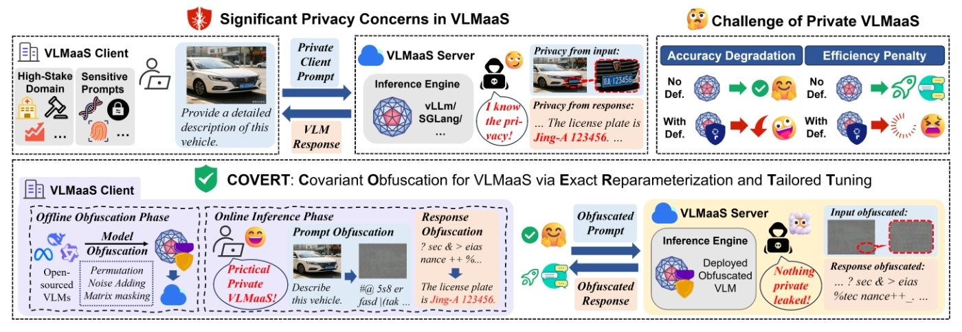
01
2 / 7
Background: Privacy Risks in VLMaaS
Challenge 1
Challenge 2
Challenge 3
Visual Overhead
Cross-Modal Noise Sensitivity
Architectural Heterogeneity
High-dimensional continuous inputs make MPC/TEE prohibitively expensive for real-time deployment.
Differential Privacy noise disrupts delicate vision-language alignment, causing catastrophic utility loss.
Text-only obfuscation does not transfer to vision encoders with convolutions and spatial priors.
Notes:
In VLMaaS, clients send sensitive images to cloud VLMs. The honest-but-curious server can invert raw images from intermediate features. Existing defenses face three fundamental challenges: cryptographic methods like MPC are too slow for visual data, differential privacy destroys cross-modal alignment, and text-only methods don't transfer to vision architectures.

Slide 3
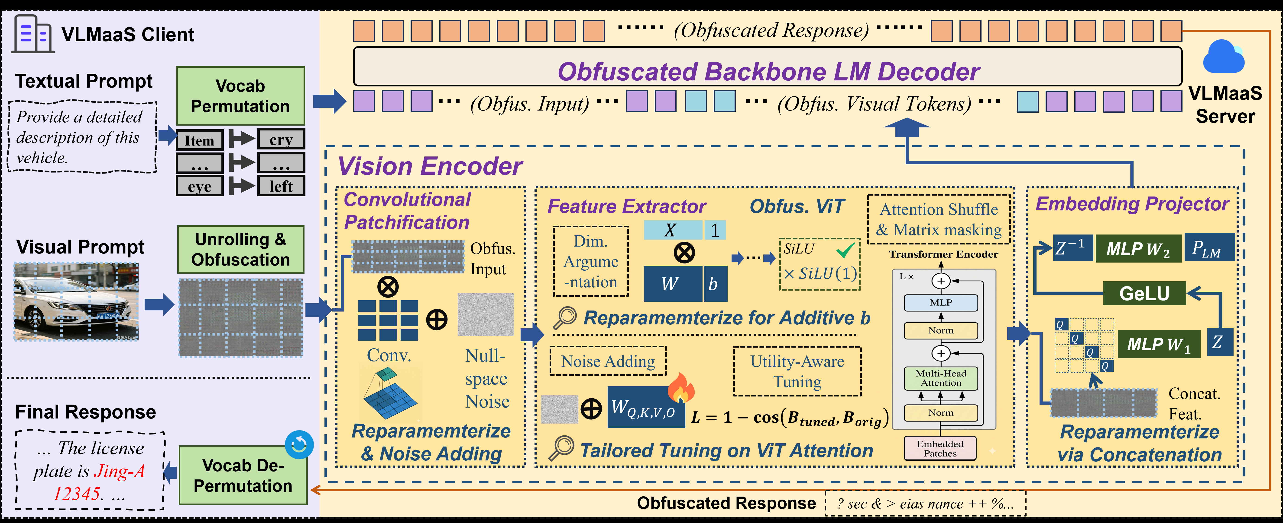
02
3 / 7
The COVERT Framework
Key idea: Jointly obfuscate client prompts and model parameters via modality-adaptive covariant transformations — exact cancellation preserves utility, while dimension expansion and noise prevent inversion.
Notes:
Here's the COVERT framework. The client performs offline obfuscation: permuting text tokens, and applying tailored transformations to the vision encoder — convolutional patchification, ViT feature extraction, and the MLP projector. During online inference, the server runs the obfuscated model on obfuscated inputs. The transformations are designed to exactly cancel out, preserving accuracy, while dimension expansion and injected null-space noise prevent the server from inverting the raw images.

Slide 4
03
4 / 7
Technical Approach
Exact Architectural Reparameterization
Utility-Aware Parameter Tuning
Adapting covariant obfuscation to every visual module
Defending against hidden-state inversion attacks
Convolutional Patchification
Vulnerability
Vectorize 3D conv as matrix multiply; inject null-space noise that is exactly canceled by paired weight transform (zero error).
Shallow ViT attention layers preserve spatial priors — adaptive attackers can reconstruct raw images (e.g., license plates).
ViT Feature Extraction
Defense
Handle pervasive additive biases: absorb into augmented weights, direct bias masking for output projection, SiLU(1) scaling for FFN gating.
Inject seeded Gaussian noise into first ViT block attention (W_Q, W_K, W_V, W_O), then fine-tune to align hidden states with the original model.
Embedding Projector
Block-diagonal inverse via Kronecker product neutralizes concatenated feature masks; hidden-layer permutation aligns with obfuscated LLM.
L = 1 - cos( B_tuned(x), B_orig(x) )
Only ~4M trainable params; 1.5h on one GPU. Private seed makes the exact trajectory irreproducible to attackers.
Notes:
COVERT has two key technical components. First, exact architectural reparameterization: we vectorize convolutions as matrix multiplications and inject null-space noise that cancels exactly, handle additive biases in ViT through weight absorption and masking, and use Kronecker products for the MLP projector. Second, utility-aware tuning: shallow ViT attention layers leak spatial information, so we inject seeded noise into the first block and fine-tune to maximize cosine similarity with original hidden states. This requires only 4 million parameters and 1.5 hours on a single GPU.

Slide 5
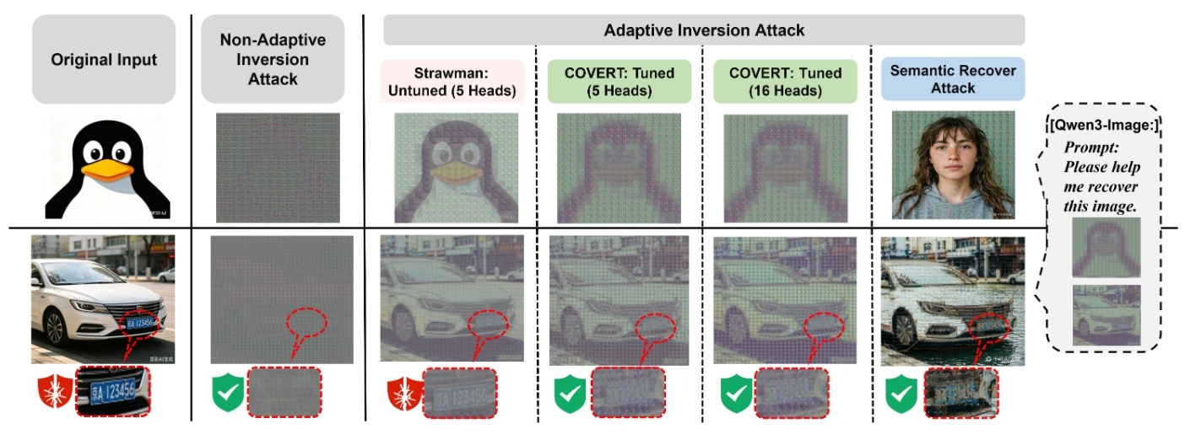
04
5 / 7
Privacy: Defense Against Inversion Attacks
Fig. 3: Non-adaptive inversion yields noise; untuned strawman leaks sensitive details; COVERT conceals all visual privacy even under 16-head adaptive attacks.
-54.46%
+39.75%
0.1550
SSIM reduction at Layer 1
MSE increase at Layer 1
SSIM aligned with deep layers
Notes:
Here are the privacy results. On the left, non-adaptive inversion produces pure noise. But under adaptive attacks, the untuned strawman leaks sensitive details like license plates. COVERT with tailored tuning completely prevents this leakage, even when the attacker brute-forces 16 attention heads. Semantic recovery using commercial models also fails completely. Quantitatively, tailored tuning reduces SSIM at the vulnerable Layer 1 by 54 percent to 0.155, matching the security level of naturally safe deeper layers, while MSE increases by 40 percent.

Slide 6
05
6 / 7
Utility and Efficiency
< 3%
< 6%
Average Accuracy Degradation
Throughput Overhead on vLLM
Across 5 benchmarks (VQA, reasoning, science, math) on Qwen2.5-VL (7B/32B/72B), MiMO-7B, Fara-7B. Larger models are more resilient: 2.58% (7B) to 1.83% (32B).
TTFT +0.86%, TPOT +8.65%, throughput -5.93%. Communication reduced to 1.30x with 64-bin quantization. Seamlessly inherits KV-cache and parallel decoding.
Comparison with Baselines
Method
Utility
Efficiency
Privacy
COVERT (Ours)
< 3% drop
< 6% overhead
Robust
DP-Forward [9]
Collapses to ~0%
Lightweight
Strong (but useless)
PrivMLLM [32] (MPC)
Near-lossless
5+ min, 2.69 GB / req
Strong
COVERT is the only approach achieving all three: robust privacy, preserved utility, and real-time efficiency.
Notes:
On utility, COVERT keeps average accuracy degradation below 3 percent across five benchmarks and model sizes from 7B to 72B. Interestingly, larger models are more resilient — the 32B model drops only 1.83 percent. On efficiency, the throughput overhead is under 6 percent on vLLM, with TTFT increasing by less than 1 percent. Compared to baselines, DP-Forward completely destroys accuracy even at relaxed privacy budgets, while MPC-based PrivMLLM requires over 5 minutes and 2.69 gigabytes per request. COVERT is the only approach that achieves all three goals simultaneously.

Slide 7

06
7 / 7
Conclusion
1
First practical privacy-preserving VLM inference framework
Modality-adaptive covariant obfuscation paradigm bridging cross-modal structural heterogeneity between vision encoders and LLM backbones.
2
Exact reparameterization + utility-aware tailored tuning
Zero-error obfuscation across convolutions, ViT, and MLP projector; seeded noise tuning defends high-fidelity hidden-state inversion attacks.
3
Favorable privacy-utility-efficiency trade-off
Robust privacy against spatial reconstruction with under 3% accuracy degradation and less than 6% inference overhead on vLLM.
Thank You
COVERT: Privacy-Preserving Covariant
Obfuscation for VLMaaS
Questions and discussion welcome
ECCV 2026
Notes:
To conclude, COVERT makes three contributions: it is the first practical privacy-preserving VLM inference framework, it introduces exact architectural reparameterization combined with utility-aware tailored tuning, and it achieves a favorable trade-off with under 3 percent accuracy loss and under 6 percent overhead. COVERT bridges the gap between robust privacy protection and real-world VLMaaS deployment. Thank you for your attention, and I welcome your questions.

