Slide 1
When and Where You Nudge Matters:
Multi-Step Interface Interventions Against Address Poisoning in Crypto Wallets
Yuqi Xu¹，Maggie Yongqi Guan², Yunlong Mao¹, Wei Tong¹, Sheng Zhong¹,
Xiaobo Zhou², Kanye Ye WANG²
¹ Nanjing University ² University of Macau
Speaker: Yuqi Xu
Email: dz20330035@smail.nju.edu.cn
Notes:
Hello, everyone.
My name is Yuqi Xu, from Nanjing University.
Today I’m going to present our work, “When and Where You Nudge Matters: Multi-Step Interface Interventions Against Address Poisoning in Crypto Wallets.”

Slide 2





Background
How address poisoning works in Crypto Wallets ?
Multi-stage flow of address poisoning
Step1: Identifying the Victim
Txhash
From
To
Amount
0x79b2669...
0xf181...52d3
0x5f66...45d1
-1000 USDC
Attacker
Victim V
monitor
select victim
（0xf181...52d3）
( Previously transacted with address
0x5f66b88782c133
eb23c7dd9257a7861e635a45d1 )
on-chain activity
Notes:
Let me first briefly explain how address poisoning works in Crypto Wallets.

Slide 3
Background
Multi-stage flow of address poisoning
Step1: Identifying the Victim on blockchain
Txhash
From
To
Amount
0x79b2669...
0xf181...52d3
0x5f66...45d1
-1000 USDC
Attacker
Victim V
monitor
select victim
（0xf181...52d3）
( Previously transacted with address
0x5f66b88782c133
eb23c7dd9257a7861e635a45d1 )
on-chain activity
Notes:
First, attackers monitor on-chain activity and identify potential victims.

Slide 4
Background
Multi-stage flow of address poisoning
Step2: Generating the Attack Address
Victim V
（0xf181...52d3）
( Previously transacted with address
0x5f66b88782c133
eb23c7dd9257a7861e635a45d1 )
generate
attack address
0x5f66ba543b8731fc8
e7a5075891d5e8c2b7845d1
Attacker
Notes:
Second , they generate a look-alike address, as shown here, with the same prefix and suffix as the legitimate recipient address of the victim.

Slide 5
Background
Multi-stage flow of address poisoning
Step3: Interacting with the Victim to Poison the History
V’s Wallet Interface
History
xx/xx/2025
inject the malicious address to history (initiating a transaction)
Receive
+0.0001 USDC
From 0x5f66...45d1
Attacker
Send
To 0x5f66...45d1
-1000 USDC
Notes:
The attacker then sends a small-value tranfer to the victim to inject the malicious address to history
.Because wallets interfaces will shorten long addresses, the malicious and legitimate addresses look identical in the transaction history.

Slide 6

Background
Multi-stage flow of address poisoning
Step4: Victim Sends Funds to the Attack Address
V’s Wallet Interface
Trasnsaction detailed page
I want to transfer to 0x5f66...45d1 again
√ +0.0001 USDC
History
Address copied!
xx/xx/2025
From
0x5f66ba543b8731fc8e7a5075891d5e8c2b7845d1
click
Receive
+0.0001 USDC
From 0x5f66...45d1
To
0xf181763259db994485283ab795448b937ece52d3
browse
transaction history
Send
To 0x5f66...45d1
-1000 USDC
Victim V
......
（0xf181...52d3）
( Previously transacted with address
0x5f66b88782c133
eb23c7dd9257a7861e635a45d1 )
transfer funds
to the attacker
paste the malicious address and initiate a transfer
Notes:
Later, when victims wants to transfer funds to their friend again, for convenience, they may browse their transaction history but open the poisoning transaction, copy the malicious address, and finally send funds to the attacker.

Slide 7
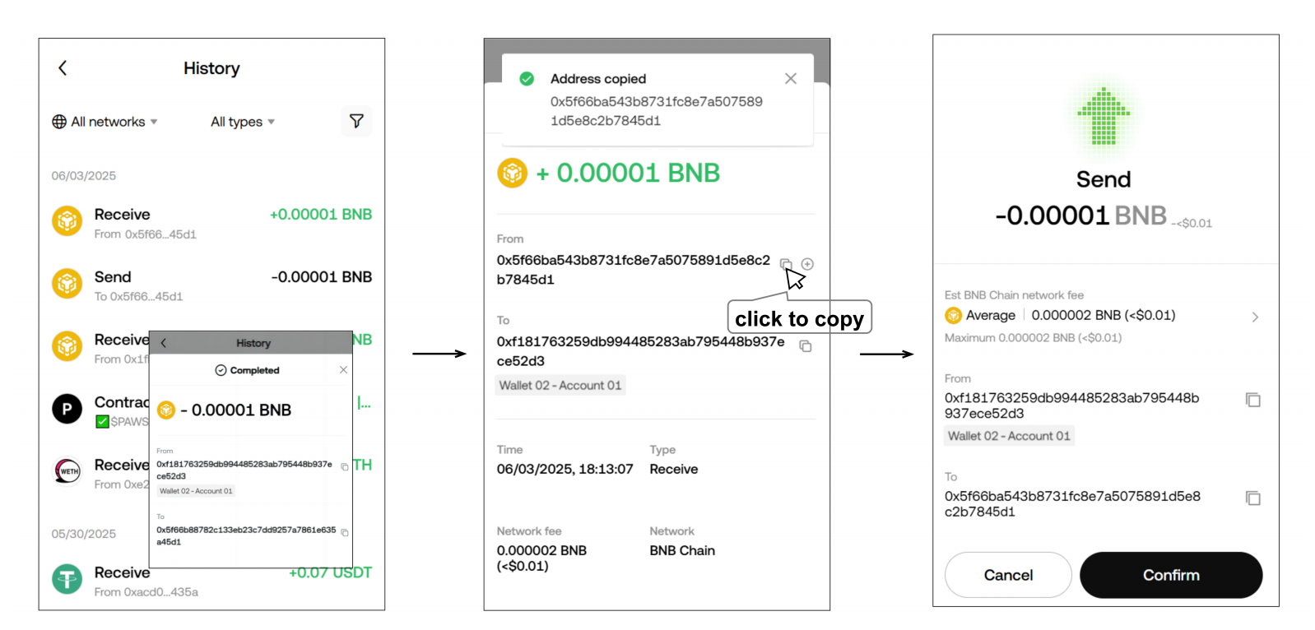
Background
Each action looks routine
1. browsing transaction history
2. Selecting a recipient address
3. Confirming a transfer
Notes:
So What is important here is that each action looks routine.
The user just browses transaction history, copies an address, and confirms a transfer.
No single action looks suspicious.
But together, they cause a fund loss.

Slide 8

Motivation and Research Gap
Detection ≠ Protection
Existing work has focused on detecting attacks and measuring their impact.
Limited attention to user-facing interface defenses
explore
Simply blocking a suspicious address
user-facing interface defenses
Notes:
Howeverm, existing work on address poisoning has focused on detecting attacks.
But detection not means protection, because detection may produce false positives, and users may still have legitimate reasons to interact with suspicious addresses.
So instead of Simply blocking a suspicious address, we explore user-facing interface defenses.

Slide 9
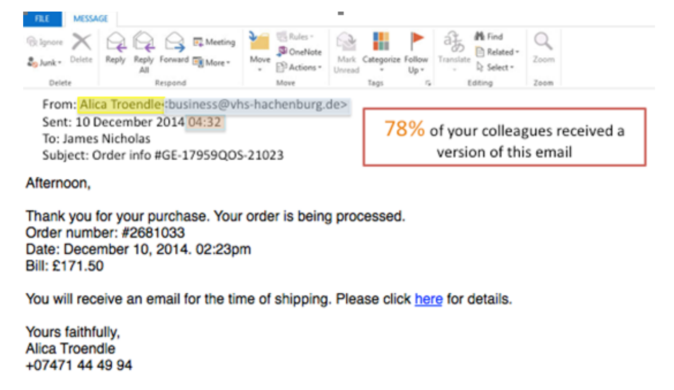


Nudge Interventions
subtle prompts and cues
shape safer behavior
Nudge Interventions
Behavior Change
Notes:
This motivates us to use nudge interventions. which use subtle prompts and cues to shape users’safer behavior, without taking away uses’ freedom to choose.

Slide 10
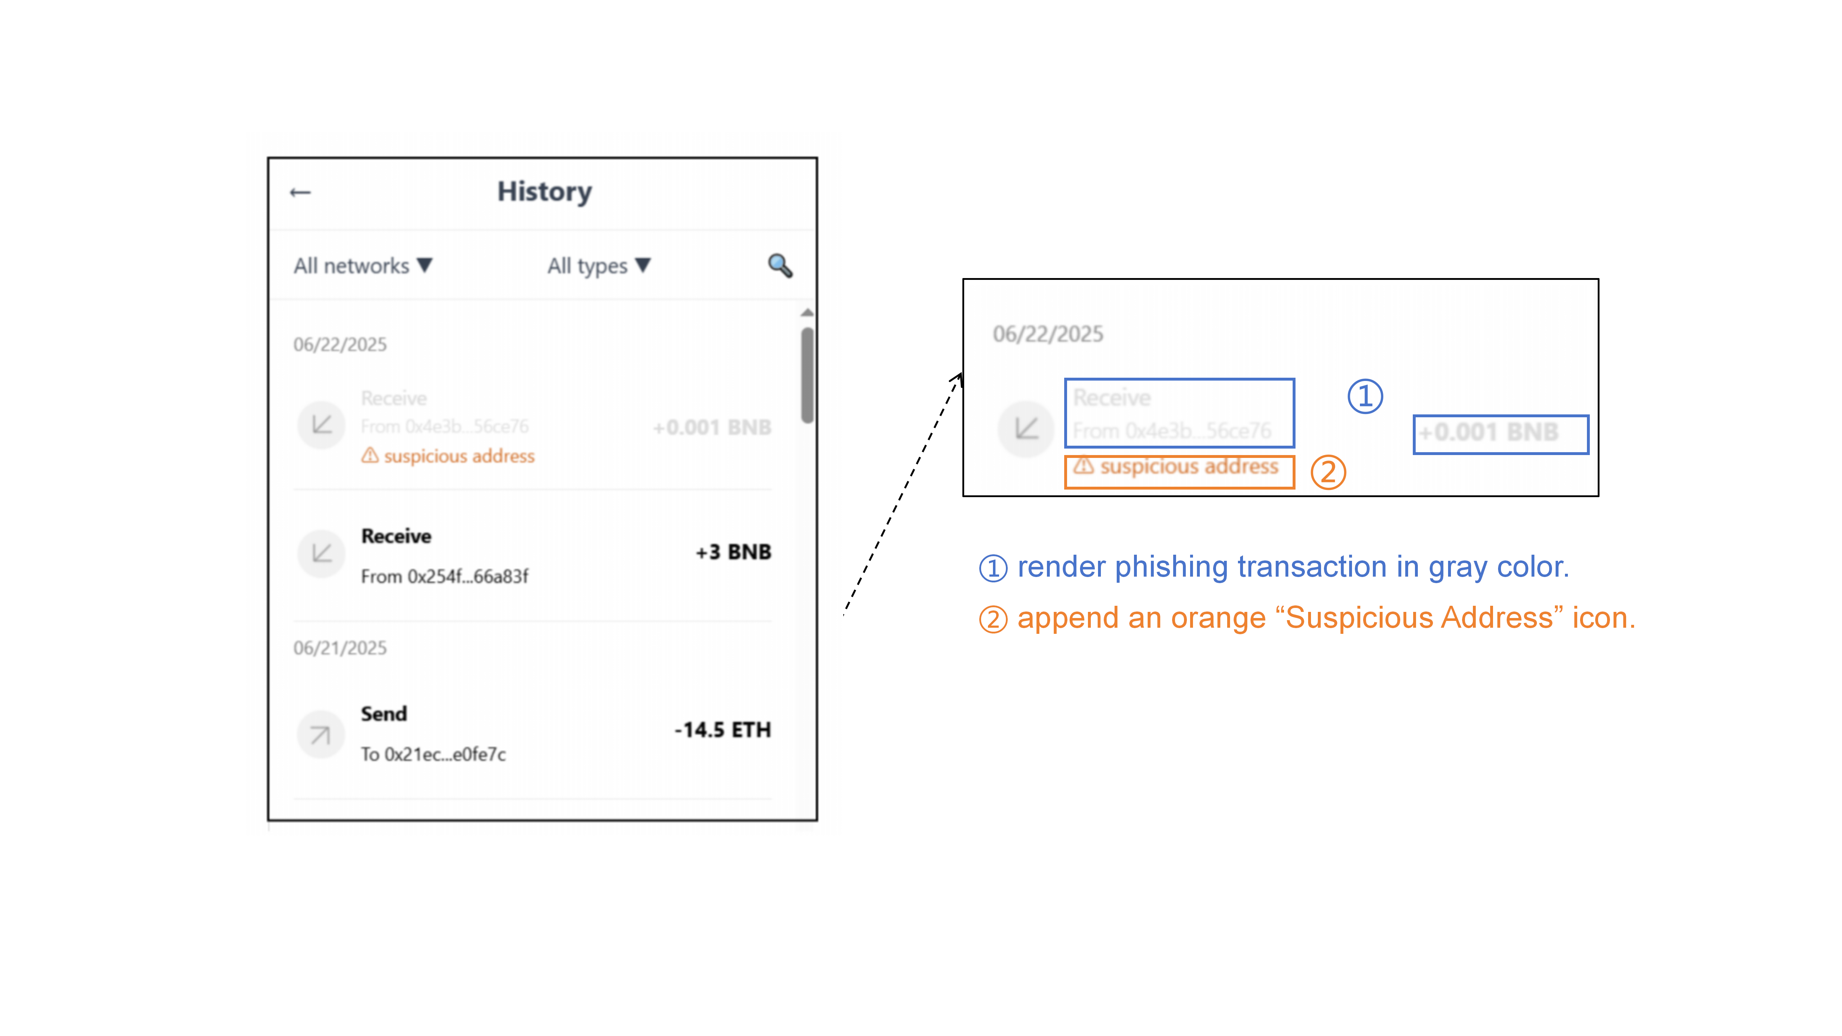
Three Interface Interventions for Each Steps.
Nudge 1 — Visual Suppression -- transaction-selection step
Grayed-out suspicious transactions redirect attention away.
Notes:
based on this , We design three interface interventions for each steps.
The first intervention is Visual Suppression, at the transaction-selection stage.
Suspicious transactions will be grayed out to redirect users’ attention away from the suspicious address.

Slide 11
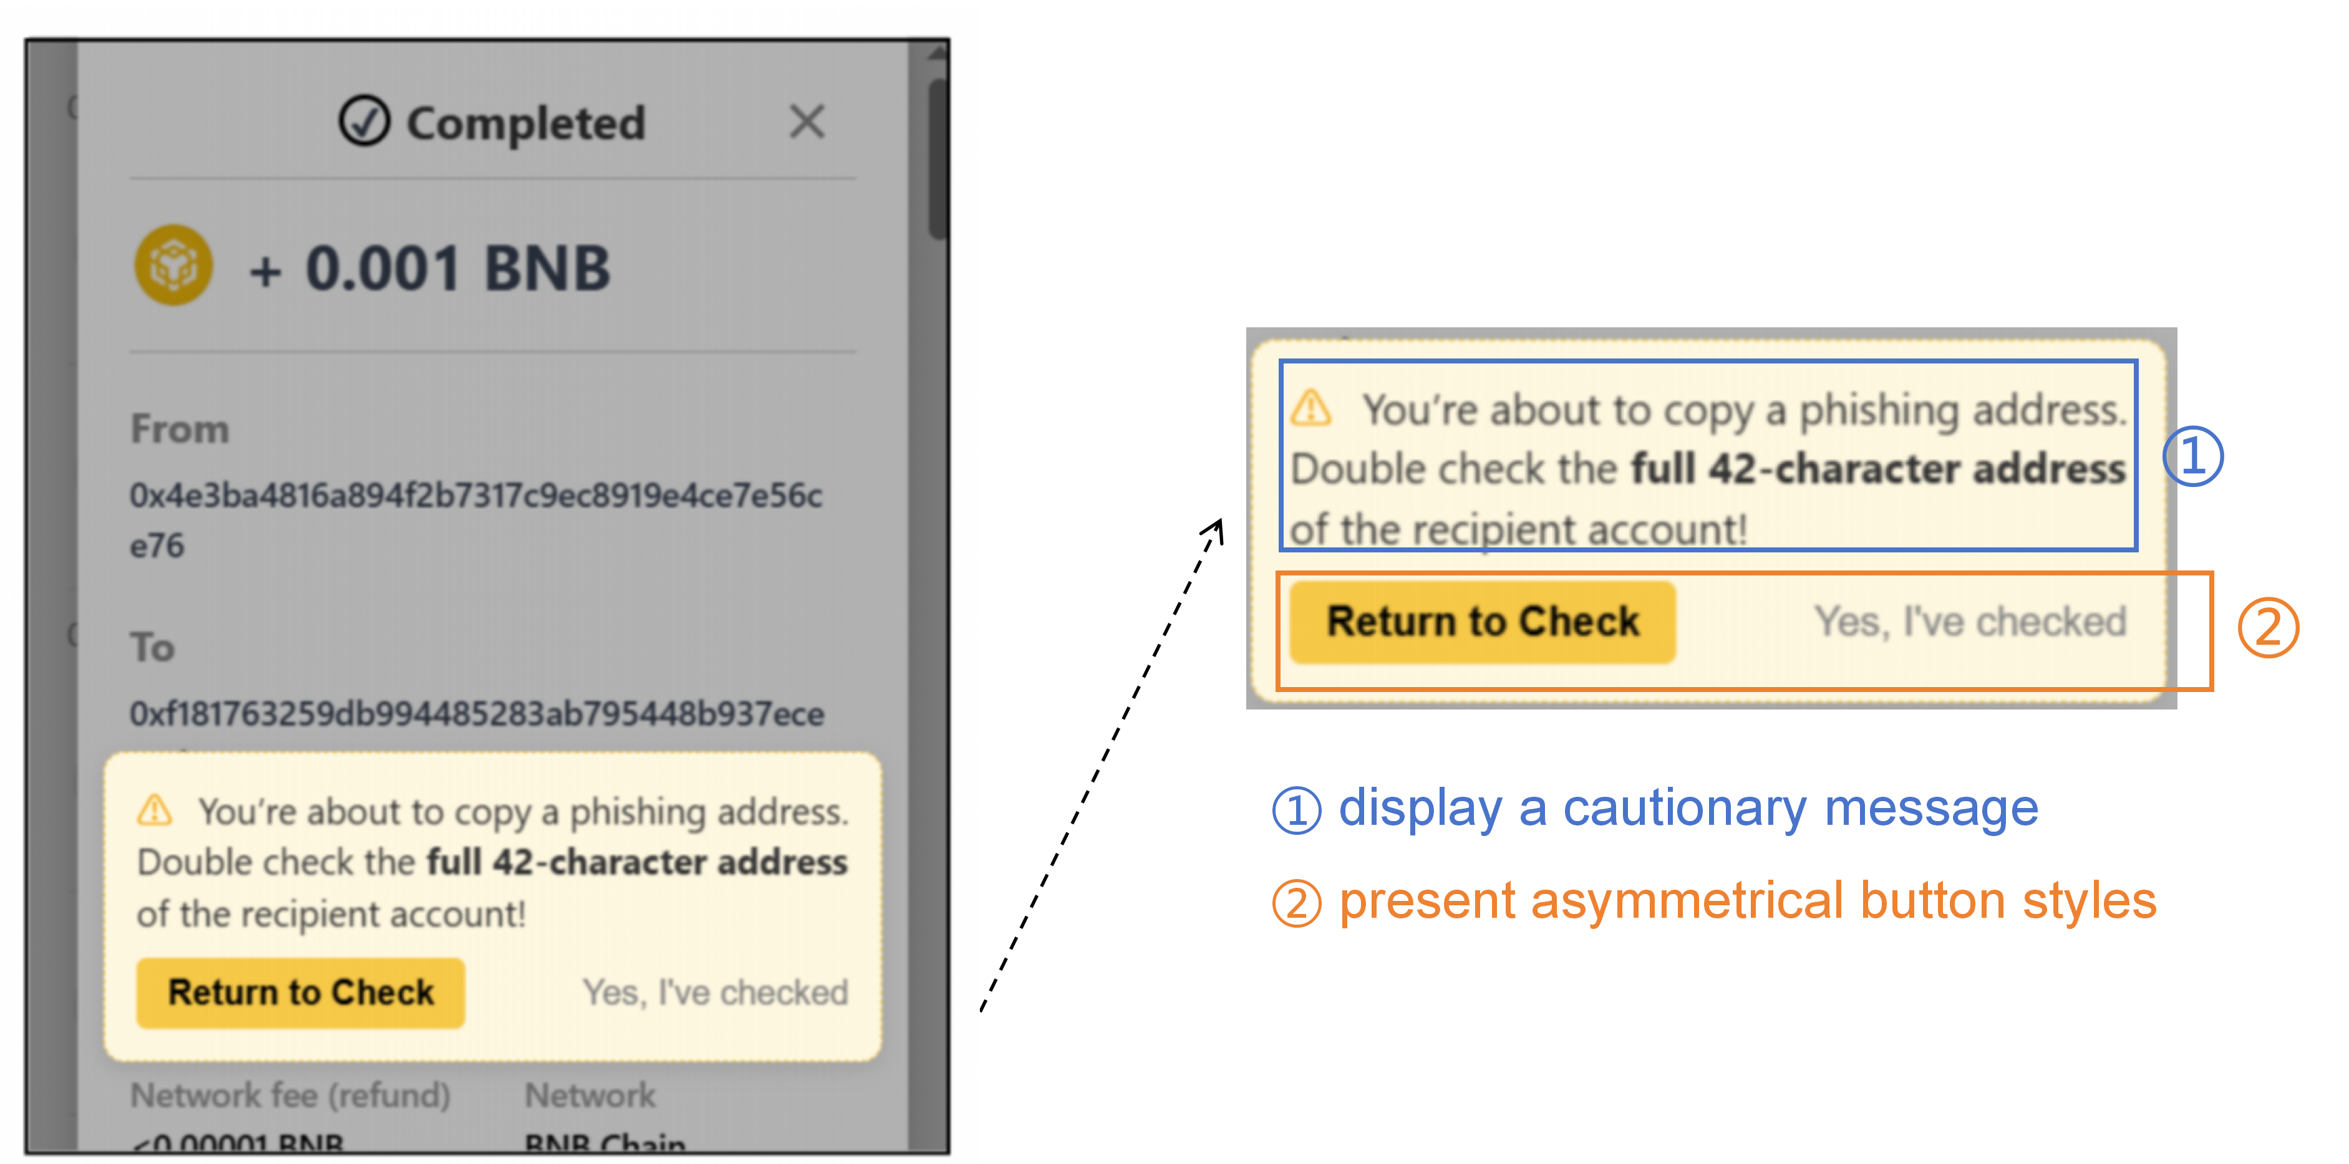
Three Nudges We Designed
Nudge 2 — Copy Warning -- address-copying step
When users try to copy a suspicious address, a warning will ask them to return and verify the full address.
Notes:
The second is Copy Warning.
When users try to copy a suspicious address, a warning will ask them to return and verify the full address.

Slide 12
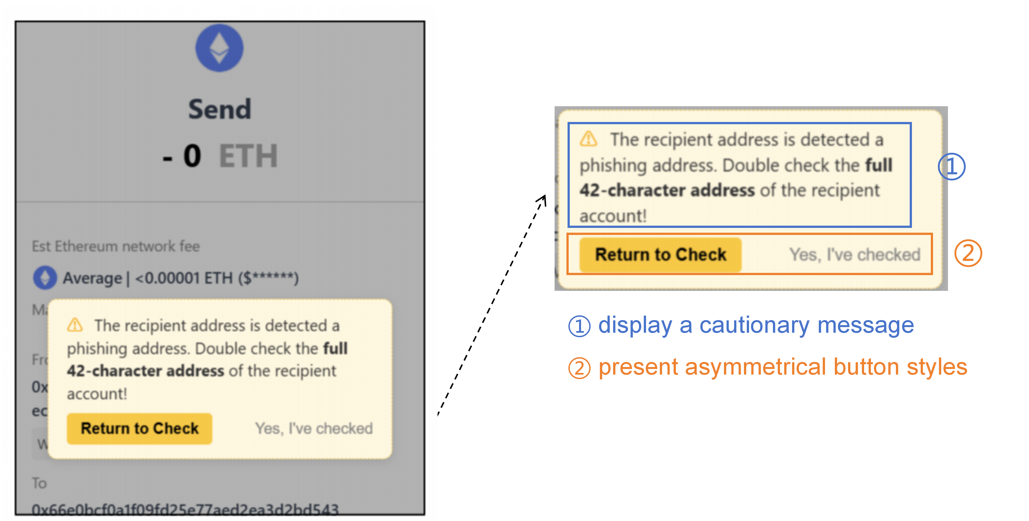
Three Nudges We Designed
Nudge 3 — Confirmation Disruption -- transfer-conformation step
when users try to submit a transfer to a suspicious address, the wallet will disrupt the confirmation flow and asks them to recheck the recipient.
Notes:
And the third is Confirmation Disruption.
when users try to submit a transfer to a suspicious address, the wallet will disrupt the confirmation flow and asks them to recheck the recipient.

Slide 13
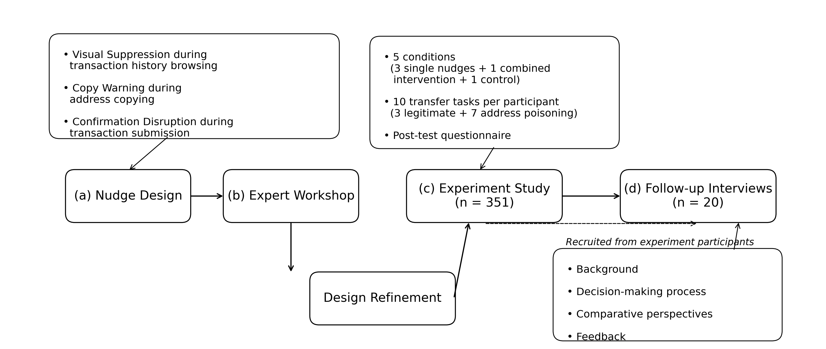
Mixed-methods Approach
Notes:
We evaluated these designs using a mixed-methods approach, including an expert workshop, a between-subjects experiment across five conditions, and follow-up deeply interviews.

Slide 14
Key Findings
Overall effectiveness
Control
23.8%
Copy Warning
41.0%
Confirmation Disruption
62.5%
Combined
91.4%
Visual Suppression
94.0%
All intervention conditions significantly outperformed Control.
Visual Suppression performed best
Notes:
So, did the interventions work?
Yes, but their effectiveness differed strongly.
As shown here, All intervention conditions significantly outperformed the Control, with Visual Suppression performing best at 94%.

Slide 15
Key Findings
Overall effectiveness
Why did these interventions perform so differently?
Control
23.8%
Copy Warning
41.0%
Confirmation Disruption
62.5%
Combined
91.4%
Visual Suppression
94.0%
All intervention conditions significantly outperformed Control.
Visual Suppression performed best
Notes:
So Why did these interventions perform so differently?

Slide 16
Key Findings
Stage 1: Browsing history (Visual suppression)
Notes:
let’s see the first step.

Slide 17
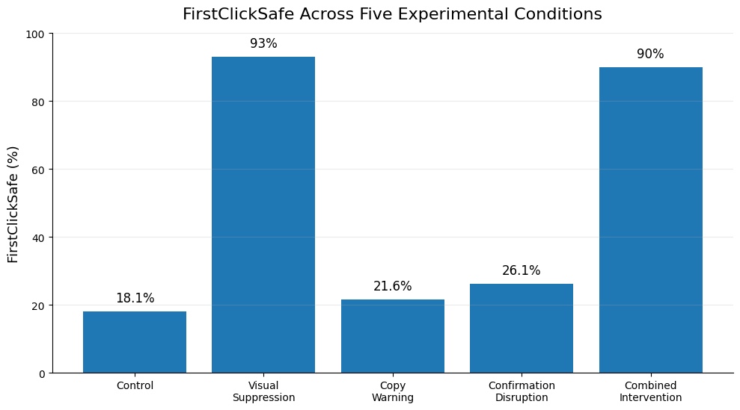

Key Findings
Stage 1: Browsing history (Visual suppression)
FirstClickSafe
Best first-selection accuracy (93%)
on correct transaction
A safe first selection
Transfer errors were completely eliminated
Notes:
let’s see the Visual Suppression , 93% of users’ first selections were on a correct transaction.
By comparison, the firstclicksafe rates were much lower in conditions without this intervention.
And once users made a safe first selection, they copy the correct address and send funds to the intened address, so transfer errors were completely eliminated.

Slide 18

Key Findings
Stage 1: Browsing history (Visual suppression)
“When choosing a transaction, I would not select this one; my intuition tells me it looks suspicious.”
Users did not always understand why the transaction was grayed out.
Simply perceived the grayed-out entries as less trustworthy and thus chose to avoid.
Visual Suppression steered attention before users entered the risky path.
Notes:
Interestingly, users did not always understand why the transaction was grayed out.
Many users simply perceived the grayed-out entries as less trustworthy and thus chose to avoid them.
So this intervention worked largely by just steering attention before users entered the risky path.

Slide 19
Key Findings
Stage 2: Copying address (Copy warning)

Slide 20
Key Findings
Stage 2: Copying address (Copy warning)
30.4%
46%
returned to recheck
of those who returned
finally chose the correct address
interrupt users
successful correction
Notes:
And For Copy Warning, among those whose first-selection was wrong, 30.4% of users returned to recheck after seeing the warning.
But among those who returned, only 46% finally change their copychoice and selected the correct address.
So the warning could interrupt users, but interruption did not always lead to successful correction.

Slide 21
Key Findings
Stage 2: Copying address (Copy warning)
No-return: Notice warning but perceive copying as low risk
-- igore and keep going
“Since I had copied the address directly, I felt confident that no mistake could have occurred, so I simply ignored the pop-up without paying much attention.”
Return but fail to revise:
Still only check few characters of the beginning and end of the address.
Going back, finding another transaction, and copying again was just too much effort.
Notes:
and from our interviews, there are three main reasons for the failure.
First, many users perceived copying as a low-risk action, so they often ignored the warning and kept going.
Second, even when they returen to check, many still only check few characters of the beginning and end of the address because the blockchain address is too long and They failed to find that the address was different.,
And third, some other users reported that they felt the going back, finding another transaction, and copying again was just too much effort. and so they finnaly kept their wrong choice.
So users sometimes paused, but still failed to recover.

Slide 22
Key Findings
Stage 3: Transaction confirmation (Confirmation disruption)

Slide 23

Key Findings
Stage 3: Transaction confirmation (Confirmation disruption)
48.8%
41.7%
returned to recheck
of those who returned
ultimately chose the correct address
ConfirmModalChoice
48.8% chose to recheck, of which 41.7% revised their copying behaivior
predict
Final transfer success
Notes:
And in the confirmation step, 48.8% returned to recheck, which was higher than Copy Warning.
At this step, Users understood that once the transaction was confirmed, it could not be reversed. So they are more causious and return.
But like those in copy warning, Limited characters verification and interaction costs limited successful recovery, with only 41.7% finally selected the correct address.
So Confirmation Disruption was better at stopping users, but not better at helping them correct the mistake.

Slide 24
Key Findings
Stage 3: Transaction confirmation (Confirmation disruption)
Recheck: Confirmation Disruption > Copy Warning
once the transaction was confirmed, it could not be reversed
-- More cautious
“ I felt confused and a bit panicked… If I proceed, I can’t take it back, so I decided to return and compare.”
No-recheck: Warning as routine confirmation prompt
Recheck but fail to revise:
Limited characters verification
interface interaction costs
Notes:
In comparison, At the confirmation stage, users were more cautious.
48.8% returned to recheck, which was higher than Copy Warning.
At this step, Users understood that once the transaction was confirmed, it could not be reversed. So they are more causious and return.

Slide 25
Key insight and Implications
Simply interrupting risky behavior is not enough
Risky action
Warning / pause
Safe path
The missing step
interventions should help users back to a safe path
- “How can I correct this?”
Notes:
This gives us two key insight.
Fistly, simply interrupting risky behavior is not enough.
Instead, interventions should help users back to a safe path.
The interface should not only say:
“Stop.”
but also answer:
“How can I correct this”

Slide 26
Key insight and Implications
Design implication 1: support recovery in multi-step interactions
Later-stage interventions should
reduce the effort required to correct an earlier mistake:
1
Surface a likely legitimate alternative
Reduce search effort
2
Highlight address discrepancies
Support meaningful verification
3
Enable one-click recovery
Make correction easy
Move from “stop” to guided recovery
Notes:
And These findings lead to design implications.
The first is to support recovery in multi-step interactions.
Later-stage interventions should reduce the effort required to correct an earlier mistake, for example, by surfacing likely legitimate alternatives, highlighting discrepancies, and enabling one-click recovery.

Slide 27
Key insight and Implications
Risk awareness shapes intervention effectiveness
Routine action
Security-aware action
“Selecting, copying, and confirming
feel routine and low-risk.”
“Why is this risky,
and what part should I verify?”
Many remained highly confident even after making an incorrect choice.
intervention effectiveness also depends on whether users recognize the risk behind the action.
Notes:
Second, users often treated selecting, copying, and confirming as routine, low-risk actions.
Many remained highly confident even after making an incorrect choice.
So intervention effectiveness also depends on whether users recognize the risk behind the step.

Slide 28
Key insight and Implications
Design implication 2: sustain risk awareness across the workflow
repeating the same warning at each step
different steps can provide lightweight and complementary cues
1
2
3
Select
Copy
Confirm
Show address history
or usage context
Summarize recipient risk before submission
Mark suspicious entries
maintain awareness without creating redundant warnings or habituation
Notes:
Second, wallet interface should sustain risk awareness across the entire workflow.
This does not mean repeating the same warning at each step.
Instead, different stages can provide lightweight and complementary cues to maintain awareness without creating redundant warnings or habituation. — for example, marking suspicious entries during selection, showing address-use signals during copying, and summarizing recipient risk before confirmation.

Slide 29

Thank You!
When and Where You Nudge Matters:
Multi-Step Interface Interventions Against Address Poisoning in Crypto Wallets
Email us at:
dz20330035@smail.nju.edu.cn
Notes:
That’s all for my presentation. And Thank you for your attention.

