Slide 1



UNIT ?
???

Slide 3
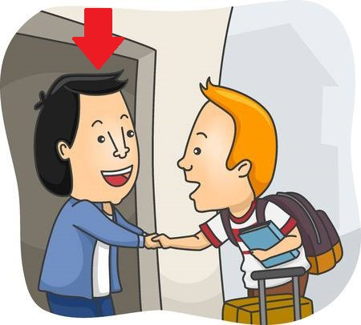

Time to repeat
host
invite
organize

Slide 4


