Slide 1



Towards optimal robustness of network controllability:
An empirical necessary condition on node degrees
Felix, Yang Lou
Centre for Chaos and Complex Networks
Department of Electrical Engineering
City University of Hong Kong

Slide 2



Acknowledgement
Prof. Guanrong Chen
Chair Professor
Department of Electrical Engineering
City University of Hong Kong
Dr. Kim Fung Tsang
Associate Professor
Department of Electrical Engineering
City University of Hong Kong
Dr. Lin Wang
Associate Professor
Department of Automation
Shanghai Jiao Tong University

Slide 3
Contents
Introduction
Controllability and its Robustness
Empirical Necessary Condition
Experimental Results
Conclusions

Slide 4

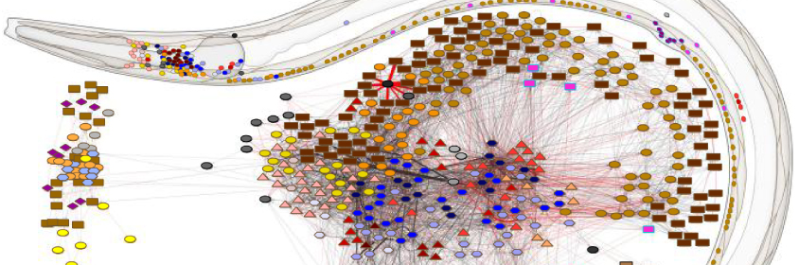


Introduction
Many real-world systems can be modeled as complex networks.
Their controllability and robustness of controllability are worth studying.
[Figures From Internet]

Slide 5
Introduction
Controllability
  The ability of a network in moving from any initial state to any target state under a suitable input within finite time
  State controllability
  Structural controllability
  It is demonstrated that clustering and modularity have no discernible impact on the network controllability, but the underlying degree correlations have certain effects ^{[1]}
  It is revealed that random networks of any topology are controllable by an infinitesimal fraction of driver nodes, if both of its minimum in- and out-degrees are greater than two ^{[2]}
M. Posfai, Y. Liu, J. Slotine, and A. Barabasi, “Effect of correlations on network controllability,” Scientific Reports, vol. 3, p.1067, 2013.
G. Menichetti, L. Dall’Asta, and G. Bianconi, “Network controllability is determined by the density of low in-degree and out-degree nodes,” Physical Review Letters, vol. 113, no. 7, p. 078701, 2014.

Slide 6
Introduction
Robustness
  The optimization of network robustness aims at enhance and maintain a good connectedness of complex networks under random failures and malicious attacks ^{[3]}
  Edge rewiring (with degree-preserving) was proposed to increase the number of edges between high-degree nodes ^{[4]}, and thus leads to generate a new network with higher k-shell component ^{[5]}
  A common observation is that heterogeneous networks with onion-like structure are robust against attacks ^{[3,6]}
C. Schneider, A. Moreira, J. Andrade, S. Havlin, and H. Herrmann, “Mitigation of malicious attacks on networks,” Proceedings of the National Academy of Sciences, vol. 108, no. 10, pp.3838–3841, 2011.
L. Bai, Y. Xiao, L. Hou, and S. Lao, “Smart rewiring: Improving network robustness faster,” Chinese Physics Letters, vol. 32, no. 7, p.078901, 2015.
H. Chan and L. Akoglu, “Optimizing network robustness by edge rewiring: A general framework,” Data Mining and Knowledge Discovery, vol. 30, no. 5, pp.1395–1425, 2016.
Z. Wu and P. Holme, “Onion structure and network robustness,” Physical Review E, vol. 84, no. 2, p.026106, 2011.

Slide 7
Introduction
Robustness of Controllability
  The robustness of networks controllability is a dynamic process that reflects how well the system can maintain the controllability against malicious attacks by means of node- and/or edge-removals
  Attack vs. defense
  It is observed that multiple-loop and multiple-chain structure enhances the robustness of controllability ^{[7-9]}
Y. Lou, L. Wang, and G. Chen, “Toward stronger robustness of network controllability: A snapback network model,” IEEE Transactions on Circuits and Systems I: Regular Papers, vol. 65, no. 9, pp.2983–2991, 2018.
G. Chen, Y. Lou, and L. Wang, “A comparative study on controllability robustness of complex networks,” IEEE Transactions on Circuits and Systems II: Express Briefs, vol. 66, no. 5, pp.828–832, 2019.
Y. Lou, L. Wang, and G. Chen, “Enhancing controllability robustness of q-snapback networks through redirecting edges,” Research, vol. 2019, no.7857534, 2019.

Slide 8
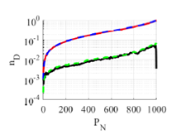
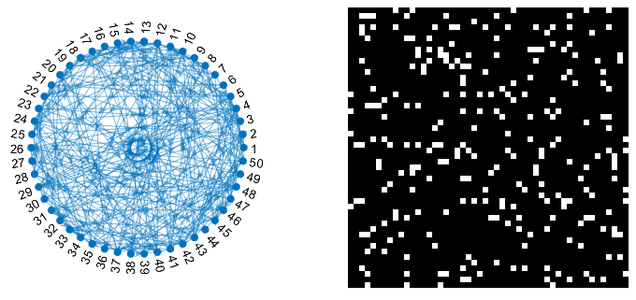
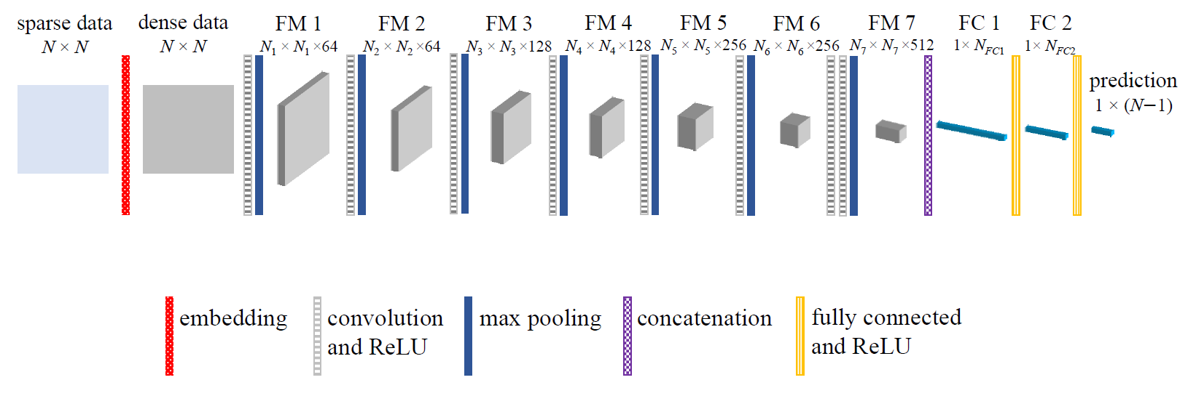
Introduction
Robustness of Controllability
  Recently, the correlation between topological features and robustness of controllability is studied using machine learning. ^{[10]}
Y. Lou, Y. He, L. Wang, and G. Chen, “Predicting network controllability robustness: A convolutional neural network approach,” arXiv:1908.09471, 2019.

Slide 9
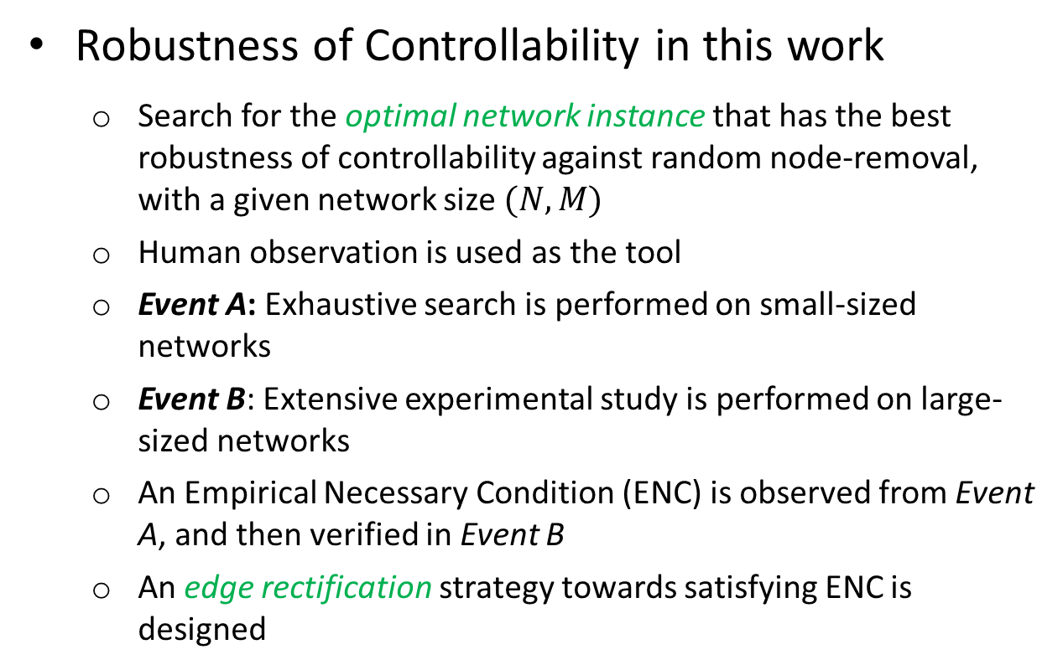
Introduction
Robustness of Controllability in this work
  Search for the optimal network instance that has the best robustness of controllability against random node-removal, with a given network size $(N,M)$
  Human observation is used as the tool
  Event A: Exhaustive search is performed on small-sized networks
  Event B: Extensive experimental study is performed on large-sized networks
  An Empirical Necessary Condition (ENC) is observed from Event A, and then verified in Event B
  An edge rectification strategy towards satisfying ENC is designed

Slide 10
Contents
Introduction
Controllability and its Robustness
Empirical Necessary Condition
Experimental Results
Conclusions

Slide 11
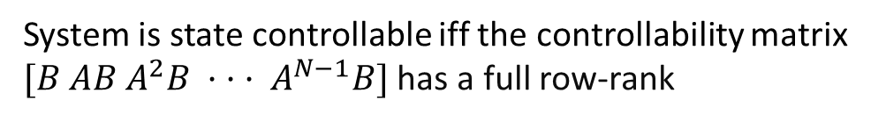

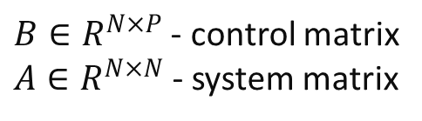

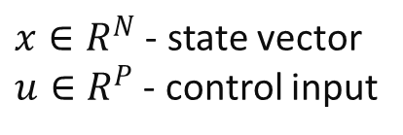
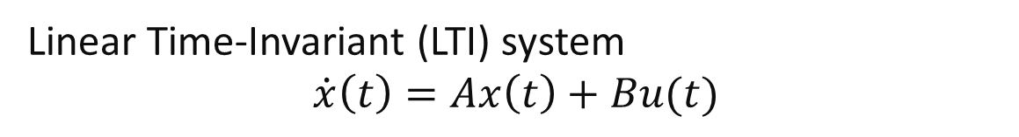

Controllability
x₃(t)
Controllable: The system orbit can be driven from any initial state to any target state in finite time, with a suitable input
$x$(t)
x₂(t)
$x$(t₀)
x₁(t)
Linear Time-Invariant (LTI) system
$$\dot{x}\left(t\right)=Ax\left(t\right)+Bu(t)$$
$x∈R^{N}$ - state vector
$u∈R^{P}$ - control input
$B∈R^{N×P}$ - control matrix
$A∈R^{N×N}$- system matrix
System is state controllable iff the controllability matrix
$[B AB A^{2}B · · · A^{N−1}B]$ has a full row-rank

Slide 12
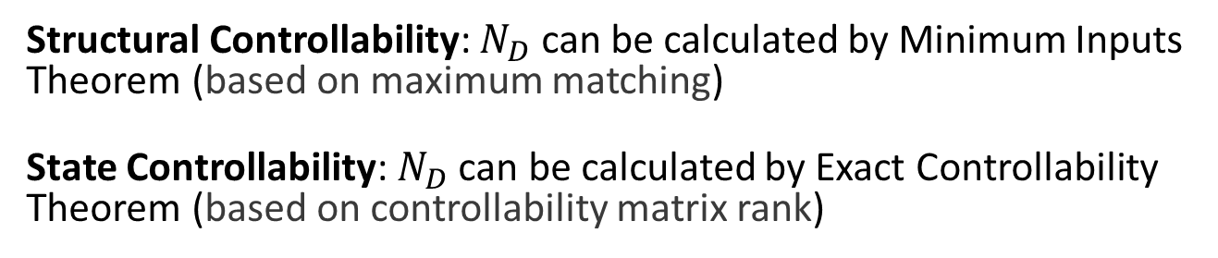
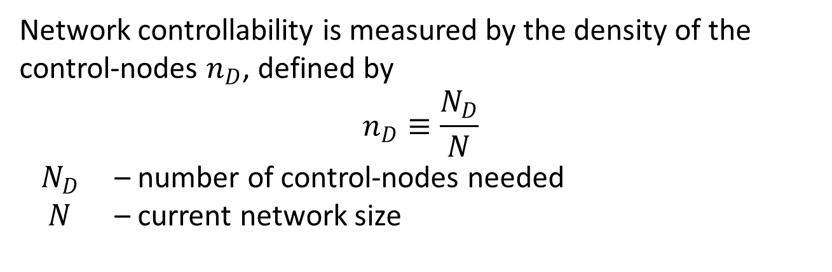

Controllability Measure
Network controllability is measured by the density of the control-nodes $n_{D}$, defined by
$$n_{D}≡\frac{N_{D}}{N}$$
$N_{D}$ – number of control-nodes needed
$N$ – current network size
$\frac{1}{N}$ (best)
1 (worst)
Structural Controllability: $N_{D}$ can be calculated by Minimum Inputs Theorem (based on maximum matching)
State Controllability: $N_{D}$ can be calculated by Exact Controllability Theorem (based on controllability matrix rank)

Slide 13
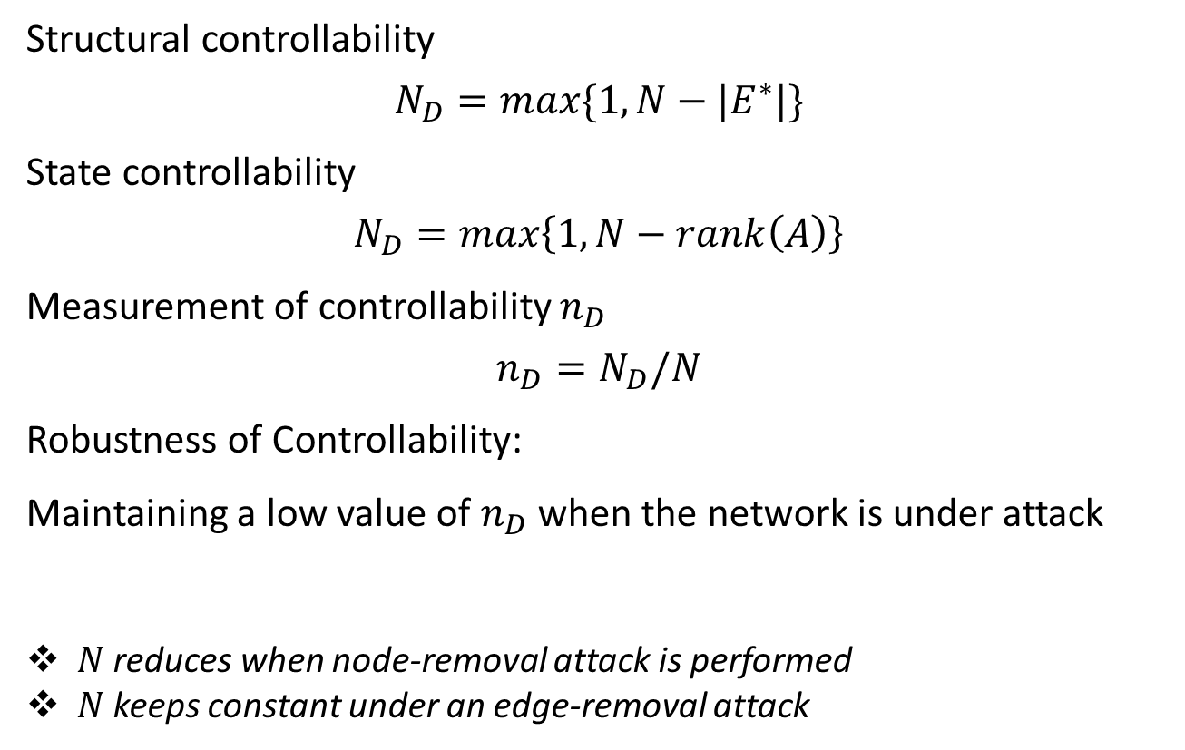
Robustness of Controllability
Structural controllability
$$N_{D}=max\{1, N−|E^{∗}|\}$$
State controllability
$$N_{D}=max\left\{1, N−rank\left(A\right)\right\}$$
Measurement of controllability $n_{D}$
$$n_{D}=N_{D}/N$$
Robustness of Controllability:
Maintaining a low value of $n_{D}$ when the network is under attack
$N$ reduces when node-removal attack is performed
$N$ keeps constant under an edge-removal attack

Slide 14
Contents
Introduction
Controllability and its Robustness
Empirical Necessary Condition
Experimental Results
Conclusions

Slide 15
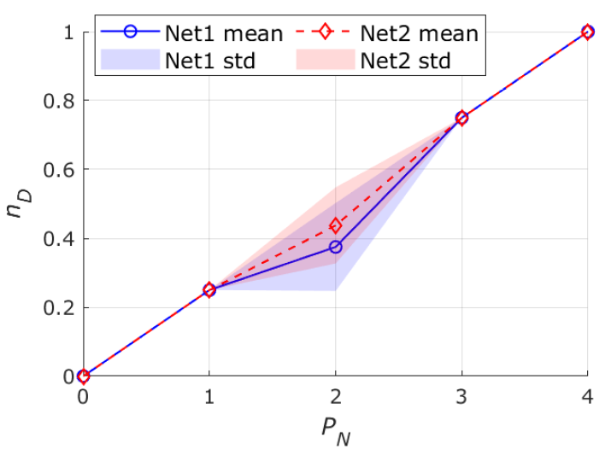
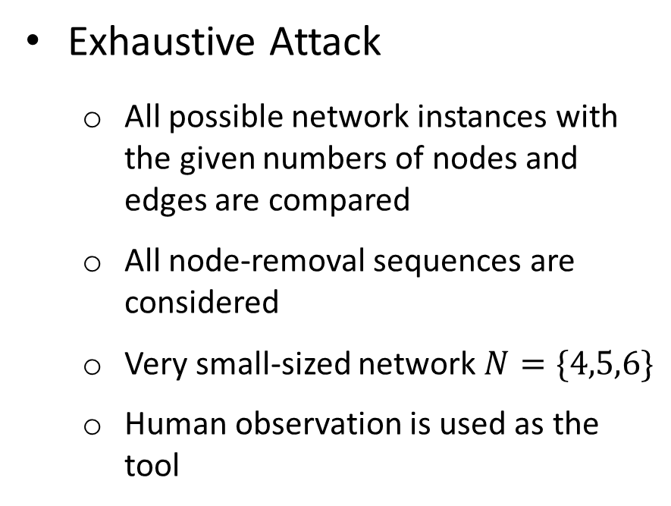
Empirical Necessary Condition (ENC)
Exhaustive Attack
  All possible network instances with the given numbers of nodes and edges are compared
  All node-removal sequences are considered
  Very small-sized network $N=\{4,5,6\}$
  Human observation is used as the tool

Slide 16
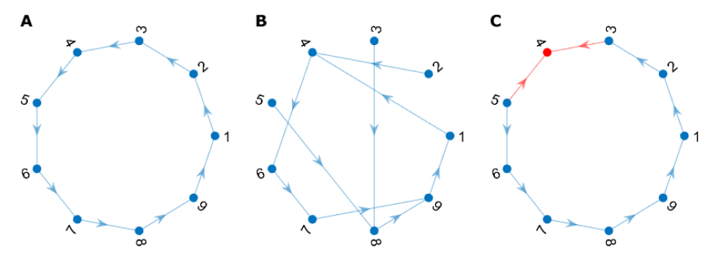


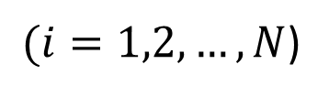

Empirical Necessary Condition (ENC)
ENC
$$\left\lfloor M/N\right\rfloor ≤k_{i}^{in/out}≤\left\lceil M/N\right\rceil$$
$(i=1,2, …, N$)
extremely-homogeneous

Slide 17
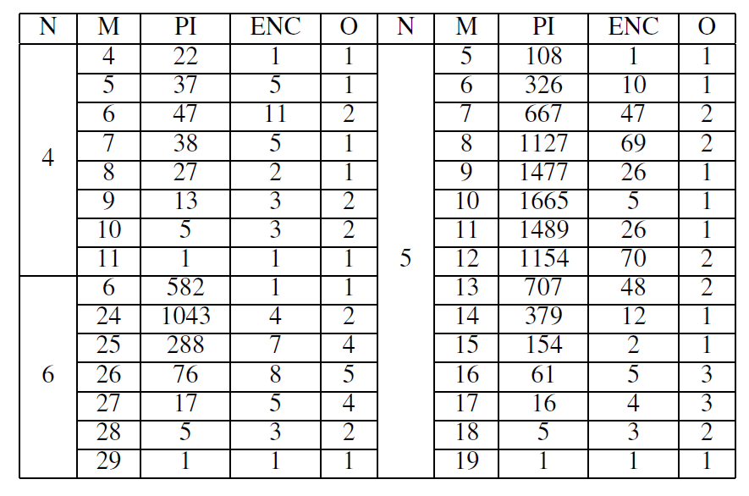
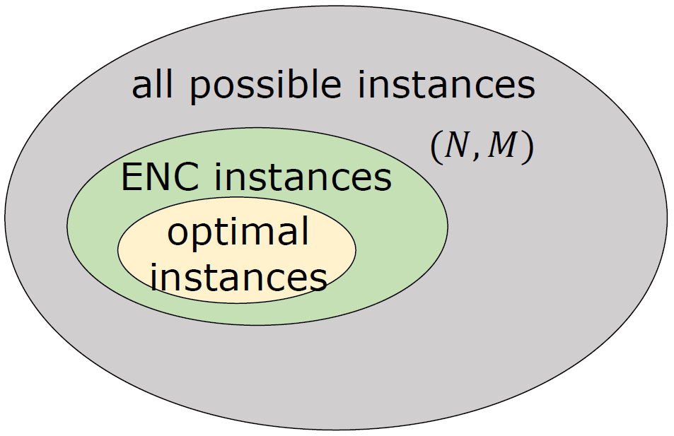
Empirical Necessary Condition (ENC)
N: nodes
M: edges
PI: possible instances
ENC: ENC instances
O: optimal instances
Their relationships:
all instances with optimal robustness of controllability satisfy the ENC
for a network instance satisfying ENC, it is not always the optimal

Slide 18
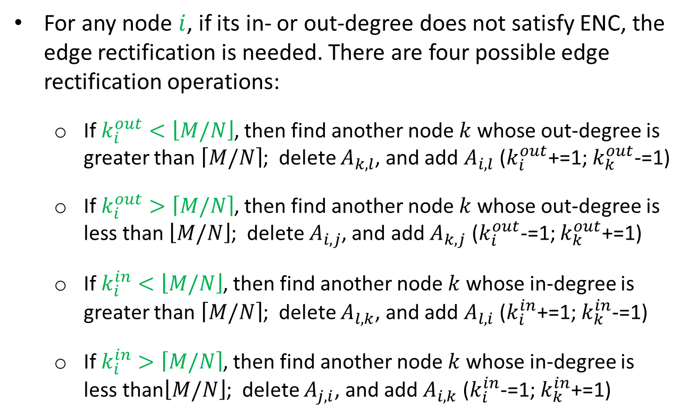
Edge Rectification
For any node $i$, if its in- or out-degree does not satisfy ENC, the edge rectification is needed. There are four possible edge rectification operations:
  If $k_{i}^{out}<\left\lfloor M/N\right\rfloor$, then find another node $k$ whose out-degree is greater than $\left\lceil M/N\right\rceil$; delete $A_{k,l}$, and add $A_{i,l}$ ($k_{i}^{out}$+=1; $k_{k}^{out}$-=1)
  If $k_{i}^{out}>\left\lceil M/N\right\rceil$, then find another node $k$ whose out-degree is less than $\left\lfloor M/N\right\rfloor$; delete $A_{i,j}$, and add $A_{k,j}$ ($k_{i}^{out}$-=1; $k_{k}^{out}$+=1)
  If $k_{i}^{in}<\left\lfloor M/N\right\rfloor$, then find another node $k$ whose in-degree is greater than $\left\lceil M/N\right\rceil$; delete $A_{l,k}$, and add $A_{l,i}$ ($k_{i}^{in}$+=1; $k_{k}^{in}$-=1)
  If $k_{i}^{in}>\left\lceil M/N\right\rceil$, then find another node $k$ whose in-degree is less than$\left\lfloor M/N\right\rfloor$; delete $A_{j,i}$, and add $A_{i,k}$ ($k_{i}^{in}$-=1; $k_{k}^{in}$+=1)

Slide 19
Contents
Introduction
Controllability and its Robustness
Empirical Necessary Condition
Experimental Results
Conclusions

Slide 20

Experimental Settings
Random Edge Rectification (RER)
  randomly pick an operation of the four edge rectification operations
  repeat until:
    the maximum number of RER operations is used up
    the network has satisfied the ENC
  RER is applied to six directed synthetic network models:
    Erdos-Renyi random graph (ER)
    Newman–Watts small-world (SW)
    generic scale-free (SF)
    q-snapback network (QSN)
    random triangle network (RTN)
    random rectangle network (RRN)

Slide 21
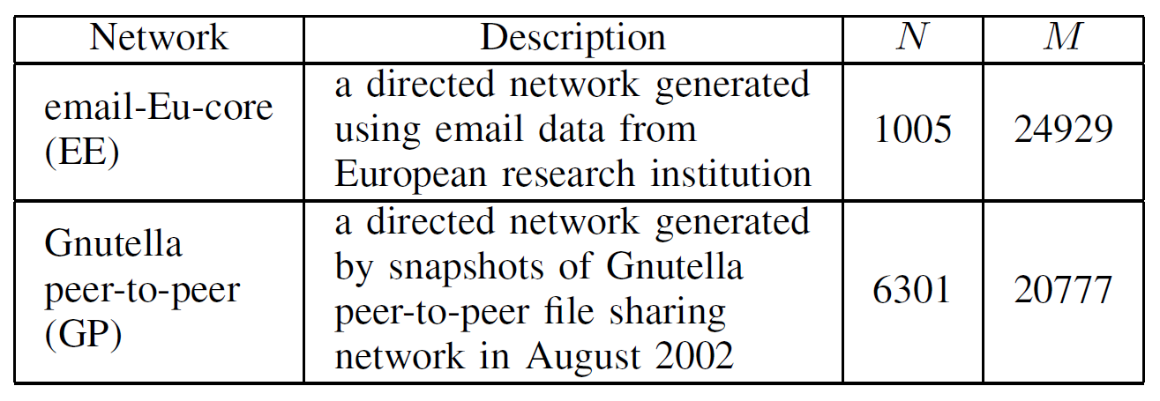
Experimental Settings
Random Edge Rectification (RER)
  RER is also two real-world networks
    email-Eu-core (EE) network
    Gnutella peer-to-peer (GP) network
[Real Network Data From: https://snap.stanford.edu/]

Slide 22
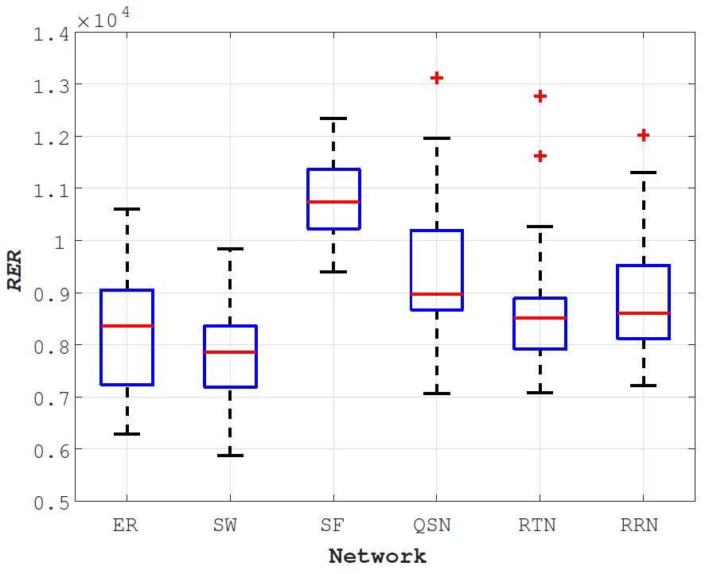
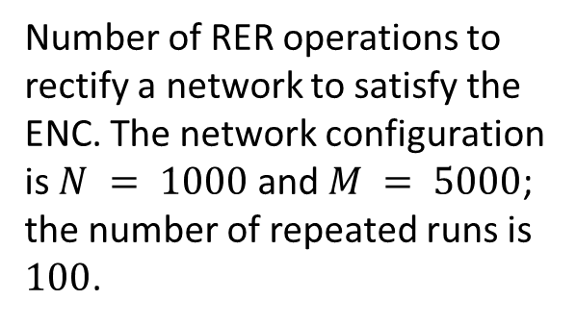
Experimental Results
Number of RER operations to rectify a network to satisfy the ENC. The network configuration is $N = 1000$ and $M = 5000$; the number of repeated runs is
$100$.
RER | 0 | 1000 | 5000 | Inf
Compare | original | ~ 10% ENC | ~ 50% ENC | ENC

Slide 23
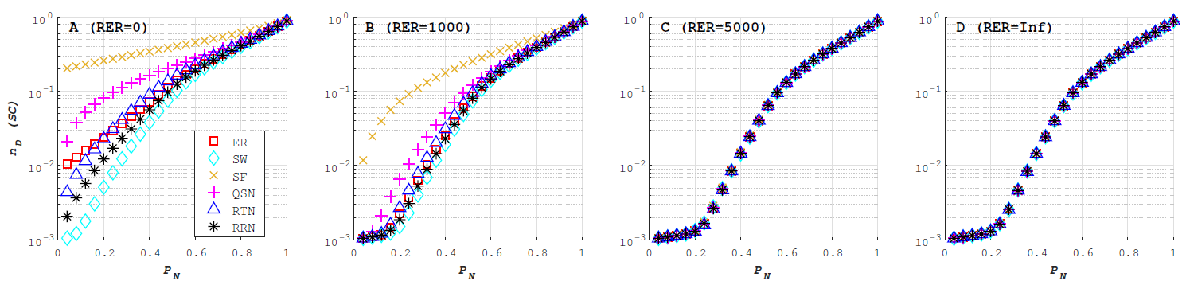
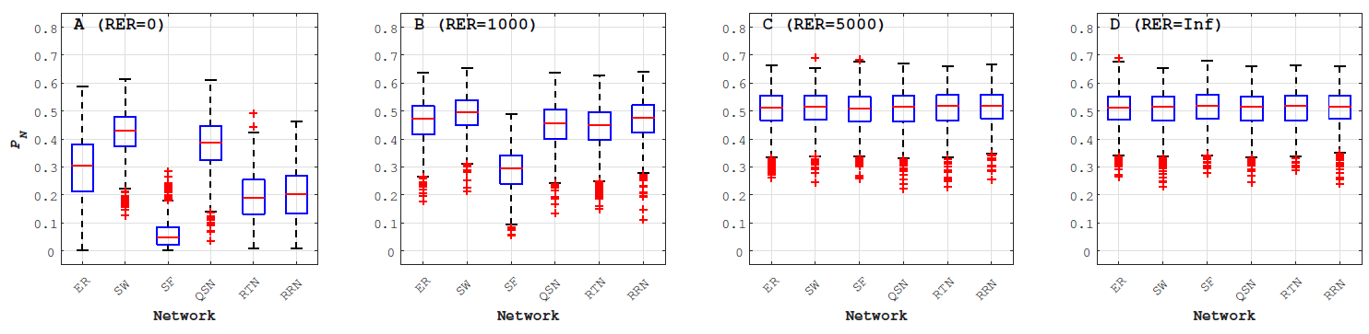
Experimental Results
Synthetic Networks
Robustness of structural controllability
Proportion of random node-removals ($PN$) to disconnect a network

Slide 24
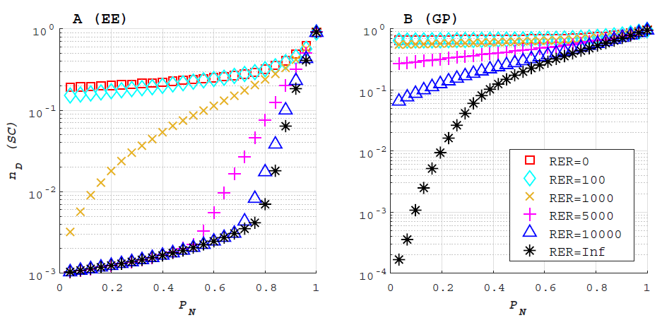
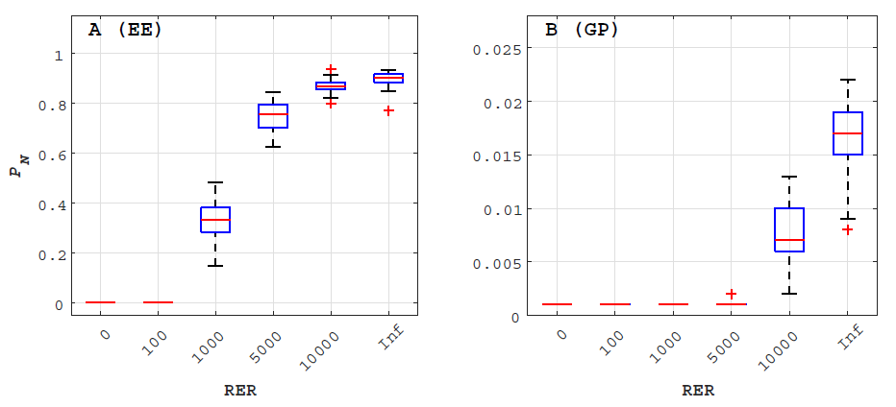
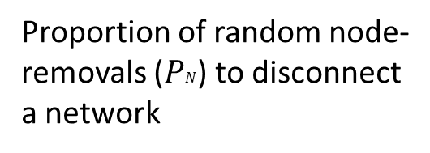
Experimental Results
Real-world Networks
Robustness of structural controllability
Proportion of random node-removals ($PN$) to disconnect a network

Slide 25
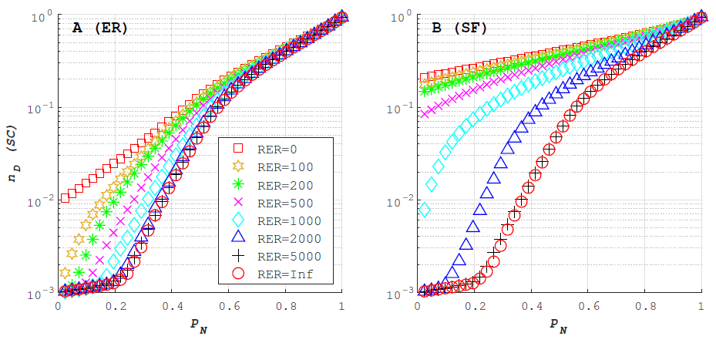
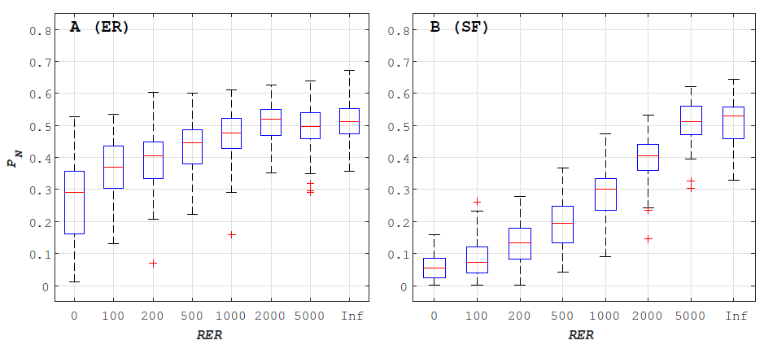
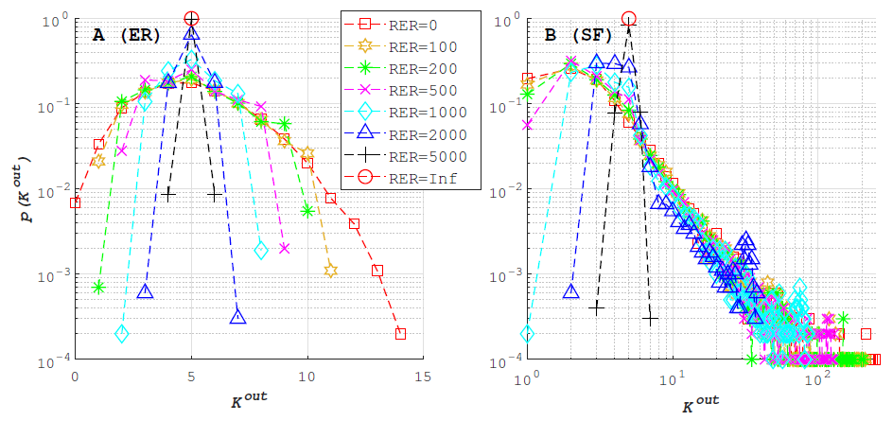
Experimental Results
ER and SF only

Slide 26
Conclusions
This work attempts to search for the network instance with optimal robustness of controllability against random node-removal attacks
Exhaustive search is applied on very small-size networks, and an empirical necessary condition (ENC) is observed that implies the optimal instance should be extremely homogeneous
Random edge rectification (RER) is designed to rectify synthetic and real-world networks towards satisfying ENC
Simulation results on large-scaled networks show that RER is effective
  to rectify a network towards satisfying ENC
  robustness of controllability is enhanced
  robustness of connectedness is enhanced

Slide 27
Reference
Full paper on arXiv

Slide 28




Thank you
https://fylou.github.io/
felix.lou@my.cityu.edu.hk

Slide 29
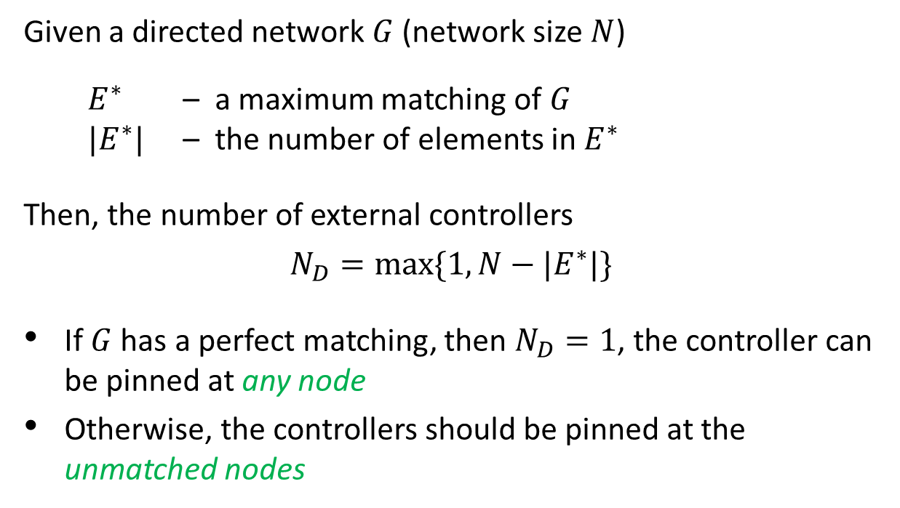
Appendix
Minimum Inputs Theorem ^{[11]}
Given a directed network $G$ (network size $N$)
  $E^{∗}$ – a maximum matching of $G$
  $|E^{∗}|$ – the number of elements in $E^{∗}$
Then, the number of external controllers
$$N_{D}=max\{1, N−|E^{∗}|\}$$
If $G$ has a perfect matching, then $N_{D}=1$, the controller can be pinned at any node
Otherwise, the controllers should be pinned at the unmatched nodes
Y. Liu, J. Slotine, and A. Barabasi, “Controllability of complex networks”, Nature, 473:167–173, 2011.

Slide 30
Appendix
Matching
A matching is a set of links that do not share start or end nodes
A maximum matching is a matching that contains the largest possible number of edges
maximum matching ⊆ maximal matching (not important)
A perfect matching is a matching which matches all nodes of the graph
A node is matched if it is an end node of an edge in the matching
Y. Liu, J. Slotine, and A. Barabasi, “Controllability of complex networks”, Nature, 473:167–173, 2011.

Slide 31
Appendix
A
B
C
matched node
unmatched node
matching link
input signal
Y. Liu, J. Slotine, and A. Barabasi, “Controllability of complex networks”, Nature, 473:167–173, 2011.
31

Slide 32
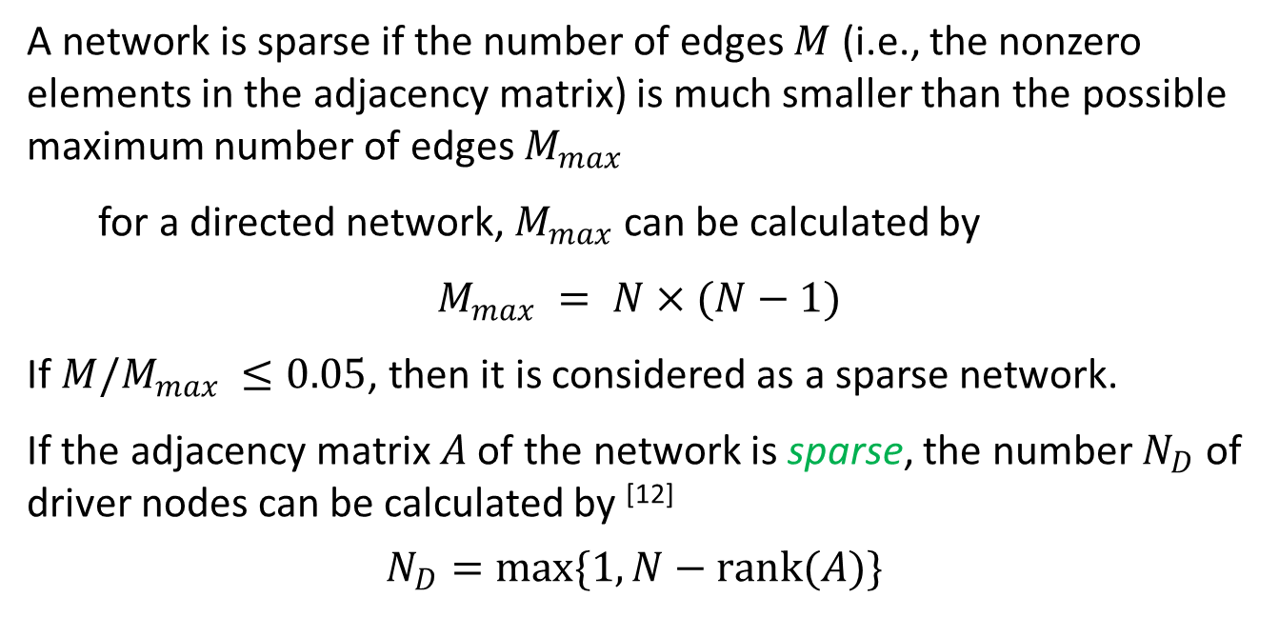
Appendix
Exact Controllability Theorem
A network is sparse if the number of edges $M$ (i.e., the nonzero elements in the adjacency matrix) is much smaller than the possible maximum number of edges $M_{max}$
for a directed network, $M_{max}$ can be calculated by
$M_{max} = N×(N−1)$
If $M/M_{max} ≤0.05$, then it is considered as a sparse network.
If the adjacency matrix $A$ of the network is sparse, the number $N_{D}$ of driver nodes can be calculated by ^{[12]}
$$N_{D}=max\{1, N−rank(A)\}$$
Z. Yuan, C. Zhao, Z. Di, W. Wang, and Y. Lai, “Exact controllability of complex networks”, Nature Communications, 4:2447, 2013.

