Slide 1


AIRWAR
Yalin Sun
Yanyu Wang

Slide 2
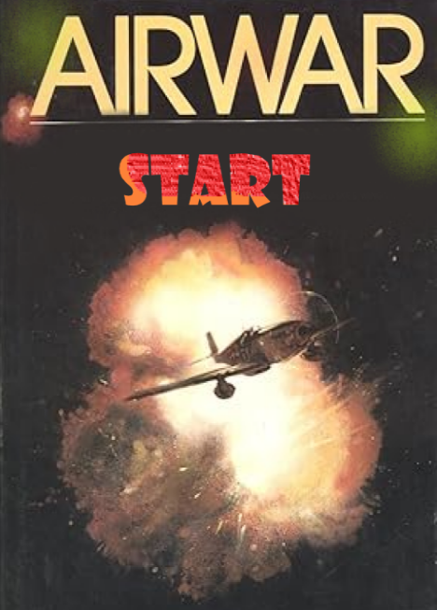
Why AirWar?
1
2
Alignment with OOD Principles
3
4
5
Real-Time Interactivity and System
Responsiveness
6
7
8
Emotional Connection and Learning Enhancement
Notes:
We chose "AirWar” for our Object Oriented Design course project for its alignment with OOD principles and nostalgic appeal. The game exemplifies OOD by featuring diverse objects like aircraft, bullets, and enemies, each with distinct attributes and methods, interacting to enable core functionalities such as movement and shooting.
Its real-time user interactivity challenges players to maneuver aircraft, evade attacks, and engage enemies, offering a practical platform to design responsive systems.
Moreover, the game evokes fond childhood memories, potentially resonating with many who enjoyed it in their youth.
By selecting this game, we not only apply OOD principles practically but also tap into the emotional connection with our gaming past, enriching our learning experience. Through this project, we aim to deepen our understanding of OOD, enhance programming skills, and relive the joy of childhood gaming.

Slide 3
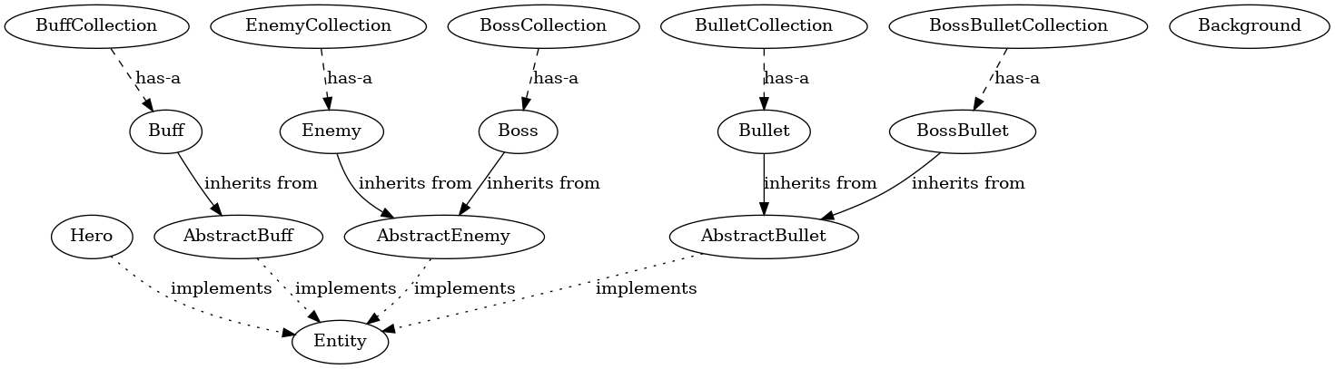
OOD in AirWar
2
3
4
5
6
7
8
Notes:
基本上照本宣科，讲讲设计思路

Slide 4

MVC in AirWar
Model
Controller
View
1
2
3
4
Entity
ViewFrame
Controller
5
6
Hero
7
Bullet
ViewPanel
8
Notes:
In the MVC architecture of AirWar, each component works together like a finely tuned machine, collaboratively crafting an immersive gaming experience.
Imagine this: as a player presses an arrow key, Controller.java immediately captures this input. Acting both as a commander and a swift messenger, it quickly relays the command to the Hero.java in the model layer, directing the game's hero to move in the specified direction. Simultaneously, other classes in the model layer, such as Enemy.java and Boss.java, continuously update the positions and behaviors of enemies, infusing the game world with vibrancy and challenge.
Meanwhile, ViewPanel.java acts as an enthusiastic narrator, meticulously depicting every movement of the hero and enemies, the trajectories of each bullet, and changes in the game background. Whenever there are updates in the model layer, ViewPanel.java accurately redraws these elements on the screen, ensuring what players see reflects the latest state of the game.

Slide 5
1
2
3
4
Show time!
4
5
5
6
6
7
7
8
Notes:
此处讲解各个主体的行为动作，以及都会触发什么数值变化
作为对前面图的补充和具体讲解
以及提醒大家触壁反弹，喷火动画和会动背景的细节

Slide 6
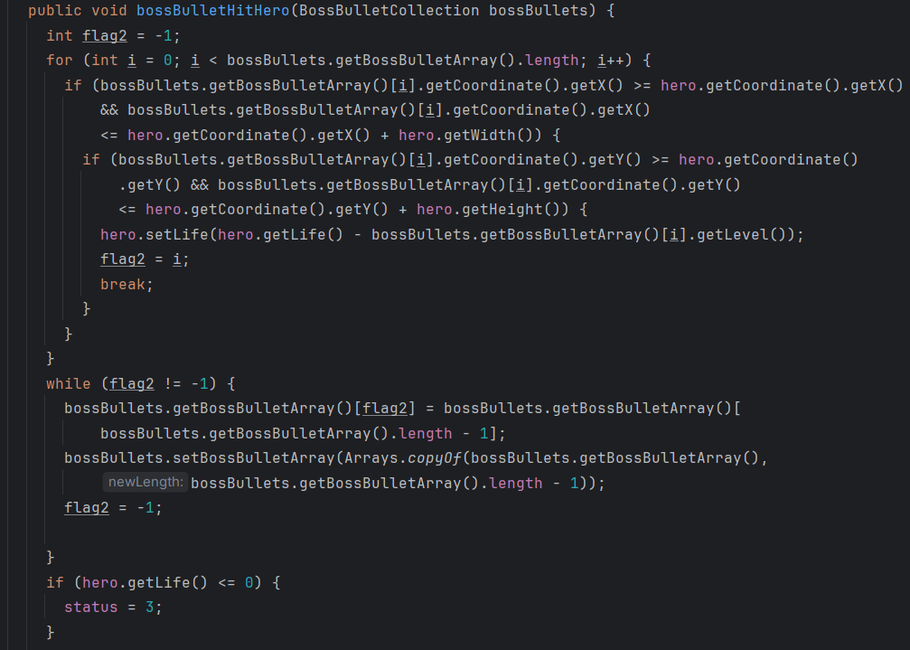
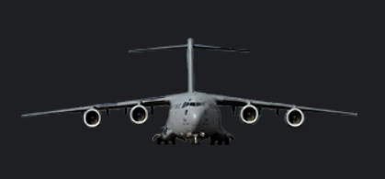
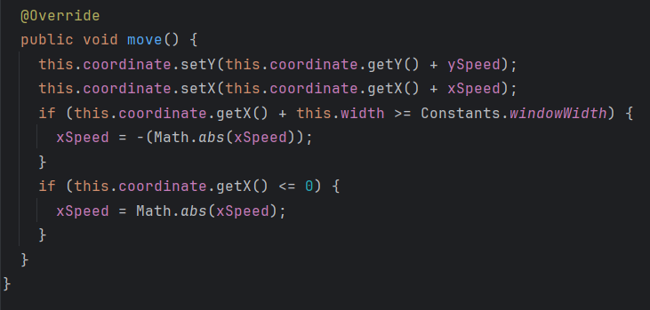
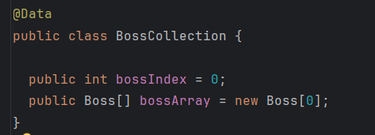
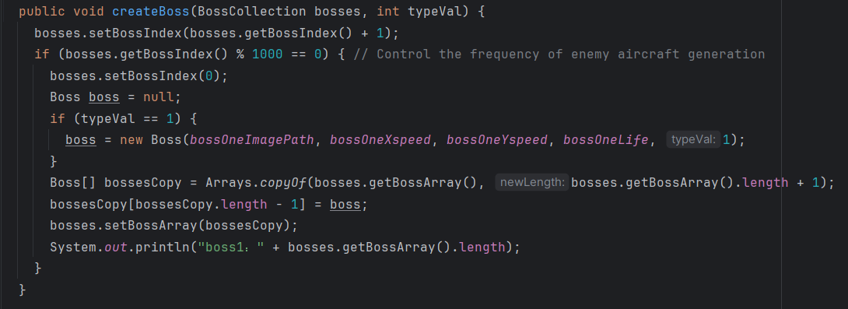
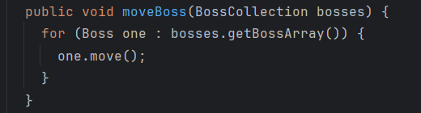
Entity-Highlights
1
2
3
4
5
6
7
8

Slide 7
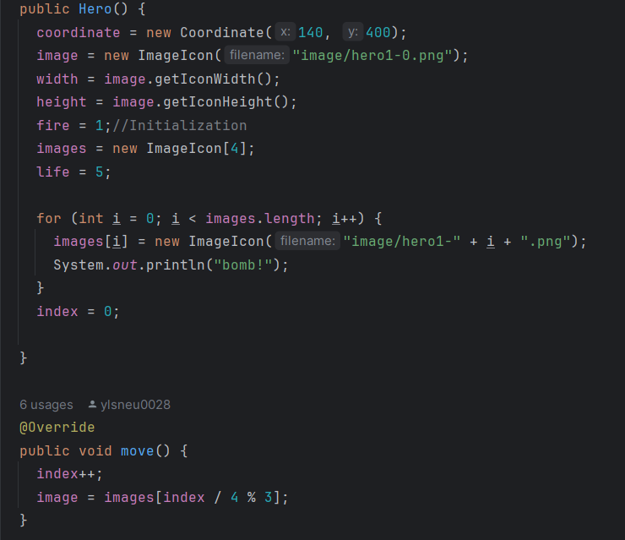
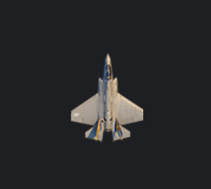
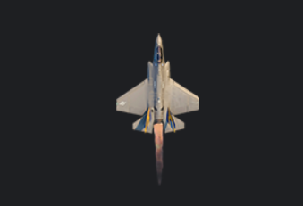
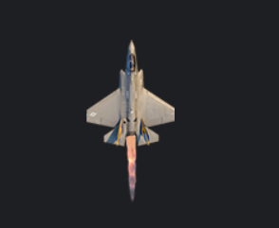
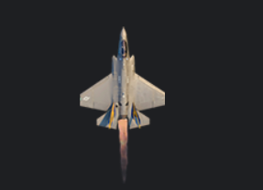
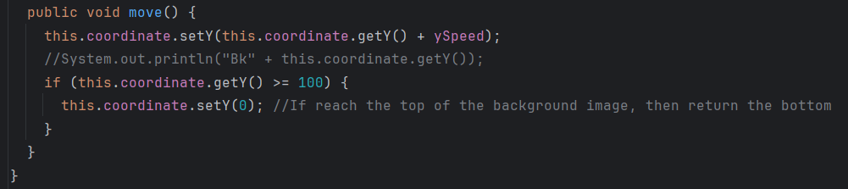
Visualization-Highlights
1
2
3
4
5
6
7
8
Notes:
As to the visual effect bk hero

Slide 8
Space for improvement
1
2
3
The functionality for switching between hero aircraft
The variety of buffs and BOSS types
……
4
5
6
7
8
**Citations：
Java Aircraft Combat Game Tutorial: https://www.bilibili.com/video/BV1oz4y1a7xU?p=10;
2. Kathy Sierra and Bert Bates; Head First Java(Second Edition) , February 2005;

