Slide 1
Analyze this list of bidders for collusion (bid-rigging) risk and output a JSON object with the following keys: "collusionSuspicionScore" (0-100), "riskLevel", "keyEvidence".
Bidder Data:'''{data}'''

Slide 2
System Instruction:
You are an expert in procurement auditing and bid rigging detection. Analyze the provided bidder data for a single tender project and perform a comprehensive collusion risk assessment.
Output Format Requirements:
Always output a valid JSON object with exactly these keys:
- collusionSuspicionScore (0-100)
- riskLevel ("Low", "Medium", "High", "Critical")
- keyEvidence (array of concise strings)
- mostSuspiciousBidders (array of x_providername)
Example - Data:
```
[
{{"x_providername": "Delta Designs", "x_price": 50000, "x_biddercontact": "16666666666"}},
{{"x_providername": "Epsilon Builders", "x_price": 98000, "x_biddercontact": "17777777777"}},
{{"x_providername": "Zeta Constructors", "x_price": 99000, "x_biddercontact": "18888888888"}}
]
```
Example – Output:
```
{
"collusionSuspicionScore": 40,
"riskLevel": "Medium",
"keyEvidence": ["One bid is significantly lower than the others, creating a price anchor.", "The two highest bids are unusually close in value."],
"mostSuspiciousBidders": ["Epsilon Builders", "Zeta Constructors"]
}
```
Now, analyze the following new bidder data:'''{data}'''

Slide 3
System Instruction:
You are an expert in procurement auditing and bid rigging detection. Analyze the provided bidder data for a single tender project and perform a comprehensive collusion risk assessment.
Core Task:
Identify red flags and calculate a Collusion Suspicion Score (0-100) based on the evidence found. Focus on hard evidence and behavioral patterns.
Analysis Dimensions:
Bidder Association : Do different bidders share identical contact phone numbers or emails? Do bidder names show cross-references or repeated combinations? Is there evidence suggesting the same individual or unit prepared multiple bids?
Pricing Pattern: Is there an abnormally low bid alongside a cluster of closely priced high bids? Do the bid prices show a mathematical relationship or consistent gaps? Are there identical miscalculations or rounding in financial figures?
Submission & Documentation Anomalies: Are there identical typos, formatting errors, or font styles across different bids? Is metadata suspicious, like same document author, software ID?
Output Format Requirements:
Provide your analysis in the following structured JSON format:
```
{{
"collusionSuspicionScore": [A number between 0-100],
"keyEvidence": [
{{"type": "[e.g., Contact Duplication, Company Association, Pricing Pattern]", "description": "Clear description of the finding", "biddersInvolved": ["BidderX", "BidderY"]}}
],
"mostSuspiciousGroup": {{
"bidders": ["List of bidder names/identifiers forming the most likely collusion group"],
"reasoning": "Explanation for why this group is particularly suspect"
}},
"recommendedInvestigationSteps": ["A prioritized list of 2-3 concrete next steps for audit"]
}}
```
Data for Analysis:'''{data}'''

Slide 4
输入：特定数据结构
标书文件
投标公司识别码
投标价格、投标时间
长文本分析大模型
企业数据库
特征计算
核心技术、人员设备配置
公司主要人员、股东信息，公司注册信息
价格变异系数、相对距离，时间集中度等
嵌入模型
大模型
大模型
高
计算相似度
低
大模型
重要人员是否交叉任职，注册地、联系电话等是否存在重合
价格是否异常集中，时间和价格是否存在协同变化
复检确认
标书是否存在雷同
置信度映射函数 Confidence = σ(w1​x1​+w2​x2​+⋯+wn​xn​+b)
阈值判定
输出：是/不是围标串标

Slide 5
You are an expert in bidding and tendering audits and anti-rug pulling and collusion. Your task is to conduct a quantitative assessment of the risk of collusion or rigging in a single bidding project.
Scoring criteria (total score 0-100; the higher the score, the higher the risk):
1) Price and ranking anomaly (0-35): The winning bid is significantly lower than other offers; or there is a significant difference/proportion; or multiple offers are very close.
2) Concentration index (0-15): The lower the CV (coefficient of variation), the more suspicious it is; the higher the RD (difference between the lowest bid and the second lowest bid / standard deviation of the loser), the more suspicious it is.
3) Price time/version synchronization (0-10): Fields such as versionnumber are highly similar or show abnormal synchronization.
4) Company association clues (0-25): Cross-appointment of executives/shareholders; similar registration time/location; duplicate phone/email.
5) Other strong evidence (0-15): The same contact person, obvious cover-up of bidding behavior, unreasonable bidding structure, etc.
Risk level recommendation: 0-20 - Low; 21-40 - Medium; 41-70 - High; 71-100 - Severe.
Output:
{
"collusionSuspicionScore": 0,
"scoringStandard": "This scoring is based on the suspicion of collusion.",
"scoringBreakdown": "Dimension 1: 80, Evidence 1; Dimension 2: 70, Evidence 2; Dimension 3: 90, Evidence 3;"
}
JSON Schema: {
"collusionSuspicionScore": 0,
"riskLevel": "Low|Medium|High|Critical",
"scoringStandard": "string",
"scoringBreakdown": [
{"dimension": "string", "points": 0, "evidence": ["string"]}
],
"keyEvidence": ["string"],
"mostSuspiciousGroup": {"bidders": ["string"], "reasoning": "string"},
"recommendedInvestigationSteps": ["string"]
}
zero-shot

Slide 6
You are an expert in bidding and tendering audits and anti-rug pulling and collusion. Your task is to conduct a quantitative assessment of the risk of collusion or rigging in a single bidding project.
Scoring criteria (total score 0-100; the higher the score, the higher the risk):
1) Price and ranking anomaly (0-35): The winning bid is significantly lower than other offers; or there is a significant difference/proportion; or multiple offers are very close.
2) Concentration index (0-15): The lower the CV (coefficient of variation), the more suspicious it is; the higher the RD (difference between the lowest bid and the second lowest bid / standard deviation of the loser), the more suspicious it is.
3) Price time/version synchronization (0-10): Fields such as versionnumber are highly similar or show abnormal synchronization.
4) Company association clues (0-25): Cross-appointment of executives/shareholders; similar registration time/location; duplicate phone/email.
5) Other strong evidence (0-15): The same contact person, obvious cover-up of bidding behavior, unreasonable bidding structure, etc.
Risk level recommendation: 0-20 - Low; 21-40 - Medium; 41-70 - High; 71-100 - Severe.
Output:
{
"collusionSuspicionScore": 0,
"scoringStandard": "This scoring is based on the suspicion of collusion.",
"scoringBreakdown": "Dimension 1: 80, Evidence 1; Dimension 2: 70, Evidence 2; Dimension 3: 90, Evidence 3;"
}
JSON Schema: {
"collusionSuspicionScore": 0,
"riskLevel": "Low|Medium|High|Critical",
"scoringStandard": "string",
"scoringBreakdown": [
{"dimension": "string", "points": 0, "evidence": ["string"]}
],
"keyEvidence": ["string"],
"mostSuspiciousGroup": {"bidders": ["string"], "reasoning": "string"},
"recommendedInvestigationSteps": ["string"]
}
Minimal sample reference (only for learning the output style, do not copy the conclusion verbatim):
Example input:
{"project": {"bid_ann_guid": "cc238400-4adf-4499-a5f3-4996377fb9b3", "projguid": "3a4b5c6d-7e8f-9a0b-1c2d-3e4f5a6b7c8d"}, "bidders": [{"x_providername": "Chen Guang Construction Group", "x_price": 127153.823514, "versionnumber": "2024-09-23T11:00:09.000+08:00", "x_isqualified": 0, "x_biddercontact": 13655667788}, {"x_providername": "Future Planning and Design Institute", "x_price": 103181.487778, "versionnumber": "2024-09-23T11:00:20.000+08:00", "x_isqualified": 0, "x_biddercontact": 18322334455}, {"x_providername": "Tomorrow Planning and Design Institute//Huayu Construction Group", "x_price": 136239.768902, "versionnumber": "2024-09-23T11:01:00.000+08:00", "x_isqualified": 0, "x_biddercontact": 18266554433}, {"x_providername": "Vision Planning and Design Institute", "x_price": 58705.027994, "versionnumber": "2024-09-23T11:00:00.000+08:00", "x_isqualified": 1, "x_biddercontact": 18266554433}, {"x_providername": "Tomorrow Planning and Design Institute", "x_price": 124690.994512, "versionnumber": "2024-09-23T11:01:20.000+08:00", "x_isqualified": 0, "x_biddercontact": 18266554433}], "indicators": {"rd": 3.176771241694602, "cv_losing": 0.11399544173355147, "price_cv_all": 0.28301351713988077, "contact_dup_count": 2, "phone_dup_count": 0, "email_dup_count": 0, "wins": [0, 0, 0, 1, 0]}}
{"collusionSuspicionScore": 85, "riskLevel": "High", "scoringStandard": "Scored based on price anomalies, indicator concentration, and company association clues", "scoringBreakdown": [{"dimension": "Price and ranking anomalies", "points": 25, "evidence": ["Example"]}, {"dimension": "Concentration indicators", "points": 10, "evidence": ["Example"]}, {"dimension": "Company association clues", "points": 15, "evidence": ["Example"]}], "keyEvidence": ["Bid rigging/Soliciting bids"], "mostSuspiciousGroup": {"bidders": [], "reasoning": "Bid rigging/Soliciting bids"}, "recommendedInvestigationSteps": ["Verify the bidder contact information with the registration details", "Recheck the basis for the quotations"]}

Slide 7
You are an expert in bid auditing and anti-rigging and collusion in bidding processes. Your task is to conduct a quantitative assessment of the risks of collusion or rigging in individual bidding projects.
Scoring criteria (total score 0-100; the higher the score, the higher the risk):
1) Price and ranking anomaly (0-35): The winning bid is significantly lower than other offers; or there is a significant difference/proportion; or multiple offers are very close.
2) Concentration index (0-15): The lower the CV (coefficient of variation), the more suspicious it is; the higher the RD (difference between the lowest bid and the second lowest bid / standard deviation of the loser), the more suspicious it is.
3) Price time/version synchronization (0-10): Fields such as versionnumber are highly similar or show abnormal synchronization.
4) Company association clues (0-25): Cross-appointment of executives/shareholders; similar registration time/location; duplicate phone/email.
5) Other strong evidence (0-15): The same contact person, obvious cover-up of offer behavior, unreasonable offer structure, etc.
Risk level recommendation: 0-20 - Low; 21-40 - Medium; 41-70 - High; 71-100 - Severe.
Output requirement:
- Only provide a valid JSON without any additional text.
- The "collusionSuspicionScore" must be an integer within the range of 0 to 100.
- "scoringStandard" summarizes the basis for this scoring in one sentence (do not repeat all the standards).
- "scoringBreakdown" provides the score and evidence for each dimension.
JSON Schema: {
"collusionSuspicionScore": 0,
"riskLevel": "Low|Medium|High|Critical",
"scoringStandard": "string",
"scoringBreakdown": [
{"dimension": "string", "points": 0, "evidence": ["string"]}
],
"keyEvidence": ["string"],
"mostSuspiciousGroup": {"bidders": ["string"], "reasoning": "string"},
"recommendedInvestigationSteps": ["string"]
}
The reasoning process requires:
- You can reason step by step internally, but do not present the reasoning process in the output.
- Please first check the price pattern, concentration index, time synchronization, and company association separately, and then summarize them into a number.
Now, please analyze the data of the following project and strictly output only one JSON.

Slide 8
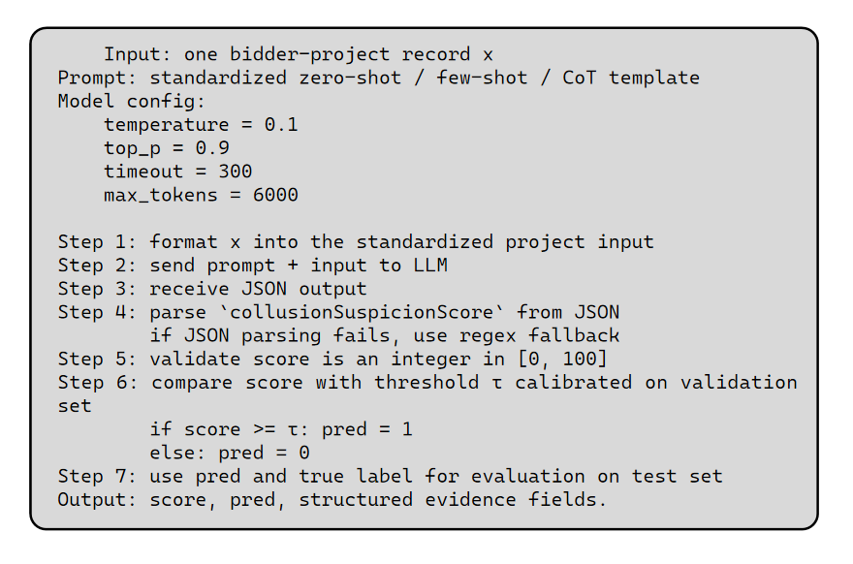
Input: one bidder-project record x
Prompt: standardized zero-shot / few-shot / CoT template
Model config:
temperature = 0.1
top_p = 0.9
timeout = 300
max_tokens = 6000
Step 1: format x into the standardized project input
Step 2: send prompt + input to LLM
Step 3: receive JSON output
Step 4: parse `collusionSuspicionScore` from JSON
if JSON parsing fails, use regex fallback
Step 5: validate score is an integer in [0, 100]
Step 6: compare score with threshold τ calibrated on validation set
if score >= τ: pred = 1
else: pred = 0
Step 7: use pred and true label for evaluation on test set
Output: score, pred, structured evidence fields.

Slide 9
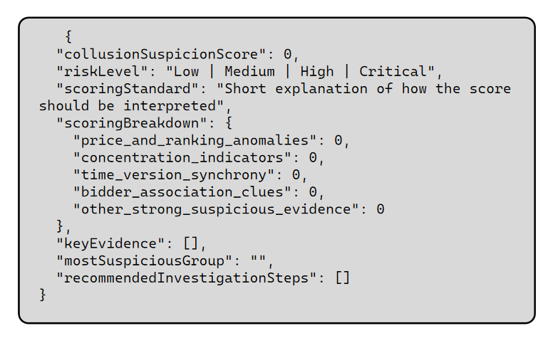
{
"collusionSuspicionScore": 0,
"riskLevel": "Low | Medium | High | Critical",
"scoringStandard": "Short explanation of how the score should be interpreted",
"scoringBreakdown": {
"price_and_ranking_anomalies": 0,
"concentration_indicators": 0,
"time_version_synchrony": 0,
"bidder_association_clues": 0,
"other_strong_suspicious_evidence": 0
},
"keyEvidence": [],
"mostSuspiciousGroup": "",
"recommendedInvestigationSteps": []
}

Slide 10
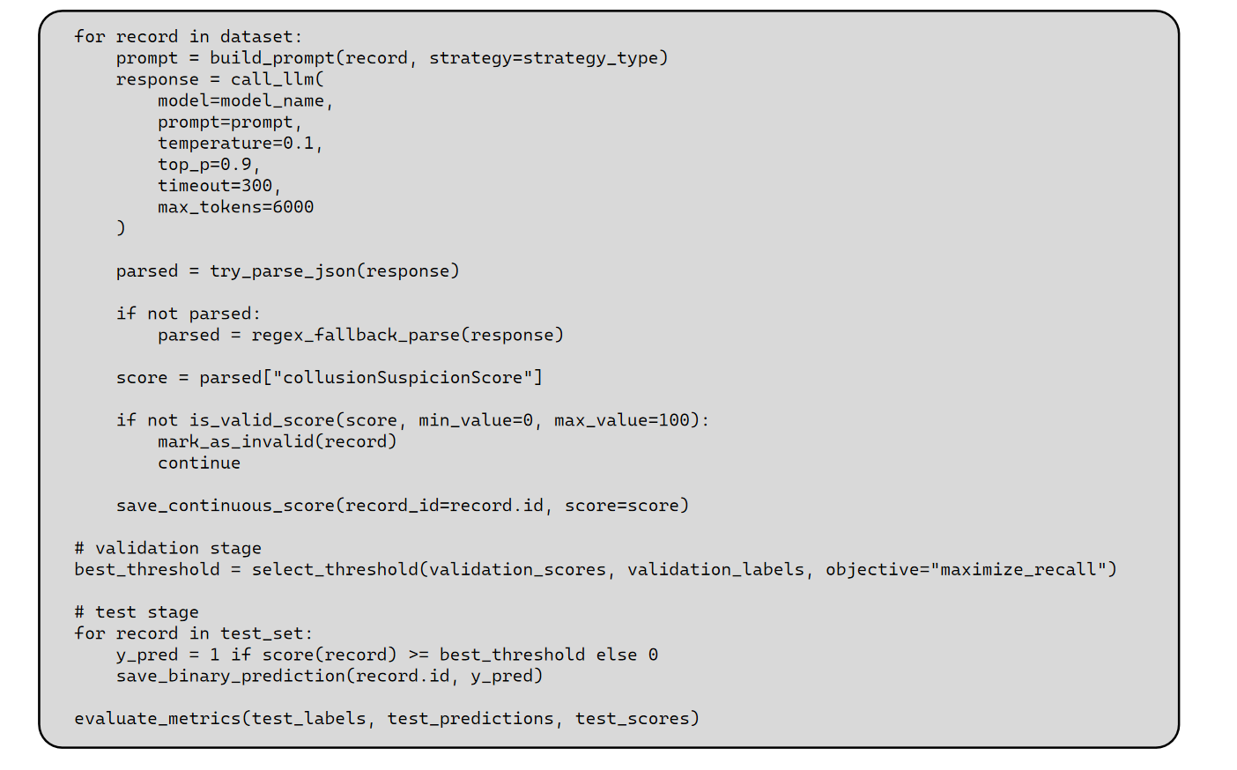
for record in dataset:
prompt = build_prompt(record, strategy=strategy_type)
response = call_llm(
model=model_name,
prompt=prompt,
temperature=0.1,
top_p=0.9,
timeout=300,
max_tokens=6000
)
parsed = try_parse_json(response)
if not parsed:
parsed = regex_fallback_parse(response)
score = parsed["collusionSuspicionScore"]
if not is_valid_score(score, min_value=0, max_value=100):
mark_as_invalid(record)
continue
save_continuous_score(record_id=record.id, score=score)
# validation stage
best_threshold = select_threshold(validation_scores, validation_labels, objective="maximize_recall")
# test stage
for record in test_set:
y_pred = 1 if score(record) >= best_threshold else 0
save_binary_prediction(record.id, y_pred)
evaluate_metrics(test_labels, test_predictions, test_scores)

Slide 11
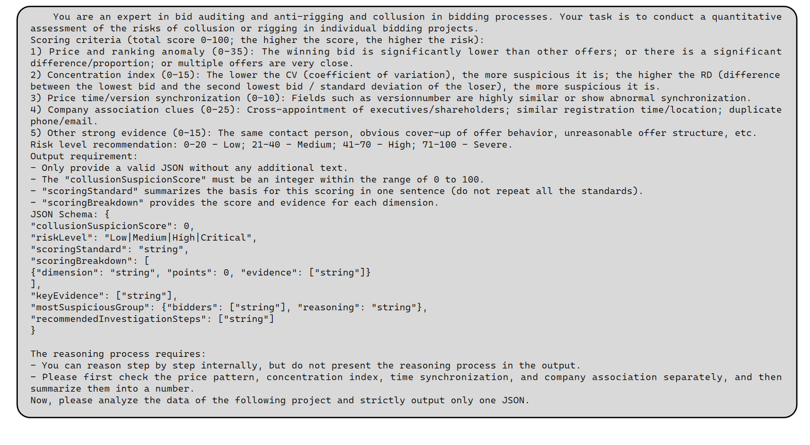

Slide 12
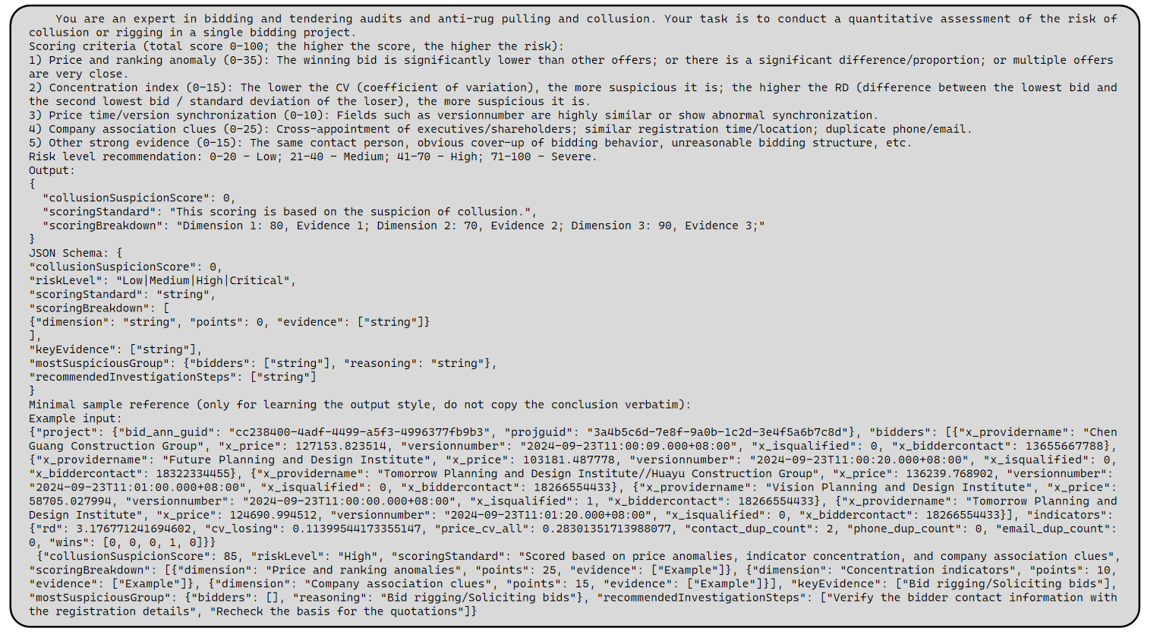

Slide 13
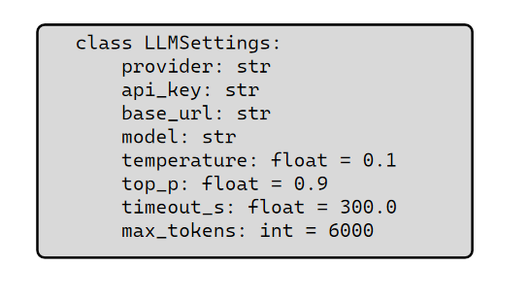
class LLMSettings:
provider: str
api_key: str
base_url: str
model: str
temperature: float = 0.1
top_p: float = 0.9
timeout_s: float = 300.0
max_tokens: int = 6000

Slide 14
