Slide 1
TLR Portal
Demonstration

Slide 2
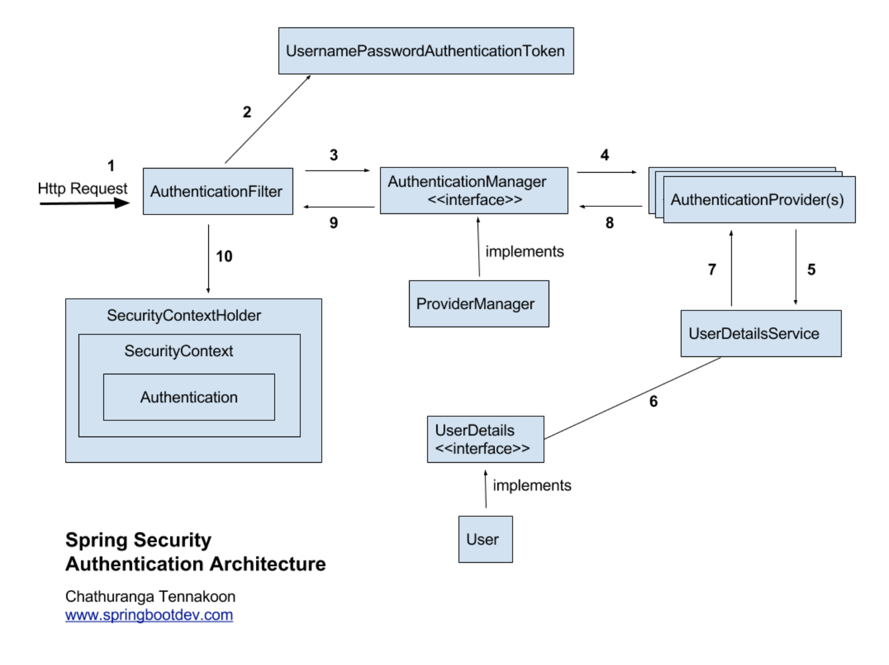
Spring security work flow
https://springbootdev.com/2017/08/23/spring-security-authentication-architecture/
LdapAuthenticationProvider
2,3 - SecurityConfiguration, 4 - Authenticator, 5 - UserService, 6 - SystemUser

Slide 3
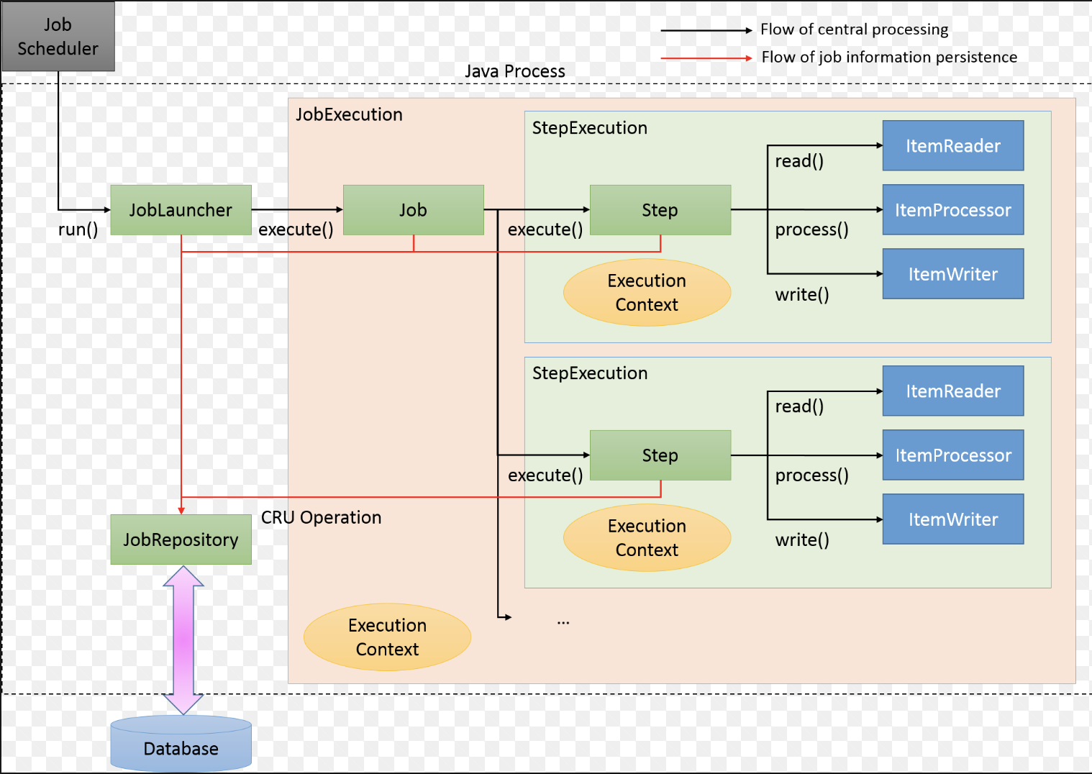
Spring batch work flow
BatchConfiguration
Scheduler
Transaction

