Slide 1
recap
BO
• Last meeting (10-13)
• whether 32 starting points is a good choice for GP & hyperparameter tuning (done)
• 5-10 seed BO (still running)
• ERCOT where to build PEM and what size (not started)
• Other projects (no decisions needed today)
• GTEP. Run PCM on the 2035 fleets
• AIChE 2026 talk: ERCOT figures freeze next week.
Notes:
Kay's wording 10-16. Rehearsal detail if asked: three decisions needed today = seed-study start size (NXT-D10a), tuned grading GP (NXT-D10b), seed count 5 vs 10 (1014-D1). GTEP: coal case solved on CRC 10-12 (5/6 optimal <= 1%, B1 accepted at 2.93% gap); PCM on the 2035 fleets awaits two data choices (generator parameters, load basis). Sources: pi-agenda.md §4; living-report-gtep.md. Verbal reconciliations for the recap wording (review 10-16): 'ERCOT figures freeze next week' — figure WORK starts 10-22, the freeze itself is 11-01 (slide 17); '5-10 seed BO (still running)' — 3 trajectories are live + P1 complete; the 5-vs-10 count is today's decision, the full study has not launched.

Slide 2
Your three asks from Tuesday — all three moved
Ask (Tue 10-13) | Status | Result in one line
Evidence that n0 = 32 is a good choice | DONE — zero new PCM runs | 32 is not yet sufficient: curtailment / cost error still drops a lot at 48; calibration at 32 is sound
Would hyperparameter tuning help? | DONE — pre-registered hyperparameter study | Yes, where the pathology lives: rbf+log1p repairs the round-3 audit (coverage 5/8 to 8/8)
5-10 random seeds behind the conclusions | RUNNING — 3 new trajectories live | P1 complete (hard cap); P2 / P3 / N1 graded r1; need your seed count to scope the rest
• Also closed this week:
• Stop rule held at both P1 overrun checkpoints (r3 = 0.62 τ, r4 = 0.30 τ — official grading).
• Shed mechanism identified from hourly data: day-ahead commitment, not PEM scarcity sales.
• ERCOT fuel-mix audit: our conversion is exact (45/45); the flagged discrepancies trace to the published dataset — AIChE figures stand.
Needed from you today: 3 decisions — seed-study n0 · grading GP · seed count (5 vs 10) — plus the wave-D wait condition restated and the standing g1 sign-off (slide 17).
Notes:
Sources: analysis/initial_design/N0_EVIDENCE.md; methods_C ledgers; mechanism/MECHANISM.md (261bed4); admin debug/fuelmix-check-2026-10-15.md. Dating: the meeting was Tue 10-13; the 1014-D* IDs are dated by when the decisions were recorded (10-14).

Slide 3
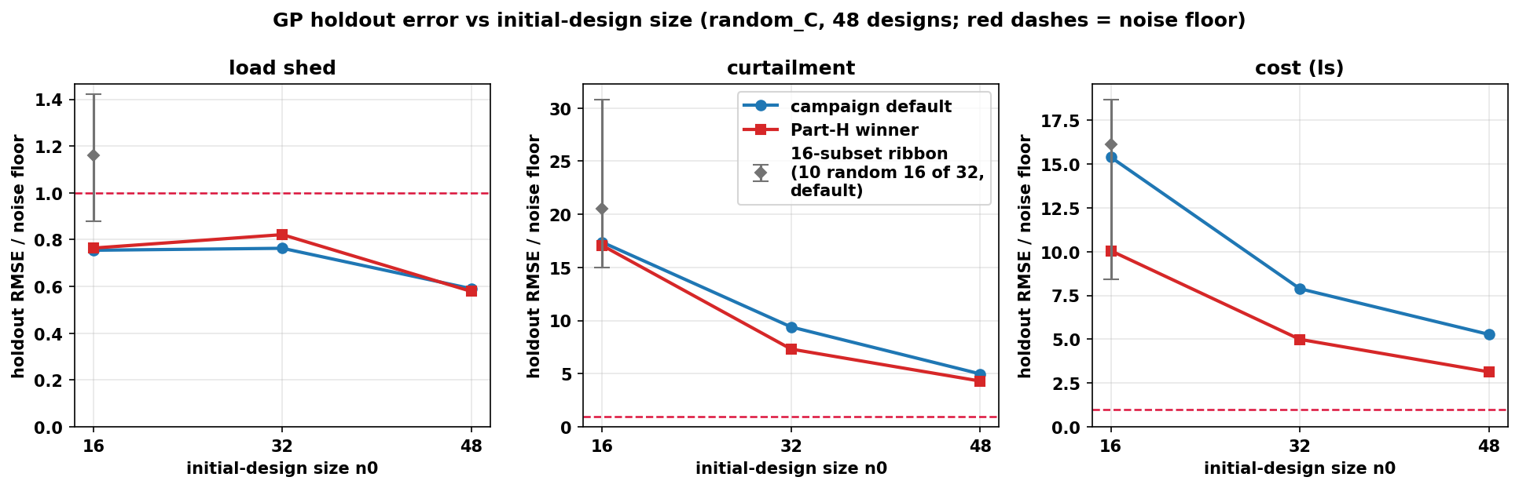
32 is not sufficient by looking at the error curve
• Holdout RMSE / noise floor (default GP)
• curtailment: 17.4, 9.4, 5.0
• cost: 15.4, 7.9, 5.3
• shed: below floor at every n0 (noise-limited)
- the curve is still descending at 48.
• But 32 could navigate BO ok
• ranking Spearman ≥ 0.94; hyperparameter tunning at 32 looks good
Notes:
criteria.json: E1 I(32to48) curt 0.470, cost 0.331 vs 1/3-rule 0.153/0.163 and 0.25 cap; E2 winner cov95 44/44/47 in [43,48]; Spearman >= 0.94 all objectives. Shed: 22/48 holdout rows below the 3,000 MWh floor. If asked why the 1/3 rule is the right bar: pre-registered geometric-convergence proxy (next 16 points should buy < 1/3 of what the last 16 bought); the 0.25 cap is a second independent bar; and at 48 the error is still ~5x the noise floor on curt/cost — the verdict survives any reasonable bar. If asked how a noise-limited shed GP drove a 3-objective BO: at explored designs shed is near-binary (the 22.4 MWh floor event vs nonzero); the GP captures that ordering, and Q2 (slide 15) shows the residual shed is PEM-independent — acquisition pressure correctly shifted to curt/cost. If asked 'your agenda said 3.0x at 48, the slide says 5.0x': the agenda quoted the in-sample LOO curve (curt 17.1-6.6-3.0); this slide is the stricter untouched-48-design holdout (17.4-9.4-5.0). The holdout is the honest number; both fail E1 the same way.

Slide 4
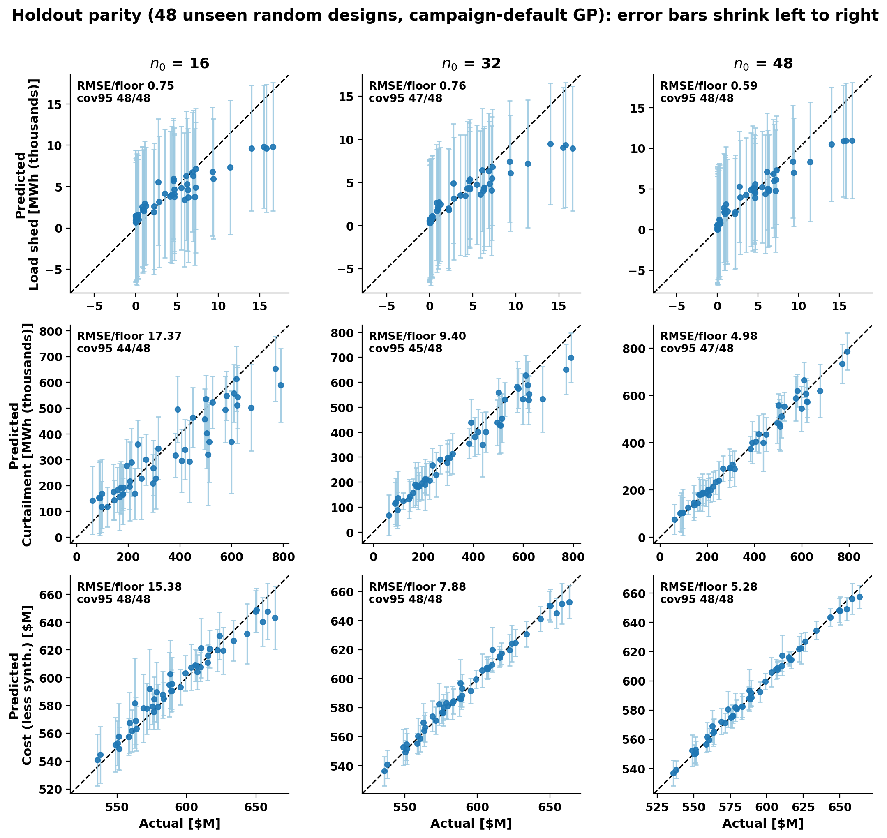
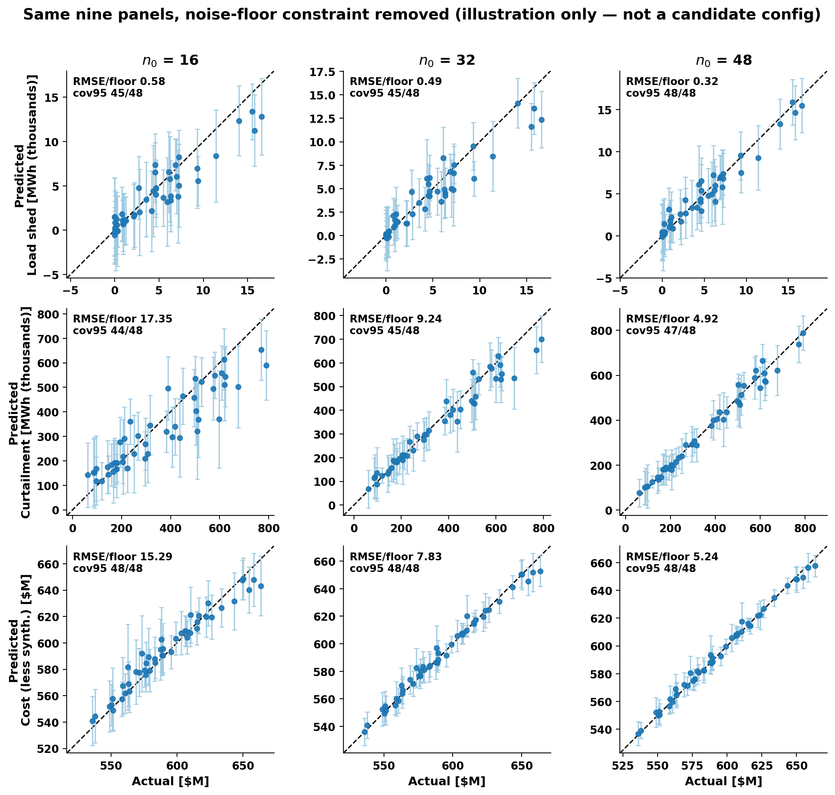
Parity plot comparison, point by point
GP 95% intervals with the floor
same GPs but likelihood noise bound fixed 1e-9;
Notes:
make_fig_parity.py: re-plot of the prompt-39 holdout scores (role=default); asserts rmse_over_floor matches holdout_results.csv to 1e-9 and cov95 exactly, per panel, before drawing. If asked why the shed bars are so wide: the predictive sd includes the floor-constrained noise (3,000 MWh) — the signal itself sits below the floor.

Slide 5
Tuning helps exactly where the pathology lives
• The start-set GP was never miscalibrated
• 32-start LOO: curtailment rms_z 0.81, coverage 31/32. The weak audit you saw (r3) belongs to the BO-augmented GP.
• Hyperparameter study (pre-registered NLPD rule)
• Winners: rbf + log1p (shed, curtailment), rbf (cost). Picked on the 32 starts, committed before any holdout scoring.
Round-3 audit cell (the PI's observation), refit + rescored:
curtailment | default GP | rbf+log1p
coverage (of 8) | 5 / 8 | 8 / 8
rms z-score | 2.008 | 1.050
reproduces recorded audit | exact | —
• Out-of-sample check:
• the winner's curtailment error rises from 4.8× (LOO) to 7.3× floor on the holdout — still better than the default; the advantage shrinks but holds.
• Secondary grid findings (BoTorch prior, kernels) → backup slide.
Notes:
part_h_loocv.csv (main-effects + best-combo design, 19 config-objective fits, LOO NLPD rule); hbo_cell.json; fits.json committed 07:34 UTC, first holdout call after. Proposal: adopt winner for grading/prediction only; acquisition untouched (NXT-D10b). H-BO cell mean_z: default 1.426 -> winner 0.967. If asked 'tuned-32 is still worse than default-48 — why not just use 48?': they fix different pathologies — tuning repairs late-round COVERAGE (5/8 -> 8/8), more points buy ACCURACY (winner 7.3x floor at 32 vs default 5.0x at 48); we propose both — tuned grading now, 48-point final paper surrogate (the D10a rider).

Slide 6
Same landscape, different probes — why seeds are the next instrument
Round-1 replay from... | Batch overlap with deployed r1 | Landscape rank corr. (Spearman)
32 starts (the real campaign) | 8 / 8 — reproduces it exactly | —
16 starts | 0 / 8 | 0.94 vs 32-start
48 starts | 0 / 8 | 0.95 vs 32-start
• How to read this
• The GPs agree on where is good (ρ ≥ 0.89 on every weight) …
• … but the acquisition argmax is a knife-edge: a different start set moves every batch member.
• A knife-edge argmax is expected for batch acquisition — which is exactly why one replay cannot answer the front question.
n0 changes which points BO probes next, even when it barely changes the fitted landscape.
Whether that changes the final front is an outcome question — answered by running the workflow from several seeds (your 1014-D1 directive), not by more GP diagnostics.
BO workflow: initial-design evidence + stop-rule closure · 2026-10-16
Notes:
replay_r1.json; frozen bo-gp 60e6328; proposal seed 20261007 re-derived and confirmed against round_records r1. Library import only — the frozen campaign state was never written. Three different Spearmans in this deck, if the PI probes: slide 5's >= 0.94 = GP-prediction vs truth RANKING on the holdout; this table's 0.94/0.95 = 16/48-start posterior LANDSCAPE vs the 32-start landscape; 'rho >= 0.89 on every weight' = the minimum of that landscape correlation across the 8 scalarization weights (min 0.892).

Slide 7
Decision
(a) BO need study starts from 32 or 48?
Start at 32
Comparable to the previous running; hyper campaign; calibration sound; replay reproduces the real r1; known cost: ~2× curtailment error vs 48.
Start at 48
More accurate surrogate, but +16 NEW PCM runs per fresh seed (≈ +25% per-seed cost) I think it – computational advantages of the paper’s claim
(b) Adopt rbf+log1p for grading only?
Yes — RECOMMENDED
Repairs the r3 overconfidence (5/8 → 8/8) with zero new runs.
Scope: grading / prediction / audit layer ONLY.
The acquisition path stays frozen
so every completed and running arm stays comparable; a tuned-acquisition arm can be a separate seed later if wanted.
Notes:
Full decision text: pi-agenda.md NXT-D10 (rigorous + plain versions). If asked 'if the curve is still descending at 48, why not 64?': the nested Sobol extends by construction — draws 49-64 are already defined, so a 64-point tier for seed 0 costs +16 runs ≈ 240 core-h and lets E1 be re-run at 48→64: if I(48→64) passes the 1/3-rule, 48 is certified as the final surrogate; if not, we learn the curve's slope. Proposed as a cheap one-seed add-on decided after the seed study launches — it does not gate anything today.

Slide 8
ACT 2 · THE STOP RULE + SEEDS (1014-D1)
The stop rule held — twice
P1 ran past its own stop to the hard cap, as a record-only overrun.
Three new trajectories are live.

Slide 9
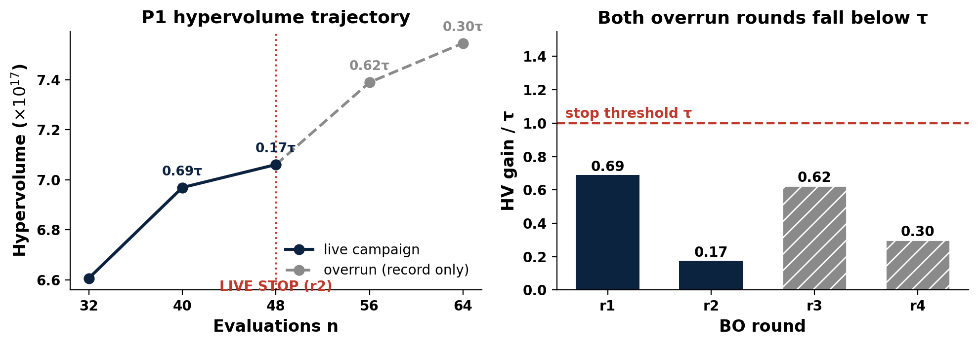
Stop rule closed at both overrun checkpoints (official)
• Live decision (10-10)
• STOP at r2: gains 0.69 τ, then 0.17 τ.
• Overrun verdict
• r3: 0.62 τ — below τ.
• r4: 0.30 τ — below τ. Hard cap; P1 complete.
• Cost of ignoring the rule
• 16 extra runs bought +6.9% HV, every increment sub-threshold.
P1: live stop at r2; overrun rounds r3 / r4 graded on CRC (record only)
/Users/yilu/Documents/GitHub/RTS-GMLC-n0evidence/trial_0826/campaign/analysis/quality_report/bo_1016/fig_stoprule_closed.png
BO workflow: initial-design evidence + stop-rule closure · 2026-10-16
Notes:
methods_C/P1/ledger.json; r4 graded on CRC (a8df435). τ = 5.263e16. Strategy-session preview reproduced every graded entry to relerr ≤ 2e-16 before the official grading landed; official numbers matched digit-for-digit.

Slide 10
Seed support is building — need your count
DECISION · 1014-D1 seed count: 5 or 10
Arm | Acquisition | Start set | Latest graded | Gain vs τ | State
P1 (the campaign) | q-ParEGO | the 32 (seed 0) | r4 (hard cap) | 0.30 τ | COMPLETE — stop held
P2 | q-ParEGO | fresh 32, seed 2 | r1 | 2.28 τ | r2 array running
P3 | q-ParEGO | fresh 32, seed 3 | r1 | 0.77 τ | r2 array running
N1 | qNEHVI | the 32 (seed 0) | r1 | 1.43 τ | r2 ran; grading lands tonight (preview 0.61 τ)
• What a 'seed' buys:
• One full workflow replicate — fresh Sobol init + BO rounds + stop rule — ≈ 1,000 core-h. Readout: the distribution of stop round and HV-at-stop across seeds.
• 5 seeds ≈ 5k core-h (fits this month); 10 seeds ≈ 10k core-h (stronger claim, ~2× queue time).
• The r1 spread above (2.28 τ vs 0.77 τ) is exactly what the trigger adjudicates. Proposal: start with 5 and pre-commit the extension — extend to 10 if the seed-to-seed range of HV-at-stop exceeds 25% of the mean BO gain (threshold yours to set). NXT-D10a fixes the start size.
BO workflow: initial-design evidence + stop-rule closure · 2026-10-16
Notes:
Ledgers: P2 r1 2.2773 τ (b46d66b), P3 r1 0.7697 τ (6fdfc93), N1 r1 1.43 τ. N1 r2 preview from the validated strategy-session HV replication (matched every graded entry to relerr <= 2e-16; P1 r4 official matched digit-for-digit) — divergence would mean a grading-infra bug, not a science change. If asked 'what if a seed never stops before the cap?': that IS the readout — the distribution of stop rounds; the hard cap bounds worst-case cost at ~1k core-h per seed. If asked 'P3 is sub-tau at r1 — will it stop at r2, and does the rule allow so short a campaign?': yes — P3 holds strike 1; a second sub-tau round stops it, and an early stop is a legitimate datum in the stop-round distribution. And r1 gain is NOT the extension-trigger input: the pre-committed trigger reads the HV-at-stop range (25% of mean gain), computed only once seeds stop.

Slide 11
ACT 3 · IN ONE WEEK, UNBLOCKED
The mechanism, and ERCOT
Two standing worries closed with zero new simulation:
why PEM cuts load shed, and whether the ERCOT conversion is sound.

Slide 12
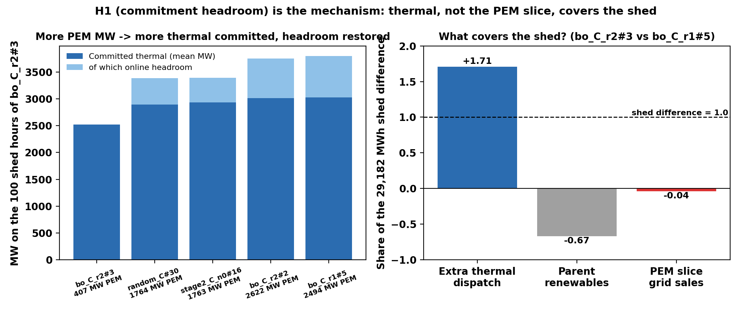
Why PEM cuts load shed — explained with hourly data (one model, one year)
PEM retrofits cut shed not by selling power in scarcity: priced PEM demand absorbs the wind forecast, so the day-ahead RUC commits ~1.2 GW more thermal and the scarce hours arrive with headroom.
• H1 commitment headroom — supported, dominant
• zero-shed designs commit +1.2-1.3 GW more thermal; headroom 737-771 MW vs exactly 0; extra thermal covers 107-171% of the shed difference in all 8 pairs.
• H2 scarcity sales (as driver), H3 location (slack-bus accounting), H4 reserve substitution — all contradicted
• Q2 floor: confirmed
• all 7 designs: one winter-morning event (12-18 h7, 22.4 MWh), same +962 MW commitment change, decomposition residual 0.000.
• Caveat: a property of cost-based RUC under priced withholding — model sensitivity goes to Discussion.
Committed thermal + headroom on the low design's 100 shed hours; shed-difference decomposition
/Users/yilu/Documents/GitHub/RTS-GMLC-mechanism/trial_0826/campaign/analysis/mechanism/fig_h1_commitment.png
BO workflow: initial-design evidence + stop-rule closure · 2026-10-16
Notes:
MECHANISM.md (261bed4): verdict table + two paper-ready paragraphs. Paper wording change: 'zero shed' → '≤ 22.4 MWh/yr, one PEM-independent commitment-limited event'. Spoken framing if useful: the day-ahead commitment stops trusting free wind. If asked 'is this a Prescient / cost-based-RUC artifact?': the mechanism needs only that DA commitment responds to the net-load increase from priced PEM withholding — any RUC formulation with that coupling should reproduce it; a reliability-based-RUC sensitivity is a bounded Discussion item, not new campaign work.

Slide 13
ERCOT: our conversion is exact; the quirks are the dataset's
ROADBLOCKER · wave D gated on 1014-D3
Flag | Finding | Action
Coal 32% of energy (real 2019: 20%) | TX-123BT's own coefficients put all 13 coal units below all 113 gas units in merit order | inherit + disclose
Gas looks like peakers | implied heat rates ~18.5 MMBtu/MWh (real CC ~7) — the paper says 'typical' coefficients | inherit + disclose
PV fleet 8.26 GW (real 2.3) | the DATASET is internally inconsistent: its paper says 2.48 GW, its published files 8.26 | inherit published files + 1 sentence
LMP $34 vs 2019 DAM $38 | right order — inflated heat rates ≈ offset missing scarcity adders | quote as 'TX-123BT prices'
• Our conversion: 45/45 cost coefficients exact; load side matches ERCOT 2019 actuals to the MW (383.8 TWh; preliminary peak 74,666 MW).
• Consequence: NO AIChE figure needs a re-run; diverted-wind ≈ $30/MWh stands as an in-model result.
• Wave D (location grids on ERCOT) IS the 'where to build PEM + what size' study from the recap — designed and ready; this audit was its last technical blocker. It waits only on the condition you set at the last meeting — please restate it.
BO workflow: initial-design evidence + stop-rule closure · 2026-10-16
Notes:
Full audit: admin/prompt/bogp/debug/fuelmix-check-2026-10-15.md. ERCOT 2019 actuals: gas 47%, coal 20%, wind 20%, nuclear 11% (ERCOT Fact Sheet 11/2020). If asked 'coal dispatches below gas in this dataset — can any ERCOT siting conclusion transfer to the real grid?': siting signals ride on network congestion + local renewable curtailment, which the dataset's transmission topology and wind/PV placement carry; the merit-order quirk shifts WHICH thermal units back down, so we report siting as a TX-123BT in-model result and check robustness via the bid-0 placebo rows in the wave-D design.

Slide 14
Decisions today + the two weeks ahead
# | Decision | Default if you only nod
1 | NXT-D10a: seed-study n0 = 32 or 48 | 32 (comparability); paper surrogate at 48
2 | NXT-D10b: rbf+log1p grading layer | adopt, grading only
3 | 1014-D1: seed count | 5 seeds now, extend to 10 if spread is wide
4 | Wave-D condition (1014-D3) | — needs your restatement
5 | g1 nuclear accounting (NXT-D7) | option c (+$28.188M, fronts unchanged)
• Next two weeks
• P2/P3/N1 arms run to their caps (automatic).
• Seed study launches at your count + n0.
• Stop-rule validation suite (synthetic + replay) lands.
• AIChE ERCOT figures 10-22 → 10-31.
• Figure freeze: 11-01.
BO workflow: initial-design evidence + stop-rule closure · 2026-10-16
Notes:
pi-agenda.md carries the rigorous + plain text for every open decision. Scope if the PI counts rows: 1-3 are today's NEW decisions; 4 is a restatement request; 5 is the standing NXT-D7 approval. g1 rehearsal (the PI's memo mentions option (b) flipping a verdict): the base nuclear fuel curve is FLAT — $3,208.99 per committed hour, zero marginal cost above 396 MW — so (a) the old delivered-x-$8.1 framing dissolves; (b) delivered-only is ill-defined and FLIPS the location analysis's nuclear cost slope (a LOCATION.md verdict); (c) restore the deleted curve: +$28.188M/yr CONSTANT in omega — an intercept shift only, every front and slope unchanged. Full text: g1_nuclear_fuel_accounting_PROPOSAL.md + pi-agenda NXT-D7.

Slide 15
Backup — hyperparameter grid by-products
• Secondary findings from the Part-H study (not decision-relevant today):
• The BoTorch default Gamma(3, 6) lengthscale prior is harmful on every objective here (curtailment error 27× floor) — bo-gp's no-prior default is right for this problem.
• Matérn 3/2 never beats Matérn 5/2 on any objective.
• Fixing the noise at the floor (vs inferring it above the floor) changes results little.
• No axis interaction was triggered: each winning combination beat every single-axis change.
BO workflow: initial-design evidence + stop-rule closure · 2026-10-16
Notes:
part_h_loocv.csv; selection rule: LOO NLPD in original units, ties within 0.02 nats break by LOO RMSE; winners committed to fits.json before the first holdout call.

Slide 16
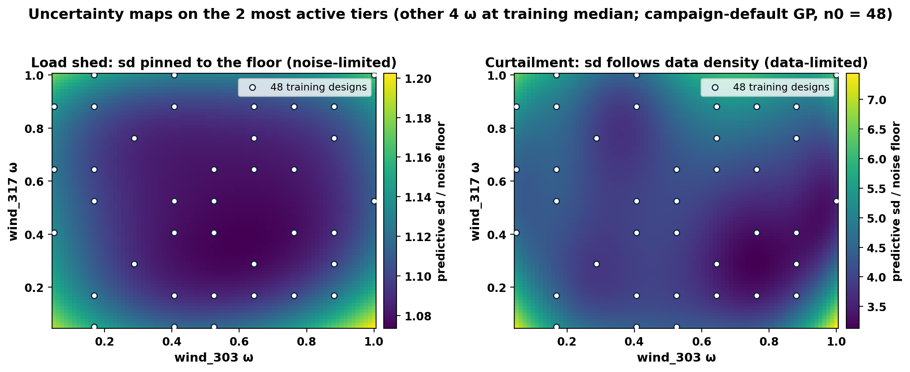
Backup — where the GP is uncertain (2-D slice)
Predictive sd / floor on the two most active tiers (wind_303, wind_317); other 4 ω at training median; n0 = 48
/Users/yilu/Documents/GitHub/RTS-GMLC-n0evidence/trial_0826/campaign/analysis/quality_report/bo_1016/fig_sd_heatmap.png
• Shed (left): sd/floor 1.07-1.20 everywhere — a featureless map pinned just above the floor; more points cannot change it (noise-limited).
• Curtailment (right): sd/floor 3.1-7.4 — lowest where training designs cluster, rising at the corners (data-limited; exactly what more points fix).
BO workflow: initial-design evidence + stop-rule closure · 2026-10-16
Notes:
make_fig_sdheat.py. Slice axes picked by curtailment ARD lengthscales (wind_303 ls 2.0 — by far the most active; wind_317 5.4). sd is the full predictive sd incl. likelihood noise, in floor units.

