Slide 1
recap
BO
• Last meeting (10-13)
• whether 32 starting points is a good choice for GP & hyperparameter tuning (done)
• 5-10 seed BO (still running)
• ERCOT where to build PEM and what size (not started)
• Other projects (no decisions needed today)
• GTEP. Run PCM on the 2035 fleets
• AIChE 2026 talk: ERCOT figures freeze next week.
Notes:
Sources: pi-agenda.md §4 rows 1014-D1..D3 (last-meeting outcomes); living-report-multipem.md (campaign status); admin/prompt/gtep/INDEX.md + living-report-gtep.md (coal case 10-12, prompt 05 awaiting the two data decisions). GTEP detail if asked: B1 = 1HR config with costs on, accepted at time limit, 2.93% gap (Kay 10-12); cost-on runs build 71-81 CTs, zero retirements.

Slide 2
Your three asks from Tuesday — all three moved
Ask (10-14) | Status | Result in one line
Evidence that n0 = 32 is a good choice | DONE — zero new PCM runs | 32 is not yet sufficient: curtailment / cost error still drops a lot at 48; calibration at 32 is sound
Would hyperparameter tuning help? | DONE — pre-registered hyperparameter study | Yes, where the pathology lives: rbf+log1p repairs the round-3 audit (coverage 5/8 to 8/8)
5-10 random seeds behind the conclusions | RUNNING — 3 new trajectories live | P1 complete (hard cap); P2 / P3 / N1 graded r1; need your seed count to scope the rest
• Also closed this week:
• Stop rule held at both P1 overrun checkpoints (r3 = 0.62 τ, r4 = 0.30 τ — official grading).
• Shed mechanism identified from hourly data: day-ahead commitment, not PEM scarcity sales.
• ERCOT fuel-mix audit: our conversion is exact (45/45); the flagged discrepancies trace to the published dataset — AIChE figures stand.
BO workflow: initial-design evidence + stop-rule closure · 2026-10-16
Notes:
Sources: analysis/initial_design/N0_EVIDENCE.md; methods_C ledgers; mechanism/MECHANISM.md (261bed4); admin debug/fuelmix-check-2026-10-15.md.

Slide 3
ACT 1 · THE GP QUESTION (1014-D2)
Is 32 starting points enough?
Test: refit the same GP on 16 / 32 / 48 starts; score every fit on an
untouched 48-run random holdout; judge by pre-registered criteria.

Slide 4
The test cost zero new PCM runs
• One nested Sobol sequence, by construction
• Draws 1-16 = the original 16 starts; 17-32 = the 32-point refresh; 33-48 = wave Q1 (already landed 10-13).
• So 16 ⊂ 32 ⊂ 48 — the 48-point design existed before the question was asked.
• Holdout nobody trained on
• waves/random_C: 48 i.i.d. uniform designs; zero overlap with the 48 training designs (asserted); never used to fit or tune.
• Pre-registered, then executed
• Acceptance criteria (E1 diminishing returns, E2 calibration, E3 tuning) fixed in the prompt BEFORE any fit.
• Pre-flight: Sobol regeneration bit-identical; 16/32 LOO tables reproduce the 10-08 deck to 4e-7.
Budget
0 new PCM runs
Every fit, audit and the frozen-machinery replay ran locally — no cluster time.
BO workflow: initial-design evidence + stop-rule closure · 2026-10-16
Notes:
Provenance: tiers.py SOBOL_SEED 20260821, scipy 1.16.3; Q1 manifest continues_waves [n0, n0b]. Asserts: initial_design/preflight.py (all pass).

Slide 5
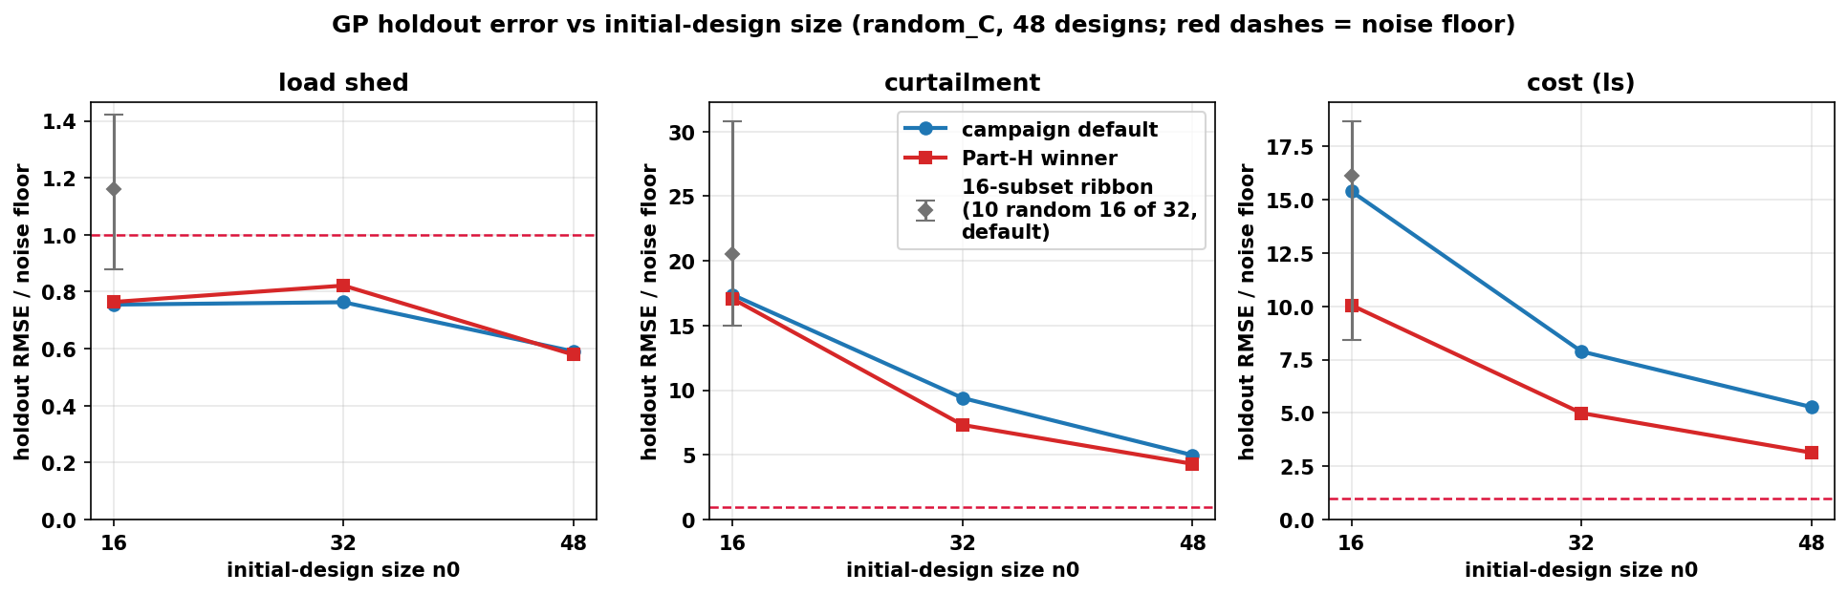
Verdict: 32 is not sufficient — the error curve has not bent
• Holdout RMSE / noise floor
• curtailment: 17.4 → 9.4 → 5.0
• cost: 15.4 → 7.9 → 5.3
• shed: below floor at every n0 (noise-limited)
• E1 (returns diminishing?) fails
• 32→48 cuts error almost as much as 16→32 — the curve is still descending at 48.
• But 32 steered BO soundly
• ranking Spearman ≥ 0.94; calibration at 32 passes (E2).
GP accuracy on the untouched holdout vs number of starting points
/Users/yilu/Documents/GitHub/RTS-GMLC-n0evidence/trial_0826/campaign/analysis/initial_design/figs/n0_curve_holdout.png
32 was good enough to steer the campaign; it is not good enough as the final reported surrogate. 48 is measurably better — and for THIS design (seed 0) the extra 16 runs already exist.
BO workflow: initial-design evidence + stop-rule closure · 2026-10-16
Notes:
criteria.json: E1 I(32to48) curt 0.470, cost 0.331 vs 1/3-rule 0.153/0.163 and 0.25 cap; E2 winner cov95 44/44/47 in [43,48]; Spearman >= 0.94 all objectives. Shed: 22/48 holdout rows below the 3,000 MWh floor. If asked why the 1/3 rule is the right bar: pre-registered geometric-convergence proxy (next 16 points should buy < 1/3 of what the last 16 bought); the 0.25 cap is a second independent bar; and at 48 the error is still ~5x the noise floor on curt/cost — the verdict survives any reasonable bar. If asked how a noise-limited shed GP drove a 3-objective BO: at explored designs shed is near-binary (the 22.4 MWh floor event vs nonzero); the GP captures that ordering, and Q2 (slide 13) shows the residual shed is PEM-independent — acquisition pressure correctly shifted to curt/cost.

Slide 6
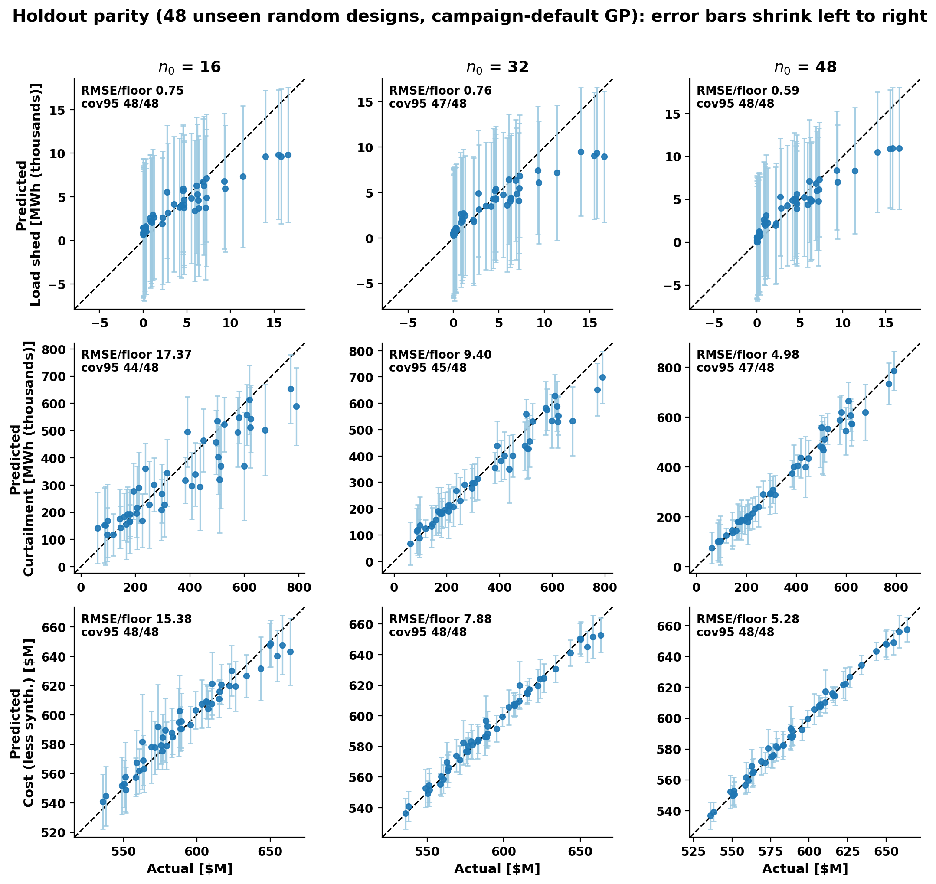
The same verdict, point by point
• How to read
• Each dot = one unseen random design; bar = the GP's 95% interval; red line = perfect prediction.
• Curtailment and cost (rows 2-3)
• Dots collapse onto the line and the bars tighten 16 → 32 → 48 — the same ~2× error cut per +16 points as the curve, now visible per design.
• Load shed (row 1)
• Scattered with wide bars at every n0 — noise-limited, as the floor analysis says. The GP stays honest about it: coverage 47-48/48.
• No new holdout touch
• Deterministic refit of the same campaign-default GPs; the script asserts every panel's RMSE and coverage match the official holdout table exactly.
Predicted vs actual on the 48 unseen designs; bars = GP 95% intervals
/Users/yilu/Documents/GitHub/RTS-GMLC-n0evidence/trial_0826/campaign/analysis/quality_report/bo_1016/fig_parity_holdout.png
BO workflow: initial-design evidence + stop-rule closure · 2026-10-16
Notes:
make_fig_parity.py: re-plot of the prompt-39 holdout scores (role=default); asserts rmse_over_floor matches holdout_results.csv to 1e-9 and cov95 exactly, per panel, before drawing. If asked why the shed bars are so wide: the predictive sd includes the floor-constrained noise (3,000 MWh) — the signal itself sits below the floor.

Slide 7
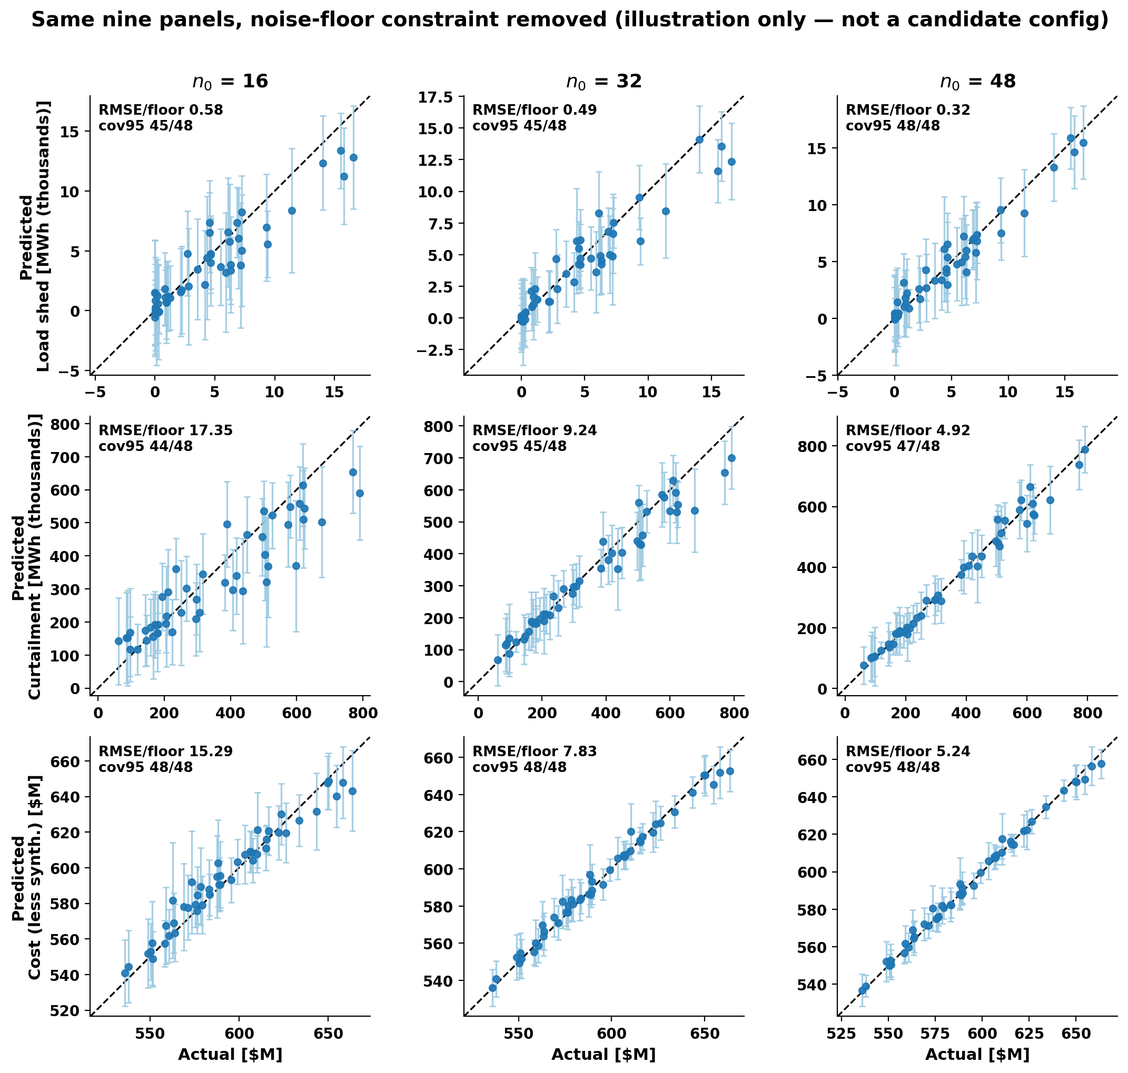
Same nine panels without the noise floors — only the shed row changes
• One change vs the previous slide
• The GP's noise lower bound is dropped; data, seed, kernel, metrics identical — flip back and forth to compare.
• The floor only ever binds on shed
• Shed: free-noise GP infers 317-527 MWh vs the 3,000 MWh floor — bars shrink ~6×, coverage stays 45-48/48, RMSE 0.32-0.58× floor.
• Curtailment / cost: inferred noise already sits 1.7-2.7× ABOVE the floor (curt 8.5-12.5k vs 5k MWh; cost $1.1-1.9M vs $0.5M), so those six panels barely move.
• Read
• Point predictions were never the problem — the wide shed bars are the pre-registered replicate-variability floor, conservative on unseen designs (the safe side for BO).
• Post-hoc illustration, outside the pre-registered axes — hints shed noise is design-dependent; a Discussion item, no decision today.
Identical GPs, likelihood noise bound (floor/σ)² → 1e-9; scored against the REAL floors
/Users/yilu/Documents/GitHub/RTS-GMLC-n0evidence/trial_0826/campaign/analysis/quality_report/bo_1016/fig_parity_nofloor.png
BO workflow: initial-design evidence + stop-rule closure · 2026-10-16
Notes:
make_fig_parity_nofloor.py (full 3x3; shed-only 2x3 variant in make_fig_nofloor.py). FlexGP with floor=1e-9 = unconstrained noise; metrics still scored against the real 3,000 MWh floor. If asked 'so is the floor wrong?': the floor encodes measured PCM replicate spread; holdout residuals below it suggest the replicate noise is heteroscedastic (large at shedding designs, small near zero shed, and random_C concentrates at low shed). A conservative homoscedastic floor costs nothing for BO — shed ordering is preserved — and a heteroscedastic noise model is future work for the final surrogate, not a campaign change.

Slide 8
Tuning helps exactly where the pathology lives
• The start-set GP was never miscalibrated
• 32-start LOO: curtailment rms_z 0.81, coverage 31/32. The weak audit you saw (r3) belongs to the BO-augmented GP.
• Hyperparameter study (pre-registered NLPD rule)
• Winners: rbf + log1p (shed, curtailment), rbf (cost). Picked on the 32 starts, committed before any holdout scoring.
Round-3 audit cell (the PI's observation), refit + rescored:
curtailment | default GP | rbf+log1p
coverage (of 8) | 5 / 8 | 8 / 8
rms z-score | 2.008 | 1.050
reproduces recorded audit | exact | —
• Out-of-sample check:
• the winner's curtailment error rises from 4.8× (LOO) to 7.3× floor on the holdout — still better than the default; the advantage shrinks but holds.
• Secondary grid findings (BoTorch prior, kernels) → backup slide.
BO workflow: initial-design evidence + stop-rule closure · 2026-10-16
Notes:
part_h_loocv.csv (main-effects + best-combo design, 19 config-objective fits, LOO NLPD rule); hbo_cell.json; fits.json committed 07:34 UTC, first holdout call after. Proposal: adopt winner for grading/prediction only; acquisition untouched (NXT-D10b).

Slide 9
Same landscape, different probes — why seeds are the next instrument
Round-1 replay from... | Batch overlap with deployed r1 | Landscape rank corr. (Spearman)
32 starts (the real campaign) | 8 / 8 — reproduces it exactly | —
16 starts | 0 / 8 | 0.94 vs 32-start
48 starts | 0 / 8 | 0.95 vs 32-start
• How to read this
• The GPs agree on where is good (ρ ≥ 0.89 on every weight) …
• … but the acquisition argmax is a knife-edge: a different start set moves every batch member.
• A knife-edge argmax is expected for batch acquisition — which is exactly why one replay cannot answer the front question.
n0 changes which points BO probes next, even when it barely changes the fitted landscape.
Whether that changes the final front is an outcome question — answered by running the workflow from several seeds (your 1014-D1 directive), not by more GP diagnostics.
BO workflow: initial-design evidence + stop-rule closure · 2026-10-16
Notes:
replay_r1.json; frozen bo-gp 60e6328; proposal seed 20261007 re-derived and confirmed against round_records r1. Library import only — the frozen campaign state was never written.

Slide 10
Decision NXT-D10 — two choices from Act 1
DECISION · NXT-D10a seed-study n0
DECISION · NXT-D10b tuned grading GP
(a) Seed study starts from 32 or 48?
Start at 32 — RECOMMENDED
Comparable to the live campaign; calibration sound; replay reproduces the real r1; known cost: ~2× curtailment error vs 48.
Start at 48
More accurate surrogate, but +16 NEW PCM runs per fresh seed (≈ +25% per-seed cost) — only seed 0's 48 points exist today.
Proposed, folds into D10a: the final paper surrogate is reported at 48.
(b) Adopt rbf+log1p for grading only?
Yes — RECOMMENDED
Repairs the r3 overconfidence (5/8 → 8/8) with zero new runs.
Scope: grading / prediction / audit layer ONLY.
The acquisition path stays frozen
so every completed and running arm stays comparable; a tuned-acquisition arm can be a separate seed later if wanted.
BO workflow: initial-design evidence + stop-rule closure · 2026-10-16
Notes:
Full decision text: pi-agenda.md NXT-D10 (rigorous + plain versions). If asked 'if the curve is still descending at 48, why not 64?': the nested Sobol extends by construction — draws 49-64 are already defined, so a 64-point tier for seed 0 costs +16 runs ≈ 240 core-h and lets E1 be re-run at 48→64: if I(48→64) passes the 1/3-rule, 48 is certified as the final surrogate; if not, we learn the curve's slope. Proposed as a cheap one-seed add-on decided after the seed study launches — it does not gate anything today.

Slide 11
ACT 2 · THE STOP RULE + SEEDS (1014-D1)
The stop rule held — twice
P1 ran past its own stop to the hard cap, as a record-only overrun.
Three new trajectories are live.

Slide 12
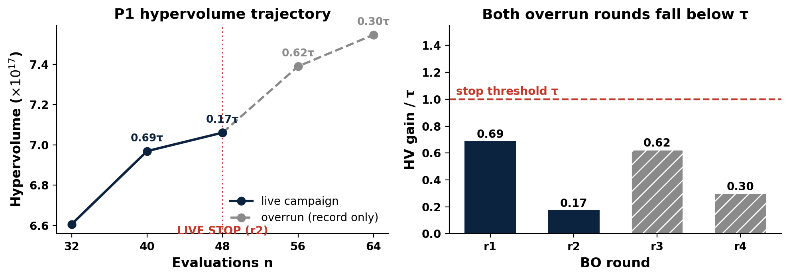
Stop rule closed at both overrun checkpoints (official)
• Live decision (10-10)
• STOP at r2: gains 0.69 τ, then 0.17 τ.
• Overrun verdict
• r3: 0.62 τ — below τ.
• r4: 0.30 τ — below τ. Hard cap; P1 complete.
• Cost of ignoring the rule
• 16 extra runs bought +6.9% HV, every increment sub-threshold.
P1: live stop at r2; overrun rounds r3 / r4 graded on CRC (record only)
/Users/yilu/Documents/GitHub/RTS-GMLC-n0evidence/trial_0826/campaign/analysis/quality_report/bo_1016/fig_stoprule_closed.png
BO workflow: initial-design evidence + stop-rule closure · 2026-10-16
Notes:
methods_C/P1/ledger.json; r4 graded on CRC (a8df435). τ = 5.263e16. Strategy-session preview reproduced every graded entry to relerr ≤ 2e-16 before the official grading landed; official numbers matched digit-for-digit.

Slide 13
Seed support is building — need your count
DECISION · 1014-D1 seed count: 5 or 10
Arm | Acquisition | Start set | Latest graded | Gain vs τ | State
P1 (the campaign) | q-ParEGO | the 32 (seed 0) | r4 (hard cap) | 0.30 τ | COMPLETE — stop held
P2 | q-ParEGO | fresh 32, seed 2 | r1 | 2.28 τ | r2 array running
P3 | q-ParEGO | fresh 32, seed 3 | r1 | 0.77 τ | r2 array running
N1 | qNEHVI | the 32 (seed 0) | r1 | 1.43 τ | r2 ran; grading lands tonight (preview 0.61 τ)
• What a 'seed' buys:
• One full workflow replicate — fresh Sobol init + BO rounds + stop rule — ≈ 1,000 core-h. Readout: the distribution of stop round and HV-at-stop across seeds.
• 5 seeds ≈ 5k core-h (fits this month); 10 seeds ≈ 10k core-h (stronger claim, ~2× queue time).
• Proposal: start with 5 and pre-commit the extension trigger — extend to 10 if the seed-to-seed range of HV-at-stop exceeds 25% of the mean BO gain (threshold yours to set). NXT-D10a fixes the start size.
BO workflow: initial-design evidence + stop-rule closure · 2026-10-16
Notes:
Ledgers: P2 r1 2.2773 τ (b46d66b), P3 r1 0.7697 τ (6fdfc93), N1 r1 1.43 τ. N1 r2 preview from the validated strategy-session HV replication (matched every graded entry to relerr <= 2e-16; P1 r4 official matched digit-for-digit) — divergence would mean a grading-infra bug, not a science change. If asked 'what if a seed never stops before the cap?': that IS the readout — the distribution of stop rounds; the hard cap bounds worst-case cost at ~1k core-h per seed.

Slide 14
ACT 3 · IN ONE WEEK, UNBLOCKED
The mechanism, and ERCOT
Two standing worries closed with zero new simulation:
why PEM cuts load shed, and whether the ERCOT conversion is sound.

Slide 15
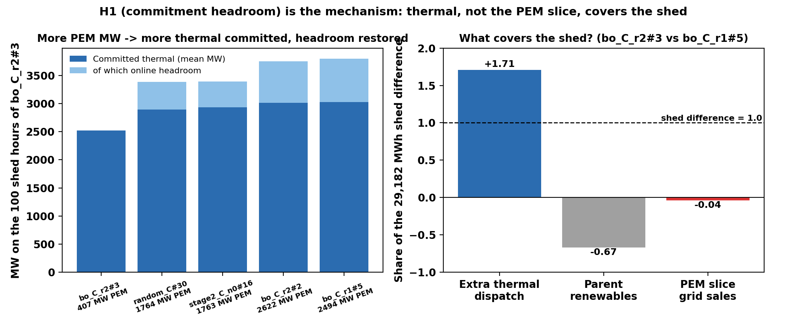
Why PEM cuts load shed — explained with hourly data (one model, one year)
PEM retrofits cut shed not by selling power in scarcity: priced PEM demand absorbs the wind forecast, so the day-ahead RUC commits ~1.2 GW more thermal and the scarce hours arrive with headroom.
• H1 commitment headroom — supported, dominant
• zero-shed designs commit +1.2-1.3 GW more thermal; headroom 737-771 MW vs exactly 0; extra thermal covers 107-171% of the shed difference in all 8 pairs.
• H2 scarcity sales (as driver), H3 location (slack-bus accounting), H4 reserve substitution — all contradicted
• Q2 floor: confirmed
• all 7 designs: one winter-morning event (12-18 h7, 22.4 MWh), same +962 MW commitment change, decomposition residual 0.000.
• Caveat: a property of cost-based RUC under priced withholding — model sensitivity goes to Discussion.
Committed thermal + headroom on the low design's 100 shed hours; shed-difference decomposition
/Users/yilu/Documents/GitHub/RTS-GMLC-mechanism/trial_0826/campaign/analysis/mechanism/fig_h1_commitment.png
BO workflow: initial-design evidence + stop-rule closure · 2026-10-16
Notes:
MECHANISM.md (261bed4): verdict table + two paper-ready paragraphs. Paper wording change: 'zero shed' → '≤ 22.4 MWh/yr, one PEM-independent commitment-limited event'. Spoken framing if useful: the day-ahead commitment stops trusting free wind. If asked 'is this a Prescient / cost-based-RUC artifact?': the mechanism needs only that DA commitment responds to the net-load increase from priced PEM withholding — any RUC formulation with that coupling should reproduce it; a reliability-based-RUC sensitivity is a bounded Discussion item, not new campaign work.

Slide 16
ERCOT: our conversion is exact; the quirks are the dataset's
ROADBLOCKER · wave D gated on 1014-D3
Flag | Finding | Action
Coal 32% of energy (real 2019: 20%) | TX-123BT's own coefficients put all 13 coal units below all 113 gas units in merit order | inherit + disclose
Gas looks like peakers | implied heat rates ~18.5 MMBtu/MWh (real CC ~7) — the paper says 'typical' coefficients | inherit + disclose
PV fleet 8.26 GW (real 2.3) | the DATASET is internally inconsistent: its paper says 2.48 GW, its published files 8.26 | inherit published files + 1 sentence
LMP $34 vs 2019 DAM $38 | right order — inflated heat rates ≈ offset missing scarcity adders | quote as 'TX-123BT prices'
• Our conversion: 45/45 cost coefficients exact; load side matches ERCOT 2019 actuals to the MW (383.8 TWh; preliminary peak 74,666 MW).
• Consequence: NO AIChE figure needs a re-run; diverted-wind ≈ $30/MWh stands as an in-model result.
• Wave D (location grids on ERCOT) still waits on the condition you set on 10-14 — please restate it.
BO workflow: initial-design evidence + stop-rule closure · 2026-10-16
Notes:
Full audit: admin/prompt/bogp/debug/fuelmix-check-2026-10-15.md. ERCOT 2019 actuals: gas 47%, coal 20%, wind 20%, nuclear 11% (ERCOT Fact Sheet 11/2020).

Slide 17
Decisions today + the two weeks ahead
# | Decision | Default if you only nod
1 | NXT-D10a: seed-study n0 = 32 or 48 | 32 (comparability); paper surrogate at 48
2 | NXT-D10b: rbf+log1p grading layer | adopt, grading only
3 | 1014-D1: seed count | 5 seeds now, extend to 10 if spread is wide
4 | Wave-D condition (1014-D3) | — needs your restatement
5 | g1 nuclear accounting (NXT-D7) | option c (+$28.188M, fronts unchanged)
• Next two weeks
• P2/P3/N1 arms run to their caps (automatic).
• Seed study launches at your count + n0.
• 37 stop-rule validation suite (synthetic + replay) lands.
• AIChE ERCOT figures 10-22 → 10-31.
• Figure freeze: 11-01.
BO workflow: initial-design evidence + stop-rule closure · 2026-10-16
Notes:
pi-agenda.md carries the rigorous + plain text for every open decision.

Slide 18
Backup — hyperparameter grid by-products
• Secondary findings from the Part-H study (not decision-relevant today):
• The BoTorch default Gamma(3, 6) lengthscale prior is harmful on every objective here (curtailment error 27× floor) — bo-gp's no-prior default is right for this problem.
• Matérn 3/2 never beats Matérn 5/2 on any objective.
• Fixing the noise at the floor (vs inferring it above the floor) changes results little.
• No axis interaction was triggered: each winning combination beat every single-axis change.
BO workflow: initial-design evidence + stop-rule closure · 2026-10-16
Notes:
part_h_loocv.csv; selection rule: LOO NLPD in original units, ties within 0.02 nats break by LOO RMSE; winners committed to fits.json before the first holdout call.

Slide 19
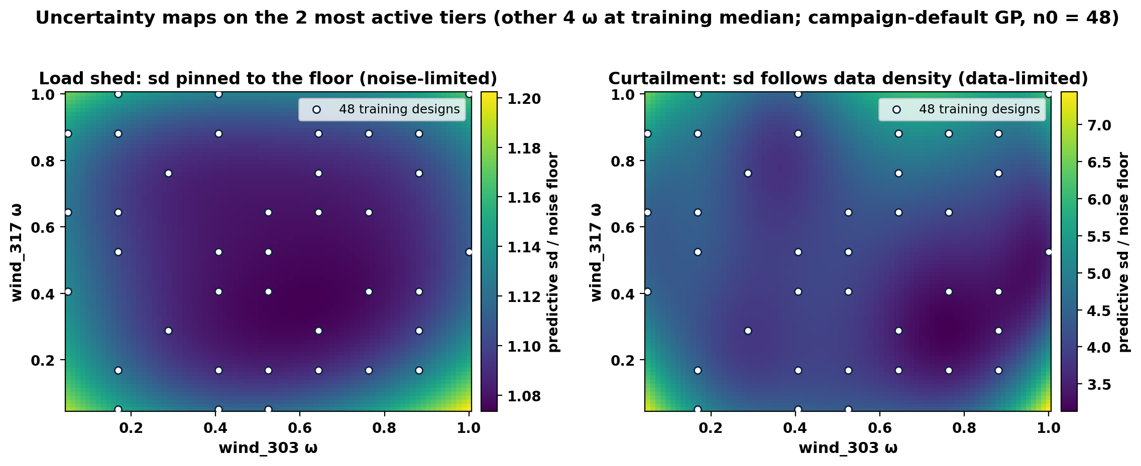
Backup — where the GP is uncertain (2-D slice)
Predictive sd / floor on the two most active tiers (wind_303, wind_317); other 4 ω at training median; n0 = 48
/Users/yilu/Documents/GitHub/RTS-GMLC-n0evidence/trial_0826/campaign/analysis/quality_report/bo_1016/fig_sd_heatmap.png
• Shed (left): sd/floor 1.07-1.20 everywhere — a featureless map pinned just above the floor; more points cannot change it (noise-limited).
• Curtailment (right): sd/floor 3.1-7.4 — lowest where training designs cluster, rising at the corners (data-limited; exactly what more points fix).
BO workflow: initial-design evidence + stop-rule closure · 2026-10-16
Notes:
make_fig_sdheat.py. Slice axes picked by curtailment ARD lengthscales (wind_303 ls 2.0 — by far the most active; wind_317 5.4). sd is the full predictive sd incl. likelihood noise, in floor units.

