Slide 1
Prescient PCM vs Paper UC: Benchmarking Status and Effort
TX-123BT ERCOT | Collaborator/Supervisor Update | March 2026
Purpose: estimate effort needed to align Prescient PCM with paper UC benchmark.
Coverage: model-difference audit, curtailment experiment status, hydro Q1 benchmark signal.
Decision focus: where to invest benchmarking effort next.
IDAES-GTEP | Benchmarking update section (~20 minutes)

Slide 2
Updates
Comparing paper’s pyomo and our PCM, main ddifferences are renewable treatment, chronology, pricing workflow.
[update] Hydro inclusion in Q1 did not materially improve alignment to paper behavior.
[update] I updated curtailment implementation and redo a Q1, it is still running after 4 days.

Slide 3
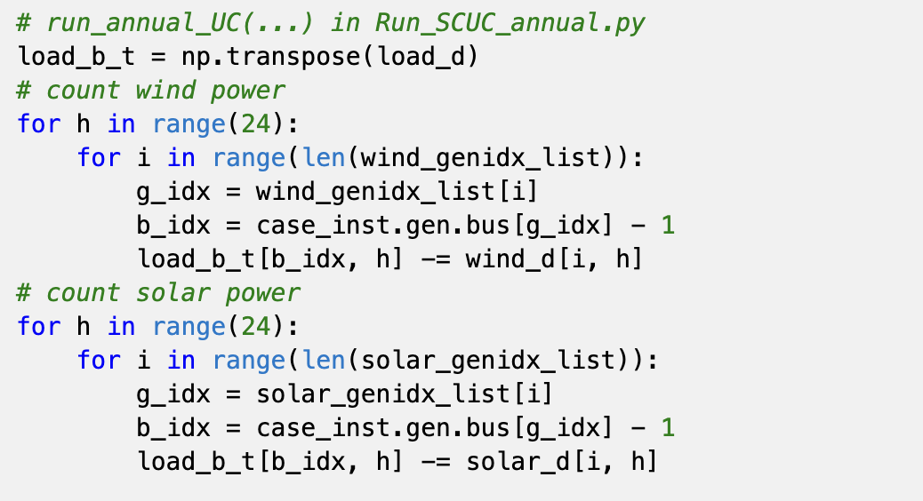
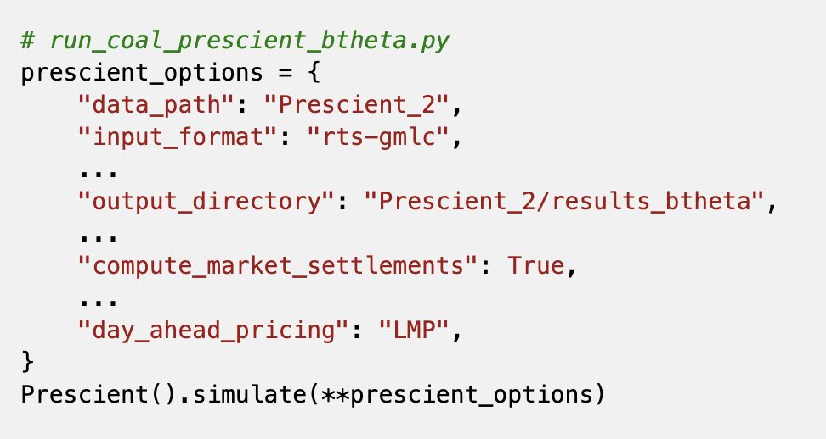
Paper UC vs Prescient PCM: Comparison Matrix
model comparison
Aspect | Paper model | Our Prescient
Renewables | Subtracted from load (net-load) | Explicit generators in clearing
Paper removed wind/solar from demand before optimization; Prescient keeps renewable units explicit in market clearing.

Slide 4
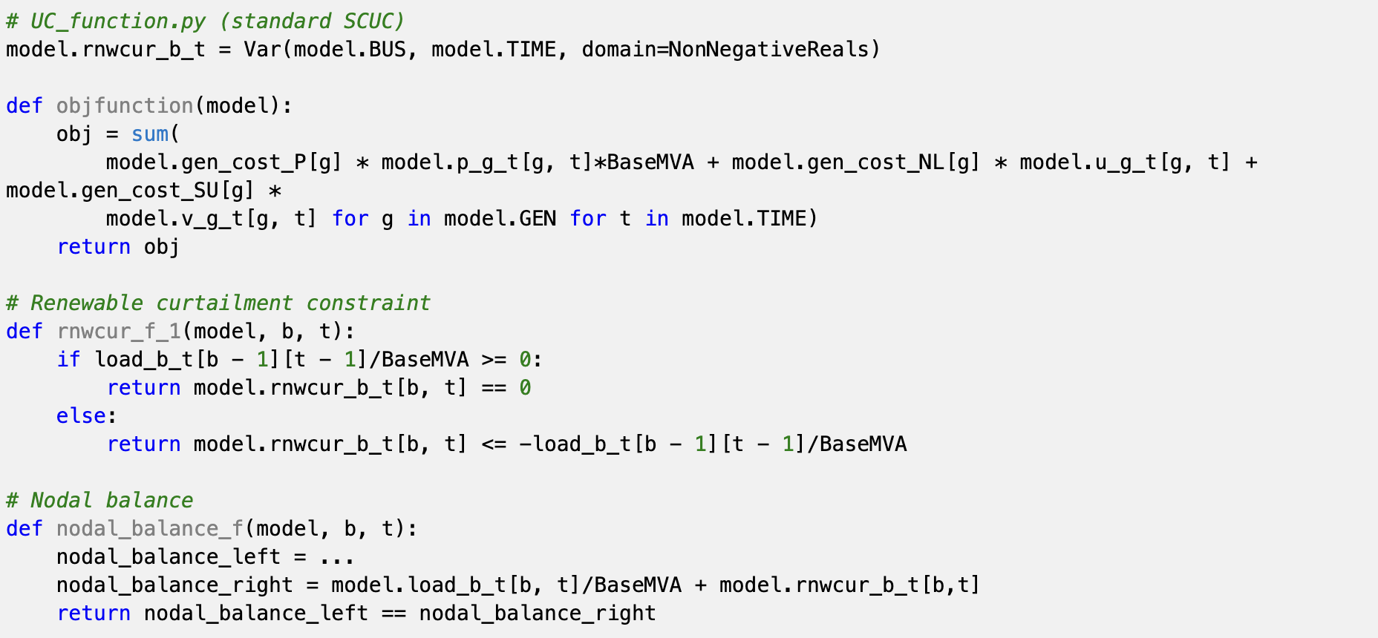
Paper UC vs Prescient PCM: Comparison Matrix
model comparison
Aspect | Paper model | Our Prescient
Curtailment | Free relief variable in balance | Penalty/cap mediated behavior
`rnwcur_b_t` will return the absolute value of netload if netload after renew is negative
it didn’t consider the economic penalty after removing renewable generations
Wind/solar are subtracted from demand first to form net load (`load_b_t`).
`rnwcur_b_t` is a nonnegative slack on nodal balance.
Objective excludes direct curtailment cost term.
paper curtailment is balancing relief, not explicit renewable market-bid economics.

Slide 5
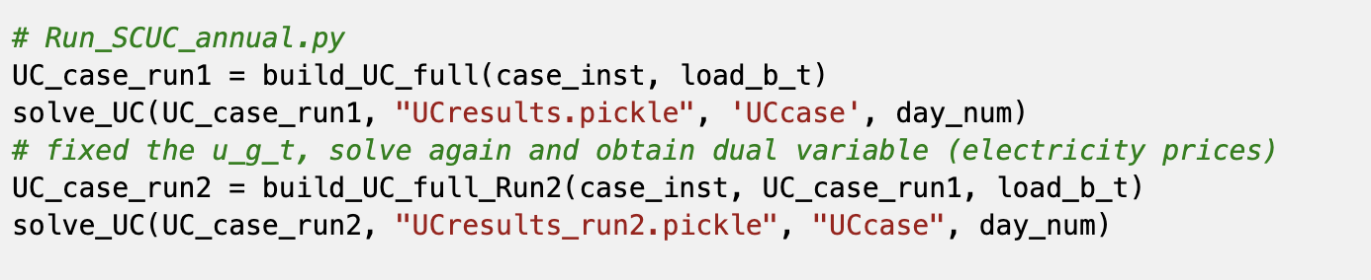
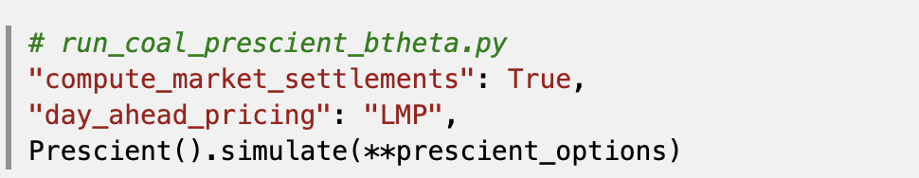
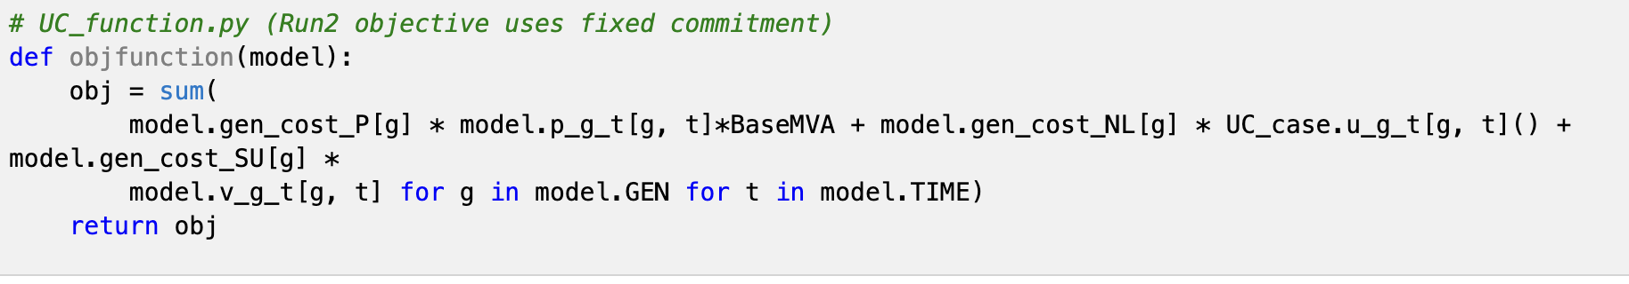
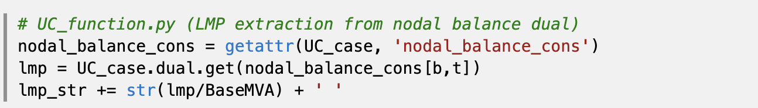
Paper UC vs Prescient PCM: Comparison Matrix
model comparison
Aspect | Paper model | Our Prescient
Pricing | Two-pass dual pricing; fixed commitment | Integrated RUC/SCED pricing
By fixing the on/off states and running the math again, the paper forces prices to only reflect the pure cost of fuel, which keeps their prices strictly positive.
Notes:
paper uses explicit fixed-commitment re-solve for dual prices; Prescient prices come from its integrated RUC/SCED market engine.

Slide 6
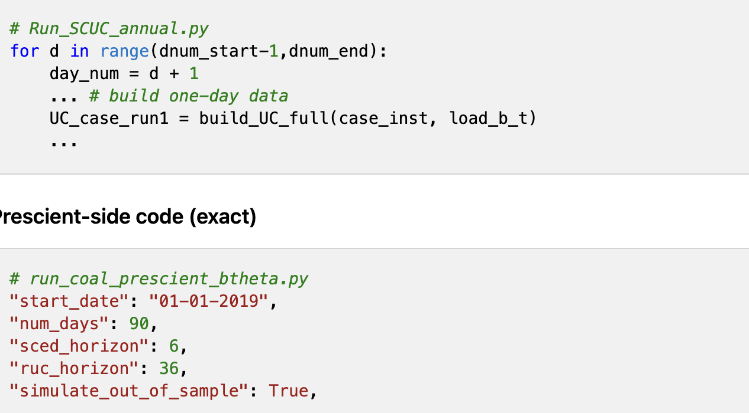
Paper UC vs Prescient PCM: Comparison Matrix
model comparison
Aspect | Paper model | Our Prescient
Chronology | Daily runs | Rolling horizons (90d, look-ahead)

Slide 7
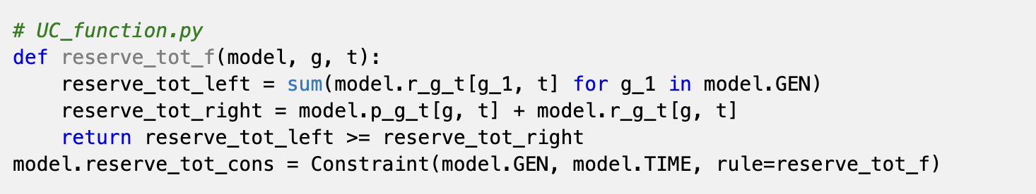
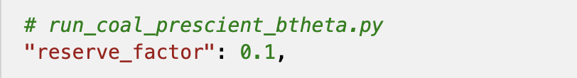
Paper UC vs Prescient PCM: Comparison Matrix
model comparison
Aspect | Paper model | Our Prescient
Reserves | Custom reserve constraints | reserve_factor design
reserve requirement structure is not equivalent. The paper's reserve_tot_f constraint enforces an N-1 adequacy form: for every generator g, total system reserve must exceed that generator's output plus its own reserve (i.e., the system can withstand losing any single unit). This is structurally different from Prescient's percentage-of-load reserve requirement (reserve_factor=0.1, meaning 10% of load). The paper form is more conservative under high single-unit concentration and less conservative when many small units are online.

Slide 8
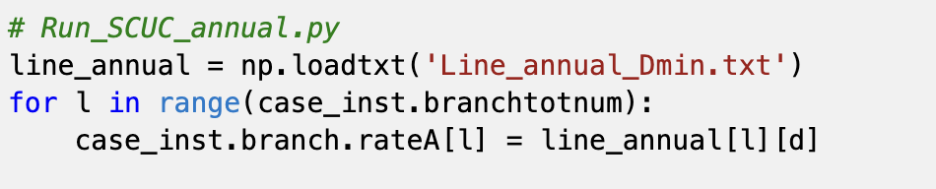
Paper UC vs Prescient PCM: Comparison Matrix
model comparison
Aspect | Paper model | Our Prescient
Line ratings | Day-specific / hourly DLR options | RTS-GMLC path unless remapped
Prescient runs use RTS-GMLC branch data path unless explicitly time-varying mapped.
Uses limits that change every day or even every hour (Dynamic Line Ratings). For example, on a cold, windy day, lines cool down faster and can carry more power safely. Prescient is static so easier to get congested

Slide 9
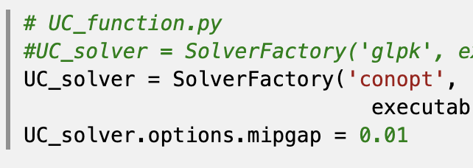
Paper UC vs Prescient PCM: Comparison Matrix
model comparison
Aspect | Paper model | Our Prescient
Solver options | Conopt (comment out glpk) | Gurobi
CONOPT is a nonlinear programming (NLP) solver that cannot handle binary/integer variables natively. The paper model declares u_g_t and v_g_t as domain=Binary, but CONOPT would solve a continuous relaxation where these variables take values in [0,1] rather than {0,1}. This means Run1 commitments may be fractional, and the Run2 dual prices are extracted from a model with relaxed (non-integer) commitment decisions fixed as continuous values.
GLPK is for integer but CONOPT is NLP it may result in 0.5 on/off which is not realistic generators
Smooth the system and make things more likely to be positive.

Slide 10
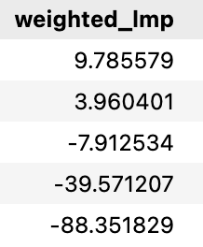
Curtailment Penalty Work: Current Status
Experiment framework in place; run still in progress
Ongoing 4-day simulation for 90-day experiment; run not finished yet.
Experiment implemented in current Prescient pipeline and reproducible by case manifest.
This section intentionally remains brief until the full run is complete.
Penalty sweep ($/MWh)
300
1000
2000
5000
10000
How new curtailment was applied:
No "renewable curtailment penalty" option in PCM
Use threshold penalty as proxies to influence dispatch, curtailment, and lmp outcomes.
Notes:
Source: /Users/yilu/Documents/GitHub/idaes-gtep/quality_reports/curtailment_penalty_experiment_setup_2026-02-28.md

Slide 11
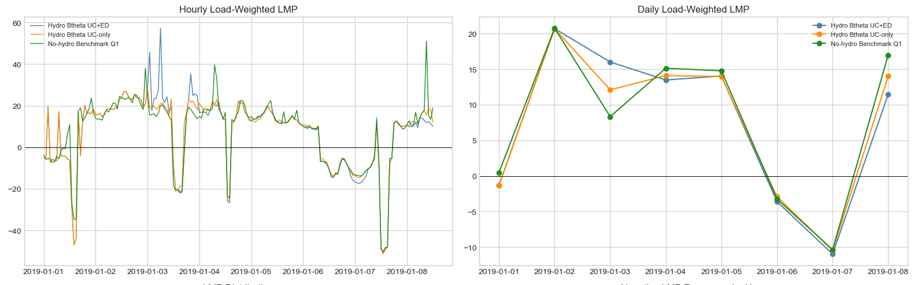
Hydro Q1 Check: No Material Improvement
Hydro inclusion does not uplift LMP alignment in current setup
Scenario | Weighted LMP | Floor-hit share | Min | Max
Hydro Btheta UC+ED | 8.33 | 1.07% | -1000.0 | 276.6
Hydro Btheta UC-only | 8.10 | 1.07% | -1000.0 | 276.2
No-hydro Benchmark Q1 | 8.26 | 1.07% | -1000.0 | 368.0
Hydro UC+ED and hydro UC-only results were very close to no-hydro Q1

Slide 12
Decisions points
Lock scope before deeper simulation spend
1. Prioritize structural alignment (renewables/chronology/pricing) before hydro expansion.
2. Define success criteria as sign/trend alignment first, magnitude second.
Notes:
This closing slide is for meeting decisions and near-term execution commitments.

Slide 13
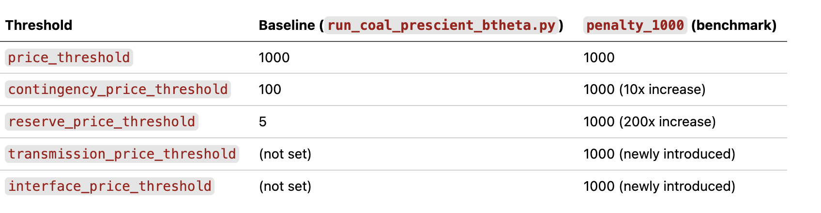
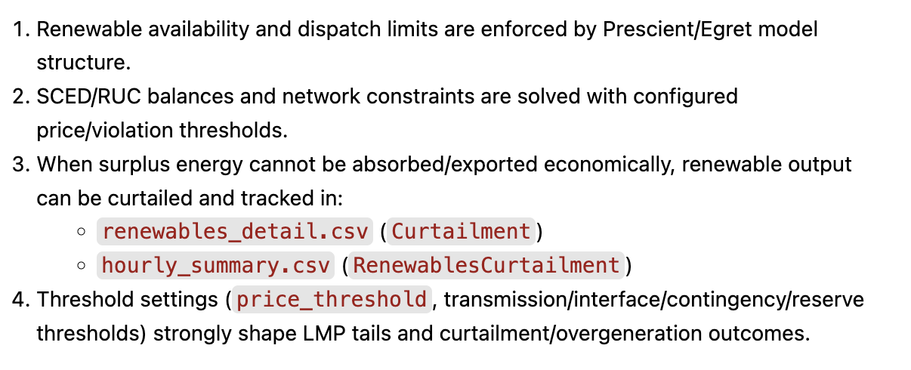
How Curtailment Is Realized in Prescient Pipeline
Proxy mechanism via SCED/RUC penalty-threshold economics
No standalone 'renewable curtailment penalty' switch in current Prescient run configuration.
Tune price/violation thresholds to shape dispatch and curtailment outcomes.
Curtailment is tracked directly in outputs:
renewables_detail.csv -> Curtailment
hourly_summary.csv -> RenewablesCurtailment
Sweep cases: 300 / 1000 / 2000 / 5000 / 10000 $/MWh.
[curtailment-penalty proxy]

Slide 14
Curtailment Penalty Sweep Results (Jan-Mar Common Window)
Common window: 2019-01-01 00:00 to 2019-03-31 23:00
Case | Neg LMP % | Floor-hit % | Weighted LMP | Curtail (MWh) | OverGen (MWh)
penalty_300 | 9.62% | 1.52% | 9.79 | 118,560 | 888,328
penalty_1000 | 10.51% | 1.50% | 3.96 | 124,325 | 889,003
penalty_2000 | 11.43% | 1.51% | -7.91 | 125,040 | 888,986
penalty_5000 | 11.91% | 1.49% | -39.57 | 121,351 | 889,607
penalty_10000 | 12.80% | 1.49% | -88.35 | 123,328 | 888,693
Higher caps widen tails and increase negative-LMP frequency.
Floor-hit fraction stays ~1.5% across cases (persistent clipping).
Weighted LMP trends downward sharply as cap increases.
Overgeneration remains high and nearly flat (~888-890 GWh): cap tuning alone is not a structural fix.

Slide 15
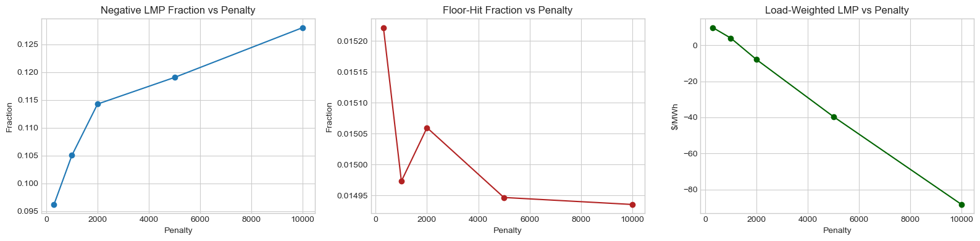
Curtailment Penalty Sweep Results (Jan-Mar Common Window)
Common window: 2019-01-01 00:00 to 2019-03-31 23:00
Case | Neg LMP % | Floor-hit % | Weighted LMP | Curtail (MWh) | OverGen (MWh)
penalty_300 | 9.62% | 1.52% | 9.79 | 118,560 | 888,328
penalty_1000 | 10.51% | 1.50% | 3.96 | 124,325 | 889,003
penalty_2000 | 11.43% | 1.51% | -7.91 | 125,040 | 888,986
penalty_5000 | 11.91% | 1.49% | -39.57 | 121,351 | 889,607
penalty_10000 | 12.80% | 1.49% | -88.35 | 123,328 | 888,693
Higher caps widen tails and increase negative-LMP frequency.
Floor-hit fraction stays ~1.5% across cases (persistent clipping).
Weighted LMP trends downward sharply as cap increases.
Overgeneration remains high and nearly flat (~888-890 GWh): cap tuning alone is not a structural fix.

Slide 16
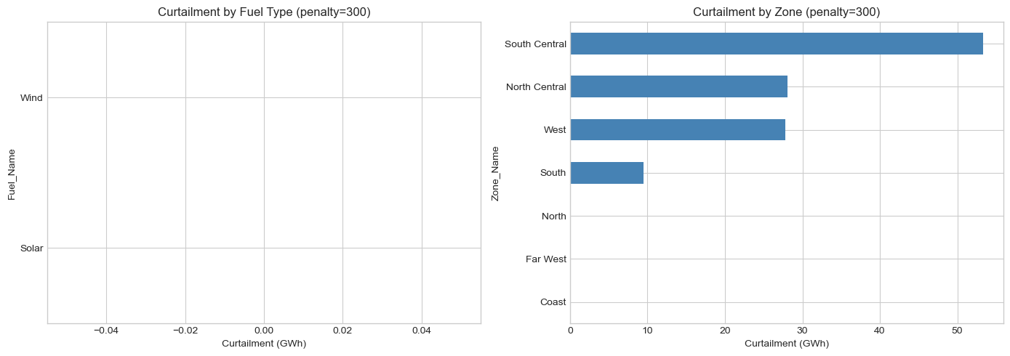
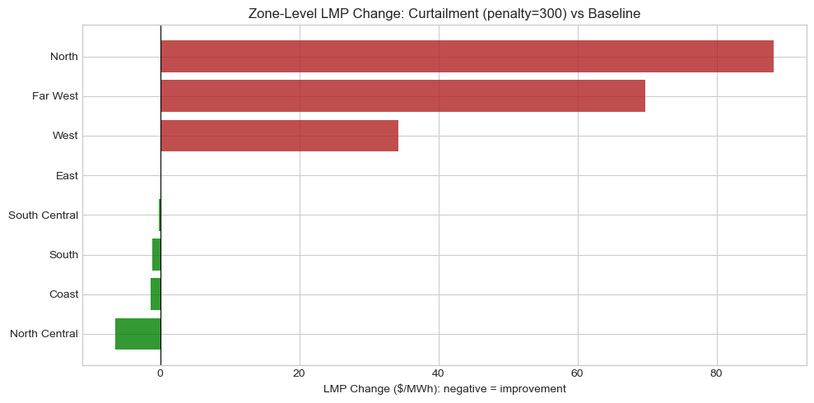
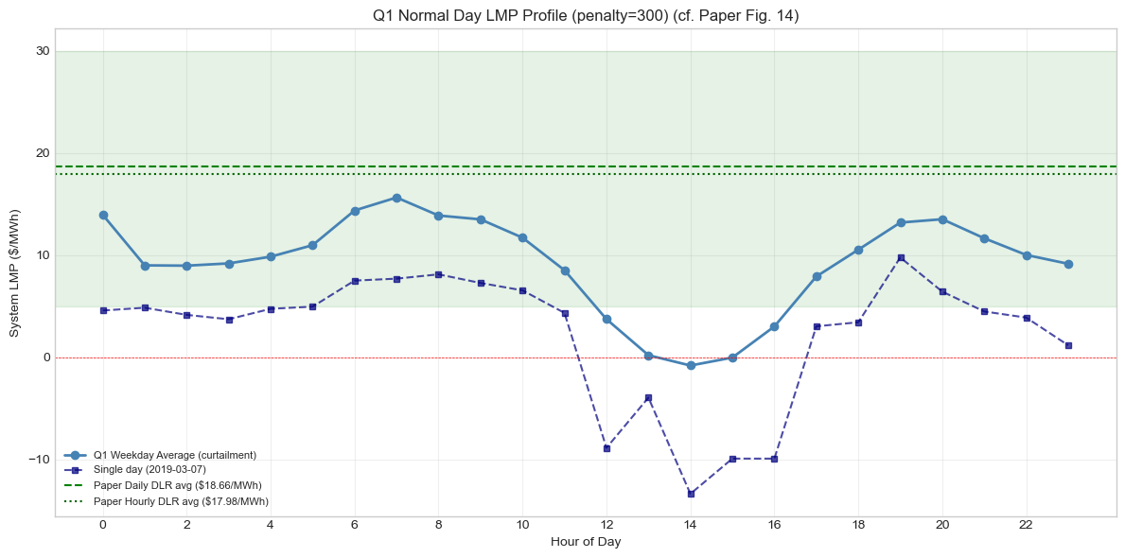
Curtailment Penalty Sweep Results (Jan-Mar Common Window)
Common window: 2019-01-01 00:00 to 2019-03-31 23:00

Slide 17
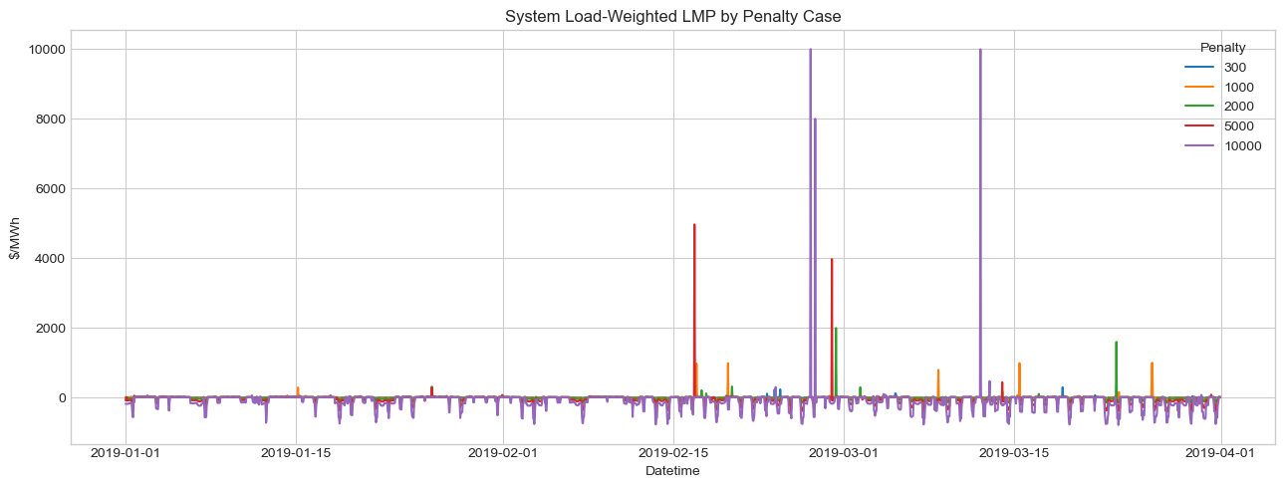
Curtailment Penalty Sweep Results (Jan-Mar Common Window)
Common window: 2019-01-01 00:00 to 2019-03-31 23:00
Case | Neg LMP % | Floor-hit % | Weighted LMP | Curtail (MWh) | OverGen (MWh)
penalty_300 | 9.62% | 1.52% | 9.79 | 118,560 | 888,328
penalty_1000 | 10.51% | 1.50% | 3.96 | 124,325 | 889,003
penalty_2000 | 11.43% | 1.51% | -7.91 | 125,040 | 888,986
penalty_5000 | 11.91% | 1.49% | -39.57 | 121,351 | 889,607
penalty_10000 | 12.80% | 1.49% | -88.35 | 123,328 | 888,693
Higher caps widen tails and increase negative-LMP frequency.
Floor-hit fraction stays ~1.5% across cases (persistent clipping).
Weighted LMP trends downward sharply as cap increases.
Overgeneration remains high and nearly flat (~888-890 GWh): cap tuning alone is not a structural fix.

Slide 18
Corrected Paper Curtailment Mechanism vs Our Model
Paper: bounded net-load slack; Ours: threshold-driven market proxy behavior
Paper Pyomo (actual implementation):
Wind/solar subtracted from load first (net-load).
rnwcur_b_t >= 0 and only active when net load < 0.
Bounded by magnitude of negative net load.
Appears in nodal balance RHS as balancing relief.
No direct curtailment objective-cost term.
Our Prescient benchmark run:
Explicit renewable participation in clearing.
Curtailment influenced by penalty/threshold economics.
Cap tuning changes tail behavior strongly.
But surplus/overgeneration remains structurally high.

