Slide 1
Prescient PCM vs Paper UC: Benchmarking Status and Effort
TX-123BT ERCOT | Collaborator/Supervisor Update | March 2026
Purpose: estimate effort needed to align Prescient PCM with paper UC benchmark.
Coverage: model-difference audit, curtailment experiment status, hydro Q1 benchmark signal.
Decision focus: where to invest benchmarking effort next.
IDAES-GTEP | Benchmarking update section (~20 minutes)

Slide 2
Updates
Comparing paper’s pyomo and our PCM, main ddifferences are renewable treatment, chronology, pricing workflow.
[update] Hydro inclusion in Q1 did not materially improve alignment to paper behavior.
[update] I updated curtailment implementation and redo a Q1, it is still running after 4 days.

Slide 3
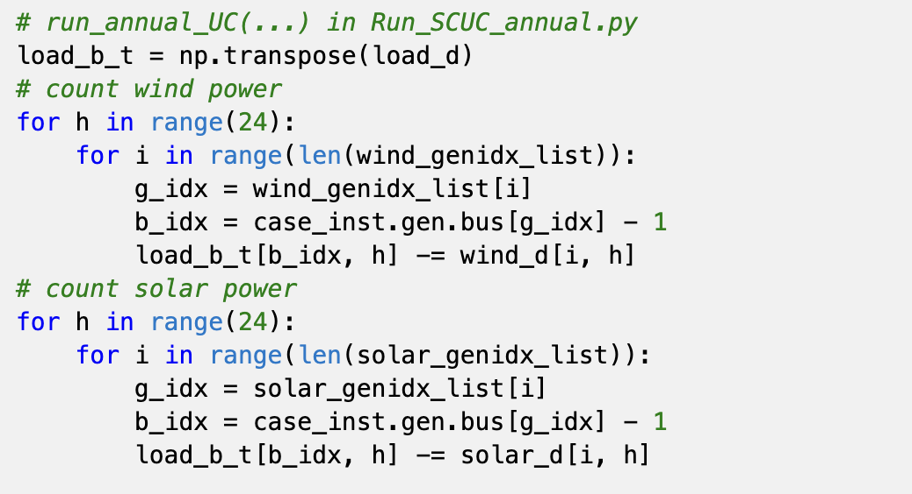
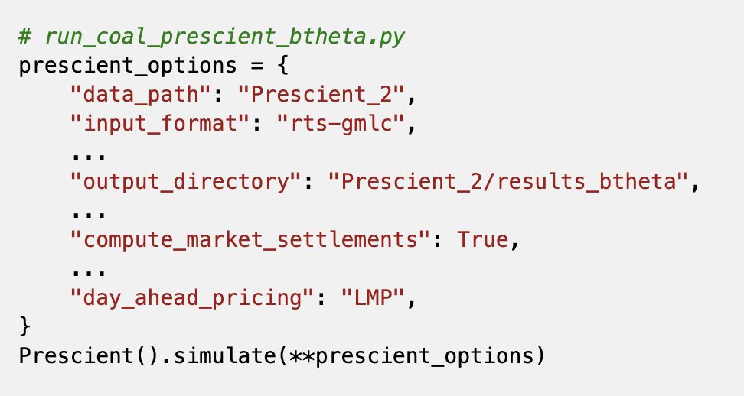
Paper UC vs Prescient PCM: Comparison Matrix
model comparison
Aspect | Paper model | Our Prescient
Renewables | Subtracted from load (net-load) | Explicit generators in clearing
Paper removed wind/solar from demand before optimization; Prescient keeps renewable units explicit in market clearing.

Slide 4
Paper UC vs Prescient PCM: Comparison Matrix
model comparison
Aspect | Paper model | Our Prescient
Curtailment | Free relief variable in balance | Penalty/cap mediated behavior

Slide 5
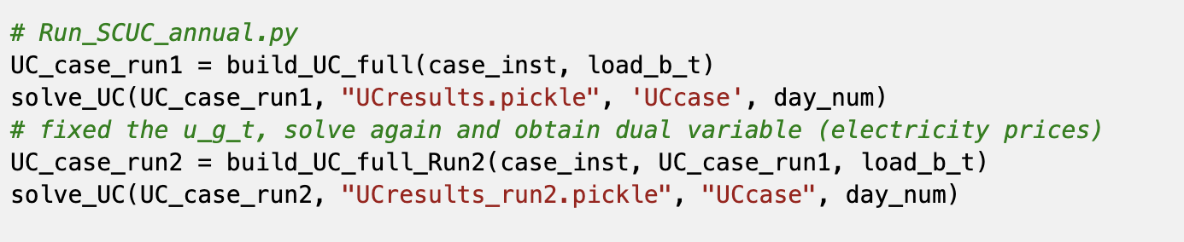
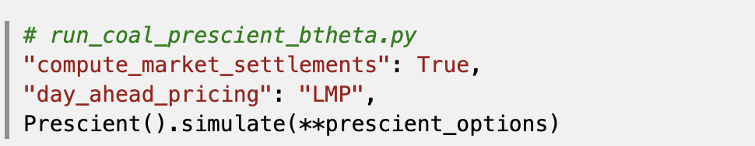
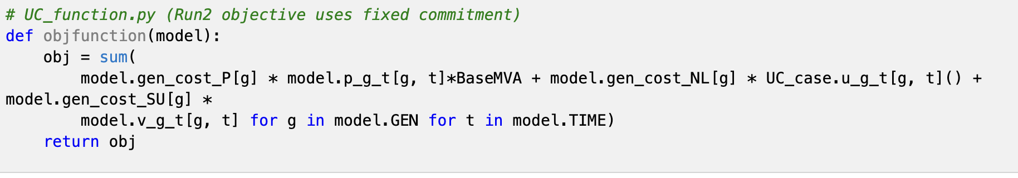
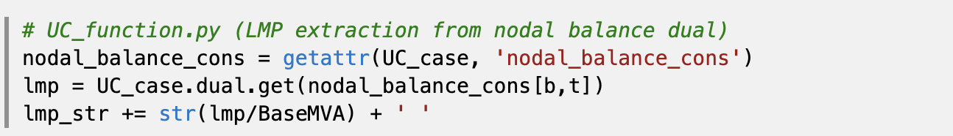
Paper UC vs Prescient PCM: Comparison Matrix
model comparison
Aspect | Paper model | Our Prescient
Pricing | Two-pass dual pricing; fixed commitment | Integrated RUC/SCED pricing
Notes:
paper uses explicit fixed-commitment re-solve for dual prices; Prescient prices come from its integrated RUC/SCED market engine.

Slide 6
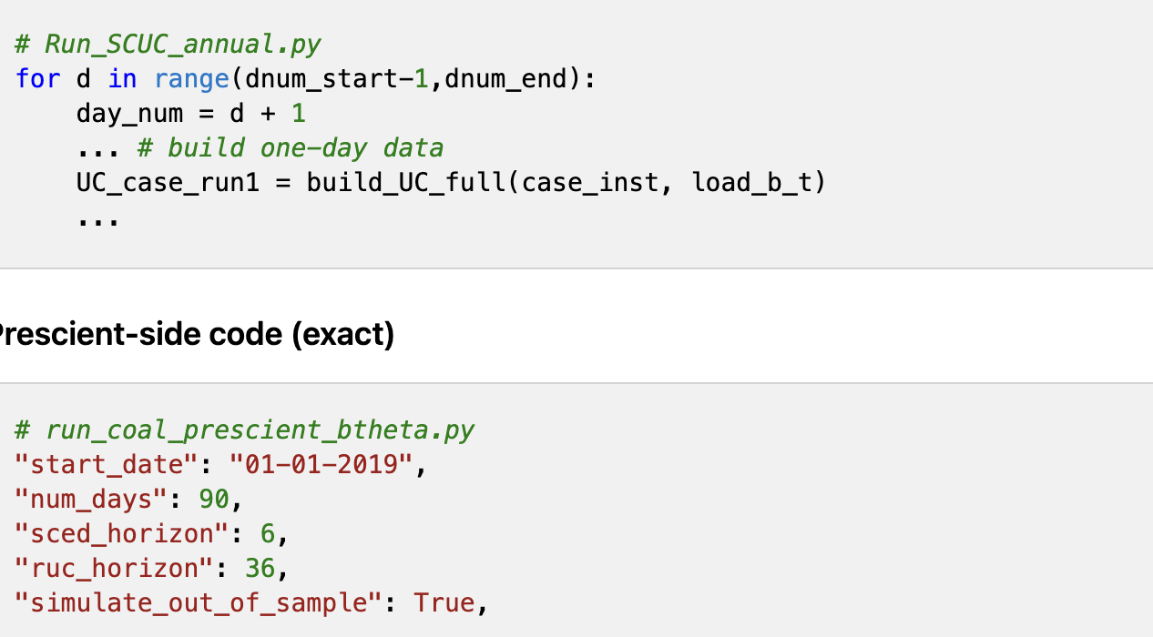
Paper UC vs Prescient PCM: Comparison Matrix
model comparison
Aspect | Paper model | Our Prescient
Chronology | Daily runs | Rolling horizons (90d, look-ahead)

Slide 7
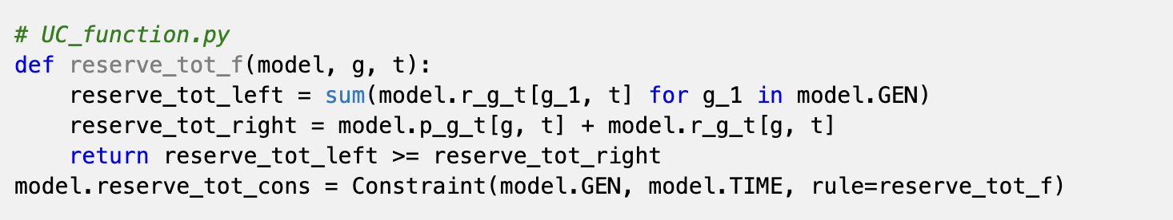
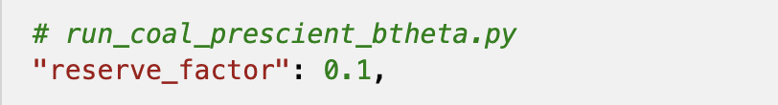
Paper UC vs Prescient PCM: Comparison Matrix
model comparison
Aspect | Paper model | Our Prescient
Reserves | Custom reserve constraints | reserve_factor design

Slide 8
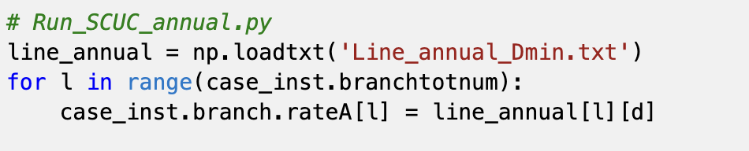
Paper UC vs Prescient PCM: Comparison Matrix
model comparison
Aspect | Paper model | Our Prescient
Line ratings | Day-specific / hourly DLR options | RTS-GMLC path unless remapped

Slide 9
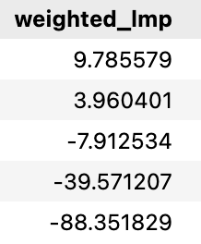
Curtailment Penalty Work: Current Status
Experiment framework in place; run still in progress
Ongoing 4-day simulation for 90-day experiment; run not finished yet.
Experiment implemented in current Prescient pipeline and reproducible by case manifest.
This section intentionally remains brief until the full run is complete.
Penalty sweep ($/MWh)
300
1000
2000
5000
10000
How new curtailment was applied:
No "renewable curtailment penalty" option in PCM
Use threshold penalty as proxies to influence dispatch, curtailment, and lmp outcomes.
Notes:
Source: /Users/yilu/Documents/GitHub/idaes-gtep/quality_reports/curtailment_penalty_experiment_setup_2026-02-28.md

Slide 10
Curtailment Penalty Work: Current Status
Experiment framework in place; run still in progress
Ongoing 4-day simulation for 90-day experiment; run not finished yet.
Experiment implemented in current Prescient pipeline and reproducible by case manifest.
This section intentionally remains brief until the full run is complete.
Penalty sweep ($/MWh)
300
1000
2000
5000
10000
How new curtailment was applied:
No "renewable curtailment penalty" option in PCM
Use threshold penalty as proxies to influence dispatch, curtailment, and lmp outcomes.
Notes:
Source: /Users/yilu/Documents/GitHub/idaes-gtep/quality_reports/curtailment_penalty_experiment_setup_2026-02-28.md

Slide 11
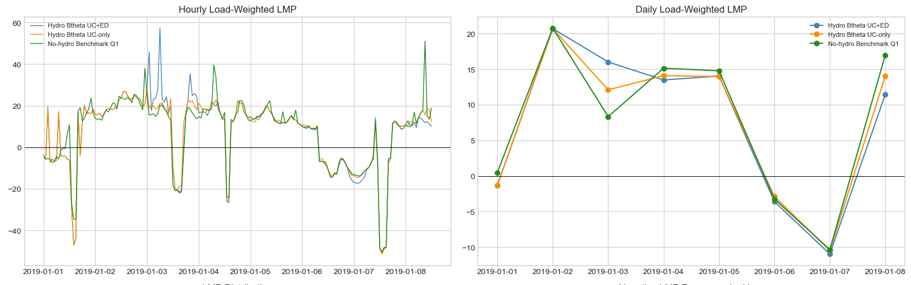
Hydro Q1 Check: No Material Improvement
Hydro inclusion does not uplift LMP alignment in current setup
Scenario | Weighted LMP | Floor-hit share | Min | Max
Hydro Btheta UC+ED | 8.33 | 1.07% | -1000.0 | 276.6
Hydro Btheta UC-only | 8.10 | 1.07% | -1000.0 | 276.2
No-hydro Benchmark Q1 | 8.26 | 1.07% | -1000.0 | 368.0
Hydro UC+ED and hydro UC-only results were very close to no-hydro Q1
Notes:
Sources: /Users/yilu/Documents/GitHub/idaes-gtep/gtep/pcm_analysis/PCM_result_hydro_q1_comparison.json; /Users/yilu/Documents/GitHub/idaes-gtep/gtep/pcm_analysis/prescient_lmp_analysis_with_hydro_q1.ipynb

Slide 12
Decisions points
Lock scope before deeper simulation spend
1. Prioritize structural alignment (renewables/chronology/pricing) before hydro expansion.
2. Define success criteria as sign/trend alignment first, magnitude second.
Notes:
This closing slide is for meeting decisions and near-term execution commitments.

Slide 13
How Curtailment Is Realized in Our Prescient Pipeline
Proxy mechanism via SCED/RUC penalty-threshold economics
No standalone 'renewable curtailment penalty' switch in current Prescient run configuration.
We tune price/violation thresholds to shape dispatch and curtailment outcomes.
Curtailment is tracked directly in outputs:
renewables_detail.csv -> Curtailment
hourly_summary.csv -> RenewablesCurtailment
Sweep cases: 300 / 1000 / 2000 / 5000 / 10000 $/MWh.
Interpretation caution: this is a curtailment-penalty proxy, not a one-parameter physical curtailment model.

Slide 14
Curtailment Penalty Sweep Results (Jan-Mar Common Window)
Common window: 2019-01-01 00:00 to 2019-03-31 23:00
Case | Neg LMP % | Floor-hit % | Weighted LMP | Curtail (MWh) | OverGen (MWh)
penalty_300 | 9.62% | 1.52% | 9.79 | 118,560 | 888,328
penalty_1000 | 10.51% | 1.50% | 3.96 | 124,325 | 889,003
penalty_2000 | 11.43% | 1.51% | -7.91 | 125,040 | 888,986
penalty_5000 | 11.91% | 1.49% | -39.57 | 121,351 | 889,607
penalty_10000 | 12.80% | 1.49% | -88.35 | 123,328 | 888,693
Higher caps widen tails and increase negative-LMP frequency.
Floor-hit fraction stays ~1.5% across cases (persistent clipping).
Weighted LMP trends downward sharply as cap increases.
Overgeneration remains high and nearly flat (~888-890 GWh): cap tuning alone is not a structural fix.

Slide 15
Corrected Paper Curtailment Mechanism vs Our Model
Paper: bounded net-load slack; Ours: threshold-driven market proxy behavior
Paper Pyomo (actual implementation):
Wind/solar subtracted from load first (net-load).
rnwcur_b_t >= 0 and only active when net load < 0.
Bounded by magnitude of negative net load.
Appears in nodal balance RHS as balancing relief.
No direct curtailment objective-cost term.
Our Prescient benchmark run:
Explicit renewable participation in clearing.
Curtailment influenced by penalty/threshold economics.
Cap tuning changes tail behavior strongly.
But surplus/overgeneration remains structurally high.
Implication: structural alignment still needed for paper-like LMP behavior.

