Slide 1
ERCOT 123 bus PCM update
Benchmarking Prescient UC+ED Against Lu et al. 2025
TX-123BT ERCOT System | B-theta DC Power Flow | 365-Day Simulation
Kay Lu | ND

Slide 2
ERCOT Data & Processing
TX-123BT test case, data pipeline, assumptions

Slide 3
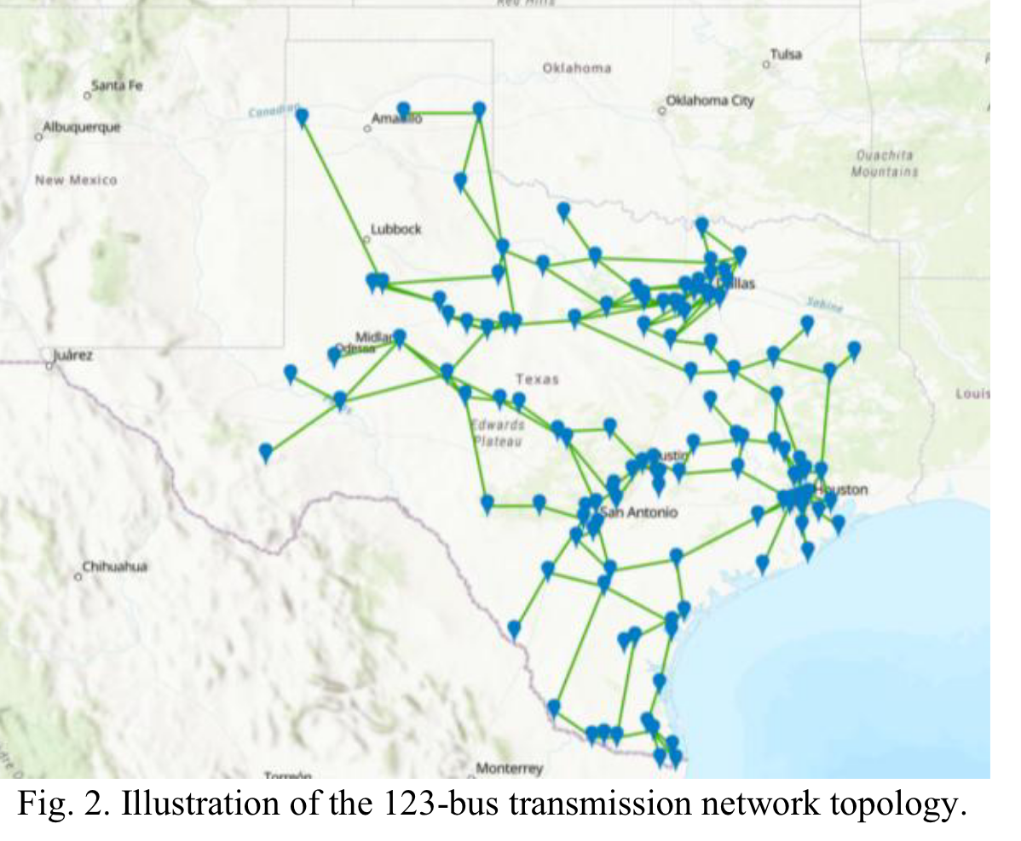
TX-123BT Test Case Overview
ERCOT 123-Bus Backbone Transmission Network
123-bus ERCOT backbone network (public dataset)
292 generators across 6 fuel types:
Nuclear, Natural Gas (CT), Coal, Wind, Solar, Hydro
188 transmission lines with impedance and ratings
5-year hourly profiles: load, wind, solar (2017-2021)
8 weather zones: COAST, EAST, FWEST, NCENT, NORTH, SCENT, SOUTH, WEST
Notes:
This is the TX-123BT test case - a 123-bus backbone model of the ERCOT system used in Lu et al. 2025. It has 292 generators across 6 fuel types and 188 transmission lines. The public dataset provides 5 years of hourly load, wind, and solar profiles.

Slide 4
Data Processing
Raw ERCOT data -> RTS-GMLC format
Raw data: Data_public_5year/
Bus_data.csv, Line_data.csv, Generator_data.xlsx
Daily load/wind/solar .txt files (5 years)
Output: gen.csv, bus.csv, branch.csv, timeseries CSVs
(temporally removed 10 hydro gen for debug)
Assume quick startup, calculated fuel price curve based on paper data
Changed egret fuel price curve calculation precision from 2 to 4 decimal places
Prescient config:
B-theta DC power flow for RUC and SCED
48h RUC horizon, 24h SCED horizon
Perfect foresight (no forecast error)
Parameter | Value
Gas fuel price | $2.29/MMBTU
Coal fuel price | $1.78/MMBTU
Nuclear fuel price | $0.81/MMBTU
Gas min up/down | 2h / 1h
Coal min up/down | 12h / 12h
Nuclear min up/down | 48h / 48h
Cost curve segments | 4 (30-50-70-100% PMax)
Notes:
I convert the raw ERCOT data into Prescient's input format using a processing notebook. The key assumptions are fuel prices, generator flexibility parameters, and piecewise-linear cost curves with 4 segments. I use 2019 data to benchmark against the paper's work.

Slide 5
PCM Results
Generally positive LMP ($24.73/MWh annual)
Differ from paper’s results

Slide 6
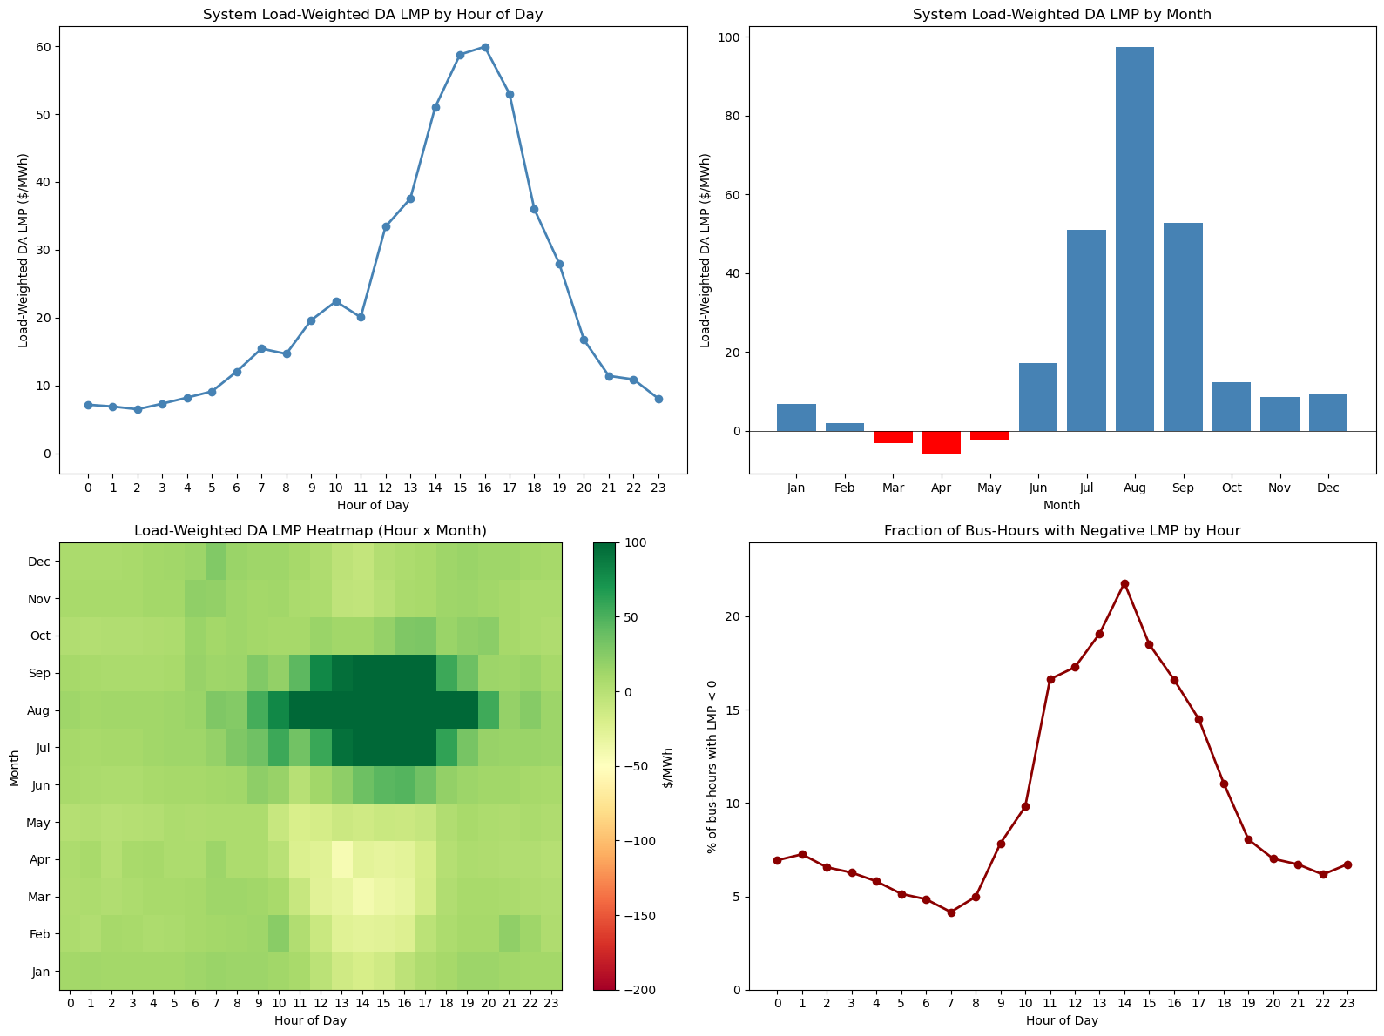
Annual LMP Summary
Load-weighted system LMP: $24.73/MWh
Total demand: 383.8 TWh
Generation cost: $1.52B
Negative LMP: 10% of bus-hours
Concentrated in wind-heavy zones (NORTH, FWEST)
Physical: renewable oversupply behind transmission constraints
However, in the paper there is no negative LMP
Notes:
The annual load-weighted LMP is about $25/MWh - generally positive. About 10% of bus-hours show negative prices, concentrated in wind-heavy zones. This is physically consistent behavior. However, the paper shows no negative LMP at all, which is a notable difference.

Slide 7
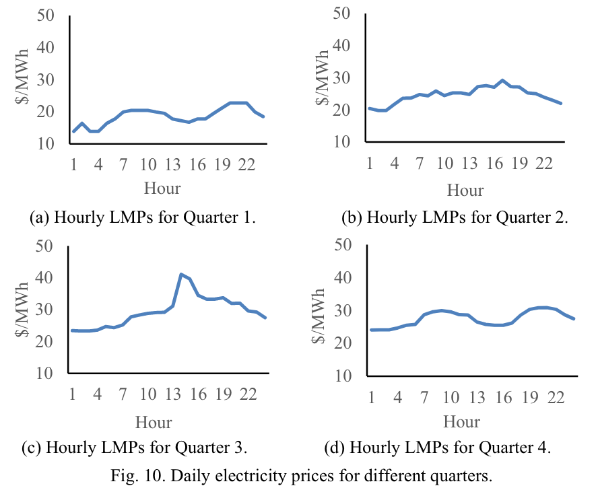
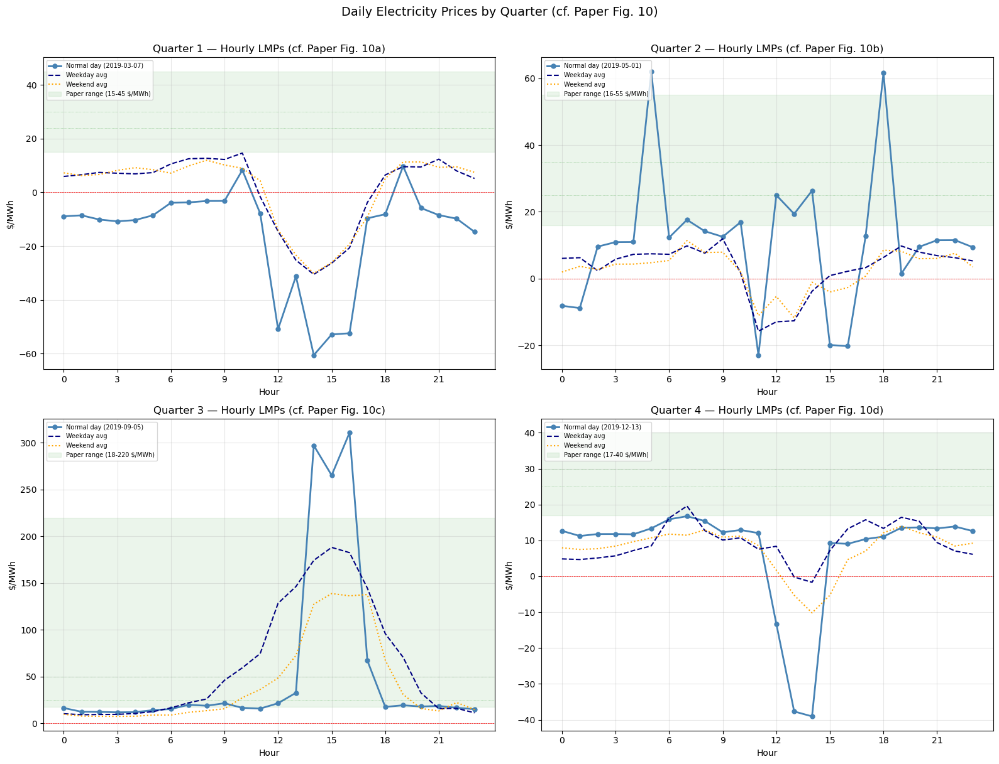
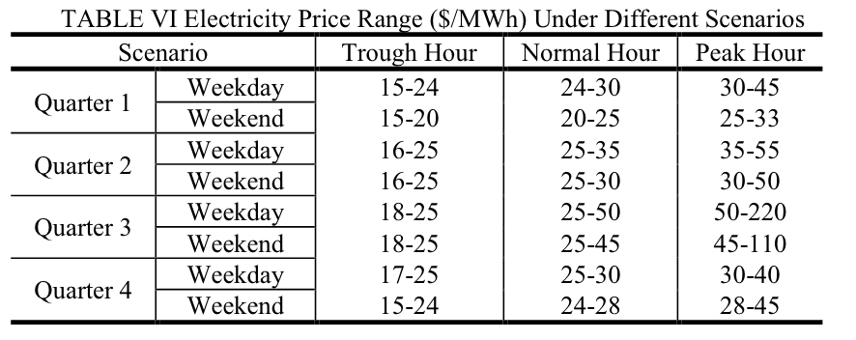
Quarterly LMP Breakdown
Q3 drives the annual average
Quarter | Load-Wt LMP
Q1 (Jan-Mar) | $1.3/MWh
Q2 (Apr-Jun) | $3.0/MWh
Q3 (Jul-Sep) | $57.0/MWh
Q4 (Oct-Dec) | $8.8/MWh
Q3 dominates annual average: peak cooling demand meets tight supply
Q1/Q2 near-zero: renewable oversupply in shoulder seasons
Mostly outside paper’s range
From PCM LMP results in bus_detail.csv
Green bar came from paper’s table VI
Notes:
Breaking it down by quarter

Slide 8
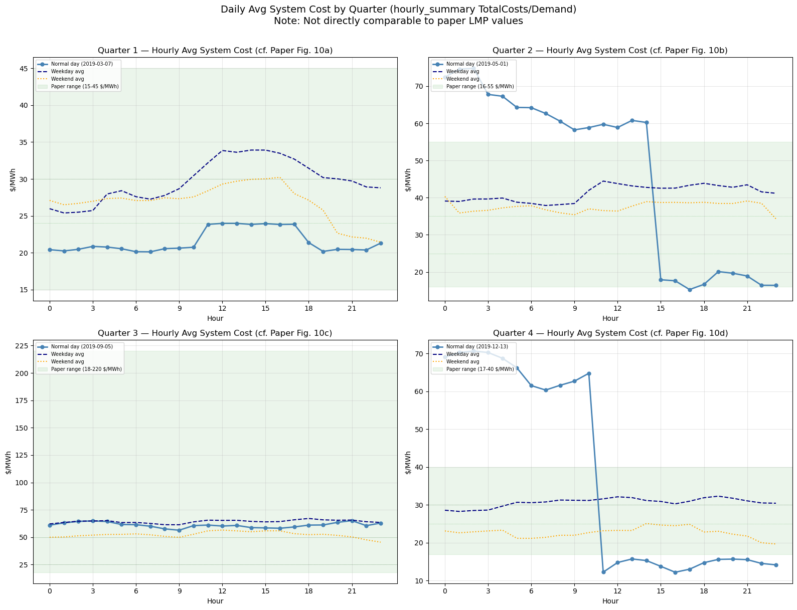
Quarterly LMP Breakdown – using price in hourly_summary
Generating positive but higher avg price
Quarter | Load-Wt LMP
Q1 (Jan-Mar) | $28.9/MWh
Q2 (Apr-Jun) | $40.2/MWh
Q3 (Jul-Sep) | $60.9/MWh
Q4 (Oct-Dec) | $28.4/MWh
Results generally higher than paper’s LMP, but showing a more similar trend
From PCM price results in hourly_summary.csv, which are all positive and within/close to paper’s range
price = total_generation/total_demand

Slide 9
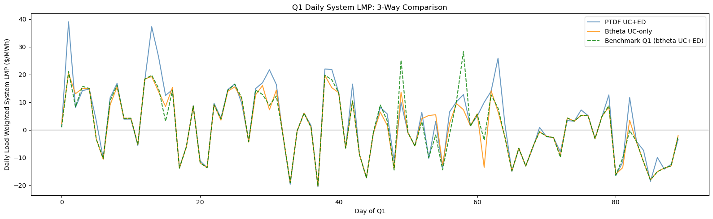
Benchmarking vs Lu et al. 2025
Same network, different fleet and LMP range
Paper: 2019 SCUC on TX-123BT, all-positive LMPs ($10-220/MWh)
Our run: 2019 UC+ED data, LMP range -$1000 to +$1395/MWh, or $5 to $146/MWh
If we take LMP from bus_detail.csv, quarterly averages are positive and reasonable and within benchmarks’ range
But Q2 Q4 hourly spikes far exceed paper benchmarks:
Most hours within range, but spikes are extreme
If we take the price from hourly_summary.csv, quarterly averages are generally close to 0 and hourly data are many times below 0
Aspect | Details
Network topology | Same 123-bus, 188-line backbone
Wind/solar profiles | Same temporal patterns
Congestion count | ~6-7 avg congested lines
LMP levels | Ours much wider range
Generator fleet | 282 vs 292 units (no hydro)
Key question remain to investigate: are LMP differences some model artifacts?
Notes:
The question is whether the specific differences model artifacts and how to improve them

Slide 10
Next Steps
Investigate Pyomo model formulation
1. Investigate Pyomo model formulation for the original paper
Examine cost expression and generator constraints
Check commitment decisions in our PCM
Compare against paper's original SCUC model
2. Price deviation
If still present after aligning with paper’s model
Will investigate after Pyomo model review
Goal: determine if deviation model-driven and how to fix them.
Notes:
Next step is to go through the paper's original Pyomo SCUC model and compare against our Prescient configuration. I want to understand what's driving these hourly spikes. I also still have negative prices in spring months, but will address that after the Pyomo review

