Slide 1
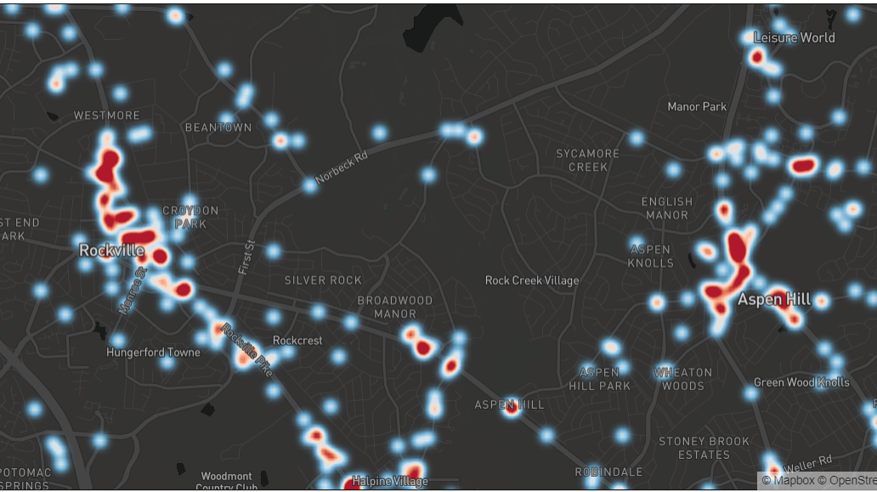
A Review for Traffic Safety in Montgomery County, MD - Traffic Violations and Vehicle Collisions Data Visualization
Yanmin lu
Deliverable 1
Data 606 Fall 2020

Slide 2


Goals
Perform an in-depth analysis of the traffic violations/incidents data that occurred in Montgomery County, to get overview insights to understand the relationship between the influence factors and crash outcomes;
Use supplement data to explore weather reason and other factors which may behind the pattern of vehicle collisions;
Use machine learning to predict the future result of traffic violations and vehicle collisions.

Slide 3

Rationale
Road safety is by any means a critical issue and is relevant to everybody's daily life.
Traffic factors are complicated.
I always have an interest to understand and analyze the real-world data for local insight, see what we can learn from the data to help better predict and avoid collisions in the future. Data analysis for traffic safety studies refers to the use of data from one or more data sources to describe a traffic safety situation and to understand factors contributing to occurrences and outcomes of crashes using numbers.
Notes:
In 2018 the lives of 501 people are cut short as a result of road traffic accident in Maryland. More people suffer non-fatal injuries and/or considerable economic losses.
However, understanding of how traffic safety is not simply extracting and summarizing numbers from the data, it is actually affected by various factors, such as geometric features of roads, bad/extreme weather data, traffic control types, and traffic volume, is critical for making informed decisions regarding safety improvements, and these factors are not typically found in the traffic safety data.
Can machine learning help us understand the causes and the factors that affect traffic violations/car crash severity?

Slide 4

Datasets
1. Crash Reporting - Incidents Data: There are around 64.7K rows and 44 columns. Each row is a "Collision".
2. Crash Reporting - Drivers Data: There are around 115K rows and 43 columns. Each row is a "Driver".
3. Crash Reporting - Non-Motorists Data: There are around 3711 rows and 32 columns. Each row is a "Non-Motorist".
4. Traffic violation data: This dataset contains traffic violation information from all electronic traffic violations issued in the County from 2012.
5. Montgomery County demographics data: The data contains various information such as population, race, car ownership. This data will be paired with other datasets.
6. Montgomery County weather data: This page provides local weather extremes and records, holiday weather, COOP data, and area climate summaries.
The Montgomery County government has continued to register traffic violation and collision cases in a daily basis and has released the data to the public as a part of the open data initiative.
Notes:
This dataset provides general information about each collision and details of all traffic collisions occurring on county and local roadways within Montgomery County, as collected via the Automated Crash Reporting System (ACRS) of the Maryland State Police, and reported by the Montgomery County Police, Gaithersburg Police, Rockville Police, or the Maryland-National Capital Park Police. Please note that these collision reports are based on preliminary information supplied to the Police Department by the reporting parties. Therefore, the collision data available on this web page may reflect: -Information not yet verified by further investigation -Information that may include verified and unverified collision data -Preliminary collision classifications may be changed at a later date based upon further investigation -Information may include mechanical or human error This dataset can be joined with the other 2 Crash Reporting datasets (see URLs below) by the State Report Number. * Crash Reporting - Drivers Data at https://data.montgomerycountymd.gov/Public-Safety/Crash-Reporting-Drivers-Data/mmzv-x632 * Crash Reporting - Non-Motorists Data at https://data.montgomerycountymd.gov/Public-Safety/Crash-Reporting-Non-Motorists-Data/n7fk-dce5 Update Frequency : Weekly
This dataset provides general information about each collision and details of all traffic collisions occurring on county and local roadways within Montgomery County, as collected via the Automated Crash Reporting System (ACRS) of the Maryland State Police, and reported by the Montgomery County Police, Gaithersburg Police, Rockville Police, or the Maryland-National Capital Park Police. Please note that these collision reports are based on preliminary information supplied to the Police Department by the reporting parties. Therefore, the collision data available on this web page may reflect: -Information not yet verified by further investigation -Information that may include verified and unverified collision data -Preliminary collision classifications may be changed at a later date based upon further investigation -Information may include mechanical or human error This dataset can be joined with the other 2 Crash Reporting datasets (see URLs below) by the State Report Number. * Crash Reporting - Drivers Data at https://data.montgomerycountymd.gov/Public-Safety/Crash-Reporting-Drivers-Data/mmzv-x632 * Crash Reporting - Non-Motorists Data at https://data.montgomerycountymd.gov/Public-Safety/Crash-Reporting-Non-Motorists-Data/n7fk-dce5 Update Frequency : Weekly

Slide 5
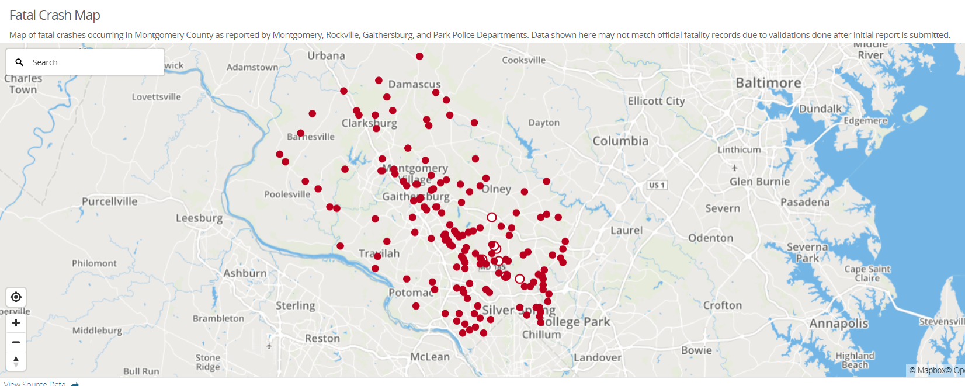




Link to my repository
https://github.com/ylu2md/ds606

Slide 6
Reference
Abraham Duplaa, "Modeling Traffic Behavior as a Function of Real-Time Traffic Flow and Weather", Jan 15, 2020 https://www.omnisci.com/blog/modeling-traffic-behavior-as-a-function-of-real-time-traffic-flow-and-weather
Hua Yang, "New York City Motor Vehicle Collision Data Visualization", https://nycdatascience.com/blog/student-works/new-york-city-motor-vehicle-collision-data-visualization/
Ming Zheng, Tong Li, Rui Zhu, Jing Chen, Zifei Ma, Mingjing Tang, "Traffic Accident’s Severity Prediction: A Deep-Learning Approach-Based CNN Network", https://ieeexplore.ieee.org/stamp/stamp.jsp?arnumber=8661485
Improving road safety using camera violation and crash data, https://www.slideshare.net/TingtingQi/improving-road-safety-using-camera-violation-and-crash-data-80194309
Chunjiao Dong, Chunfu Shao, Juan Li, Zhihua Xiong, "An Improved Deep Learning Model for Traffic Crash Prediction", Journal of Advanced Transportation, vol. 2018, Article ID 3869106, 13 pages, 2018. https://doi.org/10.1155/2018/3869106

