Slide 1
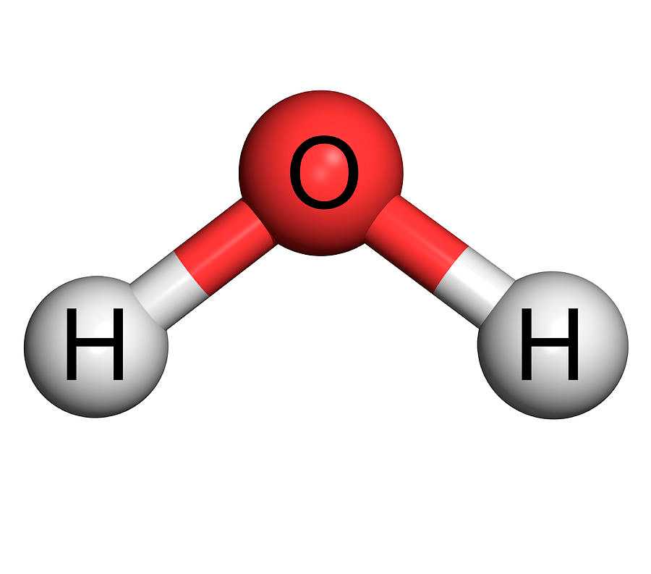

Slide 2
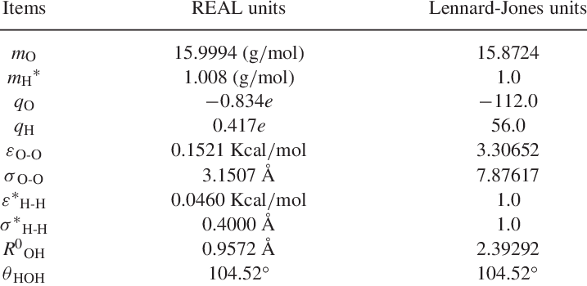
TIP3P Water Model: Parameters

Slide 3
How to move the molecules?

Slide 4
Integrator: moving the molecules forward in time

