Slide 1
SMILES

Slide 2
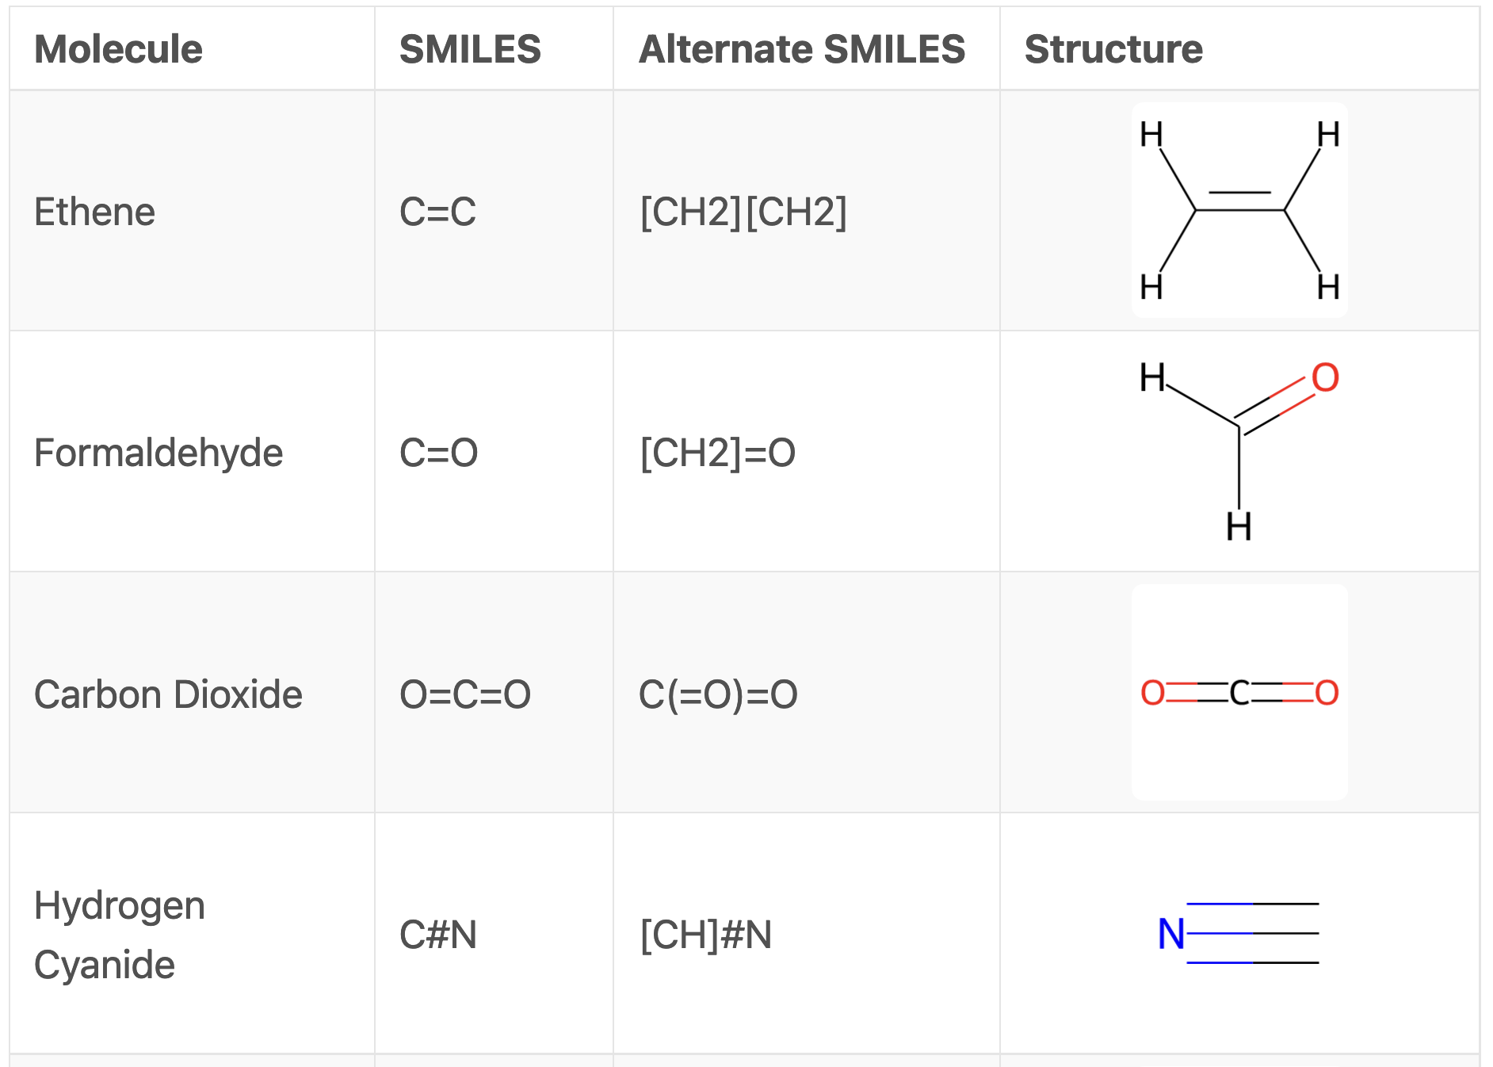
What are the rules you can observe?
Triple bond is #
If you want to write hydrogens, write them with main atom in brackets
Equals sign means double bond
Parentheses denote additional groups bonded to atom directly before

Slide 3
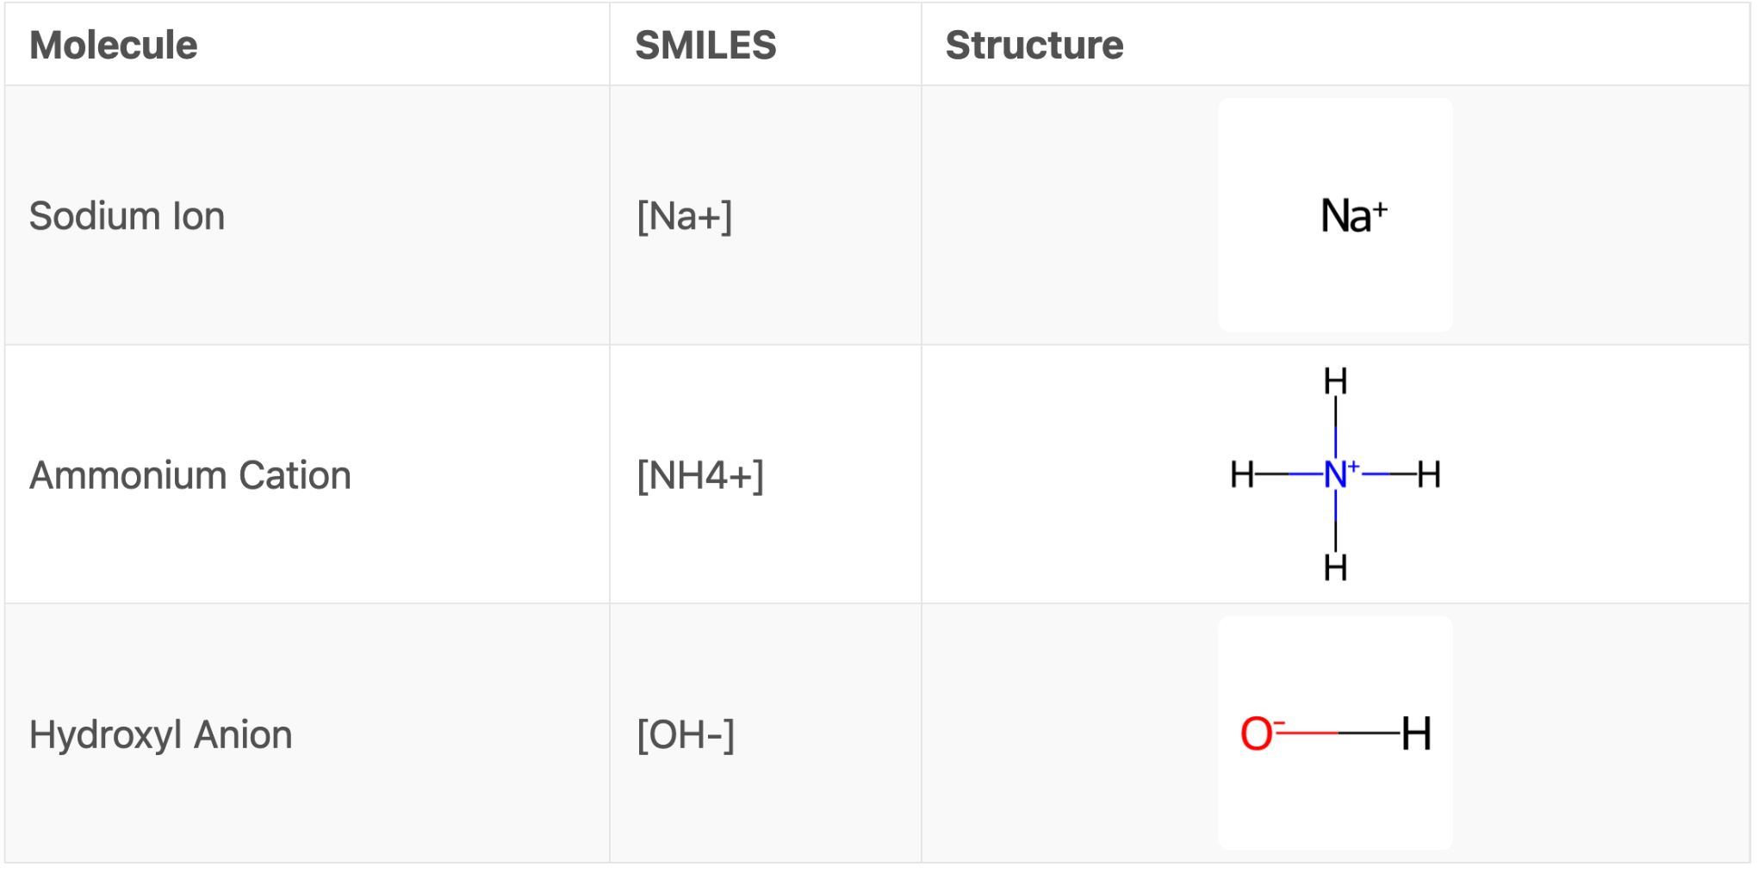
What are the rules you can observe?
Brackets can also be used to write ions

Slide 4
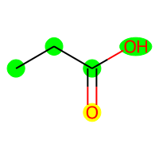
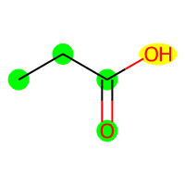
What are the rules you can observe?
We separate side chain with () from the main group
= stands for double bond
Both the following strings are correct for Propionic Acid: CCC(=O)O, CCC(O)=O

Slide 5
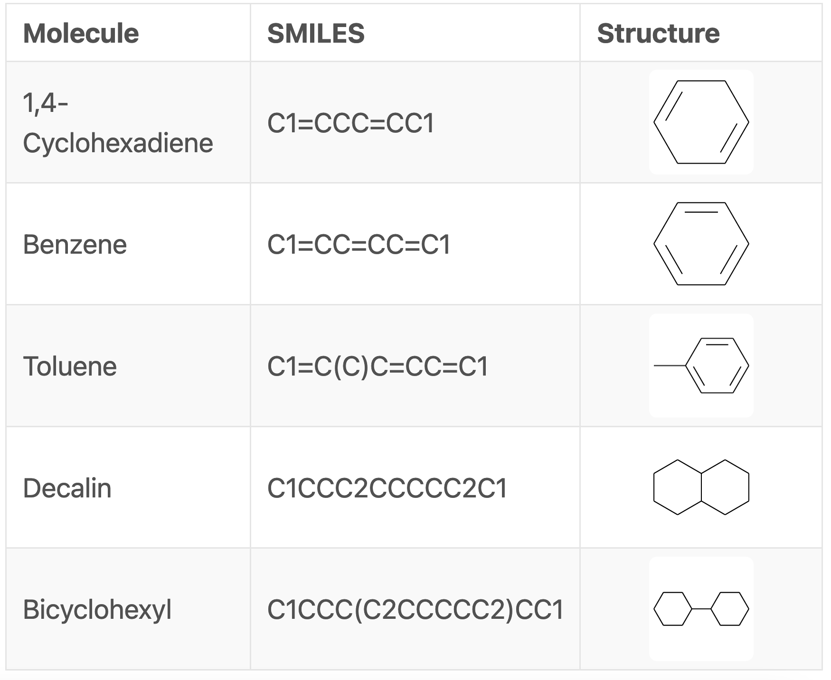
What are the rules you can observe?
Number carbons for ring structure
Start and end both are carbon 1
Parentheses for whatever is outside of main ring
Number a carbon for each ring in your structure
When rings are connected, C1, C2, etc. are the innermost carbons

