Slide 1
Company Rates
Software Engineering Project
Created by TableDroppers:
Henrikas Ragickas​
Povilas Blusevičius​
Tadej Rola​
Semih Yoltan​
Mantas Aušra​
Omirzak Akniyet

Slide 2
Introduction
System:
Company Rates is a platform that allows its users to view information and share their feedback about registered companies and rate them. The main idea is to have information of various companies in one place, which could help a person who is looking for job or specific services.
Chosen environment:
REST API runs on IIS server, hosted on Microsoft Azure cloud,
Client runs on Github Pages,
Github Pages is static site hosting service
Database Microsoft SQL Server is hosted on Microsoft Azure cloud as well
1

Slide 3
Requirements
REST API is implemented in C# programming language
using .NET Web API framework
ORM technology Entity Framework
for queries, mapping classes to objects,...
Database Microsoft SQL Server for data persistence
On client side, we use HTML, CSS (Bootstrap) and JavaScript (jQuery)
IDEs used:
Visual Studio 2017: for REST API
Visual Studio Code: for CLIENT
2

Slide 4
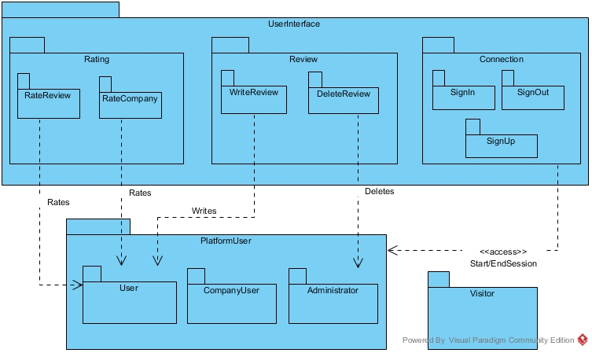
Package Diagram
3

Slide 5
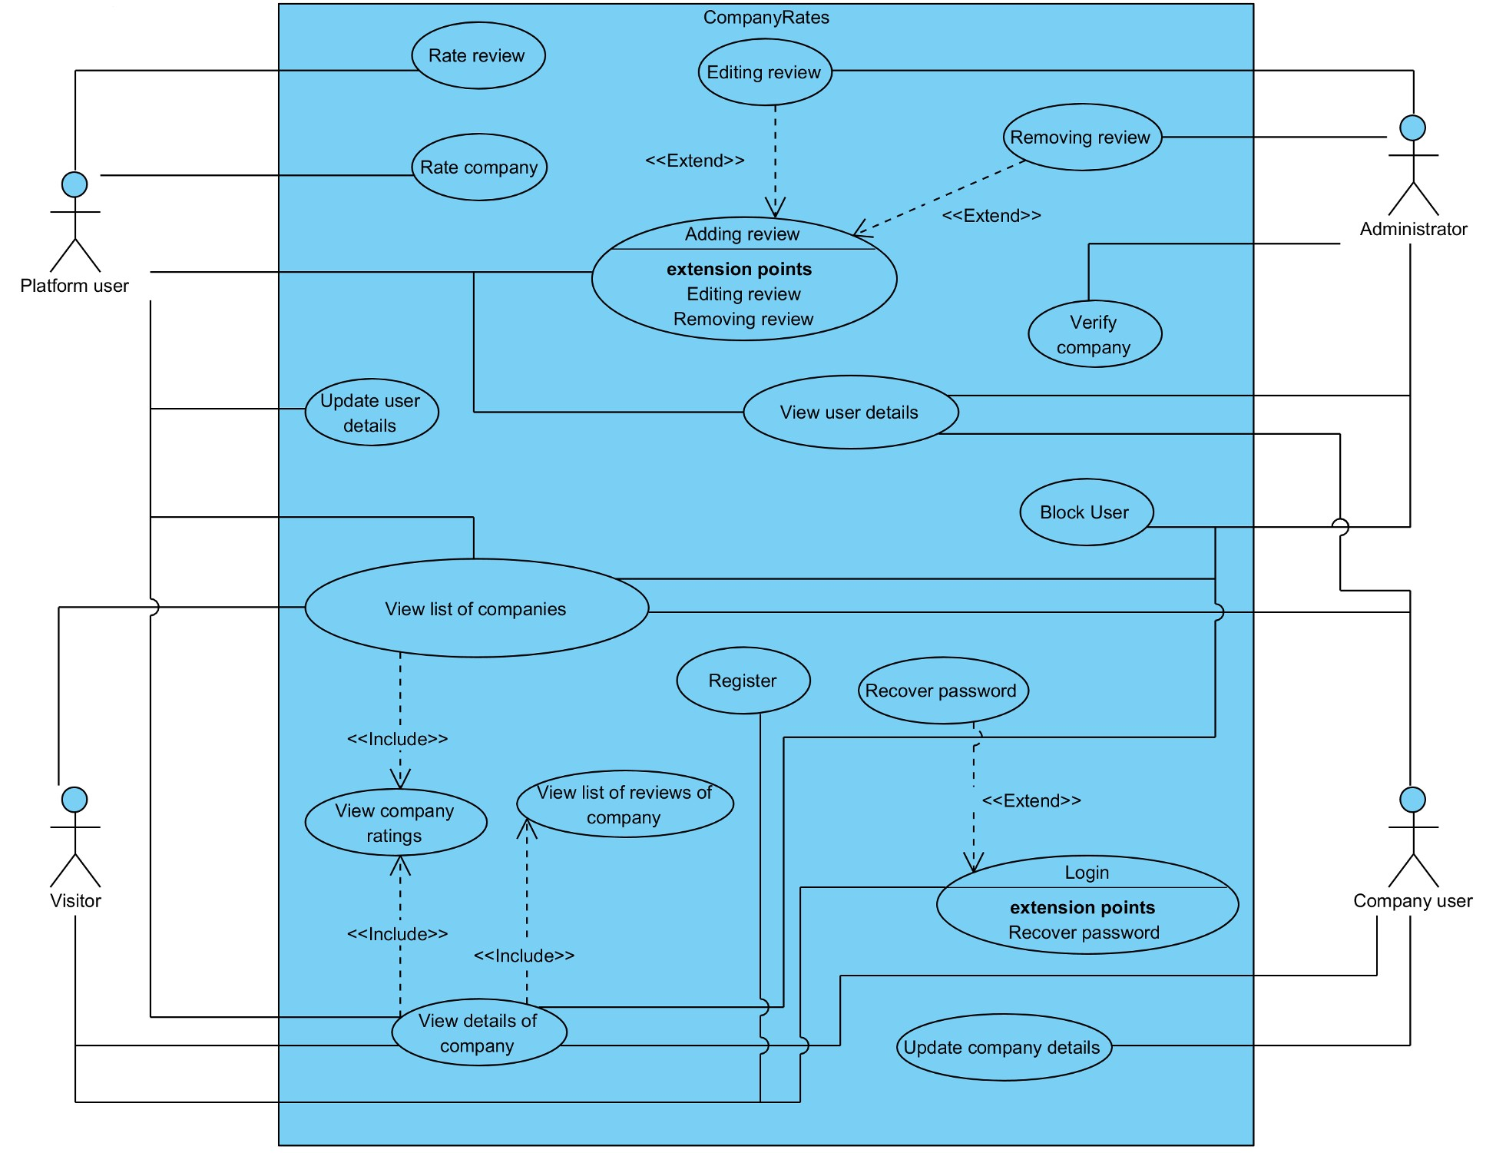
Use Cases
4

Slide 6
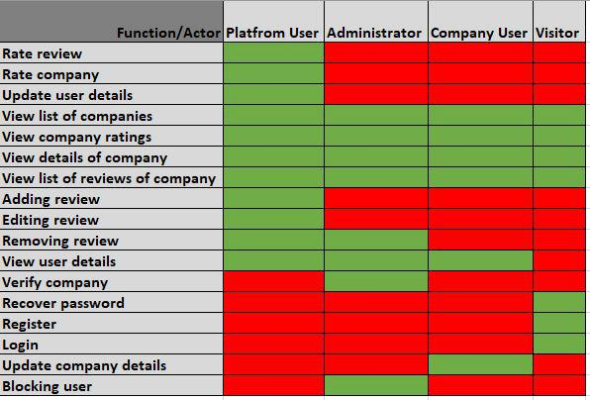
User Function Matrix
5

Slide 7
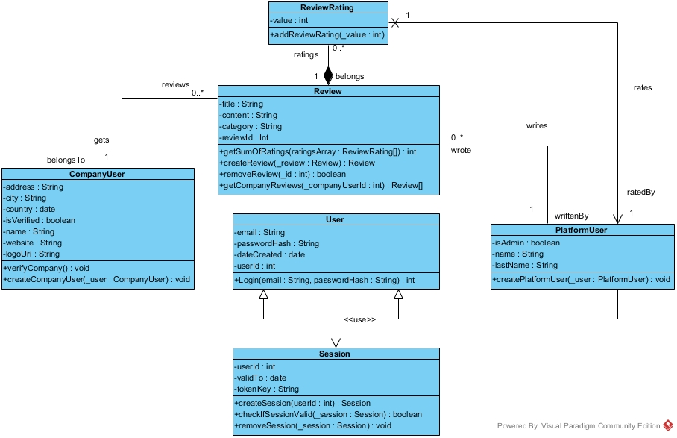
Class Diagram
6

Slide 8
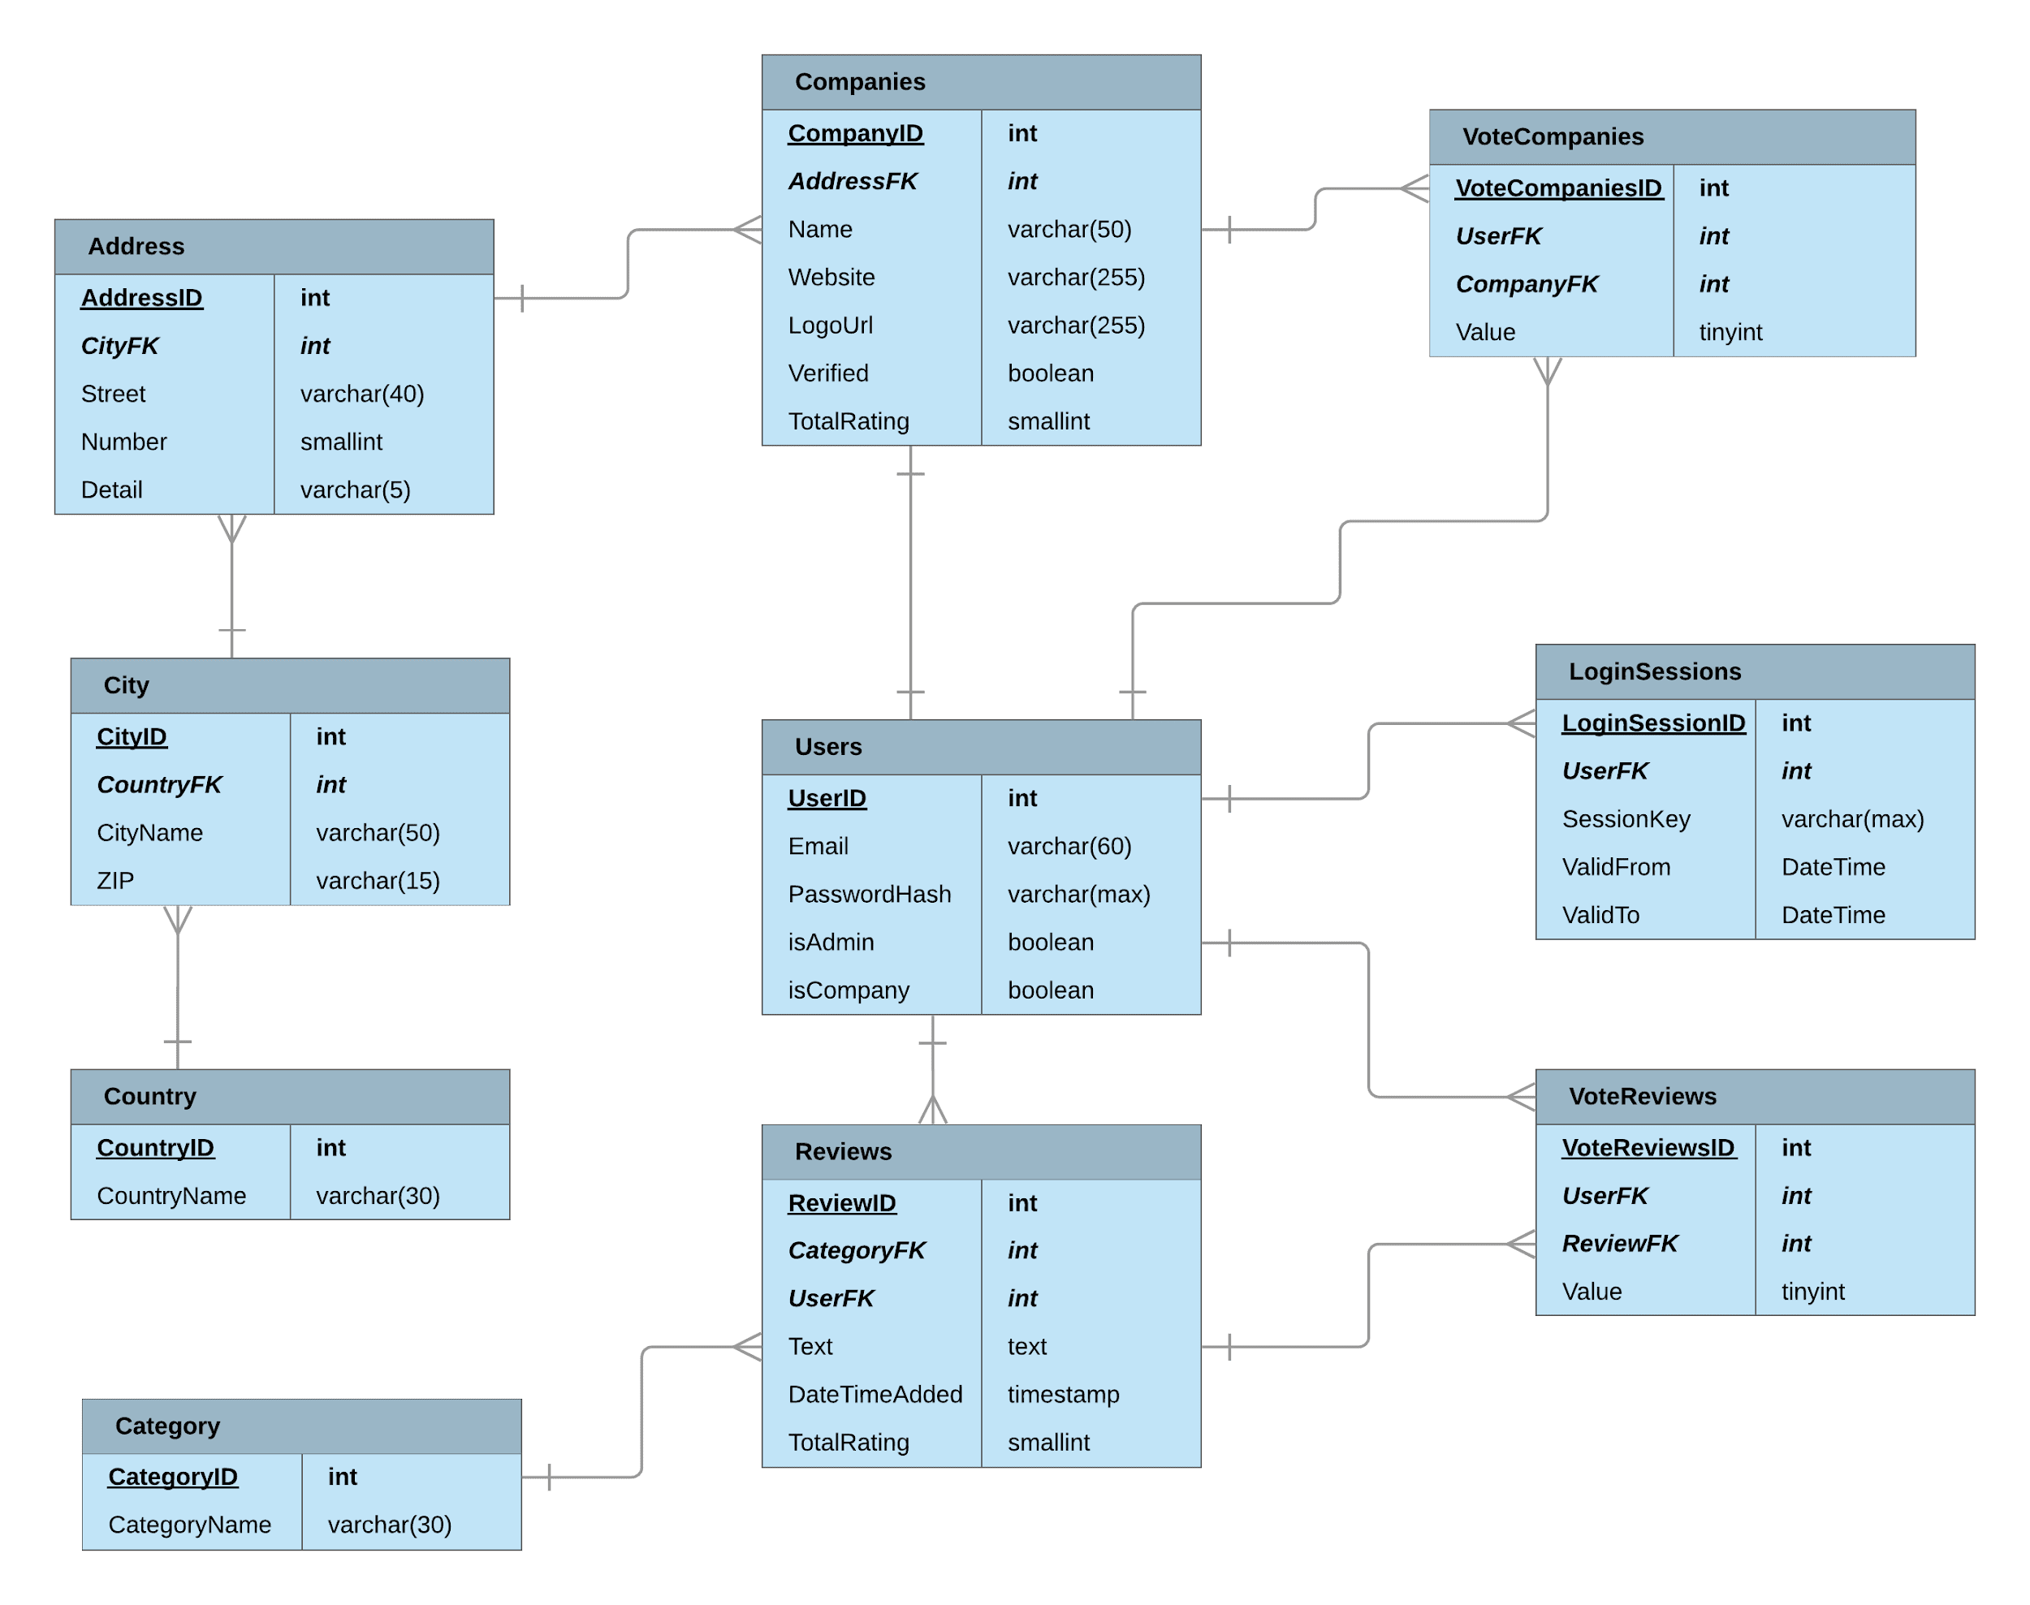
Database Structure
7

Slide 9
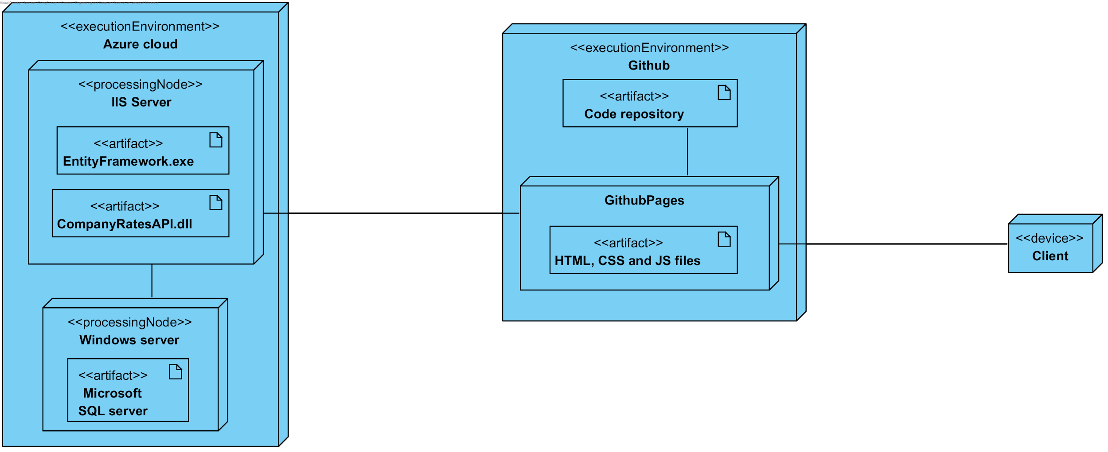
Deployment Diagram
8
Notes:
In deployment diagram we are representing physical locations, where our application is deployed and running.
On the left side of the diagram, we can see the backend part of application, where we deployed our REST API on IIS Server inside the AZURE CLOUD. In the same cloud, there is also Microsoft SQL Server hosted inside a Windows Server.
We are accessing REST API on client side, that is hosted on GitHub pages service provider for static hosting. Since we are using Github for source control, we can host the page directly from repository.
User can access application using browser on the URL that is provided by GitHub pages.

Slide 10
Conclusion
Goal to make project useful
Experience in software development management
Gained skills in UML modeling
Importance of teamwork
9

Slide 11
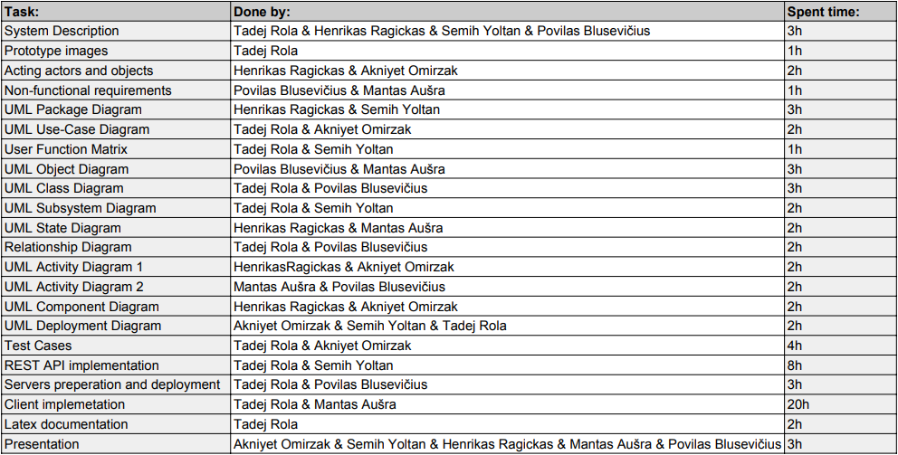
Productivity
Total time: 73h
10

Slide 12
End of presentation
Test our website here:
https://tadejrola.github.io/companyrates-client/

