Slide 1
Predictive Modeling
&
The Bayes Classifier
Rosa Cowan
April 29, 2008

Slide 2
Goal of Predictive Modeling
To identify class membership of a variable (entity, event, or phenomenon) through known values of other variables (characteristics, features, attributes).
This means finding a function f such that
    y = f(x,θ) where x = {x₁,x₂,…,x_{p}}
    θ is a set of estimated parameters for the model
    y = c ∈ {c₁,c₂,…,c_{m}} for the discrete case
    y is a real number for the continuous case

Slide 3
Example Applications of Predictive Models
Forecasting peak bloom period for Washington’s cherry blossoms
Numerous applications in Natural Language Processing including semantic parsing, named entity extraction, coreference resolution and machine translation.
Medical diagnosis (MYCIN – identification of bacterial infections)
Sensor threat identification
Predicting stock market behavior
Image processing
Predicting consumer purchasing behaviors
Predicting successful movie and record productions
Notes:
MYCIN – developed in the early 70s by PHd candidate at Stanford, Edward Shorliffe. Diagnosed blood infections

Slide 4
Predictive Modeling Ingredients
A model structure
A score function
An optimization strategy for finding the best θ
Data or expert knowledge for training and testing

Slide 5
2 Types of Predictive Models
Classifiers or Supervised Classification* – for the case when C is categorical
Regression – for the case when C is real-valued.
*The remainder of this presentation focuses on Classifiers

Slide 6
Classifier Variants &
Example Types
Discriminative: work by defining decision boundaries or decision surfaces
  Nearest Neighbor Methods; K-means
  Linear & Quadratic Discriminant Methods
  Perceptrons
  Support Vector Machines
  Tree Models (C4.5)
Probabilistic Models: work by identifying the most likely class for a given observation by modeling the underlying distributions of the features across classes*
  Bayes Modeling
  Naïve Bayes Classifiers
  *Remainder of presentation will focus on Probabilistic Models with particular attention paid to the Naïve Bayes Classifier

Slide 7

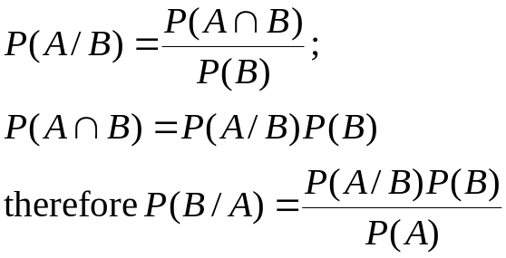
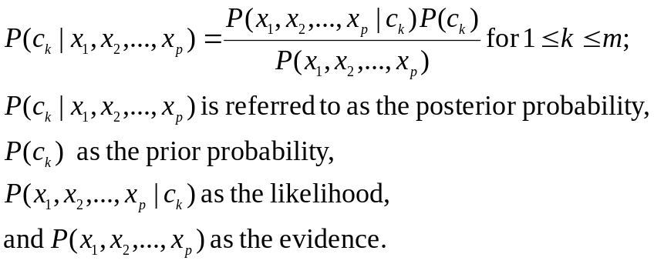
General Bayes Modeling
Uses Bayes Rule:
For general conditional probability classification modeling, we’re interesting in

Slide 8
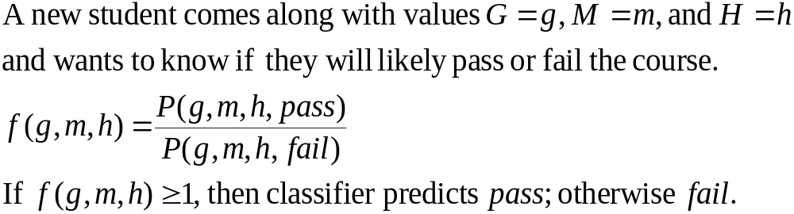
Bayes Example
Let’s say we’re interested in predicting if a particular student will pass CMSC498K.
We have data on past student performance. For each student we know:
  If student’s GPA > 3.0 (G)
  If student had a strong math background (M)
  If student is a hard worker (H)
  If student passed or failed course

Slide 9
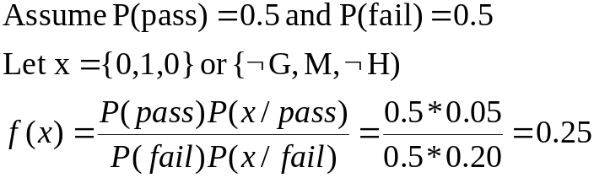
General Bayes Example (Cont.)
Pass
Fail
GPA>3 (G) | Math? (M) | Hardworker (H) | Prob
0 | 0 | 0 | 0.01
0 | 0 | 1 | 0.03
0 | 1 | 0 | 0.05
0 | 1 | 1 | 0.08
1 | 0 | 0 | 0.10
1 | 0 | 1 | 0.28
1 | 1 | 0 | 0.15
1 | 1 | 1 | 0.30
GPA>3 (G) | Math? (M) | Hardworker (H) | Prob
0 | 0 | 0 | 0.28
0 | 0 | 1 | 0.15
0 | 1 | 0 | 0.20
0 | 1 | 1 | 0.14
1 | 0 | 0 | 0.07
1 | 0 | 1 | 0.05
1 | 1 | 0 | 0.08
1 | 1 | 1 | 0.03
Joint Probability Distributions grow exponentially with # of features! For binary-valued features, we need O(2^{p}) JPDs for each class.

Slide 10
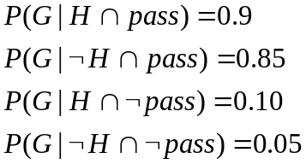


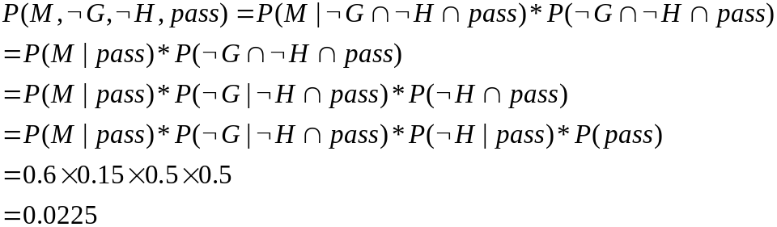
Augmented Naïve Bayes Net (Directed Acyclic Graph)
pass
0.5
G and H are conditionally independent of M given pass
G
H
M

Slide 11
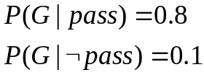
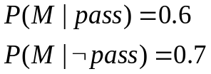
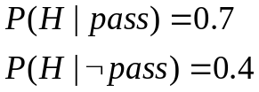
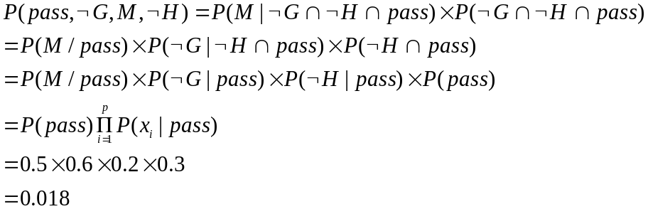
Naïve Bayes
Strong assumption of the conditional independence of all feature variables.
Feature variables only dependent on class variable
pass
0.5
G
H
M

Slide 12
Characteristics of Naïve Bayes
Only requires the estimation of the prior probabilities P(C_{K}) and p conditional probabilities for each class, to be able to answer full set of queries across classes and features.
Empirical evidence shows that Naïve Bayes classifiers work remarkable well. The use of a full Bayes (belief) network provide only limited improvements in classification performance.

Slide 13
Why do Naïve Bayes Classifiers work so well?
Performance measured using 0-1 loss function which counts the number of incorrect classifications rather than a measure of how accurate the classifier estimates the posterior probabilities
Additional explanation by Harry Zhang claiming that the distribution of dependencies among features over the classes affects the accuracy of Naïve Bayes.

Slide 14
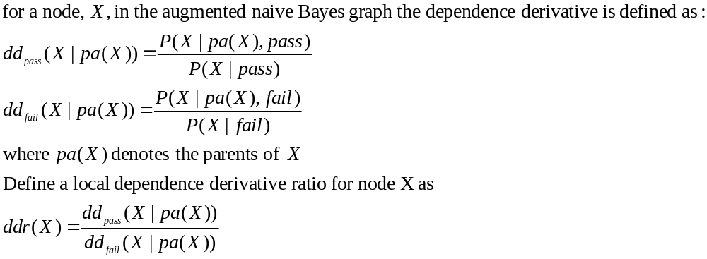
Zhang’s Explanation
Define Local Dependencies – measure of the dependency between a node and its parents. Ratio of the conditional probability of the node given its parents over the node without parents.

Slide 15
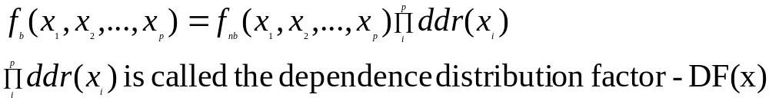
Zhang’s Theorem #1
Given an augmented naïve Bayes graph and its correspondent naïve Bayes graph on features X₁,X₂,…X_{p,} assume that f_{b} and f_{nb} are the Bayes and Naïve Bayes classifiers respectively, then the equation below is true.

Slide 16
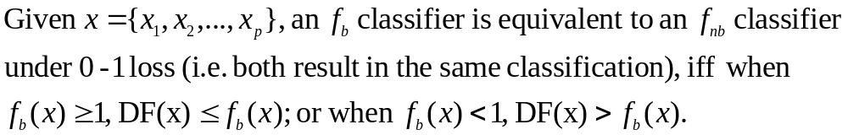
Zhang’s Theorem #2

Slide 17
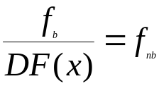
Analysis
Determine when f_{nb} results in the same classification as f_{b.}
Clearly when DF(X) = 1. There are 3 cases for DF(X)=1.
1. All the features are independent
2. Local dependencies for each node distributes evenly in both classes
3. Local dependencies supporting classification in one class are canceled by others supporting the opposite class.
If
If

Slide 18
The End Except For
Questions
List of Sources

Slide 19
List of Sources
Hand, D., Mannila, H., & Smyth, P. (2001). Principles of Data Mining; Chapter 10. Massachusetts:The MIT Press.
Zhang, H. (2004). The Optimality of Naïve Bayes. Retrieved April 17, 2008, Web site: http://www.cs.unb.ca/profs/hzhang/publications/FLAIRS04ZhangH.pdf
Moore, A. (2001) Bayes Nets for Representing and reasoning about uncertainty. Retrieved April 22, 2008, Web site:
http://www.coral-lab.org/~oates/classes/2006/Machine%20Learning/web/bayesnet.pdf
Naïve Bayes classifier. Retrieved April 10, 2008, Web site:
  http://en.wikipedia.org/wiki/Naive_Bayes_classifier
Ruane, Michael (March 30, 2008) Cherry Blossom Forecast gets a Digital Aid. Retrieved April 10, 2008, Web site: http://www.boston.com/news/nation/washington/articles/2008/03/30/cherry_blossom_forecast_gets_a_digital_aid/

