Slide 1
Statistical Machine Translation
Marianna Martindale
CMSC 498k
May 6, 2008

Slide 2
Machine Translation
Sample:
England diplomat 米利 Ban De said that, including American, Russian, Chinese, English and France's United Nations five permanent members as well as Germany to Iran proposed requests Iran to give up the refinement 浓缩铀 and the development nucleus military plan new condition.
Systran (via Babelfish), May 2, 2008
British Foreign Secretary Miliband said, including the United States, Russia, China, Britain and France, the United Nations, the five permanent members and Germany to Iran by calling on Iran to abandon uranium enrichment and development of new nuclear weapons program conditions.
Google, May 2, 2008
英国外交大臣米利班德说，包括美国、俄罗斯、中国、英国和法国在内的联合国五个常任理事国以及德国将向伊朗提出要求伊朗放弃提炼浓缩铀和发展核武计划的新条件。
BBC News, May 2, 2008

Slide 3
But it must be recognized that the notion “probability of a sentence” is an entirely useless one, under any known interpretation of this term.
--Noam Chomsky, 1969
Anytime a linguist leaves the group the recognition rate goes up.
--Fred Jelinek, IBM, 1988
(as quoted in Speech and Language Processing, Jurafsky & Martin)

Slide 4
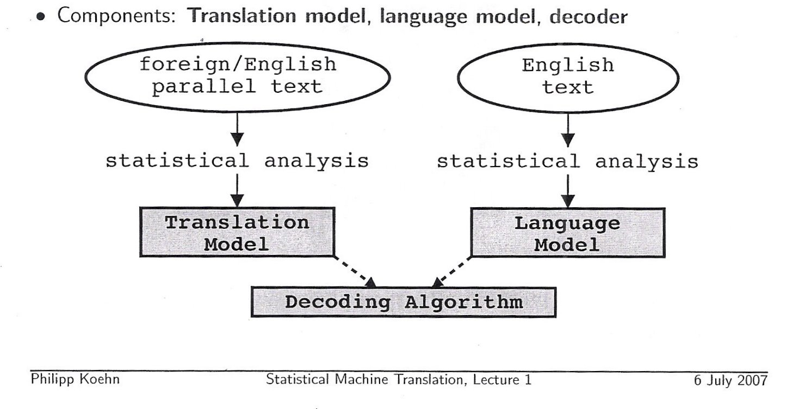
Statistical MT System Overview

Slide 5
Statistical MT System

Slide 6
Translation Model
Alignment from bitext
IBM Models
  Model 1: lexical translation *
  Model 2: adds absolute reordering model
  Model 3: adds fertility model **
  Model 4: relative reordering model
  Model 5: fixes deficiency
GIZA++

Slide 7
Alignment
Problem: we know what sentences (paragraphs) match, but how do we know which words/phrases match?
The old chicken and egg question:
  If we knew how they aligned, we could simply count to get the probability
  If we knew the probabilities, it would be simple to align them

Slide 8
Alignment - EM
Solution: Expectation Maximization*
Assume all alignments are equally probable
Align. Count. Repeat.
  Align based on the probabilities
  Based on the alignments, calculate new probablities
*See chapter 8 (section 8.4) in the textbook

Slide 9
Alignment – Phrases
Things get more complicated with phrases
Align words bi-directionally and find all phrase alignments consistent with the word alignment

Slide 10
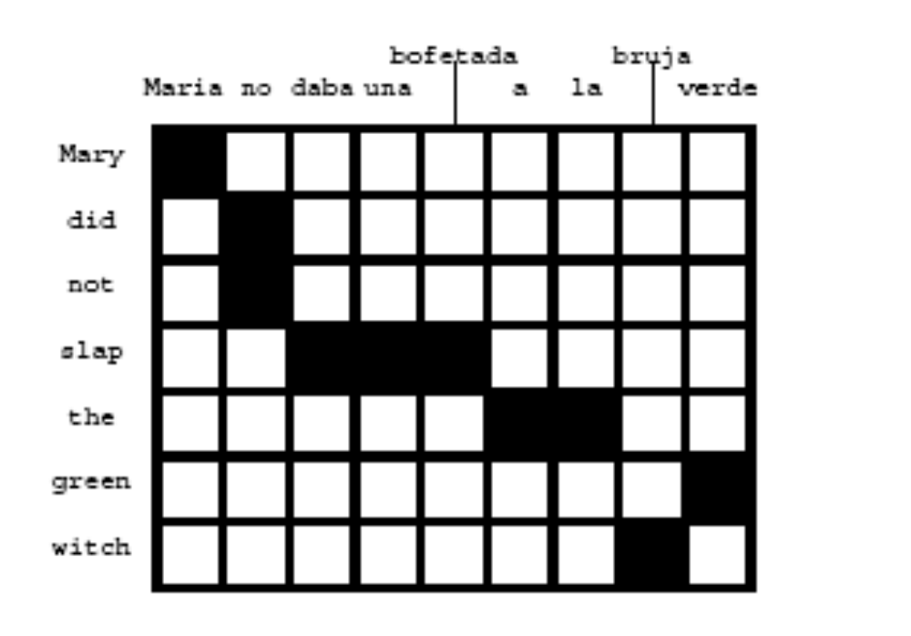
Alignment diagram
From Philipp Koehn’s SMT lecture

Slide 11
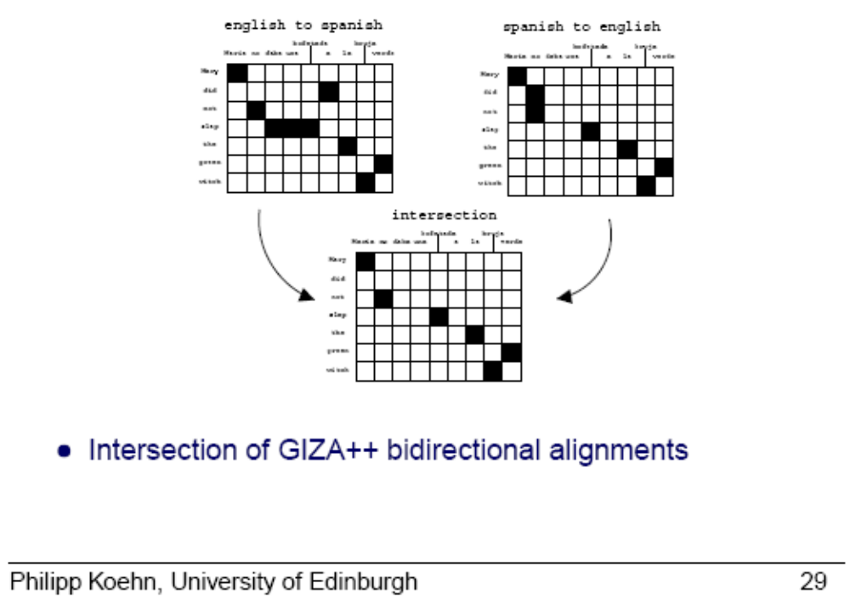
Bidirectional alignment

Slide 12
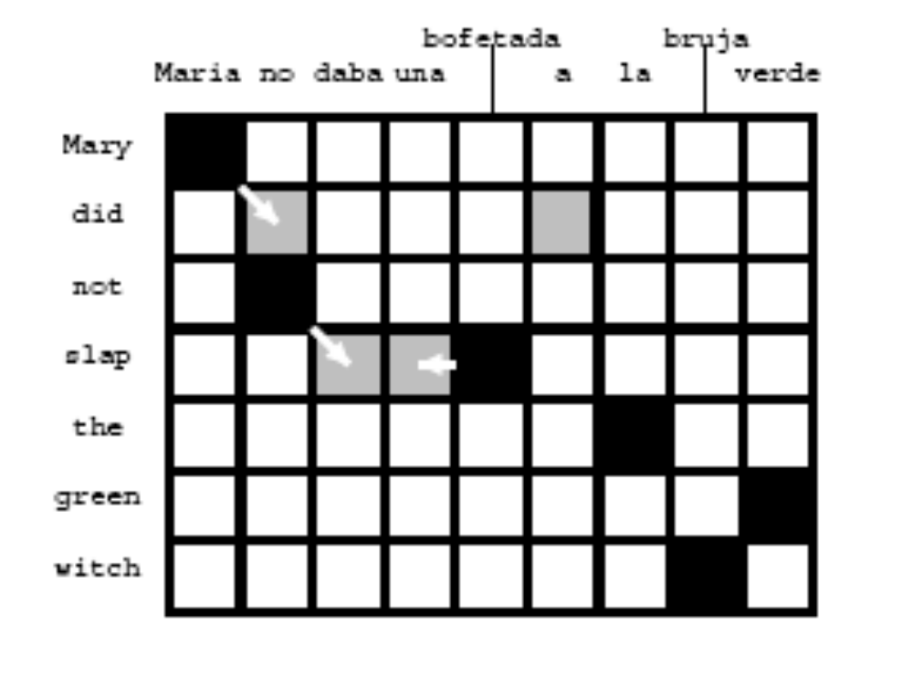
Phrase alignment cont.
Grow the missing alignment points

Slide 13
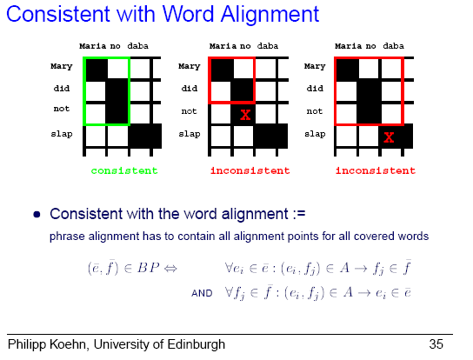
Phrase alignment cont.
Find all phrase alignments consistent with word alignment

Slide 14
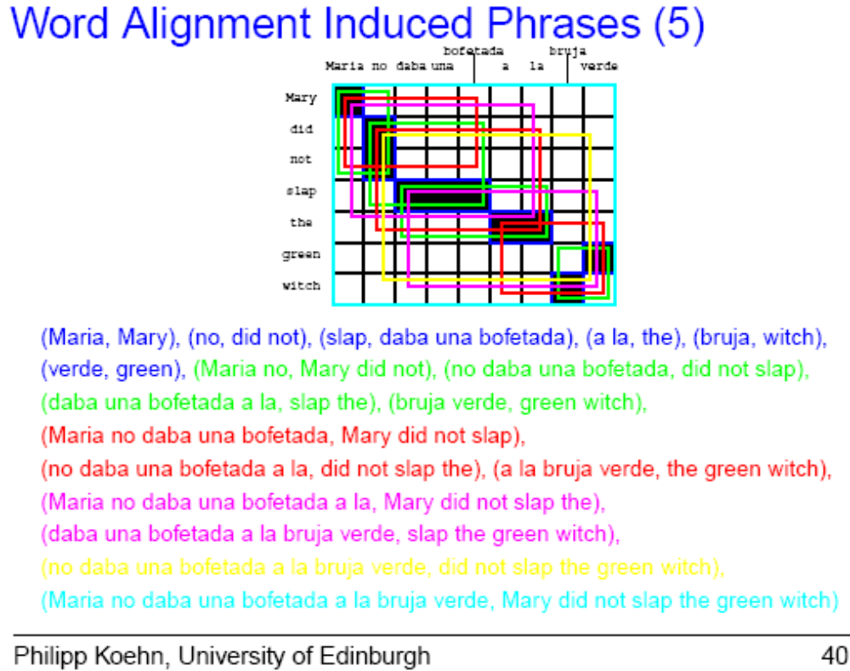
Phrase alignment cont.

Slide 15
Statistical MT System

Slide 16
Language Model
N-grams
P(e_{i}|e_{i-1}, e_{i-2})
Example:
The Dow ________
  Jones
  rose
  *hippopotamus

Slide 17
Statistical MT System

Slide 18
Decoding
Bayes Rule strikes again
Maximize P(F|E)*P(E)
  P(F|E) : Translation model
    Does F “mean” E?
  P(E) : Language model
    Does E look like English?

Slide 19
Noisy Channel Model
Predict source based on output
Noisy
Channel
Source
Output

Slide 20
Decoding (2)
Problem: P(F|E) and (especially) P(E) are tiny -> underflow!
log P(E) + log P(F|E)
And while we’re at it…
λ₁ log P(E) + λ₂ log P(F|E) + λ₃… λ_{n}
  Σ λ_{i} = 1
  Tune these weights

Slide 21
Decoding Process
Build translation in order (left-to-right)
Generate all possible translations and pick the best one
Words and phrases
NP Complete

Slide 22
Decoding Process (2)
Naïve algorithm: O(m²v^{2m})
  Given a string f of length m
  1. for all source strings e of length i <= 2m:
  a. compute
  P(e) = b(e_{l}|boundary)
  - b(boundary|e_{l}) Π^{l}_{t=2} b(e_{i}|e_{i-1})
  b. compute P(f|e) = є(m|l) 1/l^{m} Π^{m}_{j=1} Σ^{l}_{i=1} s(f_{j}|e_{i})
  c. compute P(e|f) ~ P(e) • P(f|e)
  d. if P(e|f) is the best so far, remember it
  2. print best e
m=length(f) v=vocabulary size

Slide 23
NP-completeness
Reduction 1: Hamilton Circuit
Reduction 2: Minimum Set Cover Problem

Slide 24
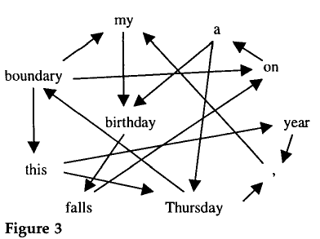
Hamilton Circuit
Word based model
Shortest path is optimal word order

Slide 25
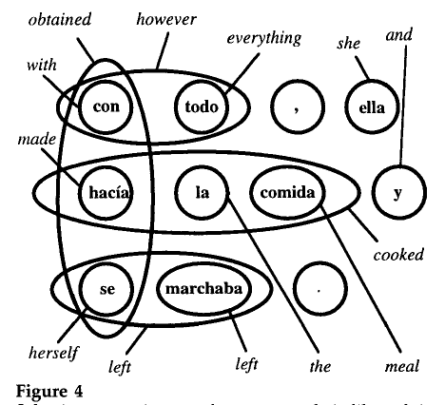
Minimum Set Cover
Dictionary with phrases (or phrase-based model)
The best translation should have the longest/most-probable translations
Similar complexity in phrase-based alignment for translation model

Slide 26
Handling NP-completeness
Heuristic search
  Beam search
  A*

Slide 27
Additional Resources
Tutorials, papers galore:
http://www.statmt.org
http://www.mt-archive.info
Specific, useful papers and tutorials:
“Statistical Phrase-Based Translation”, P Koehn, FJ Och, D Marcu.
http://www.isi.edu/~marcu/papers/phrases-hlt2003.pdf
“The Mathematics of Statistical Machine Translation: Parameter Estimation”. PE Brown, VJ Della Pietra, SA Della Pietra, RL …
http://mt-archive.info/CL-1993-Brown.pdf
“Decoding Complexity in Word-Replacement Translation Models”, Kevin Knight
http://www.isi.edu/natural-language/projects/rewrite/decoding-cl.ps
“Introduction to Statistical Machine Translation”, Chris Callison-Burch and Philipp Koehn, European Summer School for Language and Logic (ESSLL) 2005
links to all five days at http://www.statmt.org

