Slide 1


HAP: SPMD DNN Training on Heterogeneous GPU Clusters with Automated Program Synthesis
Shiwei Zhang, Lansong Diao, Chuan Wu,
Zongyan Cao, Siyu Wang, Wei Lin
The University of Hong Kong Alibaba Inc.
Notes:
Hello, everyone. I am Shiwei from the University of Hong Kong. I am glad to introduce Hap, that focus on distributed training on heterogeneous clusters.

Slide 2
Motivation: ML Models Are Demanding
PanGu-Σ (2023) is trained on 512 Ascend 910 NPUs.
Gemini 1.5 Pro (2024) is trained on multiple 4096-chip pods of TPUv4.
Llama 3 (2024) is trained on two clusters with 24,000 GPUs.
Notes:
Our work is motivated by the recent trend of large models.
Recent development of LLM has demonstrated that scaling up model provides better performance.
As a result, recent models are becoming increasingly large and require large clusters to train.

Slide 3
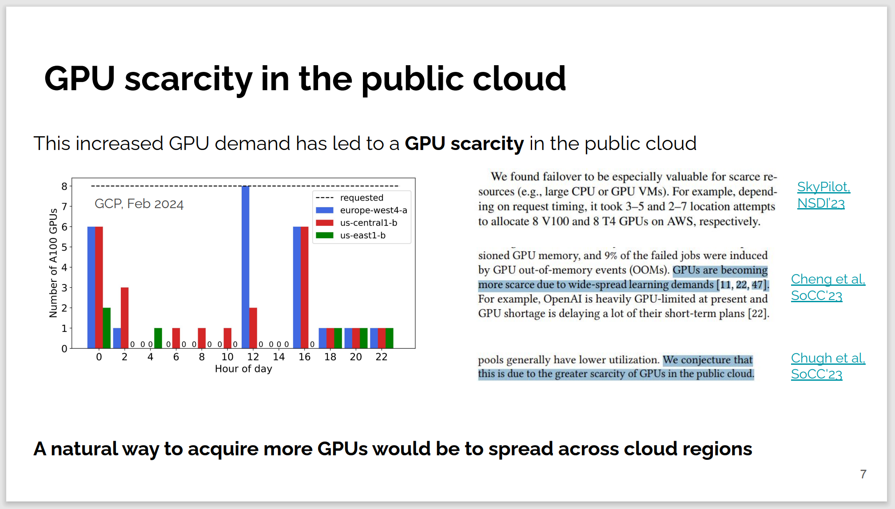
Motivation: Shortage of Homogeneous GPUs
Using GPUs of different types allows training larger models on existing infrastructure!
Foteini Strati et al. EuroMLSys ‘24
Notes:
On the other hand, the supply of GPUs is in a shortage.
Here is an excellent slide in the workshop here two days ago that shows this problem.
We see that even large cloud providers has limited supply of GPUs, and this is confirmed by many other studies.
Therefore, to train large models on today’s infrastructure, we argue that we should use all available resources, including GPUs of different types, such as V100 and A100, together, to train a single model.
With this kind of heterogeneous clusters, we can train large models that otherwise does not fit into existing infrastructure.

Slide 4
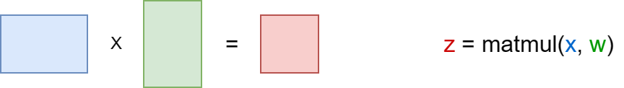
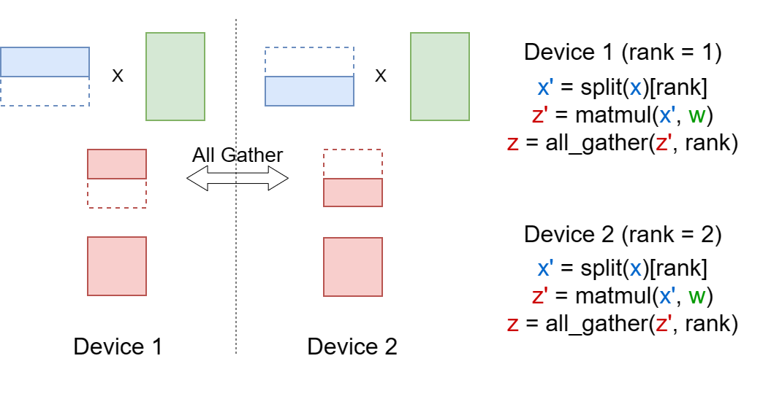
Background: Tensor Programs and SPMD Parallelism
Multiple devices run the same program to jointly produce a result that equals the single-card program.
Notes:
Our work is based on SPMD parallelism.
Current machine learning models are implemented as tensor programs, like this simple example. The variables are tensors and the instructions are tensor operations.
While the program is simple, it can be challenging to run if the input tensors are large, such as those in today’s LLM.
One approach is to shard the tensors into smaller pieces and put them onto different devices. In order to obtain the original result, we need to insert communication operations to aggregate the shards across devices.
We note that after sharding, the program runs on different devices are still the same, only the values of variables differ.

Slide 5
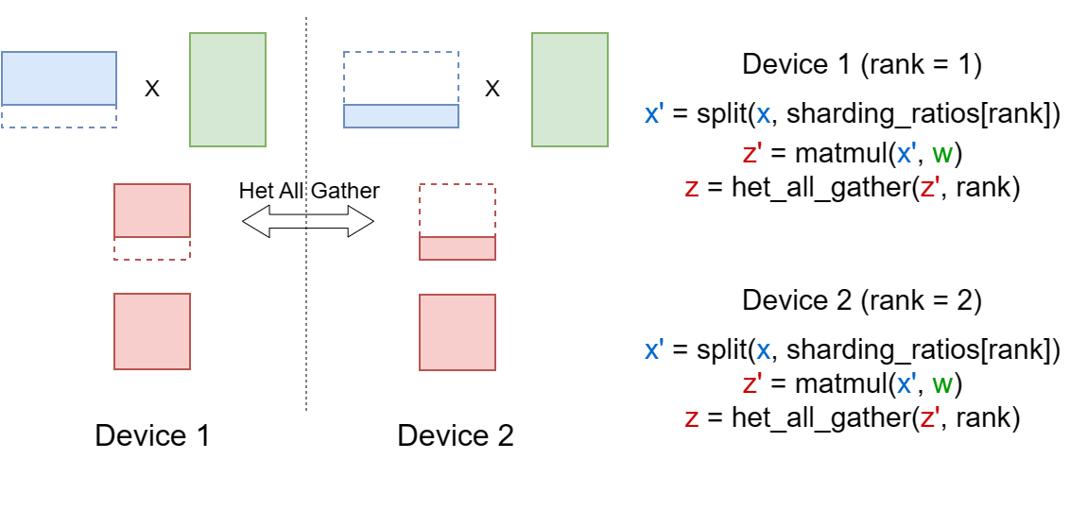
Background: Uneven Sharding
To fully utilize devices with different computation powers, we can unevenly shard the tensors to balance the workloads.
Notes:
On heterogeneous clusters with different types of devices, it may be desirable to split the tensors into uneven shards, such that some of the devices get larger shards, and other devices get smaller shards, depending on their capabilities.

Slide 6
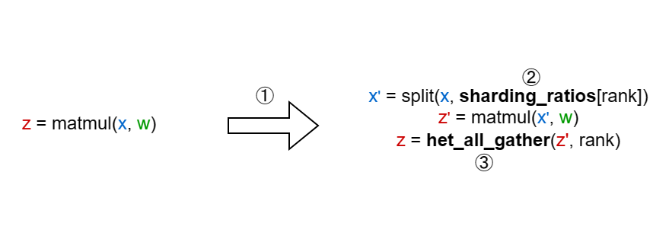
Challenges
① How to generate a distributed program that produces equivalent results
② How to determine the sharding ratios for the heterogeneous devices
③ How to choose the communication method on heterogeneous networks
Notes:
That’s the basic idea of our work.
However, there are three challenges in automating this process.
[read slides]
How do we determine the exact sharding ratio, that can best balance the workloads of the heterogeneous devices
And finally, how to implement the communication operation , with support for uneven tensor shards and heterogeneous networks

Slide 7
Challenge 1: Tensor Sharding
Different operators can be sharded on different dimensions
Sharding a BatchNorm operation may reduce training stability
An Einsum operator can be sharded on dimensions that depend on the actual code string
Collective communication needs to be inserted
AllGather and AllReduce are used to aggregate tensor shards
AllToAll may be used when two consecutive operators use different sharding methods
Notes:
While we can split any tensor on any of its dimensions, not all sharding methods preserve correct results.
For example, some naive data parallel implementations split the batch size dimension of the BatchNorm operator, which actually change the semantics of the program and reduces training stability.
Also, we need to insert communication to coordinate the devices, such as AllGather and AllReduce.

Slide 8
Solution 1: Automated Program Synthesis
We extract the semantics of the single-card program into Hoare triples.
When the precondition is met, inserting the instruction establishes the postcondition.
The precondition and postcondition are represented as sets of properties in the form of tensor | op, which denotes that if we execute the operator op, we can obtain a result that equals tensor.
Notes:
To explore all valid sharding methods, we propose a method that formalize the semantics of the tensor programs, then synthesize a program with this semantic constraints.
We first analyze the semantics of the single-card program into a set of Hoare triples, in the form like this. It means when the precondition is met, inserting the instruction into the distributed program establishes the postcondition.
The conditions are described as sets of properties, which composes of a tensor and an operator. It denotes that if we execute the operator, we can obtain a result that equals tensor.
Here is an example that states our previous example of the matmul sharding is correct. It says for any MatMul operation in the single-card program, if we shard the first input, we can run MatMul on all devices as well, and obtain a sharded output.
While each rule look trivial, repeatedly applying them allows us to verify the equivalence of a generated program.

Slide 9
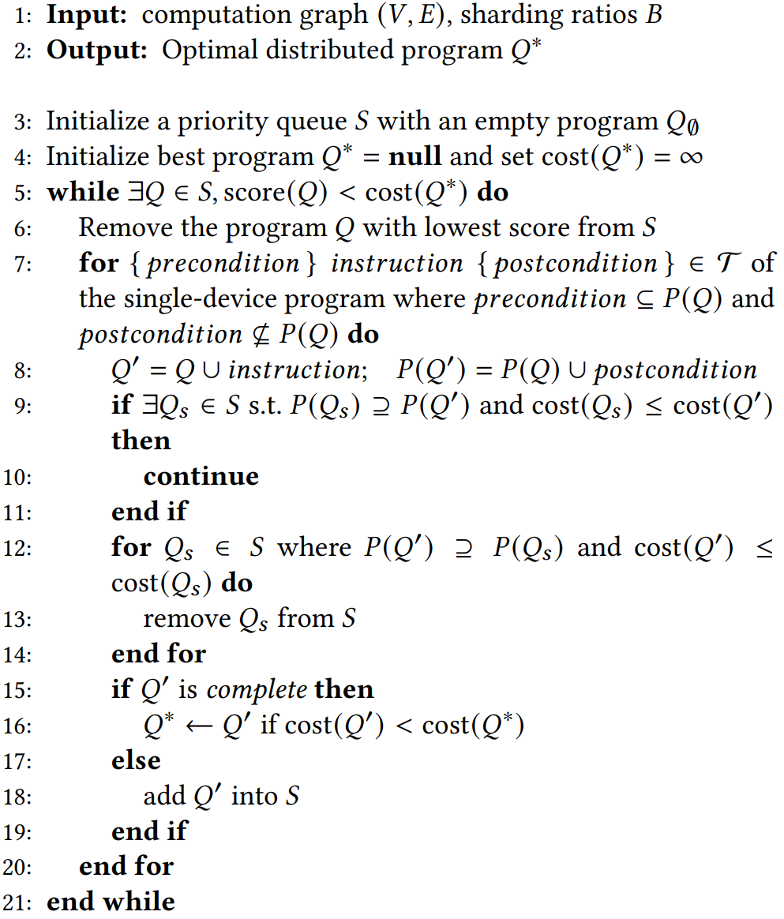
Solution 1: Automated Program Synthesis (cont'd)
The search space of distributed programs is huge.
We design an A*-based search algorithm combined with the idea of dynamic programming to practically synthesize distributed programs for common models.
Notes:
Then, the straightforward idea is to search all valid programs and choose the optimal one.
However, the search space is very huge.
Therefore, we design a search algorithm based on A* and dynamic programming to accelerate the searching.
More details can be found in the paper.

Slide 10
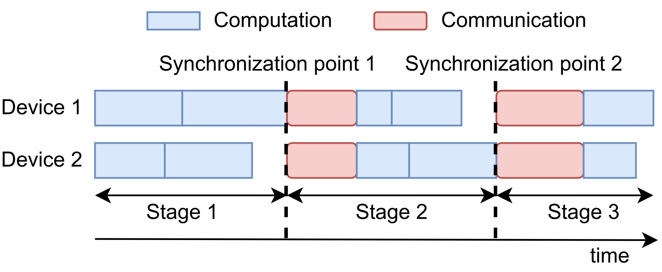
Challenge 2: Load Balancing
Communication time depends on the largest shard
Even sharding minimizes communication time
Computation time on each device is proportional to the shard size
Sharding sizes proportional to device speeds balance the computation time
Notes:
Then we need choose the sharding ratios to balance the workload of different devices.
The problem is that the computation and communication operators have different performance implications.
The collective communications often involves sending all slices to all devices, so the time depends on the largest slice.
Therefore, even sharding minimize the communication time.
However, the computation time is often proportional to the size of the shard assigned to a device.
Therefore, to balance the computation time, we want to set the sharding size proportional to the device speeds.
Now we have both communication and computation in our program, we need to somehow find a middle point between minimizing the communication and minimizing the computation.

Slide 11
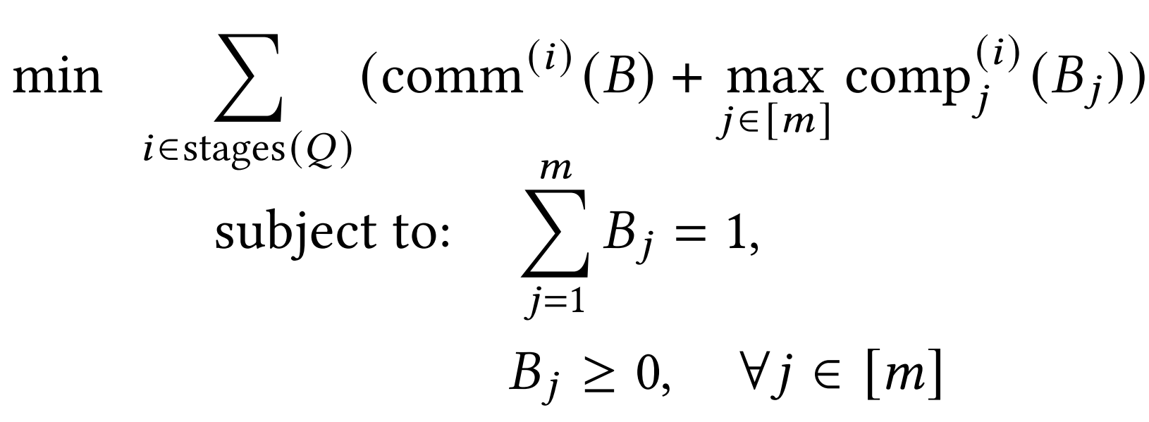
Solution 2: Linear Programming
We profile the computation and communication operations with different input shapes and fit a linear model for each operator.
The training time can be expressed as a linear function of the sharding ratios.
Notes:
Our solution is linear programming.
[read slide]
[click]
The linear programming problem can be efficiently solved with off-the-shelf solvers.

Slide 12
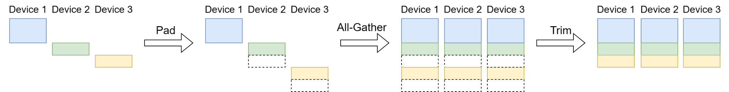
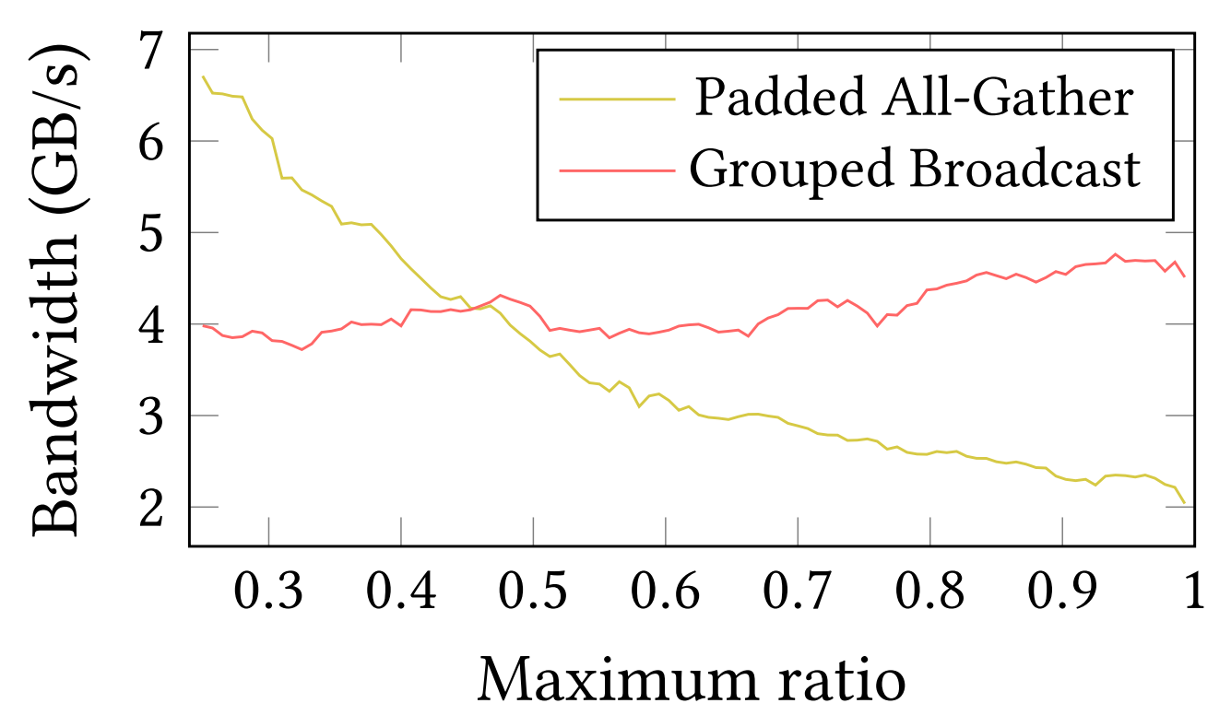
Challenges 3: Communication with Uneven Shards
The optimal communication method depends on the sharding ratios.
Notes:
The third challenge is about communication.
Popular communication libraries are optimized for homogeneous clusters and they assume the shards to have the same shape.
When the unevenly shard the tensors, we may have multiple choice to implement the communication.
For example, for the all-gather operation, we may first pad all tensors to the same size, then call the library function, and remove the pads afterwards.
Alternatively, we can instead using multiple broadcast to achieve the same result.
The two methods have different performance. When the shards are relatively even, we find the first method to perform better. In other cases, the second method can have better performance. Therefore, we need to jointly consider the communication method and sharding ratios.

Slide 13
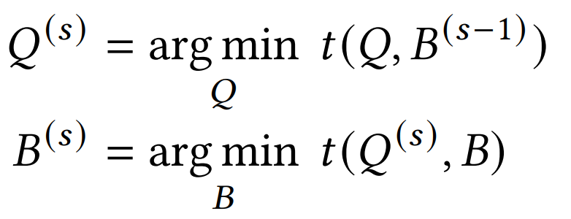
Solution 3: Integrate Communication Into Program Synthesis
We support different communication methods by adding multiple rules during program synthesis.
We alternatively optimize the distributed program Q and the sharding ratios B to approach the global optimum.
Notes:
We propose to integrate the communication optimization into program synthesis, by adding rules for different implementations of the same operations. For example, we may add a rule of the grouped broadcast operation that have the same precondition and post conditions of all gather.
Then we alternatively optimize the distributed program Q, which includes the communication, and the sharding ratios B, to approach the global optimal.

Slide 14
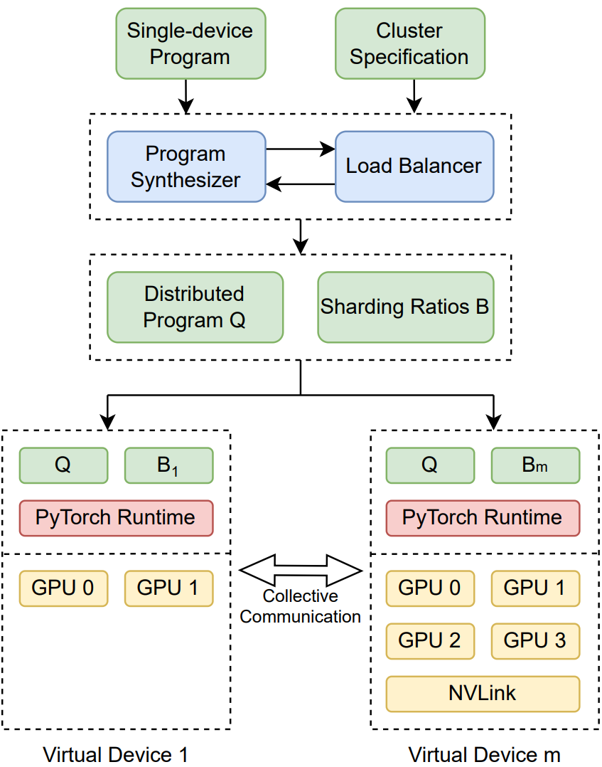
Implementation
PyTorch 1.13.1
91 semantic rules
Round sharding dimensions
Notes:
We implement HAP on Pytorch.
We wrote 91 rules that covers common operations in neural networks.
And we round sharding dimensions as the result of the linear program may be fractional.

Slide 15
Experimental Setup
8 Machines with 64 GPUs on Alibaba Cloud
6 machines with 8 P100
2 machines with 8 V100 and NVLink
4 Models
VGG19 with 133M parameters
ViT with 54M parameters
BERT with 102M parameters
BERT-MoE with up to 2.3B parameters
4 Baselines
DP-EV: Data parallelism with even partitions
DP-CP: Data parallelism with sharding ratios proportional to the computation speeds
DeepSpeed
TAG
Notes:
We conduct our experiment on public cloud with 64 GPUs.
We tested 4 models and compared to 4 baselines.
The DP-EV …

Slide 16
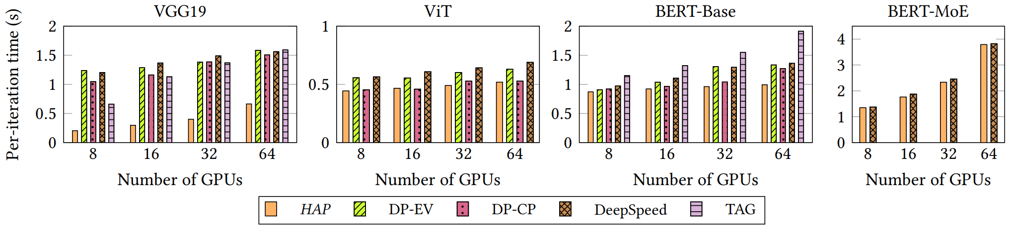
Experiment Result
Consistently outperform baselines
Up to 2.41x speed up
Notes:
The result shows that our proposed design consistently outperform all baselines on heterogeneous clusters, with up to 2.4 times speed up.

Slide 17
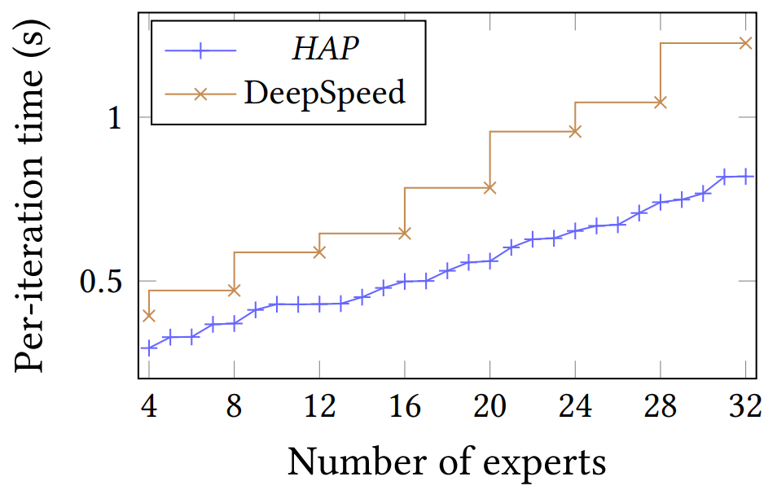
Case Study: Uneven Distribution of Experts
Most MoE frameworks can only put the same number of experts on all devices.
HAP places more experts on faster devices to achieve 64% speed up.
Notes:
[read slides]

Slide 18
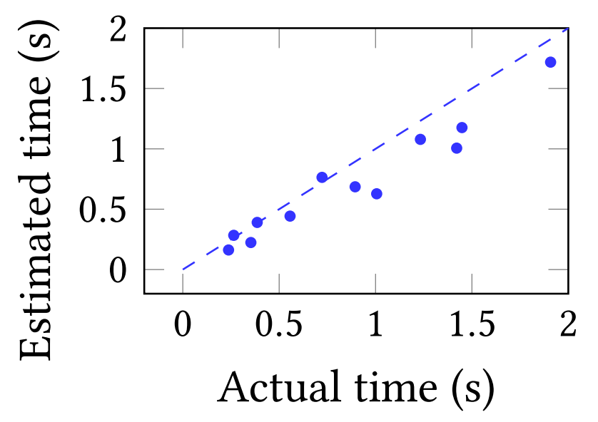
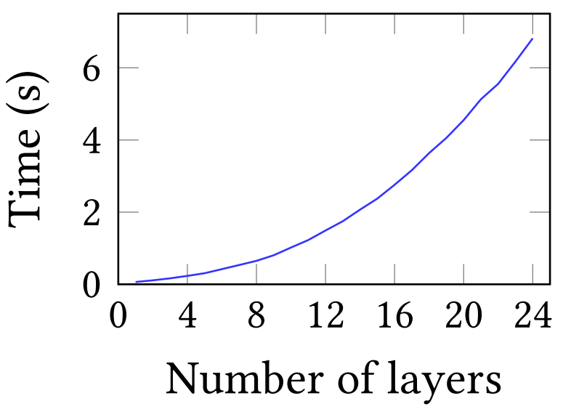
Cost Model Accuracy and Overhead
Training iteration time predicted by our cost model exhibits high linear correlation with actual measurements.
Distributed program can be synthesized within seconds for models of common sizes.
Notes:
[read slides]

Slide 19
Summary
Future Work
HAP enables training larger model by utilizing heterogeneous resources.
HAP automates distributed training by automated program synthesis.
Support branches and loops.
Notes:
In the future, we would like to support control flows to increase the expressiveness of our framework.

Slide 20



Thank you!
Contact: swzhang@cs.hku.hk
Source Code: https://github.com/alibaba/hap

Slide 21
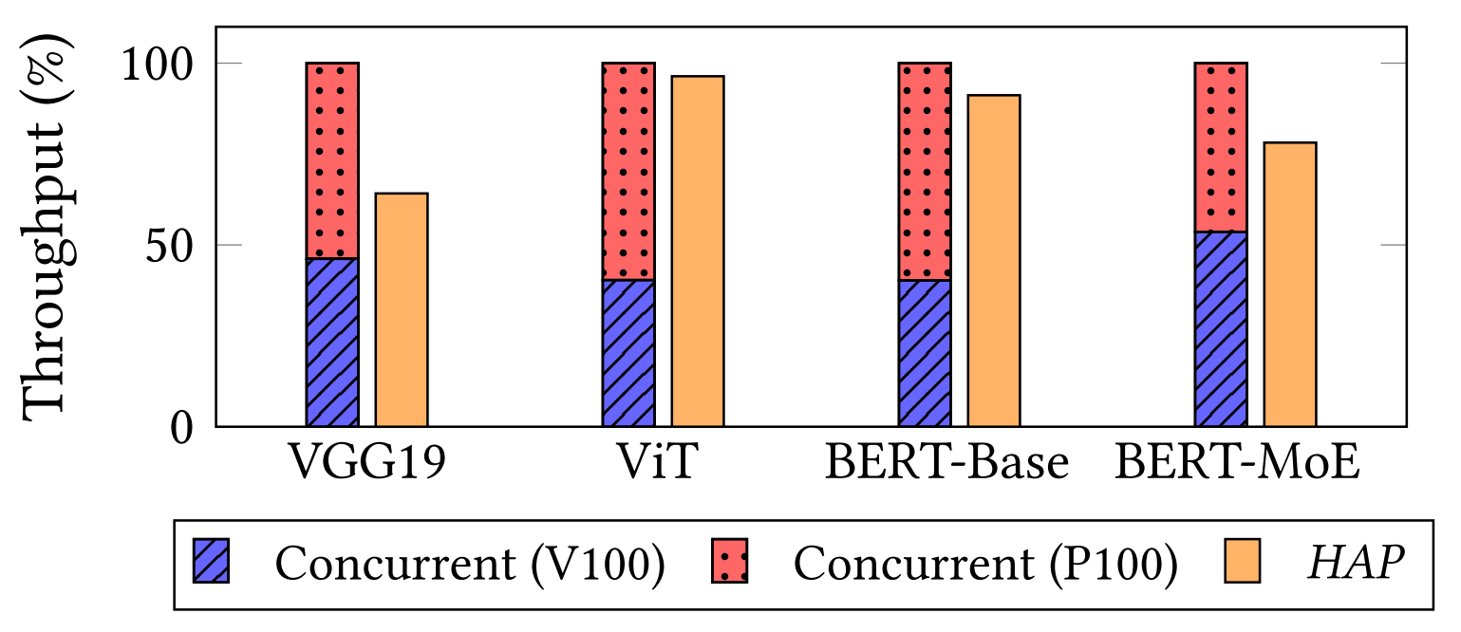

Slide 22
