Slide 1
Uber One Retention Analytics
Columbia University · APAN 5800
Yike Meng

Slide 2
TABLE OF CONTENTS
01
02
03
04
Introduction
Methods
Problems stated and its relevance
Data sources, methods, and tools used
Findings
Impacts and recommendations
Key insights
Visual dashboard
Strategic impact
Actionable recommendation

Slide 3
Problems: High Churns after Trails
The Challenges
  Uber One has strong sign-up growth of 30%, but 40% of members churn within 3 months.
  Users’ perceived value drops sharply once the trial ends.
  Churn reduces subscription revenue and weakens engagement across Rides and Eats.
What we asked?
Why are users not converting after the trial and what behaviors predict churn?
identify which members are most at risk
understand why they churn
develop targeted retention strategies.

Slide 4


2. Methods
Data Source
Source: Simulated Dataset
Sheet 1: User information
Demographic data
Membership status
Purchase behaviors
Sheet 2: Transactions data
User ID & location
Product type
Order value/ revenue
Methods
Geographic visual:
choropleth map
Line chart
Bar chart
Scatterplot
Box plot
Pie chart
Sheet → Dashboard → Story
Tools Used
Excel
Tableau

Slide 5
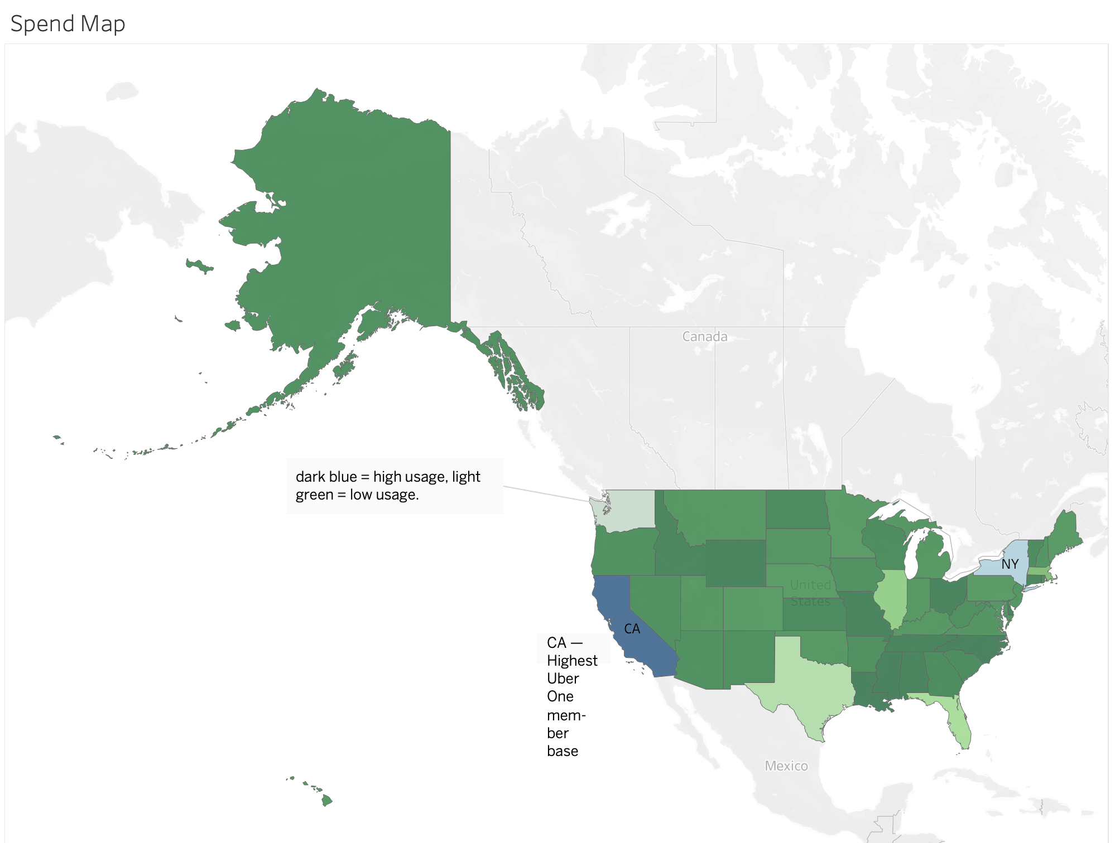
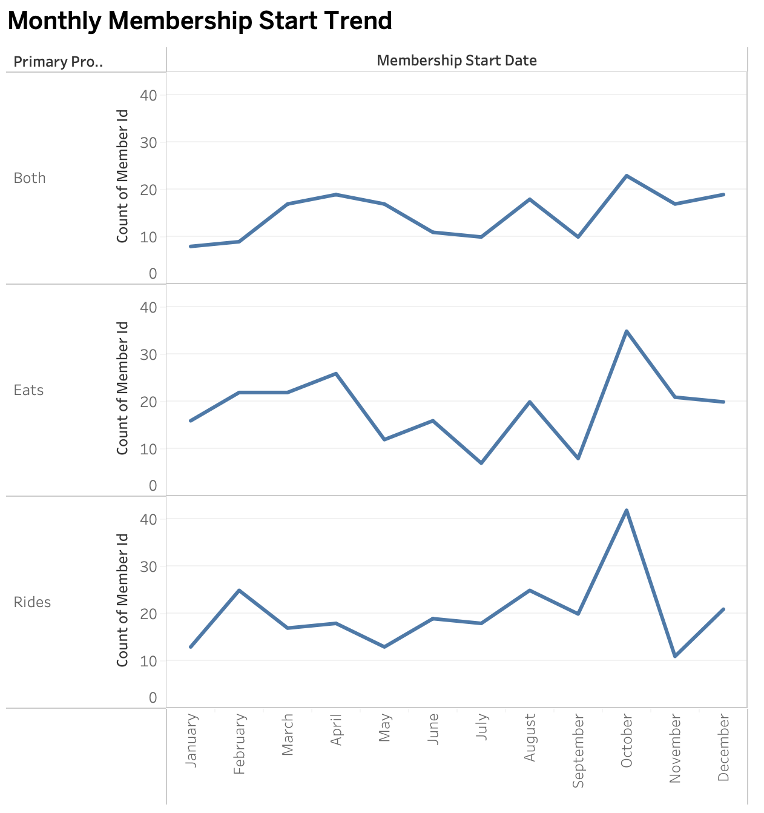
Members Overview
Eats users experience the strongest growth spikes, reflecting higher responsiveness to demand.
Rides are more volatile with a sharp October surge and then decline.
Memberships show noticeable peaks during seasonal periods.
Dual-product users exhibit steadier growth
California and New York represent Uber One’s strongest and most engaged member bases.
Ohio and North Carolina show significantly lower usage, highlighting clear opportunities for regional growth strategies or localized promotional efforts.

Slide 6
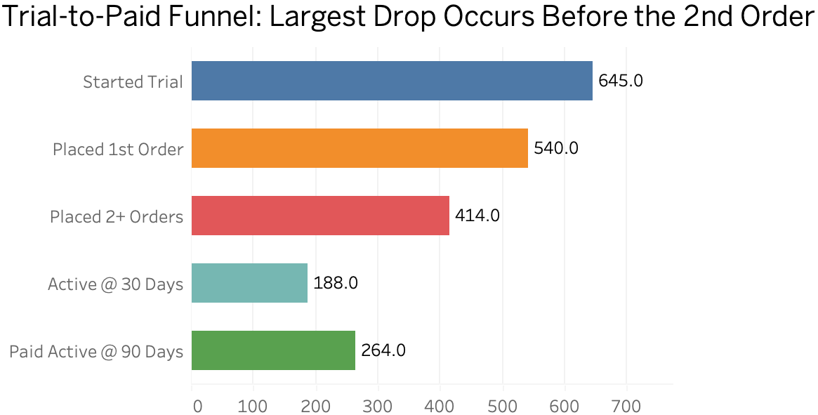
Behavioral Drivers
Largest drop-off happens before the 2nd order, showing most users try the service once but never build a habit.
Driving the 1st → 2nd order is critical.
  second-order discounts
  quick reorder prompts
  time-limited offers
A portion of low-engagement users likely remain active only because the trial auto-renews, indicating passive rather than intentional engagement.
Number of users

Slide 7
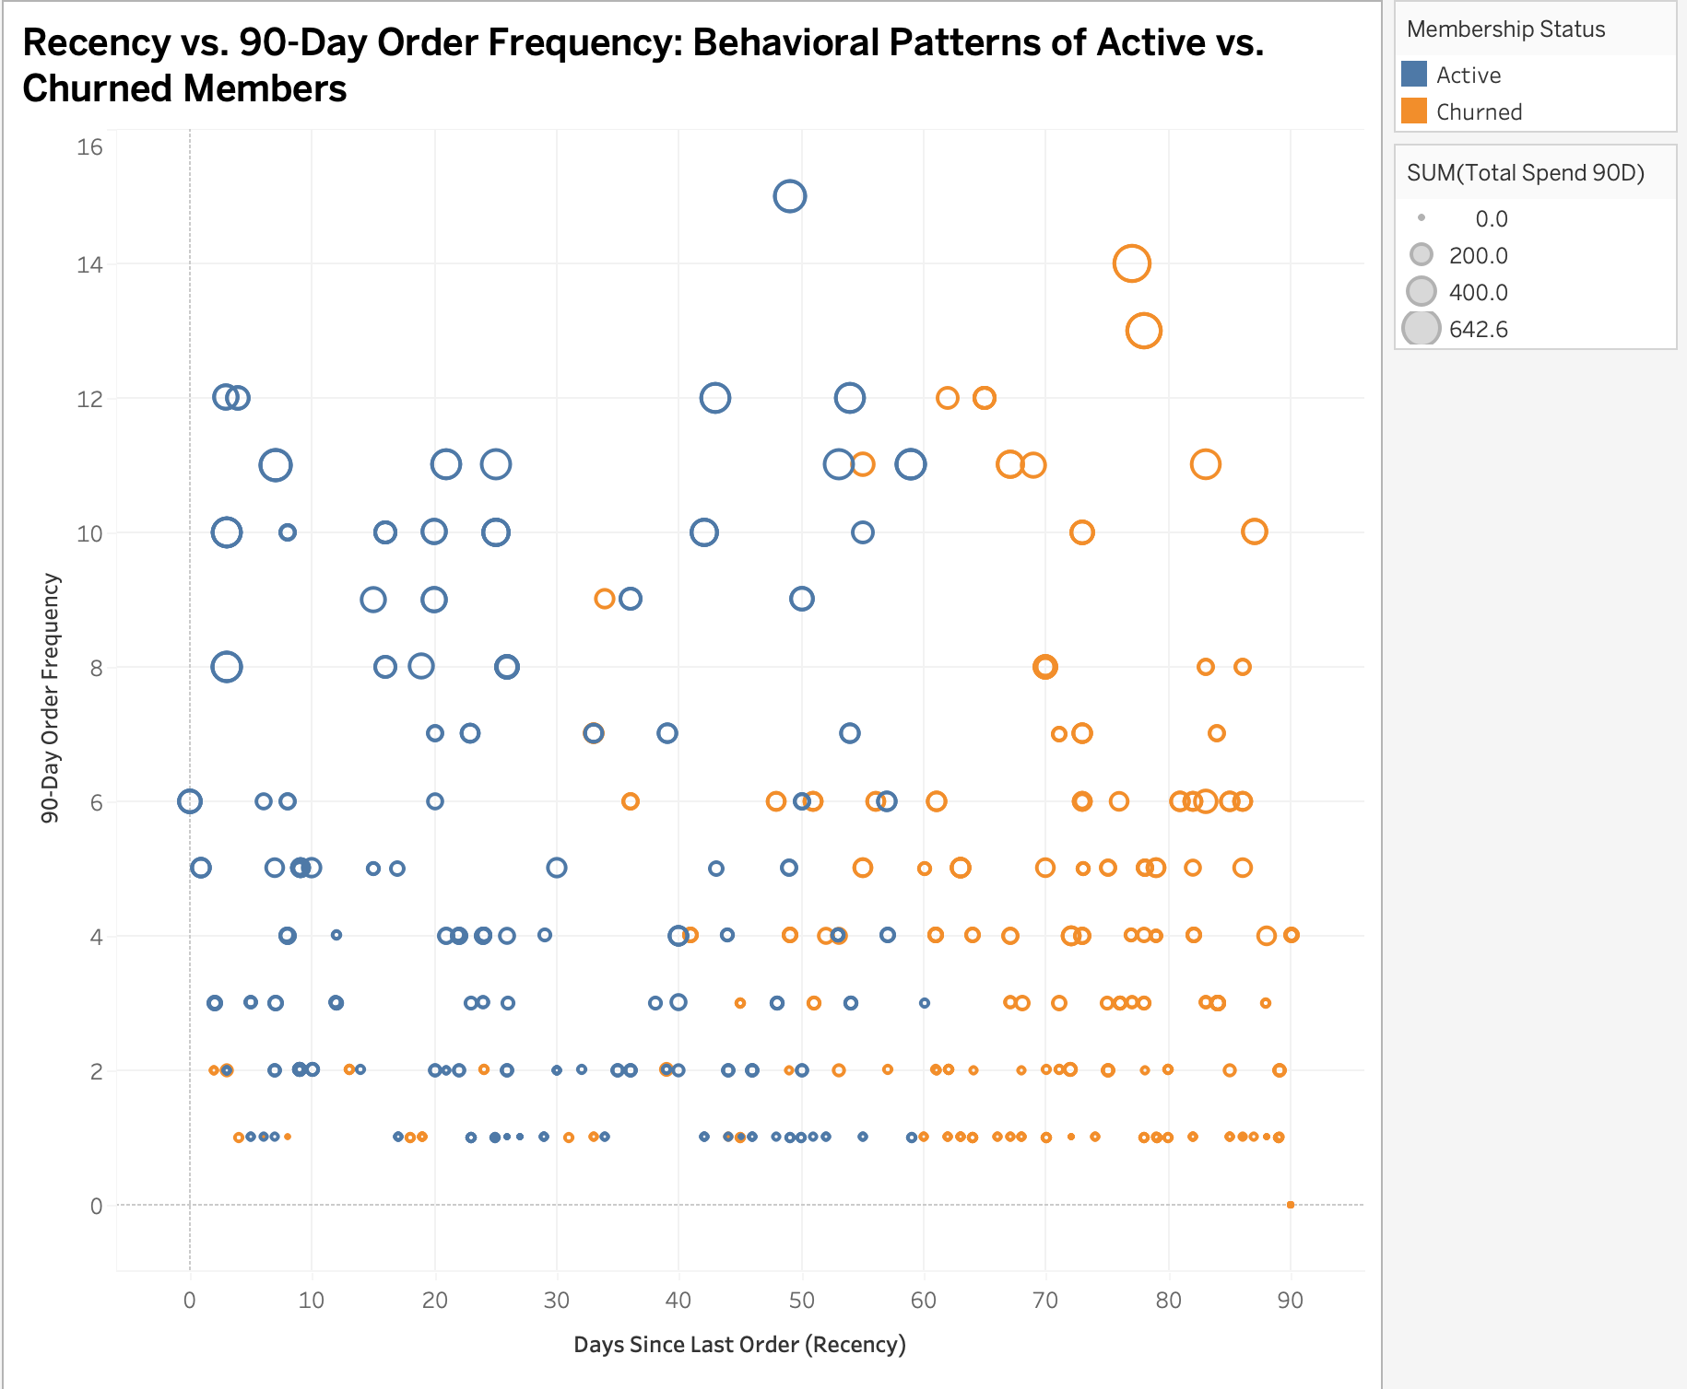
Behavioral Patterns & Churn
Churned members cluster heavily in the high-recency, low-frequency region, indicating declining engagement long before cancellation.
Active users consistently show lower recency and higher usage frequency, demonstrating clear value perception and stronger membership stickiness.
A distinct group of high-spend users is shifting toward higher recency, signaling recoverable high-value churn risks.

Slide 8
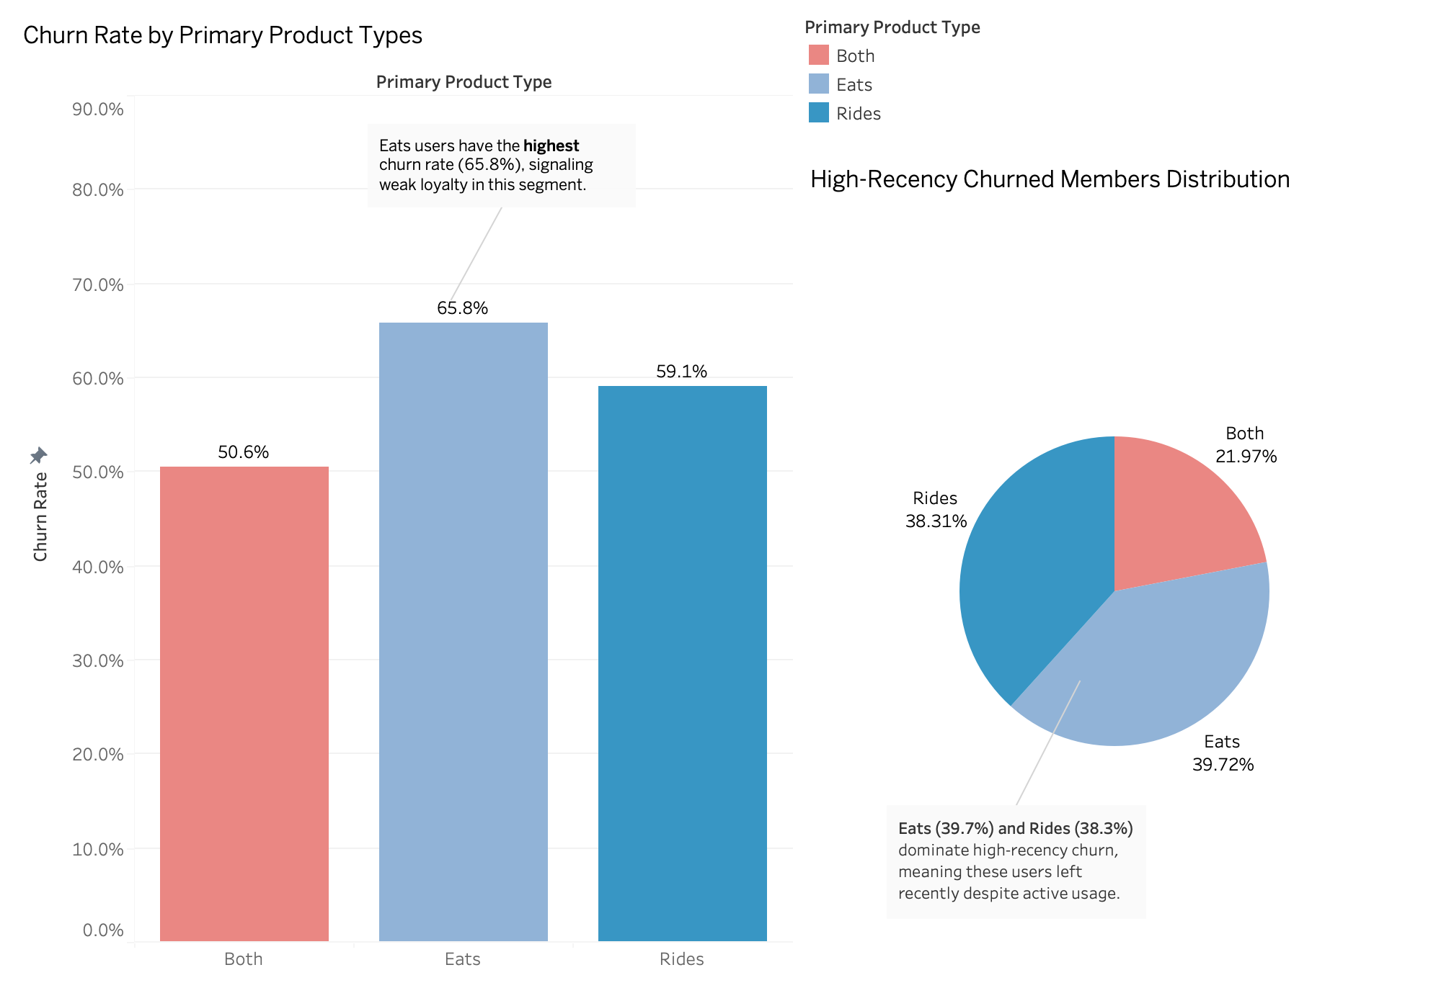
Platform Distribution
Graph A
Ubereats users show the highest churn rate, roughly 15% higher than dual-product users.
Dual-product users have the lowest churn, highlighting cross-platform engagement as a key retention driver.
Graph B
High-recency churned members are split evenly between Rides and Eats, indicating behavioral disengagement, not product preference drives churn.
graph (a)
graph (b)

Slide 9
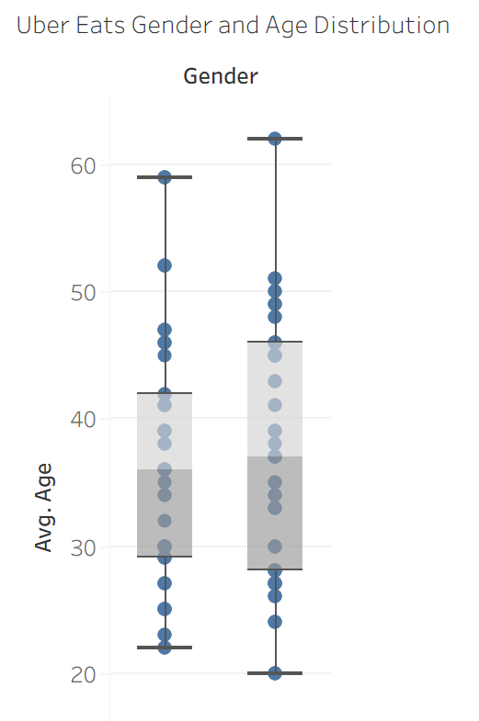
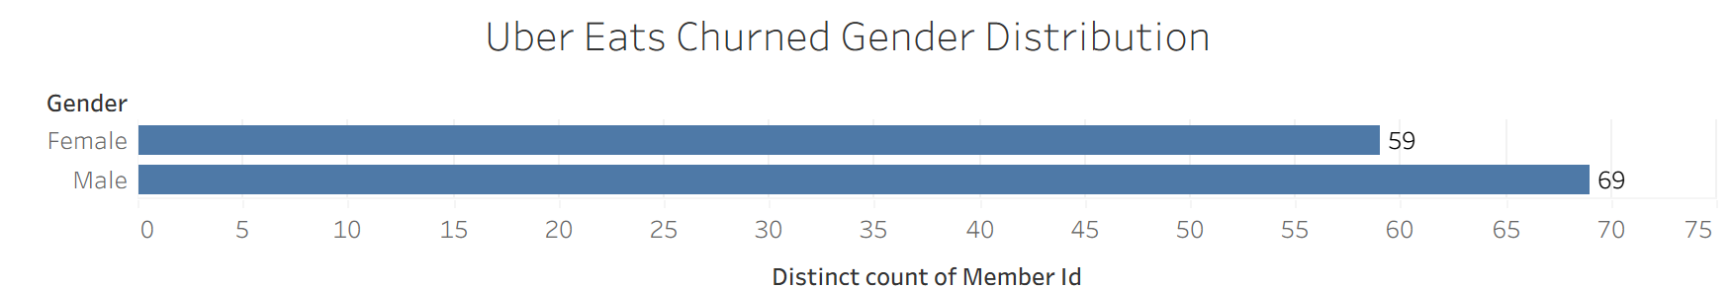
Uber Eats Churned Members Persona
Age distribution is similar across genders. Users aged 30–40 are the core churn users. Both groups have comparable medians and IQR, and 30–40 range is a key segment for churn prevention.
Males show slightly wider age spread and amount. The male box is taller, suggesting more variability in age among male churned users. There are also more male churned users overall, as shown in the bar chart.
🎯
Target Users
Age 30-45
Male
Next Step….
Personalized
Push!

Slide 10
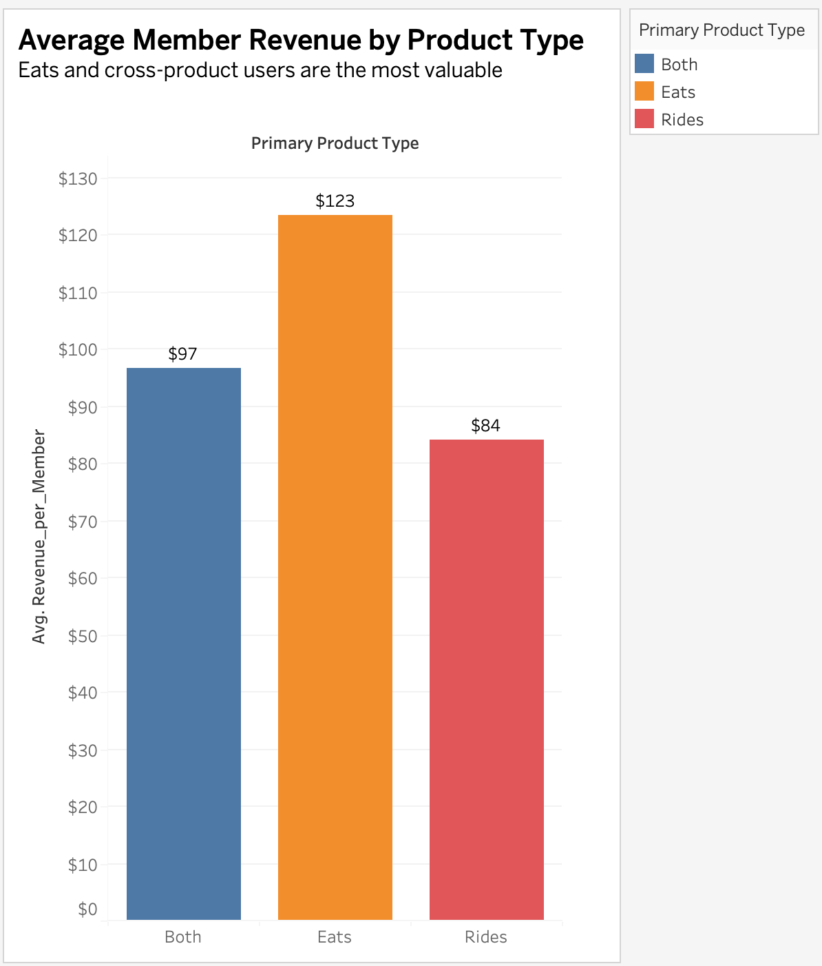
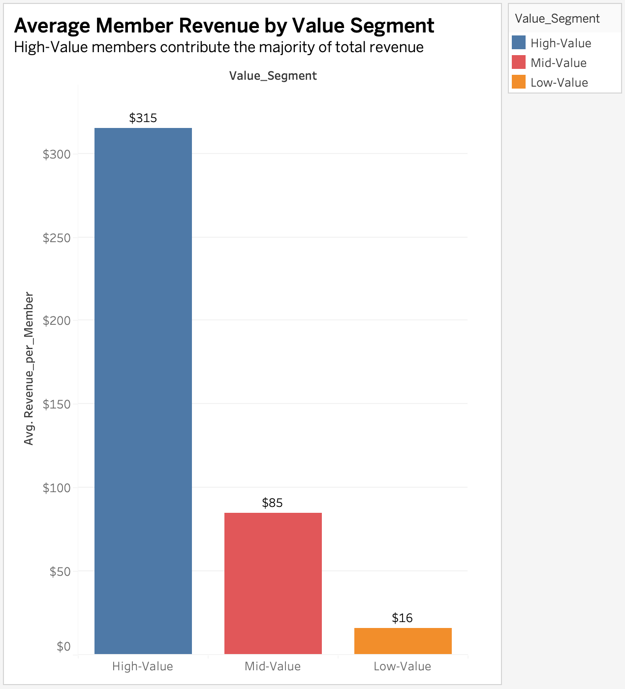
Financial Assessment
Uber One’s revenue is driven primarily by Eats-first users and High-Value members.
Eats-focused and cross-product users generate much higher revenue, highlighting Eats engagement as a key revenue driver.
High-Value members, defined by high spending and frequent orders, contribute 3–4× more revenue than other segments.

Slide 11
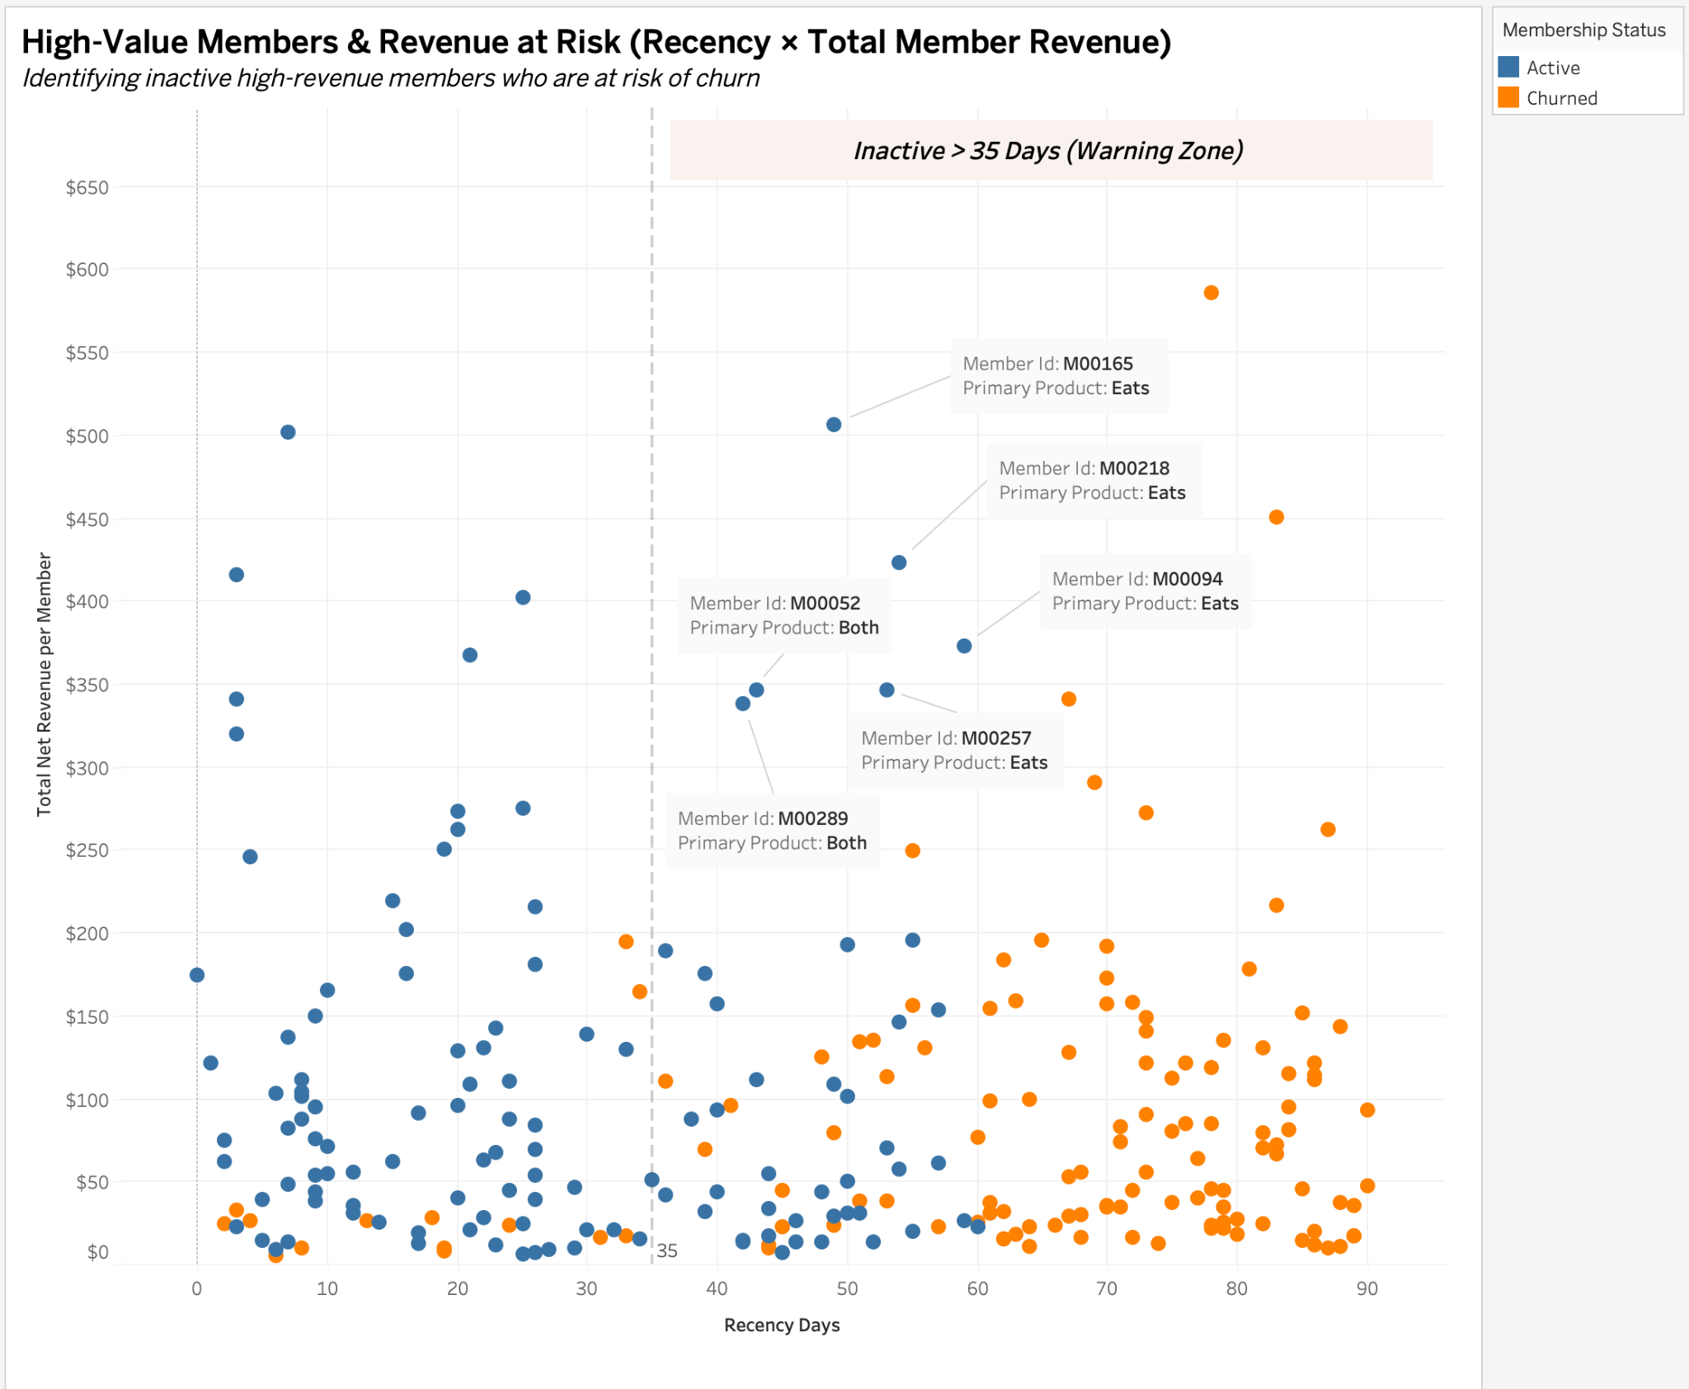
Financial Assessment
The Chart highlights several mid- to high-revenue active members whose recency exceeds 35 days, placing them in the churn warning zone.
The labeled points represent high-revenue, Eats-focused users with prolonged inactivity. These users depict future revenue at risk and should be prioritized for retention campaigns.

Slide 12




Strategic Impact
Impact:
Stronger conversion & retention engine
Revenue protection for High-Value Members
Impact:
Stabilizing volatile rides sign-up trends
Regional growth opportunities
Impact:
Opportunity for cross-product expansion
Primary platform for churn detection signals

Slide 13
🌟Tile1：Uber Rides Regional Reactivation
Target low-activation states with localized ride credits
Send peak-time reminders to prompt next-ride behavior
Trigger geo-based nudges near event zones or busy areas
Retention
Recommendations
🌟Tile2: Uber Eats — Seasonal & Category Campaigns
Run seasonal offers
Promote category-based incentives for users’ favorite food types
Deploy habit-building nudges to encourage second & third orders
🌟Tile3: Uber One — Dual-Product Growth
Push unused-benefit reminders before trial ends
Highlight dual-product savings
Offer small renewal credits for high-value or dual-product users entering risk zones

Slide 14

Thank You!

