Slide 1
Spring-Boot

Slide 2
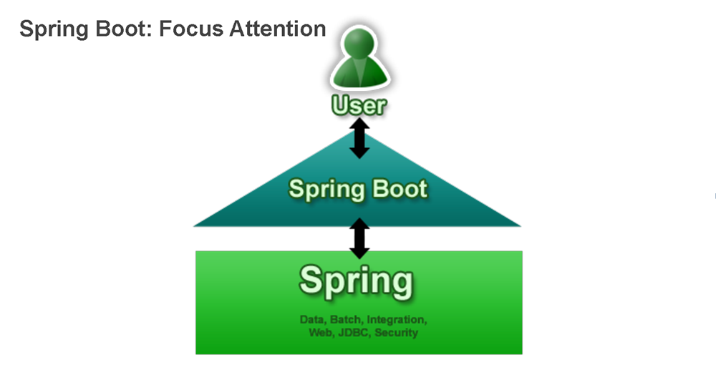
Spring Boot

Slide 3
Why Spring Boot?
Although there is nothing particularly special about Spring Boot (it is just another library that you can consume), there are a few recommendations that, when followed, will make your development process more easier.

Slide 4
What is Spring boot
Spring boot - is an opinionated library that allows to create executable spring applications with a convention over configuration approach.
Spring boot - It's basically a suite, pre-configured, set of frameworks/technologies to reduce boiler plate configuration providing you the shortest way to have a Spring web application up and running with very few lines of code/configuration out-of-the-box.

Slide 5
What spring boot do?
The magic behind this framework lies in the @EnableAutoConfiguration annotation, which will automatically load all the beans the application requires depending on what Spring Boot finds in the classpath.
Spring Boot will configure the default Hibernate as the JPA provider for us.
Spring Boot configures Thymeleaf template system as the default view resolver for our Spring application.
Spring Boot fires up an embedded container Tomcat by default

Slide 6
How to create a spring-boot app
Simply annotate your main class using the @SpringBootApplication annotation.
The SpringApplication class provides a convenient way to bootstrap a Spring application that will be started from a main() method. In many situations you can just delegate to the static SpringApplication.run() method:
@SpringBootApplication
public class App {
public static void main(String[] args) {
SpringApplication.run(App.class, args);
}
}
@Configuration
@ComponentScan @SpringBootApplication
@EnableAutoConfiguration

Slide 7
Running your app with Spring boot
Using the Maven plugin
The Spring Boot Maven plugin includes a run goal which can be used to quickly compile and run your application. Applications run in an exploded form just like in your IDE.
$ mvn spring-boot:run
Using the Gradle plugin
The Spring Boot Gradle plugin also includes a bootRun task which can be used to run your application in an exploded form. The bootRun task is added whenever you import the spring-boot-gradle-plugin in your build.gradle file
$ gradle bootRun

Slide 8
Spring Boot -Developer tools
Reload technologies by using JRebel for ZeroTurnaround
These work by rewriting classes as they are loaded to make them more amenable to reloading.
Excluding resources
Certain resources don’t necessarily need to trigger a restart when they are changed. For example, Thymeleaf templates can just be edited in-place.
By default changing resources in /META-INF/maven, /META-INF/resources ,/resources ,/static ,/public or /templates
will not trigger a restart but will trigger a live reload.
For example, to exclude only /static and /public you would set the following:
spring.devtools.restart.exclude=static/**,public/**

Slide 9
Spring Boot -Developer tools
Spring Boot includes an additional set of tools that can make the application development experience a little more pleasant. The spring-boot-devtools module can be included in any project to provide additional development-time features.
dependencies :
"org.springframework.boot:spring-boot-devtools“
Note - If you don’t want devtools to be included in a production build, you can use the excludeDevtools build property to completely remove the JAR. This property is supported with both the Maven and Gradle plugins.
Automatic restart
Applications that use spring-boot-devtools will automatically restart whenever files on the classpath change. This can be a useful feature when working in an IDE as it gives a very fast feedback loop for code changes.
Spring boot has 2 classloaders
Base classloader(3 party jars -> which is don’t change)
Restart classloader( class that are under development.)
So, this means less time to restart the app.

Slide 10
Using Spring Boot -Developer tools
Disabling restart
If you don’t want to use the restart feature you can disable it using the spring.devtools.restart.enabled property.
You can set this in your application.properties (this will still initialize the restart classloader but it won’t watch for file changes).
To completely disable restart support, for example, because it doesn’t work with a specific library, you need to set a System property before calling SpringApplication.run(…​).
E.g.
public static void main(String[] args) {
System.setProperty("spring.devtools.restart.enabled", "false");
SpringApplication.run(MyApp.class, args);
}

Slide 11
Spring Boot -Developer tools
Remote applications
Spring Boot developer tools are not just limited to local development. You can also use several features when running applications remotely.
Remote support is opt-in, to enable it you need to set a spring.devtools.remote.secret property.
For example:
spring.devtools.remote.secret=mysecret
Note:- Enabling spring-boot-devtools on a remote application is a security risk. You should never enable support on a production deployment

Slide 12
Spring Boot features
Using the ApplicationRunner or CommandLineRunner
CommandLineRunner is a hook to run application-specific code after the context is created.
With CommandLineRunner you can perform tasks after all Spring Beans are created and the Application Context has been created.
To run some specific code once the SpringApplication has started, you can implement the ApplicationRunner or CommandLineRunner interfaces.
use the org.springframework.core.annotation.Order annotation if several CommandLineRunner or ApplicationRunner beans are defined that must be called in a specific order.
@Component
@Order(value = 2)

Slide 13
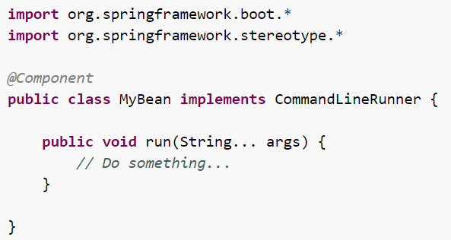
Spring Boot features
Using the ApplicationRunner or CommandLineRunner

Slide 14
Spring Boot features
We would go over a few of the more interesting configuration options in Boot.
The Port Number
easily configure Boot to use a different port like below:
server.port=8082
The Context Path
By default, the context path is “/”. You can also change it – to something like /app_name, here’s the quick and simple way to do it via properties:
server.contextPath=/springbootapp
Logging levels
Configure the Logging Levels
You can easily tune the logging levels in a Boot application; Starting with version 1.2.0 onwards, you can configure the log level in the application.properties file:
logging.level.org.springframework.web: DEBUG
logging.level.org.hibernate: ERROR

Slide 15
Spring Boot features
Register a New Servlet
If you’re deploying the application with the help of the embedded server, you can register new Servlets in a Boot application by exposing them as beans from conventional config
@Bean
public ServletRegistrationBean h2servletRegistration() {
ServletRegistrationBean registration = new ServletRegistrationBean(new WebServlet());
registration.addUrlMappings("/console/*");
return registration;
}

Slide 16
Spring Boot features
With Spring Boot it can provide a way for Java applications quickly and simply deploy through an embedded server – by default it used an embedded version of Tomcat – thus eliminating the need of Java EE containers.
With Spring Boot, we can expose components such as REST services independently, exactly as proposed in the microservices architecture, so that in any maintenance of the components, we no longer make the redeploy of all its consumers.
Actuators enable production-ready features to a Spring Boot application – without having to actually implement these things yourself.
Here’s some of the most common endpoints Boot provides out of the box:
/health – Shows application health information (a simple ‘status’ when accessed over an unauthenticated connection or full message details when authenticated). It is sensitive by default.
/info – Displays arbitrary application info. Not sensitive by default.
/metrics – Shows ‘metrics’ information for the current application. It is also sensitive by default.
/trace – Displays trace information (by default the last few HTTP requests).

Slide 17
Spring boot - Auto-configuration
Spring Boot auto-configuration attempts to automatically configure your Spring application based on the jar dependencies that you have added.
For example:-
If HSQLDB is on your classpath, and you have not manually configured any database connection beans, then it will auto-configure an in-memory database.
Gradually replacing auto-configuration
at any point you can start to define your own configuration to replace specific parts of the auto-configuration. For example, if you add your own DataSource bean, the default embedded database support will back away.
Disabling specific auto-configuration
For Example:-
@EnableAutoConfiguration(exclude={DataSourceAutoConfiguration.class})
@SpringBootApplication(exclude={WebMvcAutoConfiguration.class})

Slide 18
Externalized Configuration
Spring Boot allows you to externalize your configuration so you can work with the same application code in different environments.
You can use properties files, YAML files, environment variables and command-line arguments to externalize configuration.
Devtools global settings properties on your home directory (~/.spring-boot-devtools.properties when devtools is active).
…
Command line arguments.
..
Java System properties (System.getProperties()).
..
A RandomValuePropertySource that only has properties in random.*.
…
Profile-specific application properties outside of your packaged jar (application-{profile}.properties) and YAML variants)
Note:-To resolve ${} in @Values, you must register a static PropertySourcesPlaceholderConfigurer in either XML or annotation configuration file.

