Slide 1
MPages Development Conference
Client-Server Architectures
March 30, 2009 1:45 PM – 2:30 PM
45 Minutes

Slide 2

Introduction
Joshua Faulkenberry
Senior Web Applications Engineer, Lucile Packard Children’s Hospital at Stanford

Slide 3
Client-Server Architectures
This forum will look at different approaches available when building the infrastructure behind an MPages implementation.
  What are the Client and Server aspects of MPages?
  What options are available for generating MPages?
  What architectural approaches are available and how interoperable are they?
(Objectives/discussion points can be reported out during the conference wrap-up)

Slide 4
The “Client Side” of MPages
MPages are “Web” pages displayed in PowerChart and rendered using the copy of Internet Explorer installed on the providing Citrix server (IE6)
Technologies:
XML (Extensible Markup Language)
  A specification for creating markup languages, allowing the user to define their own elements
  Used to store and share structured data
HTML (Hypertext Markup Language)
  Describes the structure and layout of information within a document
  Used to structure the presentation of information
Notes:
Get rid of extra “structures”

Slide 5
The “Client Side” of MPages
XSL (Extensible Stylesheet Language)
  A family of languages allowing one to describe how to format or transform files encoded in the XML standard (XSLT, XSL-FO, and XPath)
CSS (Cascading Style Sheets)
  Used to describe the look and formatting of a document written in a markup language
JavaScript
  A scripting language used to create dynamic and interactive web pages
AJAX (Asynchronous JavaScript and XML)
  Allows web applications to retrieve data from the server in the background without interfering with the display and behavior of the existing page
JSON (JavaScript Object Notation)
  A text-based, human-readable format for representing data structures and associative arrays (called objects)

Slide 6
The “Server Side” of MPages
Basically consists of CCL scripts querying an Oracle Database
Technologies:
CCL (Cerner Command Language)
  Patterned after Structured Query Language (SQL) concepts
  Allows you to extract data from Oracle, SQL Server, RMS, and C-ISAM databases
XML, HTML, and/or JSON will be generated by the CCL

Slide 7
MPage Generation
“XML” MPages
“XML” MPages are generated CCL’s ECHOXML command to create and output an XML structure from a record, which is transformed into HTML on the client using XSL
Pros:
  CCL engineers do not need any prior web development knowledge
  Can make XMLCclRequests
Cons:
  Implementation without web development efforts is basic as best
  Complex development requires advanced knowledge of XML and XSL

Slide 8
MPage Generation
"Dynamic" MPages
Uses CCL as a server-side scripting language (like PHP or ASP) to generate an MPage's HTML (or XML) source
Pros:
  The most simple solution for organizations with basic web knowledge
  Can make XMLCclRequests
Cons:
  Slow to load
  Intermingled server/client technologies

Slide 9
MPage Generation
HTML Direct Loading
HTML documents are loaded directly into PowerChart using the <url> prefix and the “file:” protocol in the Preferences Maintenance Tool (PrefMaint)
Pros:
  Loads amazingly fast
  Provides a complete separation of client and server development
Cons:
  Cannot access ANY Backend data unless stored on the C:\ drive

Slide 10

MPage Generation
HTML Backend Loading
HTML documents are stored on the Backend and loaded using CCL_READFILE in PrefMaint
Pros:
  Can make XMLCclRequests
  Loads faster than Dynamic MPages
  Enables separation between server-side and client-side development
Cons:
  Requires moderate to advanced client-side web development knowledge
  HTML files stored on the Backend are difficult to manage

Slide 11
Architectural Approaches
The Model-View-Controller Pattern
An architectural pattern used in software engineering to isolate business logic from user interface considerations
  The MODEL represents the information (the data) of the application
  The VIEW corresponds to elements of the user interface such as text, images, form items, and so forth
  The CONTROLLER manages the communication of data and the business rules used to manipulate the data to and from the model

Slide 12
Architectural Approaches
Service Oriented Architecture (SOA)
Service-orientation aims at a loose coupling of the programming languages and other technologies that underlie applications.
SOA separates functions into distinct units made accessible over a network to be combined and reused in the production of business applications.
Web Services
A Web Service is defined by the W3C as "a software system designed to support interoperable machine-to-machine interaction over a network".

Slide 13

Server-Side CCL (SSCCL) Architecture
Using CCL as a server-side scripting language (“Dynamic” MPages)
CCL Script
Development
  Mainly done in CCL using Discern Visual Developer
  The CCL script generates HTML content as its output
  This creates a file which is sent to PowerChart and displayed as a web page using Internet Explorer
  JavaScript calls from the web page can post back to CCL and refresh the entire page.
Select into “NL:”
From Allergy A
...
Select into $OUTDEV
From dummyt
Detail
col 0, “<html>”, row +1
col 0, “<body>”, row +1
col 0, “Allergy list <b>”, strAllergyList, “</b>”, row +1
col 0, “</body>”, row +1
col 0, “</html>”, row +1
With format=variable, maxcol=50000
Output File
<html>
<body>
Allergy list <b>Amoxicillin, Tylenol, Peanuts</b>
</body>
</html>

Slide 14
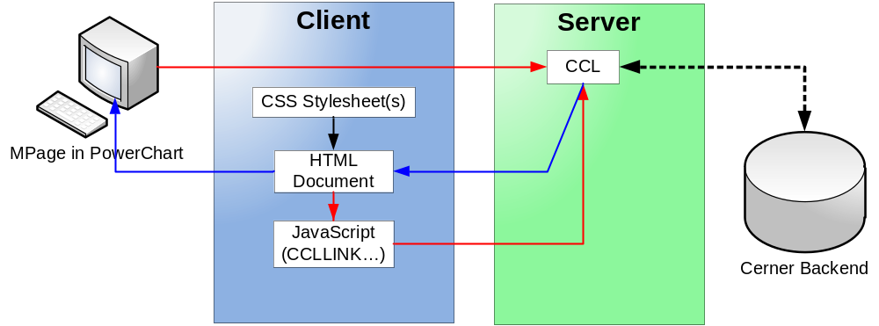
SSCCL Architecture
Server-Side Scripting Model
  CCL is called by PowerChart
  CCL queries the database and returns the HTML document
  The HTML document is rendered in PowerChart
  The HTML document references and applies CSS
  The HTML document calls JavaScript:CCLLINK() to call another CCL script and start the process over again

Slide 15
SSCCL Architecture
Pros
  Simplified development model (like PHP, ASP, or Ruby)
  Does not require JavaScript expertise for basic functionality
  Quick to develop very basic functionality
Cons
  Lacks the POWER of the service based architecture
    Asynchronous data requests
    In-state data updates
  CCL and Web development layers are “mashed” to obscuring a clear delineation
  Programmers must be experts in CCL and HTML/JavaScript
  Potentially slower than the service based architecture
  Requests for new data require a page refresh, which can be jerky and slow
  Not a Web 2.0 approach…

Slide 16
CCL as a Service (CCLS) Architecture
An adaptation of Service Oriented Architecture that looks to construct CCL programs to function like Web Services, responding with machine-readable data from the server to requests made by JavaScript on the client
Elements of CCLS
  Can be implemented on top of all of the various MPage generation methods (or any combination thereof)
  Enabled by the XMLCclRequest Object
  A clear, well defined separation between client-side and CCL development
  Facilitates the modularization and reusability of code on server and client

Slide 17
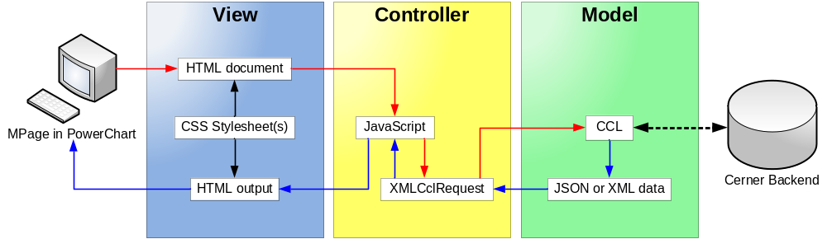
CCLS Architecture
Service Oriented Model
  HTML Document is loaded into PowerChart
  The HTML document references and applies CSS
  An XMLCclRequest is executed to call another CCL script
  CCL queries the database and returns data as XML or JSON to the HTML document
  JavaScript processes the new data to build HTML output
  HTML output is rendered to the screen in PwerChart

Slide 18
CCLS Architecture
Pros
  CCL and Web development layers are cleanly separated and delineated
    Easier to support
  Has the POWER of the service based architecture
    Asynchronous data requests
    In-state data updates
  Web and CCL programming can be done independently, so that one person only need to be an expert in one technology.
    Only data exchange format must be agreed upon
  Potentially faster than the server-side architecture
  Is a web 2.0 approach…
Cons
  Requires a web developer who has HTML and JavaScript expertise
  This is a more complex architecture
  Could take longer to develop for basic functionality
  Our Recommendation for Most MPages Projects!!!

Slide 19
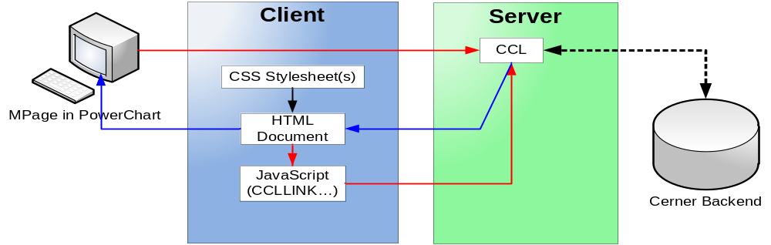
CCLS/SSCCL Hybrid Architecture
Server-side Scripting Model using the Service Architecture
  Initial page is generated using SSCCL approach in CCL only
  Once the page is loaded, it can asynchronously request data using CCL as a Service

Slide 20
CCLS/CCLSP Hybrid Architecture
Pros
  Allows for the use of service architecture in server based development environment
    Asynchronous data requests
    In-state data updates
  Is a web 2.0 approach…
Cons
  CCL and Web development layers are still “mashed” to obscuring a clear delineation
  Programmers must be experts in CCL and HTML/JavaScript
  Not nearly as clean as a purely service based architecture

Slide 21
Summary
What are the Client and Server aspects of MPages?
  XML, HTML, XSL, CSS, JavaScript, AJAX, and/or JSON on the Client; CCL on the Server
What options are available for generating MPages?
  “XML” MPages, “Dynamic” MPages, HTML Direct Loading, HTML Backend Loading
What architectural approaches are available?
  Server-Side CCL, CCL as a Service, and the SSCCL/CCLS Hybrid model

