Slide 1

Reviews analysis for steakhouses

Slide 2
We want to see the relation between the stars and reviews of steakhouses. And find the key points that most affect customers attitude to the steakhouse.

Slide 3
Data cleaning
What we do:
Select out the data that have label steakhouses.
split reviews to two parts with their stars to steakhouse.
summarize the words that have high frequency to display in reviews.

Slide 4

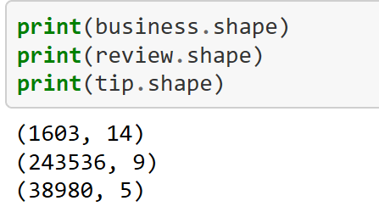
Data cleaning
After the first step, we select the data that related to steakhouses in these three CSV files.
We can see the sizes of our dataset:
we have 1603 steakhouses in business dataset, 243536 reviews that under steakhouses label, 38980 comments on tip.

Slide 5
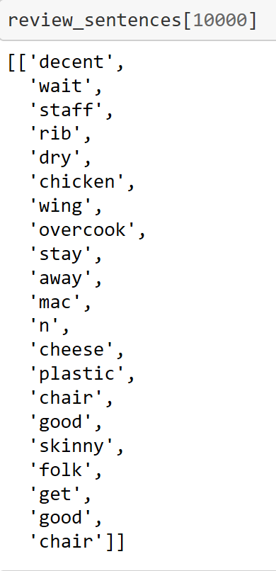
Data cleaning
We then split the reviews and select possible key words from each reviews and make a summary.
The left graph is the words we split from the 10000th
review.

Slide 6
Data visualization
We divide the split data to two parts, one is high stars comments and another one is low star comments, We create work clouds for and analysis the key points that make people give high stars or low stars
We will show the steakhouses’ distribution and their location on the maps.

