Slide 1
Intermediate Representation III

Slide 2
tomatoes + potatoes + carrots
Lexical
analyzer
tomatoes,PLUS,potatoes,PLUS,carrots,EOF
Parser
AddExpr
Symtab hierarchy
left
right
Global type table
AddExpr
symbol | kind | type
tomatoes | var | int
potatoes | var | int
carrots | var | int
Id | Type obj
int | O1
boolean | O2
Foo | O3
left
right
LocationExpr
LocationExpr
LocationExpr
id=tomatoes
id=potatoes
id=carrots
A  E1 : T[]
Additional semantic checks
Type checking
A  E1.length : int
Move tomatoes,R1
Move potatoes,R2
Add R2,R1
...
LIR

Slide 3
Representing Types
int, boolean (32 bit, value)
objects (pointer + memory block)
string (pointer + memory block)
array (pointer + memory block)

Slide 4
Object types
Field selection
Method invocation

Slide 5
Object types
class A{
int x;
int y;
…
}
DispacthVectorPtr
size ?
x
y
Runtime memory layout for object of class A
Field offsets
0
DispacthVectorPtr
1
x
2
y
Compile time information
for A class type

Slide 6
Field selection
dynType(f)=A
q = f.x;
DispacthVectorPtr
x
y
Runtime memory layout for object of class A
Field offsets
0
DispacthVectorPtr
Move f,R1
MoveField R1.1,R2
Move R2,q
1
x
2
y
Compile time information for
A class type

Slide 7
Object types and inheritance
DispacthVectorPtr
class A{
int x;
int y;
…
}
x
prefix
of A
y
z
Runtime memory layout for object of class B
class B extends A {
int z;
…
}
Field offsets
0
DispacthVectorPtr
x
prefix
of A
1
2
y
3
z
Compile time information
for B class type

Slide 8
Field selection
dynType(f)≤ A
q = f.x;
DispacthVectorPtr
x
prefix
of A
y
????
Runtime memory layout for object pointed by f
Move f,R1
MoveField R1.1,R2
Move R2,q

Slide 9
Virtual Methods
class A {
int x;
int y;
void f() {…}
void g() {…}
}
DispacthVectorPtr
x
y
Runtime memory layout for object of class A
Field offsets
0
DispacthVectorPtr
Method offsets
x
0
f
1
y
1
g
2
Compile time information for
A class type

Slide 10
Method Invocation
dynType(w)=A
w.f()
DispacthVectorPtr
x
y
Runtime memory layout for object of class A
Field offsets
0
DispacthVectorPtr
Method offsets
Move w,R1
VirtualCall R1.0(),Rdummy
x
0
f
1
y
1
g
2
Compile time information for
A class type

Slide 11
Methods and Inheritance
class A {
int x;
int y;
void f() {…}
void g() {…}
}
Method offsets of B
f
prefix
from A
g
h
class B extends A {
int z;
void f() {…}
void h() {…}
}

Slide 12
Method Invocation
DispacthVectorPtr
dynType(w)≤ A
w.f()
x
y
????
Runtime memory layout for object pointed by w
Method offsets
Move w,R1
VirtualCall R1.0(),Rdummy
f
g
????

Slide 13
Object creation
A f = new B ();
|B| = |x|+|y|+|z|+|DVPtr| =1+1+1 +1= 4 (16 bytes)
Library __allocateObject(16),R1
MoveField _B_DV ,R1.0
Move R1,f
Label generated for class type B during LIR translation

Slide 14
LIR translation example
class A {
int x;
string s;
int foo(int y) {
int z=y+1;
return z;
}
static void main(string[] args) {
A p = new B();
p.foo(5);
}
}
class B extends A {
int z;
int foo(int y) {
s = “y=“ + Library.itos(y);
Library.println(s);
int[] sarr = Library.stoa(s);
int l = sarr.length;
Library.printi(l);
return l;
}
}

Slide 15
LIR program (manual trans.)
str1: “y=“ # Literal string in program
_DV_A: [_A_foo] # dispatch table for class A
_DV_B: [_B_foo] # dispatch table for class B
_A_foo: # int foo(int y)
Move y,R1 # int z=y+1;
Add 1,R1
Move R1,z
Return z # return z;
_B_foo: # int foo(int y)
Library __itos(y),R1 # Library.itos(y);
Library __stringCat(str1,R1),R2 # "y=" + Library.itos(y);
Move this,R3 # this.s = "y=" + Library.itos(y);
MoveField R2,R3.2
MoveField R3.2,R4
Library __println(R4),Rdummy # Library.println(s);
Library __stoa(R4),R5 # int[] sarr = Library.stoa(s);
Move R5,sarr
ArrayLength sarr,R6 # int l = sarr.length;
Move R6,l
Library __printi(l),Rdummy # Library.printi(l)
Return l # return l;
# main in A
_ic_main: # A {static void main(string[] args)…}
Library __allocateObject(16),R1 # A p = new B();
MoveField _DV_B,R1.0 # Update DVPtr of new object
VirtualCall R1.0(y=5),Rdummy # p.foo(5)

Slide 16
Representing Arrays
R1:[1,2,3]
3 | 1 | 2 | 3
1 word = 4 bytes

Slide 17
Class layout implementation
class A {
int x_1;
...
boolean x_k;
void foo_1(…) {…}
...
int foo_n(…) {…}
}
class ClassLayout {
Map<Method,Integer> methodToOffset;
// DVPtr = 0
Map<Field,Integer> fieldToOffset;
}
fieldToOffset
methodToOffset
lir file
x_1 = 1
foo_1 = 0
_DV_A: [foo_1,…,foo_n]
…
…
x_k = k
foo_n = n-1
VirtualCall R1.7(),R3
MoveField R1.3,R9

Slide 18
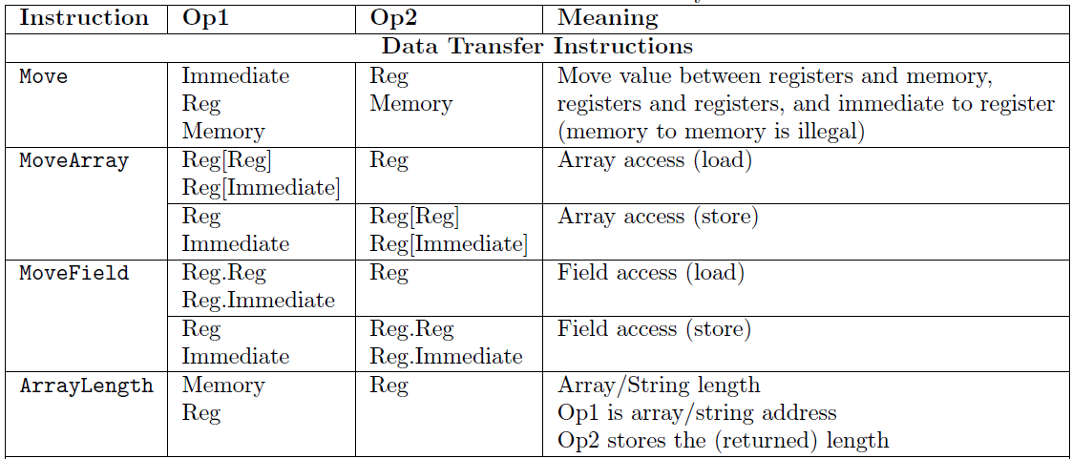
LIR spec

Slide 19
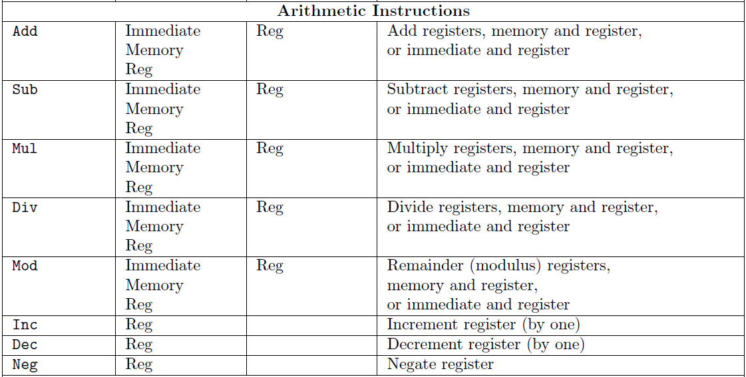
LIR spec

Slide 20
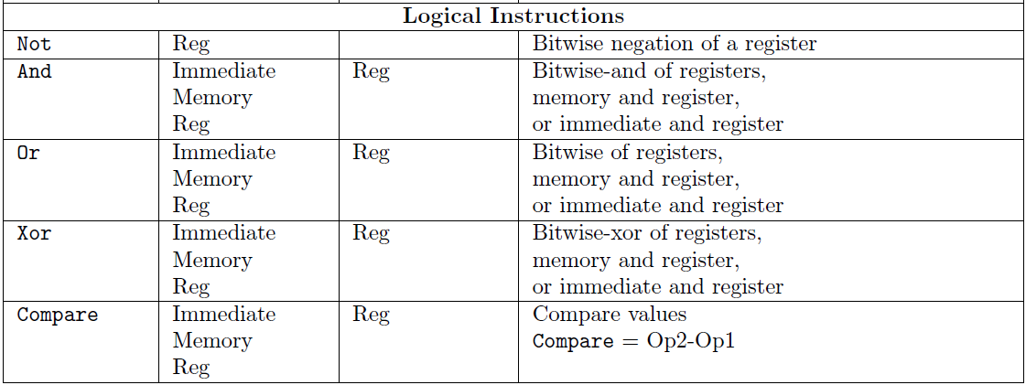
LIR spec

Slide 21
LIR optimizations
Aim to reduce number of LIR registers and number of instructions
Avoid storing variables and constants in registers
Use accumulator registers
Reuse “dead” registers
Weighted register allocation

Slide 22
Avoid storing constants and variables in registers
Don’t allocate target register for each instruction
  TR[5] = Move 5,Rj
  TR[x] = Move x,Rk
For a constant TR[5] = 5
For a variable TR[x] = x
TR[x+5] = Move 5,R1
Add x,R1
  Translation for a “simple” sub tree

Slide 23
Accumulator registers
Use same register for sub-expression and result
c+(b*a)
Move b,R1
Mul a,R1
Add c,R1
Move a,R1
Move b,R2
Mul R1,R2
Move R2,R3
Move c,R4
Add R3,R4
Move R4,R5

Slide 24
Accumulator registers
For instruction with N registers, dedicate one register for accumulation
Accumulating instructions, use:
  MoveArray R1[R2],R1
  MoveField R1.7,R1
  StaticCall _foo(R1,…),R1
  …

Slide 25
Reuse “dead” registers
Registers have very limited lifetime
TR[e1 OP e2] = R1:=TR[e1]
R2:=TR[e2]
R1:=R1 OP R2
Registers from TR[e1] can be reused in TR[e2]

Slide 26
Weighted register allocation
Sethi & Ullman algorithm
  Two expression e1, e2 and an operation OP
  e1,e2 without side effects
  R1:=TR[e1]; R2:=TR[e2]; R1:= R1 OP R2;
    equivalent to
    R1:=TR[e2]; R2:=TR[e1]; R1:= R1 OP R2;
  Weighted register allocation
    translate heavier sub-tree first
Notes:
Exploit the fact that the binary operations are associative and commutative.
See: http://repository.cmu.edu/cgi/viewcontent.cgi?article=2665&context=compsci

Slide 27
Example
R0 := TR[a+(b+(c*d))]
left child first
right child first
R0
+
R0
+
R0
a
R1
+
a
R0
+
R1
b
R2
*
b
R0
*
R2
c
d
c
R0
d
Translation using all optimizations
shown until now uses 3 registers
Managed to save two registers
Notes:
(((c*d) + b) + a)
Move c R0, Mul d R0, Add b R0, Add a R0
(a + (b + (c*d)))
Move a R0, Move b R1, Move c R2, Mul d R2, Add b R1, Add a R0

Slide 28
Weighted register allocation
Can save registers by re-ordering subtree computations
Label each node with its weight
  Weight = number of registers needed
  Leaf weight known
  Internal node weight
    w(left) > w(right) then w = left
    w(right) > w(left) then w = right
    w(right) = w(left) then w = left + 1
Choose heavier child as first to be translated
Have to check that no side effects exist

Slide 29
Weighted reg. alloc. example
R0 := TR[a+b[5*c]]
Phase 1: - check absence of side effects in expression tree
- assign weight to each AST node
+
W=2
W=1
a
array access
W=2
base
index
b
W=1
*
W=1
W=0
5
c
W=1

Slide 30
Weighted reg. alloc. example
R0 := TR[a+b[5*c]]
Phase 2: use weights to decide on order of translation
R0
+
W=2
Heavier sub-tree
W=1
a
R0
array access
W=2
base
index
Move c,R0
R1
b
W=1
R0
*
W=1
Mul 5,R0
Move b,R1
W=0
5
R0
c
W=1
MoveArray R1[R0],R0
Add a,R0

Slide 31
microLIR simulator
Written by Roman Manevich
Java application
  Accepts file.lir
  Executes program
Use it to test your translation
Comes with sample inputs
Read manual

