Slide 1

From Words to Pictures
Exploring the Fascinating World of Text-to-Image Synthesis

Slide 2

Outline
Problem Statement
Dataset Description
Related Works
Technical Approach
Implementation
Results
Performance and Evaluation

Slide 3

Problem Statement
Generating high-quality images from text prompts
Text-to-image synthesis is a challenging task that involves translating textual descriptions or prompts into a corresponding visual representation.
This problem is particularly difficult because it requires the model to understand the semantics and context of the input text and convert it into a coherent and accurate image.
Moreover, generating high-quality images that effectively capture the essence of the input text is essential for many applications in fields such as computer vision, natural language processing, and creative arts.
Therefore, developing accurate and efficient models for text-to-image synthesis is an important area of research in the field of artificial intelligence.

Slide 4
Dataset Description
LAION-5B is a publicly available dataset that was derived from Common Crawl data scraped from the web.
The dataset contains 5 billion image-text pairs that were classified based on language and filtered into separate datasets by resolution.
47% of the sample size of images came from 100 different domains, with Pinterest taking up 8.5% of the subset.
Other popular domains in the dataset included WordPress, Blogspot, Flickr, DeviantArt, and Wikimedia Commons.
LAION-5B is a valuable resource for researchers and practitioners in the field of computer vision, as it provides a large and diverse set of image-text pairs that can be used to train and test machine learning models for tasks such as text-to-image synthesis.

Slide 5
Related Works
BigGAN: This is a state-of-the-art generative model for image synthesis that utilizes a GAN (Generative Adversarial Network) architecture to generate high-quality images. (Citation: Brock et al., 2018)
CLIP Guided Diffusion: This approach combines the CLIP (Contrastive Language-Image Pre-Training) model with a diffusion process to generate high-quality images from textual prompts. (Citation: Patashnik et al., 2021)
DALL-E: This is a text-to-image synthesis model developed by OpenAI that uses a transformer-based architecture to generate images from textual prompts. (Citation: Ramesh et al., 2021)
GPT-2 Image Generation: This approach uses a GPT-2 (Generative Pre-trained Transformer 2) language model to generate textual descriptions of images, which can then be used to synthesize new images. (Citation: Xiao et al., 2020)
VQGAN+CLIP: This is a recent approach to text-to-image synthesis that utilizes a combination of a VQGAN (Vector Quantized Generative Adversarial Network) model and the CLIP model to generate high-quality images from textual prompts. (Citation: Esser et al., 2021)

Slide 6
Technical Approach
For this project, we used a pre-trained model from Hugging Face's Stable Diffusion V4.
We downloaded the pre-trained weights for the model and created a pipeline that can take in textual prompts as input and generate corresponding images.
To deploy this model as a web API, we used FastAPI, which is a modern web framework for building APIs with Python.
FastAPI allows us to easily define API endpoints and integrate our model with a frontend application.

Slide 7
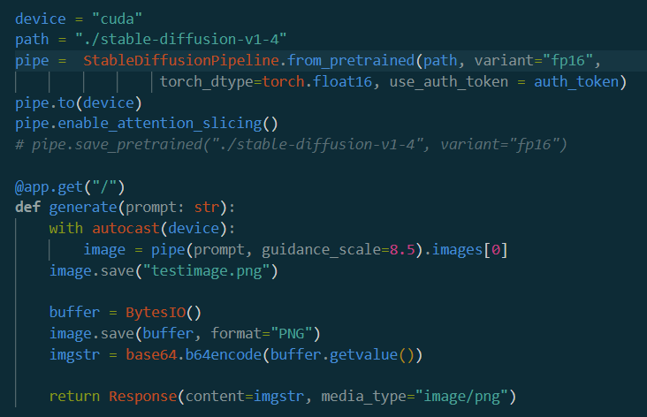
Implementation

Slide 8
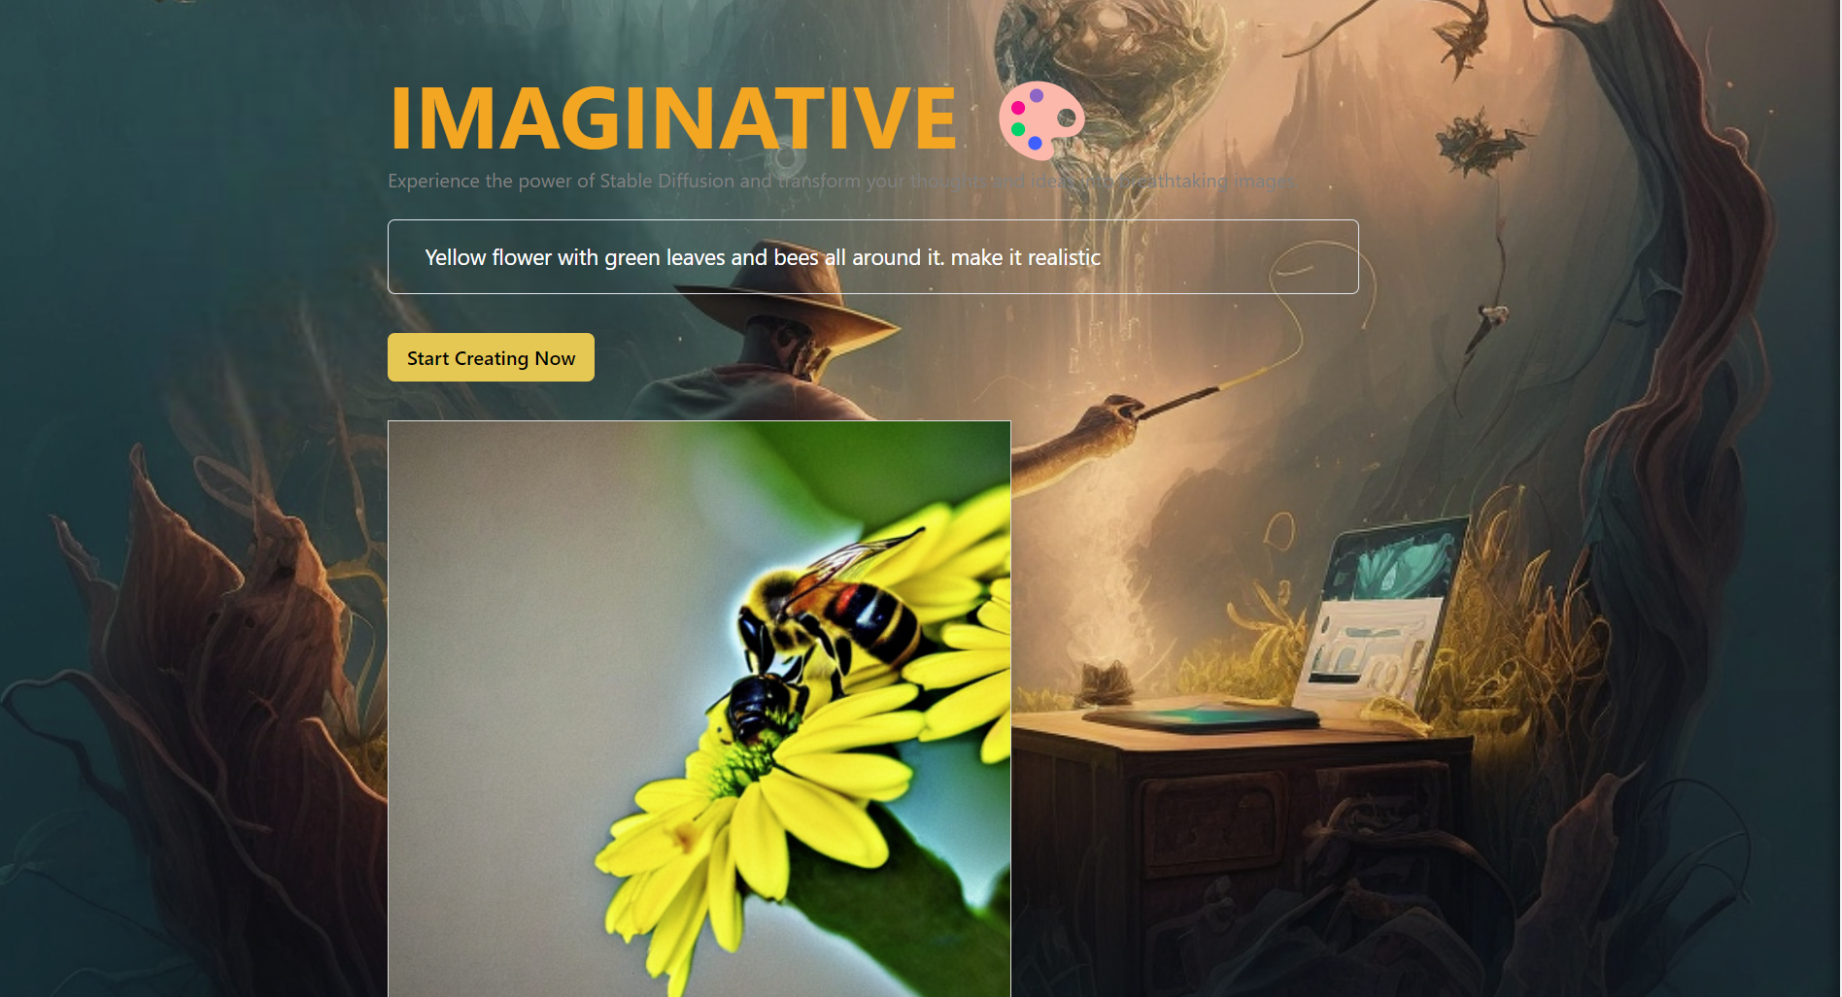
Results

Slide 9
Performance evaluation
Sensitivity analysis is a technique used to assess the impact of changes in input parameters on the model outputs. This can help identify which parameters have the greatest impact on the model's performance and inform decisions about which parameters to prioritize in future refinements of the model.
Sensitivity analysis can be performed by calculating the partial derivatives of the model outputs with respect to each input parameter. This can be done using techniques such as finite difference approximation:
df/dp = (f(p + eps) - f(p - eps)) / (2 * eps)
We could then rank the input parameters by their sensitivity, and focus on refining the model for the most sensitive parameters.

Slide 10
Conclusion and future directions
It can be concluded that SDD-V4 is a powerful tool for generating high-quality images from textual input. The model leverages the power of diffusion models to create images that capture the essence of the text, while also allowing for control over various visual attributes.
Some of the future directions for research and development of text to image generation using SDD-V4 could include improving the model's ability to generate complex scenes and more varied styles of images. This could involve exploring new training techniques, such as self-supervised learning, or incorporating additional data sources such as audio or video. Additionally, developing more effective methods for controlling specific visual attributes of the generated images could also be an interesting area of exploration.
Overall, the potential for SDD-V4 to create high-quality images from text is significant, and there is much room for further development and innovation in this field.

