Slide 1


5gSmallCellResearchAlg_L1

Slide 2
Brief
Version | Features | Cases
Detail in ‘Version.txt’ | Detail in ‘Feature list.xlsx’ | Detail in ‘Test cases.xlsx’
5g small cell research alg_L1 is designed as an EDA software for simulation, verification, test and reference based on 5G physical layer algorithm(BS side).
It’s built by formal engineering standard, with FAPI interface, detailed module and function partition, excellent coding style, strict test and verification.
Its code lines achieve 4-5w lines(Matlab) and has been verified with SystemVue and tested with above 400 cases.
It contains Framework, PUSCH TX, PUSCH RX, PUCCH TX, PUCCH RX, SSB TX, PDCCH TX, CSIRS TX, PDSCH TX, Utils etc. in version 5gSmallCellResearchAlg_L1_v1.
It also supports automatic test and compare.

Slide 3
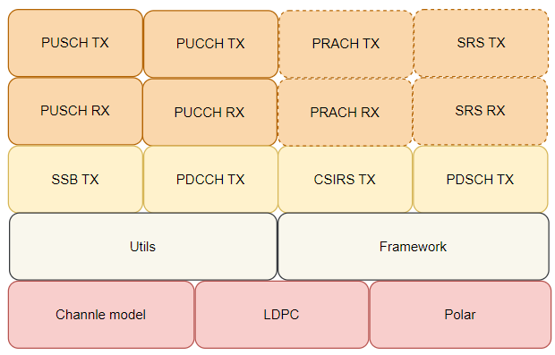
Modules

Slide 4
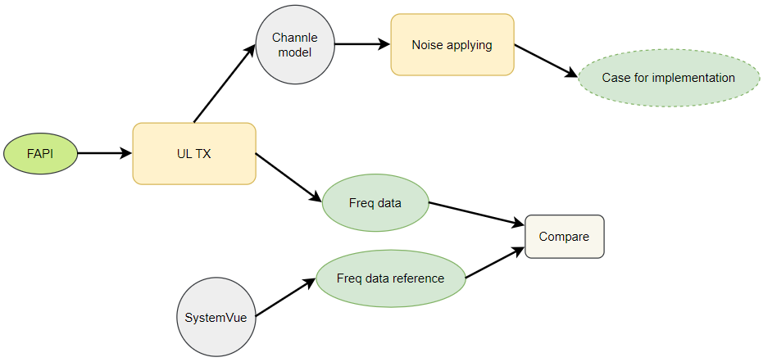
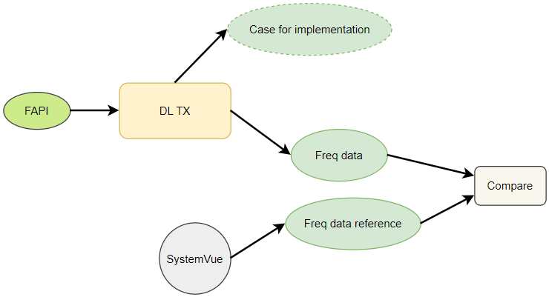
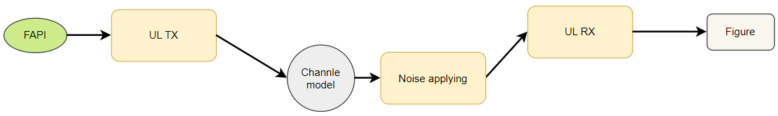
Verification & simulation

Slide 5
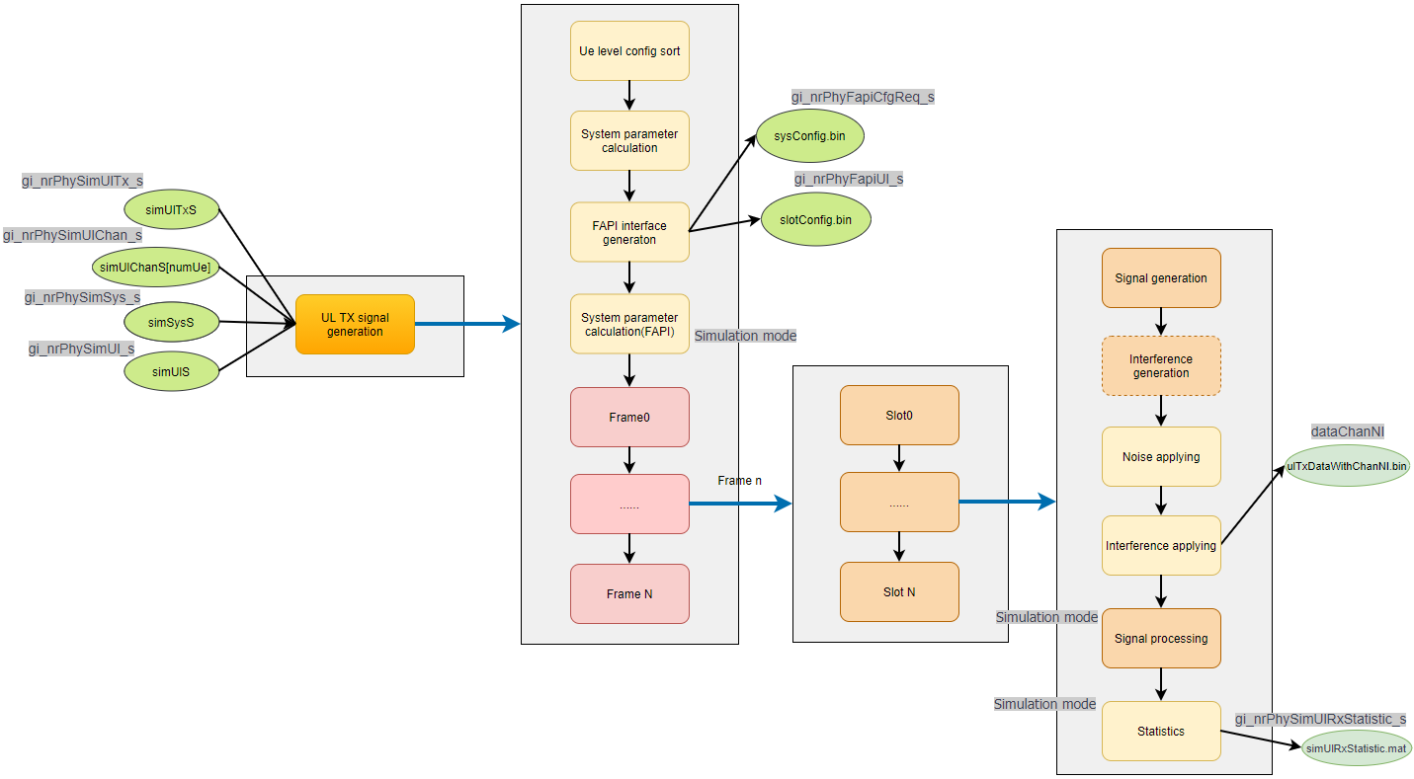
Procedure - UL

Slide 6
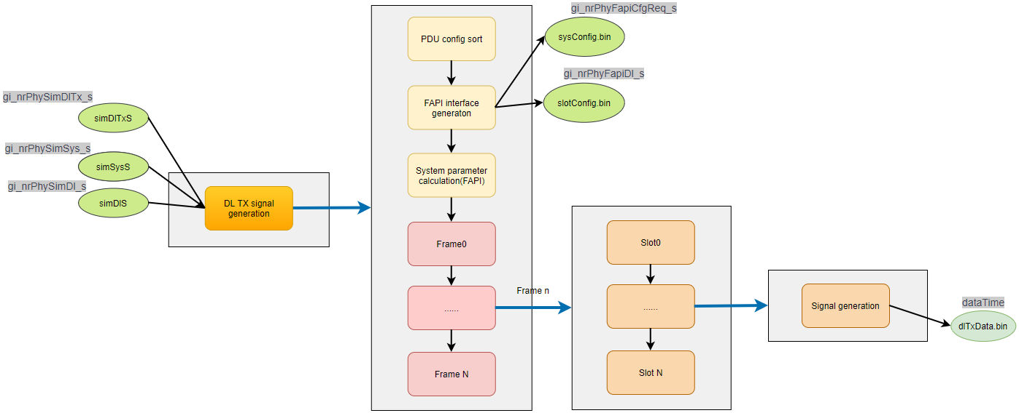
Procedure - DL

Slide 7
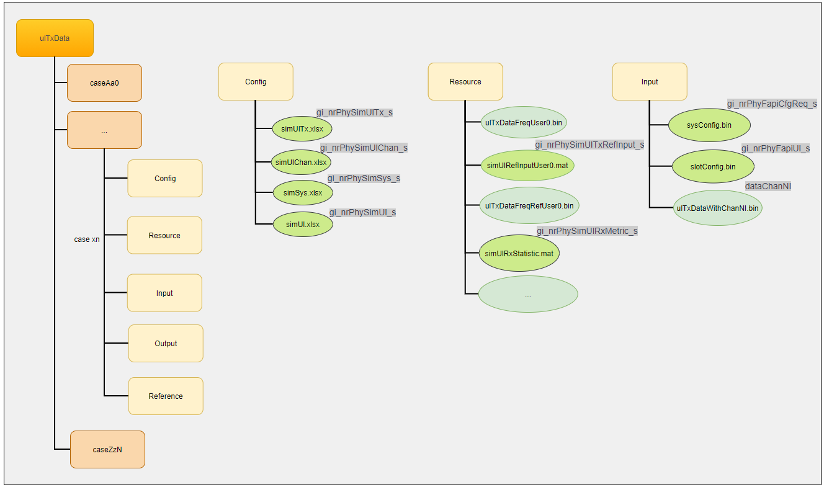
Directory - UL

Slide 8
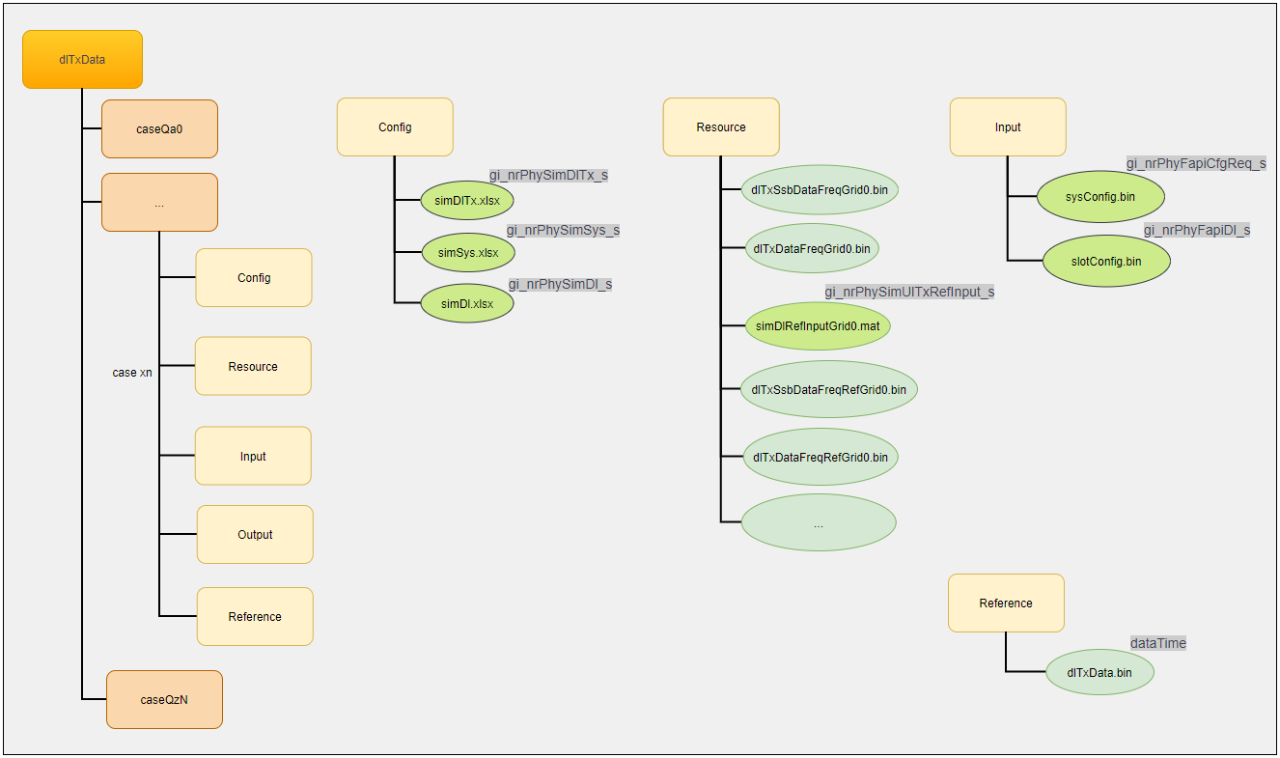
Directory - DL

Slide 9
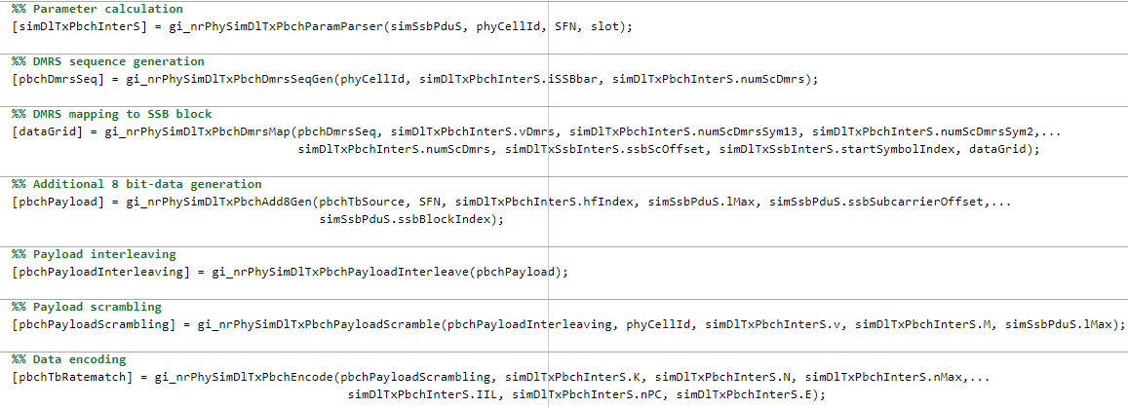
Example of function partition

Slide 10
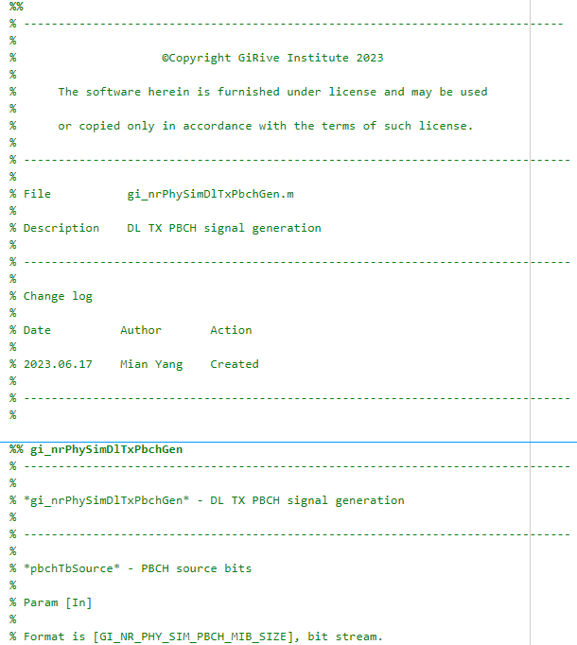
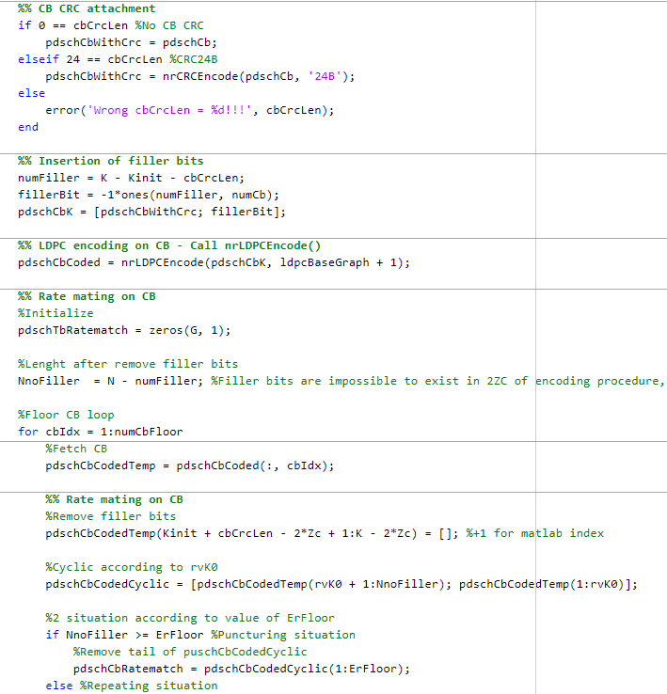
Example of coding style

Slide 11

UL TX trial
1. Running environment is MATLAB R2021b
2. Set GI_NR_PHY_SIM_UL_REF_INPUT_PARAM = 1 in ‘5gSmallCellResearchAlg_L1\Common\ gi_nrPhySimMacroDefine.m’
3. Set ‘testList.txt’ in ‘5gSmallCellCase_L1\ulTxData’

Slide 12
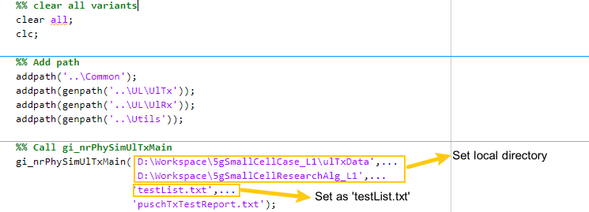
UL TX trial
4. Run ‘gi_nrPhySimTestUlGenResource.m’ in ‘5gSmallCellResearchAlg_L1\Test’,
generating ‘ulTxDataFreq.bin’, ‘simUlRefInput.mat’ in ‘ulTxData\caseTest\Resource’.
5. Run SystemVue(May ignore).

Slide 13
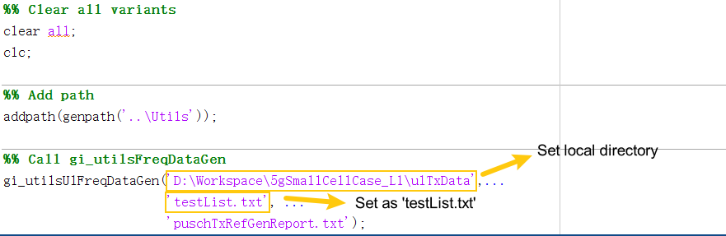
UL TX trial
6. Run ‘gi_nrPhySimTestUlFreqDataGen.m’ in ‘5gSmallCellResearchAlg_L1\Test’ ,
generating ‘ulTxDataFreqRef.bin’ in ‘ulTxData\caseTest\Resource’.

Slide 14
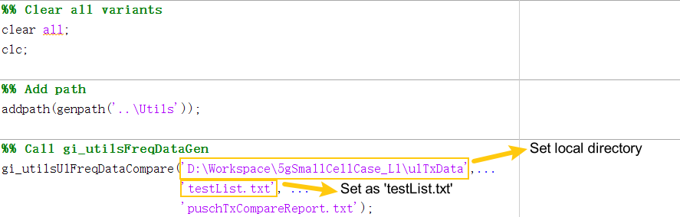
UL TX trial
7. Run ‘gi_nrPhySimTestUlFreqDataCompre.m’ in ‘5gSmallCellResearchAlg_L1\Test’,
comparing between ‘ulTxDataFreq.bin’ and ‘ulTxDataFreqRef.bin’.

Slide 15

UL RX trial
1. Running environment is MATLAB R2021b
2. Set GI_NR_PHY_SIM_UL_SIMULATION = 1 in
‘5gSmallCellResearchAlg_L1\Common\ gi_nrPhySimMacroDefine.m’
3. Set ‘testList.txt’ in ‘5gSmallCellCase_L1\ulTxData’

Slide 16
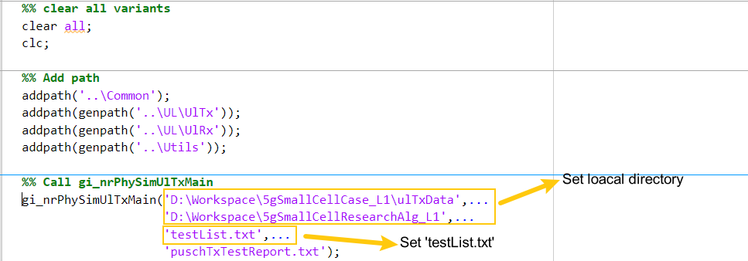
UL RX trial
4. Run ‘gi_nrPhySimTestUlGenResource.m’ in ‘5gSmallCellResearchAlg_L1\Test’,
then generate ‘simUlRxStatistic.mat’ in ‘ulTxData\caseTest\Resource’.

Slide 17
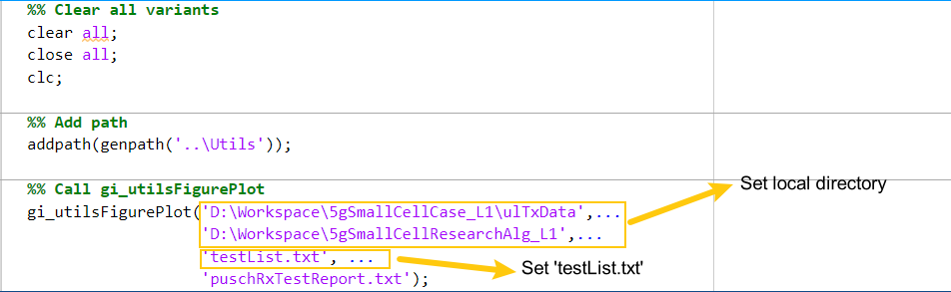
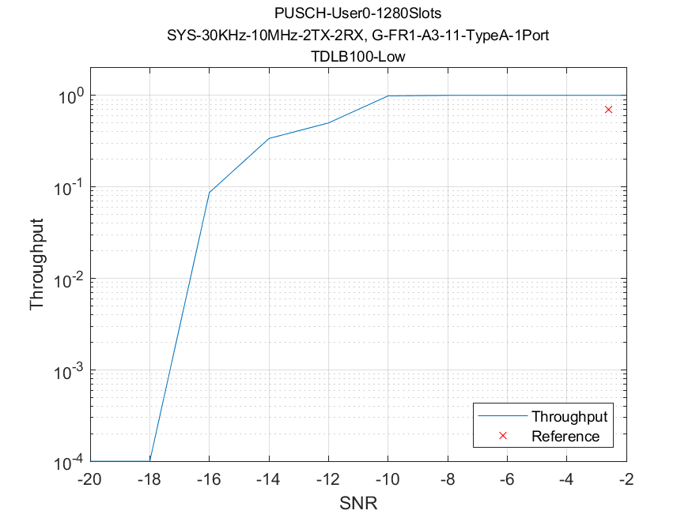
UL RX trial
5. Run ‘gi_nrPhySimTestUlFigurePlot.m’ in ‘5gSmallCellResearchAlg_L1\Test’,
then get

Slide 18

DL TX trial
1. Running environment is MATLAB R2021b
2. Set GI_NR_PHY_SIM_DL_REF_INPUT_PARAM = 1 in ‘5gSmallCellResearchAlg_L1\Common\ gi_nrPhySimMacroDefine.m’
3. Set ‘testList.txt’ in ‘5gSmallCellCase_L1\dlTxData’

Slide 19
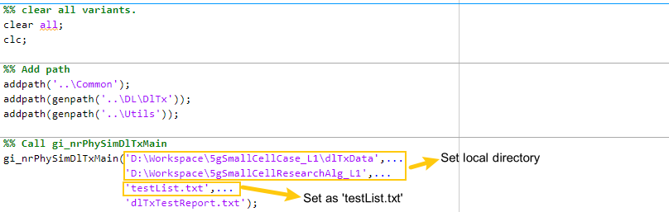
DL TX trial
4. Run ‘gi_nrPhySimTestDlGenResource.m’ in ‘5gSmallCellResearchAlg_L1\Test’,
generating ‘dlTxDataFreq.bin’, ‘simDlRefInput.mat’ in ‘dlTxData\caseTest\Resource’.
5. Run SystemVue (May ignore).

Slide 20
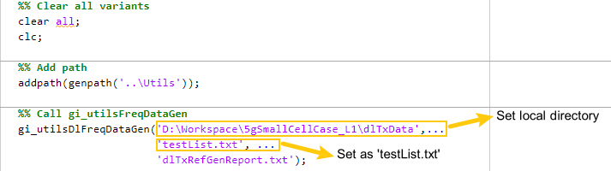
DL TX trial
6. Run ‘gi_nrPhySimTestDlFreqDataGen.m’ in ‘5gSmallCellResearchAlg_L1\Test’ ,
generating ‘dlTxDataFreqRef.bin’ in ‘dlTxData\caseTest\Resource’.

Slide 21
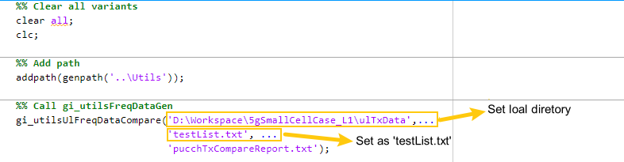
DL TX trial
7. Run ‘gi_nrPhySimTestDlFreqDataCompre.m’ in ‘5gSmallCellResearchAlg_L1\Test’,
comparing between ‘dlTxDataFreq.bin’ and ‘dlTxDataFreqRef.bin’.

Slide 22
Thank You
GiRive Institute, Co.,Ltd.
Mian(Milton) Yang
Mobile: +86 18628244323
Email: mian.yang@giriveinstitute.com

