Slide 1

It’s a Type of Magic

Slide 2

Just JavaScript with type annotations?

Slide 3
Generics
Intersection types
Union Types
Literal Types
Mapped Types
Conditional Types

Slide 4
Typescript Config
Minimum config for type safety:
Variables are non-nullable unless explicitly stated
Expressions and declarations cannot be any unless explicitly stated
Enable all strict type checking options with “strict”: true
{
"compilerOptions": {
"strictNullChecks": true,
"noImplicitAny": true,
// ...
}
}

Slide 5

Why Type-Safety?
Let the compiler help you!
Prevents several classes of bugs
Less testing effort
Write correct programs
Can be fun too!
Notes:
ruling out invalid data makes your code shorter, simpler, and more reliable
you end up needing fewer tests, yet having more reliable code
And it can be fun ☺

Slide 6
Goals
Get an intuition for types as a concept
See some examples how to use type features of TS effectively
Learn about ADTs

Slide 7

Types as Sets
Looking at types as sets helps to understand the underlying concepts
Types can be described with simple algebra
What is a Set? A collection of Objects
What is a Type? A class of Objects confining to a set of constraints
Notes:
They can come in big and small
To make it more entertainable, I will be displaying sets as colourful blobs with faces

Slide 8
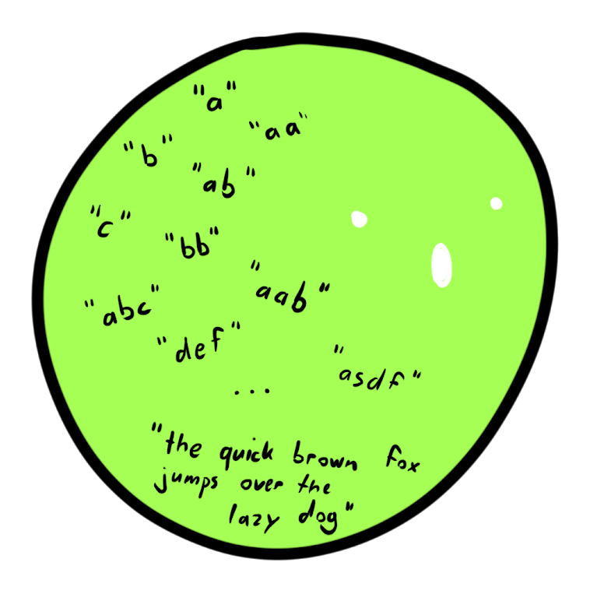
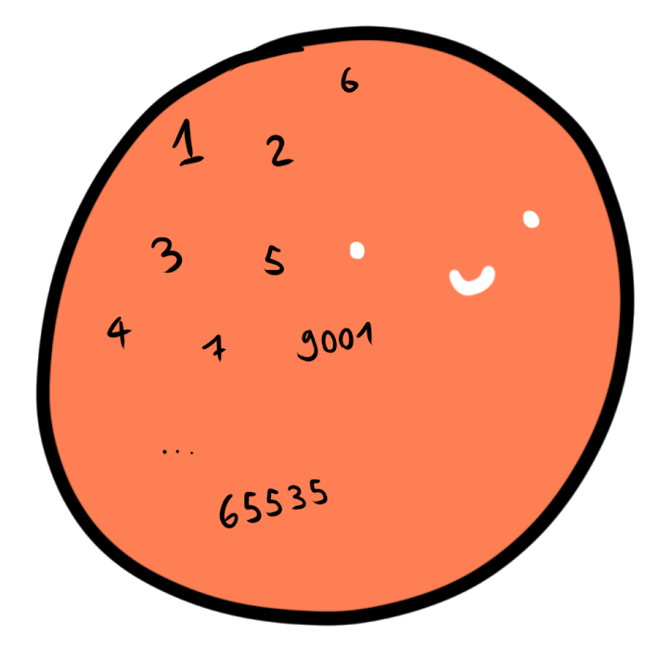
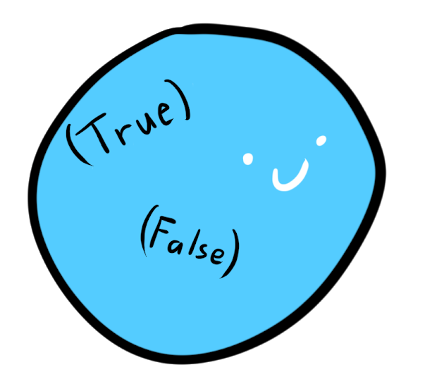
Intuition: Counting inhabitants
Boolean?
Integer?
String?
Notes:
Sometimes also cardinality

Slide 9
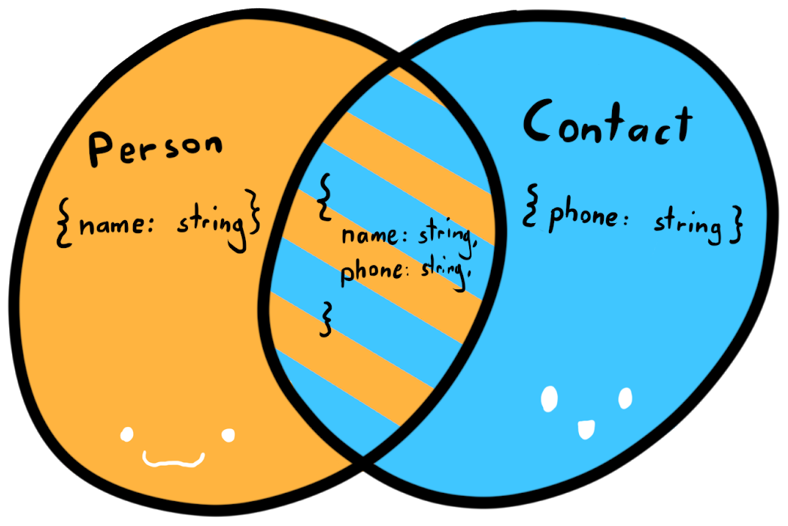
Structural Type Equality
C#, Java, etc: Nominal type systems
TypeScript, Haskell, Elm: types are defined by their shape, not their names
declare function call(c: Contact): boolean;
var personWithContact = {
name: "JoJo",
phone: "079 123 45 67"
};
call(personWithContact);
Notes:
In nominal type systems, types are differentiated by their name
In TypeScript, they are defined by their shape.
If the shape is equal, the types can be used interchangeably, no matter what the name is.
Assigning a name to a type, is actually called a “Type Alias”

Slide 10
Basic Types

Slide 11
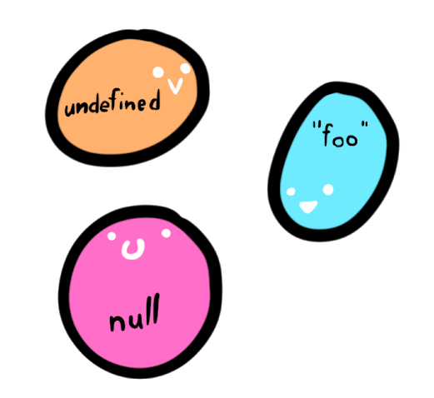
Singleton Types
Types with only one inhabitant
In Typescript:
let u; // undefined
let a = null; // null
const x = "foo"; // "foo"
Type Literals
const y = 5; // 5

Slide 12


Top Types
Also universal supertype, contains every possible value, equals the universe set U
In typescript: any and unkown
let e: unknown = 42;
let f: string = e; // type error
let c: any = "foo";
let d: number = c;
Notes:
Any is the escape hatch of the type system.
It means you don’t care what it is and nobody should tell you otherwise
All types are assignable to it and you can assign it on everything
Unknown is the type-safe counterpart to any since typescript 3.0
You have to do type checks first, before performing any operation on it
All types are assignable to it, but you cannot assign it to anything (except any)
Both types are very useful when interoping with plain javascript
The unknown type is recommended to use

Slide 13

Bottom Type
A type that contains no values, equals the empty set Ø
Has several interesting applications, similar to 0 in algebra
If the typescript ever reaches a never, it will not compile
let g: never = ({} as any); // Error

Slide 14

Type Hierarchy
$$unknown=any ⊇\left(string, number, bool, etc.\right) ⊇never$$

Slide 15
Example of using unknown
type Point = { x: number, y: number };
function isPoint(thing: unknown): thing is Point {
return (thing as Point).x !== undefined && (thing as Point).y !== undefined;
}
function tryGetProduct(value: unknown): number | undefined {
if (isPoint(value)) {
return value.x * value.y;
}
return undefined;
}

Slide 16
Combining Types

Slide 17
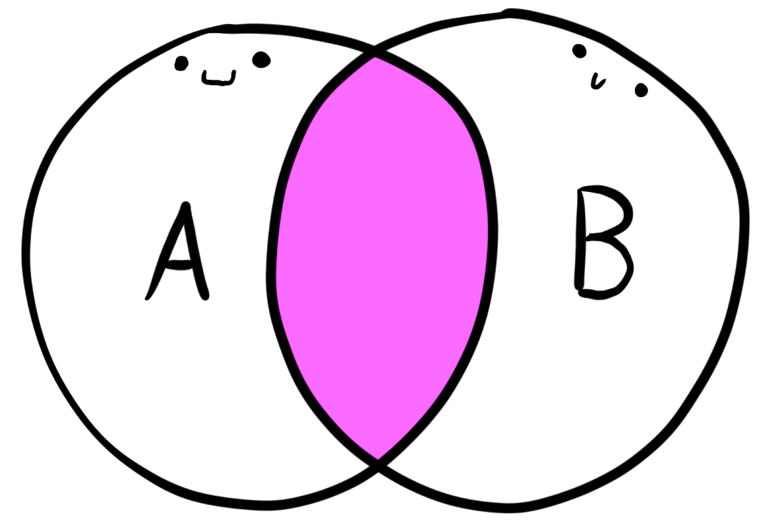

Intersection Type
$$A∩B$$
As sets:
Objects of an intersection type must contain properties of both types
type Person = { name: string }
type Contact = { phone: string }
let p: Person & Contact = {
p.name = "JoJo",
p.phone = "079 123 45 67",
};
Notes:
That’s why it’s an ampersand, it says it is a Person AND a Contact

Slide 18
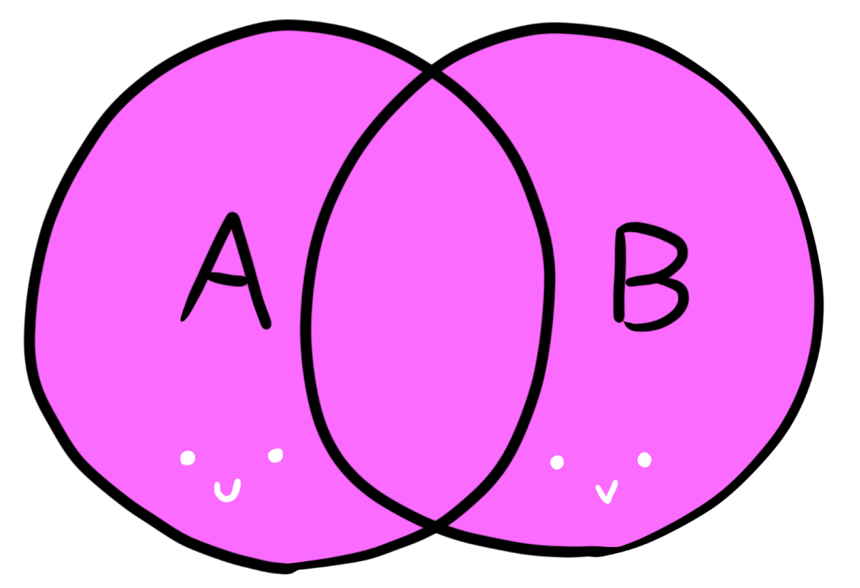

Union Type
$$A∪B$$
As Sets:
The object can be either of the two types
let h: string | number;
h = "hello";
h = 42;
Notes:
Types can be disjunct as well
That’s why it looks like an «OR», it is either or -> but it includes objects from BOTH sets

Slide 19






Some set algebra
Identity Laws:
Commutativity: Associativity:
And others apply as well ☺
$$A∪Ø=A$$
type x = number | never; // x = number
type y = number & unknown; // y = number
$$A∩U=A$$
$$A∪B=B∪A$$
$$\left(A∪B\right)∪C=A∪(B∪C)$$
$$A∩B=B∩A$$
$$(A∩B)∩C=A∩(B∩C)$$

Slide 20
Example of using Union Types
type InitAction = { type: "INIT" }
type LoginAction = { type: "LOGIN", name: string, password: string }
type Actions = InitAction | LoginAction;
function handleAction(action: Actions) {
switch (action.type) {
case "INIT":
return "Initialized";
case "LOGIN":
console.log(action.name + " logged in");
return "Logged In"
default:
console.log("WTF");
}
}
Property “name” can be safely accessed here

Slide 21
Example of using Union Types
type InitAction = { type: "INIT" }
type LoginAction = { type: "LOGIN", name: string, password: string }
type LogOutAction = { type: "LOGOUT" }
type Actions = InitAction | LoginAction | LogOutAction;
function handleAction(action: Actions) {
switch (action.type) {
case "INIT":
return "Initialized";
case "LOGIN":
console.log(action.name + " logged in");
return "Logged In"
default:
console.log("WTF");
}
}
We don’t handle all cases anymore!

Slide 22
Example of using Union Types
type InitAction = { type: "INIT" } ...
type Actions = InitAction | LoginAction | LogOutAction;
function assertNever(x: never): never {
throw new Error("Unexpected object: " + x);
}
function exhaustiveHandleAction(action: Actions) {
switch (action.type) {
case "INIT":
return "Initialized";
case "LOGIN":
console.log(action.name + " logged in");
return "Logged In"
default:
return assertNever(action);
}
}
The compiler complains if it ever reaches this point✔️

Slide 23
Algebraic Data Types

Slide 24
Sum Types
Sum types aren’t a native language feature of TS
They can be built though

Slide 25
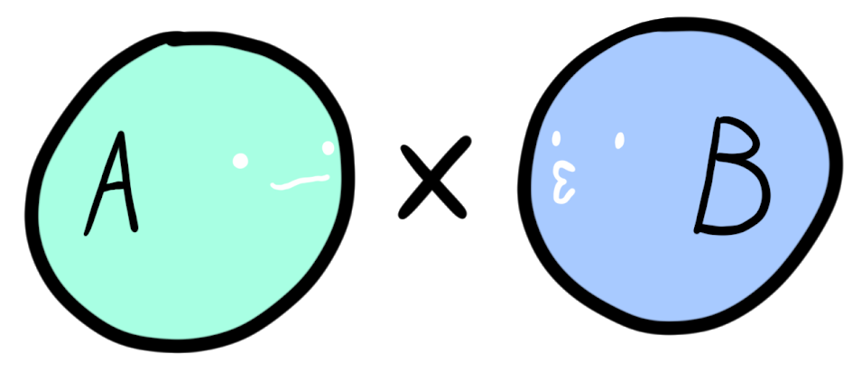
Product Type
Is equal to the carthesian product of sets

