Slide 1

It’s a Type of Magic

Slide 2

Just JavaScript with type annotations?

Slide 3
Generics
Intersection types
Union Types
Literal Types
Mapped Types
Conditional Types

Slide 4
Typescript Config
Minimum config for type safety:
Variables are non-nullable unless explicitly stated
Expressions and declarations cannot be any unless explicitly stated
Enable all strict type checking options with “strict”: true
{
"compilerOptions": {
"strictNullChecks": true,
"noImplicitAny": true,
// ...
}
}

Slide 5
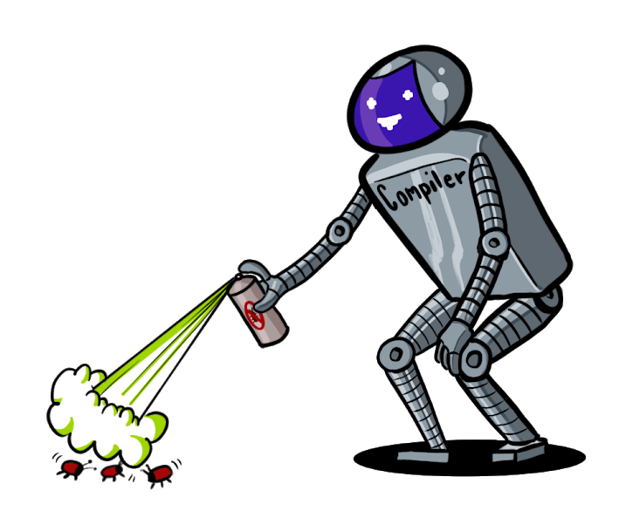
Why Type-Safety?
Let the compiler help you!
Prevents several classes of bugs
Less testing effort
Write correct programs
Can be fun too!
Notes:
ruling out invalid data makes your code shorter, simpler, and more reliable
you end up needing fewer tests, yet having more reliable code
And it can be fun ☺

Slide 6
Goals
Get an intuition for types as a concept
See some examples how to use type features of TS effectively
Learn about ADTs

Slide 7
Structure
1. Types as Sets
6. Type-Level Programming
2. Basic Types
3. Combining Types
7. Mapped Types
8. Conditional Types
4. Discriminated Unions
9. Conditional Mapped Types
5. ADTs

Slide 8
Types as Sets

Slide 9

Types as Sets
Looking at types as sets helps to understand the underlying concepts
Types can be described with simple algebra
What is a Set? A collection of Objects
What is a Type? A class of Objects confining to a set of constraints
Notes:
They can come in big and small
To make it more entertainable, I will be displaying sets as colourful blobs with faces

Slide 10
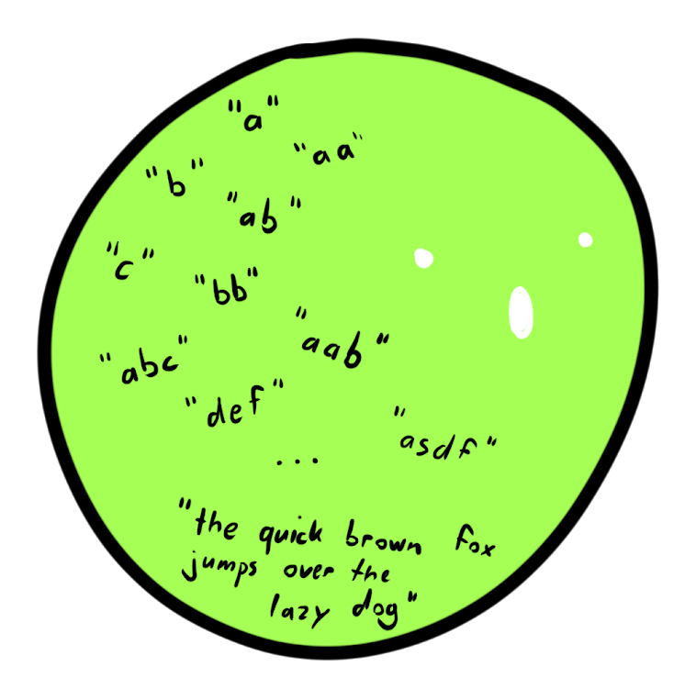
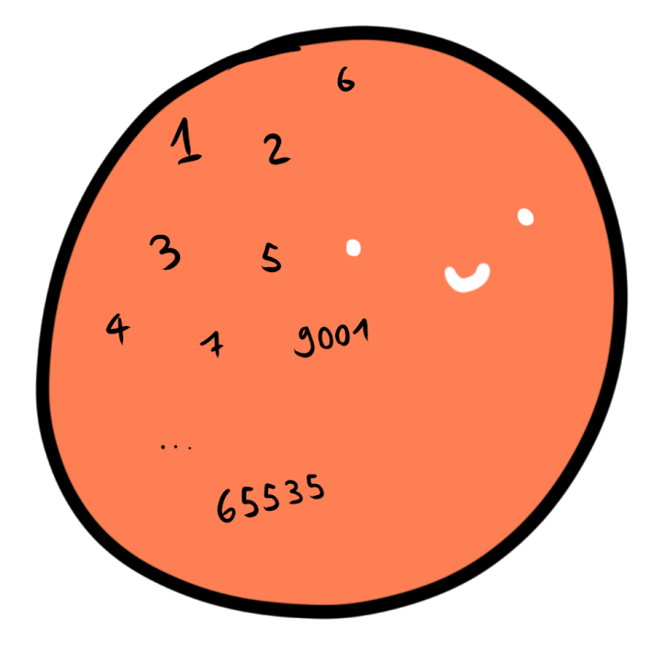
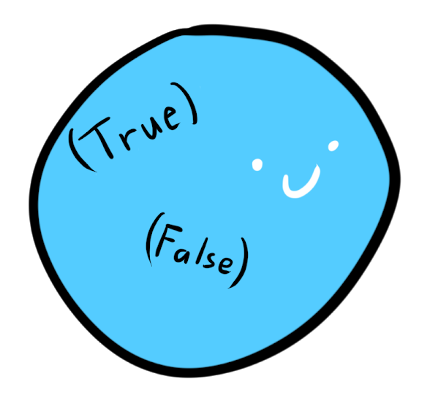
Intuition: Counting inhabitants
Boolean?
Integer?
String?
Notes:
Sometimes also cardinality

Slide 11
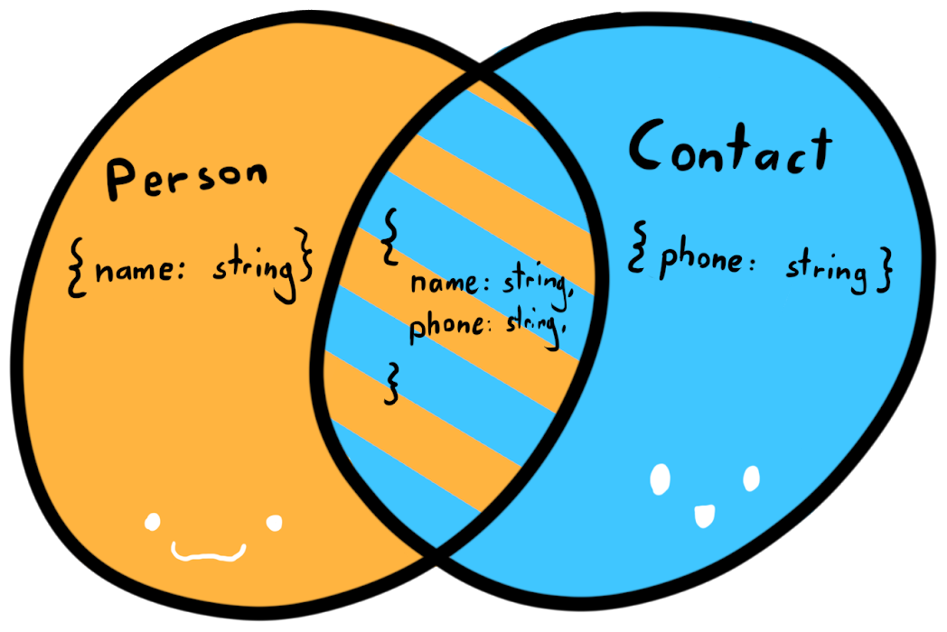
Structural Type Equality
C#, Java, etc: Nominal type systems
TypeScript, Haskell, Elm: types are defined by their shape, not their names
declare function call(c: Contact): boolean;
var personWithContact = {
name: "JoJo",
phone: "079 123 45 67"
};
call(personWithContact);
Notes:
In nominal type systems, types are differentiated by their name
In TypeScript, they are defined by their shape.
If the shape is equal, the types can be used interchangeably, no matter what the name is.
Assigning a name to a type, is actually called a “Type Alias”

Slide 12
Basic Types

Slide 13
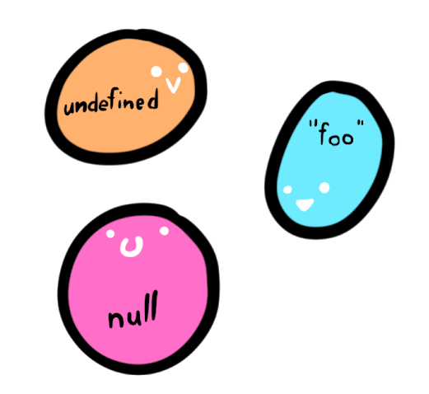
Singleton Types
Types with only one inhabitant
In Typescript:
let u; // undefined
let a = null; // null
const x = "foo"; // "foo"
Type Literals
const y = 5; // 5
Notes:
There is exactly one way to construct a singleton type.
There is undefined and null (and void) There are string literals and number literals

Slide 14
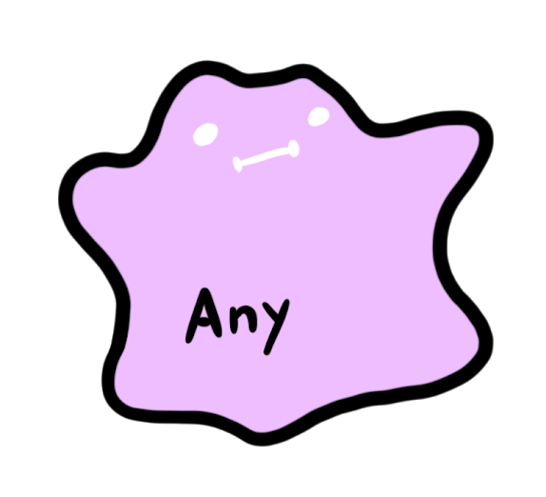

Top Types
Also universal supertype, contains every possible value, equals the universal set U
In typescript: any and unkown
let e: unknown = 42;
let f: string = e; // type error
let c: any = "foo";
let d: number = c;
Notes:
Any is the escape hatch of the type system.
It means you don’t care what it is and nobody should tell you otherwise
All types are assignable to it and you can assign it on everything
Unknown is the type-safe counterpart to any since typescript 3.0
You have to do type checks first, before performing any operation on it
All types are assignable to it, but you cannot assign it to anything (except any)
Both types are very useful when interoping with plain javascript
The unknown type is recommended to use

Slide 15
Example of using unknown
type Duck = { walkSpeed: number, quack: () => string };
function isDuck(thing: unknown): thing is Duck {
return typeof (thing as Duck).walkSpeed === "number"
&& typeof (thing as Duck).quack === "function";
}
function tryQuack(x: unknown) {
if (isDuck(x)) {
return x.quack();
}
console.log("Wasn't a duck, sorry.")
}

Slide 16
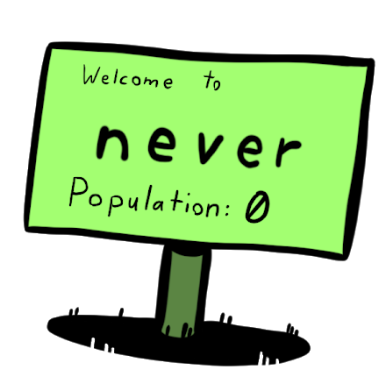
Bottom Type
A type that contains no values, equals the empty set Ø
Has several interesting applications, similar to 0 in algebra
If the typescript ever reaches a never, it will not compile
let g: never = ({} as any); // Error
Notes:
Reaching a never is impossible. Think of it this way: There are 0 ways to construct never.

Slide 17


Type as Sets
$$\text{never}=\left\{ \right\}=∅ \\ \text{any}=unknown=U \\ \text{null}=\{null\} \\ \text{foo}=\{foo\} \\ \text{number}=\left\{1, 2, …\right\}=ℝ$$
E.g. $\text{U}⊇ℝ⊇∅$

Slide 18
Combining Types

Slide 19
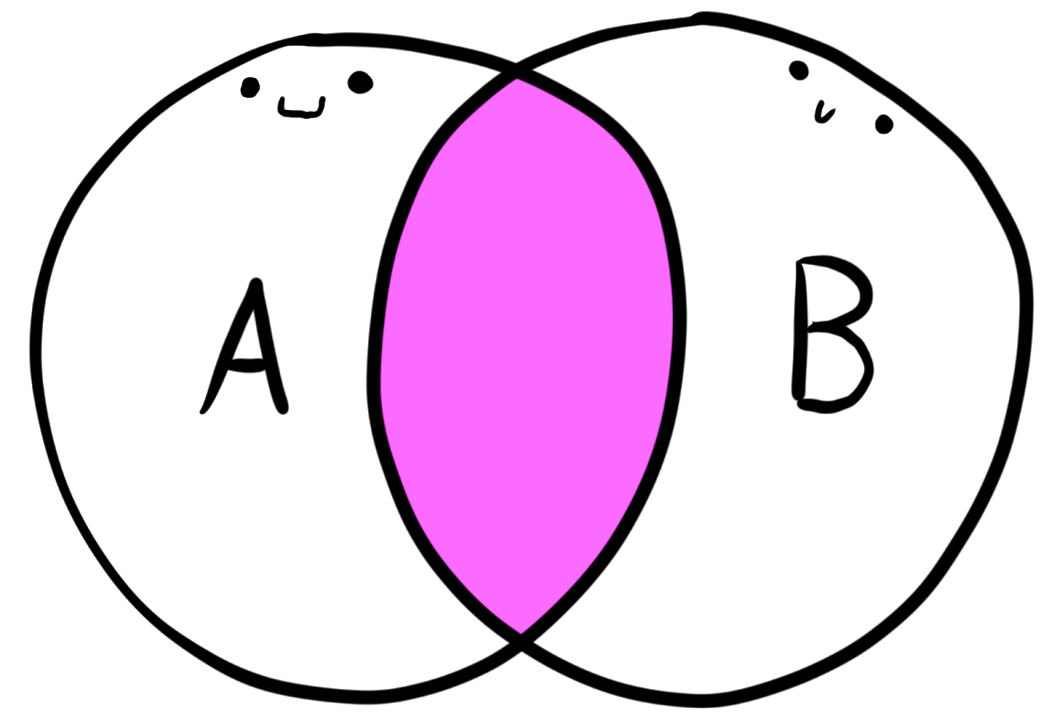

Intersection Type
$$A∩B$$
As sets:
Objects of an intersection type must contain properties of both types
type Person = { name: string }
type Contact = { phone: string }
let p: Person & Contact = {
p.name = "JoJo",
p.phone = "079 123 45 67",
};
Notes:
That’s why it’s an ampersand, it says it is a Person AND a Contact

Slide 20
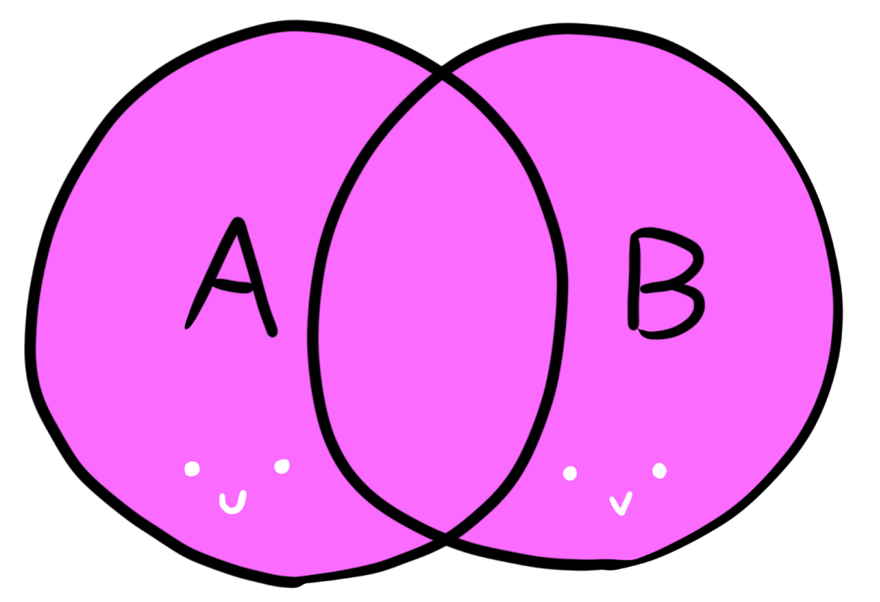

Union Type
$$A∪B$$
As Sets:
The object can be either of the two types
let h: string | number;
h = "hello";
h = 42;
type MyBoolean = true | false;// MyBoolean = boolean
type Workdays = "Mon" | "Tue" | "Wed" | "Thu" | "Fri";
type Weekdays = Workdays | "Sat" | "Sun";
Notes:
Types can be disjunct as well
That’s why it looks like an «OR», it is either or -> but it includes objects from BOTH sets
In many languages you cannot be more granular than to say you expect a string
With union types and type literals combined, you can in typescript.
That’s very useful, if you want to limit the set of possible values. It’s very similar to an enum, although more lightweight.
The same works with numbers too (and with booleans, but that’s not terribly useful)

Slide 21






Some set algebra
Identity Laws:
Commutativity: Associativity:
And others apply as well ☺
$$A∪Ø=A$$
type x = number | never; // x = number
type y = number & unknown; // y = number
$$A∩U=A$$
$$A∪B=B∪A$$
$$\left(A∪B\right)∪C=A∪(B∪C)$$
$$A∩B=B∩A$$
$$(A∩B)∩C=A∩(B∩C)$$

Slide 22
Example of using Union Types
function double(x: number | string) {
return x * 2;
}
A string cannot be multiplied

Slide 23
Example of using Union Types
function double(x: number | string) {
if(typeof x == "number") {
return x * 2;
}
return (2 * Number(x)).toString();
}
The control flow analysis infers the type of x in both cases

Slide 24
Discriminated Unions

Slide 25
Opaque Types
The structural type equality can stand in our way
Sometimes we want to differentiate values with identical structure
type Username = string;
type Password = string;
const displayUserName = (u: Username) => `User: ${u}`;
const pw: Password = "hunter2";
displayUserName(pw); // valid, but not what we want

Slide 26
Opaque Types
How to make your types “Opaque”?
Type Literals
Intersection Types
These types are now (structurally) different!
type Username = string & { type: "Username" };
type Password = string & { type: "Password" };
const displayUserName = (u: Username) => `User: ${u}`;
const pw: Password = "hunter2" as Password;
displayUserName(pw); // compiler prevents us from misusing sensitive data

Slide 27
Opaque Types
Can be made even cleaner with mapped types (more on this later)
The compiler prevents us to use a password value where we shouldn’t
type Opaque<K, T> = T & {_type: K};
type Username = Opaque<"Username", string>;
type Password = Opaque<"Password", string>;
const displayUserName = (u: Username) => `User: ${u}`;
const pw: Password = "hunter2" as Password;
displayUserName(pw); // A-OK!

Slide 28
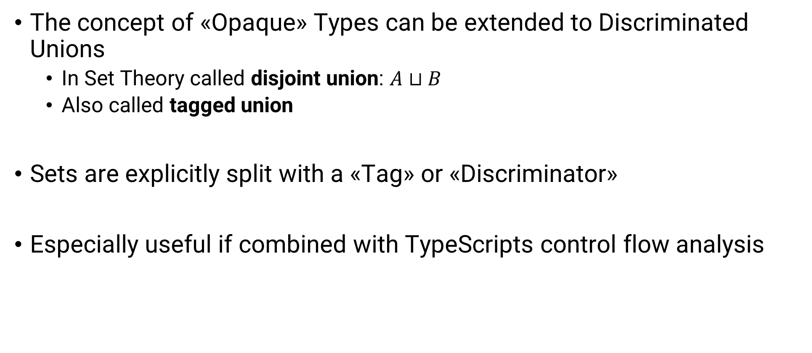
Discriminated Unions
The concept of «Opaque» Types can be extended to Discriminated Unions
In Set Theory called disjoint union: $A⊔B$
Also called tagged union
Sets are explicitly split with a «Tag» or «Discriminator»
Especially useful if combined with TypeScripts control flow analysis

Slide 29
Example of using Discriminated Unions
type InitAction = { type: "INIT" }
type LoginAction = { type: "LOGIN", name: string, password: string }
type Actions = InitAction | LoginAction;
function handleAction(action: Actions) {
switch (action.type) {
case "INIT":
return "Initialized";
case "LOGIN":
console.log(action.name + " logged in");
return "Logged In"
default:
console.log("WTF");
}
}
Property “name” can be safely accessed here

Slide 30
Exhaustiveness Checking
We often have types that cover several cases
What if you can guarantee that you cover them all?
Benefits:
Cut down bugs
Make extending functionality easier

Slide 31
Example of using Discriminated Unions
type InitAction = { type: "INIT" }
type LoginAction = { type: "LOGIN", name: string, password: string }
type LogOutAction = { type: "LOGOUT" }
type Actions = InitAction | LoginAction | LogOutAction;
function handleAction(action: Actions) {
switch (action.type) {
case "INIT":
return "Initialized";
case "LOGIN":
console.log(action.name + " logged in");
return "Logged In"
default:
console.log("WTF");
}
}
We don’t handle all cases anymore!

Slide 32
Example of using Discriminated Unions
type InitAction = { type: "INIT" }
type LoginAction = { type: "LOGIN", name: string, password: string }
type LogOutAction = { type: "LOGOUT" }
type Actions = InitAction | LoginAction | LogOutAction;
function handleAction2(action: Actions): string {
switch (action.type) {
case "INIT":
return "Initialized";
case "LOGIN":
console.log(action.name + " logged in");
return "Logged In"
default:
console.log("WTF");
}
}
Compiler complains: Function returns string | undefined
Notes:
One possibility to handle this case:
Specify the return type explicitly.
The compiler will complain, because we do not return a string in all cases.
There is one case where we don’t return at all, so the result is «undefined»
As the function potentially returns either of these types, the inferred return type is «string | undefined»
that is not compatible with the specified «string» return type
But what if we WANT to return undefined in some cases?
Then this doesn’t work.
There is another solution though…

Slide 33
Another Example of using Union Types
type InitAction = { type: "INIT" } ...
type Actions = InitAction | LoginAction | LogOutAction;
function assertNever(x: never): never {
throw new Error("Unexpected object: " + x);
}
function exhaustiveHandleAction(action: Actions) {
switch (action.type) {
case "INIT":
return "Initialized";
case "LOGIN":
console.log(action.name + " logged in");
return "Logged In"
default:
return assertNever(action);
}
}
The compiler complains if it ever reaches this point✔️
Notes:
We define a new function that returns never
Remember: never is a type that contains NO values. So it is not valid to instantiate it.
So this function is absurd, as it cannot ever reach an end point where it would return.
Easy solution: We throw an error in the function. (the inferred return type is automatically «never»).
The compiler will complain as soon as we would ever potentially call this function.
So the code will only compile, if we handled all cases.

Slide 34
Algebraic Data Types

Slide 35
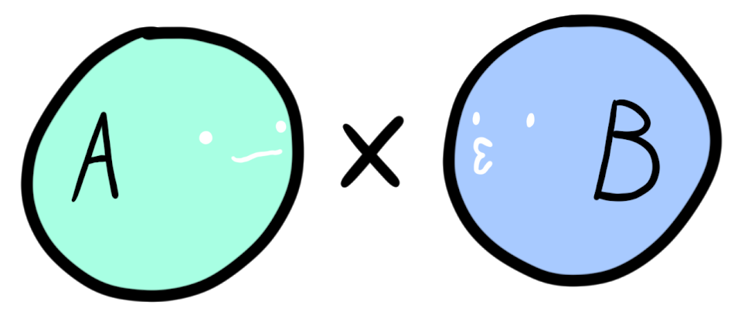
Product Type
Is equal to the carthesian product of sets
Can be modelled as a Tuple:
Or, more explicit, as an object with two properties:
let p: [number, boolean] = [5, true];
type Product<A, B> = { fst: A, snd: B };
let prod: Product<number, boolean> = { fst: 5, snd: true };

Slide 36

Product Type
Why «Product»?
Try counting the inhabitants
$$\left|\left[A,B\right]\right|=|A|×|B|$$
Notes:
A Product can also be understood as an AND in logic
The product of a type A and B contains every combination of A values and B values.

Slide 37



Product Type
Does other algebra apply? Commutativity:
let p1: [A, B] = ["A", "B"];
let p2: [B, A] = ["B", "A"]; const swap = ([x, y]) => [y, x];
$$A×B=B×A$$
Associativity:
$$\left(A×B\right)×C=A×(B×C)$$
let p2: [A, [B, C]] = ["A", ["B", "C"]];
let p3: [[A, B], C] = [["A", "B"], "C"];
let t5 = ["A", null];
const rho = ([a, _]: [any, null]) => a;
const rho_inv = (a: any) => [a, null];
Neutral-Element:
$$A×1=A$$
Notes:
A Product can also be understood as an AND in logic And there is more, but let’s leave it at that just to form the intuition

Slide 38
Sum Types
Sum types aren’t a native language feature of TS
They can be built though

Slide 39
Sum Types
Sum types aren’t a native language feature of TS
They can be built though
Dis
type Left<T> = { type: "Left", val: T};
type Right<T> = { type: "Right", val: T};
type Sum<A, B> = Left<A> | Right<B>;
let sum: Sum<number, boolean> = { type: "Left", val: 5 };
type Either<A, B> = Sum<A, B>;
type Maybe<A> = Either<A, null>;

Slide 40
Numbers | Types
0 | never
1 | undefined, null, «foo»
a + b | Either<A, B> = Left<A> | Right<B>
a x b | [A, B], Product<A, B> = [A, B]
2 = 1 + 1 | type bool = True | False
1 + a | Optional<A> = «nothing» | Some<A>
Logic | Types
False | never
True | undefined, null, «foo»
a || b | Either<A, B> = Left<A> | Right<B>
a && b | [A, B], Product<A, B> = [A, B]

Slide 41
Type-Level Programming

Slide 42
Type-Level Programming
We’re used to the value-level
Programming can also be thought in types
Allows us to shape and narrow our domain
We can think of our type expressions as functional programs evaluated via the substitution model

Slide 43
Generics are Functions
Just as functions are mappings of values, generics are mappings of types

Slide 44
Type Mapping

Slide 45
Conditional Types

Slide 46
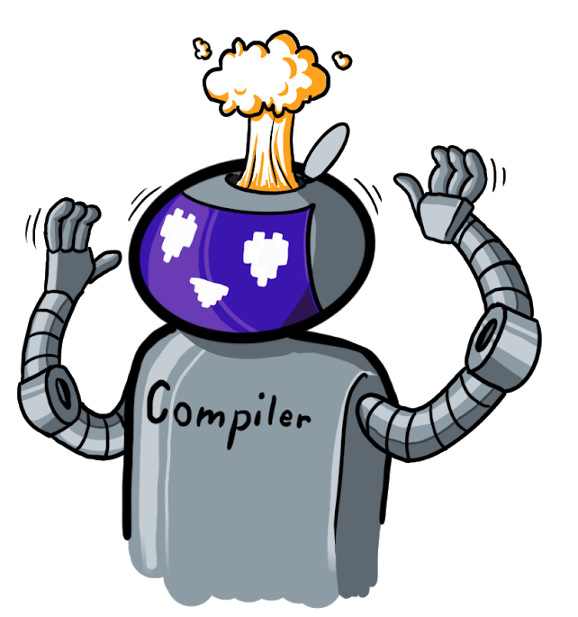
Conclusion
We have a powerful, functional-language-level type system built into JavaScript, one of the most used, handiest languages of our time

Slide 47
Reading List
https://www.typescriptlang.org/docs/handbook/advanced-types.html
https://bartoszmilewski.com/2014/10/28/category-theory-for-programmers-the-preface/

