Slide 1

It’s a Type of Magic

Slide 2

Just JavaScript with type annotations?

Slide 3
Generics
Intersection types
Union Types
Literal Types
Mapped Types
Conditional Types

Slide 4

Why Type-Safety?
Prevents several classes of bugs
Let the compiler help you
Write correct programs
Notes:
And it can be fun ☺

Slide 5
Goals

Slide 6

Types as Sets
Seeing the relationship of types and sets can help to understand the more advanced concepts
Allows us to use simple algebra to describe relationships of types
Explains a class of bugs: Invalid Data
Notes:
ruling out invalid data makes your code shorter, simpler, and more reliable you end up needing fewer tests, yet having more reliable code

Slide 7
Basic Types

Slide 8

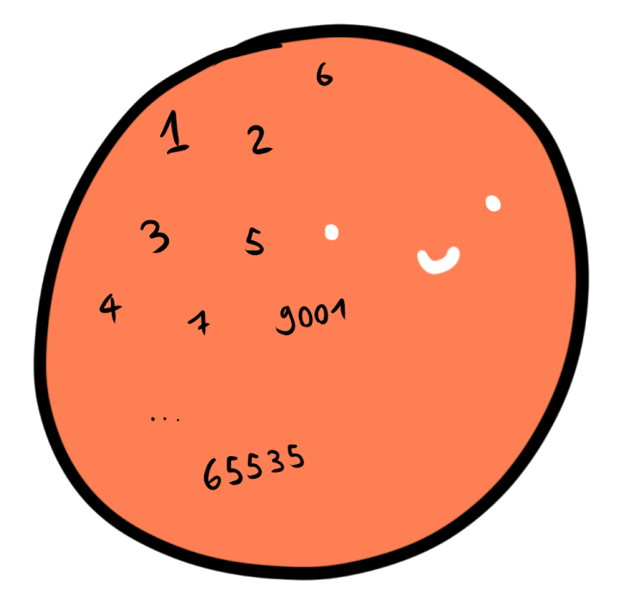
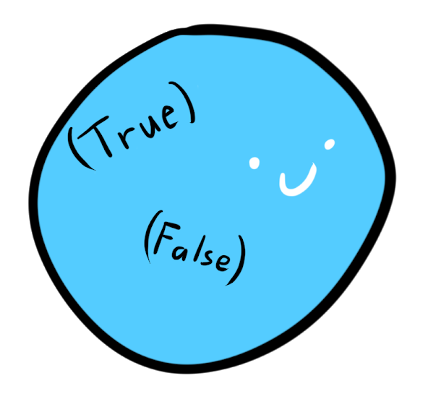
Intuition: Counting inhabitants
Boolean
Integer
String
Notes:
Sometimes also cardinality

Slide 9
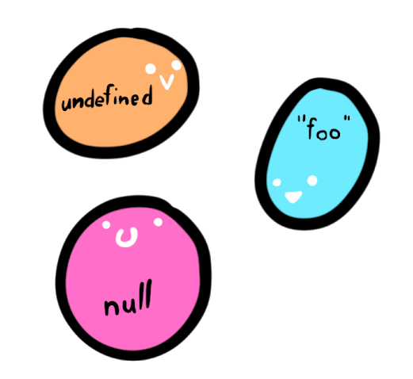
Singleton Types
Types with only one inhabitant
In Typescript:
let u; // undefined
let a = null; // null
const x = "foo"; // "foo"
Type Literals
const y = 5; // 5

Slide 10


Top Types
Also universal supertype, contains every possible value
In typescript: any and unkown
let e: unknown = 42;
let f: string = e; // type error
let c: any = "foo";
let d: number = c;
Notes:
Any is the escape hatch of the type system.
It means you don’t care what it is and nobody should tell you otherwise
All types are assignable to it and you can assign it on everything
Unknown is the type-safe counterpart to any since typescript 3.0
You have to do type checks first, before performing any operation on it
All types are assignable to it, but you cannot assign it to anything (except any)
Both types are very useful when interoping with plain javascript
The unknown type is recommended to use

Slide 11

Bottom Type
A type that contains no values
Has several interesting applications, similar to 0 in algebra
let g: never = ({} as any); // Error

Slide 12
Example of unknown

Slide 13
Combining Types

Slide 14
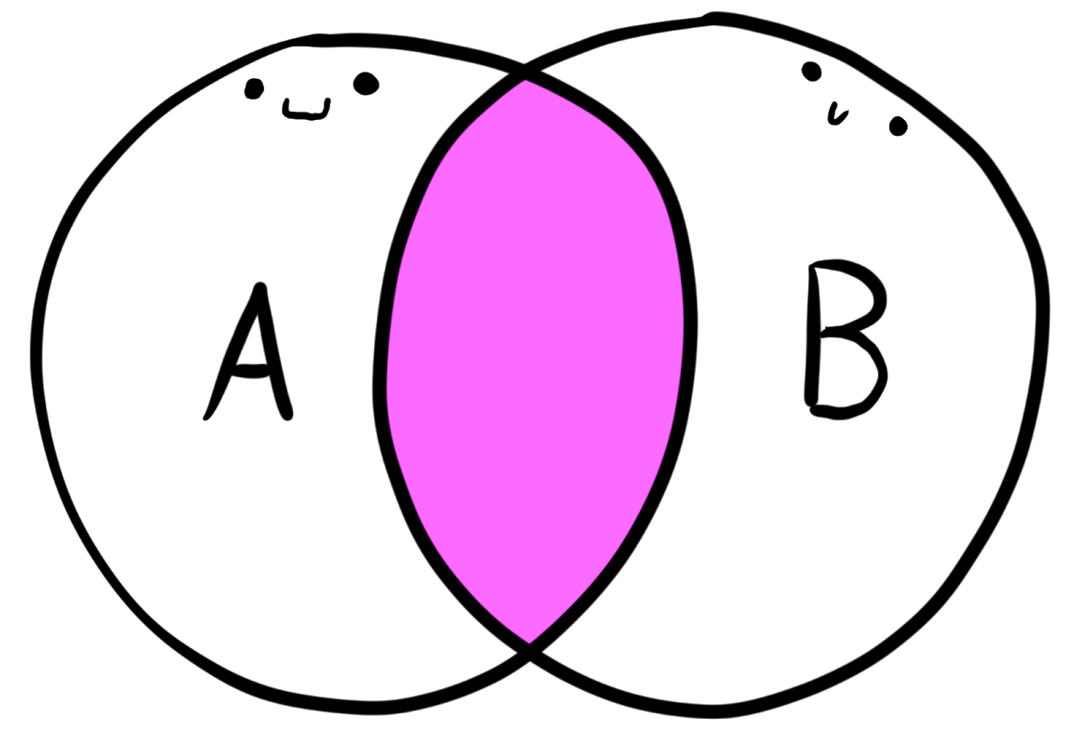

Intersection Type
$$A∪B$$
As sets:
Objects of an intersection type must contain properties of both types
type Person = { name: string, age: number }
type Serializable = { serialize: () => string };
let i: Person & Serializable;
i.name = "JoJo";
i.age = 17;
i.serialize();

Slide 15
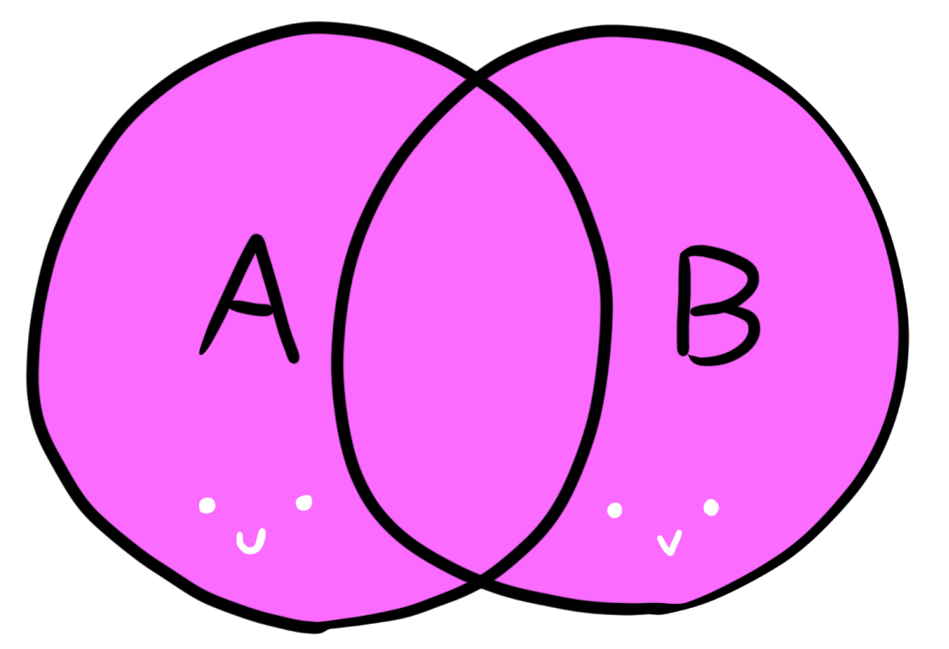

Union Type
$$A∩B$$
As Sets:
The object can be either of the two types
let h: string | number;
h = "hello"
h = 42
Notes:
Types can be disjunct as well

Slide 16
Examples / Use Cases

