Slide 1
FLIGHTS
Mulesoft project presentation

Slide 2
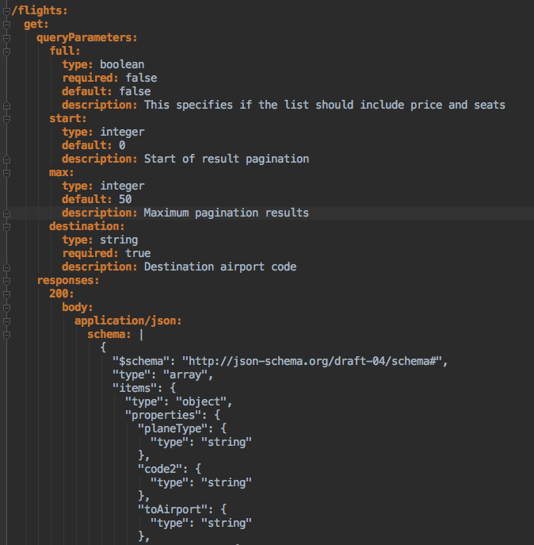
API-Led Design

Slide 3
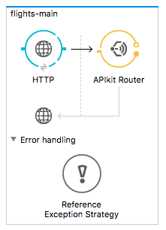
RAML API Kit routing

Slide 4
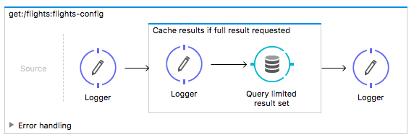
Flow
No transformation required as database connector already returns data in suitable format.
If transformation or enrichment was required Dataweave would generally be used for that purpose

Slide 5
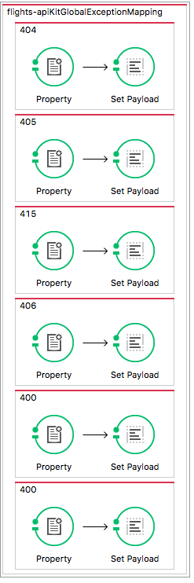
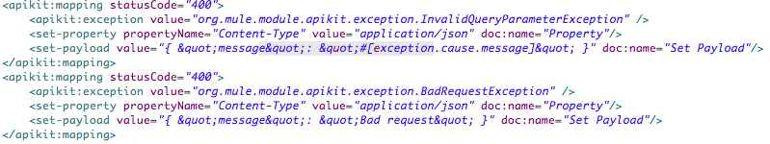
Error handling - APIKit

Slide 6
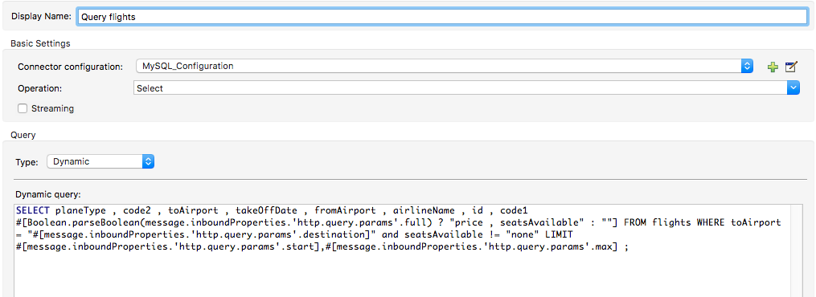
Dynamic query

Slide 7
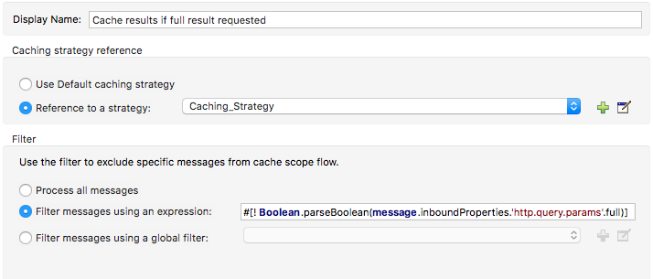
Limited query results cache

Slide 8
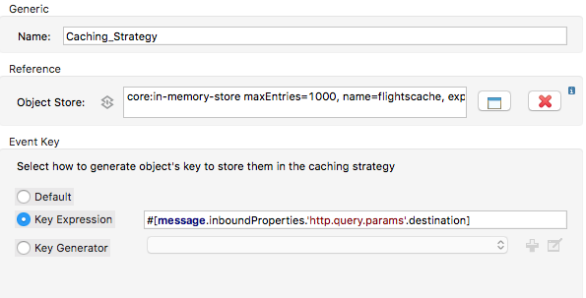
Limited result set cache

Slide 9
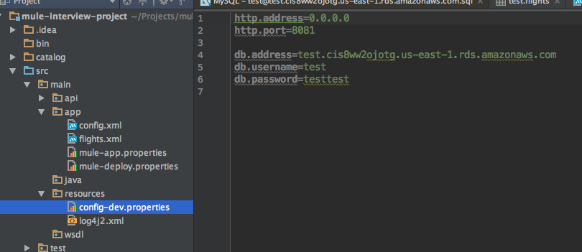
Externalized Configuration

