Slide 1

Subtask: STO characterization
Train an AI model to automatically recognize surface reconstruction patterns
Data Collection: Gather and label RHEED images corresponding to known reconstructions such as (1×1), (2×1), (√13×√13), c(6×2), etc.
Model Training: Use machine learning to learn distinguishing features of each reconstruction pattern.
Inference Output: For any given RHEED image, the trained model outputs a reconstruction classification — for example: 46 % (1×1) + 54 % (√13×√13)
2. Develop an AI model that recommends treatment conditions
Data Collection: Compile a dataset linking each RHEED image and its identified reconstruction (Result of 1) to the corresponding substrate treatment parameters
Model Training: Use regression or generative models to learn the relationship between reconstruction types and treatment conditions.
Inference Output: Given a target reconstruction (e.g., (√13×√13)), the model suggests a recommended annealing recipe, such as: Temperature = 1000 °C, Ramp Rate = 10 °C/min, Annealing Time = 30 min.

Slide 2
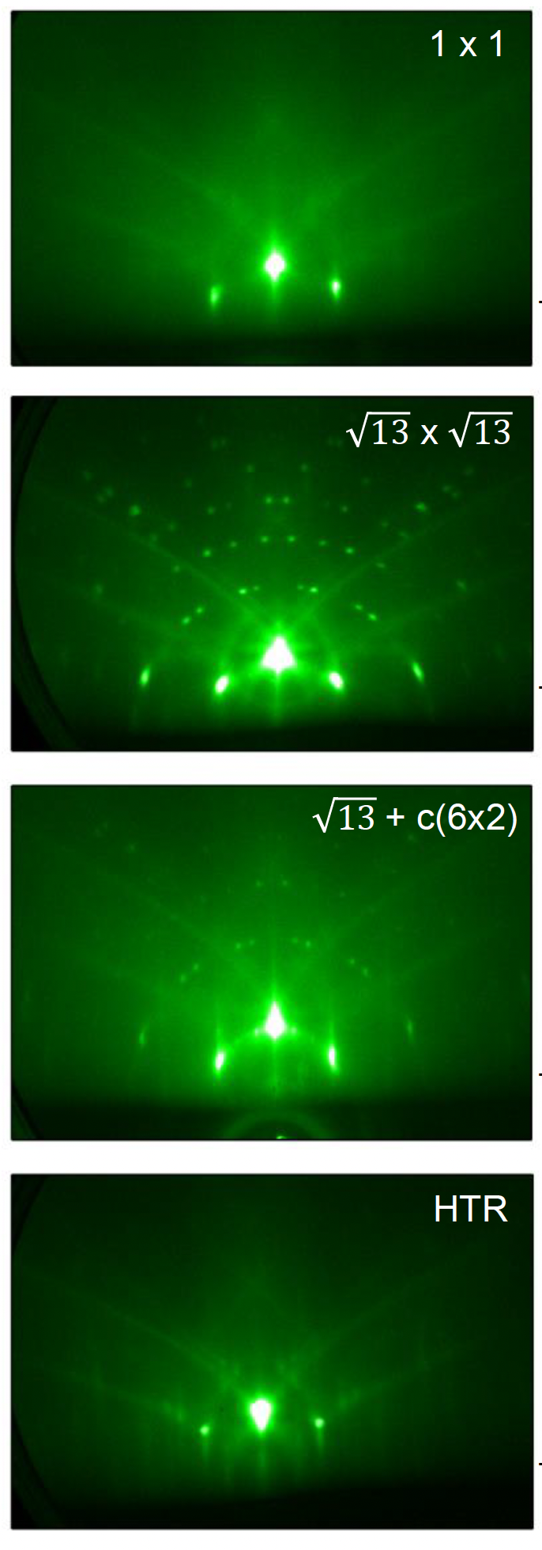


Subtask: STO characterization
1 x 1
$$\sqrt{13}×\sqrt{13}$$
High Temperature Reconstruction (HTR)
$$\sqrt{13}×\sqrt{13}+c(6×2)$$

Slide 3
Subtask: FeSe quality scoring
AI-guided monolayer FeSe growth
Data Collection: Grow monolayer FeSe on STO (001) substrates with different reconstructions and record growth parameters (source temperatures, substrate temperatures, pressure, growth time, post growth annealing time, etc.).
Model Training: Use machine learning to correlate growth conditions and substrate reconstruction with film quality.
Potential metrics for film quality:
  Resulting FeSe RHEED image
  Superconducting Tc
  ARPES MDC linewidth
  Surface quality/coverage
  Interfacial phonon replica band (ARPES)
Inference Output: the trained model will recommend substrate treatment + growth recipe. Potentially also enable closed-loop growth optimization where AI refines recipes over time using feedback from each growth.

Slide 4
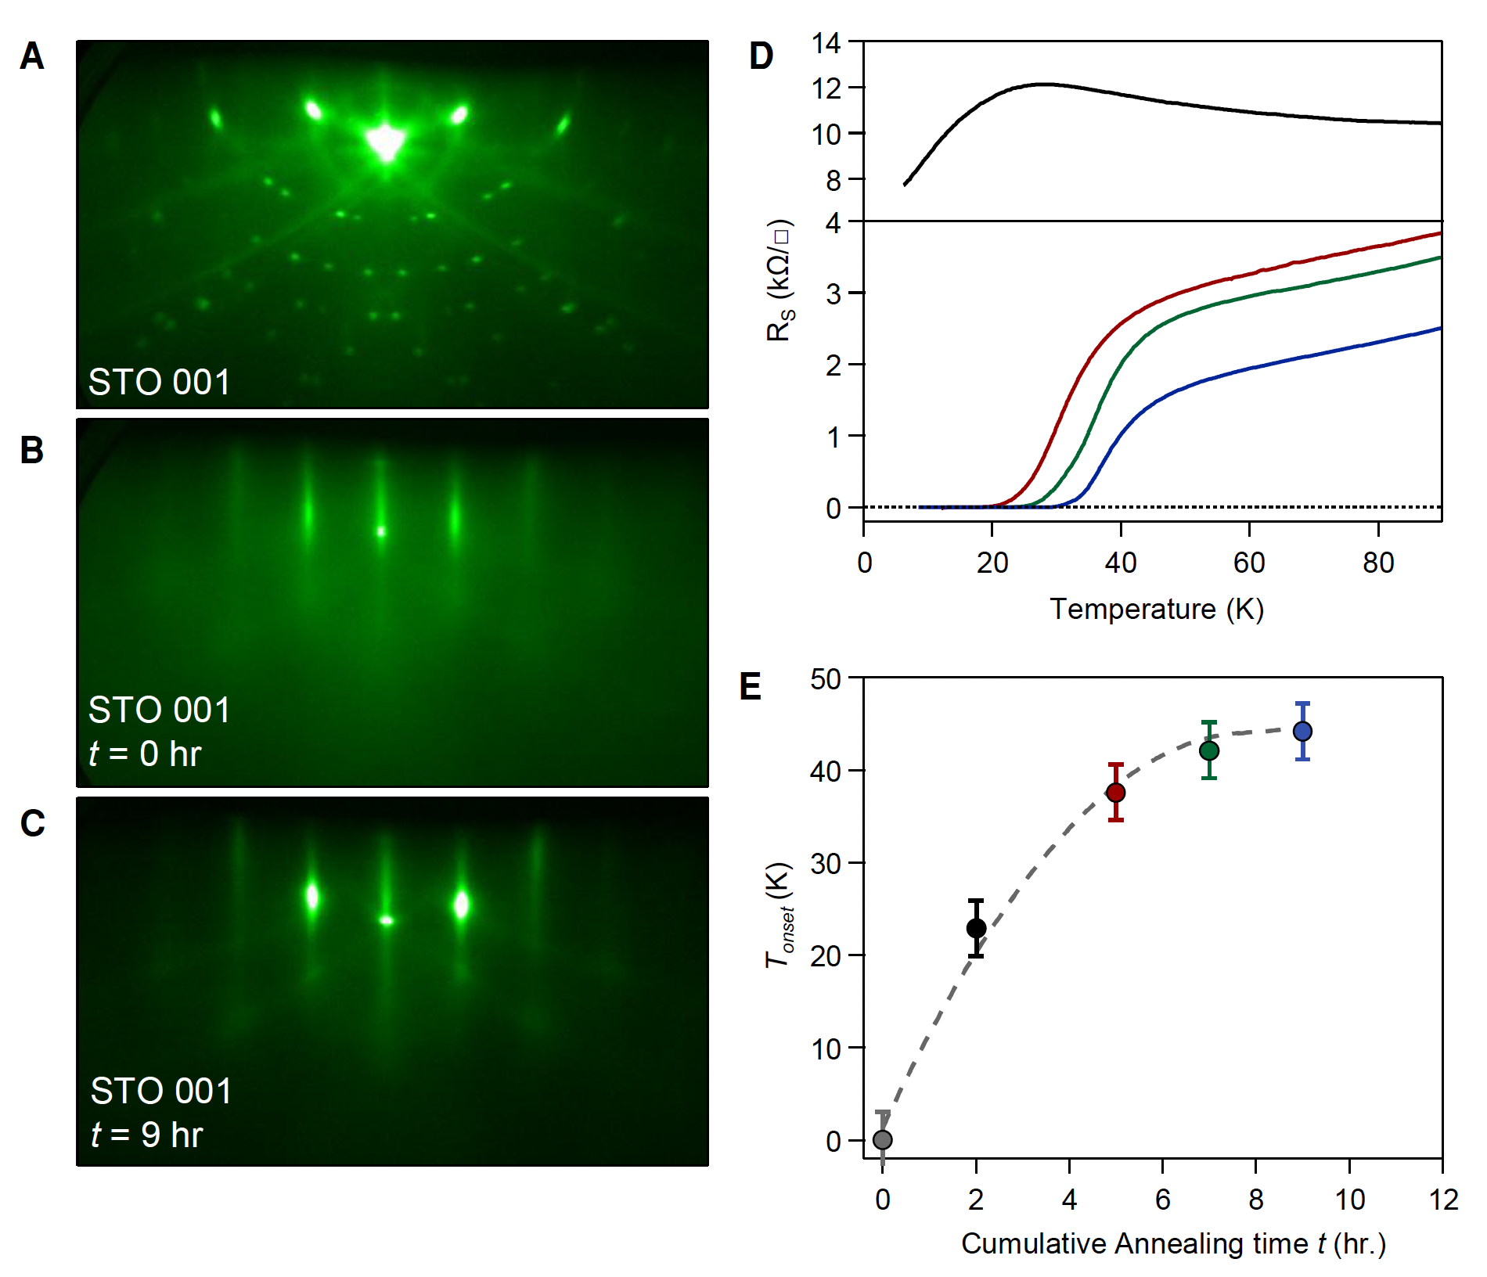
Subtask: FeSe quality scoring

