Slide 1

Good Practices for developing in python

Slide 2
Development
Operations
Python
C++
Julia
R
(etc)
Version control (git)
Virtual environments
Debugging
DIE
Task Automation

Slide 3
1. IT architecture overview

Slide 4


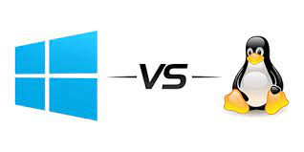


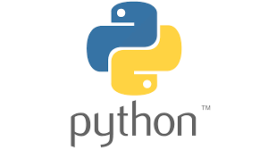


Port 8888
SSH tunnel
Notes:
* Don't know how you have setup your working environment
* Several actors involved, relatively complex architecture if not used to it, involving several technologies:
- Secure shells (SSH) connections
- Virtual environments
- Various OS
The setup of this architecture is referred to as IT operations, as opposed to development, which encompasses the actual action of writing code.
They come hand in hand,
Following this architecture we can only work in a notebook. Notebooks are great! But they are rather limited in terms of functionality: let's see how and why

Slide 5
2. Virtual Environments

Slide 6

Virtual environments
Goal: You want to install a new package to use with python / in jupyter notebook
Procedure: pip install mypackage OR conda install my_package
Result:
import mypackage
-------------------------------------------
ModuleNotFoundError: No module named mypackage
Why does pip install work inside/ outside of a virtual env?
Should you use a virtual env? When?

Slide 7
Virtual environments
Virtual environment are a complex topic, even for advandced programmers!
There are many python interpreters within a single machine
A given python interpreter comes up with ist own associated pip (= python package manager)
Just by typing python3 in the CLI (command line interface) we don't know which one we are using!
Notes:
..things will get clearer with a diagram

Slide 8
Virtual environments
Python3.7.0 (sys)
pip
Python3.9.1 (venv: env2)
pip
Python3.8.0 (conda: env1)
pip
Ipykernel
pandas
$: python3

Slide 9
Virtual environments
Python3.7.0 (sys)
pip
Python3.9.1 (venv: env2)
pip
Python3.8.0 (conda: env1)
pip
Ipykernel
pandas
$: (myenv) python3
Notes:
Desrcribe the scheme --> practice

Slide 10
Conda or venv?
Conda is a general package manager, it is not limited to python packages
Venv is a lighter, faster, python-exclusive package manager
Both support pip installation although you should privilege conda in the case of conda
Notes:
But before, mention difference conda and venv

Slide 11

Demonstration!
Notes:
* Don't know how you have setup your working environment
* Several actors involved, relatively complex architecture if not used to it, involving several technologies:
- Secure shells (SSH) connections
- Virtual environments
- Various OS
The setup of this architecture is referred to as IT operations, as opposed to development, which encompasses the actual action of writing code.
They come hand in hand,
Following this architecture we can only work in a notebook. Notebooks are great! But they are rather limited in terms of functionality: let's see how and why

Slide 12
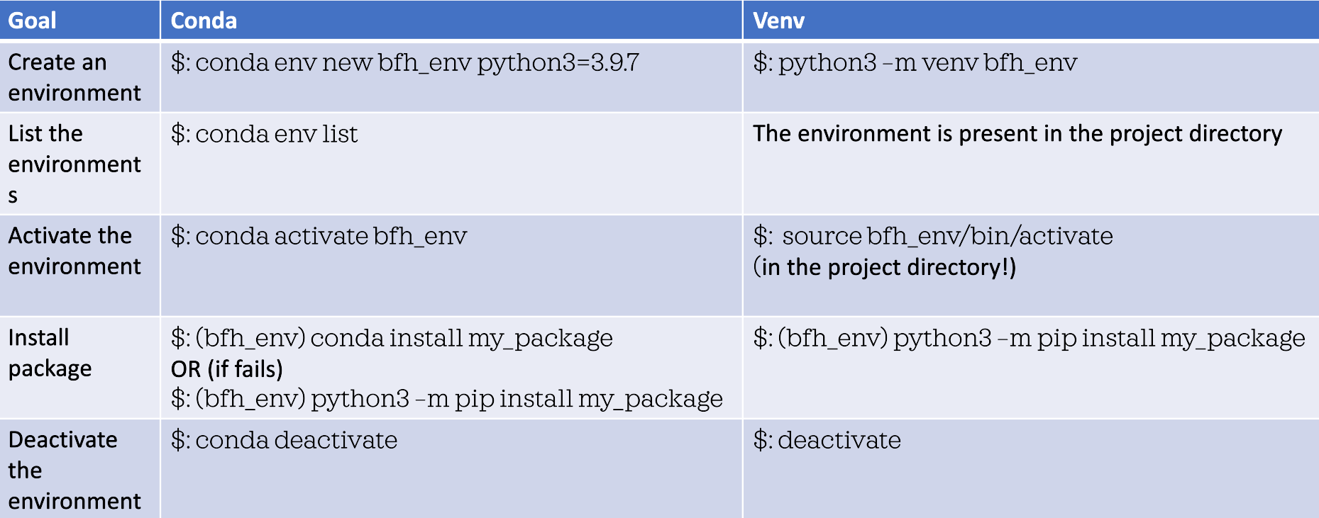
Conda/venv commands

Slide 13
Virtual environments: lessons
which python3 : tells you which python interpreter you are using
python3 –m pip install mypackage: make sure that we use the pip installer associated with the python3 interpreter
A kernel is the interface between jupyter and a python interpreter:
python3 –m ipython kernel install --name "my-kernel" --user : install the current python3 interpreter as a kernel we can use in jupyter notebook

Slide 14
1. Notebooks: limitations

Slide 15
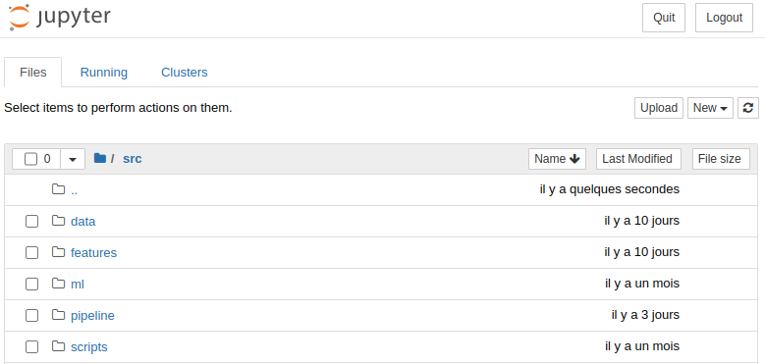
Notebooks: limitation
Port 8888
SSH tunnel
Notes:
* Don't know how you have setup your working environment
* Several actors involved, relatively complex architecture if not used to it, involving several technologies:
- Secure shells (SSH) connections
- Virtual environments
- Various OS
The setup of this architecture is referred to as IT operations, as opposed to development, which encompasses the actual action of writing code.
They come hand in hand,
Following this architecture we can only work in a notebook. Notebooks are great! But they are rather limited in terms of functionality: let's see how and why

Slide 16
Demonstration!

Slide 17


Notebooks: limitations
Cannot ensure reproducibility
Does not scale as the codebase grows
Version control hostile
Good for quick development /interactive testing
Multiple plots visualization
Solution: Python scripts :)
Notes:
Demo: move

Slide 18
2. Modularity

Slide 19
Modularity
Your code should (mainly) consists of functions
Each function should only do one thing
Too long is (way) more damageable as too short for a function
Single responsability principle: each function/module should be responsible for a single unit of work
Separation of concerns: functions/modules should be split in to modules whose functionalities overlap as little as possible
Notes:
Demo: move

Slide 20
3. Documentation

Slide 21
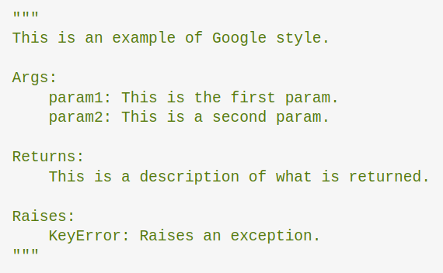
Documentation
Documentation will prevent yourself (and your colleagus) from hating you
Many styles are available: pick one and stick to it
Type hints are also a good practice
A good post about documentation
Notes:
Switch to folder 4_modularization_documentation

Slide 22
Demonstration!

Slide 23
4. Scripting

Slide 24
Packaging your file
There are (at least) 3 ways of importing your own modules:
Referencing it from the directory you are in
Having your module in a directory present in your $PYTHONPATH
Installing your module locally
Notes:
Demo: move

Slide 25
Demonstration!

Slide 26
Packaging your file
[metadata]
name = iris_package_name # Name as display on pypi: does not need to have the same name as the package
[options]
packages = iris_bfh# Specify manually which package to install
package_dir =
=src
Packaging files tutorial (Real Python) (open it in a private browser if you don’t want to subscribe: ctrl+shift+n)
Notes:
Demo: move

Slide 27

5. Debugging

Slide 28
Use a debugger
pdb the python debugger
Lets you get insights into running environment without your script crashing
Navigation: n (next) c (continue) u (up) d (down) s (step)
Has a post mortem mode!
Notes:
Demo: move

Slide 29
Demonstration!

Slide 30
CLI tips and tricks

Slide 31
Shell vs Terminal
Shell: the program that actually processes commands and outputs results (ex: sh, bash, zsh)
Terminal: A terminal is a graphical interface that acts as an intermediary between you and the shell (ex: alacritty, konsole, gnome terminal)
A console is an instanciation of a terminal
A command-line is any programs that processes commands in form of text (more general tan a terminal, does not necessarily redirect it to a shell!)
Notes:
Some commands are specific to certain shells

Slide 32

Shell vs Terminal
Command line
Terminal
Shell
Executes a
Are instances of
>: Console 1
>: Console 2
>: Console 3
Notes:
Some commands are specific to certain shells

Slide 33
Demonstration!
Notes:
Show 2 terminals
In the 2 terminals you have zsh
Sow the 3 shells bash zsh and sh

Slide 34
.rc files
Every shell executes some file on load to prepare the shell environment
The name of the file usually ends up in .rc (ex: zsh -> .zshrc, bash -> .bashrc)
These files need to be present in your home directory
Since they start with a "." they are hidden: run >:ls –a ~ to list all files in the home directory
Notes:
Give example with hello world in bashrc

Slide 35
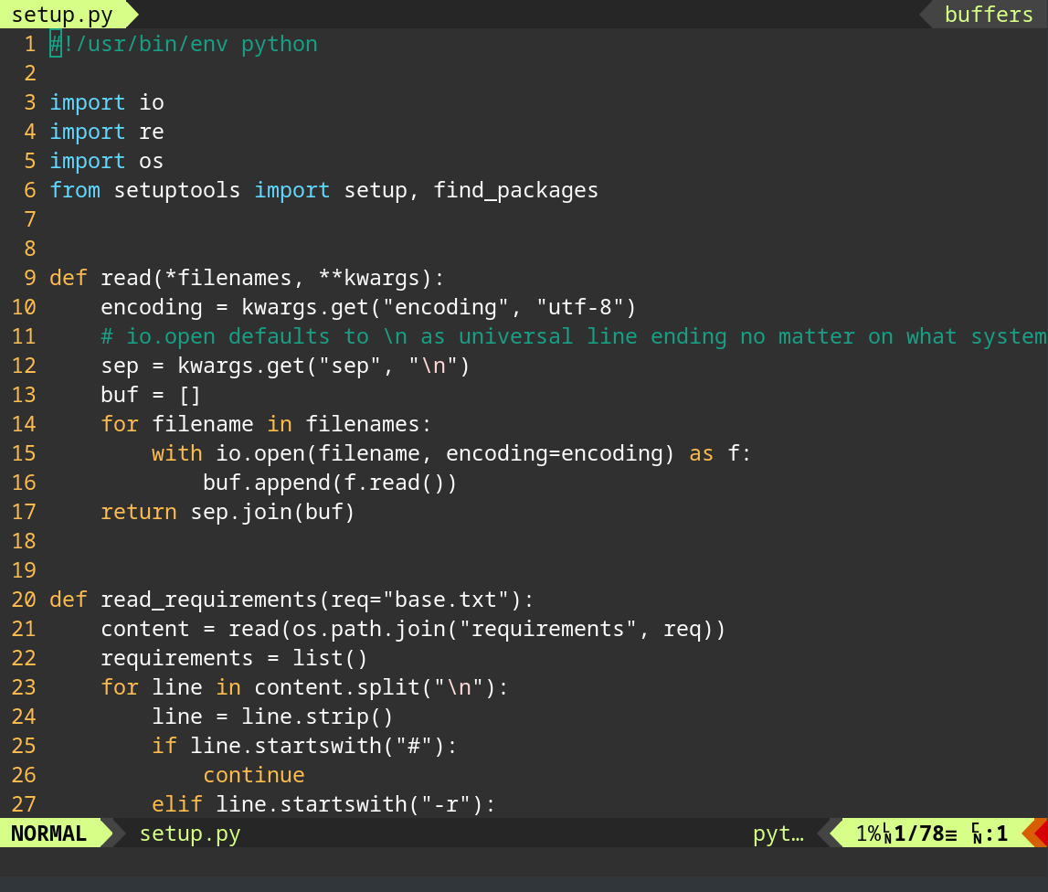
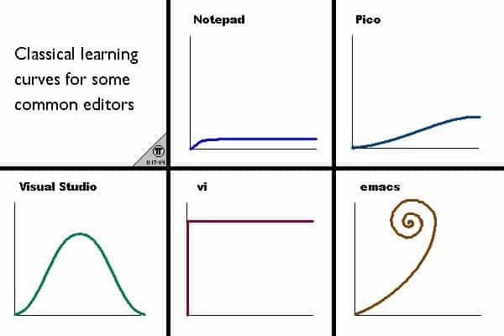
CLI text editors
You need one :)
Vim, nano, emacs
Vim: + most control – steep learning curve
Nano or emacs: + easy to learn
Notes:
Touch a file with vim, show it in the file explorer

Slide 36
Searching in the CLI
Searching files in the subdirectories: >: find . -t file –name "myfile"
Searching for an expression in files: >: grep -r "some terms" .
Searching in history (first add: stty –ixon to your .bashrc/.zshrc) >: CTRL+R to go backward >: CTRL+S to go forward
Notes:
Show example with git aliases

Slide 37
Directory navigation
>: ls –a Show all files, even the hidden ones
>: cd – Return to the previously visited directory
>: d List the last directories, allows quick jumping (zsh specific)
>: tree Display a tree view of subdirectories
>: autojump Jumps to a recent directory that matches your search
>: ranger Allows quick CLI-navigat

Slide 38
Aliases
Allows you to define a shorter version for a long command in order not to have to type it every time
In ~/.aliases add this line: alias h=echo "hello there!" and execute >: source ~/.aliases
You can now run sayhello in your command line
You should add the following line to your .zshrc/.bashrc to automatically load aliases for every console: >: source $HOME/.aliases
Aliases are shell-agnostic :)
Notes:
Show example with git aliases

Slide 39
Man pages
When running a cli command, a flag designates a boolean value while an option refers to some variable to feed to the program
Run man mycommand to get a list of the diffferent flags and options associated to the commmand
/ lets you enter the search mode, "n" to go to next match, "N" to previous
J and k to navigate up and down
Notes:
Show example with git aliases

Slide 40
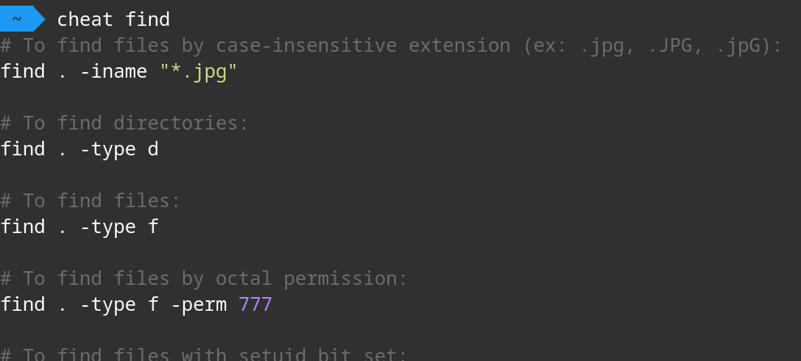
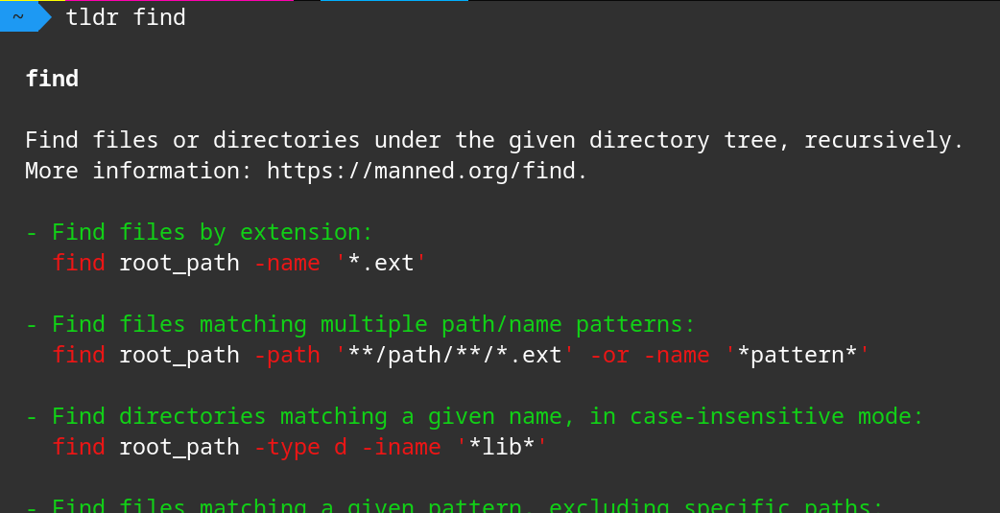
Searching a command
There are a lot of command that we use too rarely to remember
Man pages can be tedious to read (but they stay the reference!)
Tldr and /or cheat are packages that help you determine the flags you need quickly
Notes:
Show example with git aliases

Slide 41
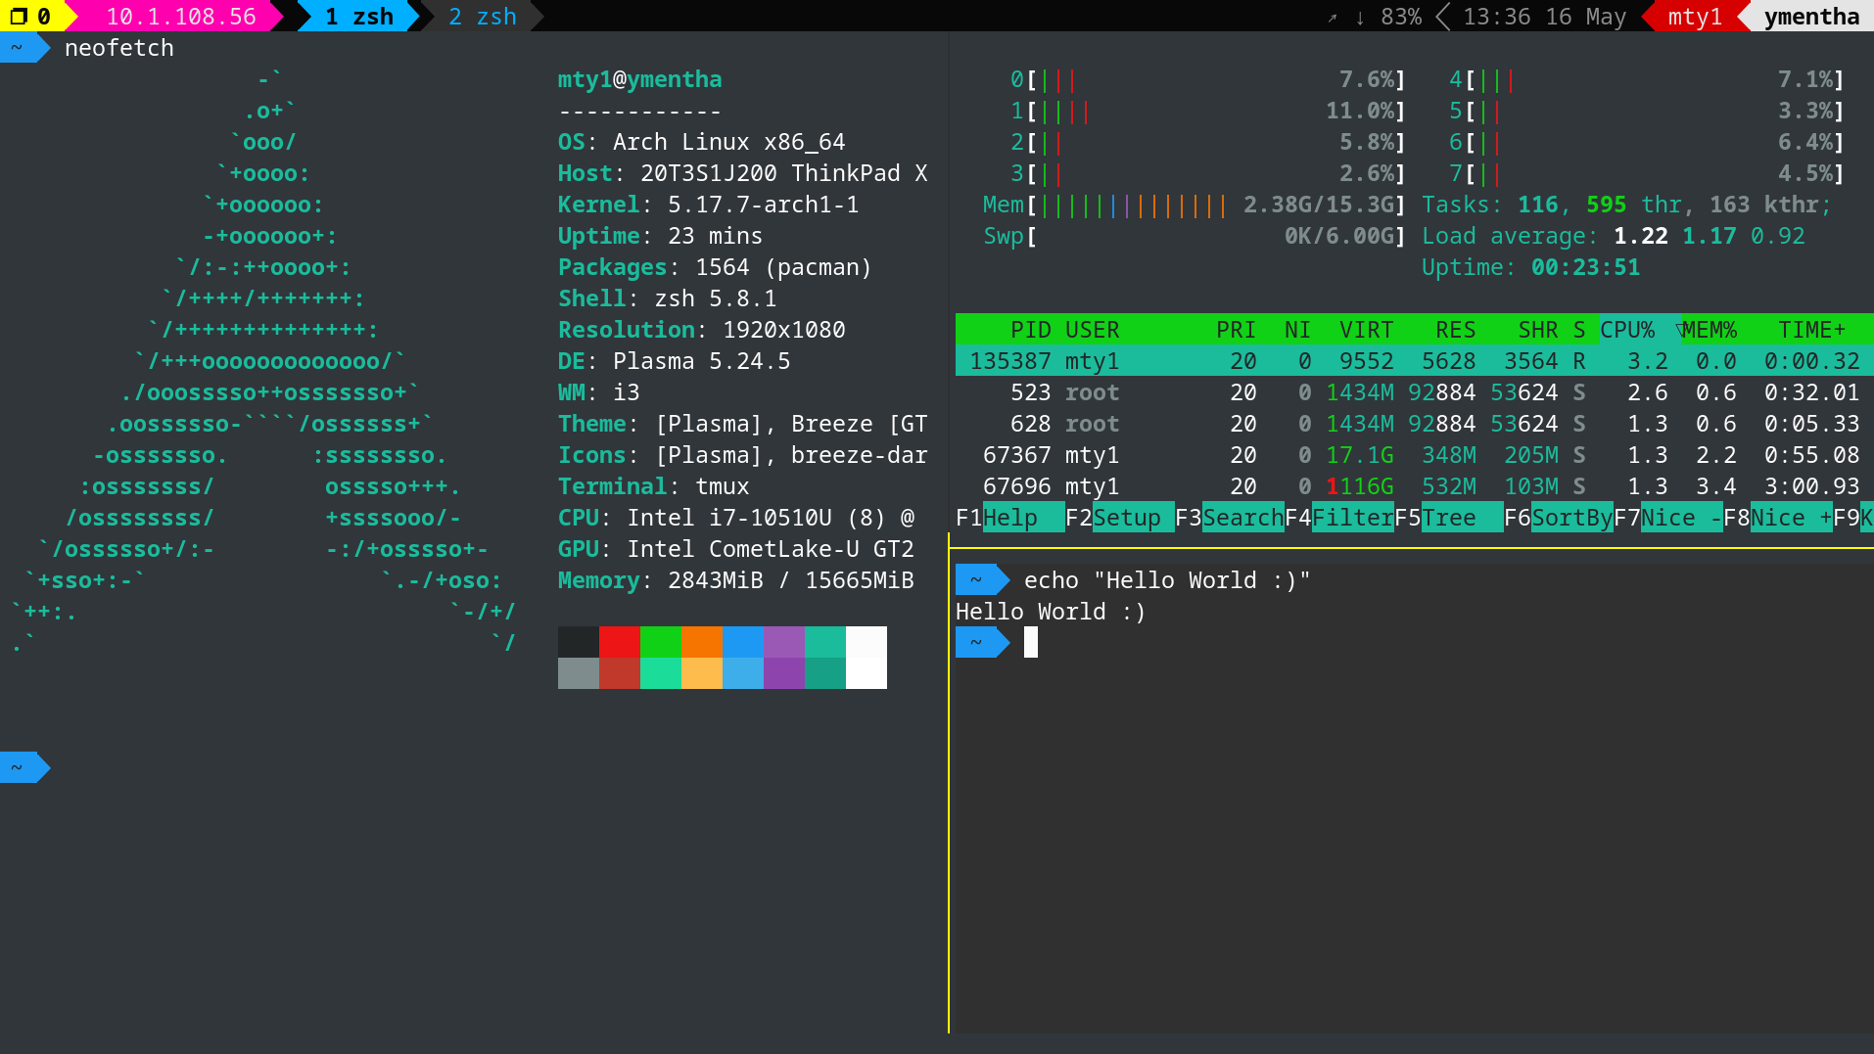
Tmux
Tmux is a terminal multiplexer: it allows you to:
Split a single console into several ones
Has detachable sessions ==> you can leave your code running in the background safely by running CTRL A+D
Notes:
Show example with git aliases

Slide 42
Environment variables
Just like you have variables in a program, you have variables in your shell (since your shell is a program!)
These variables control the flow of your applications
>: export MYVAR=ITSVALUE how to define one
>: echo $MYVAR
The most important ones in our case: $PATH, $PYTHONPATH and $HOME
$HOME is the absolute path to your home directory
$PATH is the list of directories where your shell will look for executable files (even cd, ls or pwd)
$PYTHONPATH is a list of directories where your python interpreter will look for modules (in addition to pip-installed packages)
Pythonpath resource

Slide 43
Development environment

Slide 44
Integrated Development Environments (IDEs)
Guide you in the coding process
Provide a big set of extensions for convenience (bracket pair colorizer, tree-like organisation of files)
Can handle notebook as well!

Slide 45




Integrated Development Environments (IDEs)
VScode (personal recommendation)
PyCharm
Atom
Eclipse

Slide 46
WSL

Slide 47
Linux vs Windows
Why would you prefer to develop on linux over windows?
Most of the support you will find online will be linux-based
The 500 most powerful supercomputers are linux-based
A lot of bfh-server are using on linux => you don't need to learn new commands
And finally.. Windows allows to have linux command line thanks to WSL (windows subsystem for linux) :D

Slide 48
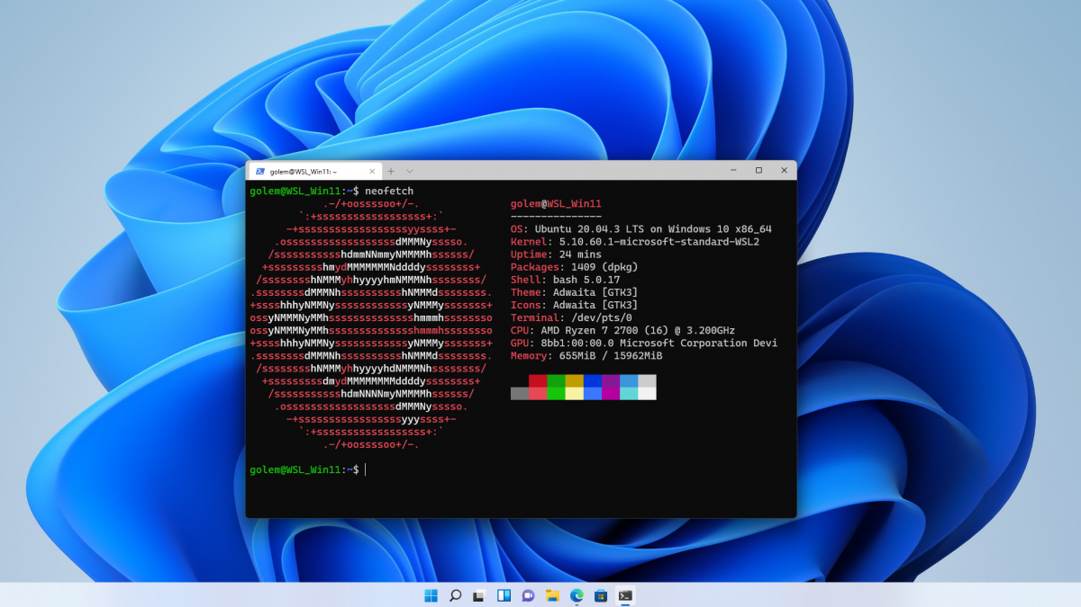
Installing WSL in a few steps
Hit the ⊞ Win key
Type "terminal"
Right-click on it
Click "Run as Administrator"
This should open a command prompt:
In the resulting powershell, type:
$: wsl –-install
Further documentation / help

Slide 49
Installing VScode
Go to: https://code.visualstudio.com/download and follow the installation instructions

Slide 50

SSH tunnel

Slide 51
Some resources
Programming
The Hitchiker's guide to python
Data processing /Machine learning workflow
(Advanced) Design Patterns
Command Line
The art of command line
And especially…..
> > > The missing semester of your computer science education (MIT) < < <
Notes:
Demo: move

Slide 52
Thank you for your attention!

