Slide 1
Herding the Elephants
Yannick Merkli, Tim Bohren, Felix Rüssli
Advisor: Albert Gran Alcoz
Supervisor: Laurent Vanbever

Slide 2
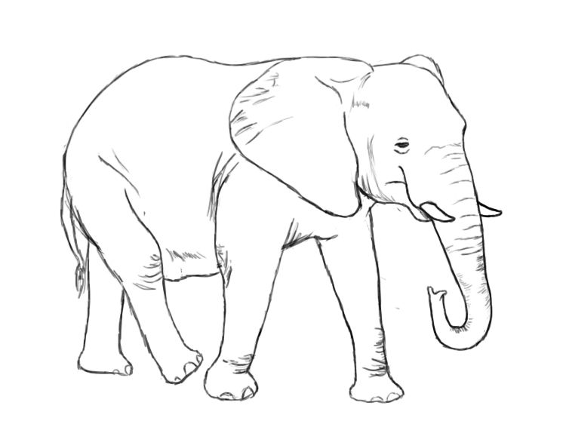
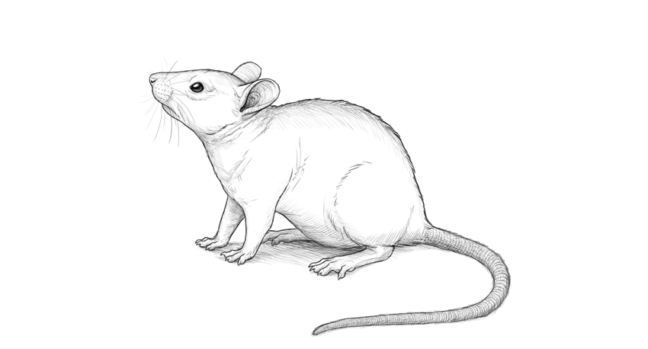
Netword operators need to effectively separate mice from elephant flows
→ seen in exercise 4

Slide 3
Who’s who in the Zoo
elephant
Mouse: small and numerous
Mole: captured by the switch
Mule: reported to the coordinator
Elephant: heavy hitter
≥ report threshold
global coordinator
mule
≥ mule threshold
local ingress switch
mole
mouse

Slide 4
Ingress switches report to the global coordinator
threshold met
➔send report
enough report ➔heavy hitter

Slide 5
Herd saves bandwidth and memory due to probabilistic reporting
elephant
New flows get sampled with probability s
Mules get reported to the coordinator with probability r
mule
reporting
mole
sampling
mouse

Slide 6
What if tables are full
table 1
table 2
table 1
table 2
flow1 | 9
flow13 | 5
flow99 | 13
flow45 | 1
flow10 | 1
Flow5 | 8
flow83 | 15
flow3 | 5
flow77 | 1
Reset hash tables

Slide 7
Most flows exhibit spatial locality

Slide 8
Test topology
sw1
sw2
h1
LB
sw3
AG
h1
sw4
sw5

Slide 9
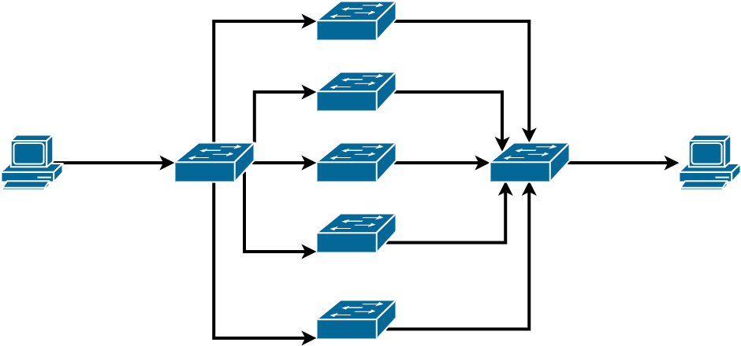
Test topology
sw1
sw2
h1
h2
lb
sw3
ag
sw4
sw5

Slide 10
Evaluation

Slide 11
Challenges
scapy and copy-to-cpu too slow, especially with the load-balancing
MAC not available
pcap too long
Load balancing
Random distribution
Communication between l2controller and coordinator is asynchronous

Slide 12
Herding the Elephants
Yannick Merkli, Tim Bohren, Felix Rüssli
Advisor: Albert Gran Alcoz
Supervisor: Laurent Vanbever

