Slide 1
Herding the Elephants Detecting Network-Wide Heavy Hitters with Limited Resources
Yannick Merkli, Tim Bohren, Felix Rüssli
Advisor: Albert Gran Alcoz
Supervisor: Laurent Vanbever

Slide 2



Network operators need to effectively separate small flows from large flows
Detect Denial-of-Service attacks
Optimize network by detecting congestion and failures
Usage based pricing
$$flow=(srcIP, dstIP, srcPort, dstPort, protocol)$$

Slide 3
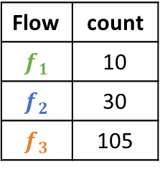
Just measure each flow on the switch…
Flow | count
$$f_{1}$$ | 10
$$f_{2}$$ | 30
$$f_{3}$$ | 105
Heavy hitters exceed some threshold of packets or bytes
Network switches are constrained in memory and computation
Measuring each flow is infeasible
Prior work focused heavy hitter detection on a single switch under these constraints
> 100

Slide 4
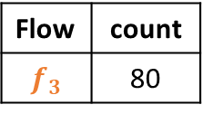
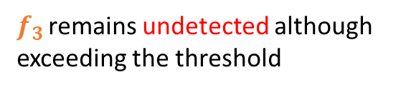
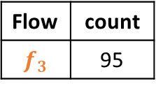

Reality is more complicated
Flow | count
$$f_{3}$$ | 90
Real networks consist of multiple ingress switches
Heavy hitters are often network-wide
Heavy hitter detection on a single switch is not enough
We need coordination among network switches for network-wide detection
Flow | count
$$f_{3}$$ | 80
Detect flows with count > 100
Flow | count
$$f_{3}$$ | 95
$f_{3}$ remains undetected although exceeding the threshold
Herd tries to solve network-wide detection under resource constraints

Slide 5

Herd is a distributed technique to detect network-wide heavy hitters under resource constraints
Communication
Ingress switches
Coordinator
use probabilistic sample-and-hold for flows → less switch memory
probabilistically report to the coordinator → less communication overhead
combines partial information to attain a global view of the network
detects heavy hitter flows

Slide 6


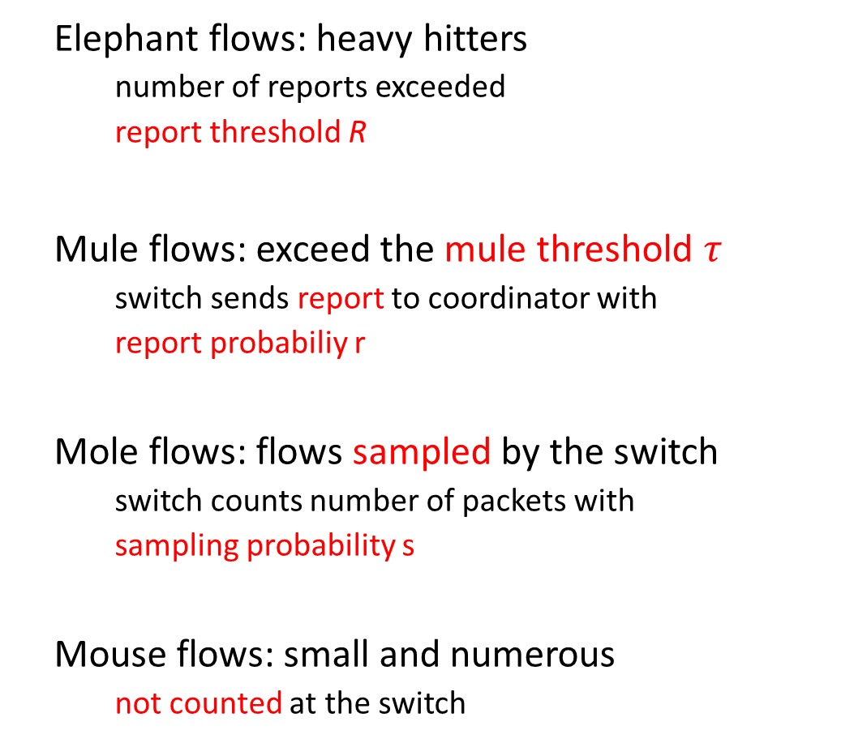
Who’s who in the Zoo
elephant
Elephant flows: heavy hitters
number of reports exceeded
report threshold R
Mule flows: exceed the mule threshold $τ$
switch sends report to coordinator with
report probabiliy r
Mole flows: flows sampled by the switch
switch counts number of packets with
sampling probability s
Mouse flows: small and numerous
not counted at the switch
central coordinator
mule
local ingress switch
mole
mouse

Slide 7
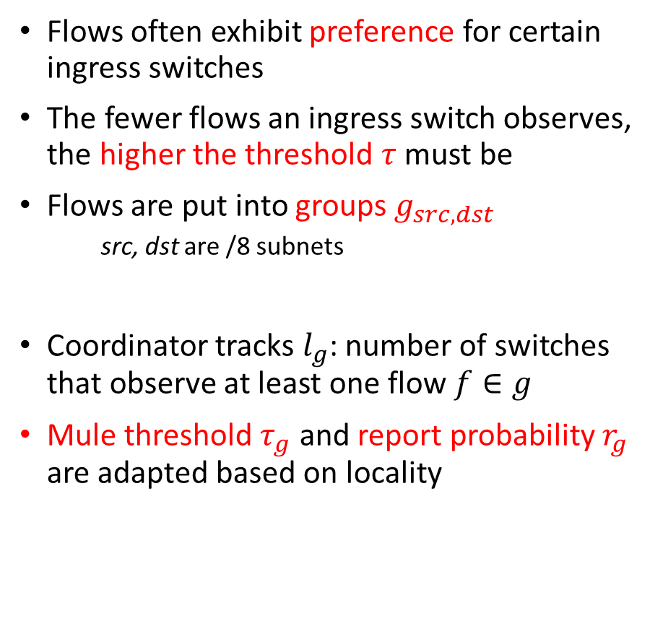
Most flows exhibit spatial locality
Flows often exhibit preference for certain ingress switches
The fewer flows an ingress switch observes, the higher the threshold $τ$ must be
Flows are put into groups $g_{src,dst}$
src, dst are /8 subnets
Coordinator tracks $l_{g}$: number of switches that observe at least one flow $f∈g$
Mule threshold $τ_{g}$ and report probability $r_{g}$ are adapted based on locality

Slide 8





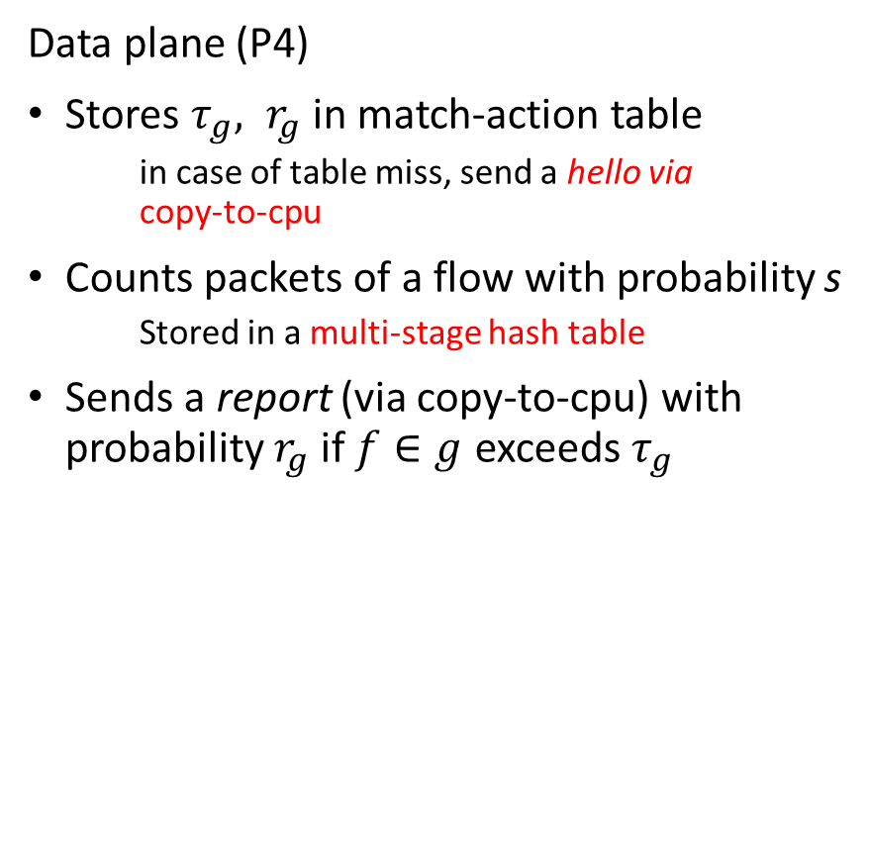






Ingress switches probabilistically sample and report flows
Data plane (P4)
Stores $τ_{g}, r_{g}$ in match-action table
in case of table miss, send a hello via copy-to-cpu
Counts packets of a flow with probability s
Stored in a multi-stage hash table
Sends a report (via copy-to-cpu) with probability $r_{g}$ if $f∈g$ exceeds $τ_{g}$
Control plane (Python)
Sends hellos and reports to coordinator by invoking remote procedure calls
Receives locality parameter $l_{g}$ via callback
Calculates and writes $τ_{g}, r_{g}$ into match-action table
copy-to-cpu
Flow count table
Group values MAT
$$hello(f)$$
$$send_hello(f)$$
$$hash(f)$$
$$g$$
$$τ_{g} r_{g}$$
$$report (f)$$
unpack
$$send_report (f)$$
$$count(f)$$
$$hello_callback(l_{g})$$
$$τ_{g}, r_{g}$$
table_add
Data plane
Control plane

Slide 9
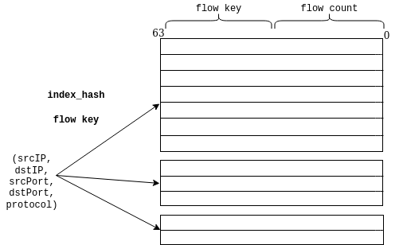
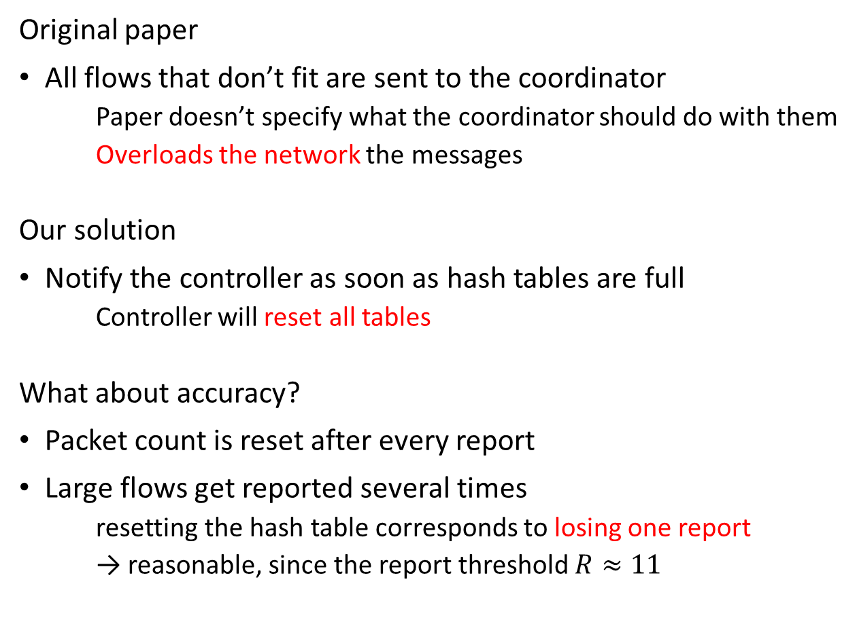
What if the multi-stage hash table is full?
Original paper
All flows that don’t fit are sent to the coordinator
Paper doesn’t specify what the coordinator should do with them
Overloads the network the messages
Our solution
Notify the controller as soon as hash tables are full
Controller will reset all tables
What about accuracy?
Packet count is reset after every report
Large flows get reported several times
resetting the hash table corresponds to losing one report
→ reasonable, since the report threshold $R≈11$

Slide 10










Coordinator tracks locality and number of report per flow
Server with an exposed RPC service for sending hellos and reports
Combines partial information to calculate and store locality parameters $l_{g}$
Dynamically updates $l_{g}$ on switches via callback functions
Tracks the number of reports for each flow f
Detects heavy hitters based on report threshold R
Locality table
Report counts
$$send_hello(f)$$
$$l_{g}$$
$$f$$
$$g$$
$$reports(f)$$
$$reports\left(f\right)≥R$$
$$hello_callback(l_{g})$$
label $f$ as heavy hitter
$$send_report (f)$$
Coordinator

Slide 11
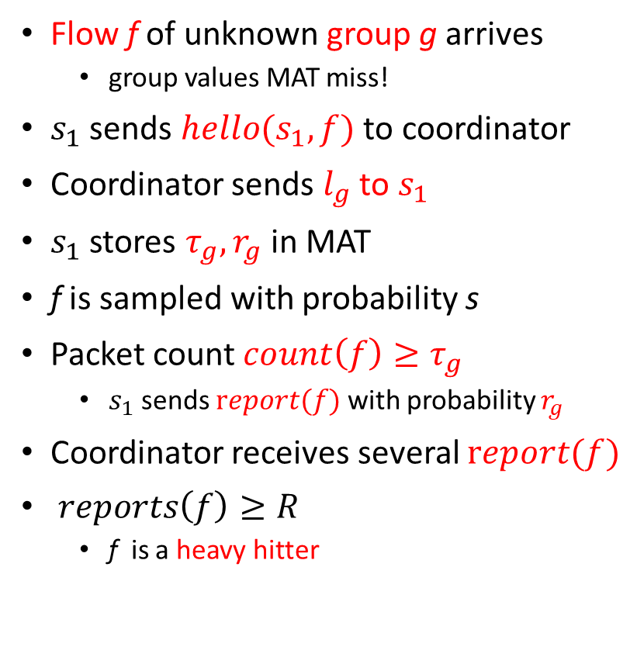









Ingress switches communicate with the coordinator
external
internal
Flow f of unknown group g arrives
group values MAT miss!
$s_{1}$ sends $hello(s_{1},f)$ to coordinator
Coordinator sends $l_{g}$ to $s_{1}$
$s_{1}$ stores ${τ_{g}, r}_{g}$ in MAT
f is sampled with probability s
Packet count $count\left(f\right)≥τ_{g}$
$s_{1}$ sends $report(f)$ with probability $r_{g}$
Coordinator receives several $report(f)$
$reports\left(f\right)≥R$
f is a heavy hitter
$$report(f)$$
Coordinator
group values MAT
$$hello(s_{1}, f)$$
$$report(f)$$
g ${{ τ}_{g}, r}_{g}$
$$reports\left(f\right)+=1$$
$$l_{g}$$
$$report(f)$$
f
f
f
f
f
$$s_{1}$$
$$count(f)$$
Multi-stage hash table

Slide 12
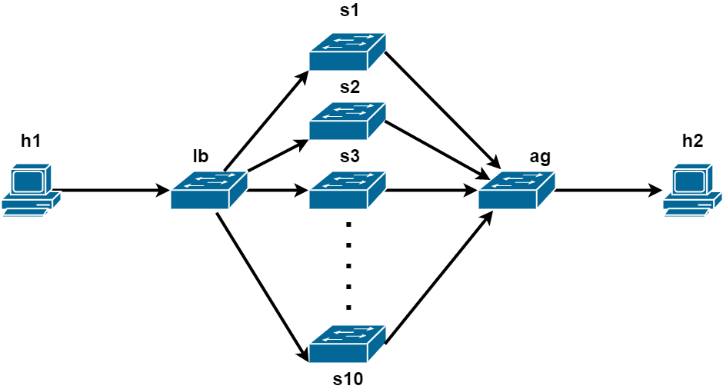
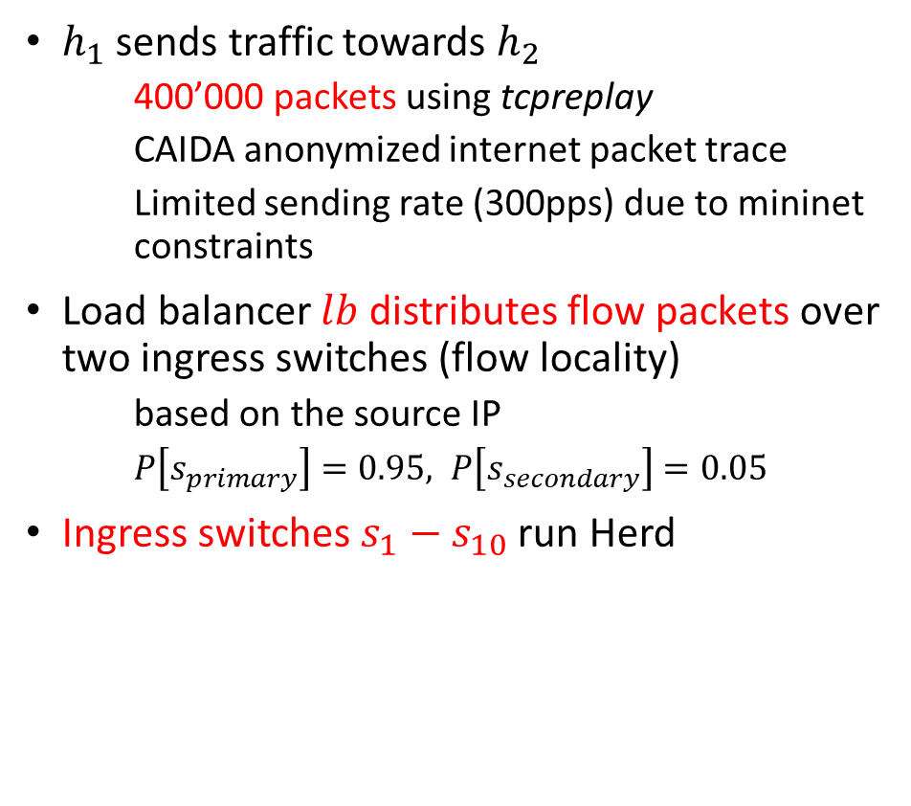
The evaluation topology is representative of a wide-area network
$h_{1}$ sends traffic towards $h_{2}$
400’000 packets using tcpreplay
CAIDA anonymized internet packet trace
Limited sending rate (300pps) due to mininet constraints
Load balancer $lb$ distributes flow packets over two ingress switches (flow locality)
based on the source IP
$P\left[s_{primary}\right]=0.95, P\left[s_{secondary}\right]=0.05$
Ingress switches $s_{1}−s_{10}$ run Herd

Slide 13
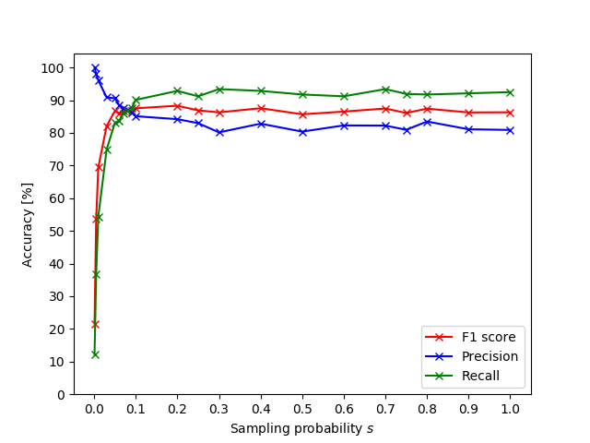
Herd(s=0.1) achieves the same detection accuracy as a protocol that samples every flow (s=1.0)
Herd(s=0.1) achieves 87% F1 score
Herd(s=1.0) achieves 86% F1 score
needs 10x more switch memory than Herd(s=0.1)
Successfully proves that Herd works under switch memory constraints
The decrease in precision can be explained with the static report threshold R

Slide 14
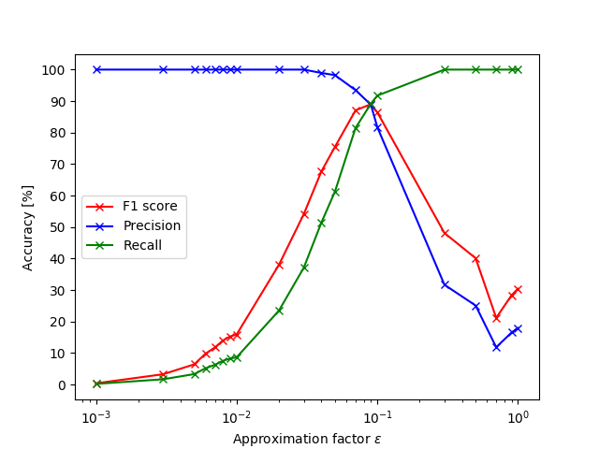

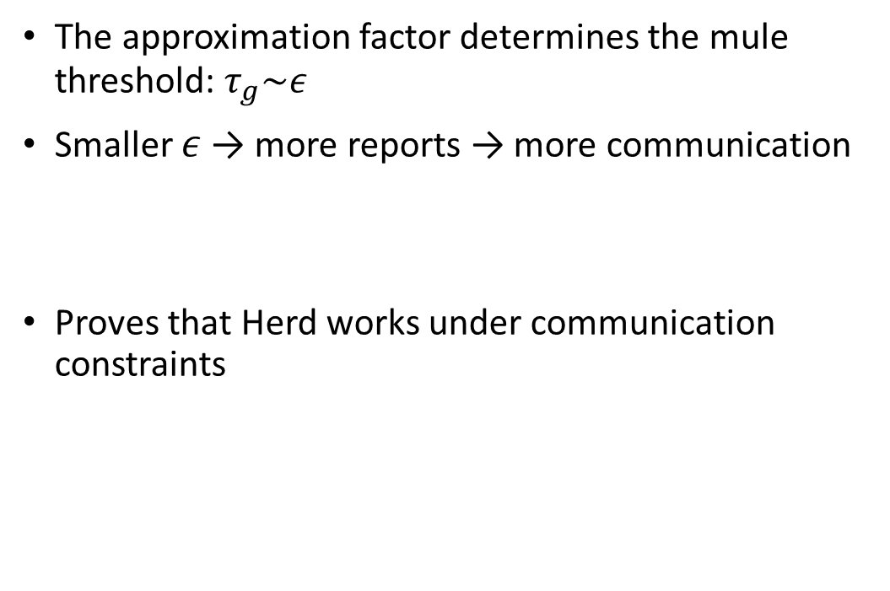
Herd achieves maximal detection accuracy for an approximation factor $ε=0.09$
The approximation factor determines the mule threshold: $τ_{g}\sim ε$
Smaller $ε$ → more reports → more communication
Proves that Herd works under communication constraints

Slide 15
Challenges
Limited sending rate
Delay between sending a hello to writing to MAT
Load balancer started dropping packets at 400pps
Original paper
Often vague and omits crucial details
Authors stress importance of tuning parameters, but their algorithm is flawed
Notes:
Speed issue in 3 points (3 types of delay), whole sentences

Slide 16
Conclusion
We were able to reproduce the main claims of Herd, namely it working under resource constraints.
Future work
Improve parameter tuning
Dynamically adjust parameters

Slide 17
Demo

Slide 18
Questions?

Slide 19
Herding the Elephants Detecting Network-Wide Heavy Hitters with Limited Resources
Yannick Merkli, Tim Bohren, Felix Rüssli
Advisor: Albert Gran Alcoz
Supervisor: Laurent Vanbever

Slide 20
Herding the Elephants Detecting Network-Wide Heavy Hitters with Limited Resources
Yannick Merkli, Tim Bohren, Felix Rüssli
Advisor: Albert Gran Alcoz
Supervisor: Laurent Vanbever

Slide 21
Herding the Elephants Detecting Network-Wide Heavy Hitters with Limited Resources
Yannick Merkli, Tim Bohren, Felix Rüssli
Advisor: Albert Gran Alcoz
Supervisor: Laurent Vanbever

