Slide 1
Herding the Elephants
Yannick Merkli, Tim Bohren, Felix Rüssli
Advisor: Albert Gran Alcoz
Supervisor: Laurent Vanbever

Slide 2
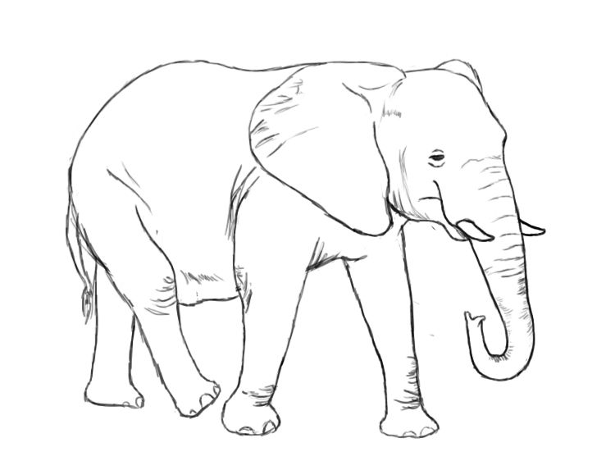
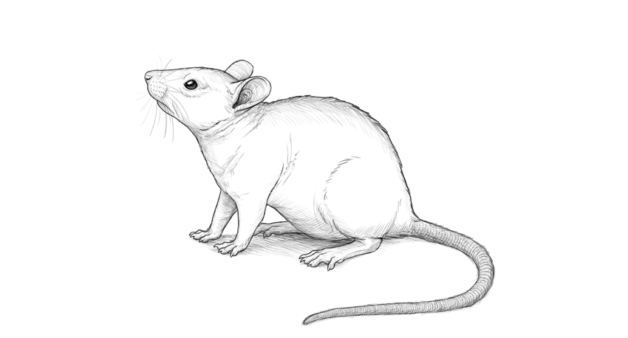
Netword operators need to effectively separate mice from elephant flows
→ seen in exercise 4

Slide 3
Who’s who in the Zoo
elephant
Mouse: small and numerous
Mole: captured by the switch
Mule: reported to the coordinator
Elephant: heavy hitter
≥ report threshold
global coordinator
mule
≥ mule threshold
local ingress switch
mole
mouse

Slide 4
Ingress switches report to the global coordinator
threshold met
➔send report
enough report ➔heavy hitter

Slide 5
Herd saves bandwidth and memory due to probabilistic reporting
elephant
New flows get sampled with probability s
Mules get reported to the coordinator with probability r
mule
reporting
mole
sampling
mouse

Slide 6
What if tables are full
table 1
table 2
table 1
table 2
flow1 | 9
flow13 | 5
flow99 | 13
flow45 | 1
flow10 | 1
Flow5 | 8
flow83 | 15
flow3 | 5
flow77 | 1
Reset hash tables

Slide 7
Most flows exhibit spatial locality

Slide 8
Test topology
sw1
sw2
h1
LB
sw3
AG
h1
sw4
sw5

Slide 9
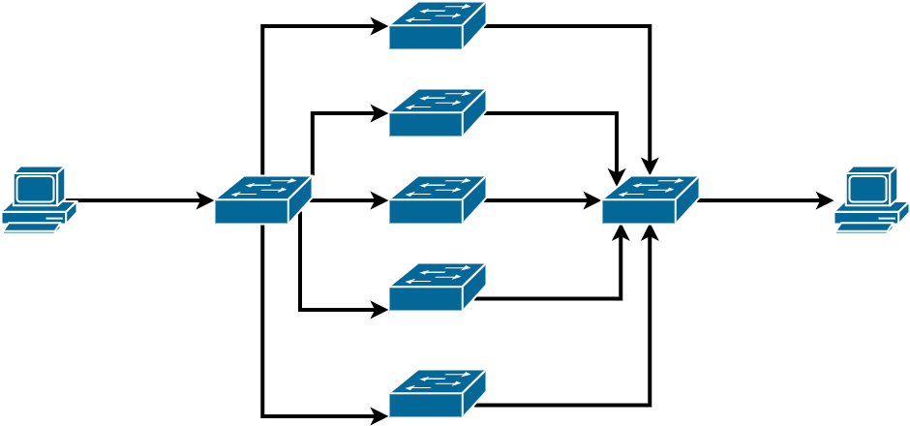
Test topology
sw1
sw2
h1
h2
lb
sw3
ag
sw4
sw5

Slide 10
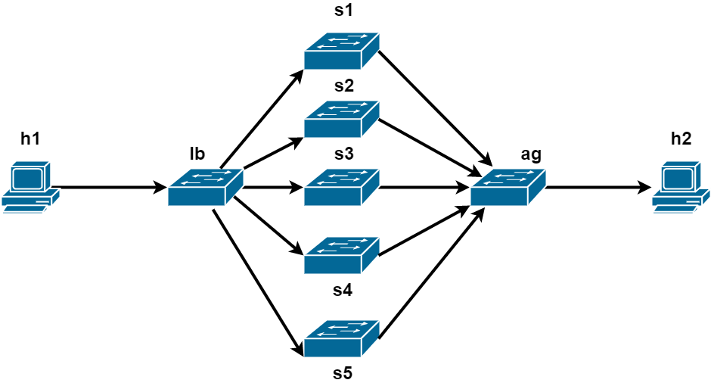
Test topology

Slide 11
Evaluation

Slide 12
Challenges
scapy and copy-to-cpu too slow, especially with the load-balancing
MAC not available
pcap files are very big
Load balancing
Random distribution
Communication between l2controller and coordinator is asynchronous

Slide 13
Herding the Elephants
Yannick Merkli, Tim Bohren, Felix Rüssli
Advisor: Albert Gran Alcoz
Supervisor: Laurent Vanbever

