Slide 1
Vehicle Classifier And Plate Recognition OJT version 3.0.1
12 Oktober 2020
CORPORATE INFORMATION SYSTEMS & TECHNOLOGY
Notes:
Assalamu’alaykum wr wb,
Selamat pagi, salam sejahtera untuk kita semua.
Sebelumnya, kami ucapkan terima kasih kepada Bapak/Ibu Dari Agit maupun AI, yang telah memberikan waktu kepada saya untuk berada disini mempresentasikan terkait role, responsibility, dan improvement seama saya berada disini.

Slide 2
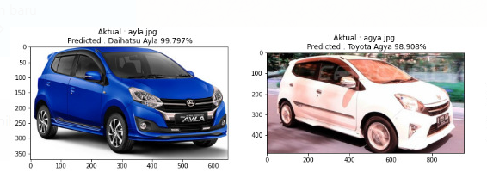
Goals
Dataset Cleansing
Can classify car make model and color.
Can recognize License Plat number
First Cleansing is deleting non car image from dataset that we get from scraping
Second Cleansing is used for extracting car object, to increase the accuracy by deleting background using YOLO
Vehicle Classification
Modeling
Method that we use is CNN for image classification using transfer learning
Technology Used
Accuracy
Python
Tensorflow
Keras
NumPy
OpenCV
Robotframework
OpenALPR
Selenium
Flask
Dataset | Accuracy (VMMRDB Dataset) | Accuracy (Custom Dataset)
Train | 97% | 99%
Validation | 83% | 91%
Testing | 80% | 93%
Dataset Scraping
Image scraping is done using robotframework-selenium library
Image scraped on these websites : https://www.mobil123.com/ , https://www.oto.com/ , https://www.mobil88.astra.co.id/ , http://garasi.id/

Slide 3
Flow Program
Configuration
Data Preparation
Modeling
Web Service
OpenALPR
YOLO
Google Drive
Install Requirement
Scraping
Cleansing Data
Train Model
Update Model
JSON
Get License Plate Number
Get Car Color
OpenALPR
Color Recognition
OpenALPR
Color Recognition
OpenALPR is an open source Automatic License Plate Recognition library. The library analyzes images and video streams to identify license plates. The output is the text representation of any license plate characters.
We use an existing model spectrico which is free to use for Enterprise. It consists of an object detector for finding the cars, and a classifier to recognize the colors of the detected cars. The object detector is an implementation of YOLOv3

Slide 4
Terima Kasih

