Slide 1
Firefox OS Architecture - Terminlogy
Gaia – the user interface of b2g, written in HTML, CSS and JavaScript
Gecko – application runtime, implements Web stack
Gonk – lower-level of b2g, consist Linux kernel and HAL (libusb, BlueZ ..). Simple Linux Distribution

Slide 2
Booting
After turning on a b2g phone, execution starts on primary bootloader
From there the process is usual to Linux – bootloaders bootstrap the next loader in the chain
At the end of of the process, execution is handed off to the Linux kernel
First show splash screen
Different protocols – fastboot, odin

Slide 3
Kernel (Linux)
The Linux kernel is Gonk
Close to stock
At the end of kernel startup, a userspace “init” process is launched
After init process, Linux kernel services system calls from userspace and interrupts

Slide 4
init process
Handles mounting the require file systems
Spawns system services
After that, it stays around to serve as process manager
It interprets scripts (init*.rc files) that consists commands describing what should be done to start various services
Firefox OS init.rc is typically the stock Android init.rc

Slide 5
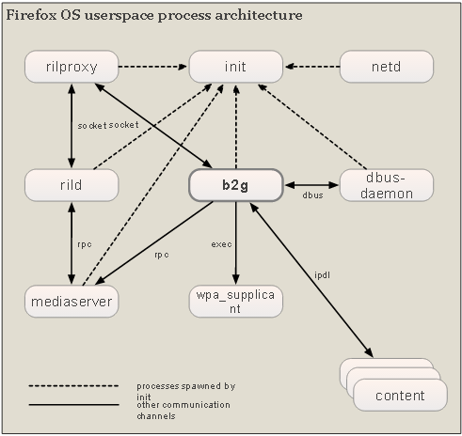
Userspace process architecture
High-level look at how the various components of Firefox OS fit together and interact with one
another.

Slide 6
b2g
Spawn number of low-rights content processes
These processes are where web applications and content loaded.
Communicate with the main Gecko server process through IPLD, a message-passing system

Slide 7
rild
Interface to the modem processor
Daemon that implements the Radio Interface Layer (RIL).
Piece of code that's implemented by the hardware vendor to talk to their modem hardware

Slide 8
rildproxy
rild client is the rildproxy process
This acts as a forwarding proxy between rild and b2g

Slide 9
mediaserver
Controls audio and video playback
Gecko talks to it through an Android Remote Procedure Call (RPC) mechanism.
Some of the media that Gecko can play are decoded by Gecko and send directly to the mediaserver process.
Other media files are decoded by libstagefight which is capable of accessing codecs and hardware encoders

Slide 10
netid
wpa_supplicant
dbus-daemon
Used to configure network interfaces
Standart UNIX-style daemon that handles connectivity with Wi-Fi acces points
The dbus-daemon implements D-Bus, a message bus system that Firefox OS uses for Bluetooth communication

Slide 11
Gecko
Implementation of Web standards
Implement everything that user sees
Most action inside Gecko is triggered by user actions. These actions are represented by input events.
These events enter Gecko through the Gonk implementation of nslAppShell

Slide 12
Hardware Abstraction Layer
One of the porting layers of Gecko
Handles low-level access to system interfaces across multiple platforms using C++ APIs
These APIs are implemented on a per-platform basis inside the Gecko HAL itself
This hardware abstraction layer is not exposed directly to JavaScript code in Gecko

