Slide 1
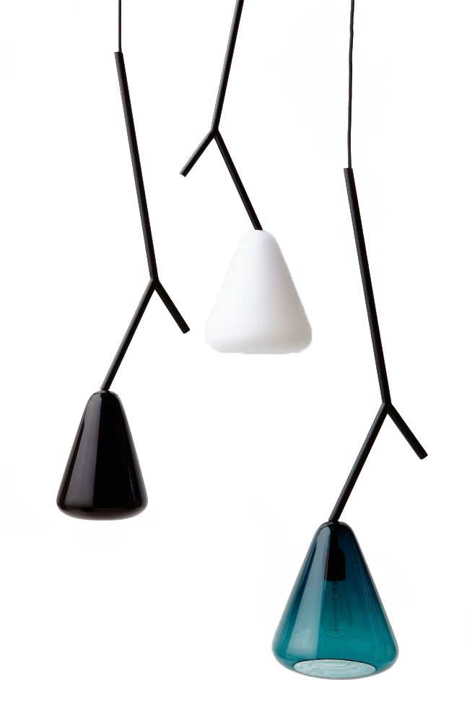
SWS3021 GROUP4
Soft Actor Critic Network
Adaptive Bitrate Algorithm
Group Members：
Yu Xiangrui
Liang Yibo
Guo Zhonghan
2022year-end summary work in these 15 days

Slide 2
SAC ABR
CONTENTS
Result
Theory
Challenge
Improvement

Slide 3
First Part
The result of our work
We test our work in 4different network conditions, and uses 5 video trace

Slide 4
Result
Good Results in specific circumstances

Slide 5
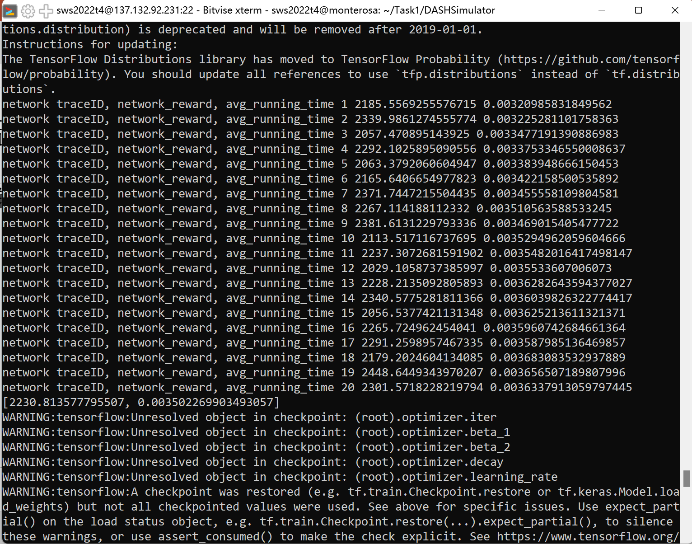

Slide 6
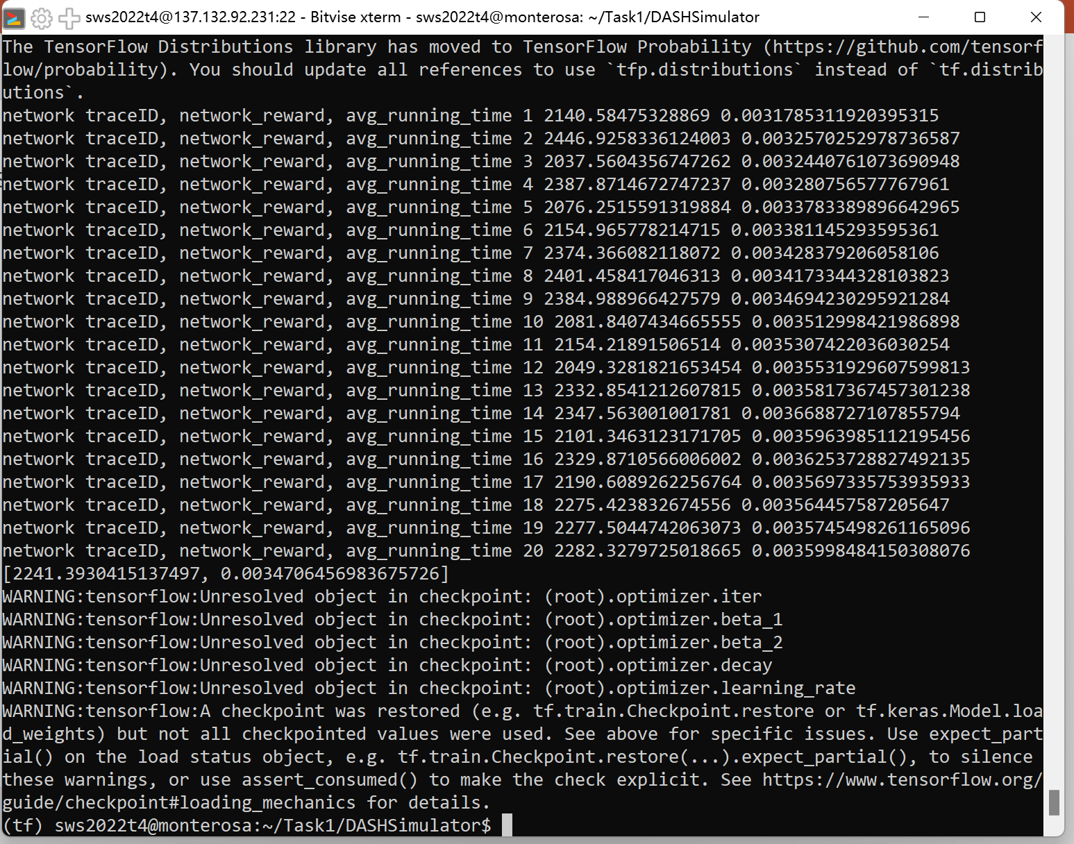

Slide 7
Result
Some bad results

Slide 8
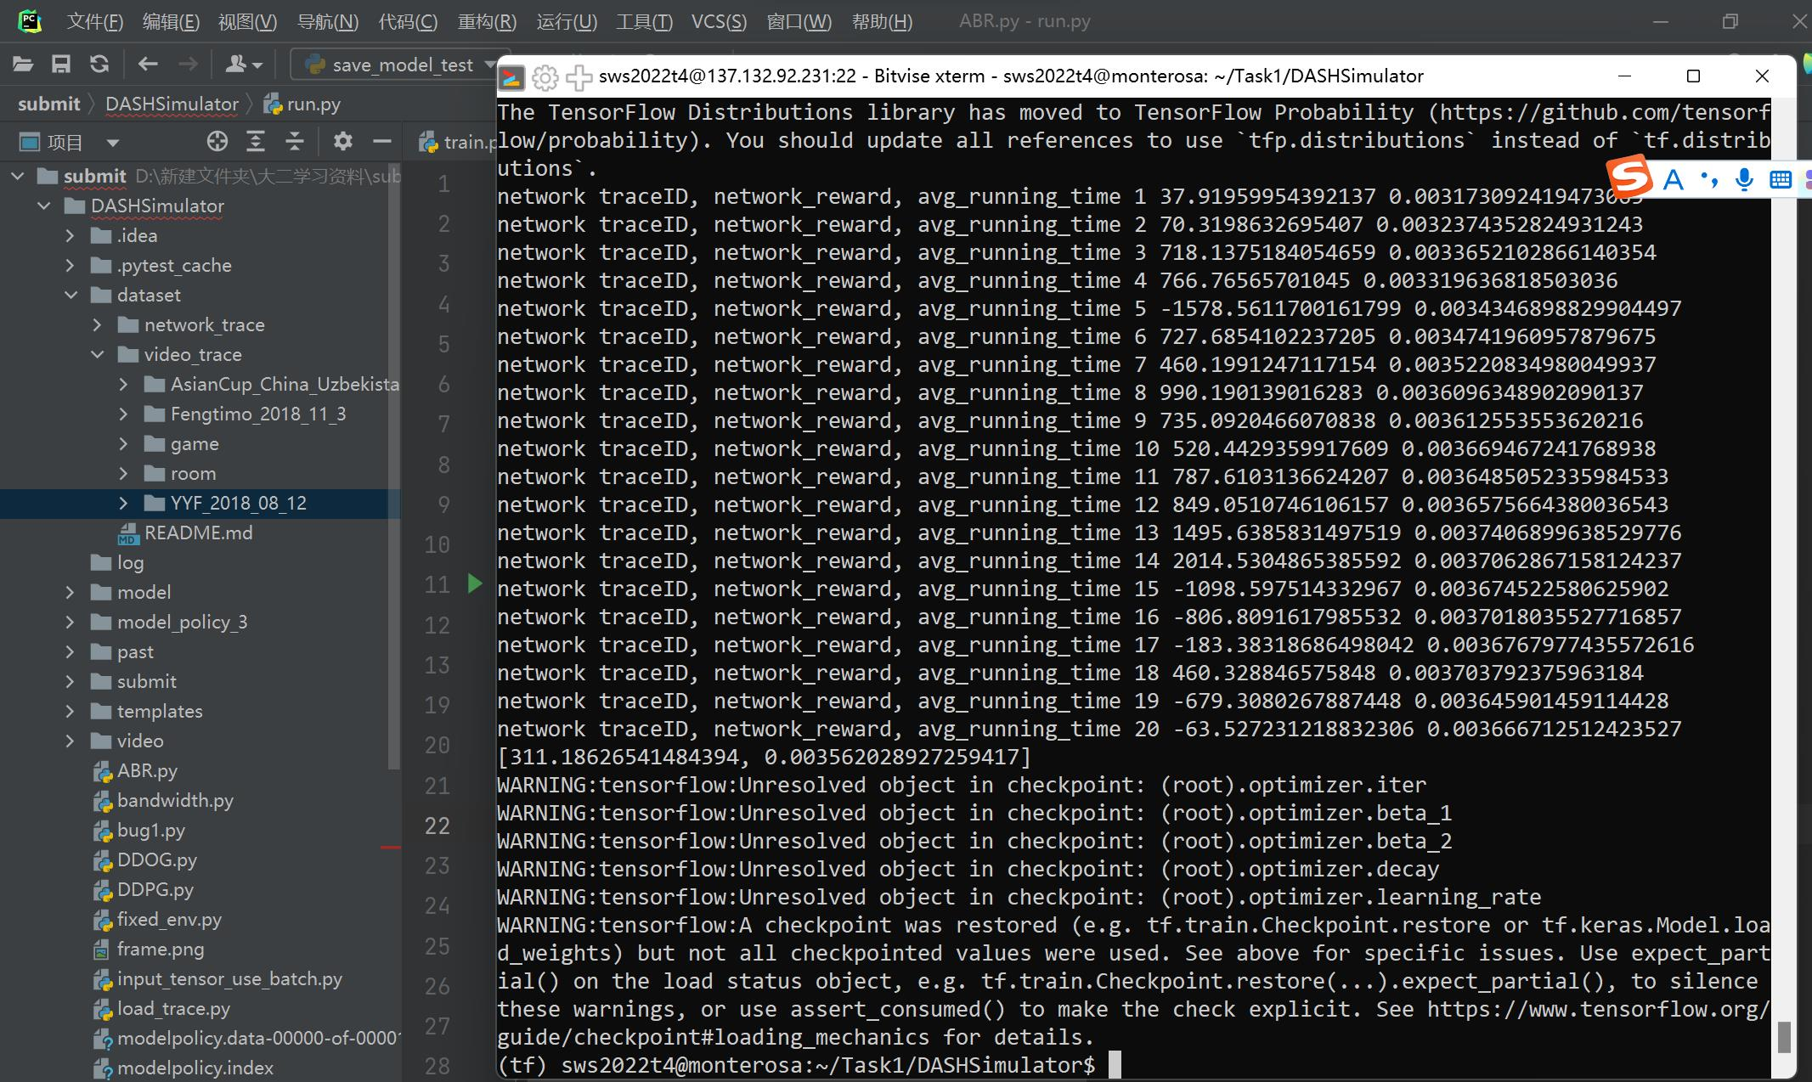

Slide 9
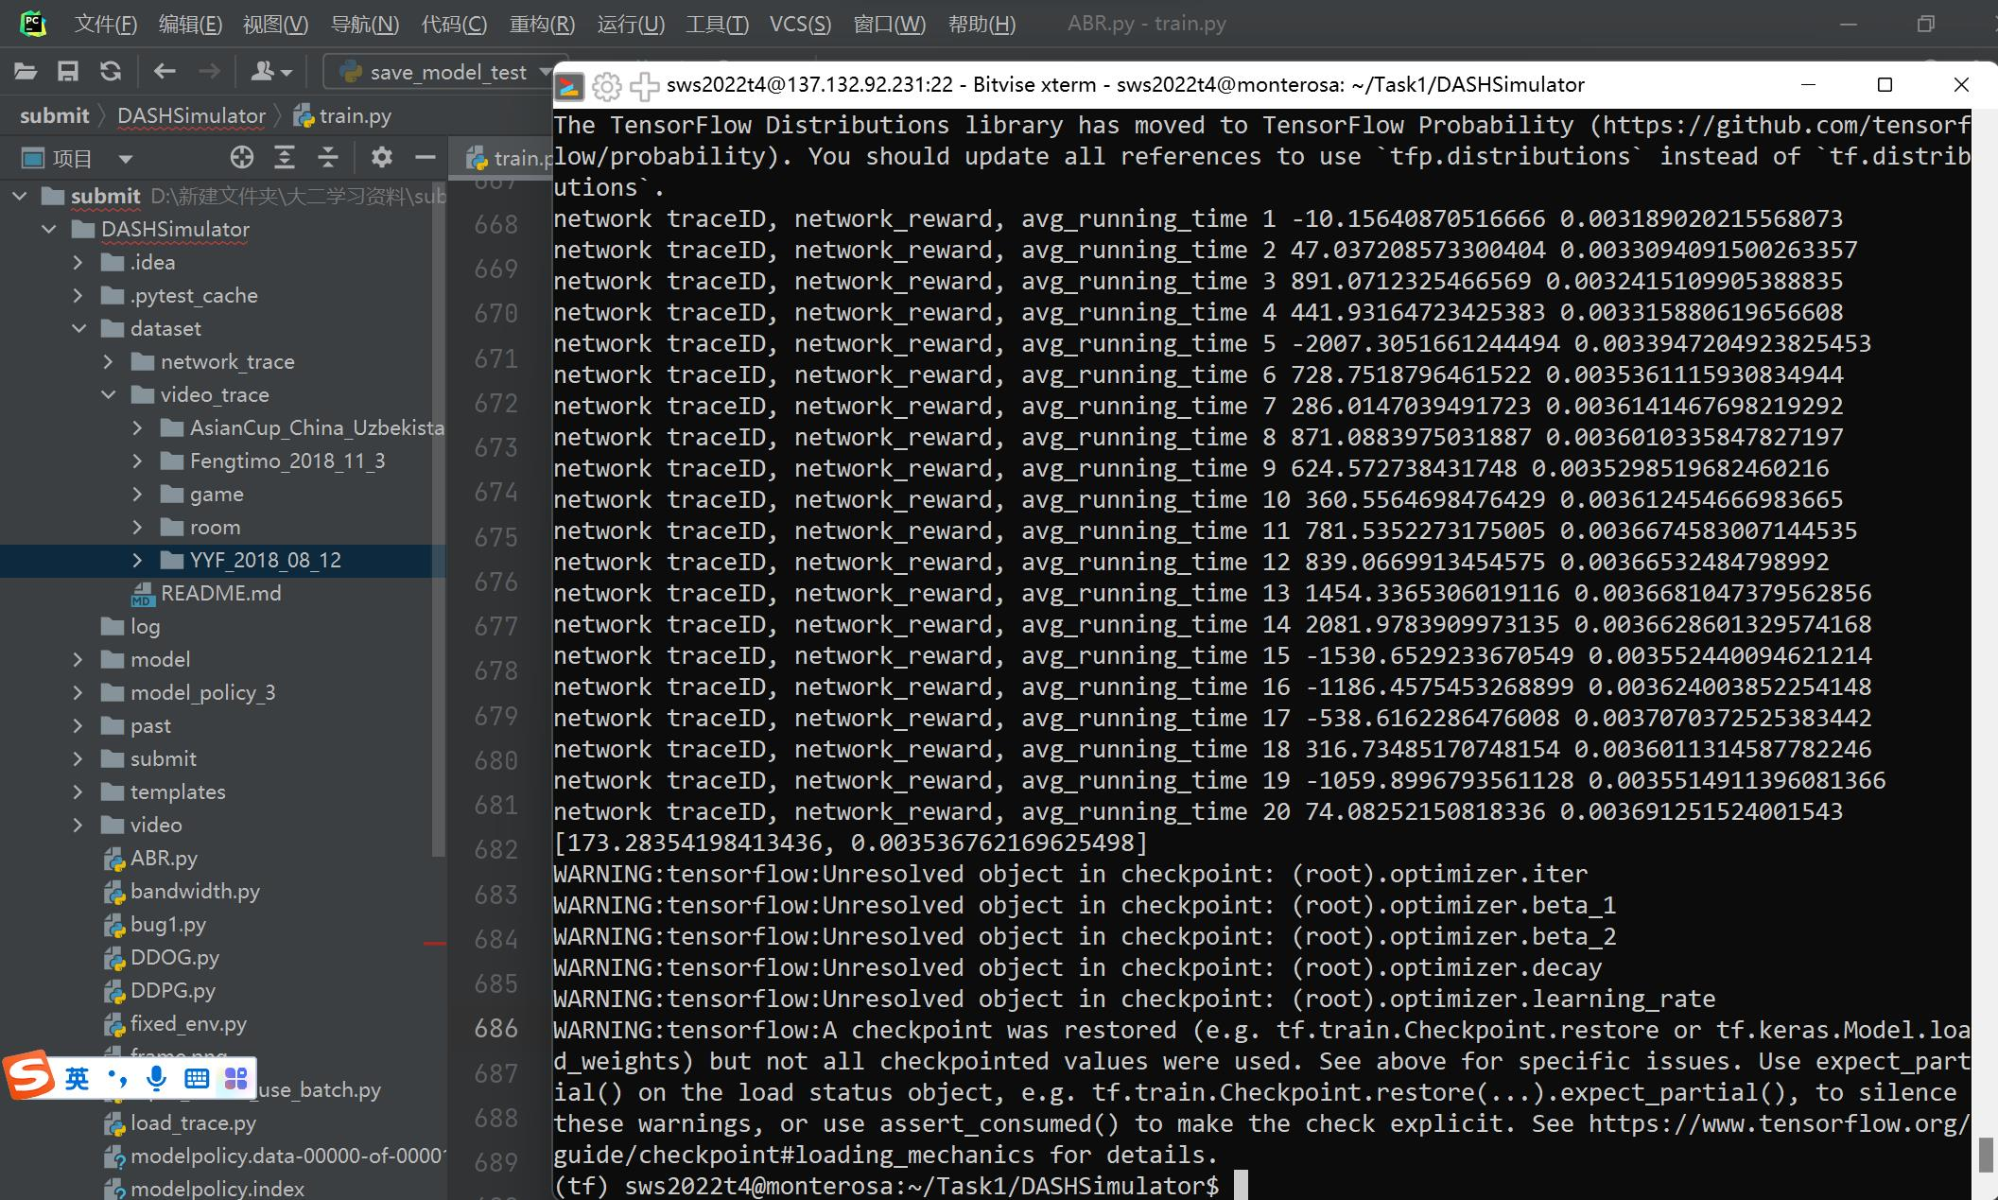

Slide 10
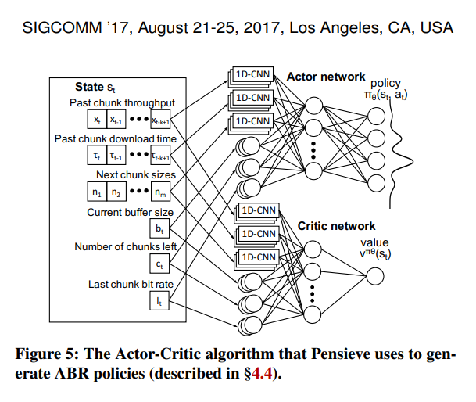
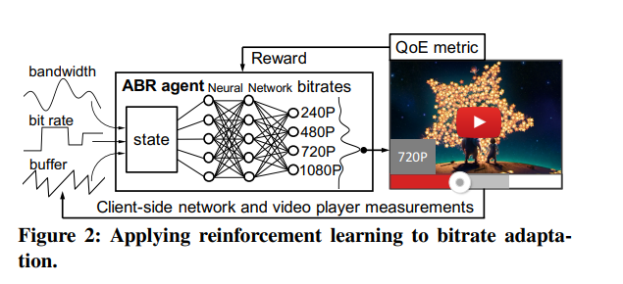
The Original Idea
Neural Adaptive Video Streaming with Pensieve Hongzi Mao, Ravi Netravali, Mohammad Alizadeh MIT Computer Science and Artificial Intelligence Laboratory {hongzi,ravinet,alizadeh}@mit.edu

Slide 11
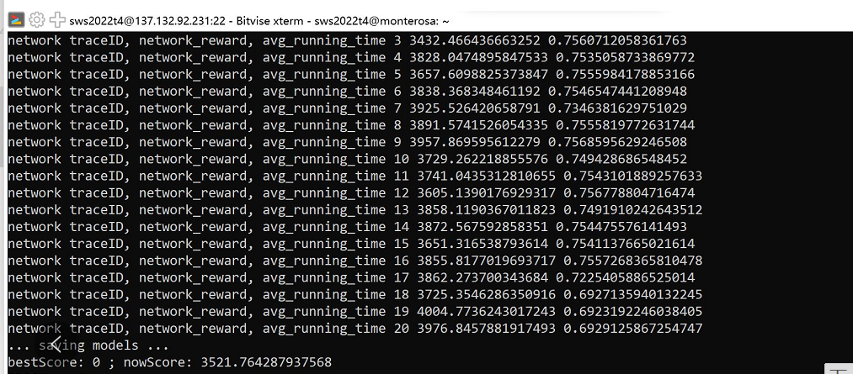

Slide 12
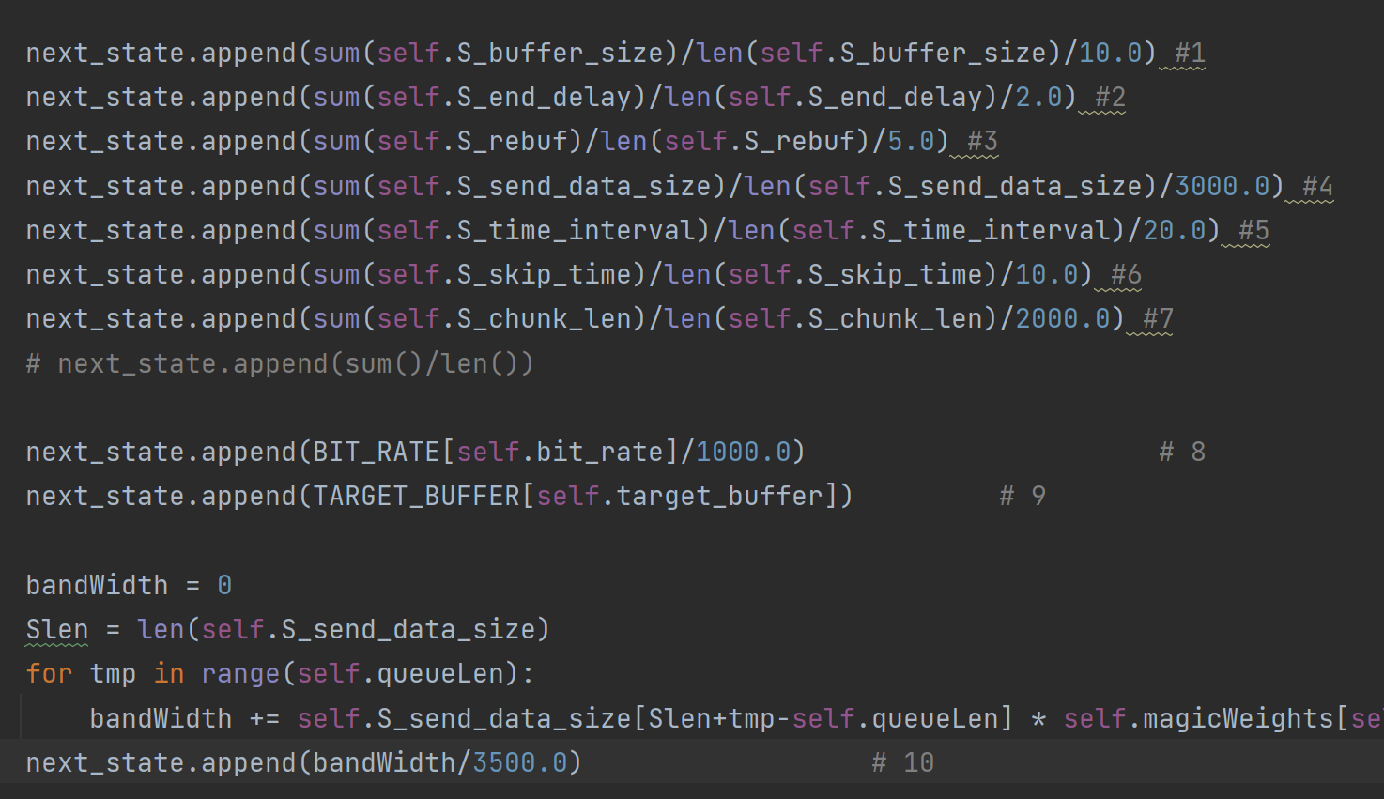
10 inputs

Slide 13
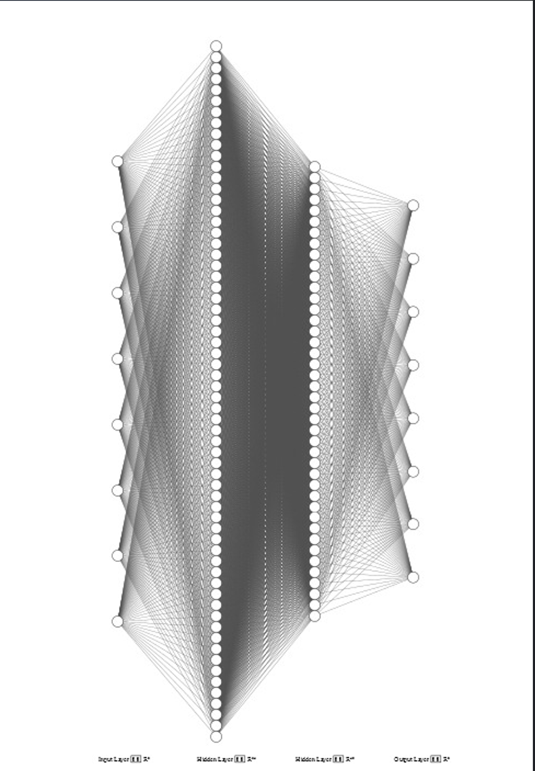
Action_Probs
State
Argmanx/ Sample
Posible Q_Value
Q_Value

Slide 14
Challenges and Improvements
Initialization and training issue
Limited training time
Normalization Issue
Speed

Slide 15
Thanks for listening

