Slide 1
SIMCOM EAT

Slide 2
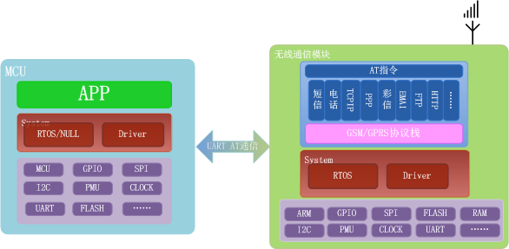
Embedded AT 技术简介
为什么使用Embedded AT？ 充分利用SIM800无线模块的资源，将原本需要外部MCU完成的程序移植内嵌到无线模块内部，以达到节约成本的目的。利用RTOS的多线程，消息等技术，开发更高效。利用硬件的API接口，减少开发难度。
Notes:
文档，demo示例，app编译环境

Slide 3
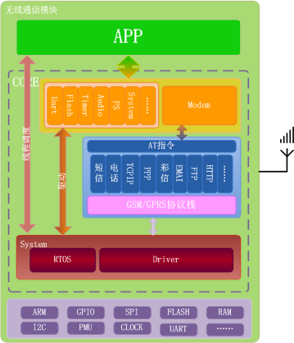
Embedded AT 技术简介

Slide 4
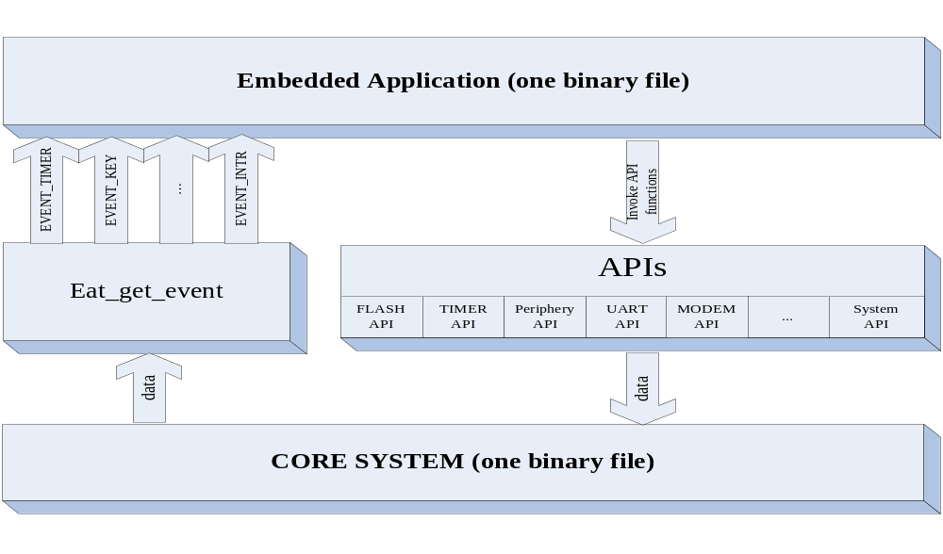
Embedded AT软件架构
General Software Architecture

Slide 5
Embedded AT 主要硬件特性(800H)
ARM7EJ-S run at 360MHz
Module flash 4MB
User locatable resource:
  - 500KByte of RAM memory
  - 1.3MByte of code memory (flash)
  - 300KByte of file system
Supports up to 29 GPIO pins*, 5 GPIO INT
Periphery Interface
  -1 SPI/Display interface or SD card interface
  -1 I2C
  -1 PWM
  -2 UART and 1 USB
  -1 ADC
  -2 Bakclight
  -5*5 Keypad

Slide 6
Embedded AT 主要软件特性（一）
● System API（EVENT,MEMORY,SEMAPHORE,SLEEP,……）
  eat_get_event, eat_get_event_num,eat_get_event_for_user eat_create_sem，eat_sem_get, eat_sem_put
  eat_reset_module, eat_power_down, eat_sleep_enable
● Modem API
eat_modem_write, eat_modem_read
● Audio API
eat_audio_play_tone_id, eat_audio_stop_tone_id eat_audio_play_data, eat_audio_stop_data
● UART API
eat_uart_open, eat_uart_close, eat_uart_set_config, eat_uart_write,wat_uart_read,eat_uart_set_debug

Slide 7
Embedded AT 主要软件特性（二）
● Flash API
eat_flash_erase, eat_flash_write, eat_update_app, eat_update_app_ok
● File system API
eat_fs_Open, eat_fs_Close, eat_fs_Read, eat_fs_Write, eat_fs_Seek, eat_fs_GetFileSize,eat_fs_GetFilePosition, eat_fs_CreateDir,etc.
● Periphery API
eat_gpio_int_callback_func, eat_adc_callback_func, eat_gpio_setup,eat_gpio_write, eat_gpio_read, eat_pin_set_mode, eat_spi_init, eat_spi_read, eat_spi_write, eat_lcd_light_sw, eat_adc_get, eat_pwm_start, eat_pwm_stop, etc.
● Timer API
eat_timer_start, eat_timer_stop, eat_get_current_time, eat_get_rtc, eat_set_rtc, eat_gpt_start, eat_gpt_stop,etc.

Slide 8
Embedded AT 主要软件特性（三）
● Socket API
eat_gprs_bearer_hold, eat_gprs_bearer_release, eat_soc_connect, eat_soc_getsockopt, eat_soc_listen, eat_soc_accept, eat_soc_recv, eat_soc_sendto, eat_soc_recvfsrom, eat_soc_select, eat_soc_select, eat_soc_gethostbyname, eat_soc_close, etc.
● SMS API
eat_set_sms_formate, at_send_pdu_sms, eat_set_sms_sc, eat_set_sms_storage, eat_send_text_sms, eat_read_sms, eat_delete_sms, eat_sms_register_new_message_callback, eat_sms_decode_tpdu, eat_set_sms_cnmi, eat_acsii_to_gsm7bit, eat_acsii_to_ucs2, etc.
● Other API
eat_network_get_creg, eat_network_get_ber, eat_network_get_csq, eat_network_get_cgatt, etc.

Slide 9

Embedded AT编译环境说明
编译器为RVCT，版本为：ARM/Thumb C/C++ Compiler, RVCT3.1 [Build 569]
下载工具：SIMCom_Multiupdate_tool_for_MTK_platform Vx.xx
安装包目录结构
build： 编译配置文件
core： SIMCOM提供的头文件及 库文件
demo： Demo源程序
Doc: 帮助文档
SIMxxx.bat：编译脚本，在命令行模式下运行脚本进行编译。
output: 编译生成临时及目标文件，编译时生成

Slide 10
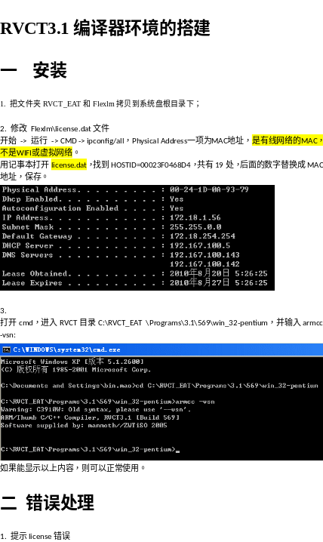
编译器安装

Slide 11
示例
#pragma arm section rodata = "APP_CFG"
APP_ENTRY_FLAG
#pragma arm section rodata
SIM800 and SIM800H add
#pragma arm section rodata="APPENTRY"
const EatEntry_st AppEntry =
{ app_main,
app_func_ext1,
...};
#pragma arm section rodata
Entry function array

Slide 12
示例
void app_func_ext1(void *data)
{
eat_uart_set_debug(EAT_UART_2);
eat_uart_set_at_port(EAT_UART_1);// UART1 is as AT PORT
}
Hardware initialize
void app_main(void *data)
{ ...
APP_InitRegions();//Init app RAM, First
APP_init_clib(); //Init C lib , Second
while(EAT_TRUE)
{ eat_get_event(&event);
switch(event.event)
{
case EAT_EVENT_MDM_READY_RD:
{ progress(); } break;
case ...
}
}}
Main thread

Slide 13
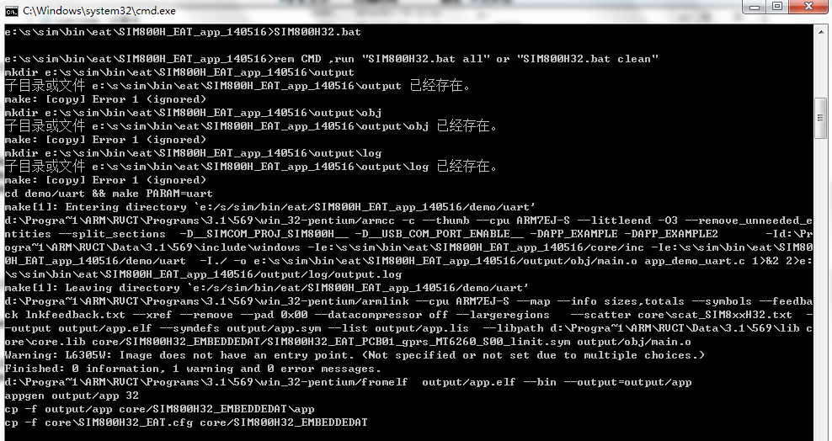
编译
生成的临时文件及log在outpu目录

Slide 14
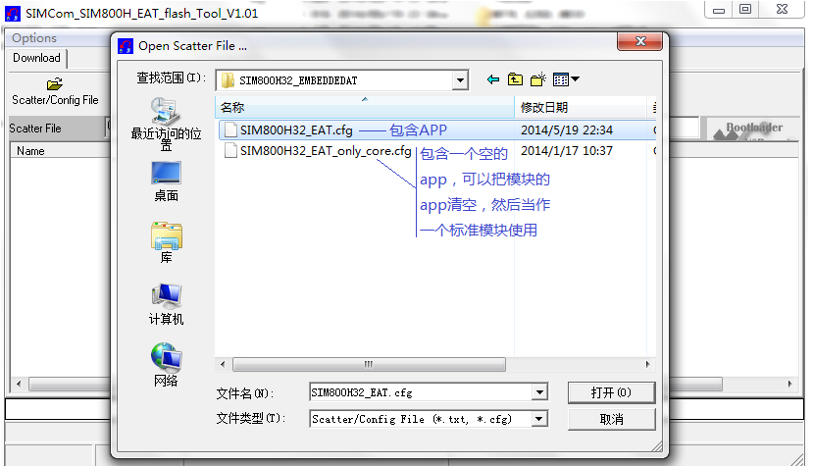
下载
选择core\SIM800H32_EMBEDDEDAT\*.cfg 文件

Slide 15
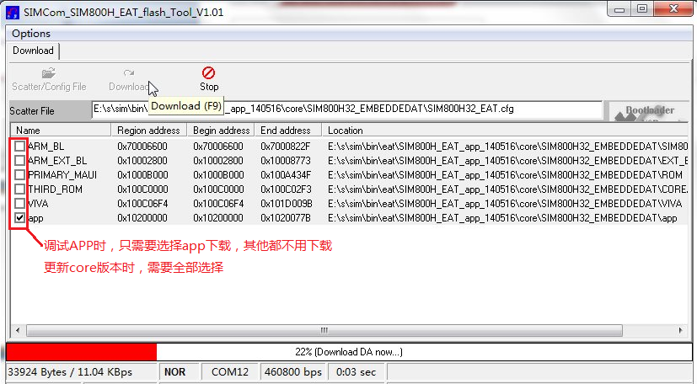
下载
设置好端口，并先点击Download，再给模块上电

Slide 16
谢谢！

